Slide 1
Redes e Comunicações
Transmissão de Dados

Slide 2
Terminology (1)
Transmitter
Receiver
Medium
  Guided medium
    e.g. twisted pair, optical fiber
  Unguided medium
    e.g. air, water, vacuum

Slide 3
Terminology (2)
Direct link
  No intermediate devices
Point-to-point
  Direct link
  Only 2 devices share link
Multi-point
  More than two devices share the link

Slide 4
Terminology (3)
Simplex
  One direction
    e.g. Television
Half duplex
  Either direction, but only one way at a time
    e.g. police radio
Full duplex
  Both directions at the same time
    e.g. telephone

Slide 5
Frequency, Spectrum and Bandwidth
Time domain concepts
  Continuous signal
    Various in a smooth way over time
  Discrete signal
    Maintains a constant level then changes to another constant level
  Periodic signal
    Pattern repeated over time
  Aperiodic signal
    Pattern not repeated over time

Slide 6
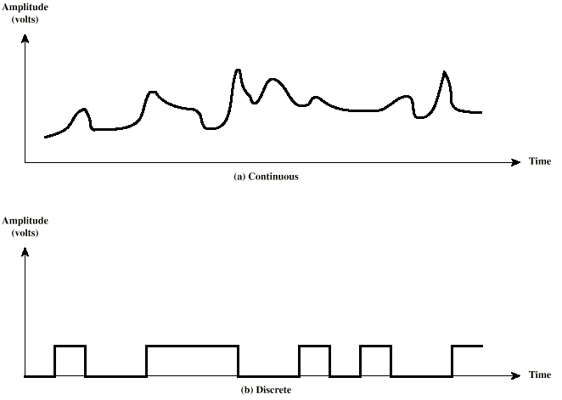
Continuous & Discrete Signals

Slide 7
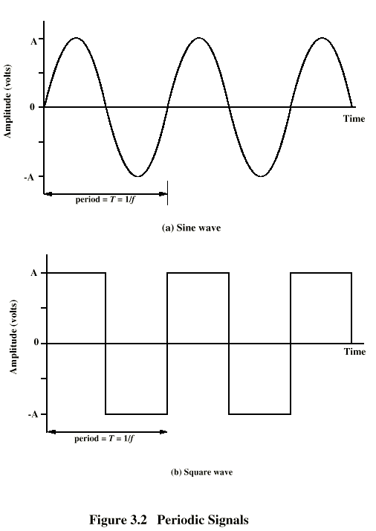
Periodic
Signals

Slide 8
Waves
Peak Amplitude (A)
  maximum strength of signal
  volts
Frequency (f)
  Rate of change of signal
  Hertz (Hz) or cycles per second
  Period = time for one repetition (T)
  T = 1/f
Phase (φ)
  Relative position in time

Slide 9
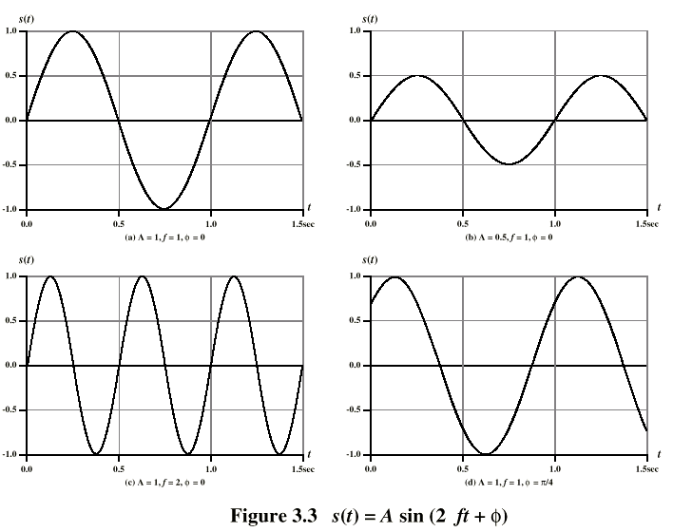
Varying Sine Waves

Slide 10
Frequency Domain Concepts
Signal usually made up of many frequencies
Components are sine waves
Can be shown (Fourier analysis) that any signal is made up of component sine waves
Can plot frequency domain functions

Slide 11
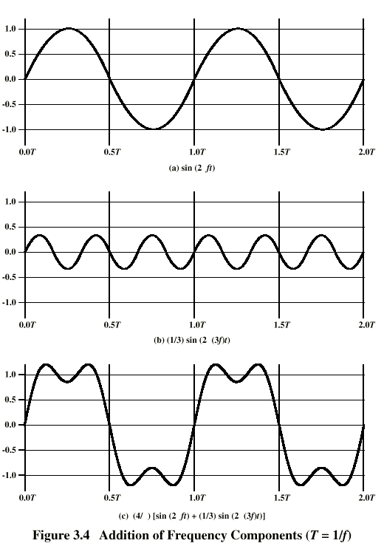
Addition of
Frequency
Components

Slide 12
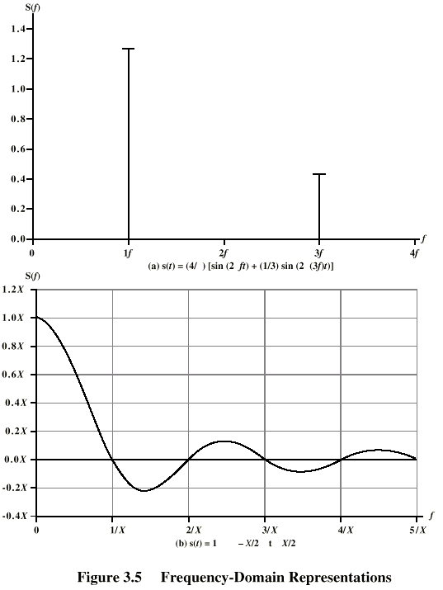
Frequency
Domain

Slide 13
Spectrum & Bandwidth
Spectrum
  range of frequencies contained in signal
Absolute bandwidth
  width of spectrum
Effective bandwidth
  Often just bandwidth
  Narrow band of frequencies containing most of the energy
DC Component
  Component of zero frequency

Slide 14
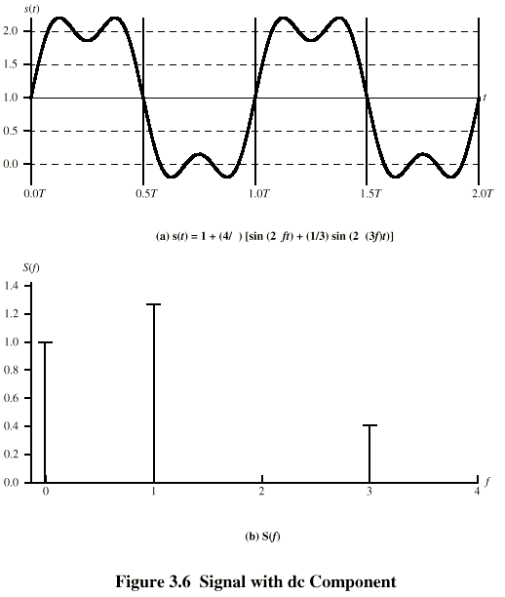
Signal with DC Component

Slide 15
Data Rate and Bandwidth
Any transmission system has a limited band of frequencies
This limits the data rate that can be carried

Slide 16
Analog and Digital Data Transmission
Data
  Entities that convey meaning
Signals
  Electric or electromagnetic representations of data
Transmission
  Communication of data by propagation and processing of signals

Slide 17
Data
Analog
  Continuous values within some interval
  e.g. sound, video
Digital
  Discrete values
  e.g. text, integers

Slide 18
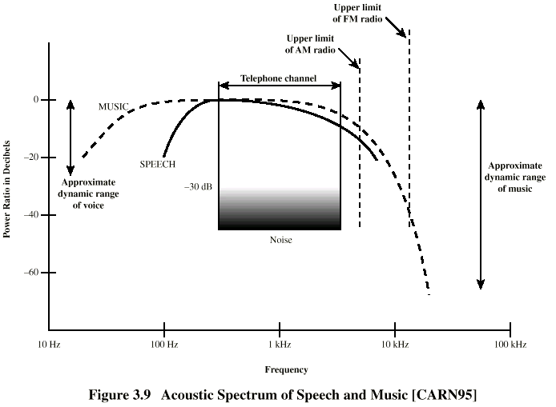
Acoustic Spectrum (Analog)

Slide 19
Signals
Means by which data are propagated
Analog
  Continuously variable
  Various media
    wire, fiber optic, space
  Speech bandwidth 100Hz to 7kHz
  Telephone bandwidth 300Hz to 3400Hz
  Video bandwidth 4MHz
Digital
  Use two DC components

Slide 20
Data and Signals
Usually use digital signals for digital data and analog signals for analog data
Can use analog signal to carry digital data
  Modem
Can use digital signal to carry analog data
  Compact Disc audio

Slide 21
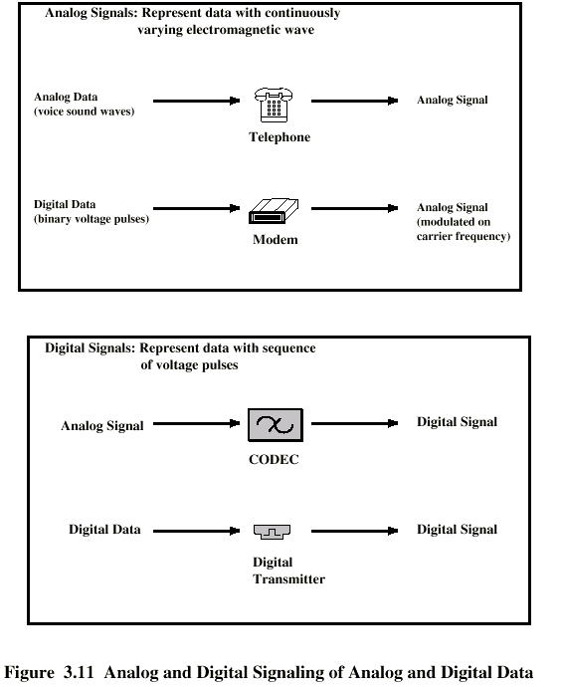
Analog Signals Carrying Analog and Digital Data

Slide 22
Digital Signals Carrying Analog and Digital Data

Slide 23
Analog Transmission
Analog signal transmitted without regard to content
May be analog or digital data
Attenuated over distance
Use amplifiers to boost signal
Also amplifies noise

Slide 24
Digital Transmission
Concerned with content
Integrity endangered by noise, attenuation etc.
Repeaters used
Repeater receives signal
Extracts bit pattern
Retransmits
Attenuation is overcome
Noise is not amplified

Slide 25
Advantages of Digital Transmission
Digital technology
  Low cost LSI/VLSI technology
Data integrity
  Longer distances over lower quality lines
Capacity utilization
  High bandwidth links economical
  High degree of multiplexing easier with digital techniques
Security & Privacy
  Encryption
Integration
  Can treat analog and digital data similarly

Slide 26
Transmission Impairments
Signal received may differ from signal transmitted
Analog - degradation of signal quality
Digital - bit errors
Caused by
  Attenuation and attenuation distortion
  Delay distortion
  Noise

Slide 27
Attenuation
Signal strength falls off with distance
Depends on medium
Received signal strength:
  must be enough to be detected
  must be sufficiently higher than noise to be received without error
Attenuation is an increasing function of frequency

Slide 28
Noise (1)
Additional signals inserted between transmitter and receiver
Thermal
  Due to thermal agitation of electrons
  Uniformly distributed
  White noise
Intermodulation
  Signals that are the sum and difference of original frequencies sharing a medium

Slide 29
Noise (2)
Crosstalk
  A signal from one line is picked up by another
Impulse
  Irregular pulses or spikes
  e.g. External electromagnetic interference
  Short duration
  High amplitude

Slide 30
Channel Capacity
Data rate
  In bits per second
  Rate at which data can be communicated
Bandwidth
  In cycles per second of Hertz
  Constrained by transmitter and medium

