Slide 1
Redes e Comunicações
Intranetworking

Slide 2
Internetworking Terms (1)
Communications Network
  Facility that provides data transfer service
An internet
  Collection of communications networks interconnected by bridges and/or routers
The Internet - note upper case I
  The global collection of thousands of individual machines and networks
Intranet
  Corporate internet operating within the organization
  Uses Internet (TCP/IP and http)technology to deliver documents and resources

Slide 3
Internetworking Terms (2)
End System (ES)
  Device attached to one of the networks of an internet
  Supports end-user applications or services
Intermediate System (IS)
  Device used to connect two networks
  Permits communication between end systems attached to different networks

Slide 4
Internetworking Terms (3)
Bridge
  IS used to connect two LANs using similar LAN protocols
  Address filter passing on packets to the required network only
  OSI layer 2 (Data Link)
Router
  Connects two (possibly dissimilar) networks
  Uses internet protocol present in each router and end system
  OSI Layer 3 (Network)

Slide 5
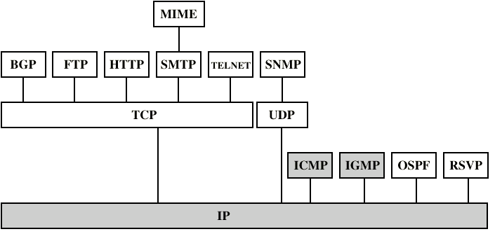
Internetworking Protocols

Slide 6
Requirements of Internetworking
Link between networks
  Minimum physical and link layer
Routing and delivery of data between processes on different networks
Accounting services and status info
Independent of network architectures

Slide 7
Network Architecture Features
Addressing
Packet size
Access mechanism
Timeouts
Error recovery
Status reporting
Routing
User access control
Connection based or connectionless

Slide 8
Architectural Approaches
Connection oriented
Connectionless

Slide 9
Connection Oriented
Assume that each network is connection oriented
IS connect two or more networks
  IS appear as DTE to each network
  Logical connection set up between DTEs
    Concatenation of logical connections across networks
  Individual network virtual circuits joined by IS
May require enhancement of local network services
  802, FDDI are datagram services

Slide 10
Connection Oriented IS Functions
Relaying
Routing
e.g. X.75 used to interconnect X.25 packet switched networks
Connection oriented not often used
  (IP dominant)

Slide 11
Connectionless Operation
Corresponds to datagram mechanism in packet switched network
Each NPDU treated separately
Network layer protocol common to all DTEs and routers
  Known generically as the internet protocol
Internet Protocol
  One such internet protocol developed for ARPANET
  RFC 791 (Get it and study it)
Lower layer protocol needed to access particular network

Slide 12
Connectionless Internetworking
Advantages
  Flexibility
  Robust
  No unnecessary overhead
Unreliable
  Not guaranteed delivery
  Not guaranteed order of delivery
    Packets can take different routes
  Reliability is responsibility of next layer up (e.g. TCP)

Slide 13
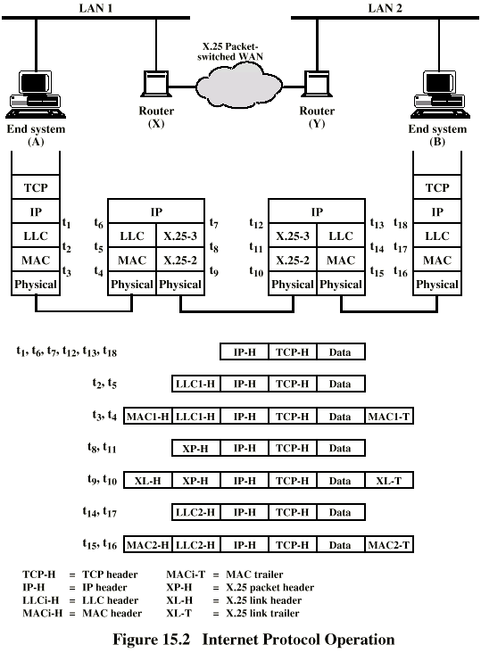
IP Operation

Slide 14
Design Issues
Routing
Datagram lifetime
Fragmentation and re-assembly
Error control
Flow control

Slide 15
Routing
End systems and routers maintain routing tables
  Indicate next router to which datagram should be sent
  Static
    May contain alternative routes
  Dynamic
    Flexible response to congestion and errors
Source routing
  Source specifies route as sequential list of routers to be followed
  Security
  Priority
Route recording

Slide 16
Datagram Lifetime
Datagrams could loop indefinitely
  Consumes resources
  Transport protocol may need upper bound on datagram life
Datagram marked with lifetime
  Time To Live field in IP
  Once lifetime expires, datagram discarded (not forwarded)
  Hop count
    Decrement time to live on passing through a each router
  Time count
    Need to know how long since last router
(Aside: compare with Logan’s Run)

Slide 17
Fragmentation and
Re-assembly
Different packet sizes
When to re-assemble
  At destination
    Results in packets getting smaller as data traverses internet
  Intermediate re-assembly
    Need large buffers at routers
    Buffers may fill with fragments
    All fragments must go through same router
      Inhibits dynamic routing

Slide 18
IP Fragmentation (1)
IP re-assembles at destination only
Uses fields in header
  Data Unit Identifier (ID)
    Identifies end system originated datagram
      Source and destination address
      Protocol layer generating data (e.g. TCP)
      Identification supplied by that layer
  Data length
    Length of user data in octets

Slide 19
IP Fragmentation (2)
  Offset
    Position of fragment of user data in original datagram
    In multiples of 64 bits (8 octets)
  More flag
    Indicates that this is not the last fragment

Slide 20
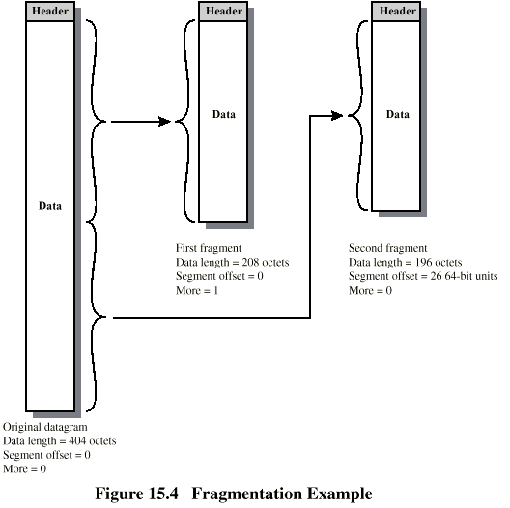
Fragmentation Example

Slide 21
Dealing with Failure
Re-assembly may fail if some fragments get lost
Need to detect failure
Re-assembly time out
  Assigned to first fragment to arrive
  If timeout expires before all fragments arrive, discard partial data
Use packet lifetime (time to live in IP)
  If time to live runs out, kill partial data

Slide 22
Error Control
Not guaranteed delivery
Router should attempt to inform source if packet discarded
  e.g. for time to live expiring
Source may modify transmission strategy
May inform high layer protocol
Datagram identification needed
(Look up ICMP)

Slide 23
Flow Control
Allows routers and/or stations to limit rate of incoming data
Limited in connectionless systems
Send flow control packets
  Requesting reduced flow
e.g. ICMP

Slide 24
Internet Protocol (IP)
Part of TCP/IP
  Used by the Internet
Specifies interface with higher layer
  e.g. TCP
Specifies protocol format and mechanisms

Slide 25
IP Services
Primitives
  Functions to be performed
  Form of primitive implementation dependent
    e.g. subroutine call
  Send
    Request transmission of data unit
  Deliver
    Notify user of arrival of data unit
Parameters
  Used to pass data and control info

Slide 26
Parameters (1)
Source address
Destination address
Protocol
  Recipient e.g. TCP
Type of Service
  Specify treatment of data unit during transmission through networks
Identification
  Source, destination address and user protocol
  Uniquely identifies PDU
  Needed for re-assembly and error reporting
  Send only

Slide 27
Parameters (2)
Don’t fragment indicator
  Can IP fragment data
  If not, may not be possible to deliver
  Send only
Time to live
  Send onl
Data length
Option data
User data

Slide 28
Type of Service
Precedence
  8 levels
Reliability
  Normal or high
Delay
  Normal or low
Throughput
  Normal or high

Slide 29
Options
Security
Source routing
Route recording
Stream identification
Timestamping

Slide 30
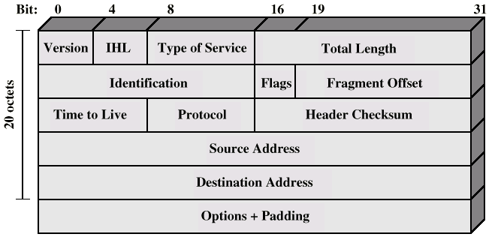
IP Protocol

Slide 31
Header Fields (1)
Version
  Currently 4
  IP v6 - see later
Internet header length
  In 32 bit words
  Including options
Type of service
Total length
  Of datagram, in octets

Slide 32
Header Fields (2)
Identification
  Sequence number
  Used with addresses and user protocol to identify datagram uniquely
Flags
  More bit
  Don’t fragment
Fragmentation offset
Time to live
Protocol
  Next higher layer to receive data field at destination

Slide 33
Header Fields (3)
Header checksum
  Reverified and recomputed at each router
  16 bit ones complement sum of all 16 bit words in header
  Set to zero during calculation
Source address
Destination address
Options
Padding
  To fill to multiple of 32 bits long

Slide 34
Data Field
Carries user data from next layer up
Integer multiple of 8 bits long (octet)
Max length of datagram (header plus data) 65,535 octets

Slide 35
IP Addresses - Class A
32 bit global internet address
Network part and host part
Class A
  Start with binary 0
  All 0 reserved
  01111111 (127) reserved for loopback
  Range 1.x.x.x to 126.x.x.x
  All allocated

Slide 36
IP Addresses - Class B
Start 10
Range 128.x.x.x to 191.x.x.x
Second Octet also included in network address
2¹⁴ = 16,384 class B addresses
All allocated

Slide 37
IP Addresses - Class C
Start 110
Range 192.x.x.x to 223.x.x.x
Second and third octet also part of network address
2²¹ = 2,097,152 addresses
Nearly all allocated
  See IPv6

Slide 38
Subnets and Subnet Masks
Allow arbitrary complexity of internetworked LANs within organization
Insulate overall internet from growth of network numbers and routing complexity
Site looks to rest of internet like single network
Each LAN assigned subnet number
Host portion of address partitioned into subnet number and host number
Local routers route within subnetted network
Subnet mask indicates which bits are subnet number and which are host number

Slide 39
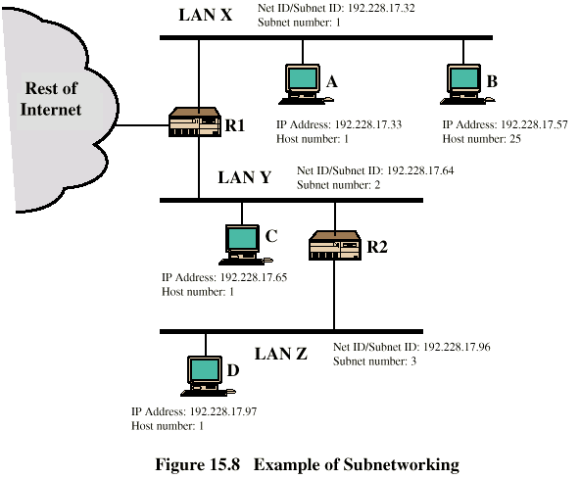
Routing Using Subnets

Slide 40
ICMP
Internet Control Message Protocol
RFC 792 (get it and study it)
Transfer of (control) messages from routers and hosts to hosts
Feedback about problems
  e.g. time to live expired
Encapsulated in IP datagram
  Not reliable

Slide 41
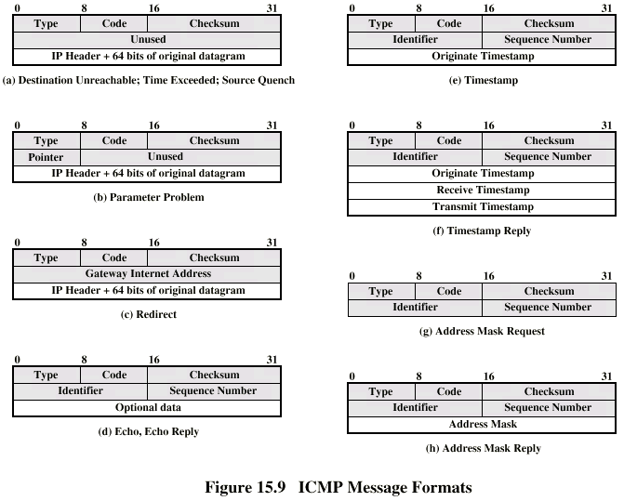
ICMP Message Formats

Slide 42
IP v6 - Version Number
IP v 1-3 defined and replaced
IP v4 - current version
IP v5 - streams protocol
IP v6 - replacement for IP v4
  During development it was called IPng
  Next Generation

Slide 43
Why Change IP?
Address space exhaustion
  Two level addressing (network and host) wastes space
  Network addresses used even if not connected to Internet
  Growth of networks and the Internet
  Extended use of TCP/IP
  Single address per host
Requirements for new types of service

Slide 44
IPv6 RFCs
1752 - Recommendations for the IP Next Generation Protocol
2460 - Overall specification
2373 - addressing structure
others (find them)

Slide 45
Expanded address space
  128 bit
Improved option mechanism
  Separate optional headers between IPv6 header and transport layer header
  Most are not examined by intermediate routes
    Improved speed and simplified router processing
    Easier to extend options
Address autoconfiguration
  Dynamic assignment of addresses

Slide 46
IPv6 Enhancements (2)
Increased addressing flexibility
  Anycast - delivered to one of a set of nodes
  Improved scalability of multicast addresses
Support for resource allocation
  Replaces type of service
  Labeling of packets to particular traffic flow
  Allows special handling
  e.g. real time video

Slide 47
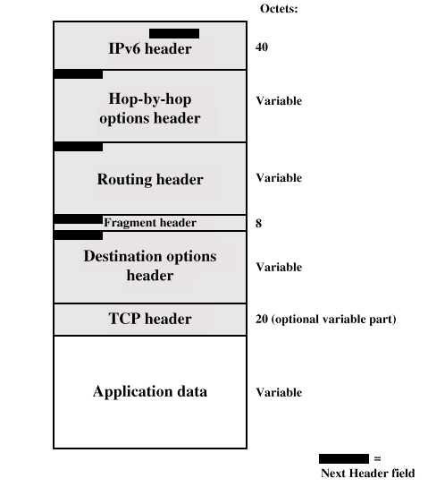
Structure

Slide 48
Extension Headers
Hop-by-Hop Options
  Require processing at each router
Routing
  Similar to v4 source routing
Fragment
Authentication
Encapsulating security payload
Destination options
  For destination node

Slide 49
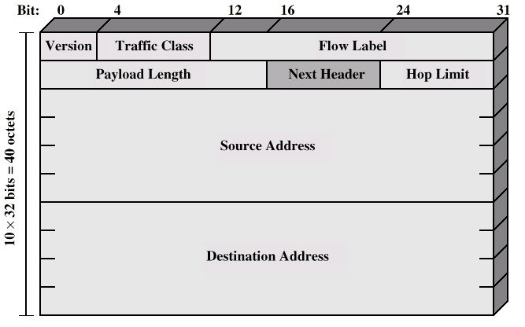
IP v6 Header

Slide 50
IP v6 Header Fields (1)
Version
  6
Traffic Class
  Classes or priorities of packet
  Still under development
  See RFC 2460
Flow Label
  Used by hosts requesting special handling
Payload length
  Includes all extension headers plus user data

Slide 51
IP v6 Header Fields (2)
Next Header
  Identifies type of header
    Extension or next layer up
Source Address
Destination address

Slide 52
IPv6 Addresses
128 bits long
Assigned to interface
Single interface may have multiple unicast addresses
Three types of address

Slide 53
Types of address
Unicast
  Single interface
Anycast
  Set of interfaces (typically different nodes)
  Delivered to any one interface
  the “nearest”
Multicast
  Set of interfaces
  Delivered to all interfaces identified

Slide 54
Hop-by-Hop Options
Next header
Header extension length
Options
  Jumbo payload
    Over 2¹⁶ = 65,535 octets
  Router alert
    Tells the router that the contents of this packet is of interest to the router
    Provides support for RSPV (chapter 16)

Slide 55
Fragmentation Header
Fragmentation only allowed at source
No fragmentation at intermediate routers
Node must perform path discovery to find smallest MTU of intermediate networks
Source fragments to match MTU
Otherwise limit to 1280 octets

Slide 56
Fragmentation Header Fields
Next Header
Reserved
Fragmentation offset
Reserved
More flag
Identification

Slide 57
Routing Header
List of one or more intermediate nodes to be visited
Next Header
Header extension length
Routing type
Segments left
  i.e. number of nodes still to be visited

Slide 58
Destination Options
Same format as Hop-by-Hop options header

Slide 59
Multicasting
Addresses that refer to group of hosts on one or more networks
Uses
  Multimedia “broadcast”
  Teleconferencing
  Database
  Distributed computing
  Real time workgroups

Slide 60
Requirements for
Multicasting (1)
Router may have to forward more than one copy of packet
Convention needed to identify multicast addresses
  IPv4 - Class D - start 1110
  IPv6 - 8 bit prefix, all 1, 4 bit flags field, 4 bit scope field, 112 bit group identifier
Nodes must translate between IP multicast addresses and list of networks containing group members
Router must translate between IP multicast address and network multicast address

Slide 61
Requirements for
Multicasting (2)
Mechanism required for hosts to join and leave multicast group
Routers must exchange info
  Which networks include members of given group
  Sufficient info to work out shortest path to each network
  Routing algorithm to work out shortest path
  Routers must determine routing paths based on source and destination addresses

Slide 62
IGMP
Internet Group Management Protocol
RFC 1112
Host and router exchange of multicast group info
Use broadcast LAN to transfer info among multiple hosts and routers

Slide 63
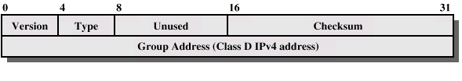
IGMP Format

Slide 64
IGMP Fields
Version
  1
Type
  1 - query sent by router
  O - report sent by host
Checksum
Group address
  Zero in request message
  Valid group address in report message

Slide 65
IGMP Operation
To join a group, hosts sends report message
  Group address of group to join
  In IP datagram to same multicast destination address
  All hosts in group receive message
  Routers listen to all multicast addresses to hear all reports
Routers periodically issue request message
  Sent to all-hosts multicast address
  Host that want to stay in groups must read all-hosts messages and respond with report for each group it is in

Slide 66
Group Membership in IPv6
Function of IGMP included in ICMP v6
New group membership termination message to allow host to leave group

