Slide 1
Comunicação e Redes
Internetwork Operation

Slide 2
Routing Protocols
Routing Information
  About topology and delays in the internet
Routing Algorithm
  Used to make routing decisions based on information

Slide 3
Autonomous Systems (AS)
Group of routers
Exchange information
Common routing protocol
Set of routers and networks managed by signle organization
A connected network
  There is at least one route between any pair of nodes

Slide 4
Interior Router Protocol (IRP)
Passes routing information between routers within AS
May be more than one AS in internet
Routing algorithms and tables may differ between different AS
Routers need some info about networks outside their AS
Used exterior router protocol (ERP)
IRP needs detailed model
ERP supports summary information on reachability

Slide 5
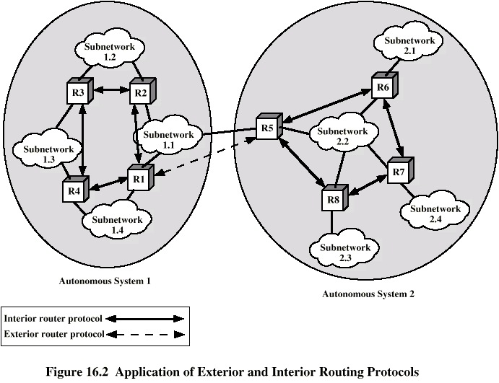
Application of IRP and ERP

Slide 6
Border Gateway Protocol (BGP)
For use with TCP/IP internets
Preferred EGP of the Internet
Messages sent over TCP connections
  Open
  Update
  Keep alive
  Notification
Procedures
  Neighbor acquisition
  Neighbor reachability
  Network reachability

Slide 7
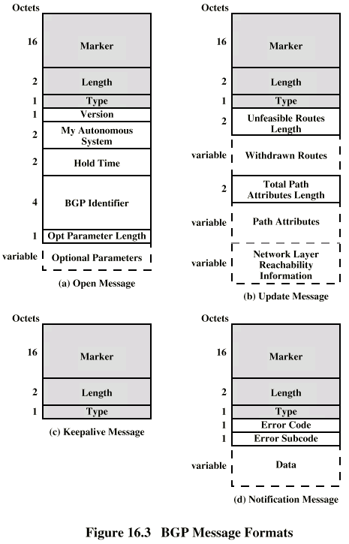
BGP Messages

Slide 8
BGP Procedure
Open TCP connection
Send Open message
  Includes proposed hold time
Receiver selects minimum of its hold time and that sent
  Max time between Keep alive and/or update messages

Slide 9
Message Types
Keep Alive
  To tell other routers that this router is still here
Update
  Info about single routes through internet
  List of routes being withdrawn
  Includes path info
    Origin (IGP or EGP)
    AS_Path (list of AS traversed)
    Next_hop (IP address of boarder router)
    Multi_Exit_Disc (Info about routers internal to AS)
    Local_pref (Inform other routers within AS)
    Atomic_Aggregate, Aggregator (Uses address tree structure to reduce amount of info needed)

Slide 10
Uses of AS_Path and Next_Hop
AS_Path
  Enables routing policy
    Avoid a particular AS
    Security
    Performance
    Quality
    Number of AS crossed
Next_Hop
  Only a few routers implement BGP
    Responsible for informing outside routers of routes to other networks in AS

Slide 11
Notification Message
Message header error
  Authentication and syntax
Open message error
  Syntax and option not recognized
  Unacceptable hold time
Update message error
  Syntax and validity errors
Hold time expired
  Connection is closed
Finite state machine error
Cease
  Used to close a connection when there is no error

Slide 12
BGP Routing Information Exchange
Within AS, router builds topology picture using IGP
Router issues Update message to other routers outside AS using BGP
These routers exchange info with other routers in other AS
Routers must then decide best routes

Slide 13
Open Shortest Path First (1)
OSPF
IGP of Internet
Replaced Routing Information Protocol (RIP)
Uses Link State Routing Algorithm
  Each router keeps list of state of local links to network
  Transmits update state info
  Little traffic as messages are small and not sent often
  RFC 2328
Route computed on least cost based on user cost metric

Slide 14
Open Shortest Path First (2)
Topology stored as directed graph
Vertices or nodes
  Router
  Network
    Transit
    Stub
Edges
  Graph edge
    Connect two router
    Connect router to network

Slide 15
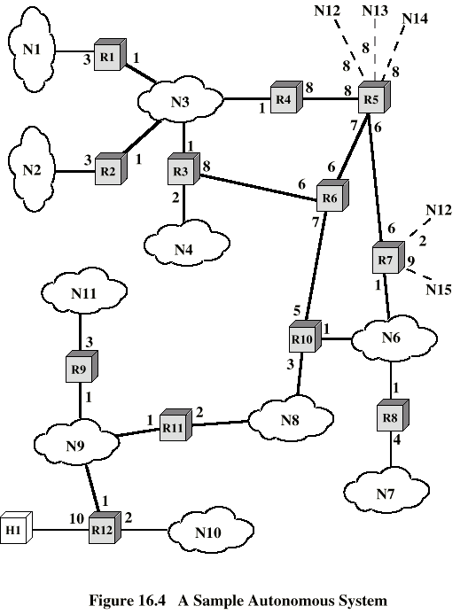
Sample AS

Slide 16
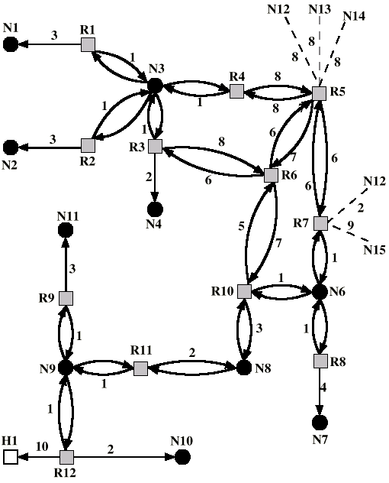
Directed
Graph of AS

Slide 17
Operation
Dijkstra’s algorithm (Appendix 10A) used to find least cost path to all other networks
Next hop used in routing packets

Slide 18
Integrates Services Architecture
Changes in traffic demands require variety of quality of service
Internet phone, multimedia, multicast
New functionality required in routers
New means of requesting QoS
ISA
RFC 1633

Slide 19
Internet Traffic
Elastic
  Can cope with wide changes in delay and/or throughput
    FTP sensitive to throughput
    E-Mail insensitive to delay
    Network Management sensitive to delay in times of heavy congestion
    Web sensitive to delay
Inelastic
  Does not easily adapt to variations
  e.g. real time traffic

Slide 20
Requirements for Inelastic Traffic
Throughput
Delay
Jitter
  Delay variation
Packet loss
Require preferential treatment for certain types of traffic
Require elastic traffic to be supported as well

Slide 21
ISA Approach
Congestion controlled by
  Routing algorithms
  Packet discard
Associate each packet with a flow
  Unidirectional
  Can be multicast
Admission Control
Routing Algorithm
Queuing discipline
Discard policy

Slide 22
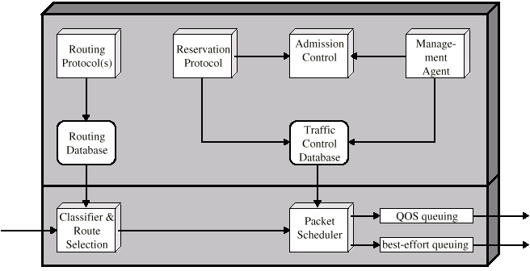
ISA Components

Slide 23
Token Bucket Traffic Specification
Token replenishment rate R
  Continually sustainable data rate
Bucket size B
  Amount that data rate can exceed R for short period
  During time period T amount of data sent can not exceed RT + B

Slide 24
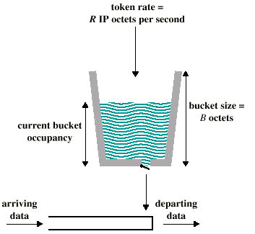
Token Bucket Scheme

Slide 25
ISA Services
Guaranteed
  Assured data rate
  Upper bound on queuing delay
  No queuing loss
  Real time playback
Controlled load
  Approximates behavior to best efforts on unloaded network
  No specific upper bound on queuing delay
  Very high delivery success
Best Effort

Slide 26
Queuing Discipline
Traditionally FIFO
  No special treatment for high priority flow packets
  Large packet can hold up smaller packets
  Greedy connection can crowd out less greedy connection
Fair queuing
  Queue maintained at each output port
  Packet placed in queue for its flow
  Round robin servicing
  Skip empty queues
  Can have weighted fair queuing

Slide 27
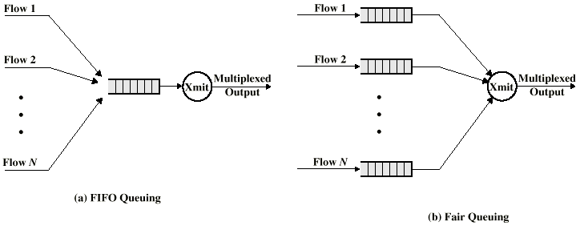
FIFO and Fair Queue

Slide 28
Resource Reservation: RSVP
Unicast applications can reserve resources in routers to meet QoS
If router can not meet request, application informed
Multicast is more demanding
May be reduced
  Some members of group may not require delivery from particular source over given time
    e.g. selection of one from a number of “channels”
  Some group members may only be able to handle a portion of the transmission

Slide 29
Soft State
Set of state info in router that expires unless refreshed
Applications must periodically renew requests during transmission
Resource ReSerVation Protocol (RSVP)
RFC 2205

Slide 30
RSVP Goals
Ability for receivers to make reservations
Deal gracefully with changes in multicast group membership
Specify resource requirements such that aggregate resources reflect requirements
Enable receivers to select one source
Deal gracefully with changes in routes
Control protocol overhead
Independent of routing protocol

Slide 31
RSVP Characteristics
Unicast and Multicast
Simplex
Receiver initiated reservation
Maintain soft state in the internet
Provide different reservation styles
Transparent operation through non-RSVP routers
Support for IPv4 and IPv6

Slide 32
Data Flow Concepts
Session
  Data flow identified by its destination
Flow descriptor
  Reservation request issued by destination
  Made up of flowspec and filterspec
  Flowspec gives required QoS
  Filterspec defines set of packets for which reservation is required

Slide 33
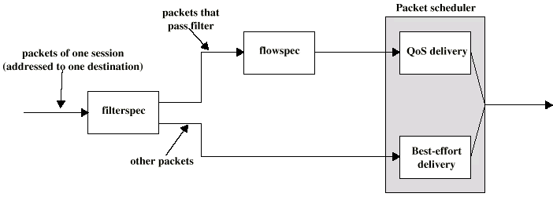
Treatment of Packets

Slide 34
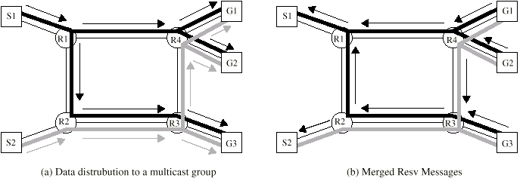
RSVP Operation

Slide 35
RSVP Message Types
Resv
  Originate at multicast receivers
  Propagate upstream through distribution tree
  Create soft states within routers
  Reach sending host enabling it to set up traffic control for first hop
Path
  Provide upstream routing information

Slide 36
Operation From Host Perspective
Receiver joins multicast group (IGMP)
Potential sender issues Path message
Receiver gets message identifying sender
Receiver has reverse path info and may start sending Resv messages
Resv messages propagate through internet and is delivered to sender
Sender starts transmitting data packets
Receiver starts receiving data packets

Slide 37
Differentiated Services
Provide simple, easy to implement, low overhead tool to support range of network services differentiated on basis of performance
IP Packets labeled for differing QoS using existing IPv4 Type of Service or IPv6 Traffic calss
Service level agreement established between provider and customer prior to use of DS
Built in aggregation
  Good scaling to larger networks and loads
Implemented by queuing and forwarding based on DS octet
  No state info on packet flows stored

Slide 38
DS Services
Defined within DS domain
  Contiguous portion of internet over which consistent set of DS policies are administered
  Typically under control of one organization
  Defined by service level agreements (SLA)

Slide 39
SLA Parameters
Detailed service performance
  Expected throughput
  Drop probability
  Latency
Constraints on ingress and egress points
Traffic profiles
  e.g. token bucket parameters
Disposition of traffic in excess of profile

Slide 40
Example Services
Level A - low latency
Level B - low loss
Level C - 90% of traffic < 50ms latency
Level D - 95% in profile traffic delivered
Level E - allotted twice bandwidth of level F traffic
Traffic with drop precedence X higher probability of delivery than that of Y

Slide 41
DS Octet - Code Pools
Leftmost 6 bits used
3 pools of code points
xxxxx0
  assignment as standards
xxxx11
  experimental or local use
xxxx01
  experimental or local but may be allocated for standards in future

Slide 42
DS Octet - Precedence Fiedl
Routing selection
Network service
Queuing discipline

Slide 43
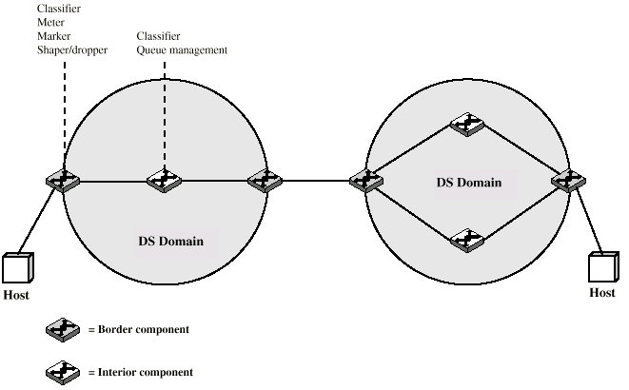
DS Domains

Slide 44
DS Configuration and Operation
Within domain, interpretation of DS code points is uniform
Routers in domain are boundary nodes or interior nodes
Traffic conditioning functions
  Classifier
  Meter
  Marker
  Shaper
  Dropper

Slide 45
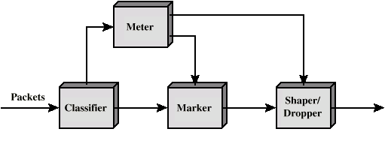
DS Traffic Conditioner

Slide 46
Required Reading
Stallings chapter 16
RFCs identified in text
Comer, Internetworking with TCP/IP volume 1

