Slide 1
Redes e Comunicações
Introdução às Redes

Slide 2
A Communications Model
Source
  generates data to be transmitted
Transmitter
  Converts data into transmittable signals
Transmission System
  Carries data
Receiver
  Converts received signal into data
Destination
  Takes incoming data

Slide 3
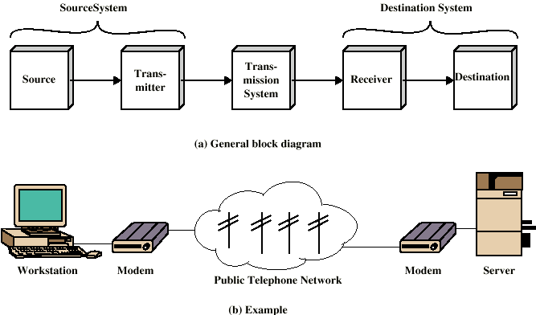
Simplified Communications Model - Diagram

Slide 4
Key Communications Tasks
Transmission System Utilization
Interfacing
Signal Generation
Synchronization
Exchange Management
Error detection and correction
Addressing and routing
Recovery
Message formatting
Security
Network Management

Slide 5
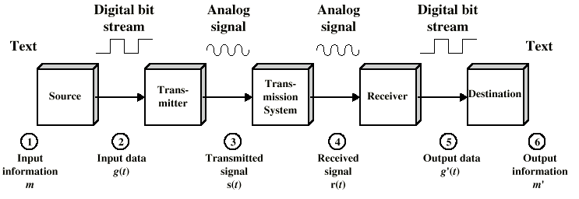
Simplified Data Communications Model

Slide 6
Networking
Point to point communication not usually practical
  Devices are too far apart
  Large set of devices would need impractical number of connections
Solution is a communications network

Slide 7
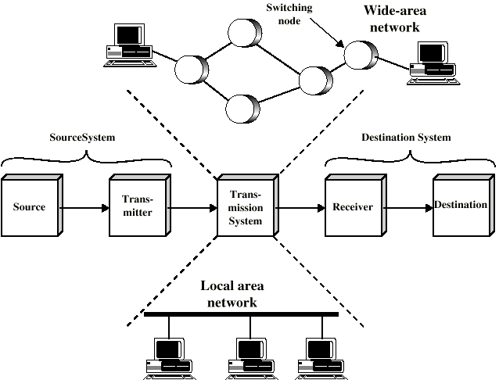
Simplified Network Model

Slide 8
Wide Area Networks
Large geographical area
Crossing public rights of way
Rely in part on common carrier circuits
Alternative technologies
  Circuit switching
  Packet switching
  Frame relay
  Asynchronous Transfer Mode (ATM)

Slide 9
Circuit Switching
Dedicated communications path established for the duration of the conversation
e.g. telephone network

Slide 10
Packet Switching
Data sent out of sequence
Small chunks (packets) of data at a time
Packets passed from node to node between source and destination
Used for terminal to computer and computer to computer communications

Slide 11
Frame Relay
Packet switching systems have large overheads to compensate for errors
Modern systems are more reliable
Errors can be caught in end system
Most overhead for error control is stripped out

Slide 12
Asynchronous Transfer Mode
ATM
Evolution of frame relay
Little overhead for error control
Fixed packet (called cell) length
Anything from 10Mbps to Gbps
Constant data rate using packet switching technique

Slide 13
Integrated Services Digital Network
ISDN
Designed to replace public telecom system
Wide variety of services
Entirely digital domain

Slide 14
Local Area Networks
Smaller scope
  Building or small campus
Usually owned by same organization as attached devices
Data rates much higher
Usually broadcast systems
Now some switched systems and ATM are being introduced

Slide 15
Protocols
Used for communications between entities in a system
Must speak the same language
Entities
  User applications
  e-mail facilities
  terminals
Systems
  Computer
  Terminal
  Remote sensor

Slide 16
Key Elements of a Protocol
Syntax
  Data formats
  Signal levels
Semantics
  Control information
  Error handling
Timing
  Speed matching
  Sequencing

Slide 17
Protocol Architecture
Task of communication broken up into modules
For example file transfer could use three modules
  File transfer application
  Communication service module
  Network access module

Slide 18
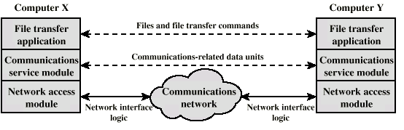
Simplified File Transfer Architecture

Slide 19
A Three Layer Model
Network Access Layer
Transport Layer
Application Layer

Slide 20
Network Access Layer
Exchange of data between the computer and the network
Sending computer provides address of destination
May invoke levels of service
Dependent on type of network used (LAN, packet switched etc.)

Slide 21
Transport Layer
Reliable data exchange
Independent of network being used
Independent of application

Slide 22
Application Layer
Support for different user applications
e.g. e-mail, file transfer

Slide 23
Addressing Requirements
Two levels of addressing required
Each computer needs unique network address
Each application on a (multi-tasking) computer needs a unique address within the computer
  The service access point or SAP

Slide 24
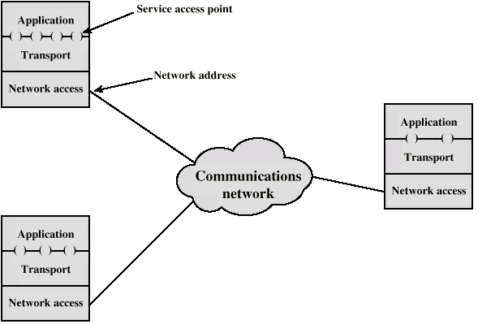
Protocol Architectures and Networks

Slide 25
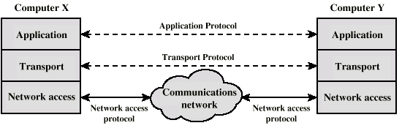
Protocols in Simplified Architecture

Slide 26
Protocol Data Units (PDU)
At each layer, protocols are used to communicate
Control information is added to user data at each layer
Transport layer may fragment user data
Each fragment has a transport header added
  Destination SAP
  Sequence number
  Error detection code
This gives a transport protocol data unit

Slide 27
Network PDU
Adds network header
  network address for destination computer
  Facilities requests

Slide 28
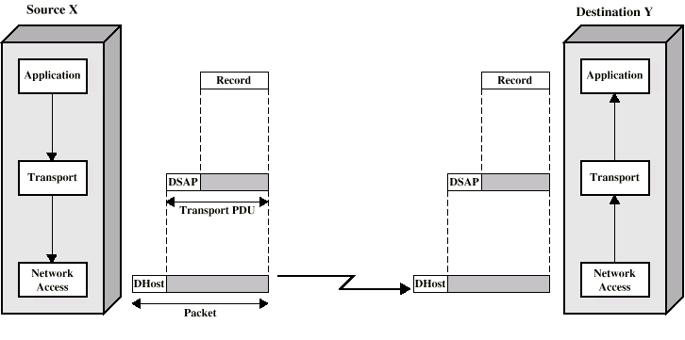
Operation of a Protocol Architecture

Slide 29
TCP/IP Protocol Architecture
Developed by the US Defense Advanced Research Project Agency (DARPA) for its packet switched network (ARPANET)
Used by the global Internet
No official model but a working one.
  Application layer
  Host to host or transport layer
  Internet layer
  Network access layer
  Physical layer

Slide 30
Physical Layer
Physical interface between data transmission device (e.g. computer) and transmission medium or network
Characteristics of transmission medium
Signal levels
Data rates
etc.

Slide 31
Network Access Layer
Exchange of data between end system and network
Destination address provision
Invoking services like priority

Slide 32
Internet Layer (IP)
Systems may be attached to different networks
Routing functions across multiple networks
Implemented in end systems and routers

Slide 33
Transport Layer (TCP)
Reliable delivery of data
Ordering of delivery

Slide 34
Application Layer
Support for user applications
e.g. http, SMPT

Slide 35
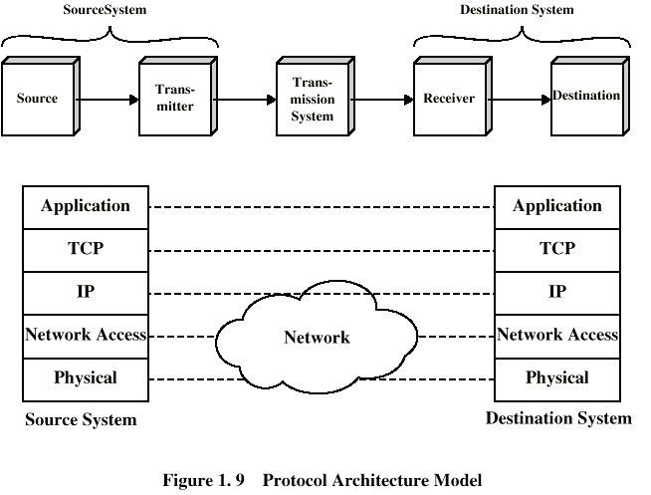
TCP/IP Protocol Architecture Model

Slide 36
OSI Model
Open Systems Interconnection
Developed by the International Organization for Standardization (ISO)
Seven layers
A theoretical system delivered too late!
TCP/IP is the de facto standard

Slide 37
OSI Layers
Application
Presentation
Session
Transport
Network
Data Link
Physical

Slide 38
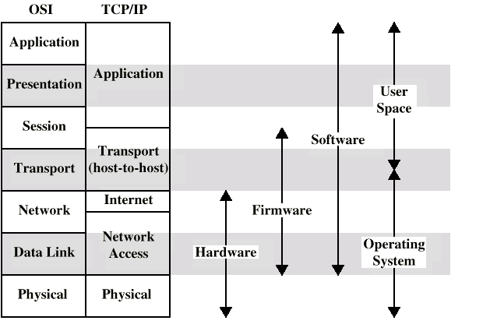
OSI v TCP/IP

Slide 39
Standards
Required to allow for interoperability between equipment
Advantages
  Ensures a large market for equipment and software
  Allows products from different vendors to communicate
Disadvantages
  Freeze technology
  May be multiple standards for the same thing

Slide 40
Standards Organizations
Internet Society
ISO
ITU-T (formally CCITT)
ATM forum

