Slide 1
Redes e Comunicações
Transport Protocols

Slide 2
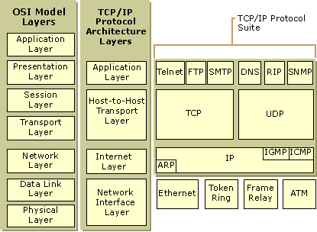
TCP/IP Architecture

Slide 3
Connection Oriented Transport Protocol Mechanisms
Logical connection
Establishment
Maintenance termination
Reliable
e.g. TCP

Slide 4
Reliable Sequencing Network Service
Assume arbitrary length message
Assume virtually 100% reliable delivery by network service
Transport service is end to end protocol between two systems on same network

Slide 5
TCP & UDP
Transmission Control Protocol
  Connection oriented
  RFC 793
User Datagram Protocol (UDP)
  Connectionless
  RFC 768

Slide 6
TCP Services
Reliable communication between pairs of processes
Across variety of reliable and unreliable networks and internets
Two labeling facilities
  Data stream push
    TCP user can require transmission of all data
    Receiver will deliver in same manner
    Avoids waiting for full buffers
  Urgent data signal
    Indicates urgent data is upcoming in stream
    User decides how to handle it

Slide 7
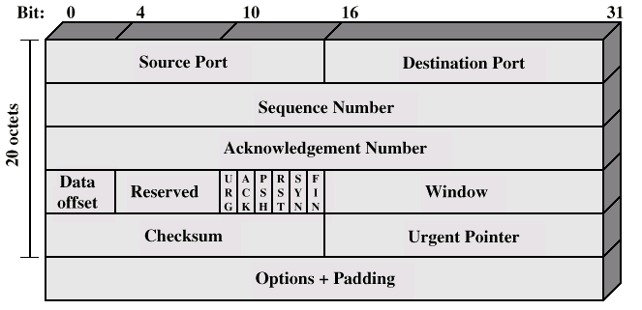
TCP Header

Slide 8
TCP Mechanisms (1)
Connection establishment
  Between pairs of ports
  One port can connect to multiple destinations

Slide 9
TCP Mechanisms (2)
Data transfer
  Logical stream of octets
  Octets numbered modulo 2²³
  Flow control by credit allocation of number of octets
  Data buffered at transmitter and receiver

Slide 10
TCP Mechanisms (3)
Connection termination
  Graceful close
  TCP users issues CLOSE primitive
  Transport entity sets FIN flag on last segment sent
  Abrupt termination by ABORT primitive
    Entity abandons all attempts to send or receive data
    RST segment transmitted

Slide 11
Implementation Policy Options
Send
Deliver
Accept
Retransmit
Acknowledge

Slide 12
Send
If no push or close TCP entity transmits at its own convenience
Data buffered at transmit buffer
May construct segment per data batch
May wait for certain amount of data

Slide 13
Deliver
In absence of push, deliver data at own convenience
May deliver as each in order segment received
May buffer data from more than one segment

Slide 14
Accept
Segments may arrive out of order
In order
  Only accept segments in order
  Discard out of order segments
In windows
  Accept all segments within receive window

Slide 15
Retransmit
TCP maintains queue of segments transmitted but not acknowledged
TCP will retransmit if not ACKed in given time
  First only
  Batch
  Individual

Slide 16
Acknowledgement
Immediate
Cumulative

Slide 17
UDP
User datagram protocol
RFC 768
Connectionless service for application level procedures
  Unreliable
  Delivery and duplication control not guaranteed
Reduced overhead
e.g. network management

Slide 18
UDP Uses
Inward data collection
Outward data dissemination
Request-Response
Real time application

Slide 19
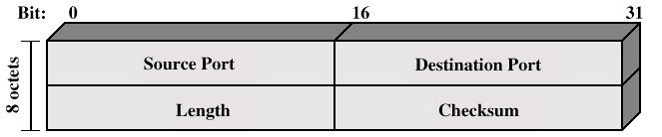
UDP Header

