Slide 1
William Stallings
Data and Computer Communications
LAN Systems

Slide 2
Ethernet (CSAM/CD)
Carriers Sense Multiple Access with Collision Detection
Xerox - Ethernet
IEEE 802.3

Slide 3
IEEE802.3 Medium Access Control
Random Access
  Stations access medium randomly
Contention
  Stations content for time on medium

Slide 4
ALOHA
Packet Radio
When station has frame, it sends
Station listens (for max round trip time)plus small increment
If ACK, fine. If not, retransmit
If no ACK after repeated transmissions, give up
Frame check sequence (as in HDLC)
If frame OK and address matches receiver, send ACK
Frame may be damaged by noise or by another station transmitting at the same time (collision)
Any overlap of frames causes collision
Max utilization 18%

Slide 5
Slotted ALOHA
Time in uniform slots equal to frame transmission time
Need central clock (or other sync mechanism)
Transmission begins at slot boundary
Frames either miss or overlap totally
Max utilization 37%

Slide 6
CSMA
Propagation time is much less than transmission time
All stations know that a transmission has started almost immediately
First listen for clear medium (carrier sense)
If medium idle, transmit
If two stations start at the same instant, collision
Wait reasonable time (round trip plus ACK contention)
No ACK then retransmit
Max utilization depends on propagation time (medium length) and frame length
  Longer frame and shorter propagation gives better utilization

Slide 7
If Busy?
If medium is idle, transmit
If busy, listen for idle then transmit immediately
If two stations are waiting, collision

Slide 8
CSMA/CD
With CSMA, collision occupies medium for duration of transmission
Stations listen whilst transmitting
If medium idle, transmit
If busy, listen for idle, then transmit
If collision detected, jam then cease transmission
After jam, wait random time then start again
  Binary exponential back off

Slide 9
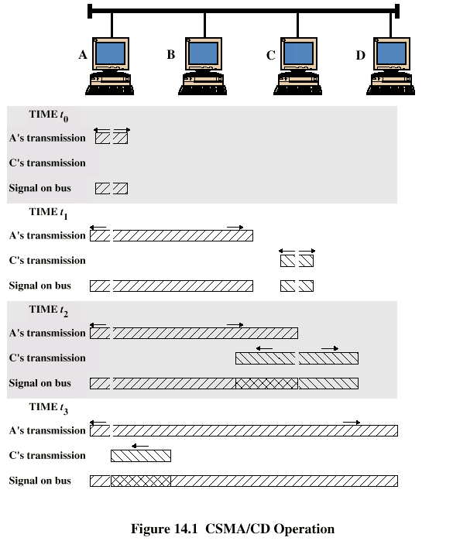
CSMA/CD
Operation

Slide 10
Collision Detection
On baseband bus, collision produces much higher signal voltage than signal
Collision detected if cable signal greater than single station signal
Signal attenuated over distance
Limit distance to 500m (10Base5) or 200m (10Base2)
For twisted pair (star-topology) activity on more than one port is collision
Special collision presence signal

Slide 11
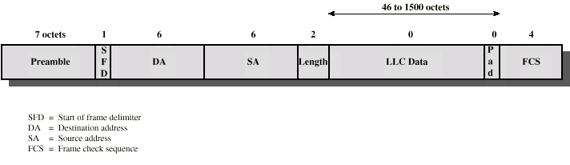
IEEE 802.3 Frame Format

Slide 12
10Mbps Specification (Ethernet)
<data rate><Signaling method><Max segment length>
10Base5 10Base2 10Base-T 10Base-FP
Medium Coaxial Coaxial UTP 850nm fiber
Signaling Baseband Baseband Baseband Manchester
Manchester Manchester Manchester On/Off
Topology Bus Bus Star Star
Nodes 100 30 - 33

Slide 13
100Mbps (Fast Ethernet)
100Base-TX 100Base-FX 100Base-T4
2 pair, STP 2 pair, Cat 5UTP 2 optical fiber 4 pair, cat 3,4,5
MLT-3 MLT-3 4B5B,NRZI 8B6T,NRZ

Slide 14
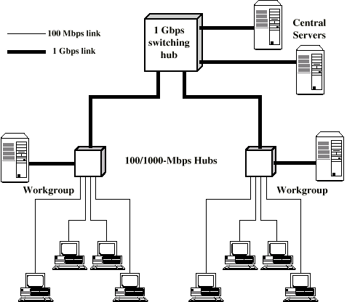
Gigabit Ethernet Configuration

Slide 15
Gigabit Ethernet - Differences
Carrier extension
At least 4096 bit-times long (512 for 10/100)
Frame bursting

Slide 16
Gigabit Ethernet - Physical
1000Base-SX
  Short wavelength, multimode fiber
1000Base-LX
  Long wavelength, Multi or single mode fiber
1000Base-CX
  Copper jumpers <25m, shielded twisted pair
1000Base-T
  4 pairs, cat 5 UTP
Signaling - 8B/10B

Slide 17
Token Ring (802.5)
MAC protocol
  Small frame (token) circulates when idle
  Station waits for token
  Changes one bit in token to make it SOF for data frame
  Append rest of data frame
  Frame makes round trip and is absorbed by transmitting station
  Station then inserts new token when transmission has finished and leading edge of returning frame arrives
  Under light loads, some inefficiency
  Under heavy loads, round robin

Slide 18
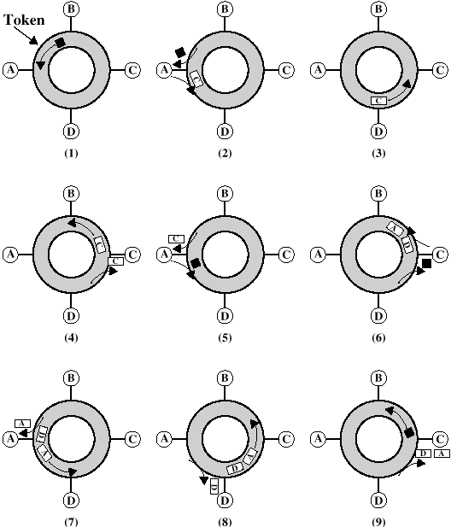
Token Ring
Operation

Slide 19
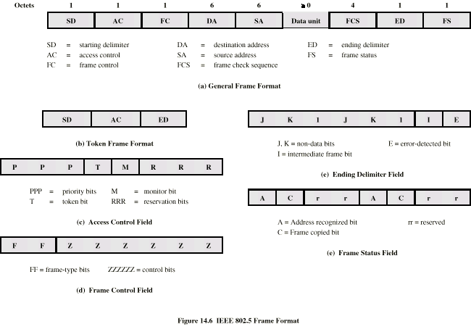
Token Ring MAC Frame

Slide 20
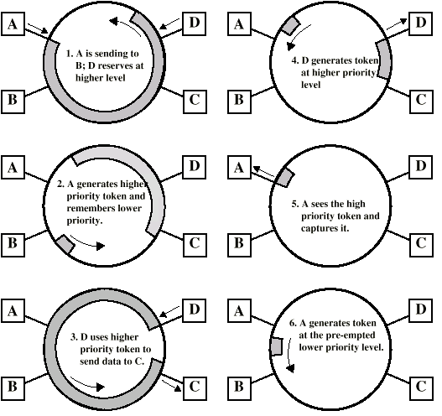
Priority
Scheme

Slide 21
Dedicated Token Ring
Central hub
Acts as switch
Full duplex point to point link
Concentrator acts as frame level repeater
No token passing

Slide 22
802.5 Physical Layer
Data Rate 4 16 100
Medium UTP,STP,Fiber
Signaling Differential Manchester
Max Frame 4550 18200 18200
Access Control TP or DTR TP or DTR DTR
Note: 1Gbit in development

Slide 23
FDDI
100Mbps
LAN and MAN applications
Token Ring

Slide 24
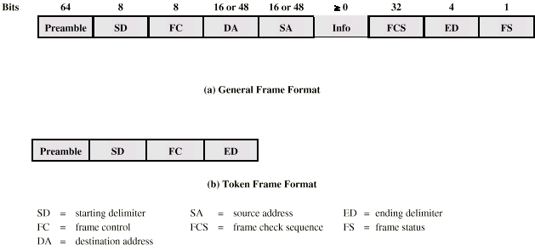
FDDI MAC Frame Format

Slide 25
FDDI MAC Protocol
As for 802.5 except:
Station seizes token by aborting token transmission
Once token captured, one or more data frames transmitted
New token released as soon as transmission finished (early token release in 802.5)

Slide 26
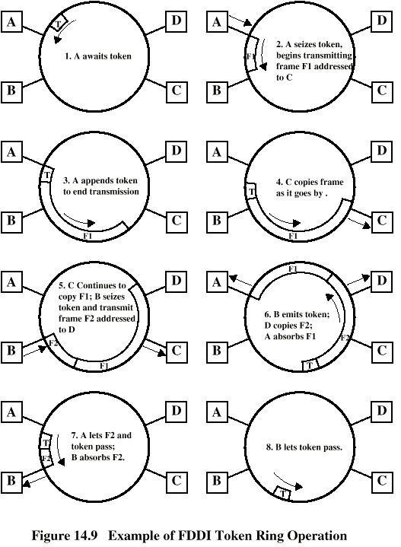
FDDI
Operation

Slide 27
FDDI Physical Layer
Medium Optical Fiber Twisted Pair
Data rate 100 100
Signaling 4B/5B/NRZI MLT-3
Max repeaters 100 100
Between repeaters 2km 100m

Slide 28
LAN Generations
First
  CSMA/CD and token ring
  Terminal to host and client server
  Moderate data rates
Second
  FDDI
  Backbone
  High performance workstations
Third
  ATM
  Aggregate throughput and real time support for multimedia applications

Slide 29
Third Generation LANs
Support for multiple guaranteed classes of service
  Live video may need 2Mbps
  File transfer can use background class
Scalable throughput
  Both aggregate and per host
Facilitate LAN/WAN internetworking

Slide 30
ATM LANs
Asynchronous Transfer Mode
Virtual paths and virtual channels
Preconfigured or switched
Gateway to ATM WAN
Backbone ATM switch
  Single ATM switch or local network of ATM switches
Workgroup ATM
  End systems connected directly to ATM switch
Mixed system

Slide 31
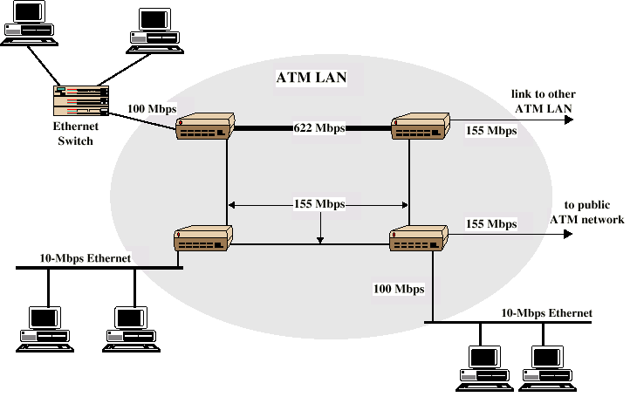
Example ATM LAN

Slide 32
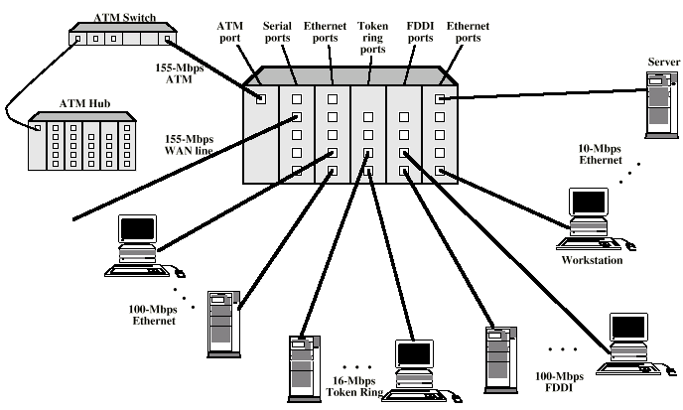
ATM LAN HUB

Slide 33
Compatibility
Interaction between end system on ATM and end system on legacy LAN
Interaction between stations on legacy LANs of same type
Interaction between stations on legacy LANs of different types

Slide 34
Fiber Channel - Background
I/O channel
  Direct point to point or multipoint comms link
  Hardware based
  High Speed
  Very short distance
  User data moved from source buffer to destiation buffer
Network connection
  Interconnected access points
  Software based protocol
  Flow control, error detection &recovery
  End systems connections

Slide 35
Fiber Channel
Best of both technologies
Channel oriented
  Data type qualifiers for routing frame payload
  Link level constructs associated with I/O ops
  Protocol interface specifications to support existing I/O architectures
    e.g. SCSI
Network oriented
  Full multiplexing between multiple destinations
  Peer to peer connectivity
  Internetworking to other connection technologies

Slide 36
Fiber Channel Elements
End systems - Nodes
Switched elements - the network or fabric
Communication across point to point links

Slide 37
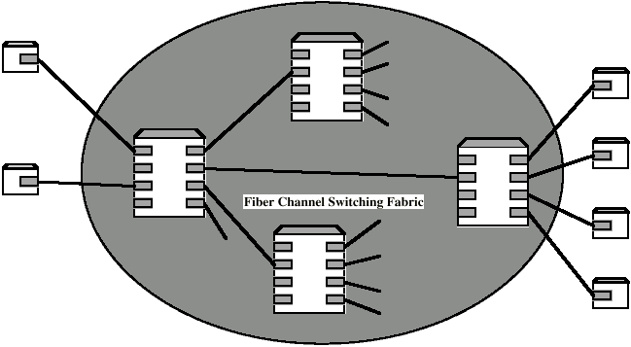
Fiber Channel Network

Slide 38
Fiber Channel Protocol Architecture (1)
FC-0 Physical Media
  Optical fiber for long distance
  coaxial cable for high speed short distance
  STP for lower speed short distance
FC-1 Transmission Protocol
  8B/10B signal encoding
FC-2 Framing Protocol
  Topologies
  Framing formats
  Flow and error control
  Sequences and exchanges (logical grouping of frames)

Slide 39
Fiber Channel Protocol Architecture (2)
FC-3 Common Services
  Including multicasting
FC-4 Mapping
  Mapping of channel and network services onto fiber channel
    e.g. IEEE 802, ATM, IP, SCSI

Slide 40
Wireless LANs
IEEE 802.11
Basic service set (cell)
  Set of stations using same MAC protocol
  Competing to access shared medium
  May be isolated
  May connect to backbone via access point (bridge)
Extended service set
  Two or more BSS connected by distributed system
  Appears as single logic LAN to LLC level

Slide 41
Types of station
No transition
  Stationary or moves within direct communication range of single BSS
BSS transition
  Moves between BSS within single ESS
ESS transition
  From a BSS in one ESS to a BSS in another ESS
  Disruption of service likely

Slide 42
Wireless LAN - Physical
Infrared
  1Mbps and 2Mbps
  Wavelength 850-950nm
Direct sequence spread spectrum
  2.4GHz ISM band
  Up to 7 channels
  Each 1Mbps or 2Mbps
Frequency hopping spread spectrum
  2.4GHz ISM band
  1Mbps or 2Mbps
Others under development

Slide 43
Media Access Control
Distributed wireless foundation MAC (DWFMAC)
Distributed coordination function (DCF)
  CSMA
  No collision detection
Point coordination function (PCF)
  Polling of central master

Slide 44
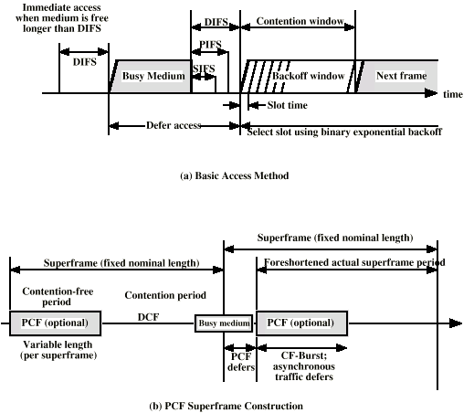
802.11 MAC Timing

Slide 45
Required Reading
Stallings chapter 14
Web sites on Ethernet, Token ring, FDDI, ATM etc.

