Slide 1

Planning and Configuring Policies and Profiles in the Enterprise
Paul Simmons
Support Engineer
Premier Directory Services
Microsoft Corporation

Slide 2
Overview
Group Policy Objects (GPOs)
  What are GPOs?
  GPO processing
  GPO planning
Profiles
  What are profiles?
  Roaming profiles
  Roaming profile GPO settings

Slide 3
Group Policy Objects
A GPO is a collection of configurations used to define and control the state of users and computers in your enterprise
Requirements:
  Microsoft® Windows® 2000 or Windows XP Professional clients
  Microsoft Active Directory™
  DNS

Slide 4
GPOs vs. Windows NT 4 System Policies
System policies:
  System Policy Editor – Poledit.exe
  Persistent – stay in registry
  Based on group membership
  Not secure
  Applied to a single domain
  Primarily used for desktop lockdown

Slide 5
GPOs vs. Windows NT 4 System Policies (2)
GPOs:
  Group Policy snap-in
  Not persistent – dynamic
  Based on object’s location in Active Directory
  Secure
  Applies to multiple domains; OUs or sites
  Can be used for desktop settings, user rights, software deployment, logon scripts, and more

Slide 6
GPO Processing
Local Group Policy
Site policy
Domain policy
OU…OU…OU

Slide 7
GPO Processing (2)
Block inheritance – Applies to an OU or domain. Prevents that OU or domain from inheriting Group Policy Objects from parent OUs or domain.
No override – Applies to a GPO. Prevents settings made by that GPO from being overwritten by GPOs applied after it.
No override beats block inheritance.

Slide 8
GPO Processing (3)
Loop back processing mode
  Applies alternate set of GPOs
  GPOs based on computer object not user object
  Intended for special use computers
Two modes
  Merge
  Replace

Slide 9
Filtering GPOs by Group Membership
Users need “Read” and “Apply Group Policy” permission to process a GPO
This can be used to filter GPOs by security group membership
You can prevent administrators from applying specific GPOs

Slide 10
Slow Link Processing
When a slow link is detected…
  Security Settings: ON (cannot be turned off)
  Administrative Templates: ON (cannot be turned off)
  Software Installation and Maintenance: OFF
  Scripts: OFF
  Folder Redirection: OFF
  Internet Explorer Maintenance: OFF

Slide 11
Slow Link Processing (2)
Slow link default is 500 KB (modifiable)
You can toggle Slow Link Detection on and off for all options except:
  Security Settings
  Administrative Templates

Slide 12
Group Policy Refresh Intervals
By default, Group Policies are refreshed every 90 minutes (30 minute randomized offset)
Domain controllers refresh every 5 minutes
Both can be modified by Group Policy
Short refresh intervals can be intolerable in a production environment

Slide 13
Synchronous and Asynchronous Processing
Synchronous
  Default behavior in Windows 2000
  Policies wait for one to complete before the next one begins
  Computer policy is applied before the CTRL+ALT+DEL is presented
  User policy is applied before the shell is active

Slide 14
Synchronous and Asynchronous Processing
Asynchronous
  Behavior can be changed through Group Policy
  GPOs process simultaneously
  Not recommended unless there are compelling performance reasons

Slide 15
GPO Planning
GPOs are based on domain and OU structures
Domain and OU design should be based on the business needs of the enterprise
For ease of deployment and administration, keep complexity to a minimum

Slide 16
GPO Planning (2)
Always test all GPO changes in a test lab that closely resembles your production environment
Always introduce new GPOs one at a time
Link GPOs instead of creating two GPOs with identical settings

Slide 17
GPO Planning (3)
Bandwidth considerations
  Kilobytes logon traffic =
  86 + 2.33 x GPOs + 0.6 x groups
  Site policies
  Slow link detection
  Roaming profile settings

Slide 18
GPO Planning Best Practices
Use FAZAM (resource kit) to back up Default Domain and Default Domain Controllers GPO
Apply only a single set of related configurations to a single GPO
Name GPOs descriptively
  Example “Sales Software Deployment Policy”

Slide 19
GPO Planning Best Practices (2)
Never change or delete the Default Domain or Default Domain Controllers Policy
Always create a new policy and give it higher priority instead
Always apply a GPO as low on the OU hierarchy as possible to achieve the desired effect

Slide 20
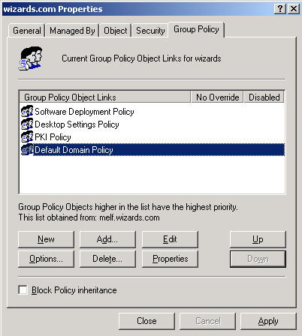
GPO Planning Best Practices (3)

Slide 21
GPO Pitfalls
Avoid use of “No Override” and “Block Inheritance” whenever possible
Limit use of “Loopback” policies
Using Security Groups and ACLs to filter GPOs should be the exception not the rule

Slide 22
GPO Pitfalls (2)
Never move a domain controller out of the scope of the Default Domain Controllers Policy
Instead create sub OUs under the Default Domain Controllers OU or link the Default Domain Controllers Policy to the new OU
Without this policy a DC will not work properly

Slide 23
Roaming Profiles
Local profile – Stored on a single computer
Roaming profile – Stored on a network server and can follow the user wherever he logs on
Profiles include:
  Application Data
  Desktop
  Favorites
  My Documents
  Start Menu
  And more…

Slide 24
Roaming Profiles (2)
Enabling roaming profiles
  Create a folder to store profiles
  Configure the folder as a shared folder
  Set the profile path in the user object to match the shared folder
    \\fileserver01\profiles\joeuser or
    \\fileserver01\profiles\%username%

Slide 25
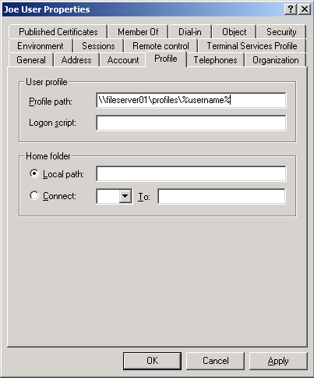
Roaming Profiles (3)

Slide 26
Roaming Profile GPOs
Log users off when roaming profile fails
Maximum retries to unload and update user profile
Wait for remote user profile
Do not detect slow network

Slide 27
Roaming Profile GPOs (2)
Delete cached copies of roaming profile
Add administrators group to roaming profile ACL
Exclude profile directories
Limit profile size

Slide 28
Thank you for joining us for Today’s Microsoft Support WebCast
For information on all upcoming Support WebCasts and access to the archived content (streaming media, Power Point slides, and transcripts), please visit:
http://support.microsoft.com/WebCasts
We sincerely appreciate your feedback. Please send any comments or suggestions regarding the Support WebCasts to feedback@microsoft.com. Include Support WebCasts in the subject line

