Slide 1
.NET Framework
VB
VC++
C#
Cobol
…
Visual Studio® .NET
Common Language Specification
ASP.NET
Windows Forms
ADO.NET: Data and XML
Base Class Library
Common Language Runtime
Windows

Slide 2
Visual C# at a Glance
Created with .NET in mind
Simplicity
Extend the reach of Microsoft Windows®
Easy creation of Web Services

Slide 3
Hello World in C#
class HelloWorld
{
static void Main()
{
System.Console.WriteLine(“Hello World”);
}
}
To Compile:
csc helloworld.cs

Slide 4
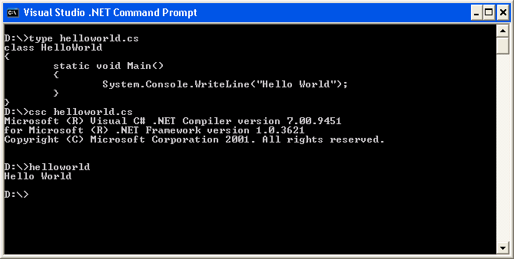
Hello World in C# (2)

Slide 5
Namespaces
Public by default
Can be nested:
namespace N1{
namespace N2{
public class C1{ … }
}
}
A new C1 object’s fully qualified name is:
N1.N2.C1

Slide 6
Variables
Initial assignment
  Initially assigned
  Initially unassigned
Local variables must be initialized
Scope
  Block
  Procedure
  Namespace

Slide 7
Data Types
Either value or reference
Value types
  Contain the data
  Normally represent a single piece of data
Reference types
  Contain the memory address
  Normally refer to objects

Slide 8
Data Types (2)
Built-in value types or primitive types
  byte, char, bool, sbyte, short, ushort, int, uint, float, double, decimal, long, ulong
Built-in reference types
  String, Object
Example:
  uint i;
  ushort ch;

Slide 9
Boxing and Unboxing
Implicitly converts a value type to an object
Allocates an instance of an object and then copies the value into the new object instance
ToString() performs boxing
Unboxing must be explicit
Example:
  int i = 123;
  object o = i; //boxing
  int j = (int) o; //unboxing

Slide 10
Operators
Arithmetic
  +, -, *, /, %
Relational
  ==, !=, <, >, <=, >=
Logical
  &, ^, |, ~, !, &&, ||, true, false
  Integers do not equate to Boolean values

Slide 11
Statements
if statements accept only Boolean values
Example:
if (a == 10) //correct
if (a = 10) //generates a compiler error
foreach
  Used for looping through the elements of an array or collection
  foreach (<type identifier> in <expression>) statement

Slide 12
Statements (2)
Switch
  You cannot fall through to the next case if the case statement is not empty
  case 1: //okay to fall through
  case 2:
  case 1: DoSomething(); // fall through not okay
  // break;
  case 2:
  case 1: DoSomething();
    goto case 2 //explicit fall through
  case 2:

Slide 13
Statements (3)
using
  Dispose() is automatically called
  Like an automatic try-catch-finally block
  Using (Time t = new Time() )
  {
  // use Time t
  } //compiler automatically calls Dispose()

Slide 14
Parameters
The “ref” keyword
Example:
class MyClass{
public static void Addition(ref int x) {
x++; }
public static void Main() {
int y = 10;
Addition(ref y);
MessageBox.Show(y.ToString()); }
}

Slide 15
Parameters (2)
The “out” keyword
Example:
  class MyClass{
public static void Addition(out int x) {
x=10+1; }
public static void Main() {
int y;
Addition(out y);
MessageBox.Show(y.ToString()); }
}

Slide 16
Struct
Similar to a class
Constructor
  Parameters required
  New keyword

Slide 17
Struct – Example 1
using System;
// struct declaration and initialization
public struct Point {
public int x, y;
public Point(int p1, int p2) {
x = p1;
y = p2;
}
}
class MainClass {
public static void Main() {
// Initialize:
Point myPoint = new Point();
Point yourPoint = new Point(10,10);
// Display results:
Console.Write("My Point: ");
Console.WriteLine("x = {0}, y = {1}", myPoint.x, myPoint.y);
Console.Write("Your Point: ");
Console.WriteLine("x = {0}, y = {1}", yourPoint.x, yourPoint.y);
}
}
Output:
My Point: x = 0, y = 0
Your Point: x = 10, y = 10

Slide 18
Struct – Example 2
using System;
// Declare a struct object without "new"
public struct Point {
public int x, y;
public Point(int x, int y) {
this.x = x;
this.y = y;
}
}
class MainClass {
public static void Main() {
// Declare an object:
Point myPoint;
// Initialize:
myPoint.x = 10;
myPoint.y = 20;
// Display results:
Console.WriteLine("My Point:");
Console.WriteLine("x = {0}, y = {1}", myPoint.x, myPoint.y);
}
}
Output:
  My Point:
  x = 10, y = 20

Slide 19
Classes
Single inheritance
Abstract classes
The “Override” keyword
Sealed classes

Slide 20
Hello World
class HelloWorld
{
static void Main()
{
Question GetStatus = new Question();
System.Console.WriteLine(“Hello World”);
GetStatus.AskIt();
}
}
class Question
{
public void AskIt()
{
System.Console.WriteLine("How are you doing?");
}
}
Output:
Hello World
How are you doing?

Slide 21
Struct vs. Class
Heap allocation
Types
Constructor
Destructor
Inheritance
Common usage

Slide 22
Destructors
Syntax:
~Class1()
Sample:
….
public static void Main()
{
MyClass classone = new MyClass();
classone = null;
GC.Collect();
}
….

Slide 23
Garbage Collector
Automatic memory manager
Represented by the GC class
Does not manage all resources
  Network connections
  Files
  Fonts
  Database connections

Slide 24
Finalize
Frees resources and performs cleanup
Can’t call it directly
Execution time is undefined
Order is not specified
Thread is not specified

Slide 25
Finalize vs. Dispose
Finalize() called by the GC
To manually handle cleanup, you should implement the IDisposable interface
GC.SuppressFinalize(this)

Slide 26
Interfaces
Methods are implicitly public
Methods do not contain implementation
Interfaces do not contain data members

Slide 27
Abstract Classes vs. Interfaces
Implementation
Access modifiers
Extending
Multiple inheritance

Slide 28
Exceptions
Inherit from System.Exception
Message property
InnerException property
C# versus Visual C++® exceptions

Slide 29
Many Additional Topics
Arrays
Collections
Component development
Windows forms
Events
Threads

Slide 30
References
GotDotNet C# Team Page
  http://www.gotdotnet.com/team/csharp/
C# Language Specification
  http://msdn.microsoft.com/library/?url=/library/en-us/csspec/html/CSharpSpecStart.asp?frame=true
Sharp New Language: C# Offers the Power of C++ and Simplicity of Visual Basic
  http://msdn.microsoft.com/msdnmag/issues/0900/csharp/csharp.asp

