Slide 1
Basic STOP Error (Blue Screen) Troubleshooting
Notes:
Welcome. My name is Doug Allen and I’m a support professional with the Microsoft Premier Product Support Services Setup team here in North Carolina.

Slide 2
OS Architecture – Background
Divided into two main sections
  Kernel mode – high-privilege, direct access to hardware, memory, HAL, MicroKernel, NT Executive Services
  User mode – low privilege, no direct access to hardware, uses APIs to request system resources, environment, and integrated subsystems

Slide 3
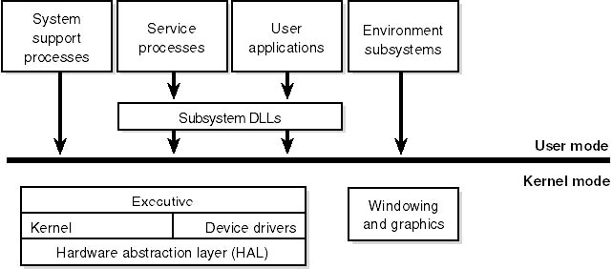
OS Architecture – Background (2)

Slide 4
Why Do STOP Screens Happen?
Services, applications, or device drivers are faulty or incompatible
Hardware problems
Disk or file system corruption
Firmware or BIOS outdated or incompatible
Viruses

Slide 5
When Do STOP Screens Happen?
Four categories
  Short startup period (phase four of the boot sequence)
  Software condition detected by the CPU
  Hardware malfunction detected by the CPU
  All the rest of the STOP codes

Slide 6
Windows NT 4.0 STOP Screen Breakdown
Five sections
  Section 1 – Debug port status info
  Section 2 – Bug check info
  Section 3 – Driver information loaded in memory
  Section 4 – Kernel build number and stack dump
  Section 5 – Debug port info

Slide 7
Windows NT 4.0 STOP Screen Breakdown (2)
Debug port status info – much like Snd/Rcv indicators of a modem
Bug check info – contains numbers in hex with symbolic string error code, and four bug check parameters
Driver information loaded in memory
  First column – load base address
  Second column – time/date stamp in hex
  Third column – names all drivers

Slide 8
Windows NT 4.0 STOP Screen Breakdown (3)
Kernel build number and stack dump – version of Ntoskrnl.exe.
  Rest is the stack dump showing range of addresses that pertain to failed module
Debug port info – confirmation of COM parameters
  May also show if the Memory.dmp file is being created

Slide 9
Windows 2000 STOP Screen Breakdown
Three sections
  Section 1 – bug check info
  Section 2 – recommended user action
  Section 3 – debug port info

Slide 10
Windows 2000 STOP Screen Breakdown (2)
Bug check info – contains numbers in hex with symbolic string error code, and four bugcheck parameters
Recommended user action – provides a list of suggestions for recovering from the error
Debug port info – much like Snd/Rcv indicators of a modem

Slide 11
The Memory.dmp File
Contains information about the computer at the time of the crash
Creates a Memory.dmp every time
Generates a STOP error if configured
Used with debugging process to determine root cause of crash
Verifies integrity using the Dumpchk.exe utility from the Windows NT® or
Windows® 2000 retail CD-ROM

Slide 12
Changes with Windows 2000 Memory.dmp Options
Mini dump (64 KB)
Kernel only dump
Complete dump

Slide 13
Memory.dmp Creation Conditions
Valid Pagefile at least same size as amount of physical RAM plus 12 MB, located on %SYSTEMROOT% partition
Enough free space to write the Memory.dmp file

Slide 14
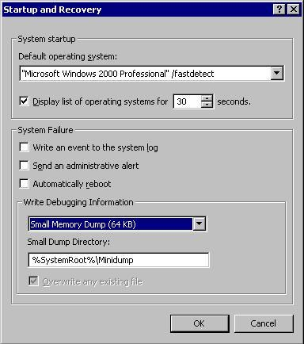
Memory.dmp Creation Conditions (2)

Slide 15
Memory.dmp Creation Conditions (3)
Must be configured to write the dump file
  Configuration options are in the Startup Shutdown tab in the GUI, or in the registry at:
    HKEY_LOCAL_MACHINE\SYSTEM
    \CurrentControlSet\Control\Session Manager
    HKEY_LOCAL_MACHINE\SYSTEM
    \CurrentControlSet\Control\CrashControl
If the system stops responding, you can force a Memory.dmp to be created

Slide 16
Forcing the Creation of a Memory Dump
Requires two configurations to be made
  Must be set to create a Memory.dmp in the Startup Recovery options
  HKEY_LOCAL_MACHINE\System\CurrentControlSet\Services\i8042prt\Parameters/, set a key named CrashOnCtrlScroll equal to REG_DWORD 0x1
To force the dump, hold down the right CTRL key while pressing the SCROLL LOCK key twice.

Slide 17
Most Common STOP Codes
STOP 0x0000000A IRQL_NOT_LESS_EQUAL
  Caused by a kernel-mode process that tried to access portion of memory at an IRQL that was too high
  Fourth parameter most important
  Usually caused by buggy device drivers, or services from backup utilities or virus scanners

Slide 18
Most Common STOP Codes (2)
STOP 0x0000001E KMODE_EXCEPTION_NOT_HANDLED
  Caused when a kernel-mode process tries to execute an illegal or unknown processor instruction
  Second parameter is most important; it is the address where the exception occurred
  If Win32k.sys is the referenced driver, check third-party remote control applications

Slide 19
Most Common STOP Codes (3)
STOP 0x00000024 NTFS_FILE_SYSTEM
  Caused by a problem that occurred in Ntfs.sys
  First parameter most important
  Usually caused by disk corruption, disk defragmenters, or (in rare cases) creating a partition larger than 7 GB on a Services for Macintosh volume with a large number of files

Slide 20
Most Common STOP Codes (4)
STOP 0x0000002E DATA_BUS_ERROR
  Caused by a parity error in the system memory
  Almost always caused by hardware problems being a configuration issue, defective hardware, incompatible hardware
  If physical RAM was recently added to the system, remove it and see if the error still occurs
  If the error persists, try disabling memory caching in the BIOS

Slide 21
Most Common STOP Codes (5)
STOP 0x00000050 PAGE_FAULT_IN_NONPAGED_AREA
  Caused when requested data is not found in memory; the system checks the page file, but the missing data is identified as unable to be written to the page file
  First parameter indicates virtual address that caused the fault
  If this occurs on a Terminal Server, check for third-party printer drivers

Slide 22
Most Common STOP Codes (6)
STOP 0x0000007B INACCESSIBLE_BOOT_DEVICE
  Caused when Windows lost access to the system partition during the Startup process
  Cannot be debugged because it usually occurs before the debugger is loaded
  This can be caused by: an incorrect driver for a SCSI, RAID, or UDMA IDE controller; incorrect ARC path in the Boot.ini; or a failed boot device
  During install, press F6 at prompt to install third-party Mass Storage drivers

Slide 23
Most Common STOP Codes (7)
STOP 0x0000007F UNEXPECTED_KERNEL_MODE_TRAP
  Caused when the CPU generates an error that the kernel does not catch
  First parameter most important (see Knowledge Base article Q137539 for details)
  Usually hardware, especially RAM
  Disable sync negotiation in SCSI BIOS; check SCSI termination
  Can also be caused by CPU over-clocking

Slide 24
Most Common STOP Codes (8)
STOP 0x0000009F DRIVER_POWER_STATE_FAILURE
  Caused when drivers do not handle power state transition requests properly
  Most frequently when shutting down or resuming from standby or hibernation mode
  Check CD writing software, applications that attempt to catch crashes, or other similar applications
  Check power management compatibility and settings

Slide 25
Most Common STOP Codes (9)
STOP 0x000000D1 DRIVER_IRQL_NOT_LESS_OR_EQUAL
  Occurs when the system attempts to access pageable memory at a process IRQL that is too high
  Fourth parameter is most important, which is the address that referenced the memory
  Very similar to STOP 0xA
  Same troubleshooting as a STOP 0xA

Slide 26
Most Common STOP Codes (10)
STOP 0xC000021A STATUS_SYSTEM_PROCESS_TERMINATED
  Caused when the user-mode subsystem (Winlogon or CSRSS) is fatally compromised and security cannot be guaranteed
  One of few user-mode errors that can bring down a machine
  Most common causes are third-party applications or mismatched system files
  Sfc/Scannow

Slide 27
Troubleshooting STOP Screens
Emergency Repair Disk (ERD)
Windows NT boot disk (see Q301680)
Parallel installation of the OS
Windows NT 4.0 and Windows 2000
  VGA mode
  Last known good
Windows 2000 Only
  Safe mode
  Recovery console

Slide 28
Troubleshooting STOP Screens (2)
System and Application Event logs
Verify the latest service pack is installed by running the Winver command
Virus check the system with the latest virus definitions
Chkdsk/f/r
Run the MPSReports utility, provided by a Microsoft Support Professional

Slide 29
Using the Recovery Console
Allows command-line access to the boot partition or simple volume
Cannot be pre-staged with Sysprep
Is very useful to disable or enable services and devices, replace files, display modify disk/partition info, and replace the master boot record or the boot sector
Q229716 lists all valid commands

Slide 30
Preventative Maintenance for STOP Screens
Always test your drivers before installing in production
Check the HCL before installing new hardware to verify compatibility
For Windows 2000, install digitally signed drivers whenever possible
Always make a new ERD after any major system change

Slide 31
Kernel and User Mode Debugging
Used to determine root cause
Should be reserved for more advanced users
Symbols and debugging tools can be downloaded from: http://www.microsoft.com/ddk/debugging/
Symbols are also on the retail CD-ROM of the OS or service pack
See Knowledge Base article Q148658 for more information about debugging

Slide 32
Additional Resources
Windows NT 4.0 and Windows 2000 Resource Kits
http://www.microsoft.com/ddk/
http://www.microsoft.com/windows2000_x000b_/techinfo/reskit/WebResources/default.asp
Hardware Compatibility List
Microsoft TechNet, MSDN®
Microsoft Knowledge Base

