Slide 1
Bird Efficient Classification
Group 6 許詠晴 謝承諺 陳彥凱

Slide 2
Outline
Introduction
Models
More Lightweight
Directly train Lightweight Model
Use knowledge distillation to compress model

Slide 3
01
Introduction

Slide 4
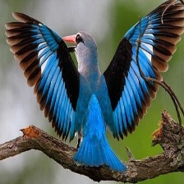
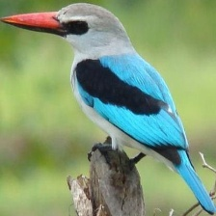
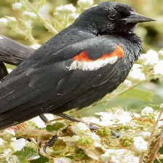
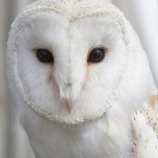
Task
image classification (Modified BIRDS 525 SPECIES) with lightweight models.

Slide 5
Direction of Implementation
Directly retrain lightweight models
Use knowledge distillation to compress a larger model

Slide 6
02
Models

Slide 7
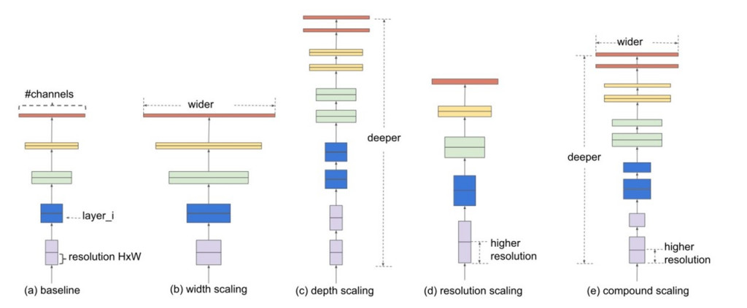
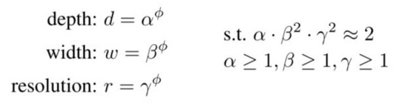
Efficientnet
Efficientnet propose a new concept (e)compound scaling, which uniformly scales all three dimensions at a fixed ratio.
We can set different depth, width, and resolution to modify the architecture.

Slide 8
Efficientnetb0, and b1
The different between b0 and b1 is the layer depth and width (channels) in each block, however the number of block is the same (7 blocks).
We can simplify the architecture as:
stem block
Final layers
linear classifier
block1
block2
block3
block4
block5
block6
block7
number of parameters: b0 is 5.3M; b1 is 8.3M

Slide 9
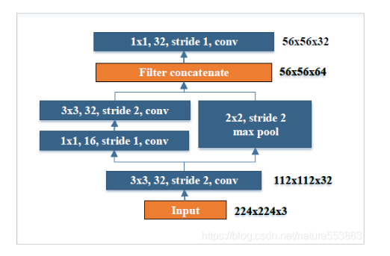
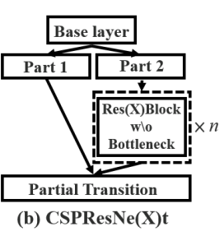
CSPPeleeNet
CSPPeleeNet is composed of a stem block, 4 CSPResNe(X)t, and finally a linear classifier.
linear classifier
CSPResNe(X)t
CSPResNe(X)t
CSPResNe(X)t
CSPResNe(X)t
stem block
stage1
stage2
stage3
Stage4
𝑛 = 3
𝑛 = 4
𝑛 = 8
𝑛 = 6
stem block
CSPResNe(X)t
We can set different 𝑛 to obtain CSPResNe(X)t at different depths.

Slide 10
03
More Lightweight

Slide 11
Directly train Lightweight Model (no finetune, no pretrained, directly train on bird dataset)
Directly train lightweight model modified from Efficientnet b0
Reduce depth, width, and resolution
#params~2.8M (from origin 5.3M)
The result is poor, only 87.7% accuracy.
Directly train model modified from CSPPeleeNet
Modify the output classes of CSPPeleeNet from 1000 class to 525
#params~2.5M (from origin 2.8M)
The result is not good, only 94.3% accuracy.

Slide 12
Directly train Lightweight Model (no finetune, no pretrained, directly train on bird dataset)
Model | # of parameters | accuracy
lighten_efficient | 2.80M | 0.877
CSPPeleeNet_large | 2.52M | 0.943
CSPPeleeNet_small | 1.36M | 0.932
𝑛 of each CSPResNe(X)t in CSPPeleeNet_large is [3,4,8,6]
CSPPeleeNet_small is [2,3,6,3]

Slide 13
Knowledge Distillation
We use this concept to make our model more lightweight.
Use a teacher model to transfer the knowledge(information) to the student model, allowing student model to achieve similar performance to the teacher model but more lightweight.
In our final case：
Teacher Model: efficientnet b1 (#params~7.8M)
Freeze all blocks before the 5th block and finetune.
Student Model: CSPPeleeNet_small (#params~1.3M)
We use knowledge distillation (KD) to compress a larger model-efficientnet b1.
We have 3 versions of KD.

Slide 14
KD_model_v1
Teacher (freeze all)
block5
Final layers
block3
block7
Ground Truth
mse_loss_ratio*
* soft_loss_ratio
mse loss
cross entropy
mse loss
KL-divergence loss
* hard_loss_ratio
student

Slide 15
KD_model_v2
KD_v2 will take multiple intermediate layers to calculate distillation loss (mse loss),
while KD_v1 will only take the last layer (after avgpool)
Teacher (freeze all)
block5
Final layers
block3
block7
Ground Truth
mse_loss_ratio*
cross entropy
* soft_loss_ratio
mse loss
KL-divergence loss
* hard_loss_ratio
student

Slide 16
KD_model_v3
Introducing a concept named KD_reviewer, which means that the student model layer will not only learn the knowledge of the corresponding teacher layer, but also learn from layers shallower than it.
Teacher (freeze all)
block5
Final layers
block3
block7
Ground Truth
mse_loss_ratio*
cross entropy
* soft_loss_ratio
mse loss
KL-divergence loss
* hard_loss_ratio
student

Slide 17
Training Detail
Initial Learning rate(lr): 1e-3
Schduler (MultiStepLR): lr x0.7 each 4 epochs
Number of epoch: 70
Batch size: 32

Slide 18
Different Loss
Teacher: efficientnet b0 (#params=5.3M), Student: CSPPeleeNet_large (#params~2.5M)
KD_model | hard_loss_ratio | soft_loss_ratio | mse_loss_ratio | Accuracy
KD_v1 | 0.8 | 0.2 | 0 | 0.947
 | 1 | 0 | 1 | 0.947
 | 0 | 1 | 1 | 0.986
KD_v2 | 0 | 1 | 1 | 0.986
KD_v3 | 0 | 1 | 1 | 0.987
We find that setting soft_loss_ratio 1, and hard_loss_ratio 0 have better performance.

Slide 19
Final Results
Teacher | Student | Student size | Accuracy | Improvement (baseline)
efficientnetb1 | CSPPeleeNet_large | 2.52M | 0.989 | +0.046 (0.943)
efficientnetb0 | CSPPeleeNet_large | 2.52M | 0.986 | +0.043 (0.943)
efficientnetb0 | CSPPeleeNet_mid | 2.10M | 0.983 | +0.043 (0.940)
efficientnetb1 | CSPPeleeNet_small | 1.36M | 0.986 | +0.054 (0.932)

Slide 20
Q&A

Slide 21
Thanks
Group 6

