Slide 1
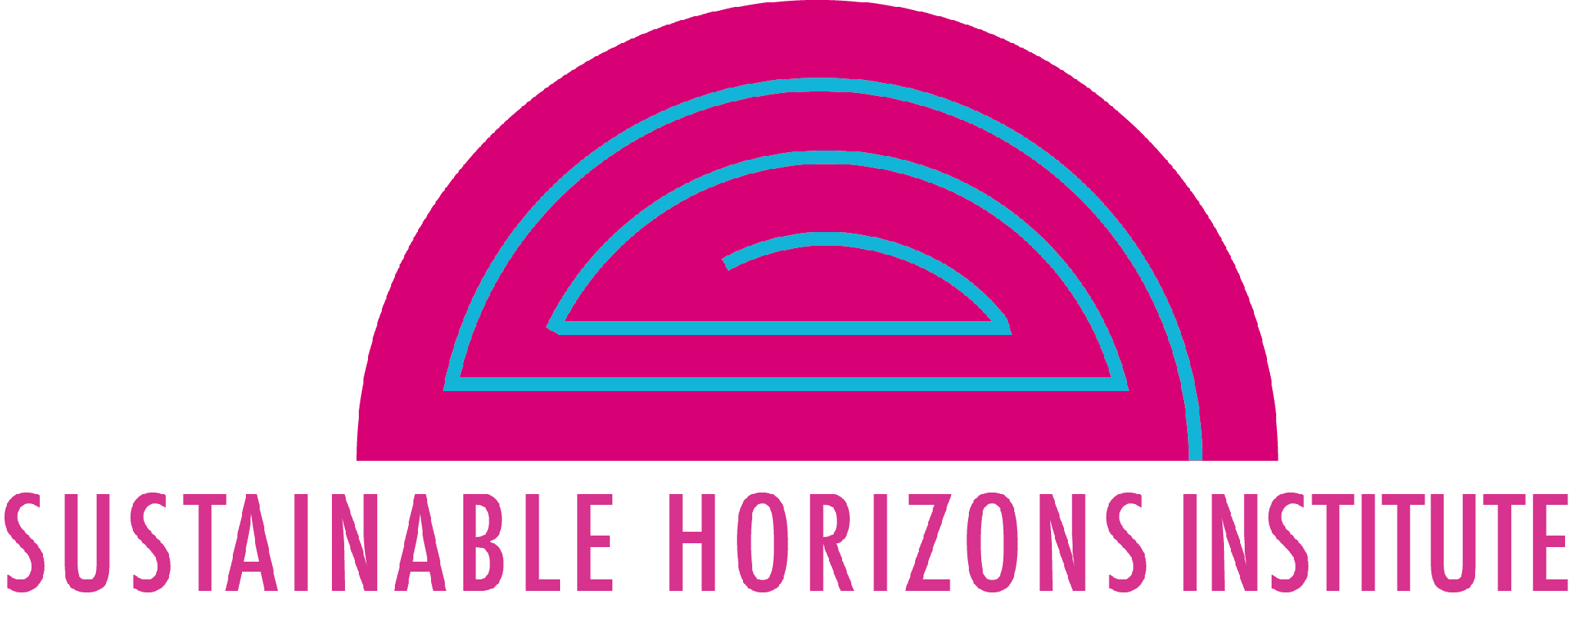
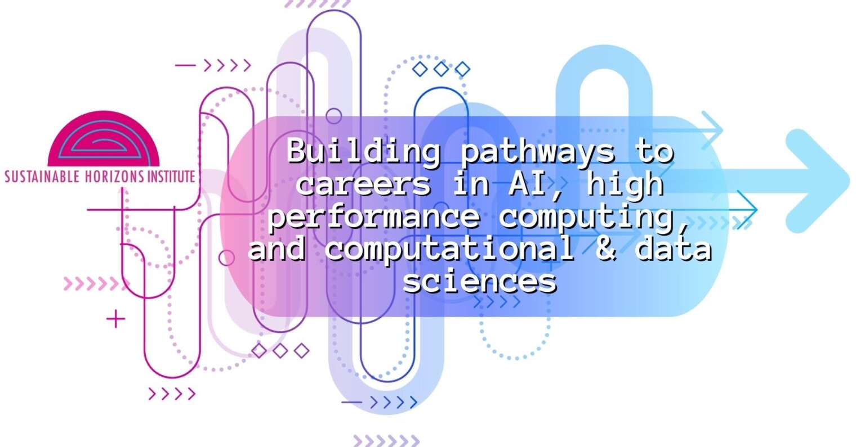
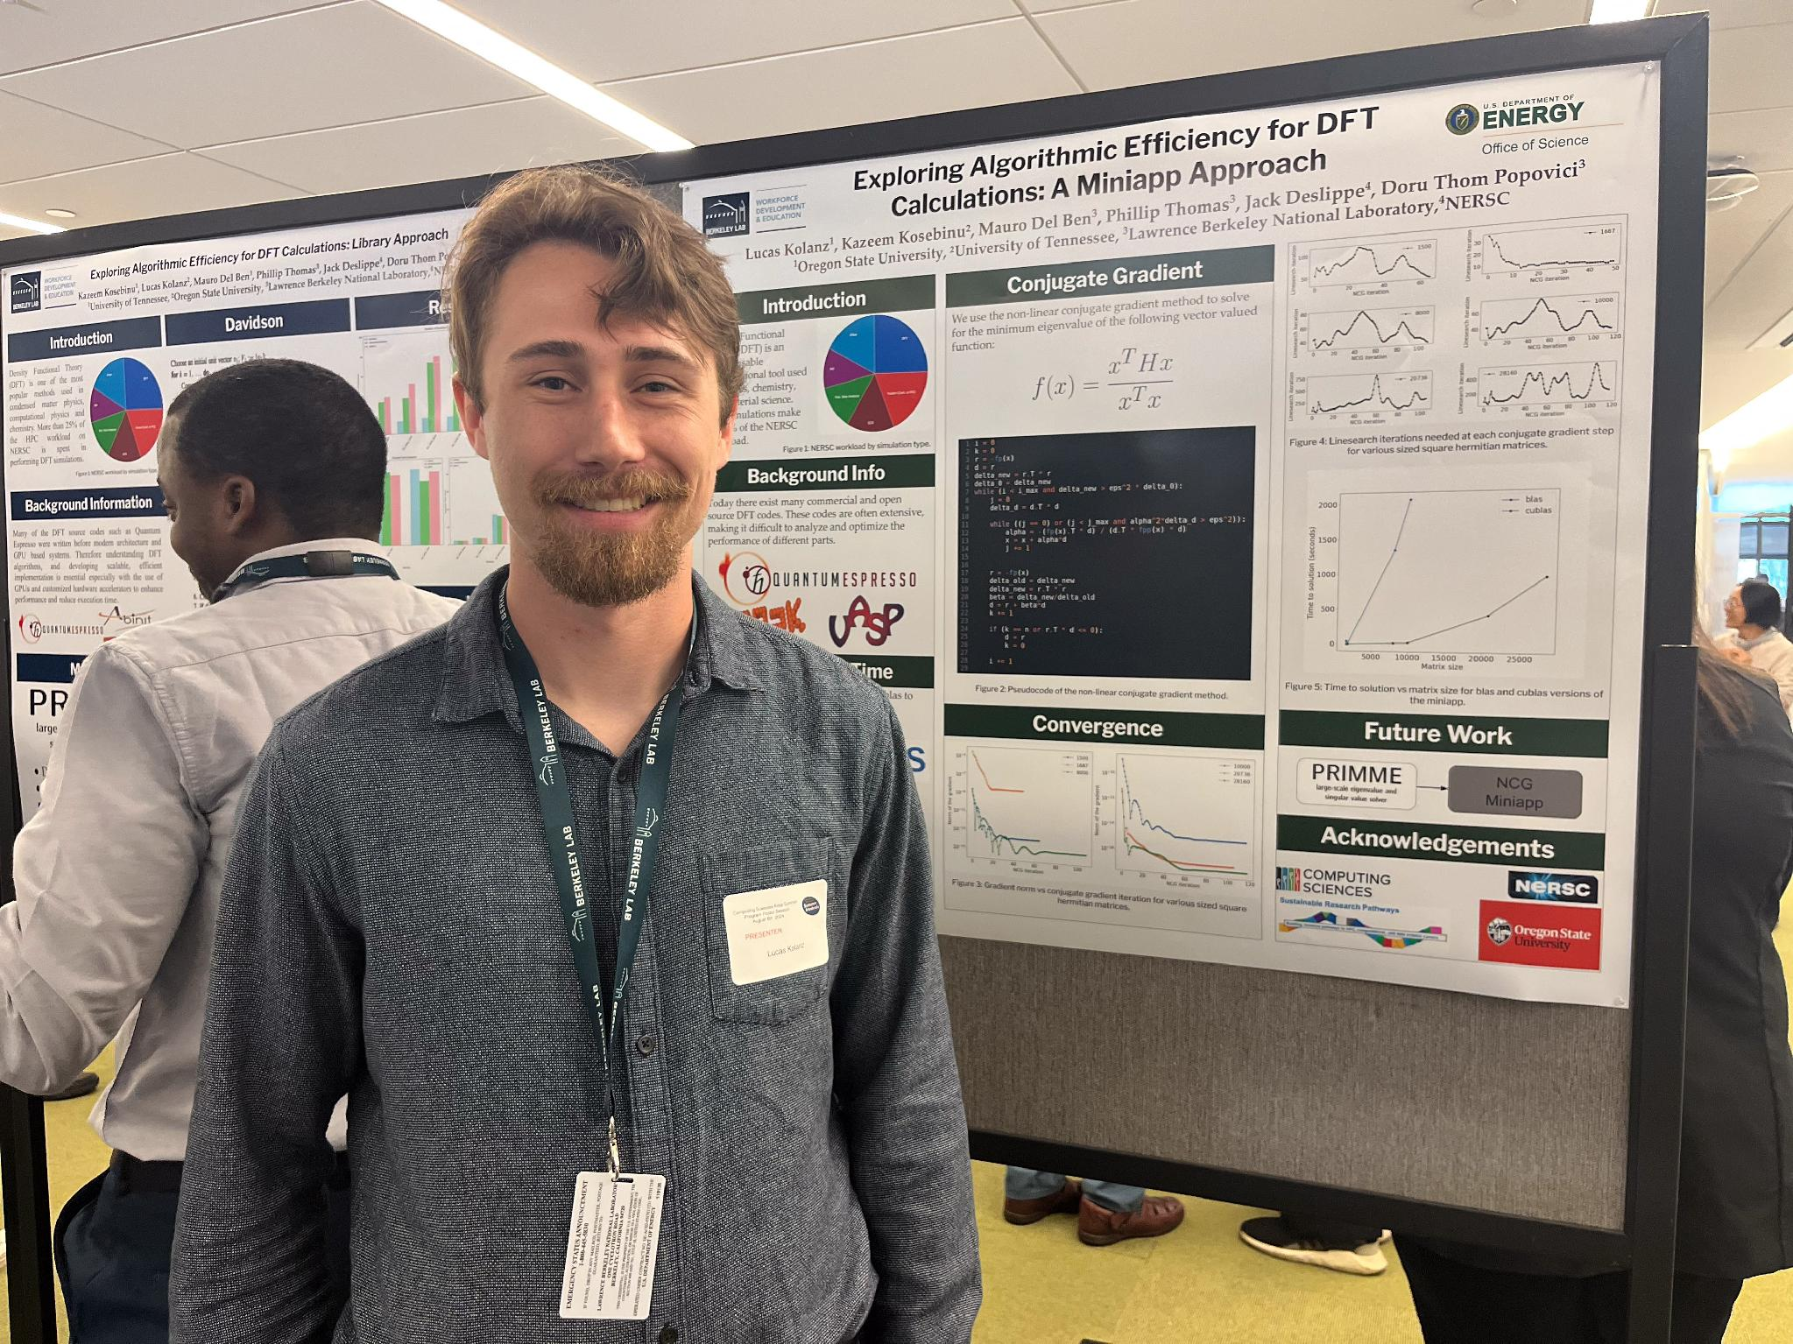
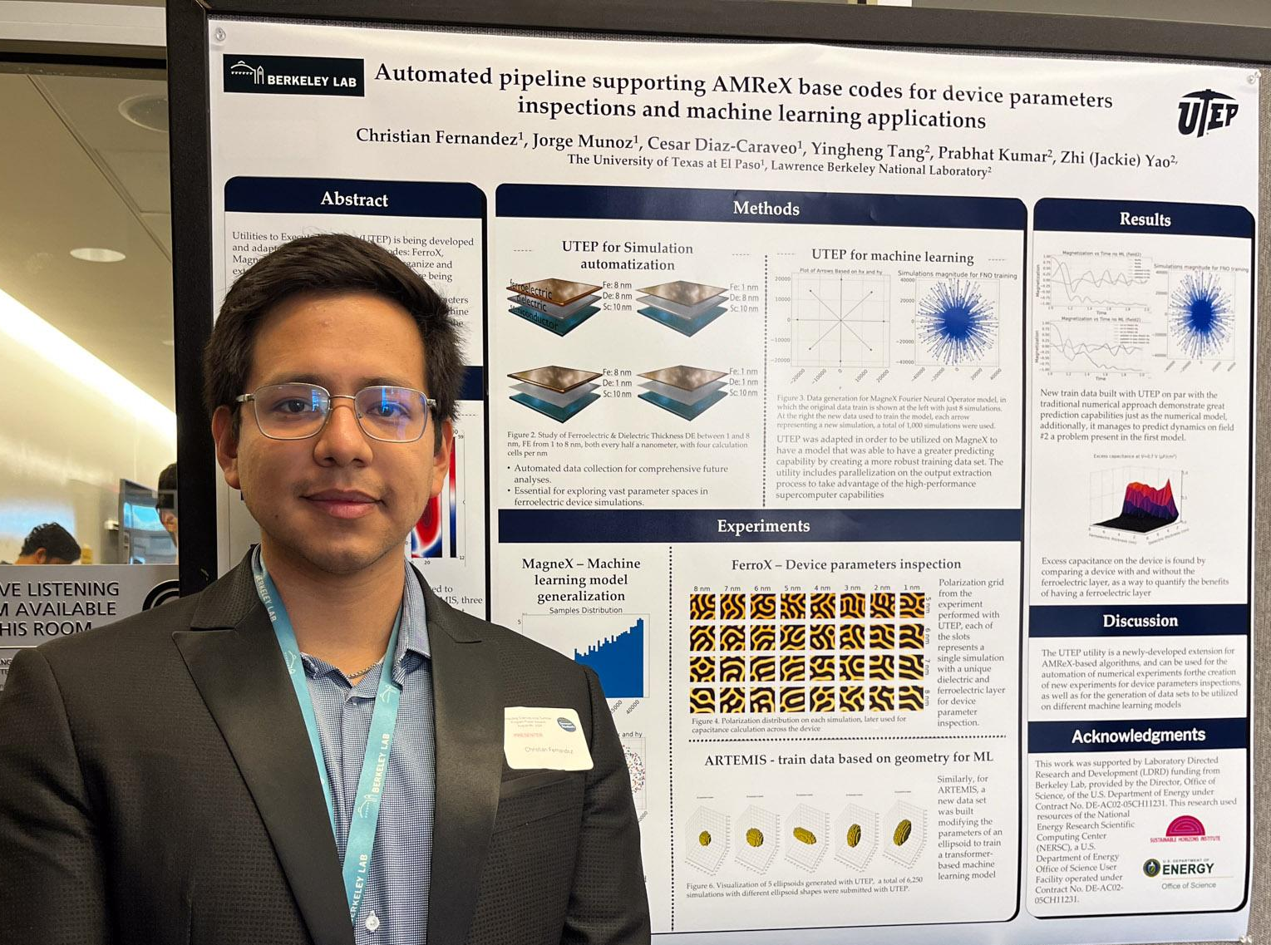
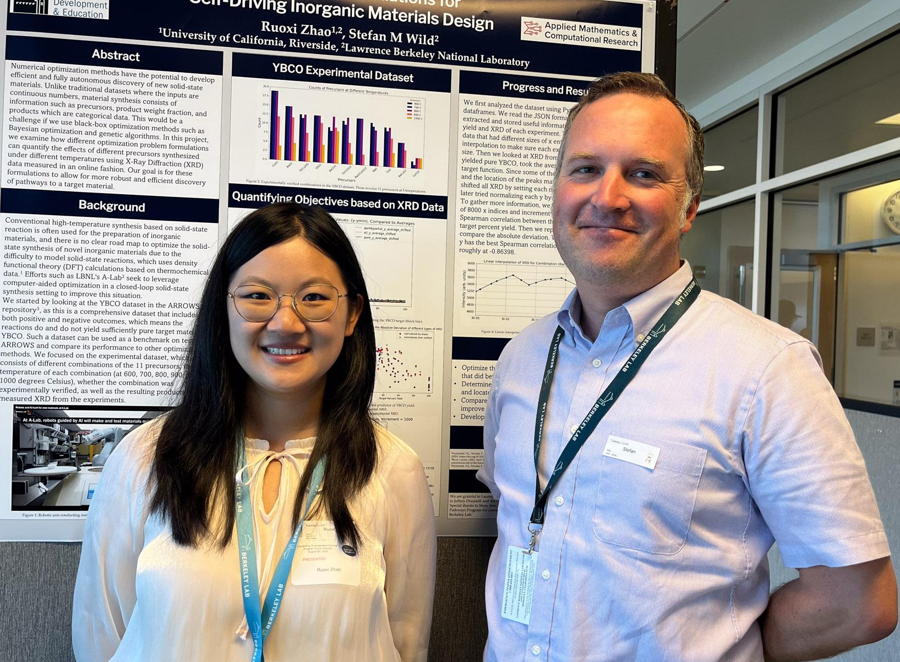
PESO Support Expands Pathways to DOE Labs through SRP
Sustainable Research Pathways (SRP)
Scientific Workforce Achievement
Led by Sustainable Horizons Institute, the Sustainable Research Pathways (SRP) program matched 9 DOE Lab researchers at 4 labs with 20 new faculty and students for summer 2026 collaborations
Significance and Impact
SRP expands the pathways to DOE Labs by introducing lab staff to faculty and students who likely would not otherwise collaborate with the labs
Since 2015, SRP has facilitated matching DOE mentors with 500 students and 171 faculty from 261 universities who now work in DOE labs, academia, & industry
18 DOE lab researchers at 6 labs applied to match with faculty and students; 15 DOE staff matched with 37 faculty and/or students; 9 staff with 20 faculty and students were funded, leaving 17 unfunded matches
SRP has produced lasting and repeat interactions with DOE labs
SRP student poster session
Technical Approach
SRP conducts extensive outreach and recruitment across the U.S., with a focus on non-R1 institutions
SRP has been refined over the years to provide multiple opportunities to facilitate genuine and otherwise unlikely connections
Hallmarks include a finely tuned virtual matching workshop and the use of machine learning and other innovative techniques
PI(s): Lois Curfman McInnes (ANL), Dan Martin (LBNL)
Collaborating Institutions: Sustainable Horizons Institute, BNL, LANL, LLNL, ORNL, SNL
ASCR Program: NGSST (PESO Project: https://pesoproject.org)
ASCR PM: David Rabson
Publication for this work: Iterative Co-Design, Co-Development and Co-Delivery: Accelerating American S&T Productivity through Public-Private Partnerships,
Notes:
LOCAL LAB POC: Lois Curfman McInnes (ANL curfman@anl.gov), Dan Martin (LBNL dfmartin@lbl.gov )
TALKING POINTS:
Department of Energy National Laboratories are facing workforce challenges and need to develop more effective techniques to attract and sustain a full spectrum of talent.
SRP expands the pathways to DOE Labs by introducing lab staff to faculty and students who likely would not otherwise collaborate with the labs
Led by Sustainable Horizons Institute (Mary Ann Leung) and funded by the DOE PESO project, the Sustainable Research Pathways (SRP) program matched 9 DOE Lab researchers at 4 labs with 20 new faculty and students for summer 2026 collaborations
METADATA:
Name of the associated awarded project: PESO
PI name(s): Lois Curfman McInnes
Name of the program manager: David Rabson
CITATIONS:
Iterative Co-Design, Co-Development and Co-Delivery: Accelerating American S&T Productivity through Public-Private Partnerships
BACKGROUND:
The SRP was established over 10 years ago at Berkeley Lab. With ECP support SRP expanded to a multi-lab program that has placed over 300 faculty and students into internships at 10 DOE labs. As a result, a number of SRP participants are currently employed at DOE labs, have received joint research funding with DOE researchers, and have received prestigious awards such CSFG, SSGF, NSF GRF, and the Presidential Awards for Excellence in Science, Mathematics and Engineering Mentoring (PASEM)

