Slide 1
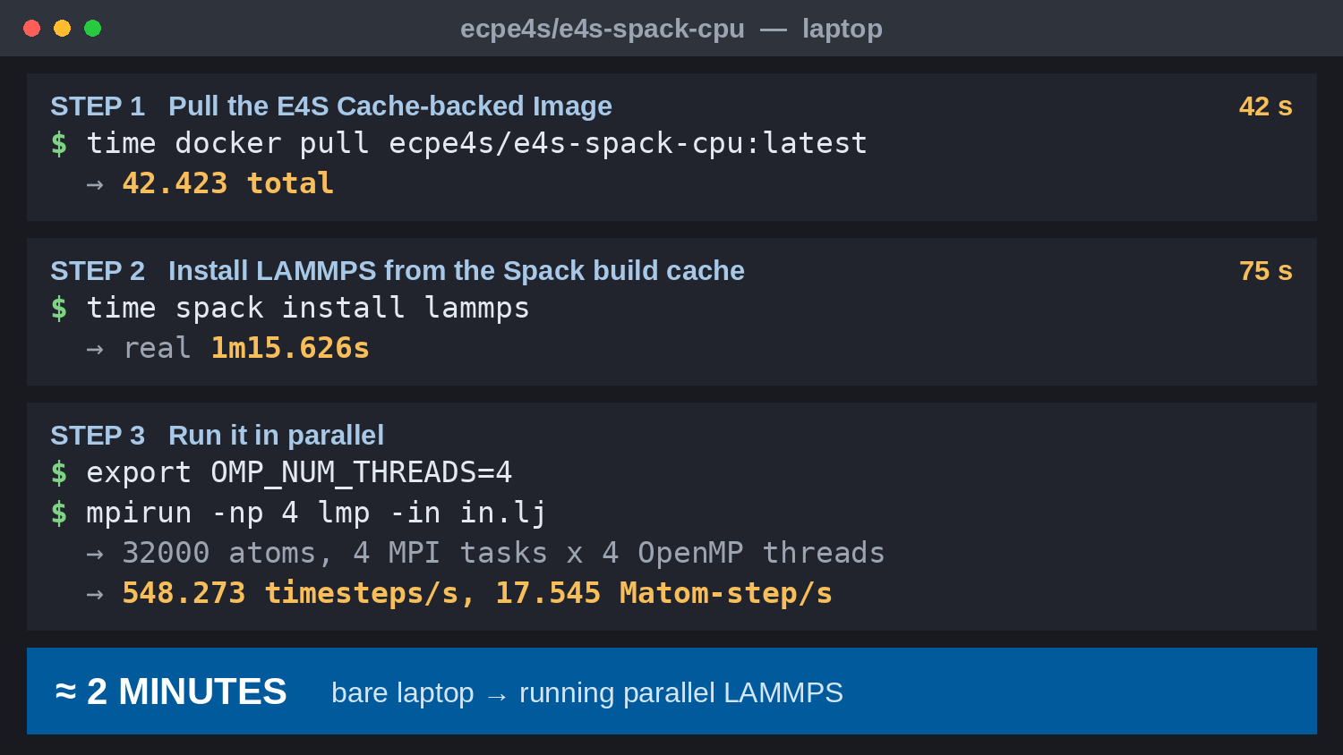












Zero to LAMMPS in Two Minutes
Scientific Achievement
E4S Cache-backed Image (E4S CBI): a minimal container (Spack, MPICH) backed by a Spack build cache that can access all of the hundreds of libraries, tools, and apps in E4S
Any E4S library, tool, or application available in “real time” — curated, reproducible, ubiquitous
On a laptop: 42 s to pull the image, 75 s to install LAMMPS from the cache
Result: a fully functional parallel LAMMPS in under two minutes
Significance and Impact
Removes the build-and-install barrier between a researcher and a running application
Simulation is the entry point for many AI-for-science workflows, including surrogate training
Scales unchanged from a laptop quick start to leadership-class runs and the cloud
Captured on a laptop: a 42-second docker pull of the E4S Cache-backed Image (ecpe4s/e4s-spack-cpu), a 75-second spack install lammps from the E4S build cache, and a four-rank, four-thread LAMMPS run — about two minutes end to end. E4S CBIs are available for all major CPU and GPU platforms. User content runs essentially unchanged from laptop to cloud to leadership-class systems.
The E4S Quick Start guide walks a new user through the same four steps — pull the Docker image, supply MPI code, launch the container, then compile and run — and the E4S Guide Bot answers questions interactively along the way. (Source: e4s.io)
Technical Approach
The Cache-backed Image stays small; the build cache supplies the rest of E4S on demand
Cached binaries replace source builds, cutting a multi-hour install to 75 seconds
LAMMPS in.lj: 32,000 atoms, 4 MPI ranks × 4 OpenMP threads, 17.5 Matom-step/s
PIs: Michael Heroux, (ParaTools, Inc.), Lois Curfman McInnes (Argonne)
E4S lead: Sameer Shende (U of Oregon/ParaTools)
E4S Cache-backed Image: ecpe4s/e4s-spack-cpu; stack curated by E4S/Spack
ASCR Program: Next-Generation Scientific Software Technologies
ASCR PM: David Rabson
E4S website: https://e4s.io
PESO website: https://pesoproject.org LAMMPS: https://www.lammps.org
https://pesoproject.org
Stewarding and advancing the current and future ecosystem of HPC-AI computing software
Notes:
LOCAL LAB POC: Michael Heroux, ParaTools, Inc. (mheroux@paratools.com)
TALKING POINTS:
Scientific software is usually hard to install. A researcher who wants to try a new simulation code often spends hours, sometimes days, resolving compilers, libraries, and dependencies before running anything at all. That setup cost is a real barrier to entry, and it falls hardest on newcomers and on scientists whose expertise is in the science rather than the software.
E4S (Ecosystem for Science) removes that barrier. The PESO project delivers it through what we call the E4S Cache-backed Image: a deliberately small container holding just Spack and MPICH, backed by a Spack build cache that reaches the entire curated E4S collection. The image stays small precisely because it does not carry the software — it carries the means to fetch any of it, already built and already tested, on demand.
Here is what that looks like in practice on an ordinary laptop. Pulling the E4S Cache-backed Image took 42 seconds. Installing LAMMPS, a widely used molecular dynamics code, took another 75 seconds. Two minutes after starting, we were running a real parallel simulation of 32,000 atoms across four MPI ranks and four OpenMP threads per rank.
This matters well beyond convenience. Running a simulation code is the first step in a great many AI-for-science workflows, such as generating the training data behind a surrogate model. Making that first step take two minutes instead of two days changes what researchers are willing to attempt.
The same Cache-backed Image runs unchanged on a laptop, in the cloud, and on leadership-class systems, and published E4S releases let others reproduce a computational result exactly. This is DOE software investment being turned into something any scientist can pick up and use immediately.
METADATA:
Name of the associated awarded project: PESO (Partnering for Scientific-software Ecosystem Stewardship Opportunities), Consortium for the Advancement of Scientific Software (CASS)
PI names: Michael Heroux (ParaTools, Inc.), Lois Curfman McInnes (Argonne National Laboratory)
E4S lead: Sameer Shende (University of Oregon / ParaTools, Inc.)
Name of the program manager: David Rabson, ASCR Next-Generation Scientific Software Technologies
Software / product references: E4S, https://e4s.io ; Spack, https://spack.io ; LAMMPS, https://www.lammps.org ; E4S Cache-backed Image, ecpe4s/e4s-spack-cpu.
REPRODUCIBILITY: E4S publishes curated, versioned releases of the full software stack, so a container tag plus a Spack specification is sufficient to reconstruct the exact software environment used for a published run. Add any formal reproducibility badges here if the associated publications carry them.
BACKGROUND AND CONTEXT INFORMATION:
Terminology: the E4S Cache-backed Image is the minimal ecpe4s/e4s-spack-cpu container — Spack and MPICH only — paired with the E4S Spack build cache that backs it. Use the full name on first mention in any talk; "Cache-backed Image" is fine thereafter.
Timings shown on the slide were measured on a MacBook (aarch64) using the E4S Cache-backed Image, ecpe4s/e4s-spack-cpu:latest, and LAMMPS 22 Jul 2025. The benchmark is the standard LAMMPS Lennard-Jones melt input, in.lj, with 32,000 atoms for 100 timesteps: loop time 0.182 s on 16 processors, 548.3 timesteps/s, 17.545 Matom-step/s, with 100.6% CPU use across 4 MPI tasks by 4 OpenMP threads. Numbers will vary with hardware and network speed; the point is the order of magnitude, not the exact seconds.
The speed comes from the cache half of the Cache-backed Image. Rather than compiling LAMMPS and its dependencies from source, Spack retrieves prebuilt binaries that E4S has already built and tested against the image's compiler and MPI, so an install that would normally take hours completes in about a minute.
The E4S Quick Start guide at e4s.io presents this as four steps: download the Cache-backed Image, supply MPI code, launch the container interactively, then compile and run. The E4S Guide Bot provides interactive help alongside the documentation.

