Slide 1
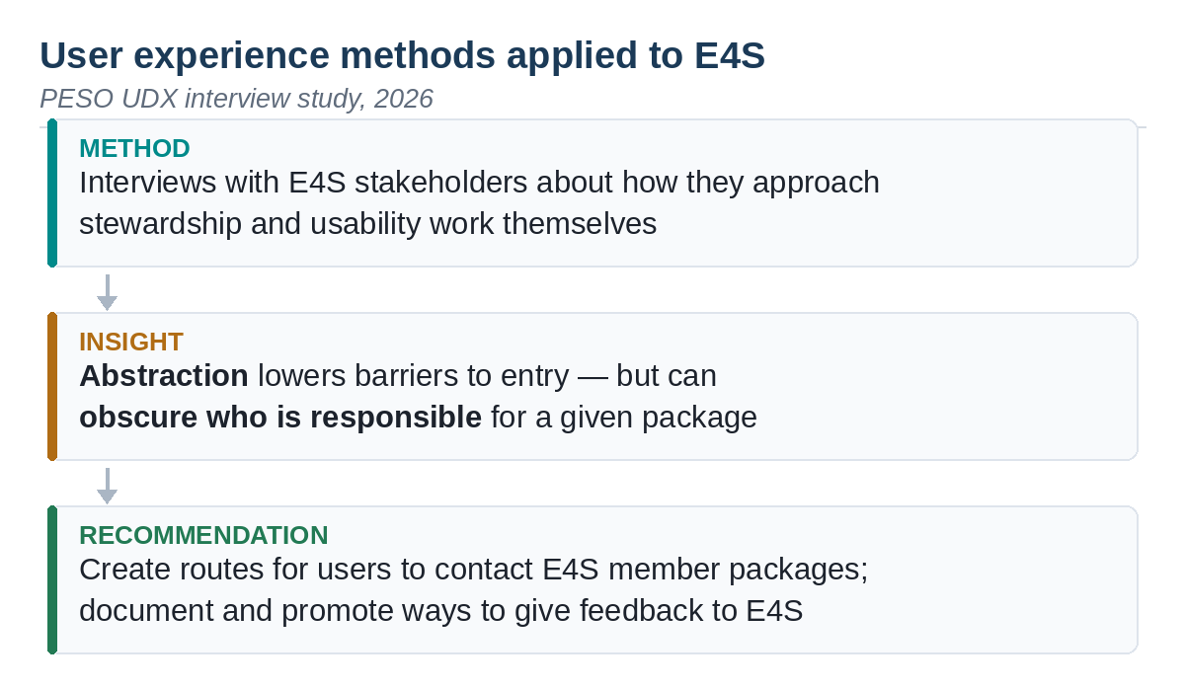

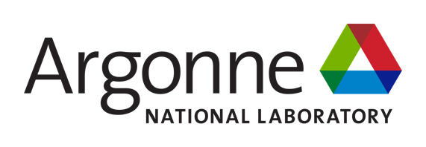










Designing HPC Software for People
Scientific Achievement
PESO UDX: user experience methods applied to PESO and CASS software
Interviews asked how E4S stakeholders approach stewardship and usability work
Finding: abstraction lowers barriers but can obscure who is responsible
Recommendation: create routes for users to reach E4S member packages
Significance and Impact
Usability problems hinder adoption and make development unnecessarily difficult
Findings feed back into E4S, showing users the teams behind each package
CASS and The Good Docs Project pair technical writers with software teams
PESO's strategy is to empower and assist developers, not work around them
Technical Approach
Interviews, heuristic evaluations, and collaborative exercises as assessment tools
Heuristic evaluation checks a tool against Nielsen's ten usability principles
UDX webinars and discussion hours alternate monthly, upskilling the community
Talks archived on the CASS channel; slides in the UX in Science Zenodo community
PESO's UDX work turns user experience methods into concrete changes to scientific software. Interviews with E4S stakeholders about how they approach stewardship found that abstraction, while it lowers barriers to entry, can leave users unsure who is responsible for a given package — and yielded specific recommendations for restoring those connections.
Community resources extend the same work. UDX webinars run the first Tuesday of odd months and discussion hours the first Tuesday of even months, with past talks archived at go.lbl.gov/udx-webinars and slides deposited in the UX in Science Zenodo community.
PIs: Michael Heroux, (ParaTools, Inc.), Lois Curfman McInnes (Argonne)
UDX lead: Johanna (Hannah) Cohoon (LBNL), hcohoon@lbl.gov
Collaborating: LBNL, CASS, The Good Docs Project
ASCR Program: Next-Generation Scientific Software Technologies
ASCR PM: David Rabson
UDX webinars: https://go.lbl.gov/udx-webinars
PESO: https://pesoproject.org CASS: https://cass.community
https://pesoproject.org
Stewarding and advancing the current and future ecosystem of HPC-AI computing software
Notes:
LOCAL LAB POC:
Johanna (Hannah) Cohoon, Lawrence Berkeley National Laboratory, hcohoon@lbl.gov
TALKING POINTS:
Scientific software succeeds or fails on whether people can actually use it. A library can be fast, correct, and well engineered and still go unused because installing it is confusing, the documentation assumes knowledge the reader does not have, or nobody can tell who to ask when something breaks. Those are user experience problems, and they are as real a barrier as any technical one.
PESO treats them as such. The user and developer experience effort, UDX, applies established methods from user experience research — interviews, heuristic evaluations, and collaborative exercises — to the software the project builds and stewards. The goal is not to study users in the abstract, but to change specific tools.
Here is what that looks like in practice. The team interviewed E4S stakeholders about how they themselves approach stewardship and usability work. A clear pattern emerged: abstraction is genuinely valuable, because hiding complexity is what lets a newcomer get started at all. But the same abstraction can backfire. When a user only ever sees the top-level interface, they may have no idea which member package is responsible for the behavior they are seeing, or who to contact about it.
The recommendation follows directly. Create routes for users to reach the individual E4S member packages when they need to, and document and promote the ways users can send feedback to E4S. That is a concrete, actionable change to how a major DOE software product presents itself, produced by asking people how they work rather than by guessing.
The same effort builds shared capacity across the community. UDX webinars and discussion hours alternate month by month, talks are archived publicly, and slides are deposited in a Zenodo community so they outlast the meeting. A partnership between CASS and The Good Docs Project is now pairing professional technical writers with volunteering software teams to audit their documentation. The through-line is PESO's stated strategy: empower and assist developers rather than work around them.
METADATA:
Name of the associated awarded project: PESO, Consortium for the Advancement of Scientific Software (CASS)
PI names: Michael Heroux (ParaTools, Inc.), Lois Curfman McInnes (Argonne National Laboratory)
UDX lead: Johanna (Hannah) Cohoon (Lawrence Berkeley National Laboratory)
Name of the program manager: David Rabson, ASCR Next-Generation Scientific Software Technologies
Presented at the DOE ASCR Computer Science Principal Investigators Meeting, Rockville, MD, July 2026
CITATIONS:
[NEEDS ATTENTION] The source poster cites no PESO publication for this work. The template requires at least one publication citation on the slide face; add one before submission, with full citation and DOI in these notes, and confirm any accepted manuscript has been submitted to OSTI.
Works cited by the poster (references, not PESO outputs): Jakob Nielsen (1994, April 24), 10 Usability Heuristics for User Interface Design, Nielsen Norman Group, https://www.nngroup.com/articles/ten-usability-heuristics/ ; The Good Docs Project (2025, September 2), From code to clarity: What makes good docs?, Zenodo, https://doi.org/10.5281/zenodo.17049866
Community resources: UDX webinar archive, https://go.lbl.gov/udx-webinars ; UX in Science Zenodo community.
AWARDS:
[none noted; add if applicable]
REPRODUCIBILITY:
Qualitative interview work rather than computational results, so reproducibility here means methodological transparency: heuristic evaluations follow Nielsen's published ten principles, and webinar materials are deposited in a public Zenodo community. If interview protocols or anonymized findings are being published, cite them here.
BACKGROUND AND CONTEXT INFORMATION:
Terminology: UDX is user and developer experience — deliberately broader than UX, because PESO's audience includes the people building the software as well as the people running it. Define it on first use in any talk.
A heuristic evaluation is a structured usability assessment in which an evaluator checks a design or tool against a fixed set of established principles. The poster uses Jakob Nielsen's ten usability heuristics, first published in 1994 and still the standard reference. This is a low-cost method: a small number of trained evaluators can surface a large share of usability problems without running a full user study.
Recruiting note from the poster: to adapt standard design guidelines for HPC settings, the team is seeking volunteers who will conduct a heuristic evaluation of a software product's usability and then be interviewed about the experience. Worth mentioning if the audience includes potential participants.
Meeting cadence: webinars on the first Tuesday of odd-numbered months at 12pm Eastern, discussion hours on the first Tuesday of even-numbered months at the same time. The poster notes the next webinar as September 1 and the next discussion hour as October 6, with August cancelled; check current dates before presenting.

