Slide 1
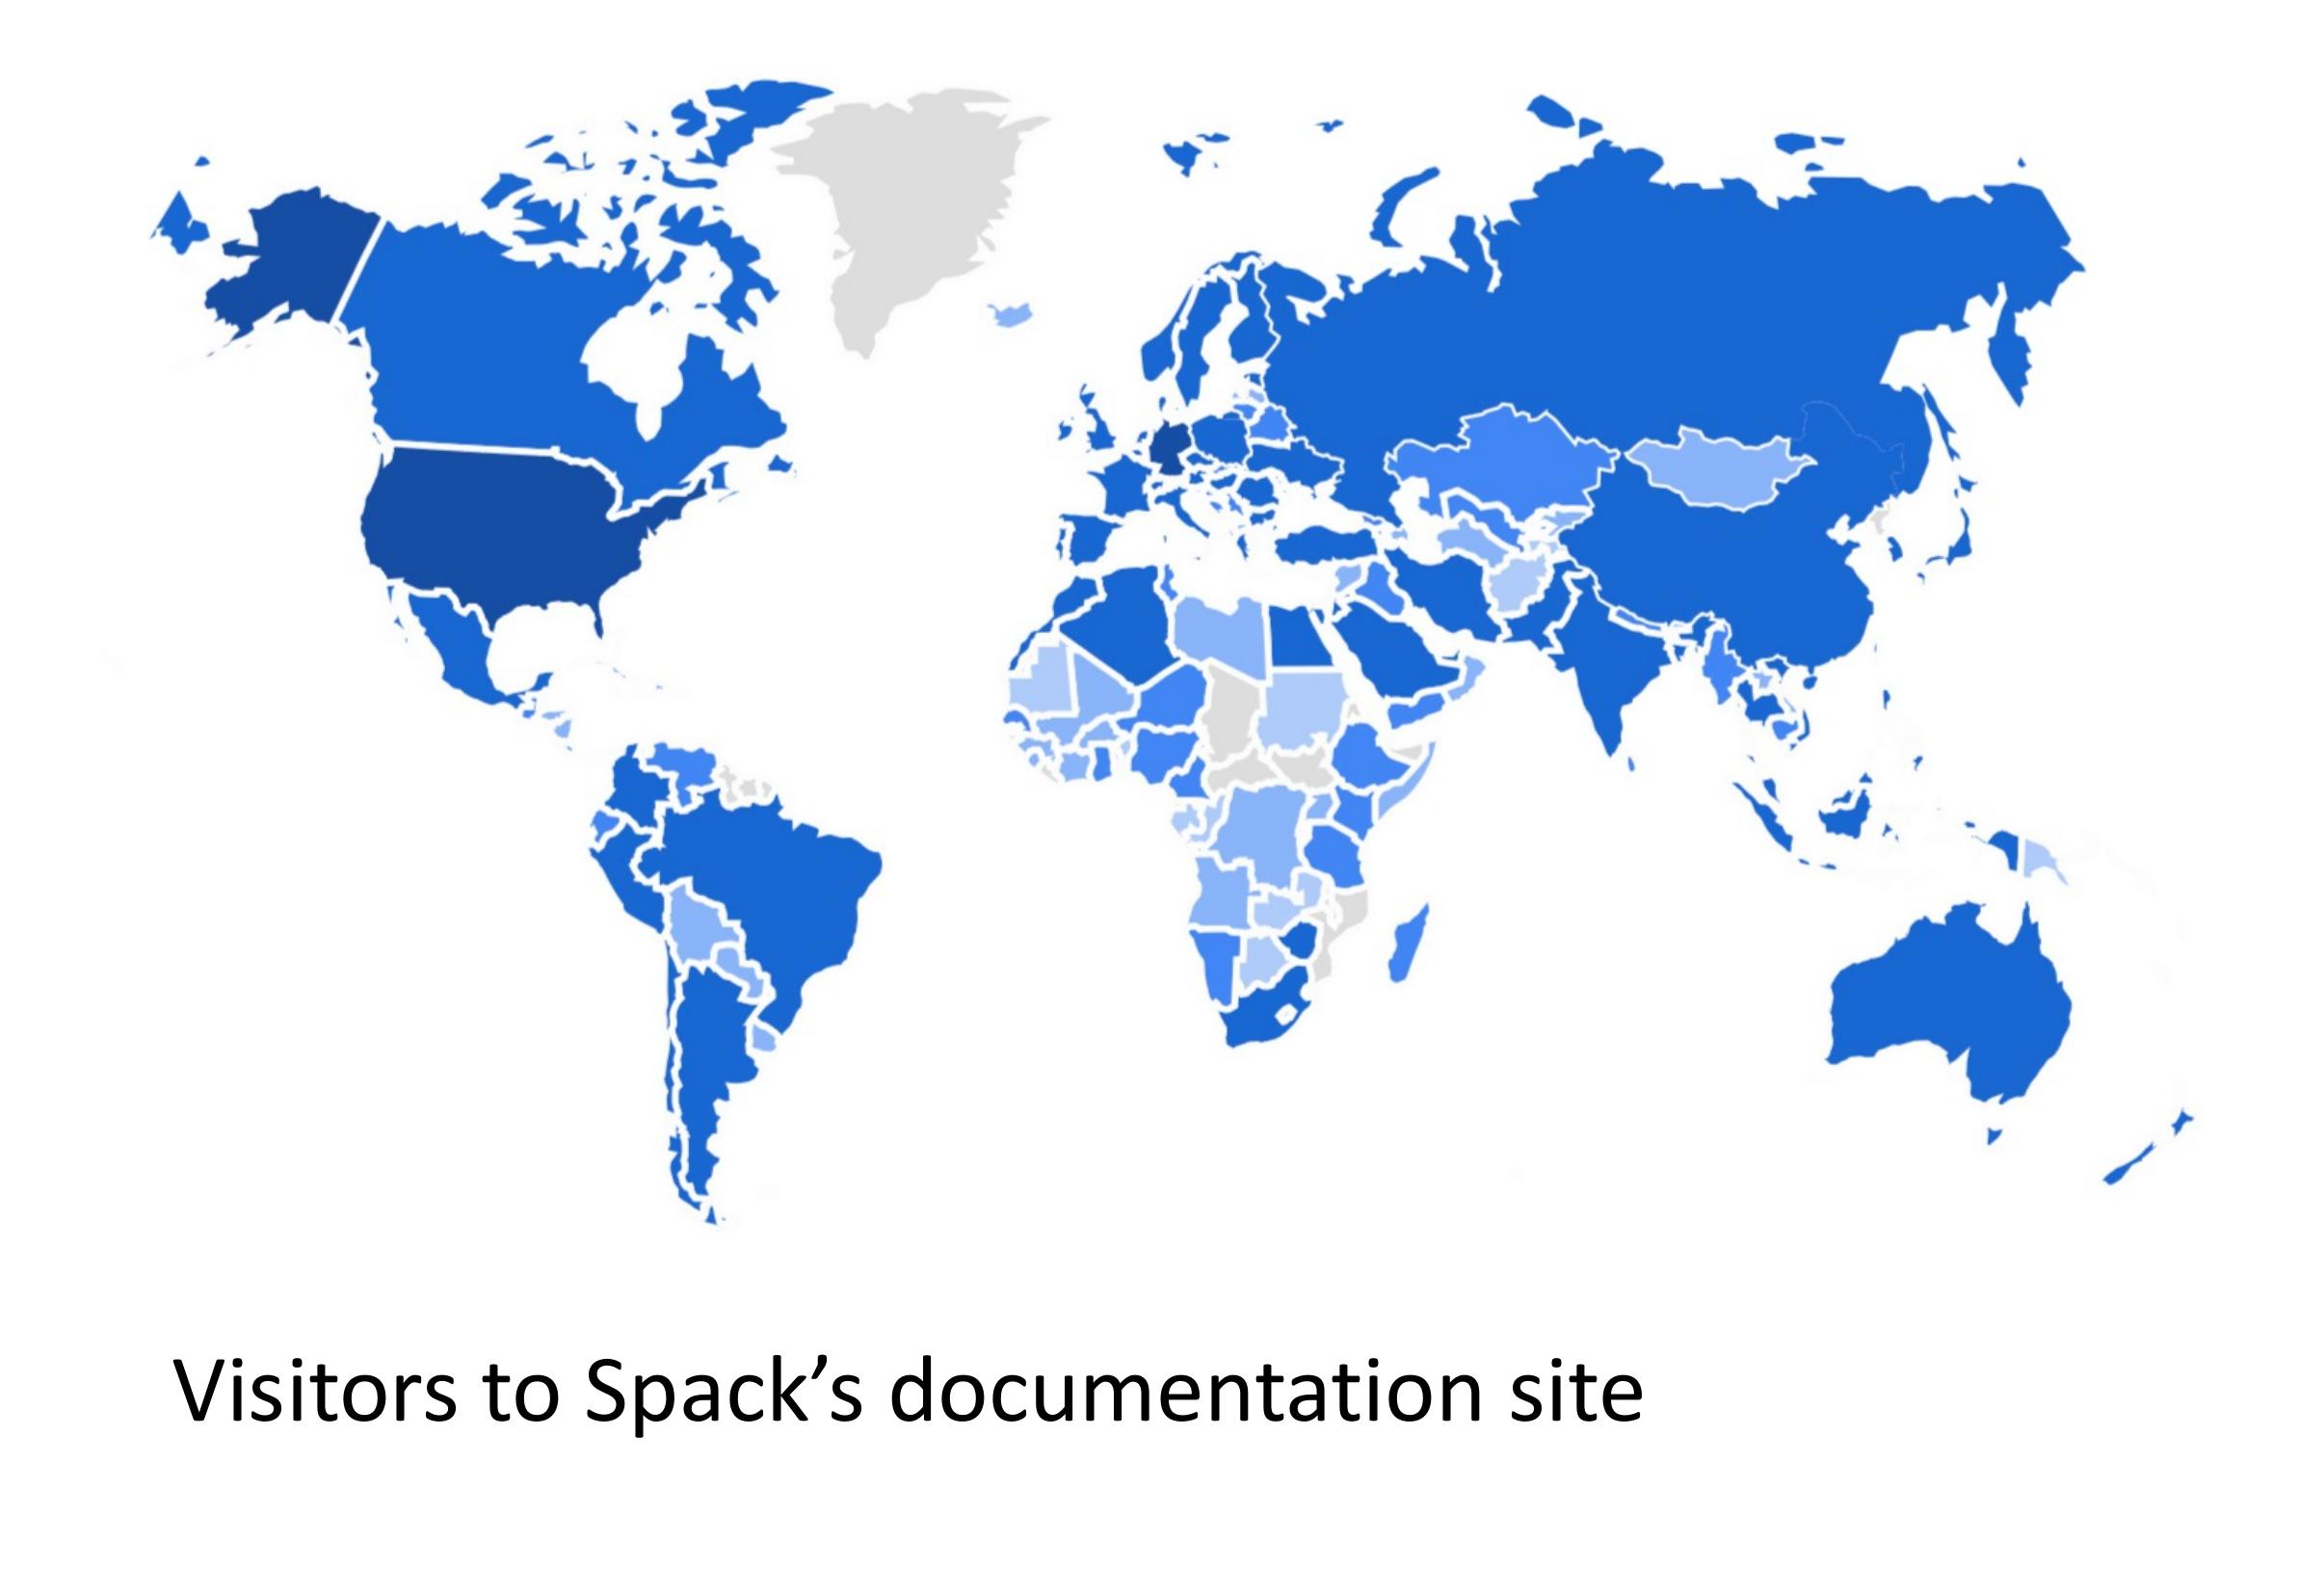
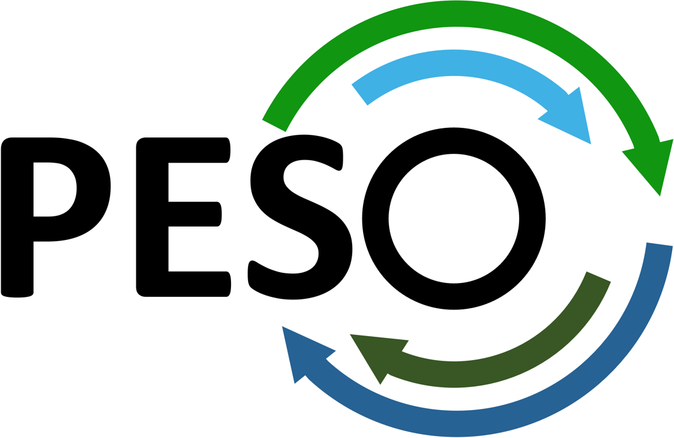
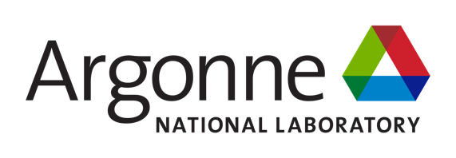










Spack Grows the Commons
Scientific Achievement
Spack 1.2 adds a parallel installer, concretization groups/caching, and SBOM generation
Concretization caching: 3 solves down to 1; spec resolve time 6.21 s to 1.79 s
Contributors: 1,400 to 1,600+; packages: 8,200 to 8,800 across four releases
Joined the Linux Foundation; set up neutral, community-run governance
Significance and Impact
Spack underpins DOE's E4S stack, a shared dependency for open computational science
SBOMs give every research group a standard, auditable record of its software stack
One open toolchain serves academia, industry, and government labs alike
Technical Approach
Concretization groups let solved spec subsets reuse each other's results
Cached concretization stores solver output by hash to skip re-solving
SBOMs follow SPDX 2.3 with NTIA minimum elements for security tooling
Documentation-site visits from nearly every country trace the reach of an open, community-governed package manager: Spack now has over 1,600 contributors spanning academia, industry, and government labs, with research software engineers, developers, and computational scientists all drawing on the same open toolchain.
That global, cross-sector user base is exactly what Spack's 1.2 features are built to serve: faster concretization and SBOMs make the shared stack easier to run and easier to trust at any scale, from a laptop to a leadership-class system.
PIs: Michael Heroux, (ParaTools, Inc.), Lois Curfman McInnes (Argonne)
Spack technical lead: Todd Gamblin (LLNL)
ASCR Program: Next-Generation Scientific Software Technologies
ASCR PM: David Rabson
Spack website: https://spack.io, https://github.com/spack/spack
PESO website: https://pesoproject.org
https://pesoproject.org
Stewarding and advancing the current and future ecosystem of HPC-AI computing software
Notes:
LOCAL LAB POC:
Todd Gamblin
TALKING POINTS:
Open science depends on shared software infrastructure and building that software is often the hardest part. Every research group that wants to run HPC applications must resolve compilers, libraries, and dependencies before a single simulation runs — work that is largely the same from one institution to the next, yet has traditionally been redone in isolation everywhere.
Spack is the open-source package manager the community built to stop repeating that work. Maintained by a large international community and supported through PESO and the High Performance Software Foundation, Spack automates builds of scientific software and its dependencies, with a simple, parameterized syntax that lets users tune configuration without hand-editing build scripts. It is the foundation of DOE's E4S software stack.
The 1.2 release adds four capabilities the community asked for: an interactive parallel installer with a live terminal UI, concretization groups that let independently-solved parts of a spec reuse each other's results, cached concretization that stores and retrieves solver output by hash, and SBOM generation in the SPDX 2.3 standard for supply-chain security. Concretization caching alone cut a three-solve sequence down to one, and a typical spec resolve from 6.21 seconds to 1.79.
Over the past two years the project has grown from 1,400 to more than 1,600 contributors and from 8,200 to 8,800 packages, joined the Linux Foundation, and set up neutral governance so no single institution controls its direction. Documentation-site visits arrive from nearly every country, and the user base spans research software engineers, developers, system administrators, and computational scientists in roughly equal measure — evidence that Spack has become genuinely shared infrastructure rather than a single lab's tool.
That is the DOE mission in practice: public investment in open software that any research group, anywhere, can build on, verify, and extend — and that keeps getting faster and more secure as the community that relies on it keeps growing.
METADATA:
Name of the associated awarded project: PESO, Consortium for the Advancement of Scientific Software (CASS)
PI names: Michael Heroux (ParaTools, Inc.), Lois Curfman McInnes (Argonne National Laboratory)
Spack technical lead: Todd Gamblin (Lawrence Livermore National Laboratory)
Name of the program manager: David Rabson, ASCR Next-Generation Scientific Software Technologies
CITATIONS:
[to be completed before submission] Add full citations, including DOIs, for the associated Spack publications, and confirm that accepted manuscripts have been submitted to OSTI. At least one publication citation should also appear on the slide itself.
Software references: Spack, https://spack.io ; source, https://github.com/spack/spack ; E4S, https://e4s.io .
AWARDS:
[none noted; add if applicable]
REPRODUCIBILITY:
Spack's cached concretization stores solver results by input hash, and SBOM generation records the exact supplier, version, and dependency graph of every installed package — together giving a verifiable record sufficient to reconstruct a software environment used for a published result.
BACKGROUND AND CONTEXT INFORMATION:
Source: poster "What's New in Spack 1.2," presented at the DOE ASCR Computer Science Principal Investigators Meeting, Rockville, MD, July 2026.
Growth figures and the contributor/documentation-visitor map are drawn directly from the poster's 'What's happened in the past two years?' panel. Percentages in the role breakdown: Research Software Engineer (RSE) 21.1%, Software Developer 17.9%, System Administrator 12.2%, Computational Scientist 11.8%, User Support Staff (not separately labeled in caption) 8.9-10.6% range across DevOps/SRE and User Support Staff, HPC User/Analyst smallest slice.

