Slide 1
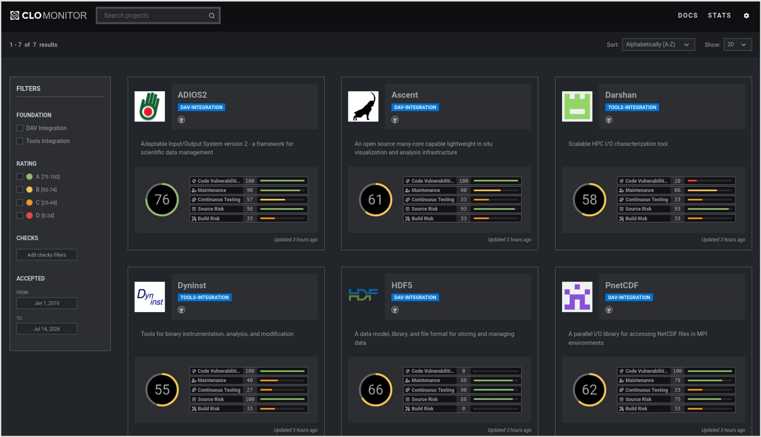
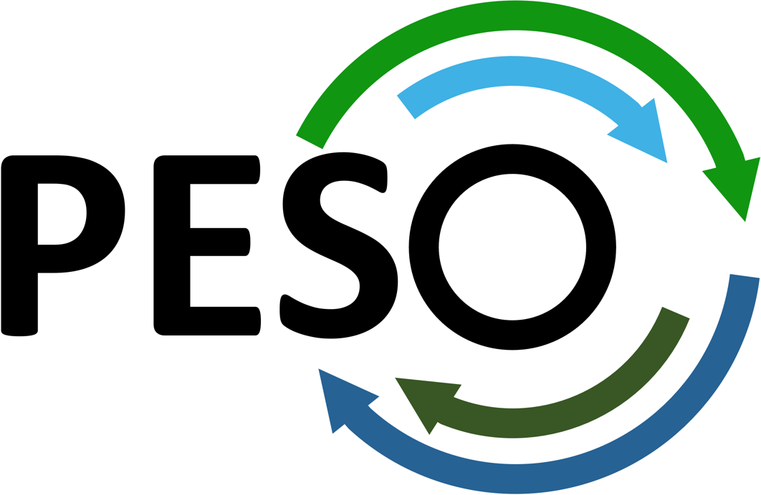
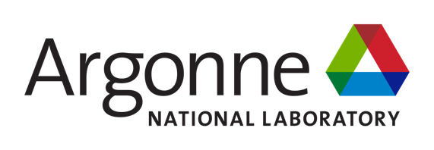








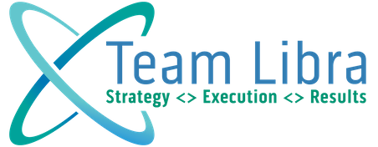

Sustaining DOE's HPC Software
Scientific Achievement
A CLOMonitor dashboard fork now tracks OpenSSF security scores for every DAV & TOOLS project
ADIOS2's Scorecard rose 7.1 → 8.6/10, passing the Best Practices badge
Security policies shipped for ADIOS2, Viskores, ZFP, Darshan, and PAPI; supply-chain hardening fixed vulnerabilities across the stack
Significance and Impact
16 DAV & TOOLS products stay interoperable and DOE-workflow-ready via shared Spack, CDash, and CI
Curated Spack environments feed E4S, the Ecosystem for Science, so a fix made once reaches every facility
Automated Frontier deployment and shared binary caches speed the path from a merged PR to an exascale-ready module
The CLOMonitor fork dashboard scores each DAV & TOOLS project on five OpenSSF (Open Source Security Foundation) measures — code vulnerabilities, maintenance, continuous testing, source risk, and build risk — shown here for ADIOS2, Ascent, Darshan, Dyninst, HDF5, and PnetCDF.
The 0–100 score in each circle is CLOMonitor's own composite rating, a separate metric from the OpenSSF Scorecard figure (7.1 → 8.6/10) cited for ADIOS2 at left.
Technical Approach
Three-tier CI: per-product GitHub/GitLab workflows, Spack CI on Frank Cluster, Jacamar-based Frontier facility CI — synced via gh-gl-sync
Each Integration = a curated Spack environment + site configs, shared with E4S
CDash and smoke tests validate every build and installed package at runtime
PIs: Michael Heroux (ParaTools, Inc.), Lois Curfman McInnes (Argonne)
DAV & TOOLS lead: [add name and contact]
Collaborating institutions: Argonne, Berkeley Lab, Brookhaven, Kitware, LLNL, LANL, ORNL, PNNL, ParaTools, Sandia, Team Libra
ASCR Program: Next-Generation Scientific Software Technologies
ASCR PM: David Rabson
PESO website: https://pesoproject.org
https://pesoproject.org
Stewarding and advancing the current and future ecosystem of HPC-AI computing software
Notes:
LOCAL LAB POC:
[add name and contact]
TALKING POINTS:
DOE's HPC software ecosystem depends on dozens of independently maintained open-source libraries and tools — ParaView, ADIOS2, HDF5, HPCToolkit, PAPI, and more — that all need to stay secure, interoperable, and deployable across every DOE computing facility. That sustainability burden is more than any single upstream team can carry alone.
The PESO project's DAV and TOOLS Integrations supply shared infrastructure instead: per-product continuous integration across GitHub and GitLab, Spack recipes that define how each package is built, and a security-hardening layer built on the OpenSSF Best Practices Badge and Scorecard frameworks, all tracked on a shared CLOMonitor dashboard fork.
The results are concrete. ADIOS2's OpenSSF Scorecard rose from 7.1 to 8.6 out of 10, enough to pass the Best Practices badge. New security policies now cover ADIOS2, Viskores, ZFP, Darshan, and PAPI. Supply-chain hardening — hashed CI dependencies, minimal workflow-token permissions, branch protection — has closed vulnerabilities across many of the products, and the same curated Spack environments are automatically deployed and refreshed on the Frontier exascale system, with Perlmutter and Aurora coming next.
This matters beyond convenience. Quality and security work done once, centrally, by the DAV and TOOLS Integrations reaches every DOE facility and every downstream user through E4S, rather than being repeated — or skipped — by each individual product team separately.
That is DOE software investment being turned into a more trustworthy, more sustainable exascale software ecosystem, in coordination with RAPIDS, STEP, E4S, FASTMath, and DOE facility partners.
METADATA:
Name of the associated awarded project: PESO, Consortium for the Advancement of Scientific Software (CASS)
PI names: Michael Heroux (ParaTools, Inc.), Lois Curfman McInnes (Argonne National Laboratory)
DAV & TOOLS Integrations lead: [add name and contact]
Name of the program manager: David Rabson, ASCR Next-Generation Scientific Software Technologies
CITATIONS:
[to be completed before submission] The source poster names no publication. Add full citations, including DOIs, for any associated DAV/TOOLS Integrations paper or report, and confirm accepted manuscripts are submitted to OSTI. At least one publication citation should also appear on the slide itself.
Software / project references: PESO, https://pesoproject.org ; DAV Integration, https://dav-sdk.github.io/ ; TOOLS Integration, https://tools-integration.github.io/ ; CLOMonitor, https://clomonitor.io ; OpenSSF Scorecard and Best Practices Badge, https://openssf.org
AWARDS:
[none noted; add if applicable]
REPRODUCIBILITY:
Each Integration is a curated, versioned Spack environment shared with E4S, so a Spack environment specification plus the CDash/CLOMonitor record is sufficient to reconstruct the exact software configuration deployed on Frontier at a given time.
BACKGROUND AND CONTEXT INFORMATION:
Terminology: DAV Integration curates data-analysis and visualization software (ParaView, Catalyst, ADIOS2, HDF5, PnetCDF, Viskores, VisIt, Ascent, DIY, ZFP). TOOLS Integration curates performance-analysis and instrumentation software (HPCToolkit, PAPI, TAU, ERT, Darshan, Dyninst). Together they total 16 products tracked across the DAV & TOOLS Integrations.
The CLOMonitor dashboard fork shown in the figure listed 7 tracked projects as of the source poster (July 2026); the cropped screenshot shows 6 of the 7 visible cards (ADIOS2, Ascent, Darshan, Dyninst, HDF5, PnetCDF).
Source material: DAVTOOLS-poster_final_2026_07_16, presented at the DOE ASCR Computer Science Principal Investigators Meeting, Rockville, MD, July 2026. One institution logo in the poster header (rightmost, before the PESO badge) was not legible enough to identify and was omitted from the collaborating-institutions list on the slide.

