Slide 1

¹ list of references

Slide 2
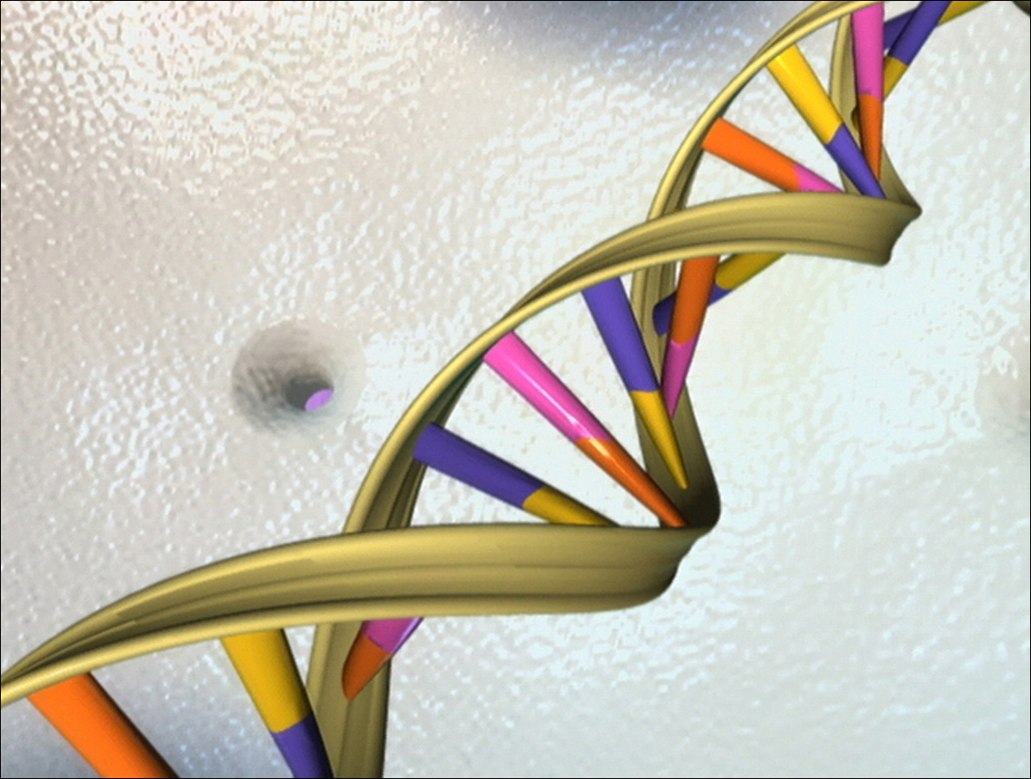

What is the Connectivity Map?
Definition: “The Connectivity Map is an algorithm which calculates the connection between genes and drugs (= instances). The goal was to provide connections between small molecules. The output of this algorithm gives you the possibility to predict the behavior of a gene when it reacts with a specific drug.”
connection
² list of references
What happens?
³ list of references

Slide 3

How the connections are found
1309 drugs
5 cell lines
² list of references
⁴ list of references
After 6 respectively 12 hours the drugs take effect on the cell lines.

Slide 4

How the connections are found
After 6 respectively 12 hours
cell lines
microarrays
⁴ list of references
⁵ list of references
Then you get 22283 genes which are up or down regulated.

Slide 5
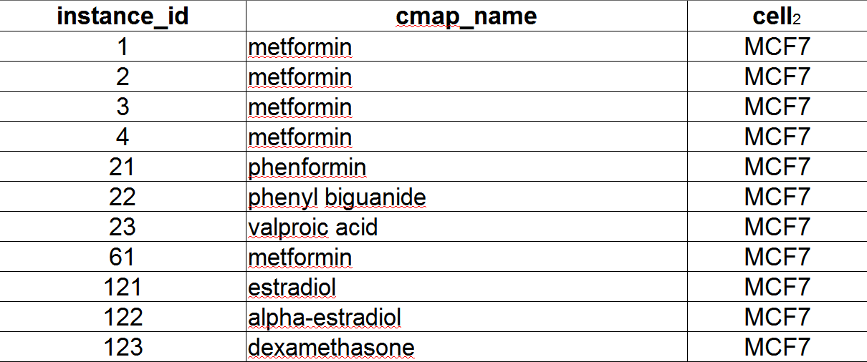
Constructing the rankmatrix
Every instance from a certain cell line gets an instance_id for identification.

Slide 6
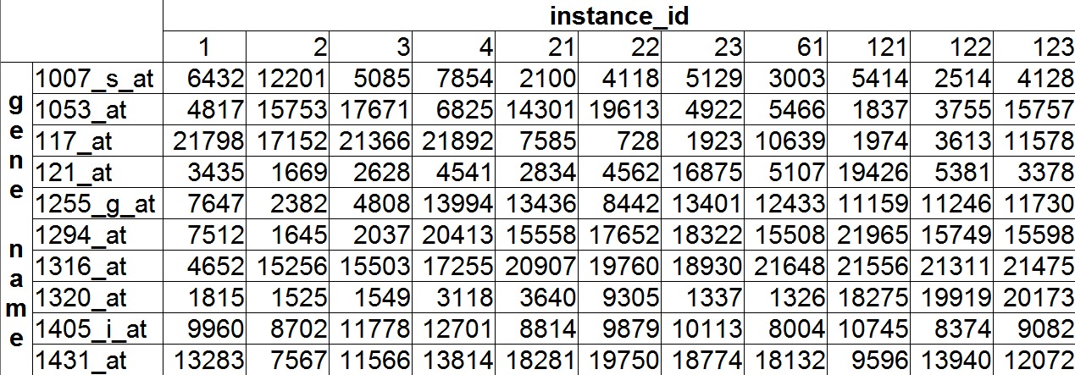
Constructing the rankmatrix
Every gene gets a rank – which says how strong it is regulated – for a certain instance.

Slide 7
The alzheimer disease
A neuronal disease
Up regulated genes
200720_s_at
200721_s_at
200801_x_at
201122_x_at
201123_s_at
203157_s_at
203158_s_at
203159_at
203618_at
203619_s_at
204471_at
209026_x_at
211414_at
211714_x_at
212203_x_at
212320_at
213753_x_at
213757_at
213867_x_at
216963_s_at
216967_at
217897_at
219024_at
221510_s_at
AFFX-HSAC07/X00351_3_at
AFFX-HSAC07/X00351_5_at
AFFX-HSAC07/X00351_M_at
222101_s_at
218892_at
Down regulated genes
200012_x_at
200061_s_at
200974_at
205120_s_at
205121_at
206714_at
207187_at
207830_s_at
211108_s_at
211109_at
215787_at
207953_at
208014_x_at
207683_at
201492_s_at
Detailed results
1 diclofenac [445]
2 indometacin [262]
3 trichostatin A [1072]
4 nitrendipine [336]
5 topiramate [915]
6 troglitazone [1070]
7 valproic acid [1047]
lidocaine

Slide 8
How do we get this detailed results!?

Slide 9
The Kolmogorov-Smirnoff-Statistic
non-parametric statistic
rank based
model structure is not specified a priori but is instead determined from data

Slide 10
The Kolmogorov-Smirnoff-Statistic
Based on the following formula:
Set ks^{i} = a, if a > b.
Set ks^{i} = -b if b > a.

Slide 11
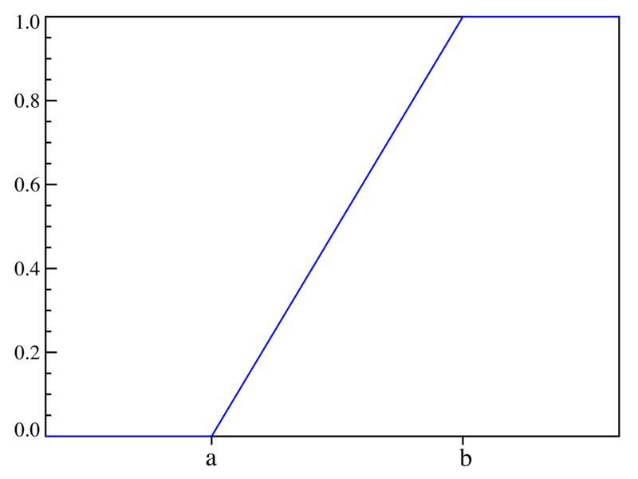
Remember the uniform distribution function
Probabilities of events in the intervall (a,b) are equaled.
⁶ list of references

Slide 12
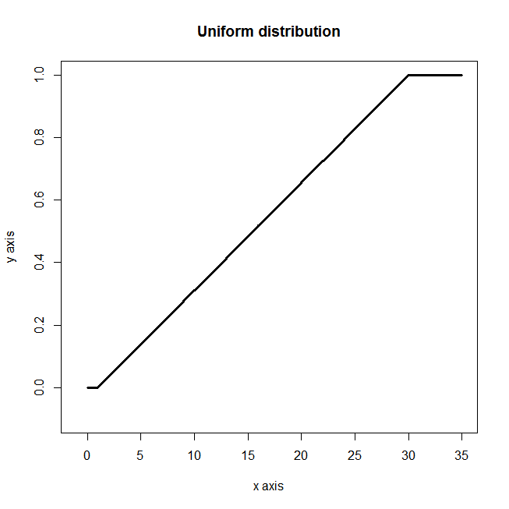
Using the uniform distribution
Up regulated genes
200720_s_at
200721_s_at
200801_x_at
201122_x_at
201123_s_at
203157_s_at
203158_s_at
203159_at
203618_at
203619_s_at
204471_at
209026_x_at
211414_at
211714_x_at
212203_x_at
212320_at
213753_x_at
213757_at
213867_x_at
216963_s_at
216967_at
217897_at
219024_at
221510_s_at
AFFX-HSAC07/X00351_3_at
AFFX-HSAC07/X00351_5_at
AFFX-HSAC07/X00351_M_at
222101_s_at
218892_at

Slide 13
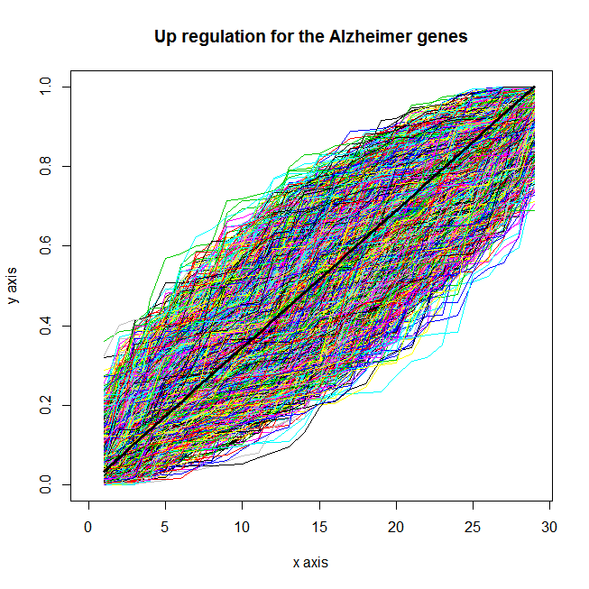
Using the uniform distribution
Up regulated genes
200720_s_at
200721_s_at
200801_x_at
201122_x_at
201123_s_at
203157_s_at
203158_s_at
203159_at
203618_at
203619_s_at
204471_at
209026_x_at
211414_at
211714_x_at
212203_x_at
212320_at
213753_x_at
213757_at
213867_x_at
216963_s_at
216967_at
217897_at
219024_at
221510_s_at
AFFX-HSAC07/X00351_3_at
AFFX-HSAC07/X00351_5_at
AFFX-HSAC07/X00351_M_at
222101_s_at
218892_at
6100 graphs...
...based on v/n.

Slide 14
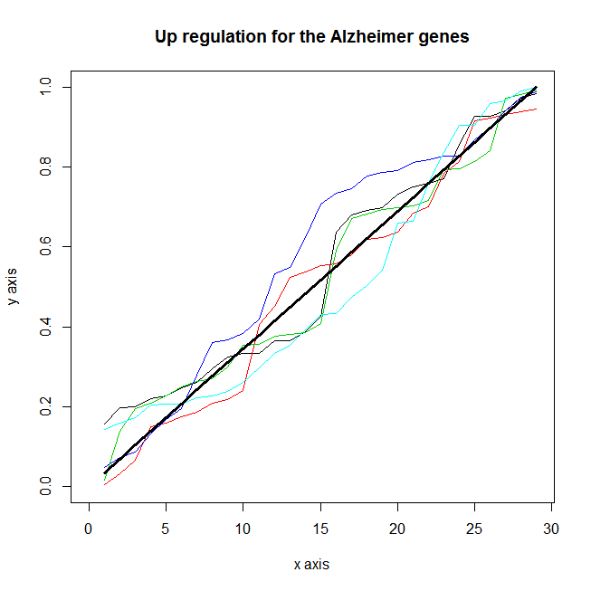
Using the uniform distribution
Up regulated genes
200720_s_at
200721_s_at
200801_x_at
201122_x_at
201123_s_at
203157_s_at
203158_s_at
203159_at
203618_at
203619_s_at
204471_at
209026_x_at
211414_at
211714_x_at
212203_x_at
212320_at
213753_x_at
213757_at
213867_x_at
216963_s_at
216967_at
217897_at
219024_at
221510_s_at
AFFX-HSAC07/X00351_3_at
AFFX-HSAC07/X00351_5_at
AFFX-HSAC07/X00351_M_at
222101_s_at
218892_at
For better imagination, we just use the first 5 graphs.

Slide 15
Back to Kolmogorov-Smirnoff
How do you get
the ks^{i} score?
Measure distances

Slide 16
The Kolmogorov-Smirnoff-Statistic
How do you get
the ks^{i} score?
Set ks^{i} = a, if a > b.
Set ks^{i} = -b if b > a.
Measure distances

Slide 17
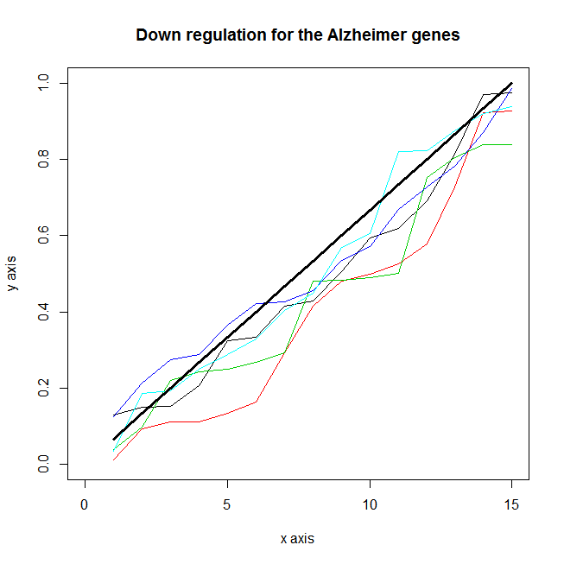
Calculating the ks^{i} for down regulation
Down regulated genes
200012_x_at
200061_s_at
200974_at
205120_s_at
205121_at
206714_at
207187_at
207830_s_at
211108_s_at
211109_at
215787_at
207953_at
208014_x_at
207683_at
201492_s_at
It is similar to the algorithm before

Slide 18
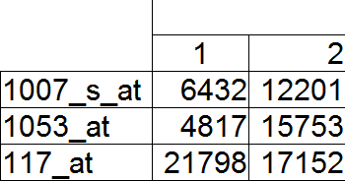
Computing Kolmogorov-Smirnoff
Pseudo Code:
instances <- number of drugs/instances in rankmatrix #6100
n <- number of genes in rankmatrix #22283
upReg/downReg <- load txt-file with the genes which should be up/down regulated and get the ranks from the rankmatrix #loading a “grp-file”
for (i in 1:drugs) {
v_up <- sort(upReg[,i])
v_down <- sort(downReg[,i]) }
detailedMaxValue(v_up, n)
detailedMaxValue(v_down, n)

Slide 19
The detailedMaxValue function
detailedMaxValue <- function(v, n) {
t <- length(v)
j <- 1:t
a <- max(j/t - v/n)
b <- max(v/n - (j-1)/t)
if (a > b) {k <- a}
else {k <- -b}
return (k)
}

Slide 20
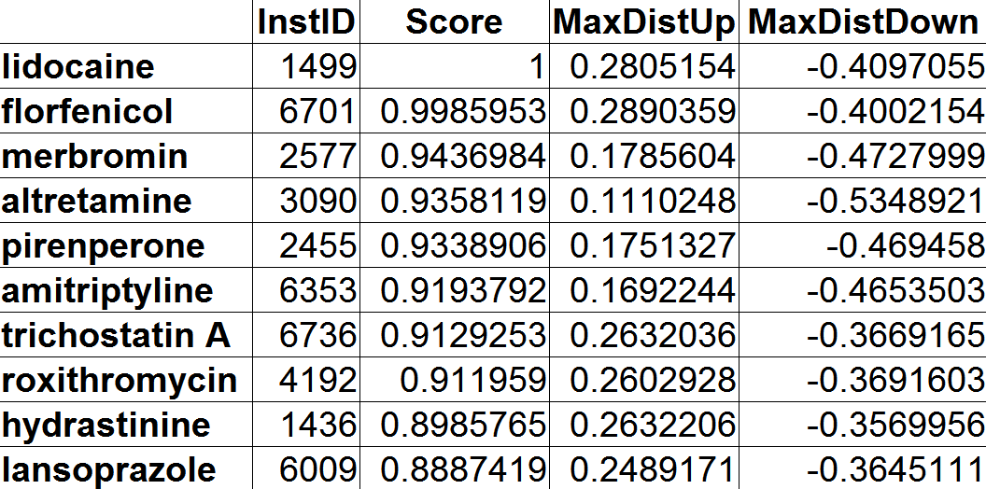
Output of the detailed results
Normalized in a scale of -1 to 1.

Slide 21
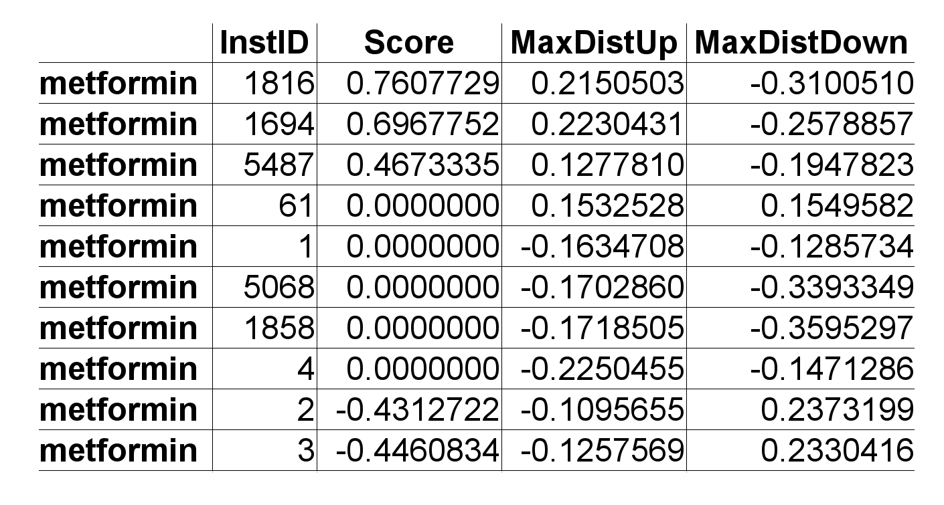
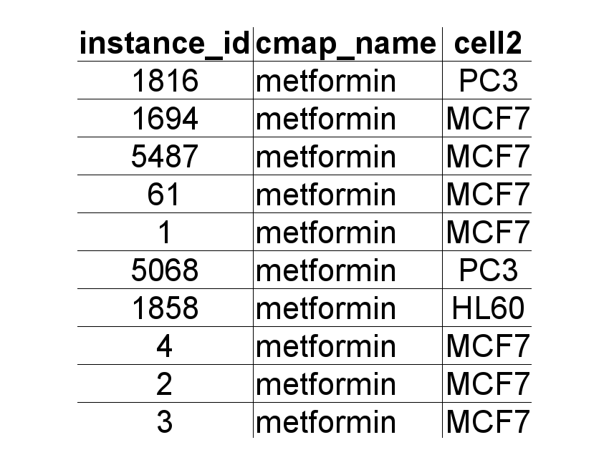
Permuted results
Results by Name – Algorithm:
Take detailed results of a specific drug
Save their ranks (rownumber in detailed results) and sort them
Calculate Kolmogorov-Smirnoff
detailed results
^
Results by name & cell line – Algorithm:
Take detailed results of a specific drug and the same cell line
Save their ranks and sort them
Calculate Kolmogorov-Smirnoff
List with instances and cell lines

Slide 22
Permuted results and the p-value
This calculation is similar to the detailed results. The output is a result calculated by drug name and by drug name and cell line.
Permuted results:
Enrichment score
p-Value
Non-null %
mean
specificity
n
Calculation of the enrichtment score, with random variables, 100.000 times.

Slide 23
Computing the p-value
Parameter:
d = 100.000
ks₀ = enrichment score of a specific instance with n entries (n ranks).
ks_{m} = m to d enrichment scores with n random entries (100.000 random experiments).

Slide 24
A practical example
Values:
d = 100.000
ks₀ = 0.2142623 (metformin with 10 ranks in the detailed results)
n_entries = 10
NoOfDrugs = 1.309
ks_{m} = 1 to 100.000 enrichment scores with 10 random variables between 1 and 1.309
=> 100.000 ks_{m} enrichment scores which are compared with the ks₀. The p-value ist the number of ks_{m} which are greater or equaled Null divided by 100.000.
Count the number of times q that this inequation is true and divide it by d.

Slide 25
A practical example with code
pValue <- function (n_entries, noOfDrugs) {
pValue <- c()
for (i in 1:100000) {
value <- sample.int(noOfDrugs, n_entries)
random <- sort.list(value, na.last = NA, method = "radix")
value <- value[random]
pValue[i] <- pMaxValue(value, noOfDrugs)
}
pValue <- abs(pValue)
return(pValue)
}
write(pValue, file)
load(file)
use: pValue

Slide 26
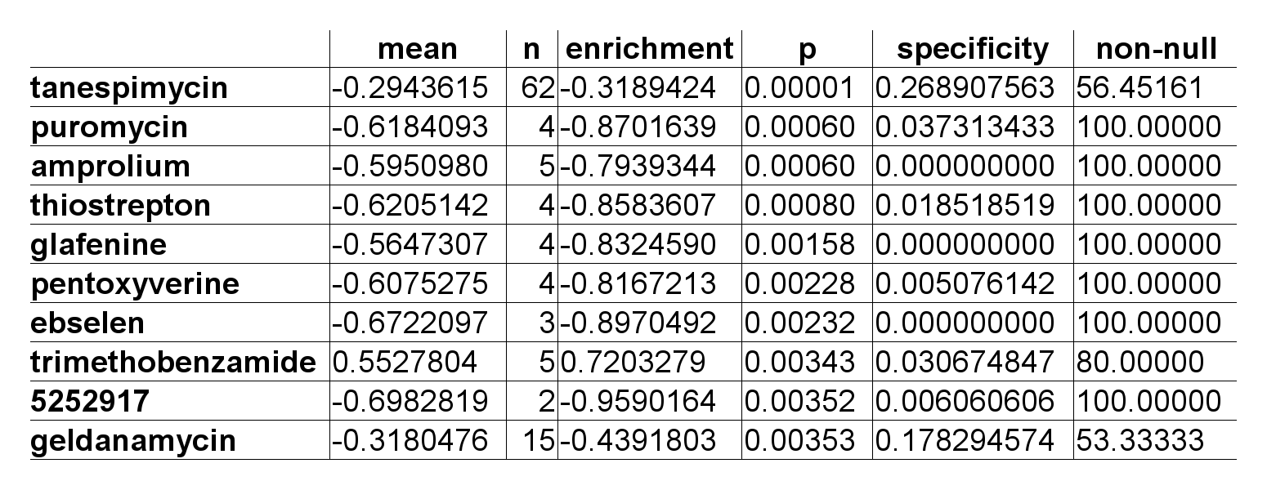
A practical example and its solution
significant
An estimate of the likelihood that the enrichment of a set of instances in the list of all instances in a given result would be observed by chance.

Slide 27
Any questions left!?
For further information, I am happy to help you:
Michael Bauer
Heuweg 25
84079 Bruckberg
Mobile: 0160 / 750 40 18
E-Mail: michael.bauer.tsv@gmail.com

Slide 28
Thanks for your attention!

Slide 29
List of references
¹ http://www.broadinstitute.org/cmap/
² http://www.nigms.nih.gov/NR/rdonlyres/B2E50701-FCF8-4309-B279-86536A0E859E/5159/pills.jpg
³ http://topnews.ae/images/Gene5.jpg
⁴http://us.123rf.com/400wm/400/400/szakaly/szakaly1101/szakaly110100002/8533916-rot-fl-ssigkeit-und-petrischale-in-einem-labor.jpg
⁵ http://www.ruhr-uni-bochum.de/ces/Bilder/microarray.JPG
⁶http://upload.wikimedia.org/wikipedia/commons/b/b7/Uniform_distribution_CDF.png

