Slide 1


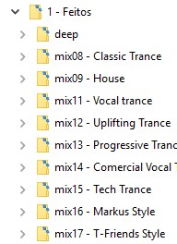
MAJOR GENRES
SUB-GENRES (partial)
…

