Slide 1
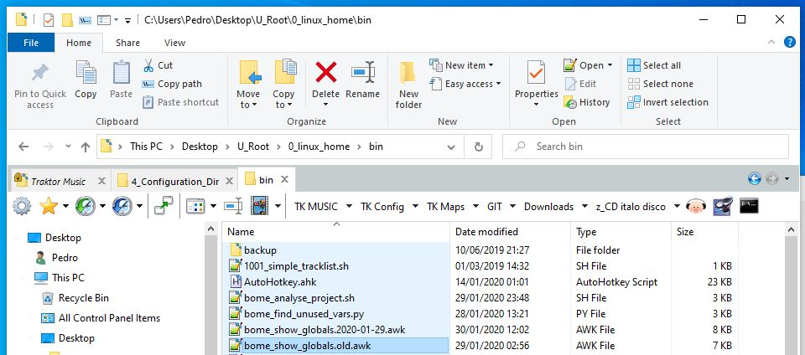
QQTABBAR: windows explorer tabs, folder bookmarks and program launchers
Startup folder (auto-opens)
Active tab
Duplicate tab
(double click)
Locked Tab (doesn’t close)
Folder Bookmarks
Open linux terminal here
Programs shortcuts (with selected file)

Slide 2
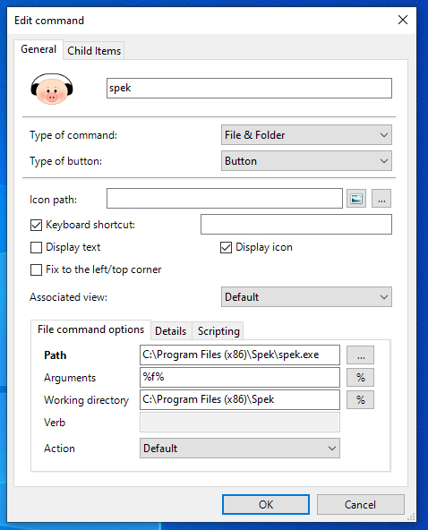
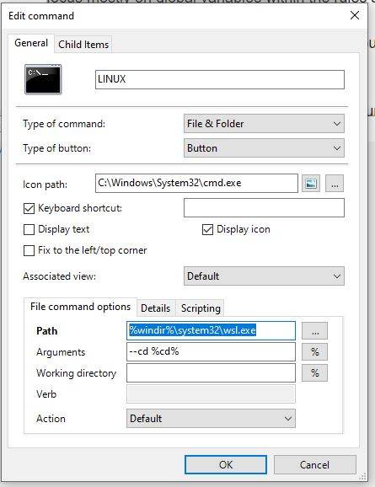
QQTABBAR: Program launcher with current file
QQTABBAR: Launch linux terminal in current folder

