Slide 1
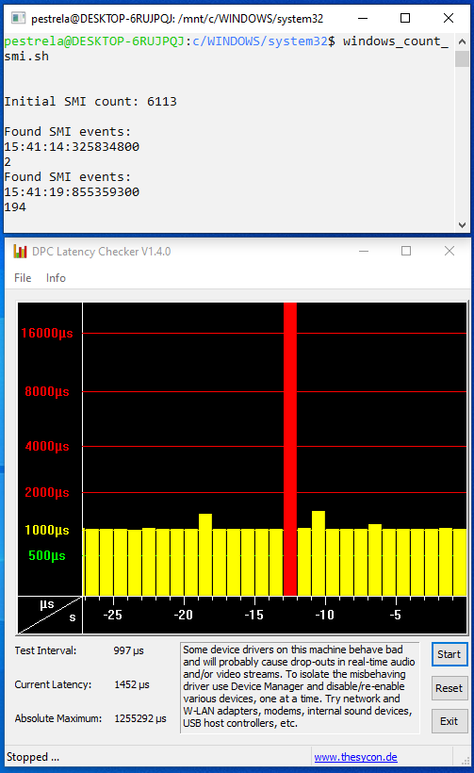
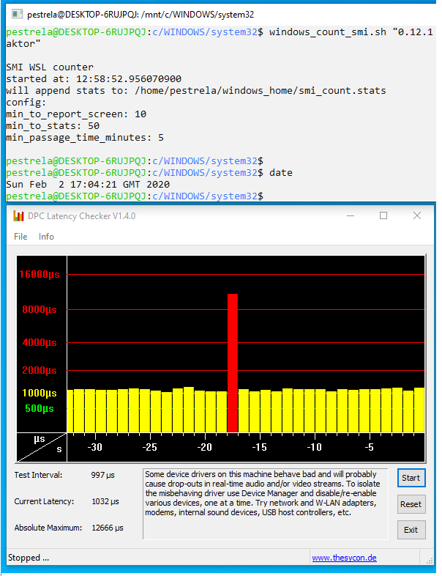
BIOS 0.18.0
BIOS 0.12.1
Random hundreds of SMI interrupts:
= SECONDS of latency
9560 old BIOS:
= MILLISECONDS of latency
Dell XPS 15 9560 Bios 0.18.0
(0.16.0 same issue)
(~2 events per hour)
(10 hour test)
Dell XPS 15 9560 Bios 0.12.1
(10 hour test)

Slide 2
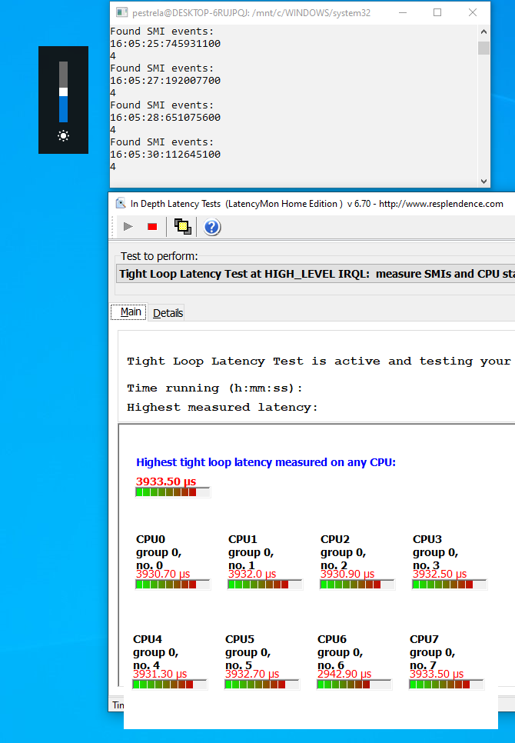
SMI COUNTER DEMO
(SMI = ring-2 bios interrupts)
Fn+Brightness = 4 SMIs:
= MILLISECONDS of latency
Dell XPS 15 9560 Bios 0.16.0
https://en.wikipedia.org/wiki/System_Management_Mode
https://github.com/pestrela/smi_counter

Slide 3
CONTROL
MEASUREMENT
QUICK FIX
Fn+Brightness = 4 SMIs:
= MILLISECONDS of latency
Random hundreds of SMI interrupts:
= SECONDS of latency
9560 old BIOS:
= no SECONDS latency
Dell XPS 15 9560 Bios 0.16.0
Dell XPS 15 9560 Bios 0.18.0
(0.16.0 same issue)
(~2 events per hour)
(10 hour test)
Dell XPS 15 9560 Bios 0.12.1
(10 hour test)

