Slide 1
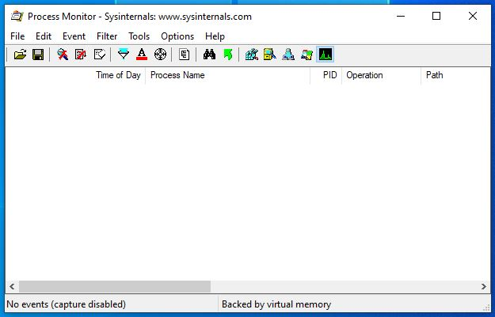
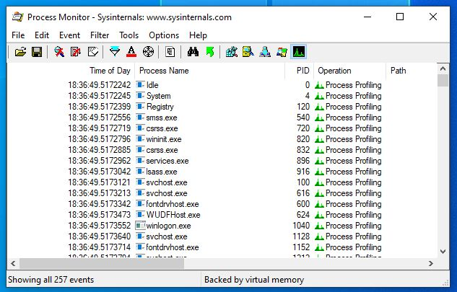
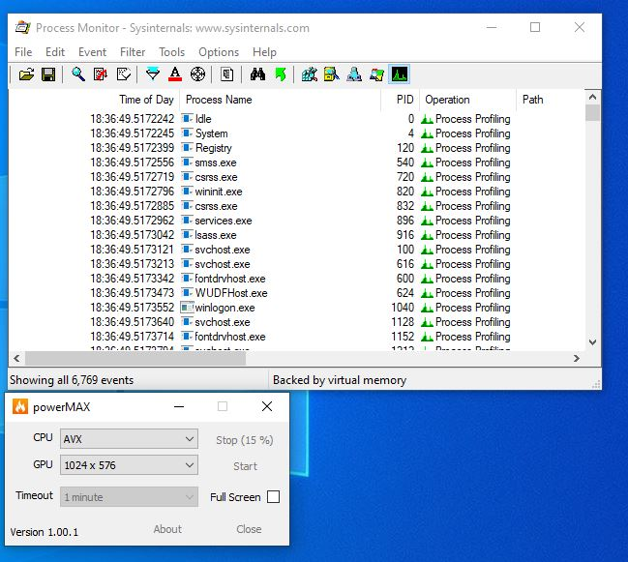
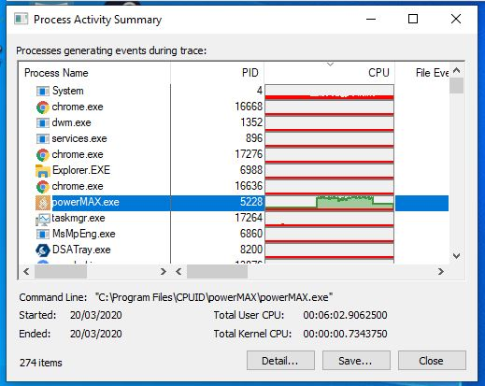
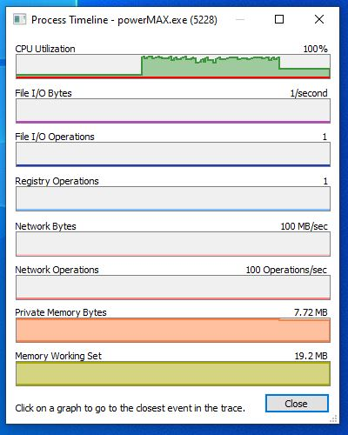
A) CONFIG
Disabled
4X Disabled, 1x Enabled
B) CAPTURE
<300 events per second!!
(CPU hog, for testing)
C) ANALYSIS
https://github.com/pestrela/smi_counter https://www.howtogeek.com/268337/what-is-this-process-and-why-is-it-running/
https://superuser.com/questions/453909/log-cpu-by-process-over-time

