Slide 1
Petablox: Declarative Program Analysis for Big Code
Mayur Naik
Joint work with:
Ravi Mangal, Xin Zhang Aditya Nori Radu Grigore, Hongseok Yang
Georgia Tech MSR Oxford Univ.
Notes:
Thank you.

Slide 2
Background
Problem: Automatically infer or predict salient behaviors or vulnerabilities in a given program
Long-standing problem in program analysis
Difficult tradeoffs, uncertain or missing specifications, etc.
Idea: Can we leverage collective knowledge amassed from analyzing existing programs?

Slide 3
Example: Integer overflow vulnerability (1/3)
CVE-2009-1570 (GIMP)
if (Bitmap_Head.biWidth < 0)
{
g_set_error (error, G_FILE_ERROR,G_FILE_ERROR_FAILED,
_("'%s' is not a valid BMP file"),
gimp_filename_to_utf8 (filename));
return -1;
}
...
rowbytes = ((Bitmap_Head.biWidth * Bitmap_Head.biBitCnt - 1) / 32) * 4 + 4;
...
buffer = g_malloc (rowbytes);

Slide 4
Example: Integer overflow vulnerability (2/3)
CVE-2011-2194 (VLC Player)
if ( p_sys->i_track_id < 0 )
{
input_item_node_AppendNode( p_input_node, p_new_node );
vlc_gc_decref( p_new_input );
return true;
}
...
input_item_t **pp;
pp = realloc( p_sys->pp_tracklist, (p_sys->i_track_id + 1) * sizeof(*pp) );

Slide 5
Example: Integer overflow vulnerability (3/3)
CVE-2013-0913 (Linux Kernel)
if (args->buffer_count < 1) {
DRM_ERROR("execbuf2 with %d buffers\n", args->buffer_count);
return -EINVAL;
}
exec2_list = kmalloc(sizeof(*exec2_list) * args->buffer_count,
GFP_KERNEL | __GFP_NOWARN | __GFP_NORETRY);

Slide 6
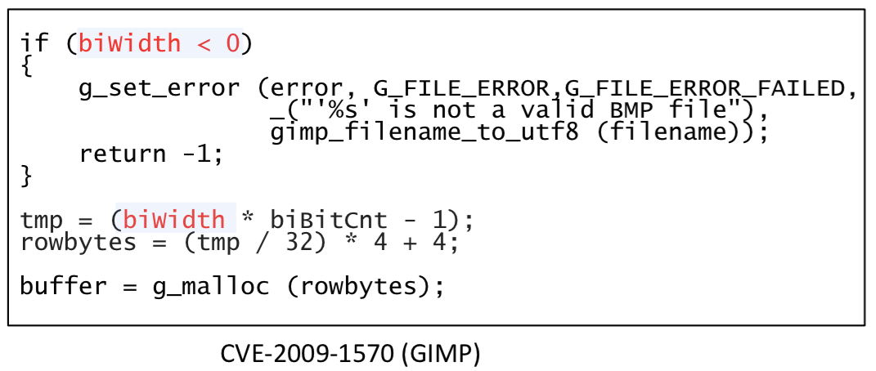
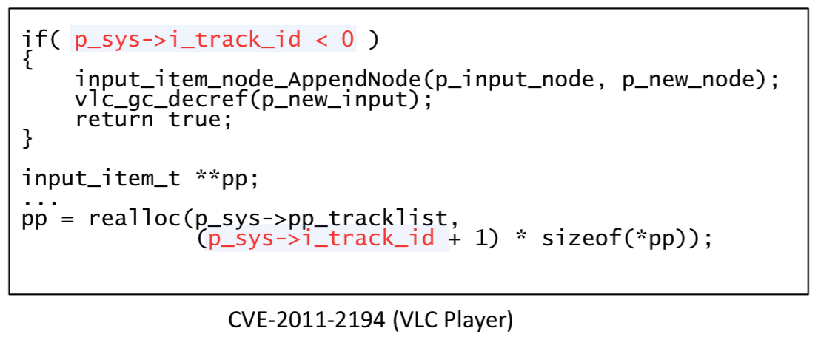
What specification to check?
Integer overflows?
+ well-defined
− necessary but not sufficient (many benign overflows)
The pattern:
“Integer overflow on an expression derived from an input variable after some sanitization but before the expression is used to allocate a memory buffer”

Slide 7
How to check the specification?
Combination of:
Integer overflow analysis
Information-flow analysis
Alias analysis
Concurrency analysis
The pattern:
“Integer overflow on an expression derived from an input variable after some sanitization but before the expression is used to allocate a memory buffer”

Slide 8
What information do the analyses need?
Information-flow analysis must know sensitive sink:
first argument of g_malloc in GIMP
second argument of realloc in VLC
Environment assumptions
Behavior of missing program parts
Loop invariants
Function pre/post conditions
…

Slide 9
How effective are the analyses?
Necessarily approximate for undecidability reasons
Must strike tradeoffs between soundness, completeness, and scalability

Slide 10
Declarative program analysis using Datalog
flow(v1, v2) :- assign(v2, e1), ref(e1, v1).
e
f
assign(tmp, e)
ref(e, biwidth)
assign(rowbytes, f)
ref(f, tmp)
flow(biwidth, tmp)
flow(tmp, rowbytes)

Slide 11
Expressing fixpoint computations
flow(v1, v2) :- assign(v2, e1), ref(e1, v1).
flow(v1, v3) :- flow(v1, v2), flow(v2, v3).
assign(tmp, e)
ref(e, biwidth)
assign(rowbytes, f)
ref(f, tmp)
flow(biwidth, tmp)
flow(tmp, rowbytes)
flow(biwidth, rowbytes)

Slide 12
Derivations of analysis results
Expressive: enables analytics clients to mine rich features and patterns
Uniform: spans reasoning performed across multiple analyses
Portable: does not require to modify the underlying constraint solver
assign(tmp, e)
ref(e, biwidth)
assign(rowbytes, f)
ref(f, tmp)
flow(biwidth, tmp)
flow(tmp, rowbytes)
flow(biwidth, rowbytes)

Slide 13
Combining logical and probabilistic reasoning
flow(v1, v2) :- assign(v2, e1), ref(e1, v1).
flow(v1, v3) :- flow(v1, v2), flow(v2, v3).
Hard constraints:
Soft constraints:
vulnerable(v) :- source(v), overflow(v), sink(v). weight 0.84
sink(v) :- flow(v, v2), arg(v2, m, k), alloc(m, k). weight 0.95
Hard optimization problem (MaxSAT)
Two phases: grounding ➔ solving; both hard to scale
Where do weights come from?
Crowdsourcing, active learning, …

Slide 14
Declarative program analysis: Prevalent view
Program text
Analysis result
Constraint generation
Datalog constraints
Constraint resolution
Separates analysis specification from implementation
Enables sophisticated implementations
Provides natural program specifications

Slide 15
Declarative program analysis: Our view
Goal: extend these benefits in context of common and emerging use-cases of analyses
Client-driven analysis: find good program abstractions
Summary-based analysis: transfer analysis results across programs
User-guided analysis: incorporate analysis users’ feedback
Idea: Automatically synthesize analysis use-cases

Slide 16
Example use-case: client-driven analysis
Program text
Analysis result
Constraint generation
Datalog constraints
Constraint resolution
Refined abstraction
Counter-examples
Constraint resolution
MaxSAT
constraints
Constraint generation

Slide 17
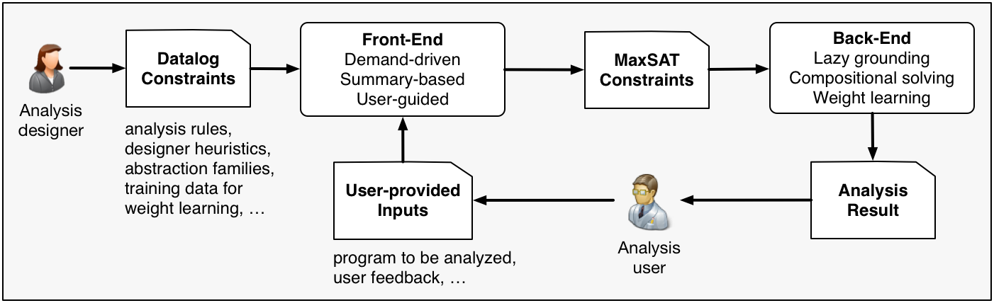
Petablox program analysis framework

Slide 18
Rest of the talk: Two use-cases
Client-driven analysis: finding suitable program abstractions
User-guided analysis: incorporating analysis users’ feedback

Slide 19
Pointer analysis example
f(){
v1 = new ...;
v2 = id1(v1);
v3 = id2(v2);
q2:assert(v3!= v1);
}
id1(v){return v;}
g(){
v4 = new ...;
v5 = id1(v4);
v6 = id2(v5);
q1:assert(v6!= v1);
}
id2(v){return v;}
Notes:
In the rest of the talk, I am going to use pointer analysis as an example to illustrate our approach. The example program allocates an object in each of methods f and g, and passes it to methods id1 and id2. The pointer analysis is asked to prove two queries: q1 says that v6 does not alias with v1 at the end of g, while q2 says that v3 does not alias with v1 at the end of f. Proving q1 requires a context sensitive analysis which can distinguish different calling contexts of id1 and id2. Otherwise, the confusion of calling contexts will cause a spurious flow shown on the slide, which will fail the proof of q1. Q2 on the other hand cannot be proven as v3 does alias with v1 .
A standard approach to distinguish between calling contexts is to clone, or inline the called method body at a call site. You might ask why not inline every method call? This is infeasible as it will grow the program size exponentially and make the analysis not terminating with the presence of recursion. To address this problem, our goal is to clone selectively.

Slide 20
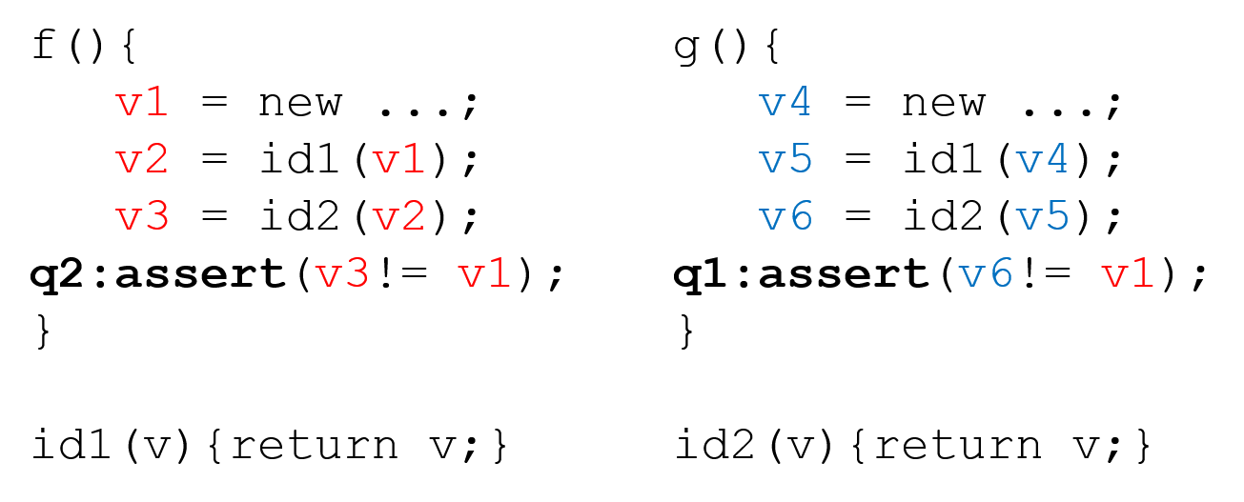
Pointer analysis as graph reachability
a₁
0
a₀
b₀
3
b₁
6’
6
6’’
a₁
a₀
b₀
b₁
1
4
c₁
c₀
d₀
d₁
7’
7
7’’
c₁
c₀
d₀
d₁
2
5
Notes:
For exposition, we recast this problem as a graph reachability problem, which encodes both control flow and dataflow. Nodes 0, 1, 2 represent the basic blocks of f, while nodes 3, 4 and 5 represent the basic blocks of g. 6 and 7 represent the bodies of id1 and id2, while node 6’, 6’’, 7’, 7’’ are their clones at different call sites. Edges with the same label represents matching calls and returns. For an edge pair a0 and a1, a valid abstraction will either choose a0, which means no clone for id1 in f, or a1, which means cloning id1 in f.
Then, proving q1 becomes to show node 5 is not reachable from 0, while q2 becomes to show that node 2 is not reachable from node 0.

Slide 21
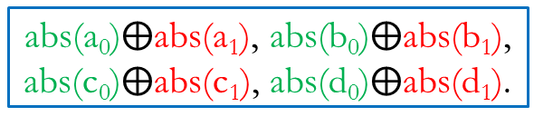
Graph reachability in Datalog
a₁
0
a₀
b₀
3
b₁
Input relations:
edge(i, j, n), abs(n)
Output relations:
path(i, j)
Rules:
(1) path(i, i).
(2) path(i, j) :- path(i, k), edge(k, j, n), abs(n).
6’
6
6’’
a₁
a₀
b₀
b₁
1
4
c₁
c₀
d₀
d₁
7’
7
7’’
c₁
c₀
d₀
d₁
2
5
Input tuples:
edge(0, 6, a₀), edge(0, 6’, a₁), edge(3, 6, b₀),
…
Query Tuple | Original Query
q₁: path(0, 5) | assert(v6!= v1)
q₂: path(0, 2) | assert(v3!= v1)
16 possible abstractions in total
Notes:
We express the graph reachability problem in Datalog. Input relation edge represents the possible edges in the graph. The correspondent input tuples are fixed.
Relation abs is the program abstraction. It specifies what edges may be used in computing graph reachability. The correspondent input tuples are configurable. For any edge pair like a0 or a1, we can either choose a0 or a1. Choosing a1 over a0 will produce a more precise but more expensive abstraction, as it means to clone the method. There’re 16 possible such abstractions in total.
The only output relation is the path relation, which represents graph reachability. Proving q1 becomes to show path(0, 5) is not derived under certain abstraction while q2 becomes to show path(0, 2) is not derived under certain abstraction.
There’re two rules. Rule 1 states that each node is reachable from itself. Rule 2 states that Node j is reachable from Node i if node k is reachable from Node i and edge(k, j) is allowed in the abstraction.

Slide 22


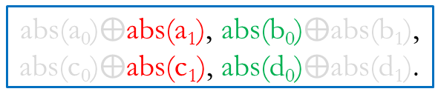
Desired result
a₁
0
a₀
b₀
3
b₁
Input relations:
edge(i, j, n), abs(n)
Output relations:
path(i, j)
Rules:
(1) path(i, i).
(2) path(i, j) :- path(i, k), edge(k, j, n), abs(n).
6’
6
6’’
a₁
a₀
b₀
b₁
1
4
c₁
c₀
d₀
d₁
7’
7
7’’
c₁
c₀
d₀
d₁
2
5
Input tuples:
edge(0, 6, a₀), edge(0, 6’, a₁), edge(3, 6, b₀),
…
Query | Answer
q₁: path(0, 5) | a₁b₀c₁d₀
q₂: path(0, 2) | Impossibility
abs(a₀)$⨁$abs(a₁), abs(b₀)$⨁$abs(b₁),
abs(c₀)$⨁$abs(c₁), abs(d₀)$⨁$abs(d₁).
Notes:
It turns out that q1 is provable with the cheapest abstraction a1b0c1d0, while q2 is impossible to prove. Our goal is to find such cheapest abstraction for q1 and conclude q2 is impossible to prove.

Slide 23
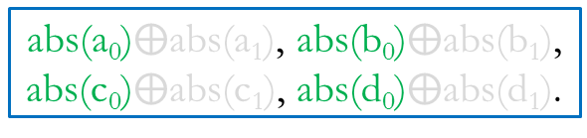
Iteration 1
a₁
0
a₀
b₀
3
b₁
path(0, 0).
path(0, 6) :- path(0, 0), edge(0, 6, a₀), abs(a₀).
path(0, 1) :- path(0, 6), edge(6, 1, a₀), abs(a₀).
path(0, 7) :- path(0, 1), edge(1, 7, c₀), abs(c₀).
path(0, 2) :- path(0, 7), edge(7, 2, c₀), abs(c₀).
path(0, 4) :- path(0, 6), edge(6, 4, b₀), abs(b₀).
path(0, 7) :- path(0, 4), edge(4, 7, d₀), abs(d₀).
path(0, 5) :- path(0, 7), edge(7, 5, d₀), abs(d₀).
…
6’
6
6’’
a₁
a₀
b₀
b₁
1
4
c₁
c₀
d₀
d₁
7’
7
7’’
c₁
c₀
d₀
d₁
2
5
Query | Eliminated Abstractions
q₁: path(0, 5)
q₂: path(0, 2)
abs(a₀)$⨁$abs(a₁), abs(b₀)$⨁$abs(b₁),
abs(c₀)$⨁$abs(c₁), abs(d₀)$⨁$abs(d₁).
Notes:
Same as a standard CEGAR approach, our approach starts with the cheapest abstraction in the space, which is a0b0c0d0, meaning no cloning at all. We fail to prove both queries as both tuples are derived.
We try to learn from counterexamples and avoid similar failures in the future. But what is a counterexample for Datalog programs?

Slide 24
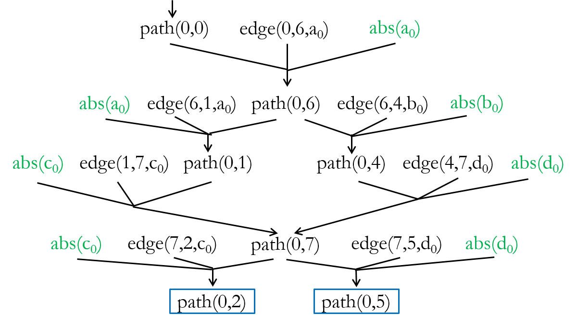
Iteration 1 - derivation graph
a₁
0
a₀
b₀
3
b₁
6’
6
6’’
a₁
a₀
b₀
b₁
1
4
c₁
c₀
d₀
d₁
7’
7
7’’
c₁
c₀
d₀
d₁
2
5
Query | Eliminated Abstractions
q₁: path(0, 5)
q₂: path(0, 2)
abs(a₀)$⨁$abs(a₁), abs(b₀)$⨁$abs(b₁),
abs(c₀)$⨁$abs(c₁), abs(d₀)$⨁$abs(d₁).
Notes:
It is a derivation graph for the query tuples.

Slide 25
Iteration 1 - derivation graph
path(0,0)
edge(0,6,a₀)
abs(a₀)
abs(a₀)
edge(6,1,a₀)
path(0,6)
edge(6,4,b₀)
abs(b₀)
abs(c₀)
edge(1,7,c₀)
path(0,1)
path(0,4)
edge(4,7,d₀)
abs(d₀)
abs(c₀)
edge(7,2,c₀)
path(0,7)
edge(7,5,d₀)
abs(d₀)
path(0,2)
path(0,5)
Notes:
Let us take a closer look at the derivation graph.

Slide 26

Iteration 1 - derivation graph
path(0,0)
edge(0,6,a₀)
abs(a₀)
abs(a₀)
edge(6,1,a₀)
path(0,6)
edge(6,4,b₀)
abs(b₀)
abs(c₀)
edge(1,7,c₀)
path(0,1)
path(0,4)
edge(4,7,d₀)
abs(d₀)
abs(c₀)
edge(7,2,c₀)
path(0,7)
edge(7,5,d₀)
abs(d₀)
path(0,2)
path(0,5)
a₀$∗$c₀$∗$
Notes:
We can observe that, as long as we have a0 and c0 in the abstraction, path(0, 2) will be derived.

Slide 27

Iteration 1 - derivation graph
path(0,0)
edge(0,6,a₀)
abs(a₀)
abs(a₀)
edge(6,1,a₀)
path(0,6)
edge(6,4,b₀)
abs(b₀)
abs(c₀)
edge(1,7,c₀)
path(0,1)
path(0,4)
edge(4,7,d₀)
abs(d₀)
abs(c₀)
edge(7,2,c₀)
path(0,7)
edge(7,5,d₀)
abs(d₀)
path(0,2)
path(0,5)
a₀$∗$c₀$\text{d}\text{0}$
Notes:
For path(0, 5), as long as we have a0c0d0

Slide 28

Iteration 1 - derivation graph
path(0,0)
edge(0,6,a₀)
abs(a₀)
abs(a₀)
edge(6,1,a₀)
path(0,6)
edge(6,4,b₀)
abs(b₀)
abs(c₀)
edge(1,7,c₀)
path(0,1)
path(0,4)
edge(4,7,d₀)
abs(d₀)
abs(c₀)
edge(7,2,c₀)
path(0,7)
edge(7,5,d₀)
abs(d₀)
path(0,2)
path(0,5)
a₀b₀$∗$d₀
Notes:
Or a0b0d0, it will be derived.
Put eliminated abstractions below

Slide 29
Iteration 1 - derivation graph
a₁
0
a₀
b₀
3
b₁
6’
6
6’’
a₁
a₀
b₀
b₁
1
4
c₁
c₀
d₀
d₁
7’
7
7’’
c₁
c₀
d₀
d₁
2
5
Query | Eliminated Abstractions
q₁: path(0, 5) | a₀c₀d₀, a₀b₀d₀ (4/16)
q₂: path(0, 2) | a₀c₀ (4/16)
abs(a₀)$⨁$abs(a₁), abs(b₀)$⨁$abs(b₁),
abs(c₀)$⨁$abs(c₁), abs(d₀)$⨁$abs(d₁).
Notes:
Therefore, we eliminate four abstractions for each queries.
Our next step should be find the cheapest abstraction avoiding all existing counterexamples. How do we do this?

Slide 30
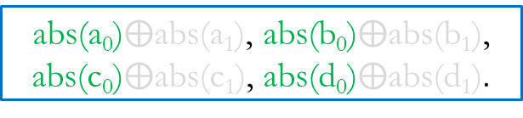
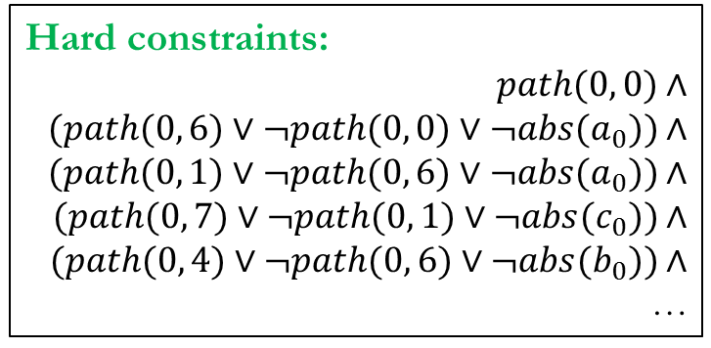
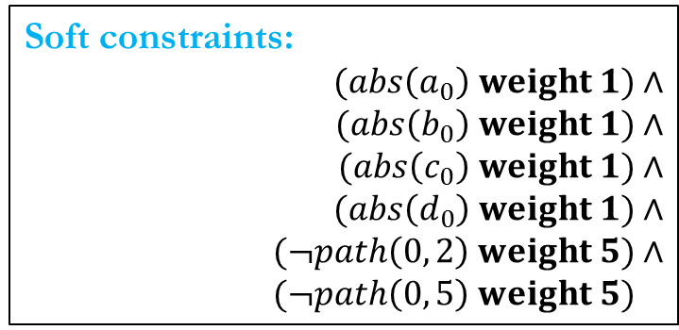
Encoded as MaxSAT
Avoid all the counterexamples
Hard constraints:
$$path(0, 0\text{)}∧$$
$$(path(0, \text{6}\text{)}∨¬path(0, \text{0)}∨¬abs(a_{0})\text{)}∧$$
$$(path(0, \text{1}\text{)}∨¬path(0, \text{6)}∨¬abs(a_{0})\text{)}∧$$
$$(path(0, \text{7}\text{)}∨¬path(0, \text{1}\text{)}∨¬abs(c_{0})\text{)}∧$$
$$(path(0, \text{4}\text{)}∨¬path(0, \text{6}\text{)}∨¬abs(b_{0})\text{)}∧$$
…
Minimize the abstraction cost
Soft constraints:
$$(abs\left(a_{0}\right) weight 1)∧$$
$$(abs\left(b_{0}\right) weight 1)∧$$
$$(abs\left(c_{0}\right) weight 1)∧$$
$$(abs\left(d_{0}\right) weight 1)∧$$
$$(¬path\left(0, 2\right) weight 5)∧$$
$$(¬path\left(0, 5\right) weight 5)∧$$
abs(a₀)$⨁$abs(a₁), abs(b₀)$⨁$abs(b₁),
abs(c₀)$⨁$abs(c₁), abs(d₀)$⨁$abs(d₁).
Notes:
We encode the derivation graph as the hard constraints. Each grounded Datalog rules is translated into a Horn clause. We use the tuple itself as the boolean variable, representing the existence of the tuple in the derivation. The constraints regarding derivation graph have to be hard as they explain why each tuple is derived. This is related with the soundness of the Datalog analysis.
There are two kinds of soft constraints. The first kind of soft constraints encodes the cost of abstraction. The higher weight, the cheaper the abstraction is. For example, we assign weight 1 to a0, which means if we have a0 in the abstraction, we gain a Score 1. If we have abs(a0) = false, which means we don’t have a0 but a1 in the abstraction. In this case, we get a score of 0, explicitly. ( too low-level) (mention cloning again)
The second kind of soft constraints are about queries. We use the negation of the query tuple to express that we want to get rid of them. You might wonder why we encode query tuples as soft constraints rather than hard constraints. This is because no matter what abstraction we choose, q2 cannot be proven. If we encode it as a hard constraint, it will make the whole formula unsatisfiable, preventing the proof of the other query.
You may further wonder why we use 5 as the weight for the queries. We use 5, which is greater than the highest sum of weight of all abstractions, that is 4. Therefore, when this constraint is violated, it means no abstraction in the space can prove this query, even with the most expensive abstraction.

Slide 31
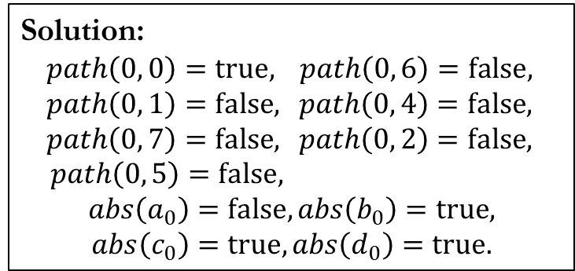
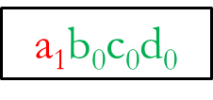
Encoded as MaxSAT
Solution:
$path\left(0, 0\right)=true,$ $path\left(0, 6\right)=false,$
$path\left(0, 1\right)=false,$ $path\left(0, 4\right)=false,$
$path\left(0, 7\right)=false,$ $path\left(0, 2\right)=false,$
$path\left(0, 5\right)=false, p,ath\left(0, 6\right)=0,$
$$abs\left(a_{0}\right)=false,abs\left(b_{0}\right)=true,$$
$$abs\left(c_{0}\right)=true,abs\left(d_{0}\right)=true.$$
Hard constraints:
$$path(0, 0\text{)}∧$$
$$(path(0, \text{6}\text{)}∨¬path(0, \text{0)}∨¬abs(a_{0}\text{)}\text{)}∧$$
$$(path(0, \text{1}\text{)}∨¬path(0, \text{6)}∨¬abs(a_{0}\text{))}∧$$
$$(path(0, \text{7}\text{)}∨¬path(0, \text{1}\text{)}∨¬abs(c_{0}\text{))}∧$$
$$(path(0, \text{4}\text{)}∨¬path(0, \text{6}\text{)}∨¬abs(b_{0}\text{))}∧$$
…
Soft constraints:
$$(abs\left(a_{0}\right) weight 1)∧$$
$$(abs\left(b_{0}\right) weight 1)∧$$
$$(abs\left(c_{0}\right) weight 1)∧$$
$$(abs\left(d_{0}\right) weight 1)∧$$
$$(¬path\left(0, 2\right) weight 5)∧$$
$$(¬path\left(0, 5\right) weight 5)∧$$
a₁$\text{b}\text{0}$c₀d₀
Query | Eliminated Abstractions
q₁: path(0, 5) | a₀c₀d₀, a₀b₀d₀ (4/16)
q₂: path(0, 2) | a₀c₀ (4/16)
Notes:
MAXST solve produces the solution shown on the slides. The solutions suggests flipping a0 to a1 while keeping all the other abstraction tuples.. This yields a1b0c0d0 to be the next abstraction to try. This abstraction is the cheapest abstraction among the viable abstractions left.

Slide 32





Iteration 2 and beyond
Iteration 1
Derivation${ D}_{1}$
$$\text{Constraint}\text{s}$$
$$C_{1}$$
$$C_{1}∧$$
a₁$\text{b}\text{0}$c₀d₀
Query | Answer | Eliminated Abstractions
q₁: path(0, 5) |  | a₀c₀d₀, a₀b₀d₀, (4/16)
q₂: path(0, 2) |  | a₀c₀, a₁c₀ (4/16)
Notes:
After the first iteration, we eliminate 4 abstractions for each query, and use a1b0c0d0 as the next abstraction to try.

Slide 33

Iteration 2 and beyond
Iteration 2
Derivation${ D}_{2}$
$$\text{Constraint}\text{s}$$
$$C_{1}$$
$$C_{1}∧$$
a₁$\text{b}\text{0}$c₀d₀
Query | Answer | Eliminated Abstractions
q₁: path(0, 5) |  | a₀c₀d₀, a₀b₀d₀, (4/16)
q₂: path(0, 2) |  | a₀c₀, a₁c₀ (4/16)
Notes:
In the second iteration, q1 and q2 are still unproven as both tuples are derived. We get another derivation D2 and pass it to the MAXSAT solver.

Slide 34

Iteration 2 and beyond
Iteration 2
Derivation${ D}_{2}$
$$\text{Constraint}\text{s}$$
$$C_{1}$$
$$C_{1}∧$$
$$C_{2}∧$$
a₁$\text{b}\text{0}$c₀d₀
Query | Answer | Eliminated Abstractions
q₁: path(0, 5) |  | a₀c₀d₀, a₀b₀d₀, (4/16)
q₂: path(0, 2) |  | a₀c₀ (4/16)
Notes:
MAXSAT encodes D2 as constraints C2

Slide 35

Iteration 2 and beyond
Iteration 2
Derivation${ D}_{2}$
$$\text{Constraint}\text{s}$$
$$C_{1}$$
$$C_{1}∧$$
$$C_{2}∧$$
a₁$\text{b}\text{0}$c₁d₀
Query | Answer | Eliminated Abstractions
q₁: path(0, 5) |  | a₀c₀d₀, a₀b₀d₀, a₁c₀d₀ (6/16)
q₂: path(0, 2) |  | a₀c₀, a₁c₀ (8/16)
Notes:
By taking the conjunction of C2 and C1 coming from the first iteration, the MAXSAT eliminates 6 abstractions for q1, and 8 abstractions for q2. It produces a1b0c1d0 as the abstraction for the third iteration.

Slide 36


Iteration 2 and beyond
Iteration 3
Derivation${ D}_{3}$
$$\text{Constraint}\text{s}$$
$$C_{1}$$
$$C_{1}∧$$
$$C_{2}∧$$
q₁ is proven.
a₁$\text{b}\text{0}$c₁d₀
Query | Answer | Eliminated Abstractions
q₁: path(0, 5) |  | a₀c₀d₀, a₀b₀d₀, a₁c₀d₀ (6/16)
q₂: path(0, 2) |  | a₀c₀, a₁c₀ (8/16)
a₁$\text{b}\text{0}$c₁d₀
Notes:
In the third iteration, q1 is proven as path(0, 5) is no longer derived. Therefore we find the cheapest abstraction to prove q1, which is a1b0c1d0.

Slide 37

Iteration 2 and beyond
Iteration 3
Derivation${ D}_{3}$
$$\text{Constraint}\text{s}$$
$$C_{1}$$
$$C_{1}∧$$
$$C_{2}∧$$
$$C_{3}∧$$
q₁ is proven.
q₂ is impossible to prove.
a₁$\text{b}\text{0}$c₁d₀
Query | Answer | Eliminated Abstractions
q₁: path(0, 5) |  | a₀c₀d₀, a₀b₀d₀, a₁c₀d₀ (6/16)
q₂: path(0, 2) |  | a₀c₀, a₁c₀, a₁c₁, a₀c₁ (16/16)
a₁$\text{b}\text{0}$c₁d₀
Impossibility
Notes:
Q2 is still derived. We encode the derivation D3 as constraint C3 and pass it to the MAXSAT solver. By taking the conjunction of all the constraints across iterations, MAXSAT eliminates all the 16 abstractions for q2, and conclude q2 is impossible to prove.

Slide 38
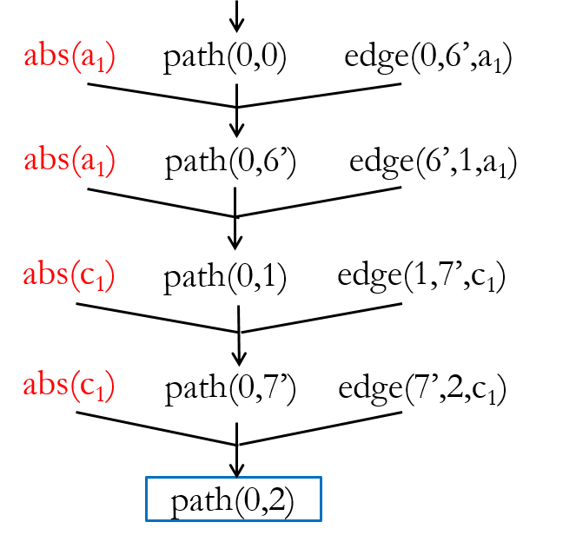


Mixing counterexamples
Iteration 1
Iteration 3
Eliminated
Abstractions:
a₀$∗$c₀$∗$
a₁$∗$c₁$∗$
Notes:
If we take a closer look at the progress of resolving q2. Iteration 1 eliminates 4 abstractions while Iteration 3 eliminates 4 different abstractions. We notice that the two derivations share the same intermediate tuple path(0, 1). When MAXSAT solver takes the conjunction of two derivations, something interesting happens.

Slide 39
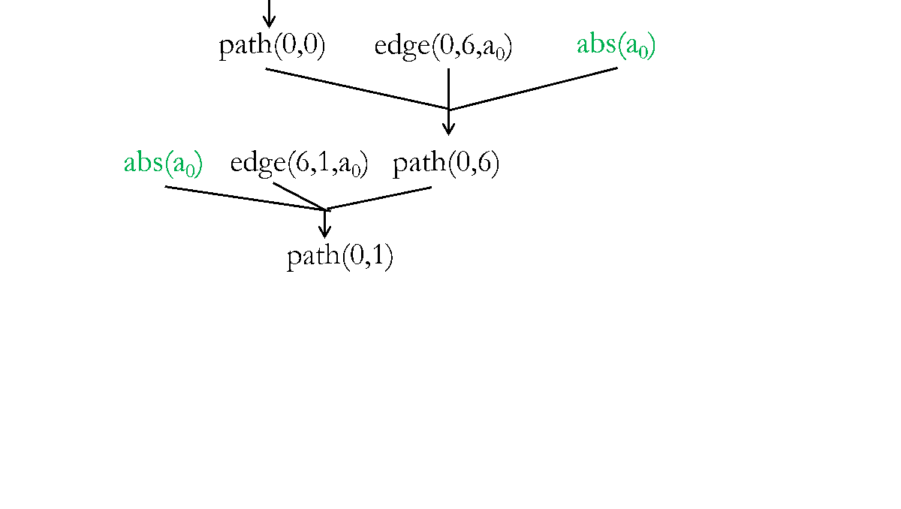
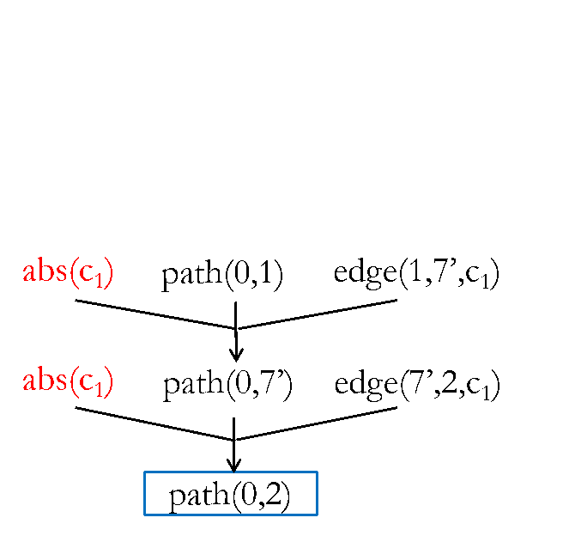

Mixing counterexamples
Iteration 1
Mixed!
Iteration 3
Eliminated
Abstractions:
a₀$∗$c₀$∗$
a₀$∗$c₁$∗$
a₁$∗$c₁$∗$
Notes:
It turns out that we get a new counterexample for free by mixing the constraints of these two derivations. This counterexample eliminates 4 new abstractions, which neither of the previous derivations eliminate. By mixing counterexamples across iterations, our approach converges faster.

Slide 40
Experimental setup
Implemented using off-the-shelf solvers:
Datalog: bddbddb
MaxSAT: MiFuMaX
Applied to two analyses that are challenging to scale:
k-object-sensitivity pointer analysis:
flow-insensitive, weak updates, cloning-based
typestate analysis:
flow-sensitive, strong updates, summary-based
Evaluated on 8 Java programs (250-450 KLOC each)
Notes:
We have implemented our approach in the Jchord program analysis framework for Java. Our implementation uses unmodified, off-the-shelf Datalog and MAXSAT solvers. We applied the approach to two client analyses that are challenging to scale: one is a k-obj pointer analysis and the other is a typestate analysis.
These two analyses differ in many aspects such as flow sensitivity, heap updates, and context sensitivity.
These differences highlight the generality of our approach.
We applied these two analyses to 8 real-world Java programs, mostly from DaCapo suite and Ashes Suite.

Slide 41
Pointer analysis results
4-object-sensitivity
< 50%
 | queries |  |  | abstraction size |  | iterations
 | total | resolved
 |  | current | baseline | final | max
toba-s | 7 | 7 | 0 | 170 | 18K | 10
javasrc-p | 46 | 46 | 0 | 470 | 18K | 13
weblech | 5 | 5 | 2 | 140 | 31K | 10
hedc | 47 | 47 | 6 | 730 | 29K | 18
antlr | 143 | 143 | 5 | 970 | 29K | 15
luindex | 138 | 138 | 67 | 1K | 40K | 26
lusearch | 322 | 322 | 29 | 1K | 39K | 17
schroeder-m | 51 | 51 | 25 | 450 | 58K | 15
< 3% of max
Notes:
The “resolved” column shows the number of queries either proven or found to be impossible to prove. Our approach resolves all the queries while, the baseline, the 4-object-sensitivity analysis, only resolves up to 50% of the queries.
The “final” column shows the sizes of abstractions our approach uses in the last iteration. One way to view the size of the abstraction is to view it as the number of 1s in the abstraction bitvector. “max” shows the size of the most expensive abstraction. As shown on the slide, the size of the final abstraction our approach uses is less than 3% of that of the most expensive abstraction.
Animation on click 1: baseline resolves only upto X% queries
Animation on click 2 for final vs. max abstraction size (pop up)
State that we indeed go to 0.5MLOC with k =10

Slide 42
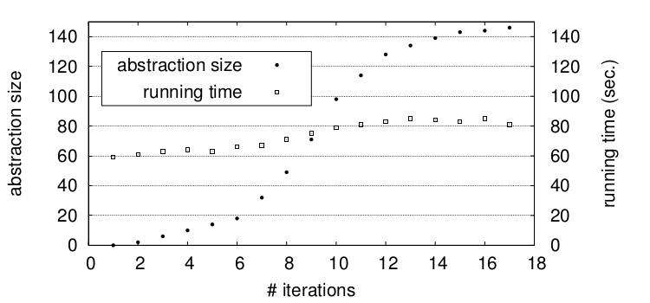
Performance of Datalog solver
k = 4, 3h28m
Baseline
k = 3, 590s
k = 2, 214s
lusearch
k = 1, 153s
Notes:
This slide shows how the abstraction size and the datalog solver running time change across iterations on benchmark lusearch, The rest benchmarks look similar.
(Remove the following paragraph?)
The x axis is the number of iterations. This curve (use pointer) shows the abstraction size corresponding to the y axis on the left, while this curve (use pointer) shows the datalog running time corresponding to the y axis on the right.
Although the abstraction size grows linearly across iterations, the running time of the datalog solver remains almost constant. This is because by selectively cloning the call sites and allocation sites, our approach increases the abstraction cost by minimum amount required to prove the queries. On the other hand, the baseline, which uses a uniform k value, increases the Datalog running time exponentially.

Slide 43
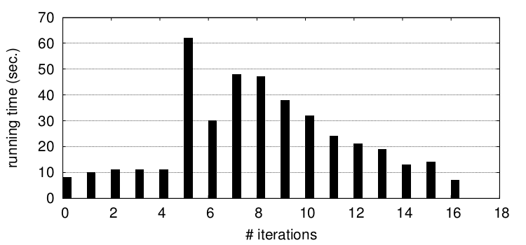
Performance of MaxSAT solver
lusearch
Notes:
This slide shows the running time of the maxsat solver in each iteration for the lusearch benchmark.
[Animation on click: Blue Up Arrow] We see that in the initial iterations, the running time steadily increases -> constraints harder to solve -> abstraction size gets larger and larger.
[Animation on click: Blue Down Arrow] But in the later iterations, the running time steadily decreases -> constraints easier to solve -> fewer and fewer queries remain

Slide 44
Statistics of MaxSAT formulae
 | pointer analysis
 | variables | clauses
toba-s | 0.7M | 1.5M
javasrc-p | 0.5M | 0.9M
weblech | 1.6M | 3.3M
hedc | 1.2M | 2.7M
antlr | 3.6M | 6.9M
luindex | 2.4M | 5.6M
lusearch | 2.1M | 5.0M
schroeder-m | 6.7M | 23.7M
Notes:
Here are statistics of the formulae fed to the maxsat solver in the last iteration for the pointer analysis on all benchmarks. The number of variables in these formulas ranges from 1M to 7M, and the number of clauses ranges from 1M to 24M. The statistics look similar for typestate analysis. These numbers highlight two strengths of our technique: the richness of the abstraction search space it explores, and the benefit of leveraging off-the-shelf maxsat solvers.

Slide 45
User-guided analysis: Motivation
Analysis writers make various approximations
Properties may be impossible to define precisely (e.g., security vulnerabilities, harmful race conditions, etc.)
Computing exact solutions impossible or prohibitively costly
Program parts missing or opaque to analysis
=> Analyses produce false positives or false negatives
Idea: shift decisions about approximation from analysis writers to analysis users

Slide 46
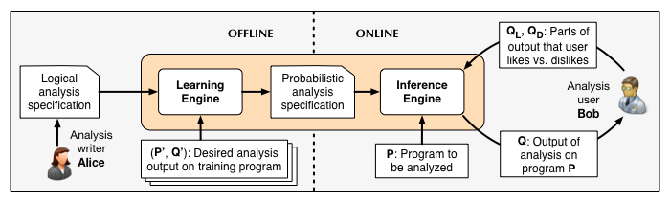
User-guided analysis: Our approach

Slide 47
Simplified datarace analysis in Datalog
Input relations:
next(p1, p2), mayAlias(p1, p2), guarded(p1, p2)
Output relations:
parallel(p1, p2), race(p1, p2)
Rules:
parallel(p3, p2) :- parallel(p1, p2), next (p3, p1).
(2) parallel(p1, p2) :- parallel(p2, p1).
race(p1, p2) :- parallel(p1, p2), mayAlias(p1, p2), ¬guarded(p1, p2).
weight w1
¬parallel(p1, p2). weight w0
¬race(p1, p2). weight w0
Notes:
We express the graph reachability problem in Datalog. Input relation edge represents the possible edges in the graph. The correspondent input tuples are fixed.
Relation abs is the program abstraction. It specifies what edges may be used in computing graph reachability. The correspondent input tuples are configurable. For any edge pair like a0 or a1, we can either choose a0 or a1. Choosing a1 over a0 will produce a more precise but more expensive abstraction, as it means to clone the method. There’re 16 possible such abstractions in total.
The only output relation is the path relation, which represents graph reachability. Proving q1 becomes to show path(0, 5) is not derived under certain abstraction while q2 becomes to show path(0, 2) is not derived under certain abstraction.
There’re two rules. Rule 1 states that each node is reachable from itself. Rule 2 states that Node j is reachable from Node i if node k is reachable from Node i and edge(k, j) is allowed in the abstraction.

Slide 48
A concurrent program: Apache ftp server
public class RequestHandler {
FtpRequestImpl request; FtpWriter writer; BufferedReader reader; Socket controlSocket; boolean isConnectionClosed; … public void getRequest( ) { return request; // x0 }
public void close( ) { synchronized (this) { if (isConnectionClosed) return; isConnectionClosed = true; } request.clear(); // x1 request = null; // x2 writer.close(); // y1 writer = null; // y2 reader.close(); reader = null; controlSocket.close(); controlSocket = null; }

Slide 49
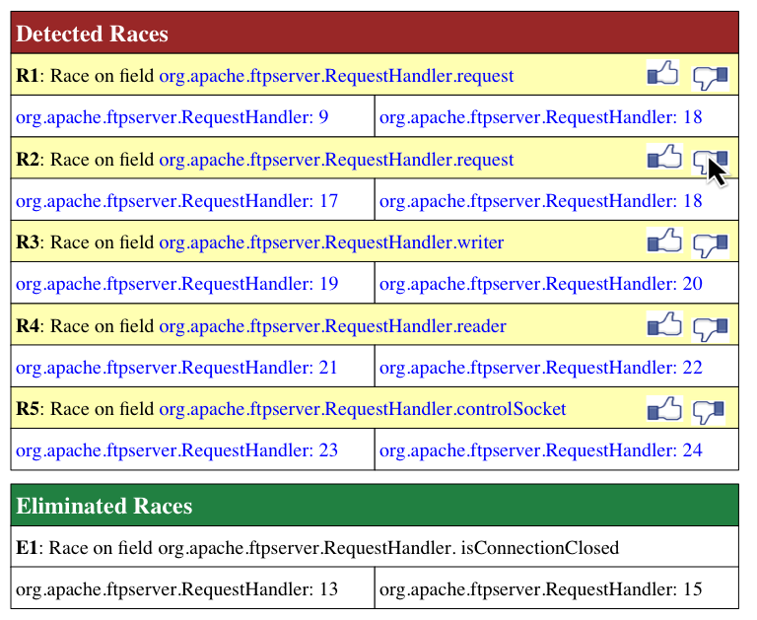
Before user feedback

Slide 50
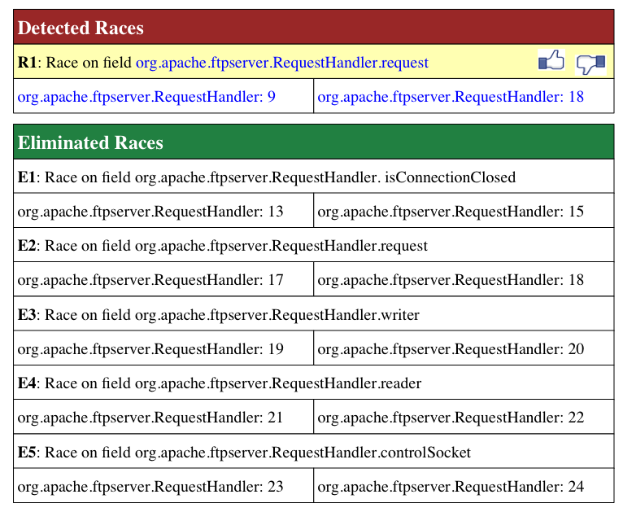
After user feedback

Slide 51
How does it work?
Input facts: next(x2, x1), mayAlias(x2, x1), ¬guarded(x2, x1), next(y1, x2), mayAlias(y2, y1), ¬guarded(y2, y1)
MaxSAT formula: (¬parallel(x1, x1) ∨ ¬next(x2, x1) ∨ parallel(x2, x1)) weight w1 ∧
(¬parallel(x1, x2) ∨ ¬next(x2, x1) ∨ parallel(x2, x2)) weight w1 ∧
􏰂 (¬parallel(x2, x2) ∨ ¬next(y1, x2) ∨ parallel(y1, x2)) weight w1 ∧ (¬parallel(y2, y1) ∨ ¬mayAlias(y2, y1) ∨ guarded(y2, y1) ∨ race(y2, y1)) ∧
(¬parallel(x2, x1) ∨ ¬mayAlias(x2, x1) ∨ guarded(x2, x1) ∨ race(x2, x1)) ∧
¬race(x2, x1) weight w2
Output facts (before feedback): parallel(x0, x2), race(x0, x2), parallel(x2, x1), race(x2, x1), parallel(y2, y1), race(y2, y1)
Output facts (after feedback):
parallel(x0, x2), race(x0, x2)

Slide 52
Empirical evaluation
Implemented using off-the-shelf solvers:
Datalog: bddbddb
MaxSAT: MCSls
Applied to three different static analyses:
Datarace detection
Monomorphic call site inference
Downcast safety checking
Evaluated on 7 Java programs (150-350 KLOC each)

Slide 53
Datarace analysis precision results

Slide 54
Datarace analysis scalability results
 | Total ground clauses | # iterations |  | Total time (hrs:mins) |  | # ground clauses
 |  | Lazy | Guided | Lazy | Guided | Lazy | Guided
antlr | 2.4 x 10²⁴ | 751 | 4 | 3:02 | 0:05 | 0.2M | 0.3M
avrora | 1.8 x 10²⁶ | 492 | 12 | 6:31 | 0:25 | 0.8M | 1.6M
ftp | 3.7 x 10²³ | 463 | 5 | 7:53 | 0:08 | 1.2M | 1.4M
hedc | 1.9 x 10²⁴ | 354 | 6 | 1:55 | 0:06 | 0.8M | 0.9M
luindex | 1.6 x 10²⁵ | 481 | 7 | 4:07 | 0:12 | 0.6M | 1.1M
lusearch | 1.7 x 10²⁵ | 429 | 6 | 2:38 | 0:14 | 0.6M | 1.0M
weblech | 4.4 x 10²⁴ | 416 | 6 | 1:59 | 0:07 | 0.6M | 0.9M

Slide 55
Key takeaways
Extend benefits of constraint-based analysis in context of common and emerging use-cases of program analysis
Requires reasoning about a mix of hard (inviolable, logical) and soft (violable, probabilistic) propositional constraints
Motivates new problems and techniques to scale MaxSAT
Motivates new problems and techniques in weight learning

Slide 56
Thank you!

