Slide 1
Reading Assistant with RAG (Retrieval-Augmented Generation)
Petar Mihaylov
Intelligent Agents with Generative Artificial Intelligence, FMI 2025

Slide 2

RAG combines information retrieval with text generation. It retrieves relevant information from a database based on the question from the user, then uses those retrieved pieces to generate a more informed and accurate response.

Slide 3
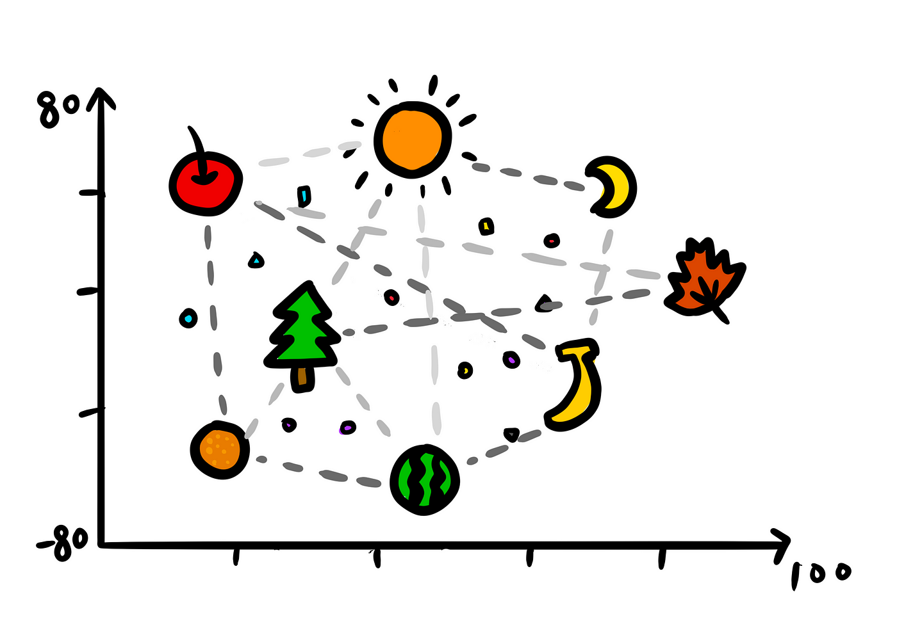
For the model to use the best context of information we will use embeddings.
Embeddings are the numerical representation of the words in a high dimensional space , with vectors, to represent the connections between the semantics, grammatical structures or other learned patterns from the data the model was trained on.

Slide 4
Since the embeddings will give us tons of values, we need to use Principal Component Analysis (PCA) to reduce the dimensionality of the dataset of the values.

Slide 5

Then we store the embeddings in the open-source database ChromaDB

Slide 6
This project’s idea is to load any epub (e-book) file and ask llama3.2 questions about the book, since the task is aimed at complex subject books, like religion analysis.

Slide 7
So after we have downloaded the model locally with ollama and extracted the text from the e-book with ebooklib, we can proceed to ask the LLM queries and use its knowledge.

