Slide 1
MyTaxiService
Krishnan Ranjithkumar
Petar Korda

Slide 2
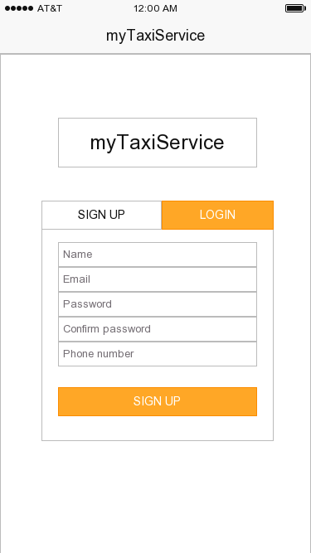
User Interface

Slide 3
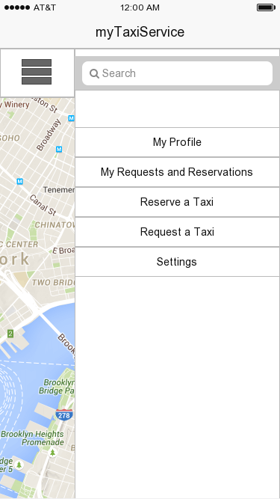
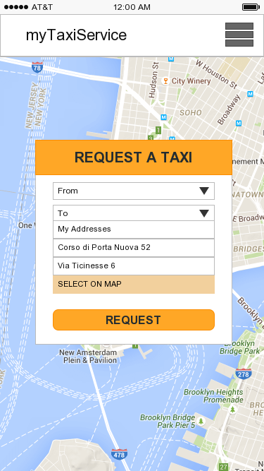

Slide 4
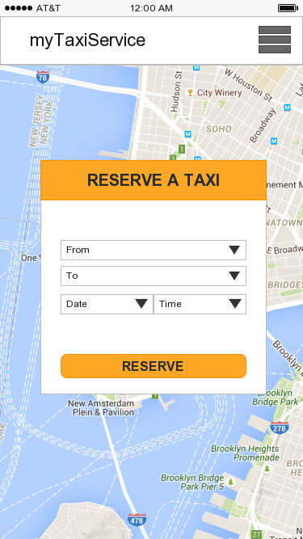
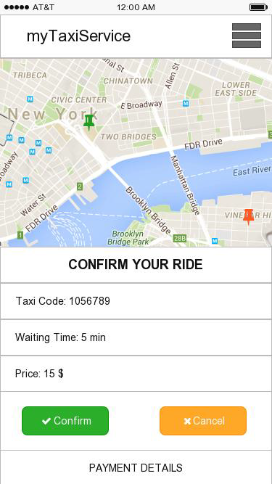

Slide 5
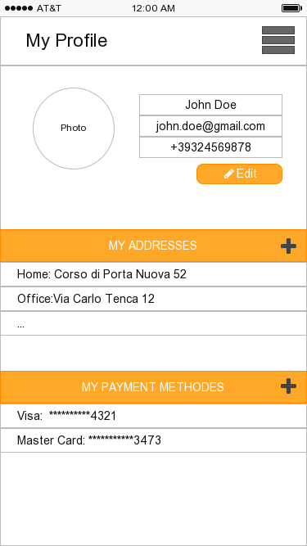
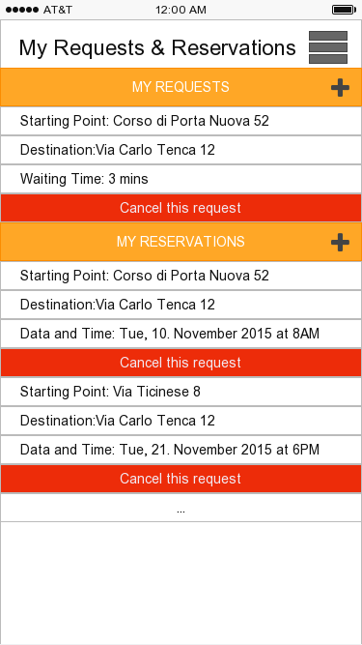

Slide 6
FUNCTIONAL REQUIREMENTS
[G1] Allow visitors to register to the application.
[R1] Visitor has to fill and submit the registration form (Name, Email, Password and
Phone number).
[R2] The Name, Email and Phone number should not match any other users data.
[D1] The email and phone number should be valid.
[G2] Allow registered users to log in to the application, with same credentials for both
the web and the mobile application.
[R1] User has to type in his email/phone number and password in order to log in
[R2] User's credentials should match with the ones submitted at the time of registration.
[R2] If the user wants to log in from his phone, he need to have MyTaxiService
application installed in his phone
[D1] System will implement the forget password functionality.
[D2] Wrong credentials will not grant access to the application

Slide 7
[G3] Passenger can request a taxi ride.
[R1] Passenger has to be logged in to the mobile or web application with his credentials.
[R2] Passenger has to specify his starting point and destination and submit a request.
[R3] Passenger can specify his starting point and destination by using the map, explicitly
typing in the addresses, or using his GPS location (only for the starting point).
[G4] The system will notify the passenger with the taxi code, fare amount and waiting
time, when a taxi driver accepts the system's request.
[R1] System has to receive the request from the passenger.
[R2] System has to forward the passenger's request to the very first taxi in the queue in
zone where the passenger's starting point is.
[R3] Taxi driver has to accept the system's request.
[D1] All the taxis in the queue are free.

Slide 8
[G5] The passenger can either accept or cancel the taxi proposal.//has to pay the fare
amount.
[R1]he has to receive the taxi proposal
[R2]if he accepts the taxi proposal he has to pay through the application
[R3]if he rejects the taxi proposal, the request will be canceled.
[D1]within 2 minutes he has to either accept or reject the taxi proposal
[D2]if he doesn't do anything within 2 minutes, that the request will be automatically
canceled by the system
[G6] Taxi is dispatched and will arrive at the requested location.
[R1]Taxi proposal needs to be accepted by the passenger
[R2]Taxi fare needs to be paid by the passenger
[R3]The system will allocate the requested taxi to the customer.
[D1]The passenger will be acknowledged by the system for his payment.
[D2] taxi will arrive within the specified waiting time

Slide 9
[G7] Passenger can reserve a taxi ride specifying his starting point, his destination and
the desired time
[R1] Passenger has to be logged in to the mobile or web application with his credentials.
[R2] Passenger has to specify his starting point, destination, date and time and submit a
request.
[R3] Passenger can specify his starting point and destination by using the map, explicitly
typing in the addresses, or using his GPS location (only for the starting point).
[D] The reservation must occur at least 2 hours before the desired time, and at most 1
week before the desired time
[G8] When the passenger reserves a taxi ride, he will be informed with a code of the
incoming taxi 10 minutes before the specified time of the ride.
[R1]The passenger will receive the remainder message from the system on his day of
travel before two hours from his pickup time and he is asked to either accepts or cancel
the reservation
[R2] if he accepts it, taxi will be allocated by the system.
[R3] if he rejects it, he will be refunded only 50% of his payment

Slide 10
[G9] The passenger can cancel his request.
[R1]The passenger should have accepted the taxi proposal and paid the fare.
[R2]If he cancels the request, he will be refunded only 50% of his payment
[D1] If he doesn't show up in the starting point within 15 minutes from the pick up time,
the system will cancel the request automatically, and the passenger will not be refunded
any money.
[G10] The passenger can cancel his reservation.
[R1] The passenger should have accepted the taxi proposal for reservation and paid the
fare.
[R2] If he cancels the reservation before 48h of the specified time, he will be refunded
70% of his payment
[R3]If he cancels the reservation before 1 hour of the specified time, he will be refunded
50% of his payment
[D1] If he doesn't show up in the starting point within 15 minutes from the pick up time,
the system will cancel the reservation automatically, and the passenger will not be
refunded any money

Slide 11
[G11] Available driver can confirm or reject the certain request for the ride.
[R1] The request should have been forwarded to the taxi driver
[R2] If the driver rejects the request, he will be reallocated to the end of the queue
[R3] If the driver confirms the request, the taxi proposal will be put together and sent to
the passenger
[D1] If the driver rejected the request, he has to convey his reasons to the HR
department of the taxi service

Slide 12
The World
The Machine
Need for a taxi
Taxi moves
Taxi breakdown
Accidents
Customer's travel to
pickup point
Database queries
Allocation of taxi algorithms
Fares and waiting time calculation
Taxi requests
Taxi reservation
Payment
Taxi proposal
Taxi reminders
Forwarding of the request to drivers

Slide 13
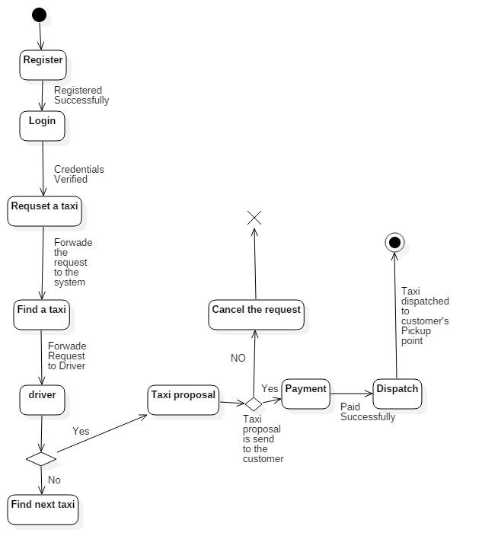
State Machine Diagrams
Requesting a Taxi

Slide 14
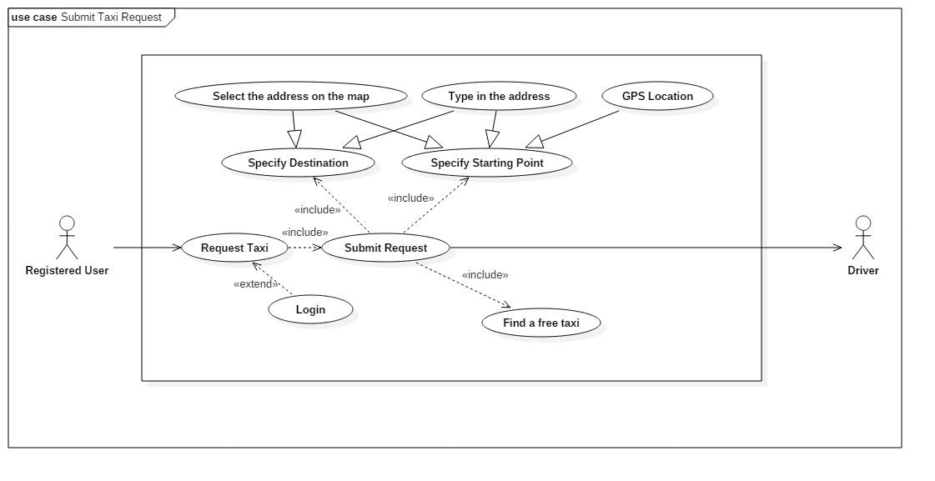

Slide 15
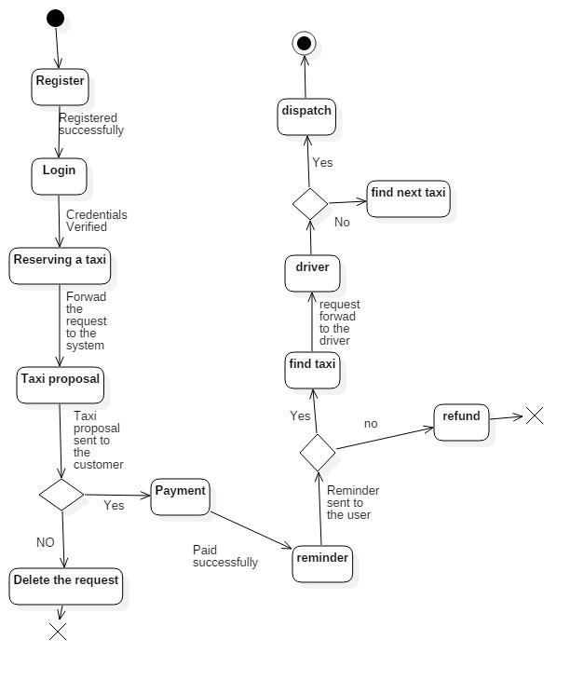
Reserving a Taxi

Slide 16
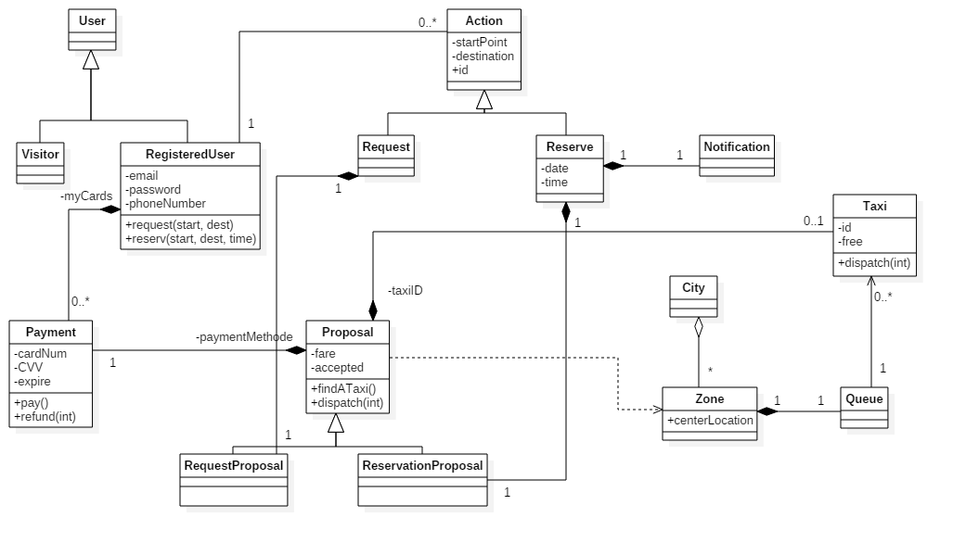
Class Diagram

Slide 17
Alloys
Facts
//user constraints
fact UserProperties {
//no two registered users can have the same email
all disj u1,u2: RegisteredUser | (u1.email != u2.email)
//no two registered users can have the same phone number
all disj u1,u2: RegisteredUser | (u1.phone != u2.phone)
}
//taxi can not wait in more than one queue
fact TaxiQueueing {
all t: Taxi | lone q: Queue | t in q.waiting
}
fact ZoneProperties {
//every queue has to be associated with exactly one zone
all q: Queue | (one z: Zone | z.queue = q)
//each zone has to be part of the city
one c: City | c.zones = Zone
}

Slide 18
fact TaxiAndProposal {
//if a taxi accepts proposal it is not in the queue
all r: Proposal, q: Queue | no (r.taxi & q.waiting)
//taxi can't accept more than one proposal at the time
all t: Taxi | lone r: Proposal | t in r.taxi
//differen proposal should be generated for each request/reservation
all p: RequestProposal | one r: Request | p in r.proposal
all p: ReservationProposal | one r: Reserve | p in r.proposal
//amount should only exist if associated within proposal
all a: Amount | some p: Proposal | p.fare = a
//for one user there cannot be more than one taxi associated with a //proposal at the time
//(these are the current proposals)
no disj r1, r2: Request | one u: RegisteredUser | (r1 in u.actions) and (r2 in u.actions)
implies (#r1.proposal + #r2.proposal) = 1
}

Slide 19
fact ActionPropreties {
//every action should be done by the user
all a: Action | one u: RegisteredUser | a in u.actions
//starting point and destination must be different
all a: Action | a.start != a.destination
//datetime must always be associated with reservation
all d: DateTime | one r: Reserve | d in r.datetime
//user can not reserve multiple taxies at the same time
all disj r1,r2: Reserve | (r1.datetime = r2.datetime) implies no u: RegisteredUser | (r1 in
u.actions) and (r2 in u.actions)
}

Slide 20
Assertions
//two reservations can't occure in the same time for the same passenger
assert SameTimeReservation {
no disj r1, r2: Reserve | one u: RegisteredUser | (r1.datetime = r2.datetime) and ((r1 in
u.actions) and (r2 in u.actions))
}
check SameTimeReservation for 10
//starting point and destination have to be different
assert StartAndDestination {
all a: Action | a.start != a.destination
}
check StartAndDestination for 10

Slide 21
PREDICATES
//add a request
pred addRequest [u1,u2: RegisteredUser, r: Request] {
(r not in u1.actions) implies u2.actions = u1.actions + r
}
pred showAddRequest [u1,u2: RegisteredUser, r: Request] {
addRequest[u1, u2, r]
}
run showAddRequest
//add a reservation
pred addReservation [u1,u2: RegisteredUser, r: Reserve] {
(r not in u1.actions) implies u2.actions = u1.actions + r
}
run addReservation
//delete a request
pred deleteRequest [u1,u2: RegisteredUser, r: Request] {
(r in u1.actions) implies u2.actions = u1.actions - r
}
run deleteRequest
//delete a reservation
pred deleteReservation [u1,u2: RegisteredUser, r: Reserve] {
(r in u1.actions) implies u2.actions = u1.actions - r
}
run deleteReservation

Slide 22
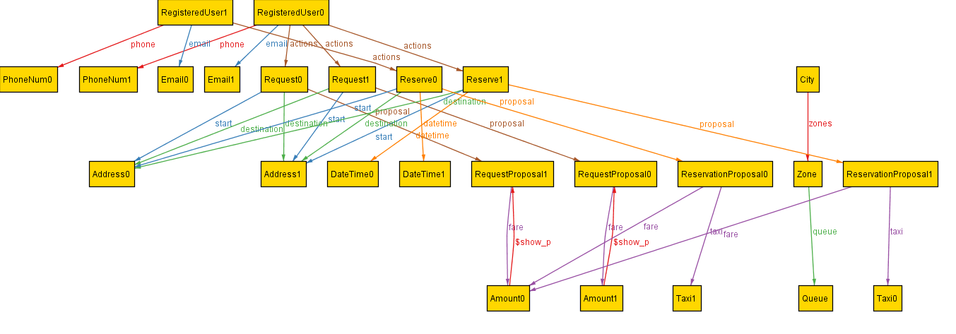
The Generated World

Slide 23
Cost Estimation
Function Points
Internal Logic File:
Application stores information of these data structures:
Users - Simple 7
Taxi - Simple 7
Zone - Simple 7
Request - Medium 10
Reservation - Medium 10
Payment Information - Medium 10
Total ILF = 3*7 + 3*10 = 51
External Interface File:
Application interacts with external APIs - Maps (for locations, and routes) and
PaymentAPI (for transactions):
Location - Simple 5
Transaction - Simple 5
Total EIF = 10

Slide 24
External Inputs:
The application can interact with user or driver.
User:
Login/Logout - Simple 3
Registration - Simple 3
Edit profile information - Simple 3
Add address/payment - Simple 3
Delete address/payment - Simple 3
Cancel Request/Reservation - Medium 4
Driver:
Declaring availability - Medium 4
Accepting/Declining rides - Simple 3
Total EI = 10*3 + 3*4 = 42
External Inquiries:
Users can request or reserve a taxi ride, and they can request information about
it or their profiles:
Request/Reservation - Complex 6
View profile - Simple 3
View all Requests/Reservation - Simple 3
View single Request/Reservation - Simple 3
Total EQ = 2*6 + 5*3 = 27

Slide 25
External Outputs:
Application can cause these output actions:
Dispatch a taxi - Simple 4
Refund - Complex 7
Total EO = 4 + 7 = 11
Total number of FPs we get by adding up all these values:
UFP = 51 + 10 + 42 + 27 + 11 = 141

Slide 26
COCOMO
For Java AVC = 53
SLOC = AVC * UFP = 53 * 141 = 7473
Effort = 2.94*EAF*(KSLOC)^E
For Cost Drivers we selected all Nominal values, except for Reusability factor, which we
considered as High (because this application might be used in other similar systems, or other towns etc.). Therefore EAF = 1.07
For Scale Drivers the values for Precedentedness, Risk Resolution, Process Maturity are Low(because the team members don't have much experience in this field), and the values for Flexibility and Team Cohesion are High.
E = 0.91 + 0.01*sum(ScaleDriver weight) = 1.1
Finally we get the Effort value:
Effort = 2.94*1.07*(7.5)^1.1 = 28.9 Person - Months

Slide 27
Duration of the project is calculated in the following way:
Duration = 3.67*(Effort)^E ~ 12 Months
If we assume that the cost per person (CPP) for this project is 1000 €, we get the total cost:
Cost = Effort * CPP = 28900 €

Slide 28
Tasks, Schedule and Resource Allocation
Documents | Started | Finished | Duration | Work done and hours spent
 |  |  |  | Ranjithkumar | Petar korda
Requirement analysis and specification document | 2nd Week of October 2015 | 2nd Week of November 2015 | 32 days | Part of goal identified, UML diagrams designed ,possible scenarios identified-22 hrs | Part of goal identified, UI designs ,Alloy modeling-22 hrs
Architecture and algorithmic design | 2nd Week of November 2015 | 1st Week of December 2015 | 20 days | Algorithmic design part-15 hrs | Architecture design part-15 hrs
Review of the gathered Information | 1st Week of December 2015 | 2nd Week of December 2015 | 7 days | Both of us Worked together for 10 hrs each
Integration and Test planning | 2nd Week of December 2015 | 4th Week of December 2015 | 18 days | Test cases design and planning-15 hrs | Integration design and Planning-15hrs
Cost Estimation and Planning | 2nd Week of January 2016 | 3rd Week of January 2016 | 10 days | COCOMO estimation and Planning-10 hrs | Function Point Estimation and planning -10 hrs

Slide 29
Project Development
Core system - Server application
User application - Front - end
Driver application - Front - end for the driver
The core system development involves four sub stages as follows:
[1] Development of Zone module-15 days
[2] Development of action module-2 months (One team member develops the part for
Requests, other for Reservations)
[3] Development of User account module-15 days
[4] Development of Payment and refund module-1 month (Split the work between both
team members)
Development of [1] and [2] can be done parallel with one team member working on [1] and the
other on [2]

Slide 30
The User application development involves two sub stages as follows
Mobile application-Android application will be developed by one person and IOS application will be developed by another person and this process takes 20 days to get completed.
Web Application-Both of us works together to finish this app in 10 days.
The Driver application can be created by both the person working together in a month

Slide 31
Risks
Some of the risks that the project myTaxiService might face are:
Team size and lack of experience - The lack of the experience might prolong the
duration of the project development. Additional expert might be needed
Lack of time - Since both team members have responsibilities on the university, the time they are to devote to this project might not be enough Hazards - injuries, illness, etc.
Customer risks - customer might want to change some requirements which would
prolong the project duration

Slide 32
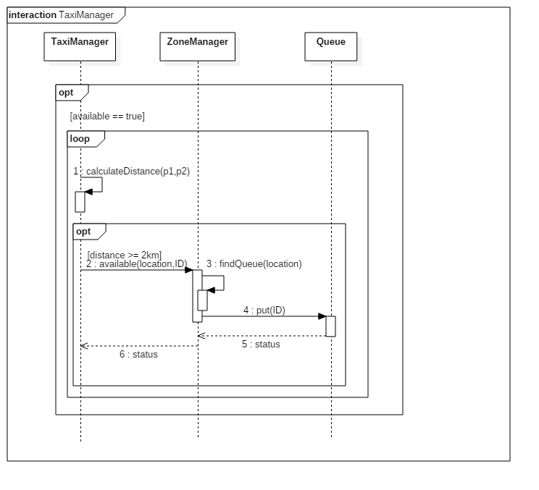
DD improvements - Zone changing for taxies

Slide 33
Code Inspection
System: Glassfish 4.1.1 Server
Class assigned: ActiveJmsResourceAdapter

Slide 34
ActiveJmsResourceAdapter
Part of the JMS (Java Messaging Service) module of Glassfish server
Provides additional configuration to:
ManagedConnectionFactory (connections created by the Resource Adapter) and
ResourceAdapter (allows applications deployed in that application server to use Message Queue to send and receive JMS messages)

Slide 35
Issues found in the code by applying the checklist
Naming conventions -> 9
Indentation -> 14
Braces -> 9
File organization -> 6
Wrapping lines -> 11
Comments -> 2
Java source file -> 1
Class and interface declarations -> 1
Initialization and declaration -> 5
Output format -> 1
Exceptions -> 1

Slide 36
1 | Methode: setProperty | 1833 | Not indicative enough, this sets the property of ManagedConnectionFactory, but can be missunderstood as setting the property of ResourceAdapter
7 - Constants are declared using all uppercase with words separated by an underscore | RECONNECTENABLED, RECONNECTINTERVAL, RECONNECTATTEMPTS, GROUPNAME, CLUSTERCONTAINER | 166 - 170 | Not following the convention
7 | BROKERTYPE, BROKERINSTANCENAME, BROKERBINDADDRESS, BROKERPORT, BROKERARGS, BROKERHOMEDIR, BROKERLIBDIR, BROKERVARDIR, BROKERJAVADIR, BROKERSTARTTIMEOUT, ADMINUSERNAME, ADMINPASSWORD, ADMINPASSFILE | 173 - 185 | Not following the convention

Slide 37
Integration Test Plan
Plan how to test the interaction among the different components by integrating it together.
Test cases are constructed to test whether all the components interact correctly

Slide 38
myTaxiService subsystems
Core System - business logic
User Application - user management and front - end applications
Driver Application - taxi application

Slide 39
Bottom-up integration for subsystems
Queue
ZoneManager
Request
Reservation
ProposalManager
AccountManager
Android App
iOS App
Web App
TaxiManager

Slide 40
High level components

Slide 41
Thread integration testing
Two main functionalities of the system: Requesting a taxi, and reserving a taxi ride
First all components are integrated, but only parts required for Requests, and then the Reservation functionalities are added and integrated separately

Slide 42
Integration test cases
Individual steps and test descriptions
Number of test cases -> 21
Test case Id | IT9
Test case components | Request manager→Queue(high level component)
Input specifications | Check the typical starting point and destination (both may or may not be in the same zone).
Output Specifications | Check the corresponding queue is called and taxi is found.
Environmental Needs | IT1,IT2,IT3 succeeded

Slide 43
Integration Test Procedures
ITP1 -> This procedure verifies whether system satisfies taxi request
ITP2 -> This procedure verifies whether system satisfies taxi reservation
ITP3 -> This procedure verifies whether front end satisfies registering, logging in, requesting, reserving
ITP4 -> This procedure verifies whether driver app satisfies forwarding requests, availability, cancelation, dispatching

Slide 44
Stubs and Drivers
FareCalculator stub - for the test IT3
WaitCalculator stub - for the test IT4
FrontEnd driver - for the test IT16

