Slide 1
Crystal Classification
Sprint 3: Train & Val
MAJIC Petar

Slide 2
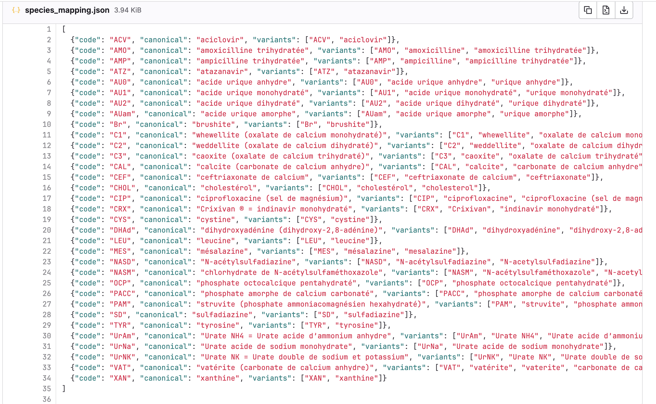
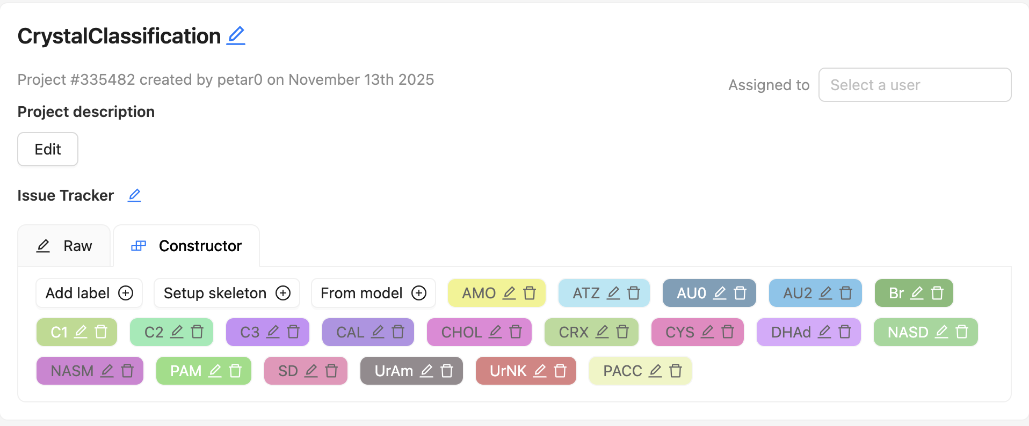
Labels

Slide 3
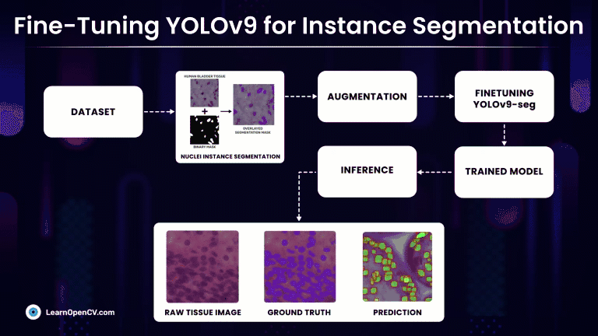
Workflow – from the source
https://learnopencv.com/yolov9-instance-segmentation-on-medical-dataset/#aioseo-comparsion-1-yolov9e-seg-v-s-yolov8l-seg-with-imgsz1024

Slide 4
Training workflow
CVAT Export
Augmentation
Finetuning YOLO model
Predict with trained model
Results

Slide 5
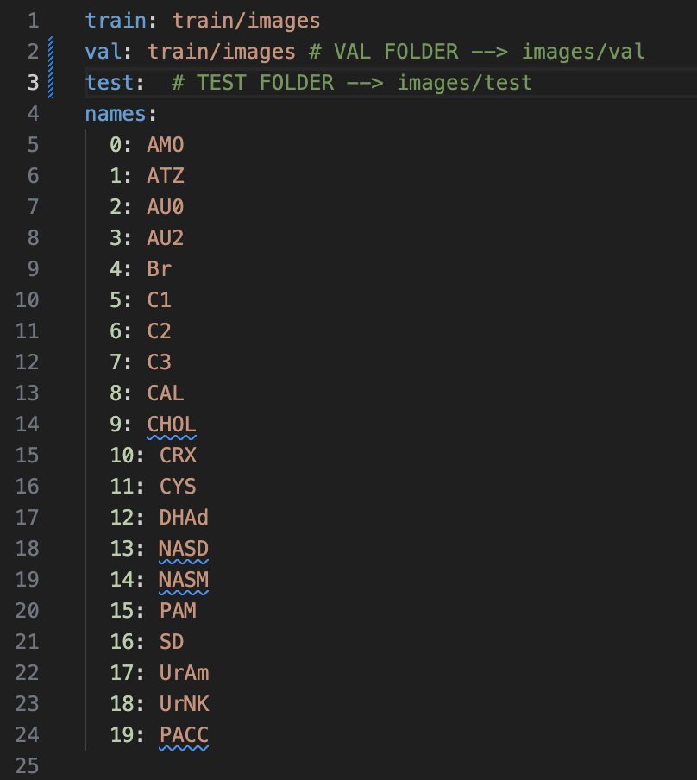
CVAT export format
Ultralytics YOLO Segmentation 1.0
  images/train/
  images/val/
  labels/train/
  labels/val/
  data.yaml
  Annotated masks saved as poligons in .txt

Slide 6
Augmentation
YOLO built-in augmentation
custom augmentation YAML file
  Parameter during training phase: cfg=augment.yaml
Augmentations
  Rotations
  Horizontal flip
  Mild color (HSV) changes
  Copy-Paste (class inequality)

Slide 7
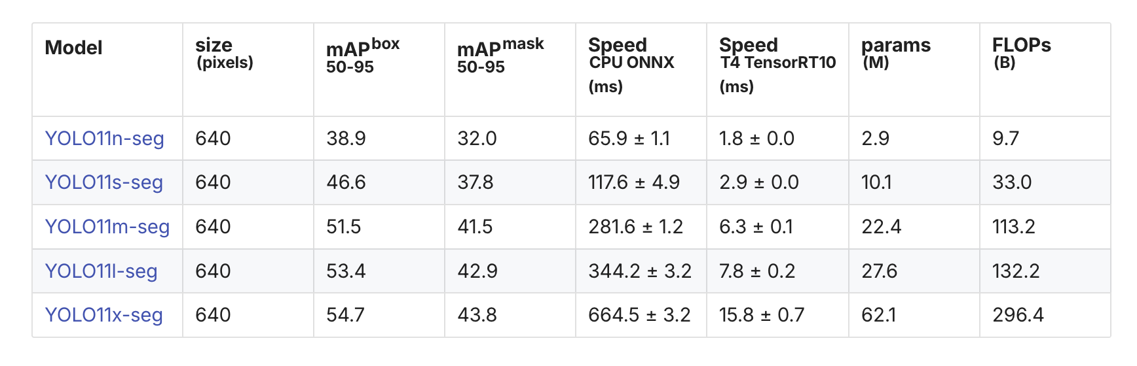
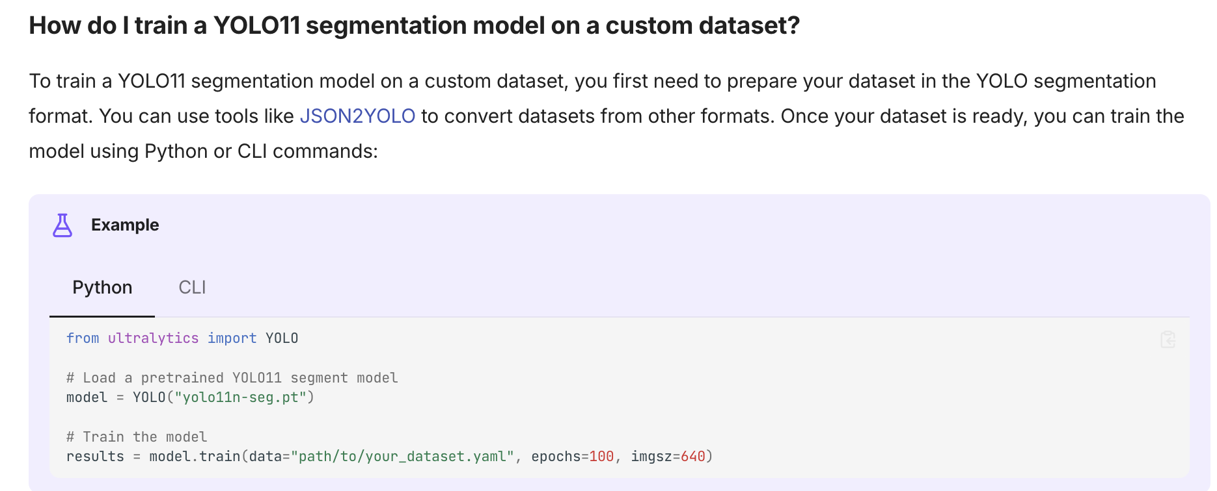
Finetuning YOLO model
https://docs.ultralytics.com/tasks/segment/

Slide 8
Results
YOLOv11-seg returns:
Bounding boxes (result.boxes.xyxy)
Class IDs (result.boxes.cls)
Confidence scores (result.boxes.conf)
Segmentation masks:
  polygon masks → result.masks.xy
  binary masks → result.masks.data
Annotated output image (if save=True)
Class name mapping (result.names)

