Slide 1


Prix Recherche et Innovation
9ème édition (2026)
Détection de cristaux dans des images médicales
MAJIC Petar
Gilles Venturini, Barthélemy Serres, CHU Orléans

Slide 2
Objectives
Study the state of the art (image recognition of urine crystals).
Collect and preprocess data (urine crystal images).
Explore annotation/segmentation tools to build a labeled dataset.
Propose and implement classification strategy.
Deliver the fine tuned model in Google Colab.

Slide 3
Technologies and Tools
Programming: Python
Annotation tools: CVAT AI
Environment: VisualStudio Code, Google Colab, GitLab

Slide 4
Tasks and deliverables
Phase 1 – Literature review and data preparation – duration 1 month
  Deliverables: Preprocessed dataset + CSV
Phase 2 – Dataset creation – duration 1 month
  Deliverables: Prepared dataset for annotation
Phase 3 – Dataset annotation – duration 2 months
  Deliverables: annotated dataset
Phase 4 – Model fine tuning – duration 1 month
  Deliverables: fine tunded model with metrics on validation dataset

Slide 5
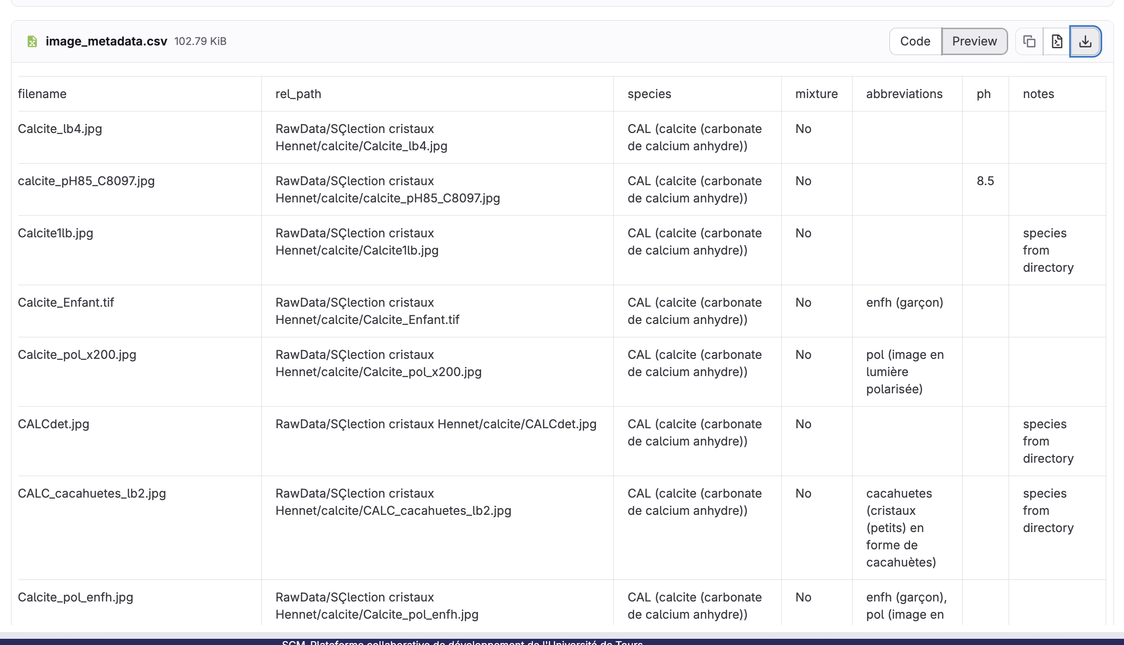
Phase 1 – metadata csv

Slide 6
Phase 1 - problems
Class and folder structure issues
Folder name ≠ true class label (directory class is not reliable)
Multiple crystal types appear in the same folder
Mixed crystals in the same image (real-world mixtures)
Some images are stored in the wrong folder (rare but present)
Not all classes exist in the dataset
High morphological diversity inside the same class (same crystal, different shapes)
Potential sub-classes / different morphologies (e.g., brushite)

Slide 7
Phase 1 - problems
File naming and metadata problems
File names contain non-standard textual annotations
Hard to automatically interpret text labels (abbreviations, inconsistent format)
Some filenames include multiple crystal classes
Context information exist (pH, polarization, intoxication, etc.) but not structured

Slide 8
Phase 1 - problems
Image quality & acquisition variability
Strong class imbalance (very different number of images per class)
Highly variable image resolution (very low resolution to high resolution)
Different lighting conditions (white light vs polarized light)
Different polarization types
Different magnification levels without metadata
Crystal size is highly variable (scale is inconsistent)

Slide 9
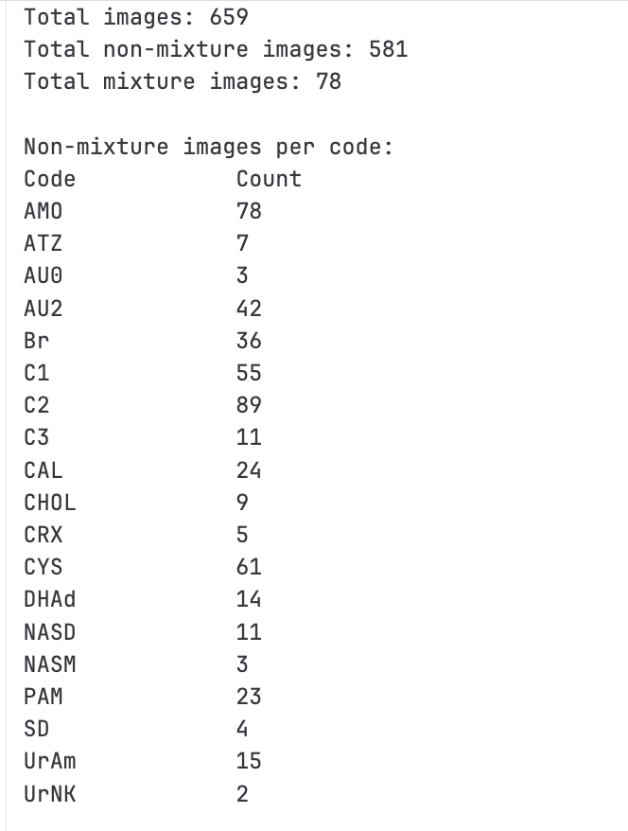
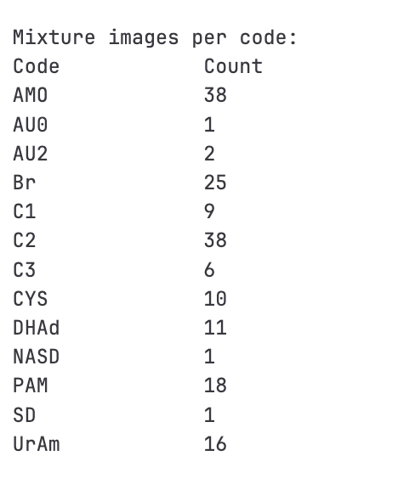
Phase 2 – prepared dataset

Slide 10
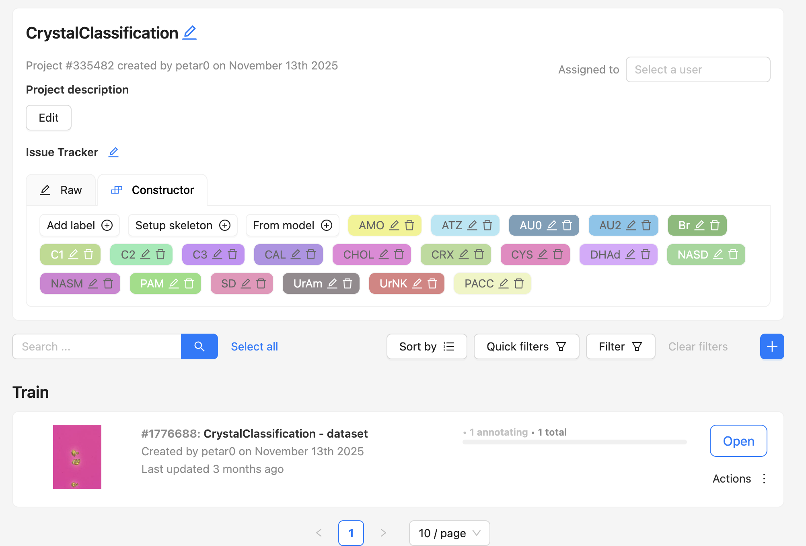
Phase 3 – annotated dataset
CVAT AI

Slide 11
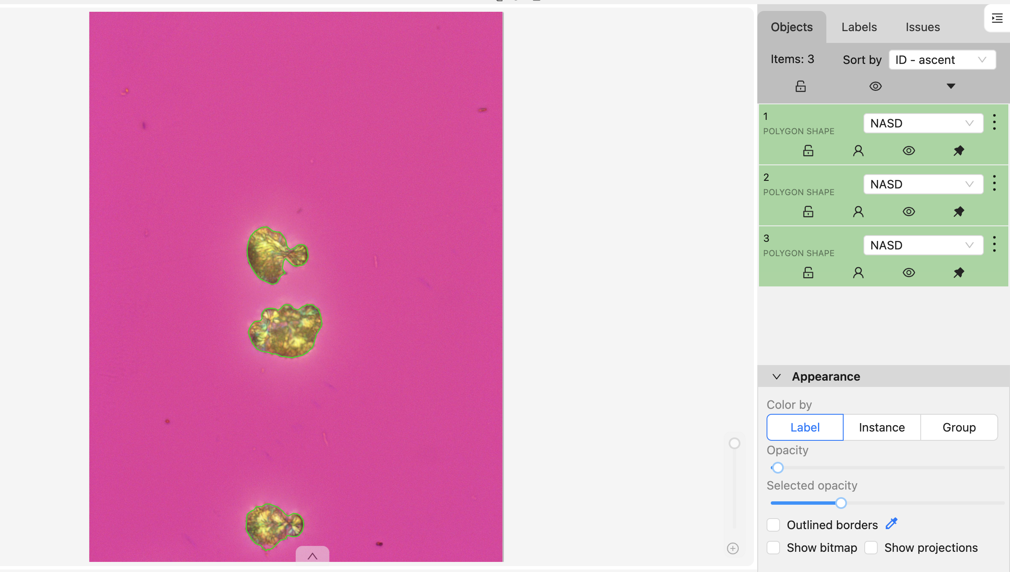
Phase 3 – annotated dataset

Slide 12
Phase 4 – fine tuned model with metrics
Dataset (659)
Labeled (612)
Train set
Val set
Unlabeled (47)

Slide 13
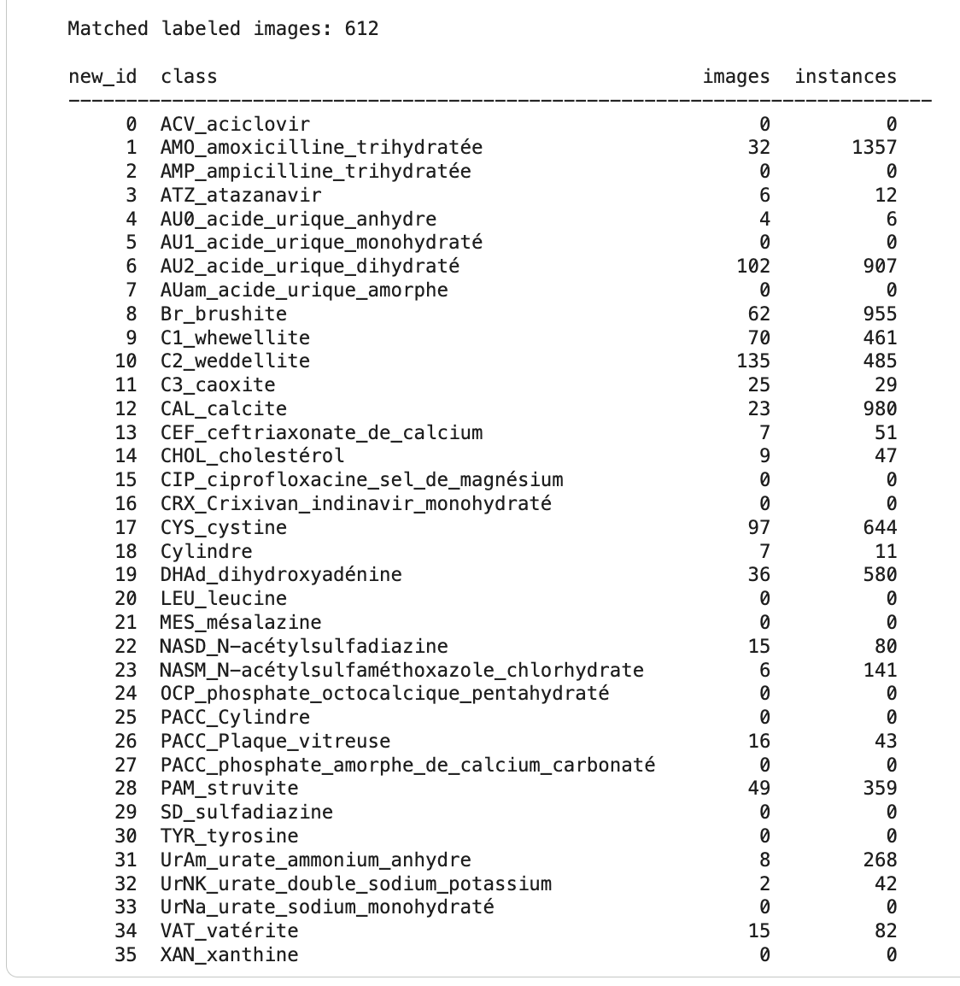
Phase 4 – fine tuned model with metrics
Making baseline

Slide 14
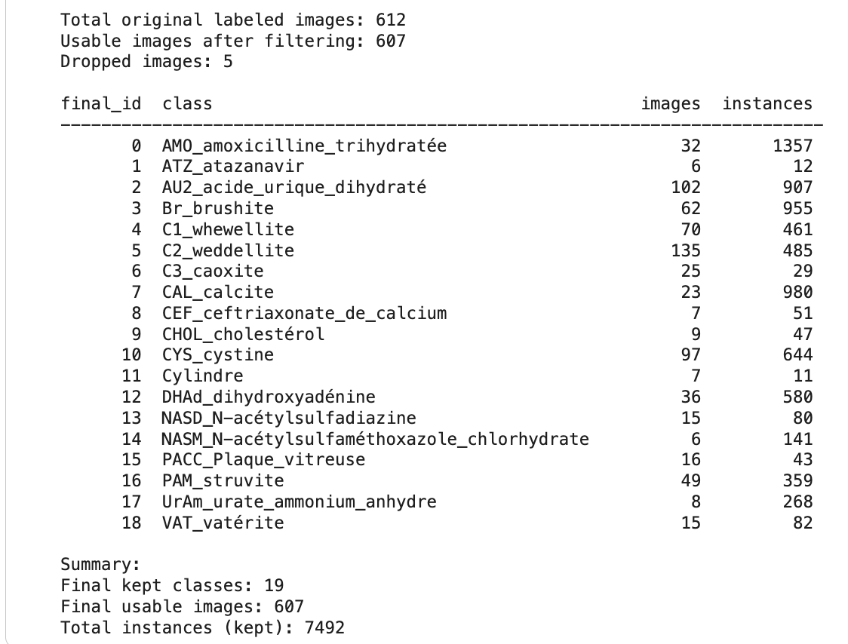
Phase 4 – fine tuned model with metrics

Slide 15
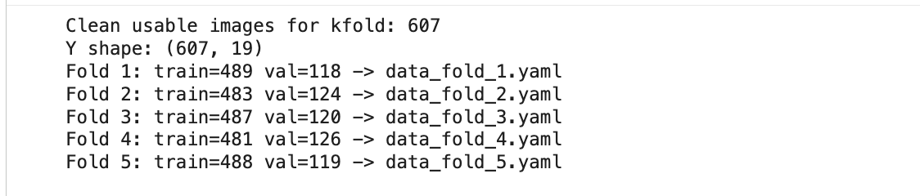
Phase 4 – fine tuned model with metrics
Train and val split

Slide 16
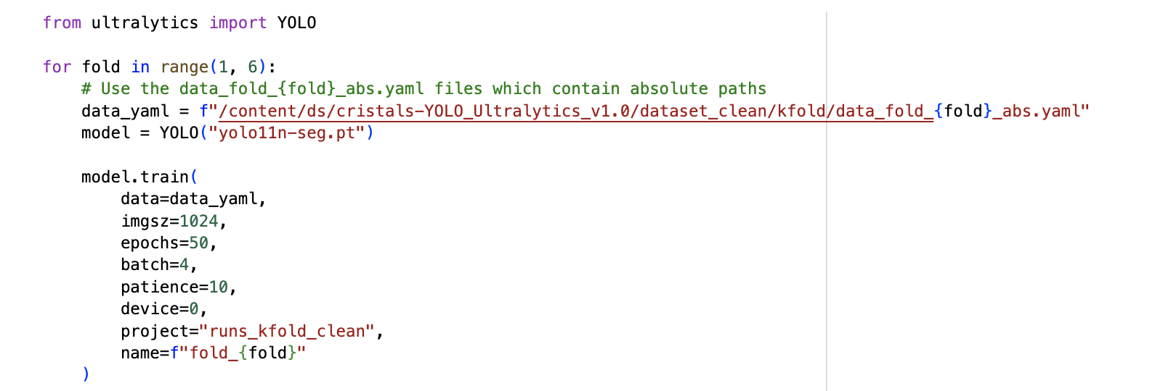
Baseline model

Slide 17
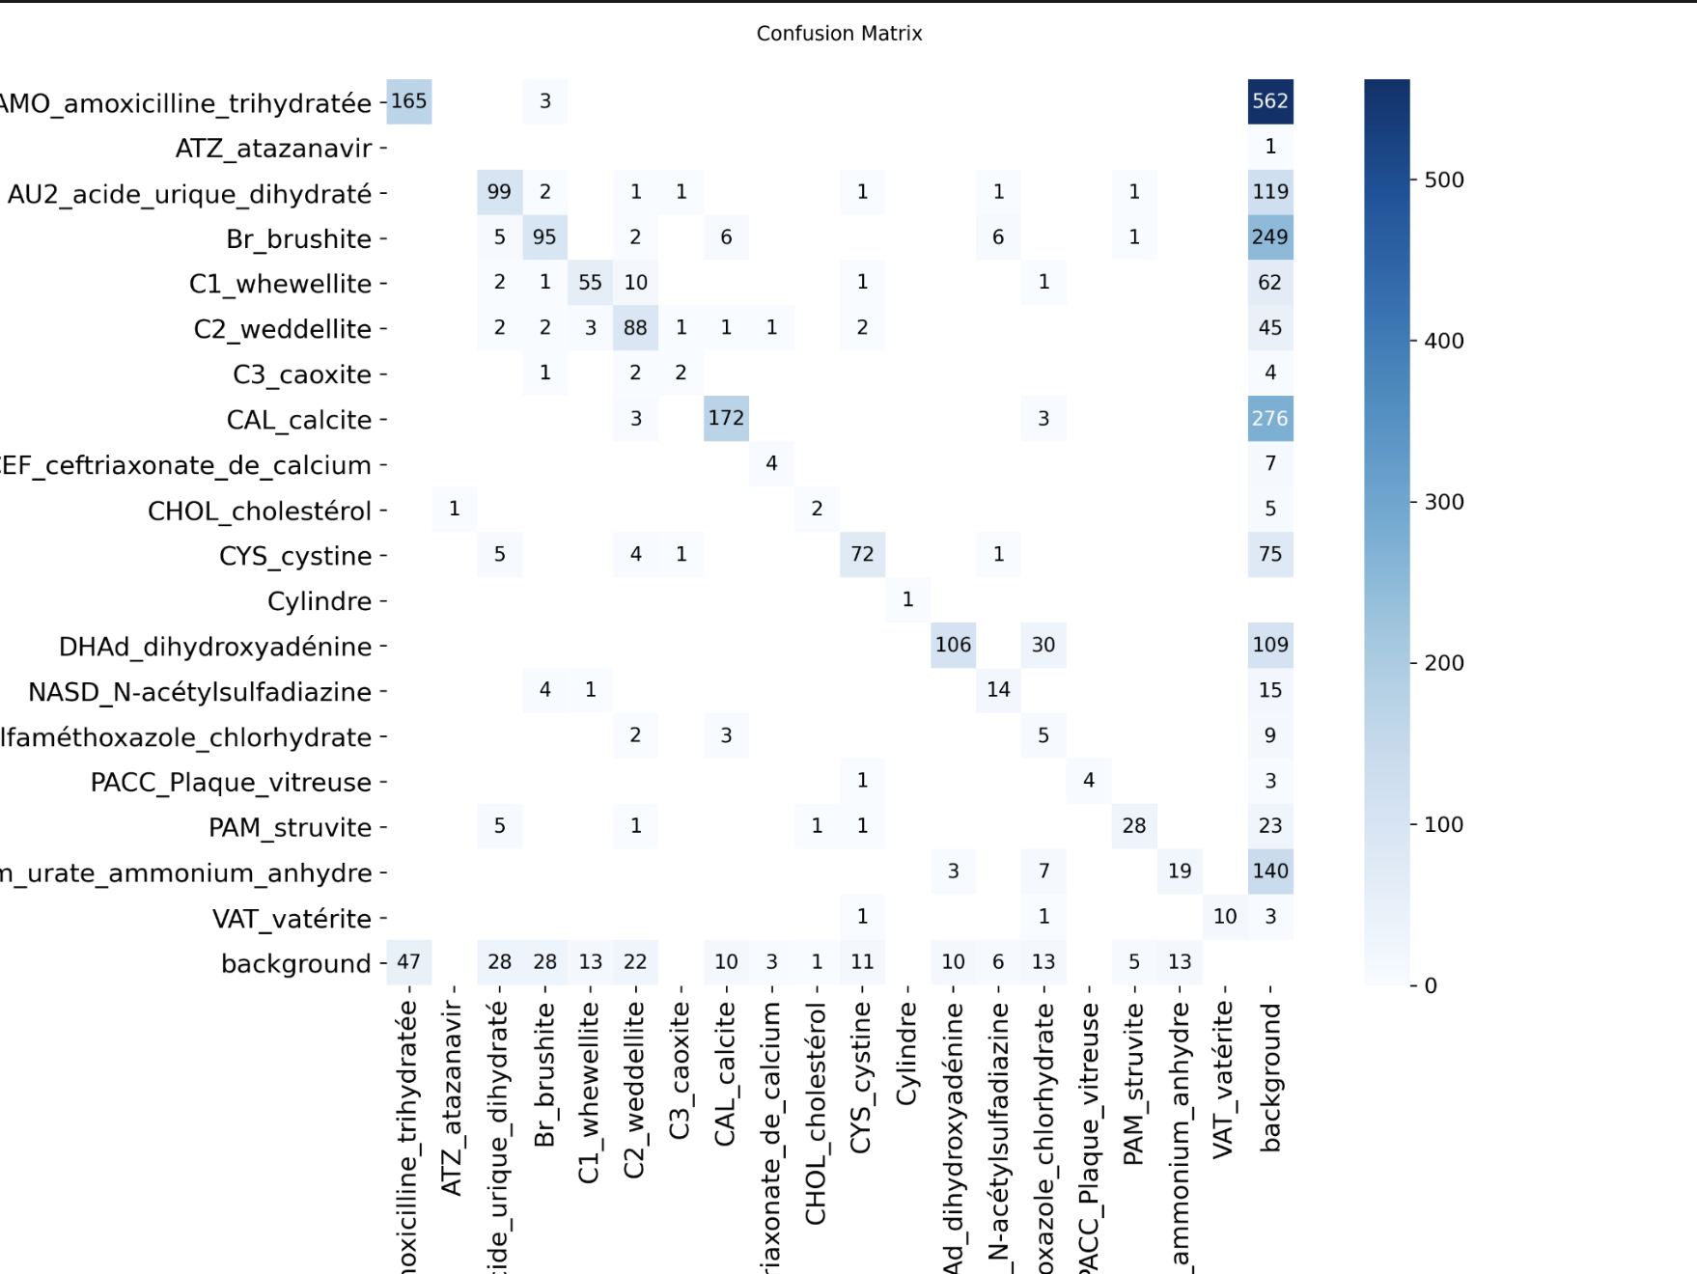
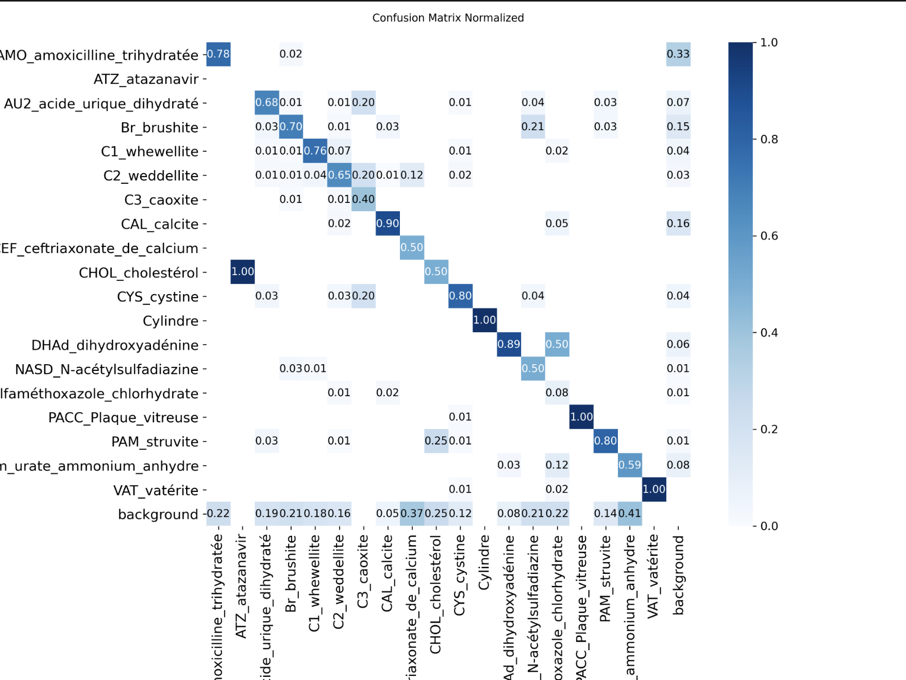
Baseline metrics

Slide 18
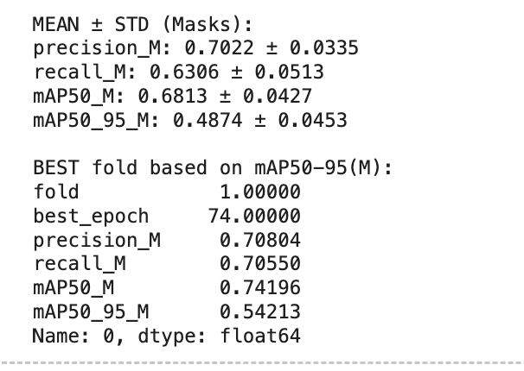
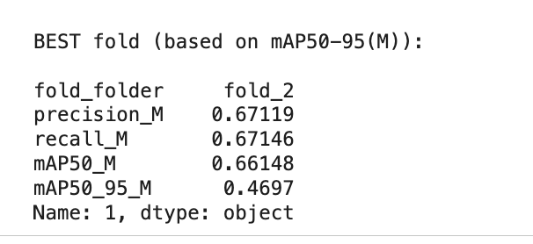
Comparison

Slide 19
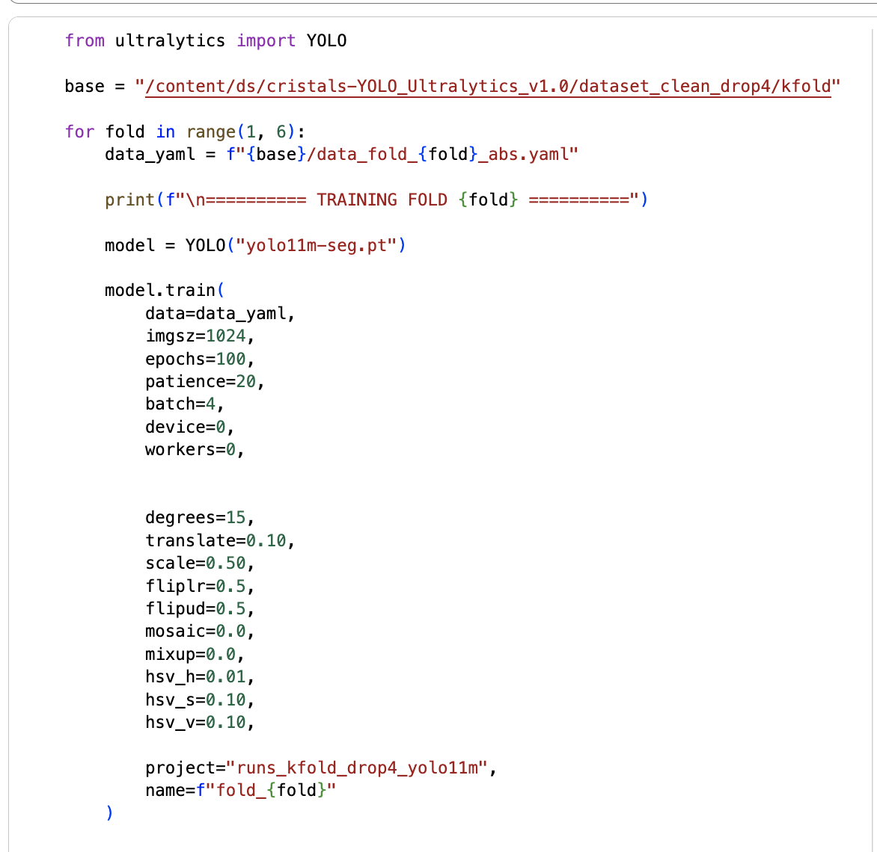
Newimproved model

Slide 20
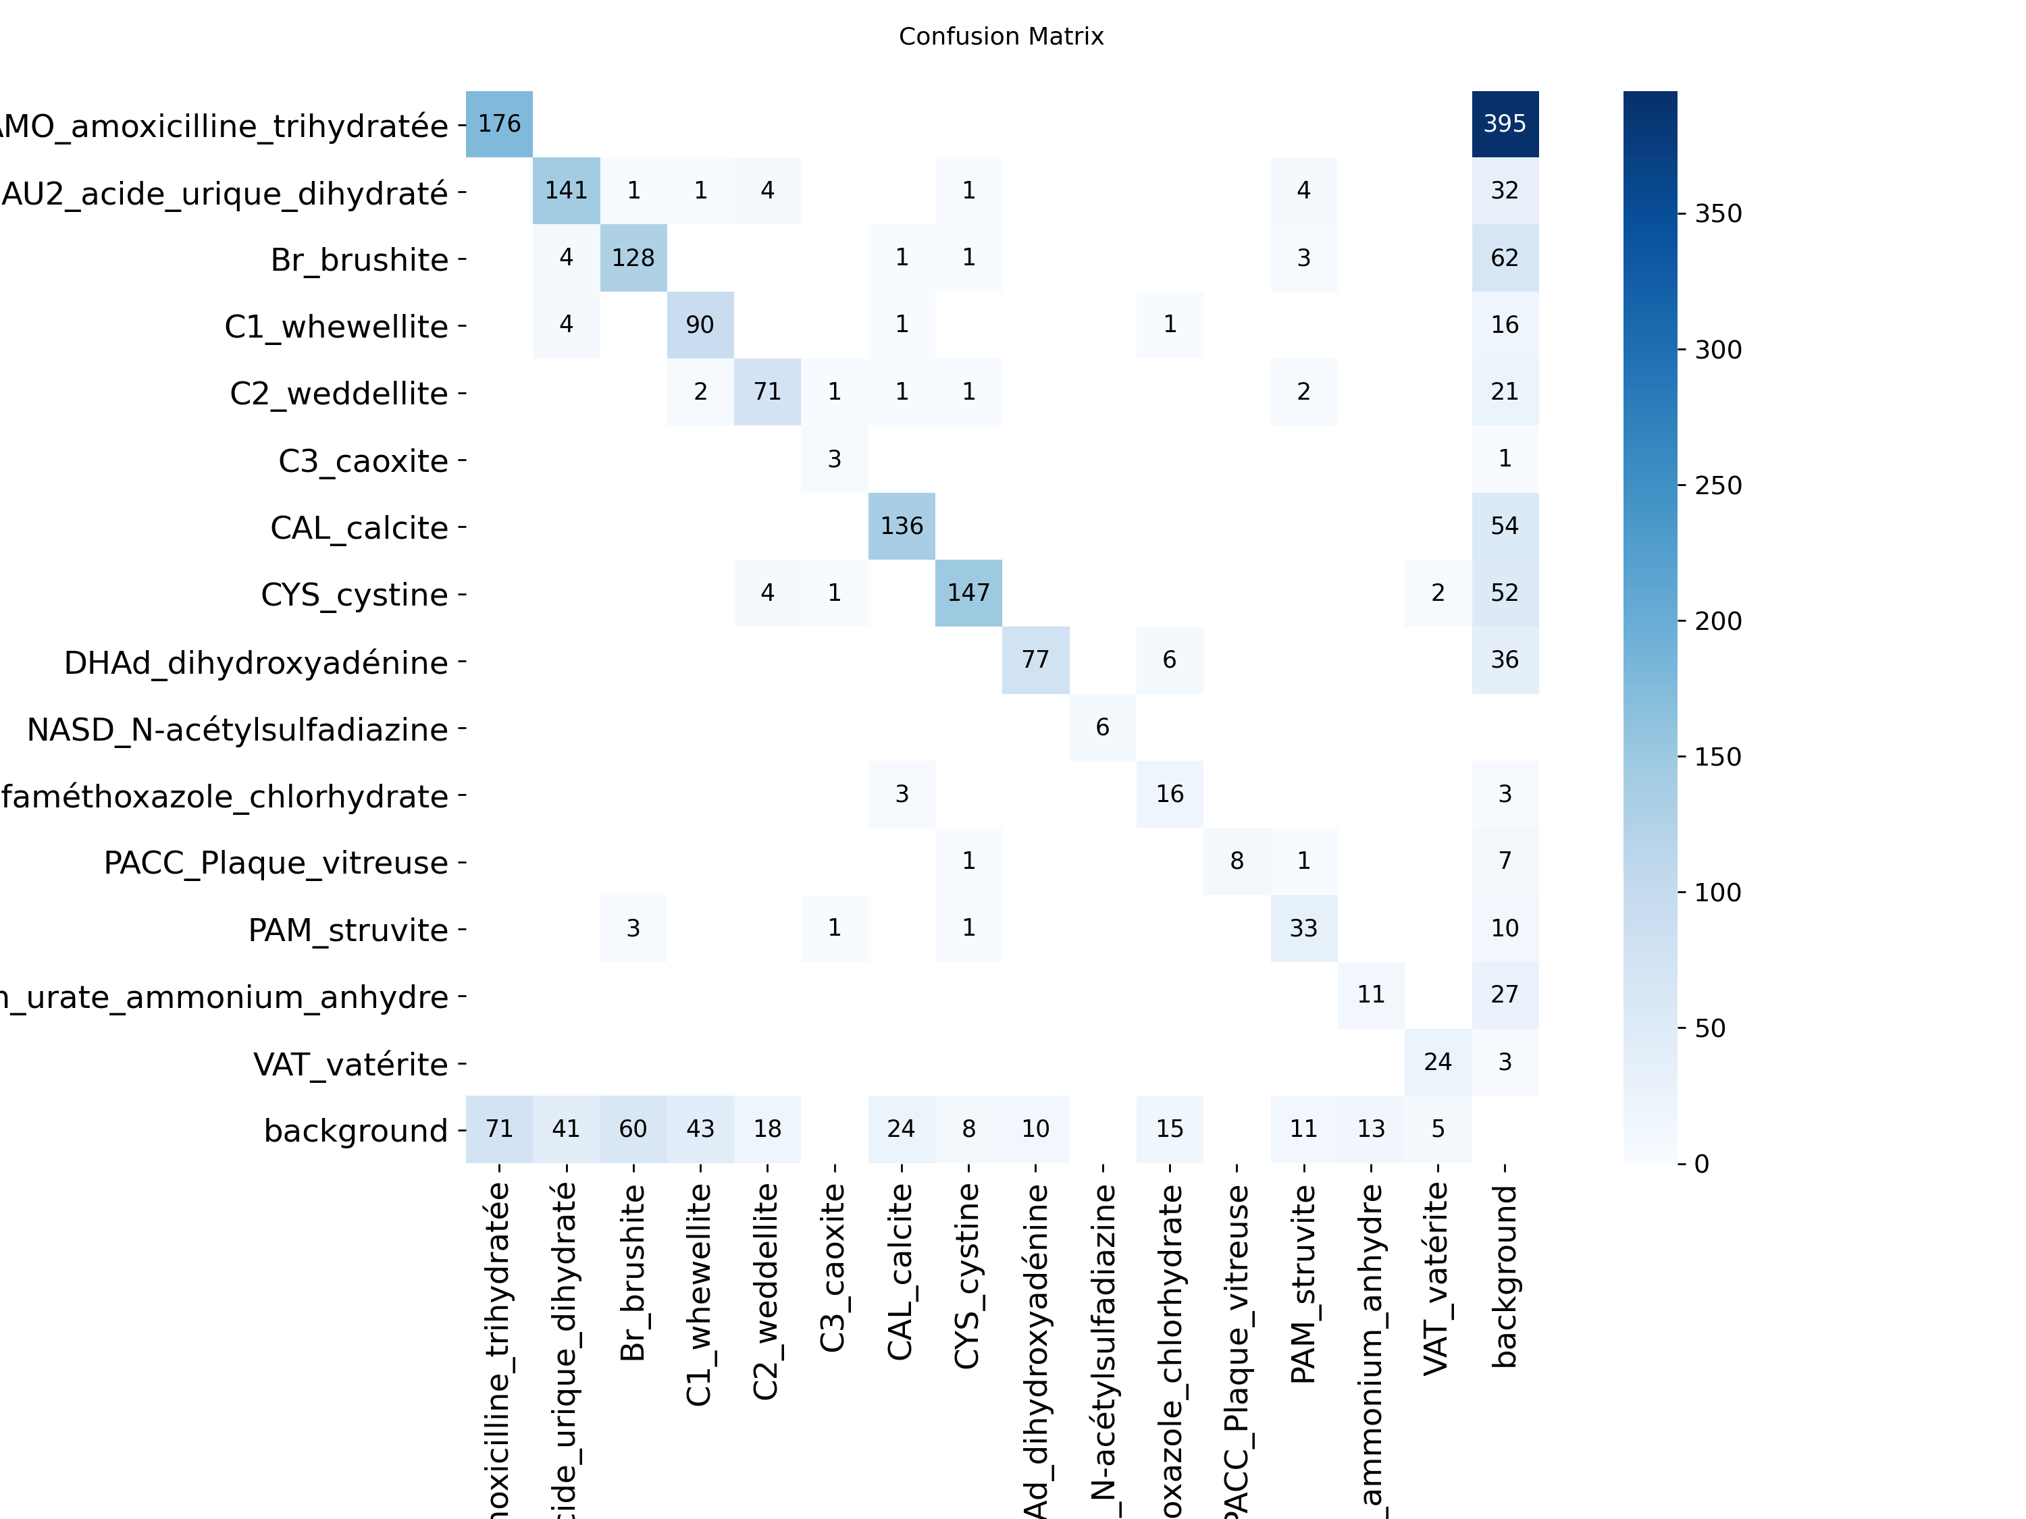
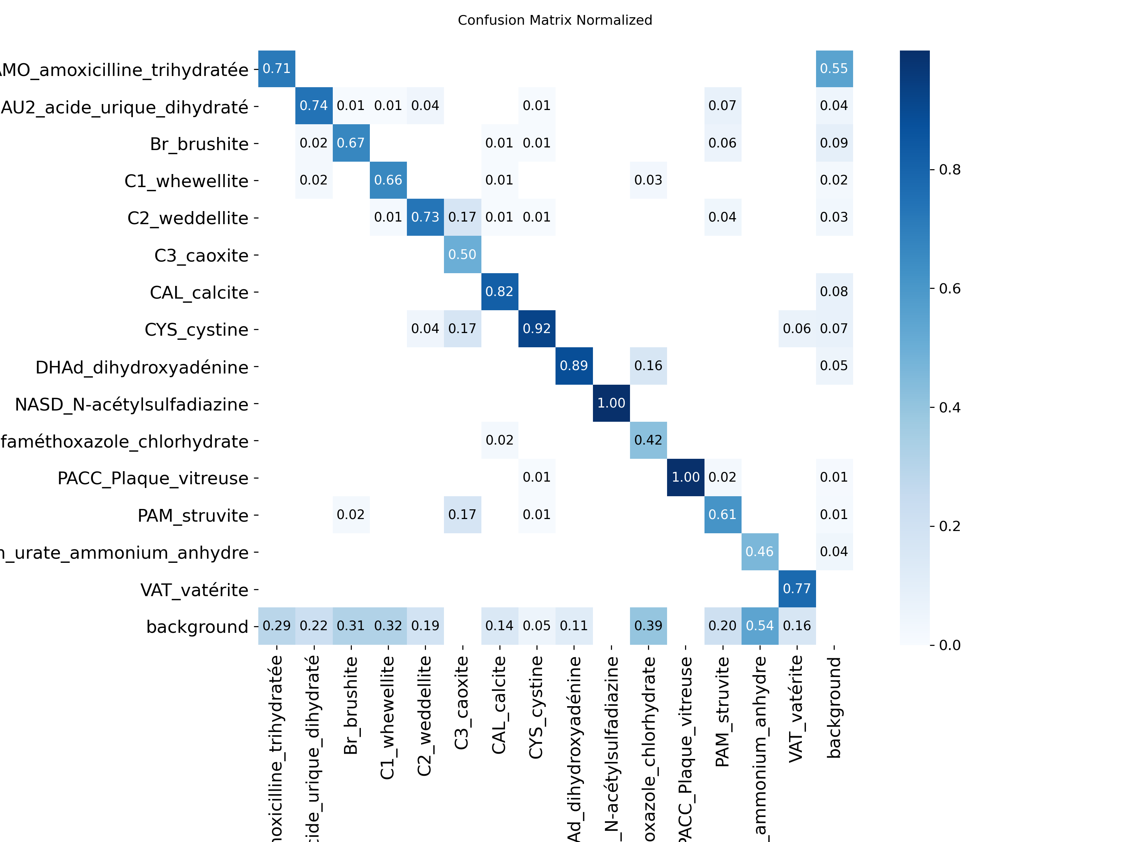
New metrics

