Slide 1
Training and validation

Slide 2
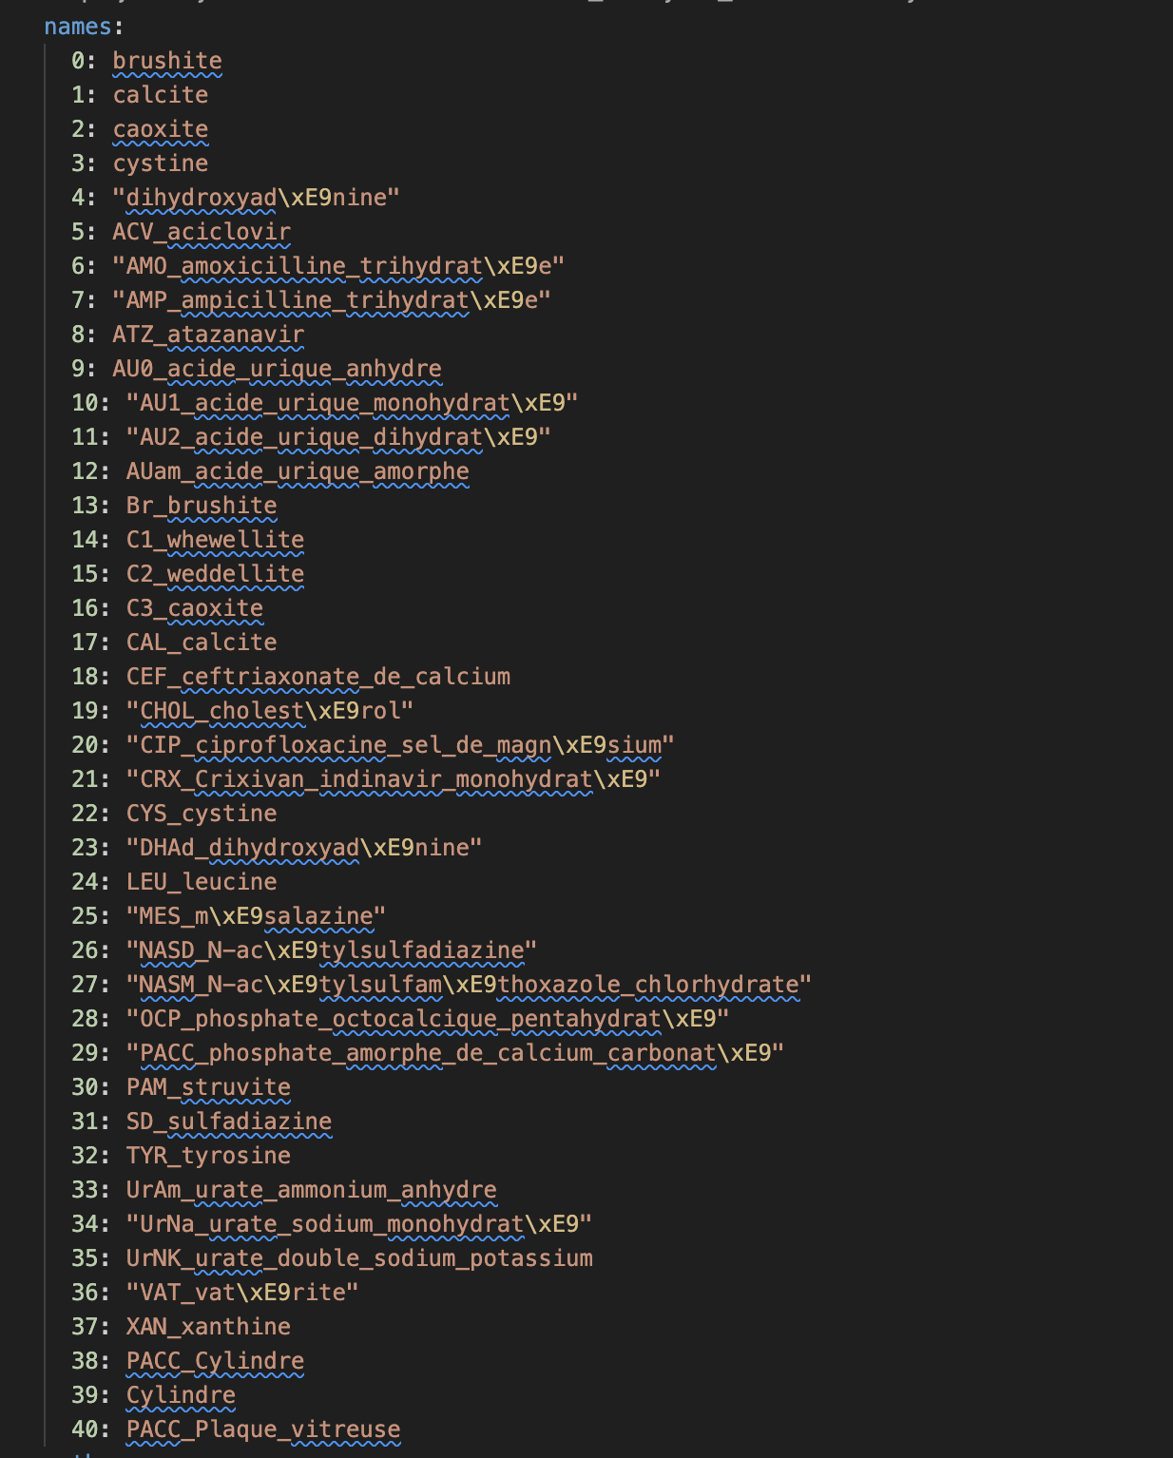
Classes – data.yaml

Slide 3
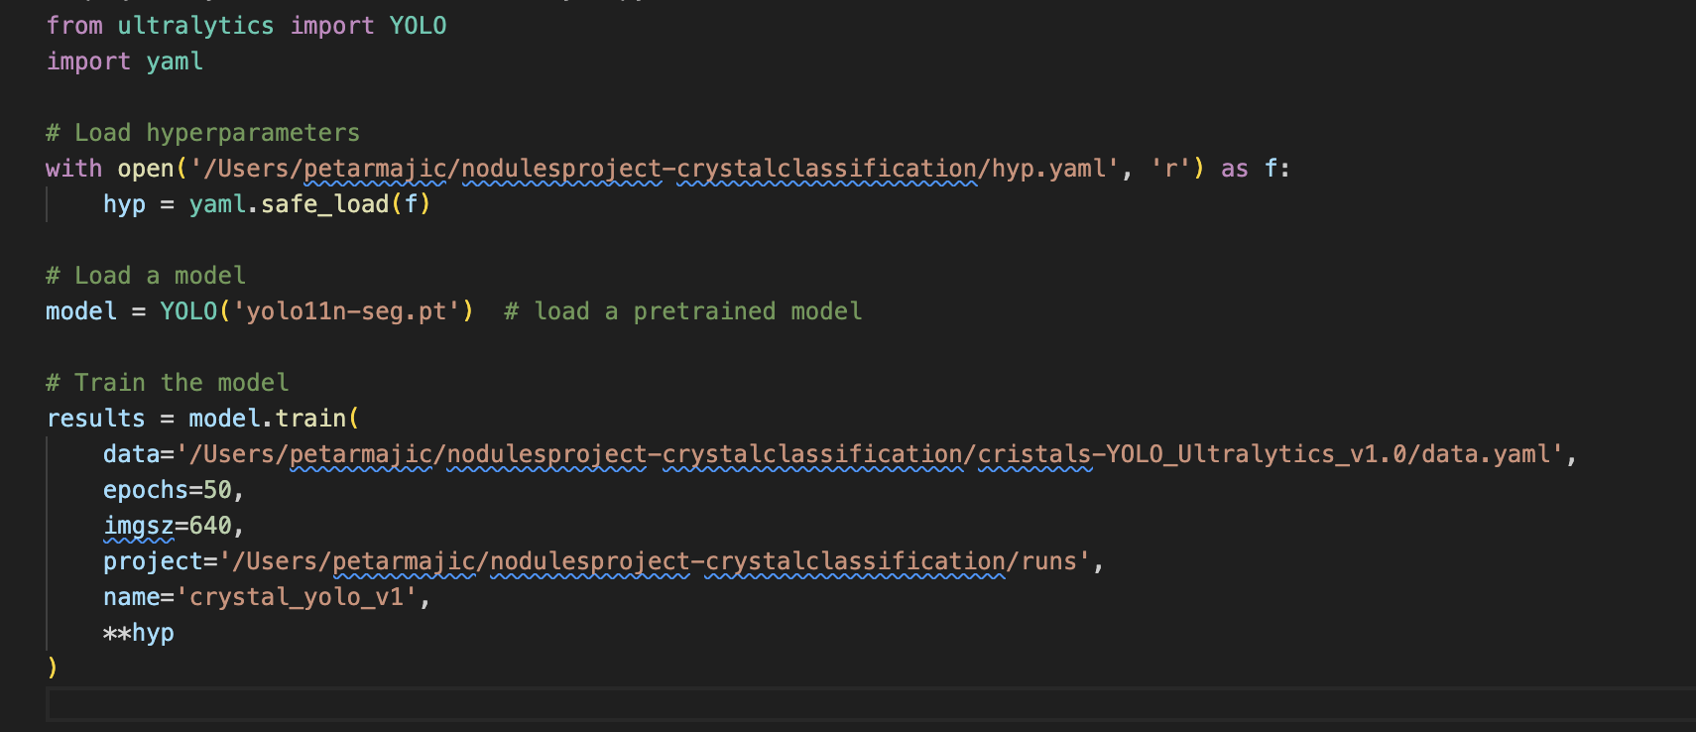
Training script

Slide 4
Images - overall
Total images: 659
Labeled images (usable for ground truth labels): 613
Unlabeled images: 46
Dataset (659)
Labeled (613)
Train set (490) – 80%
Val set
(113) – 20%
Unlabeled (46)
Test set
(46)

Slide 5
Labeled (613)
My approach
  Shuffle by random seed and split into:
    Train set – 80%
    Val set – 20%
  Randomness
  Inequality of classes in validation metrics?
    Accuracy
    Confusion matrix
Other approaches
  Stratified Split (by every folder?, what is the class of one image?)
  K-Fold Cross-Validation (K = 5, training process longer 5 times)

Slide 6
Unlabeled (46)
Only 10 classes
Is it enough?
How to cover all classes?

Slide 7
Report – analysis of experiment
2 parts
Val set
  Analysis of all metrics: accuracy, recall, confusion matrix, loss function
  observed with mathematical background and formulas
Test set
  Analysis of bounding boxes of the predicted images
  observed directly with the naked eye

