Slide 1

Analysis on Wild Fires in The USA
presented by
Peta Roberts
Alex Yee
Madhulika Gupta

Slide 2
Questions asked:
How many wild fires were there in the USA?
Which states / regions are the most prone to the wild fires?
Where were the biggest fires?
What caused the fires?

Slide 3
source:
From Karen Short, 2015. “Spatial wildfire occurrence for the United States 1992-2013 [FOA_FOD]
1.88 Million US Wildfires
kaggle.com: 24 years of geo-referenced wildfire records

Slide 4
Cleanup Procedure / Backend creation
Down load sqlite file from Kaggle.com. Couldn’t read it. Used another dbase
Pull it in pandas.
Delete extra columns.
Renamed columns.
Reduce records from 1.8m to 140,000 by using only those fires above 25 acres.
Team members created the dfs related to their own graphs
Pull the required data through app.py file.
Creating the routes and connecting them to the front end

Slide 5
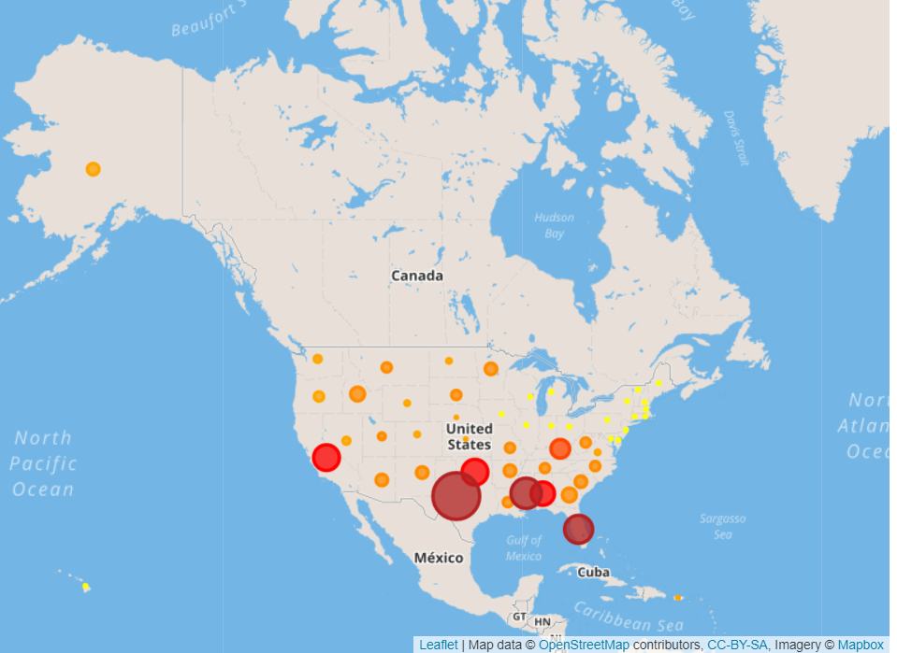
Number of Fires Per state http://127.0.0.1:5000/states

Slide 6
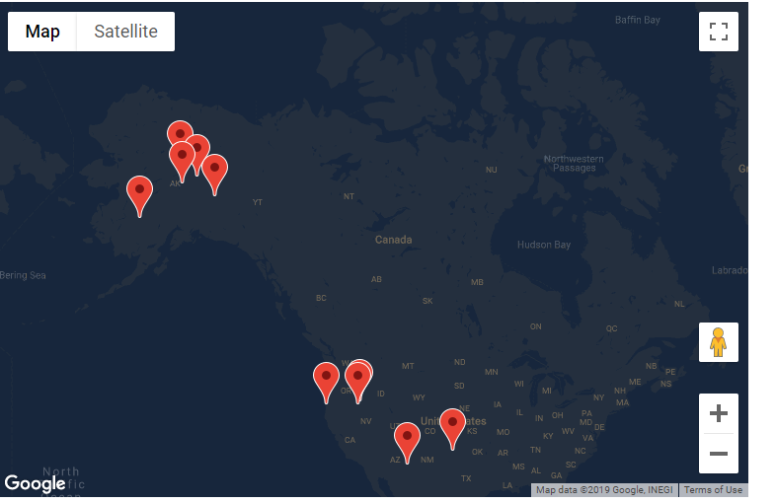
Top ten largest fires from 1993 – 2013 http://127.0.0.1:5000/topten

Slide 7
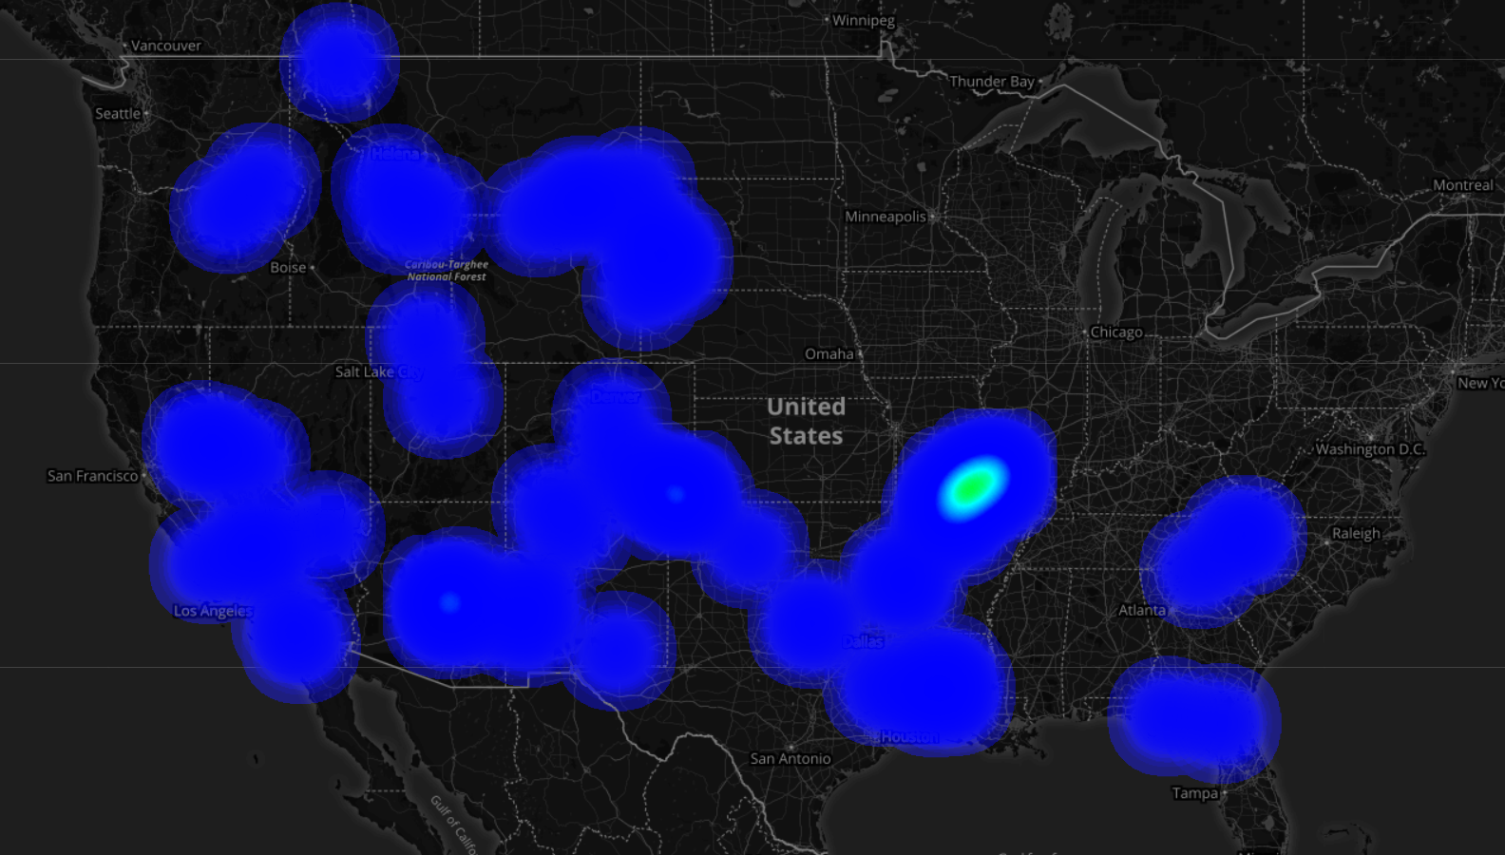
Heat Map of the regions http://127.0.0.1:5000/regions

Slide 8
Completing front end requirements
Creating webpages using the HTML
Using CSS files.
Creating a common styling for all pages through bootstrap, including the navigation bar
Mimicked the weather analysis homework to create navigatable pages
Creating maps with Leaflet / google maps

Slide 9
Technologies used:
DataBases
Sqlite
CSV files
Front End
HTML
CSS
Javascript
D3
Google Maps
Leaflet
Bootstrap
Back End
Python
Pandas

Slide 10
Analysis and conclusions
The regions most affected by the phenomenon of wildfires were in Alaska and Texas
States in the north east had less fires compared to everywhere else in the country.
The most wildfires from 1993-2013 took place in Texas.
The most severe wildfires in terms of number of acres destroyed were in Alaska.

Slide 11
Lessons Learnt
The order in which the source files are lined up in the index files matter a lot.
Initially used D3 to load in CSV data, had to import using JSON instead
Leaflet.js file is a necessity to render leaflet maps
All files in a project should be on the same version of the source files(we learnt this the hard way).
Bootstrap styling overrides all other css styling.
Huge database give you huge trouble, making the rendering of maps very slow.
Trouble learning Google Maps API

Slide 12
Thank you

