Slide 1

Ecosystem & Socioeconomic Profile (ESP):
Gulf of Alaska (GOA) Pacific Cod
Kalei Shotwell & Russel Dame,
January 2026 Director's Debrief
ESP Team and Contributors:
Anna Ableman
Alisa Abookire
Grant Adams
Steven Barbeaux
Matt Callahan
Wei Cheng
Bridget Ferriss Peter-John Hulson
Ben Laurel
Beth Matta
Krista Oke
Zack Oyafuso
Lauren Rogers
Sean Rohan
Margaret Siple
Katie Sweeney
Muyin Wang
Stephani Zador
Notes:
Thank you to all the team and contributors that worked on this report. Was a big effort during holiday time, so I really appreciate everyone's willingness to pitch in.

Slide 2
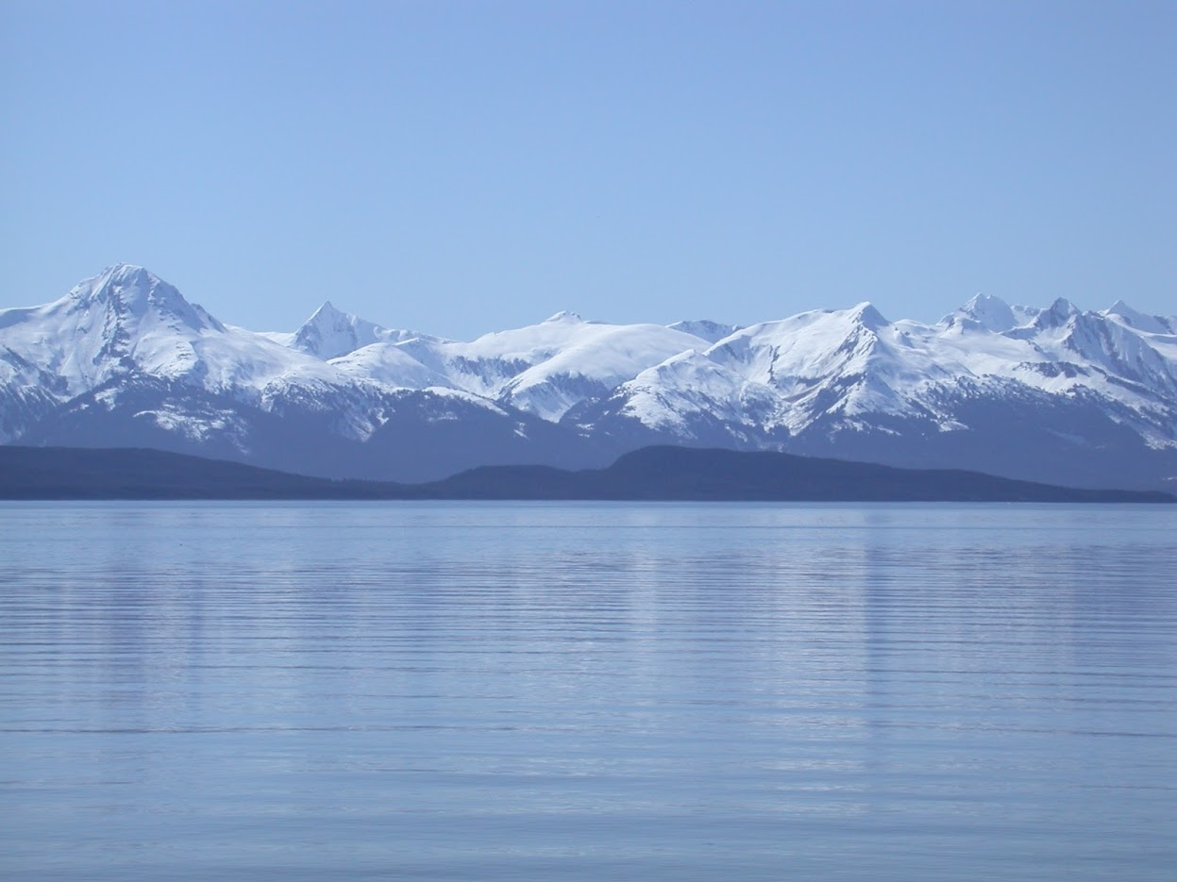
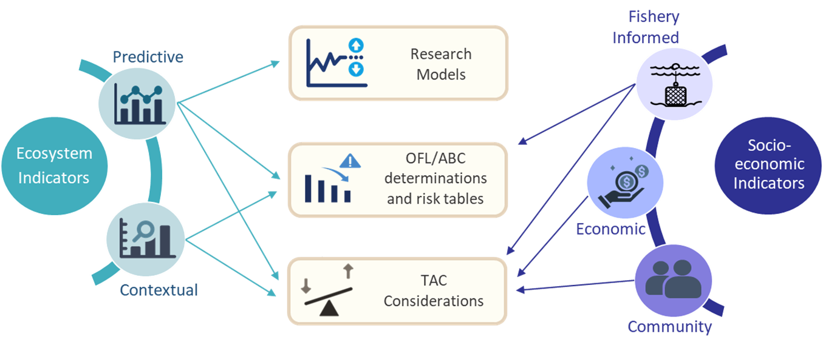
Indicator Pathways to Decisions
Notes:
Reminder that we have switched to a new conceptual framework for communicating ecosystem indicators, evaluating them as predictive and contextual where we can using a statistical analysis. This highlights important indicators and results for informing decisions. We did this with the crab ESPs in September and GPT approved for groundfish also in September.

Slide 3
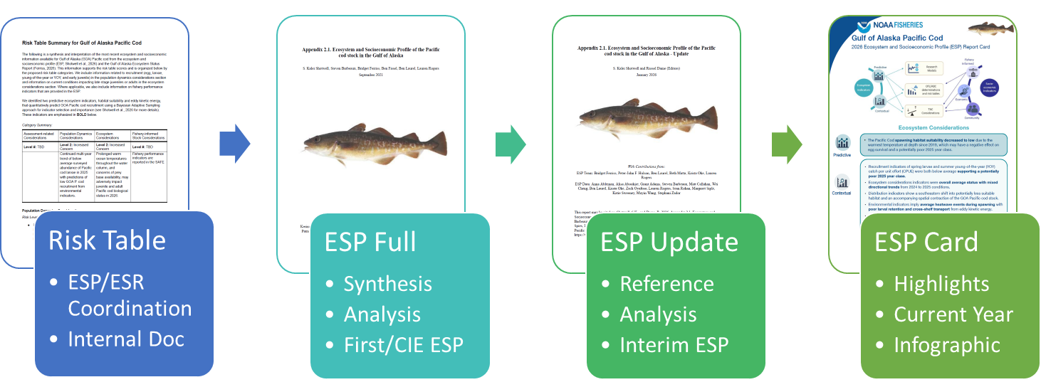
Templates for Streamlining Communication
Notes:
Along with new categories, we also improved our communication of ESP products. We've created multiple new templates to accomplish this, namely:
New risk table coordination template, which allows both the ESP and ESR editors to collaborate and provide a standardized response to authors for informing their risk tables. Used with crab stocks in September and with GOA Pcod now.
We have updated the ESP full template to match the minimum specifications from the National ESP guidance and our regional requirements
We also have a new ESP update template also following the National ESP guidance that is intended for use as a somewhat static reference document for interim ESPs when only minor changes are made to the ESP indicator suite and only the indicator analysis is re-run with new data. This is what we used for GOA Pcod this year.
Finally we have a new infographic style report card that accompanies the ESP update report and covers current year highlights. This style is meant for rapid communication in the presentations and what I'll focus on for the results of GOA Pcod ESP.

Slide 4
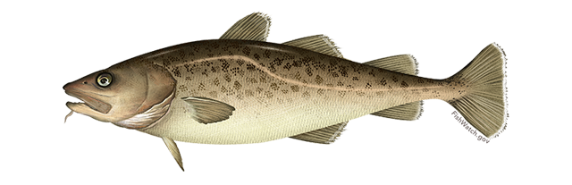
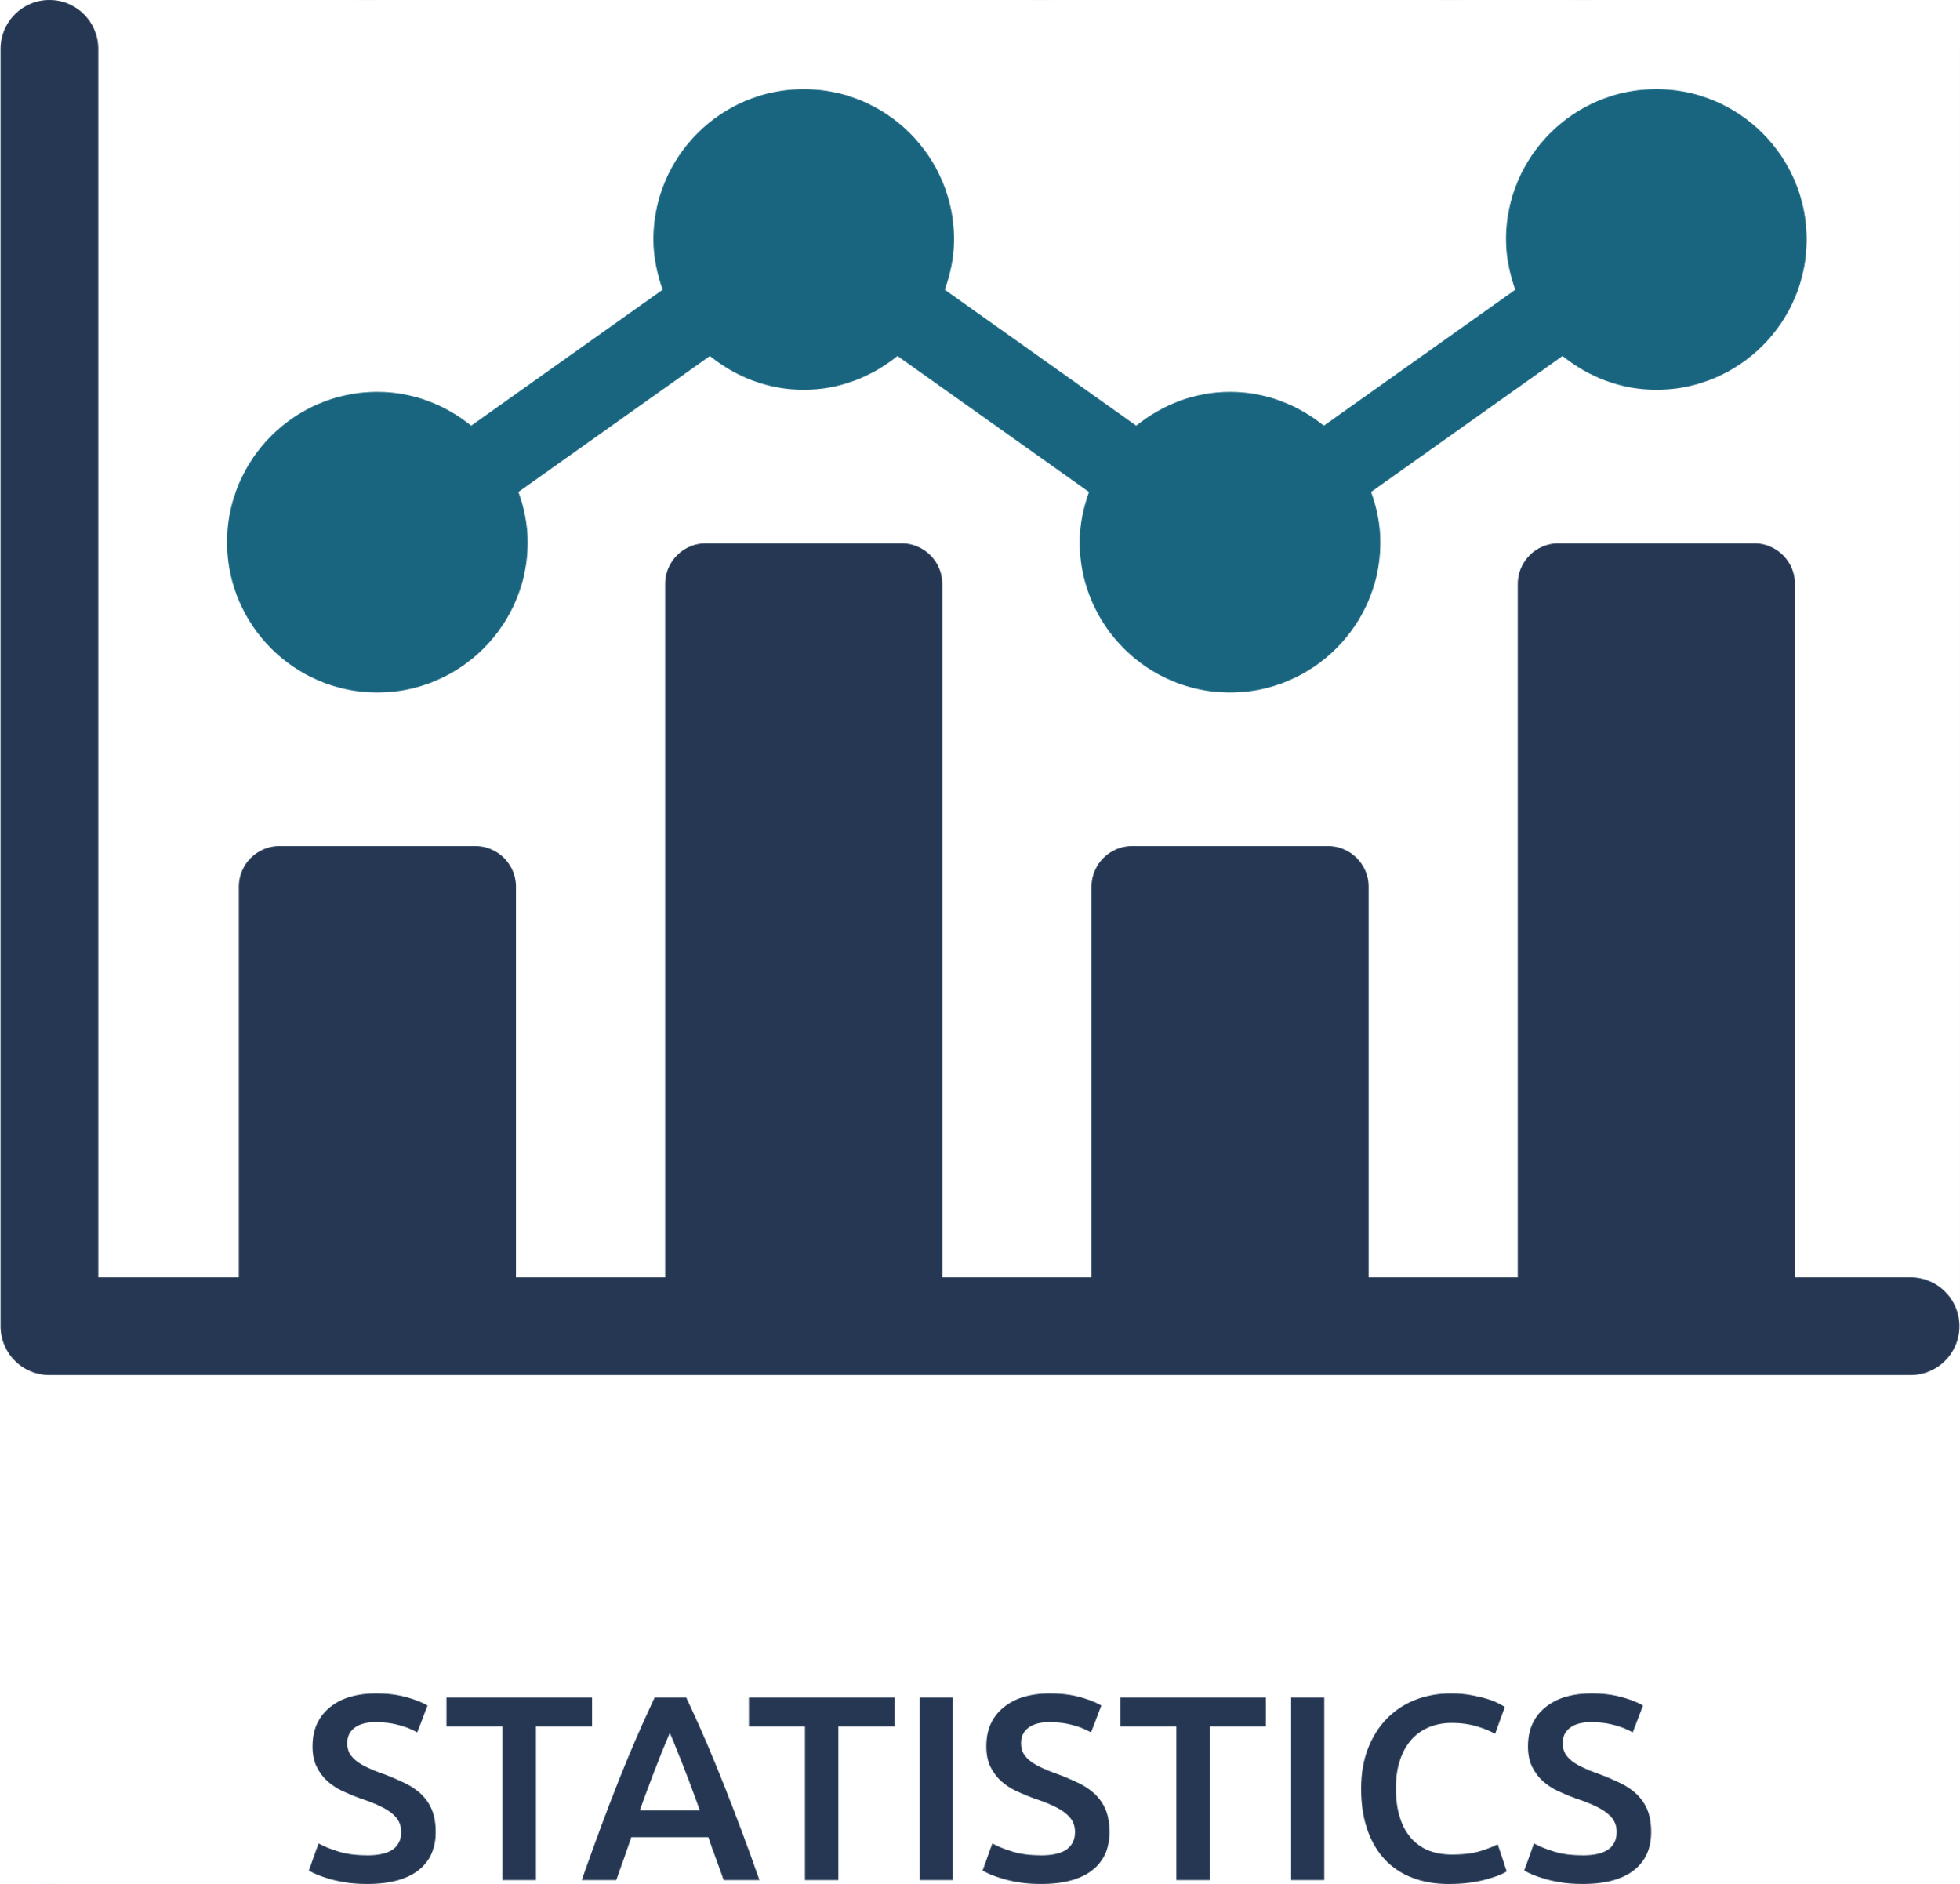
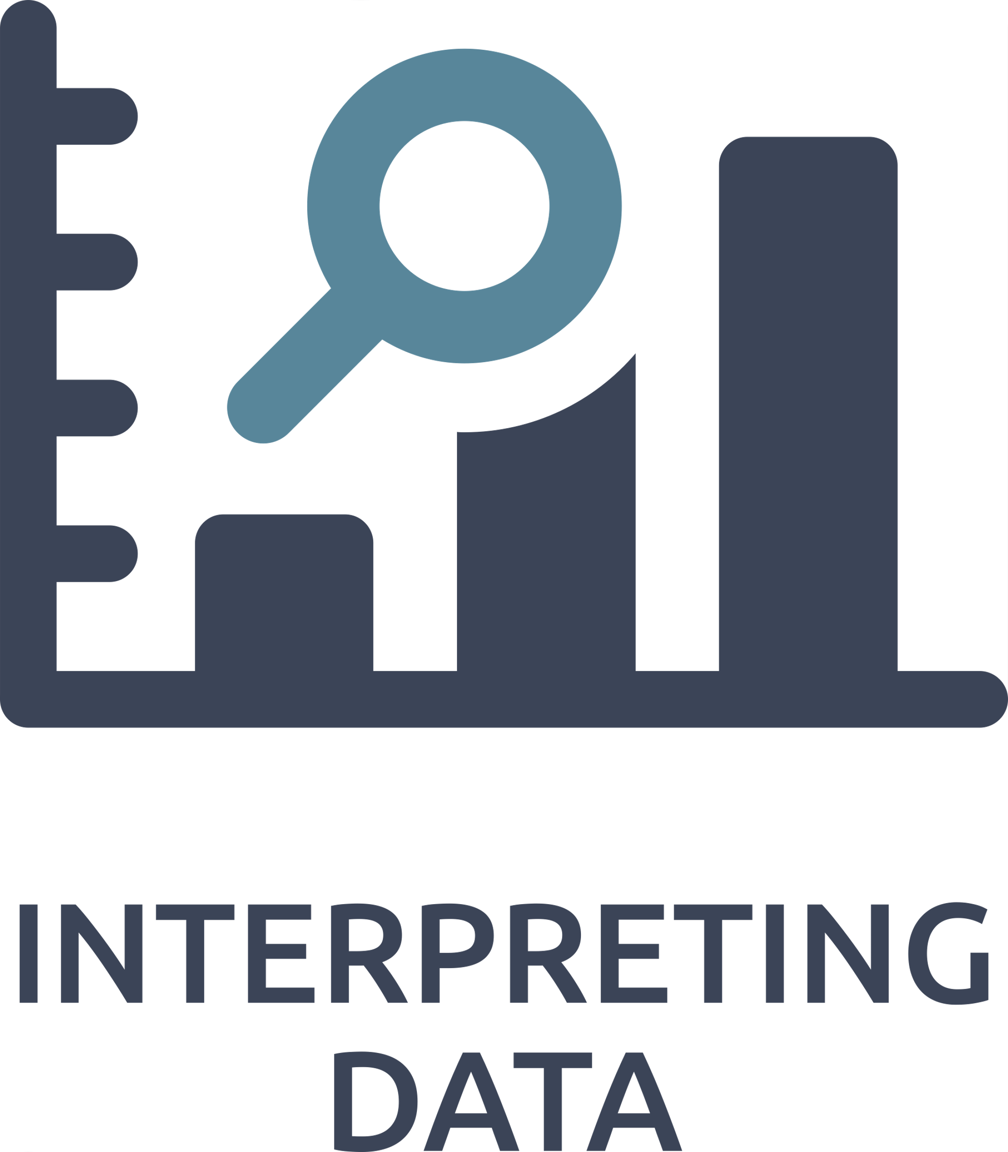
GOA Pacific Cod Report Card
Ecosystem Considerations
The Pacific Cod spawning habitat suitability decreased to low due to the warmest temperature at depth since 2019, which may have a negative effect on egg survival and a potentially poor 2025 year class.
Predictive
Recruitment indicators of spring larvae and summer young-of-the-year (YOY) catch per unit effort (CPUE) were both below average supporting a potentially poor 2025 year class.
Contextual ecosystem indicators were overall average status with mixed directional trends from 2024 to 2025 conditions.
Distribution indicators show a southeastern shift into potentially less suitable habitat and an accompanying spatial contraction of the GOA Pacific cod stock.
Environmental indicators imply average heatwave events during spawning with poor larval retention and cross-shelf transport from eddy kinetic energy.
Prey indicators show average spring bloom timing, sufficient forage resources for seabirds, but below average body condition for juvenile and adult Pacific cod and slightly increased metabolic demand.
Predator indicators were below average biomass consumed of Pacific cod based on predators in the multispecies model but a steadily increasing population of Steller sea lions in the GOA.
Contextual
Notes:
Here are the highlights of the GOA Pcod ESP Update Report. This is the front page of the report card graphic.
There was one predictive indicator based on the updated Bayesian Adaptative Sampling or BAS analysis. That's a change from last year where there was two, but one dropped out in the analysis this year. Spawning habitat suitability decreased to low due to the warmest temperature at depth since 2019. This may have a negative effect on egg survival and potentially mean a poor 2025 year class. This model fits the recruitment time series fairly well but does not capture the downward swing in the last five years.
That poor recruitment for 2025 is also supported by below average spring larvae (EcoFOCI) and summer YOY (Beach Seine) CPUE. These additional recruitment indicators were not used in the statistical analysis because they have too short or gappy time series.
The remainder of the contextual ecosystem indicators were overall average status with mixed directional trends from 2024 to 2025 conditions. These are organized into distribution, environment, prey, and predator following the ESR format.
Distribution indicators show a southeastern shift into potentially less suitable habitat and an accompanying spatial contraction of the GOA Pacific cod stock.
Environmental indicators imply average heatwave events during spawning with poor larval retention and cross-shelf transport from eddy kinetic energy.
Prey indicators show average spring bloom timing, sufficient forage resources for seabirds, but below average body condition for juvenile and adult Pacific cod and a slightly increased metabolic demand.
Predator indicators were below average biomass consumed of Pacific cod based on arrowtooth, Pacific cod, and pollock predation in the multispecies model but a steadily increasing population of Steller sea lions in the GOA.

Slide 5
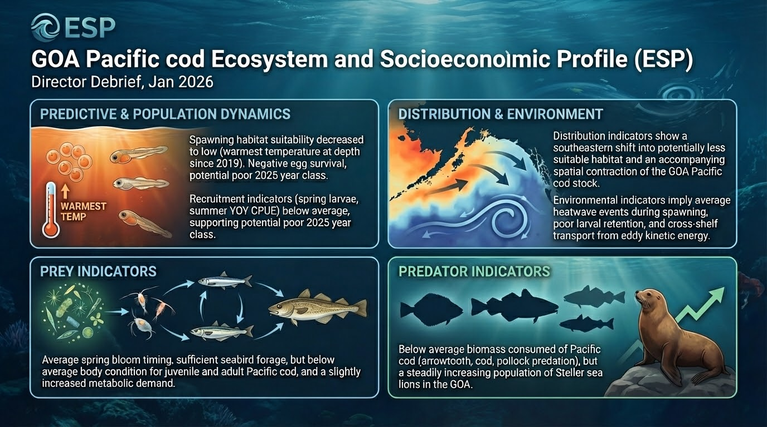
Notes:
Beautified version of previous slide, use this if only want one slide
Here are the highlights of the GOA Pcod ESP Update Report. This is the front page of the report card graphic.
There was one predictive indicator based on the updated Bayesian Adaptative Sampling or BAS analysis. That's a change from last year where there was two, but one dropped out in the analysis this year. Spawning habitat suitability decreased to low due to the warmest temperature at depth since 2019. This may have a negative effect on egg survival and potentially mean a poor 2025 year class. This model fits the recruitment time series fairly well but does not capture the downward swing in the last five years.
That poor recruitment for 2025 is also supported by below average spring larvae (EcoFOCI) and summer YOY (Beach Seine) CPUE. These additional recruitment indicators were not used in the statistical analysis because they have too short or gappy time series.
The remainder of the contextual ecosystem indicators were overall average status with mixed directional trends from 2024 to 2025 conditions. These are organized into distribution, environment, prey, and predator following the ESR format.
Distribution indicators show a southeastern shift into potentially less suitable habitat and an accompanying spatial contraction of the GOA Pacific cod stock.
Environmental indicators imply average heatwave events during spawning with poor larval retention and cross-shelf transport from eddy kinetic energy.
Prey indicators show average spring bloom timing, sufficient forage resources for seabirds, but below average body condition for juvenile and adult Pacific cod and a slightly increased metabolic demand.
Predator indicators were below average biomass consumed of Pacific cod based on arrowtooth, Pacific cod, and pollock predation in the multispecies model but a steadily increasing population of Steller sea lions in the GOA.

