Slide 1
2023 Pcod assessment
September 2023 Plan Team

Slide 2
Overview
Housecleaning (minsamplesize)
Environmental link
Description of environmental index
Link for growth
Individual parameters: determining index
Combined preferred model
Comparisons with base model
Link for LL survey q
Retrospective comparison w/ and w/o link
Evaluation of new index

Slide 3
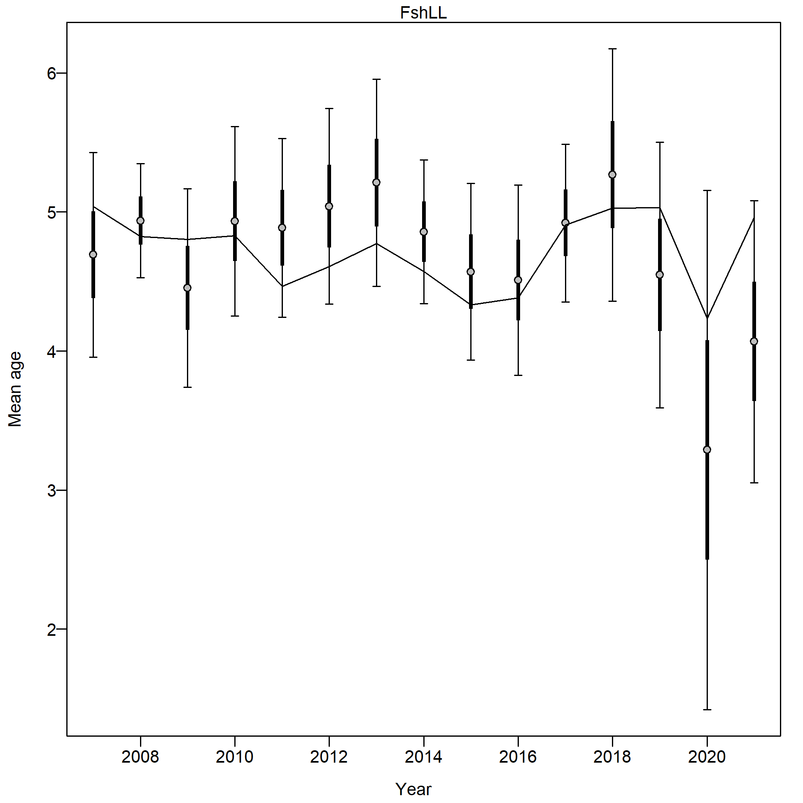
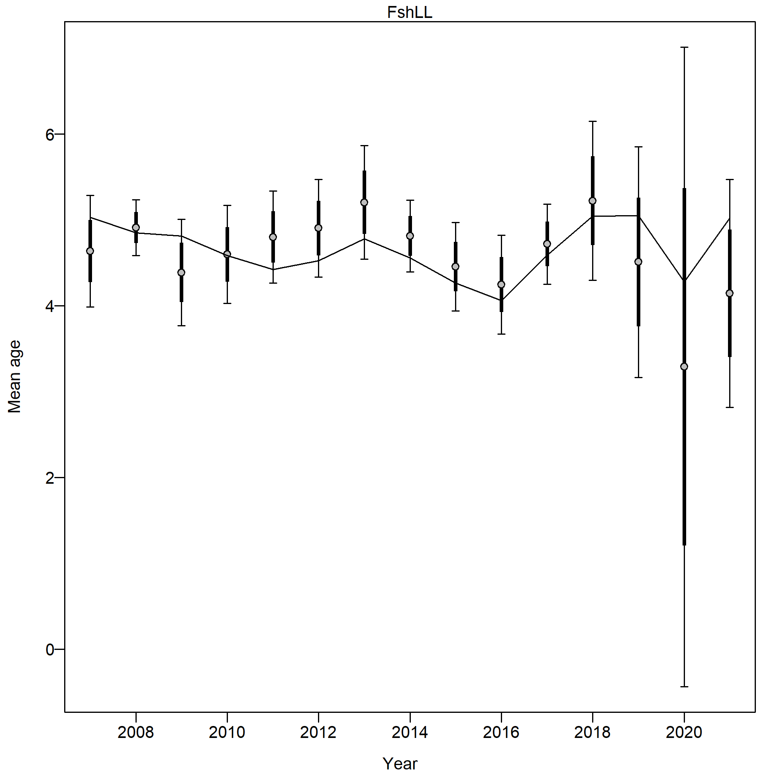
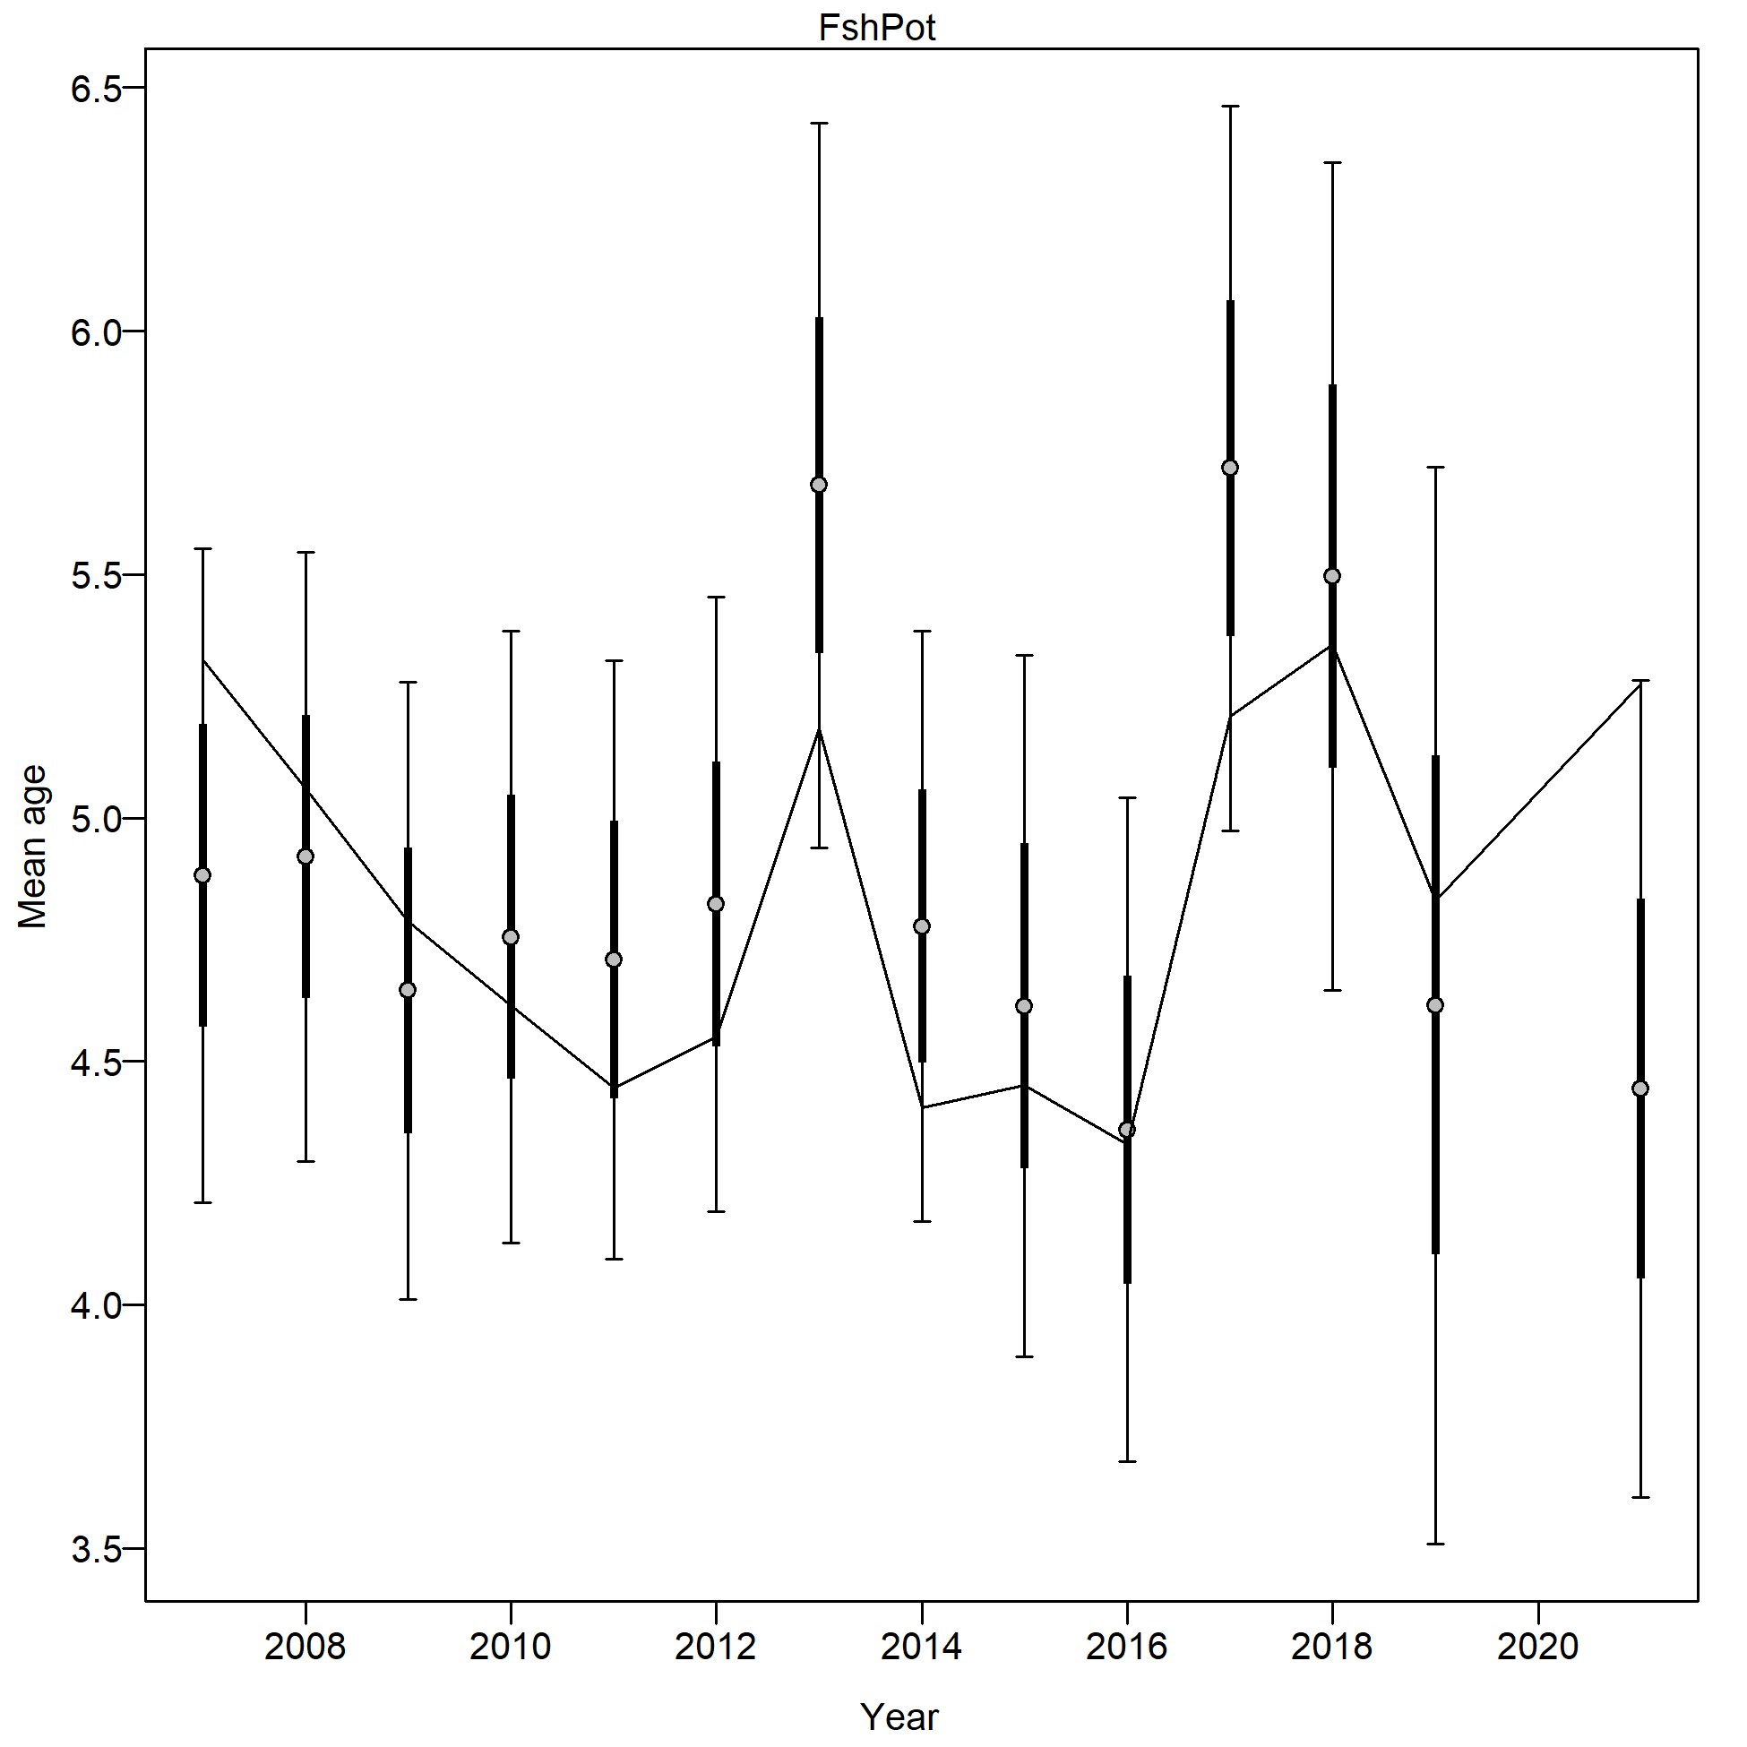
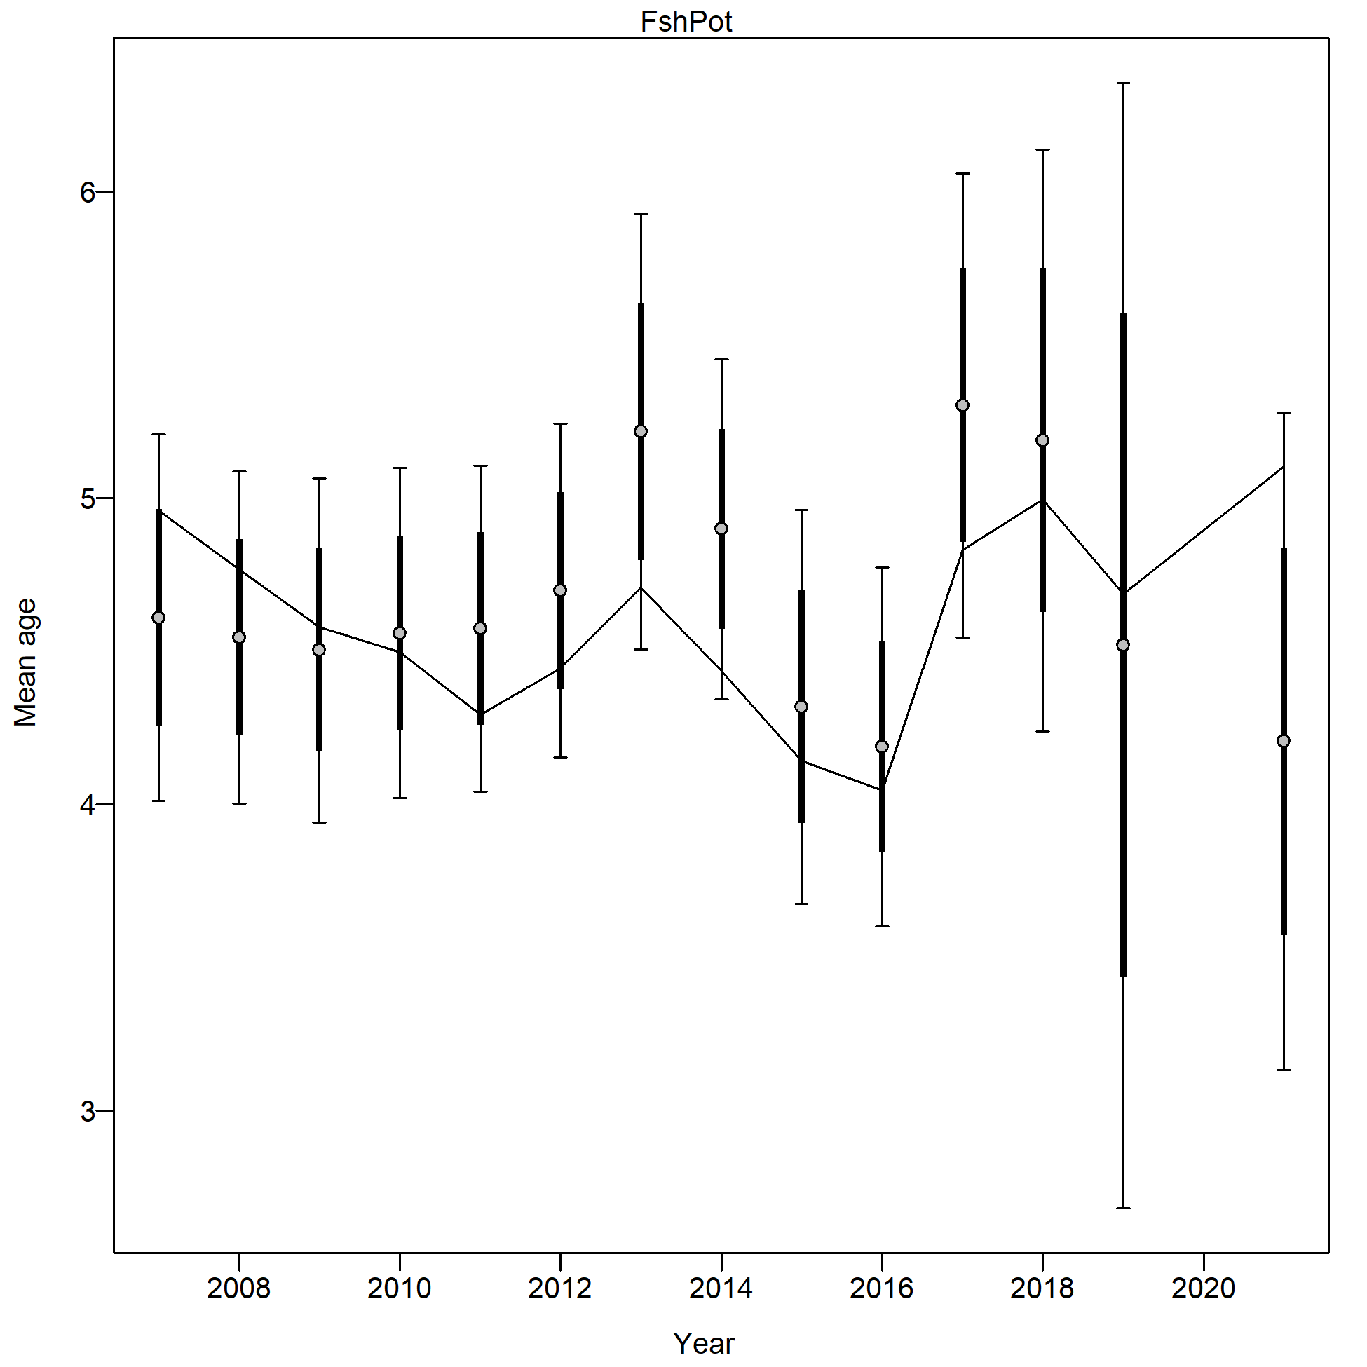
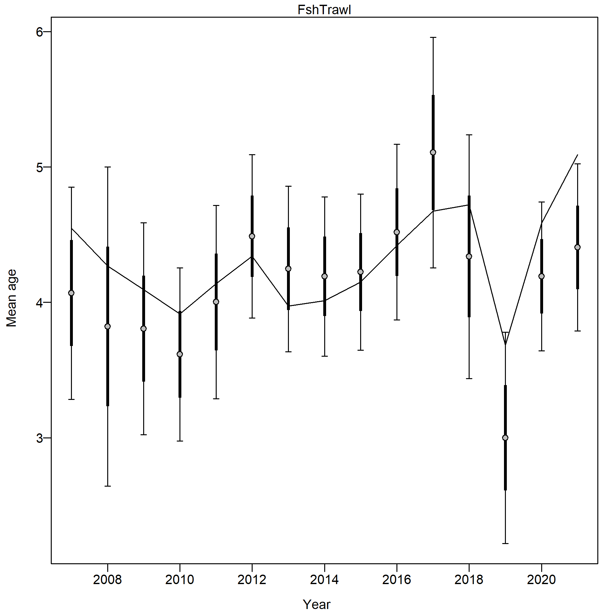
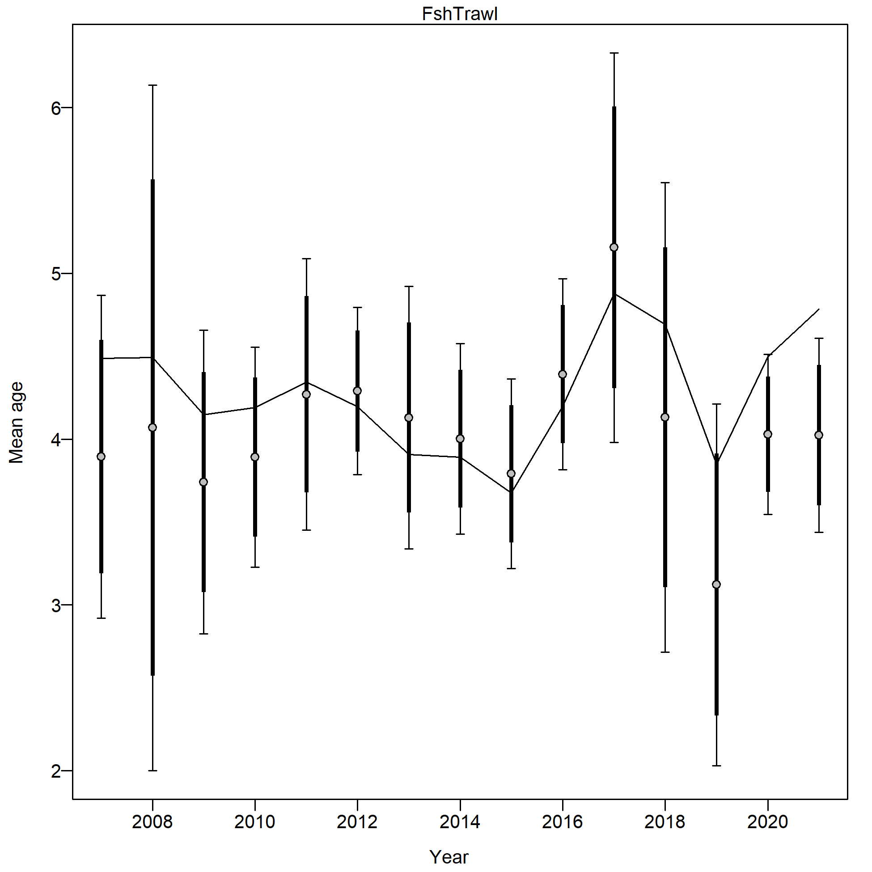
Housecleaning:
2019.1a
2019.1b
Minsample size issue
Likelihoods

Slide 4
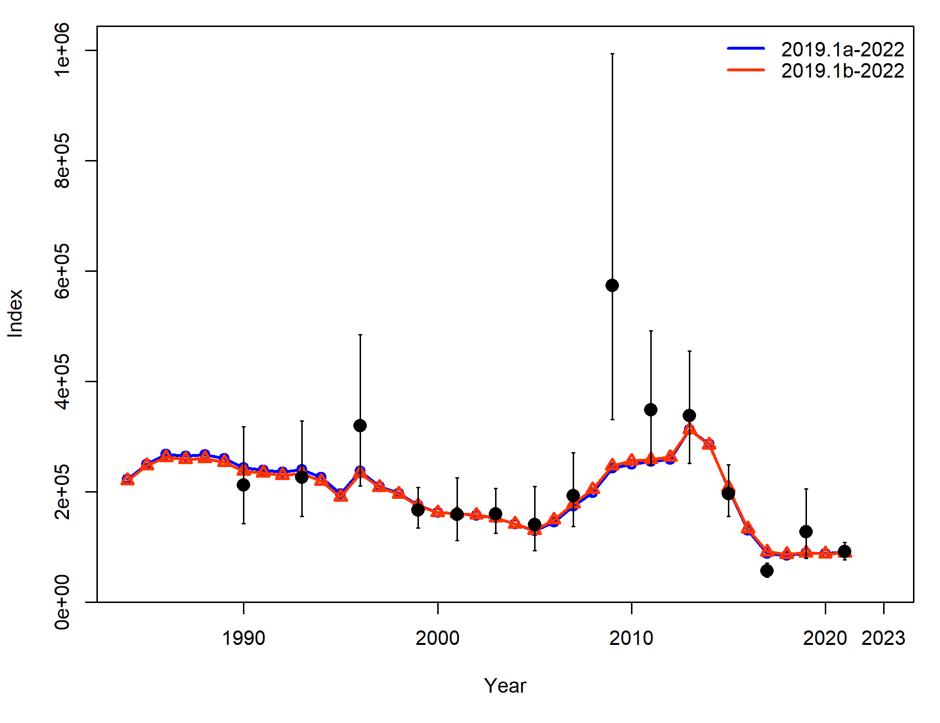
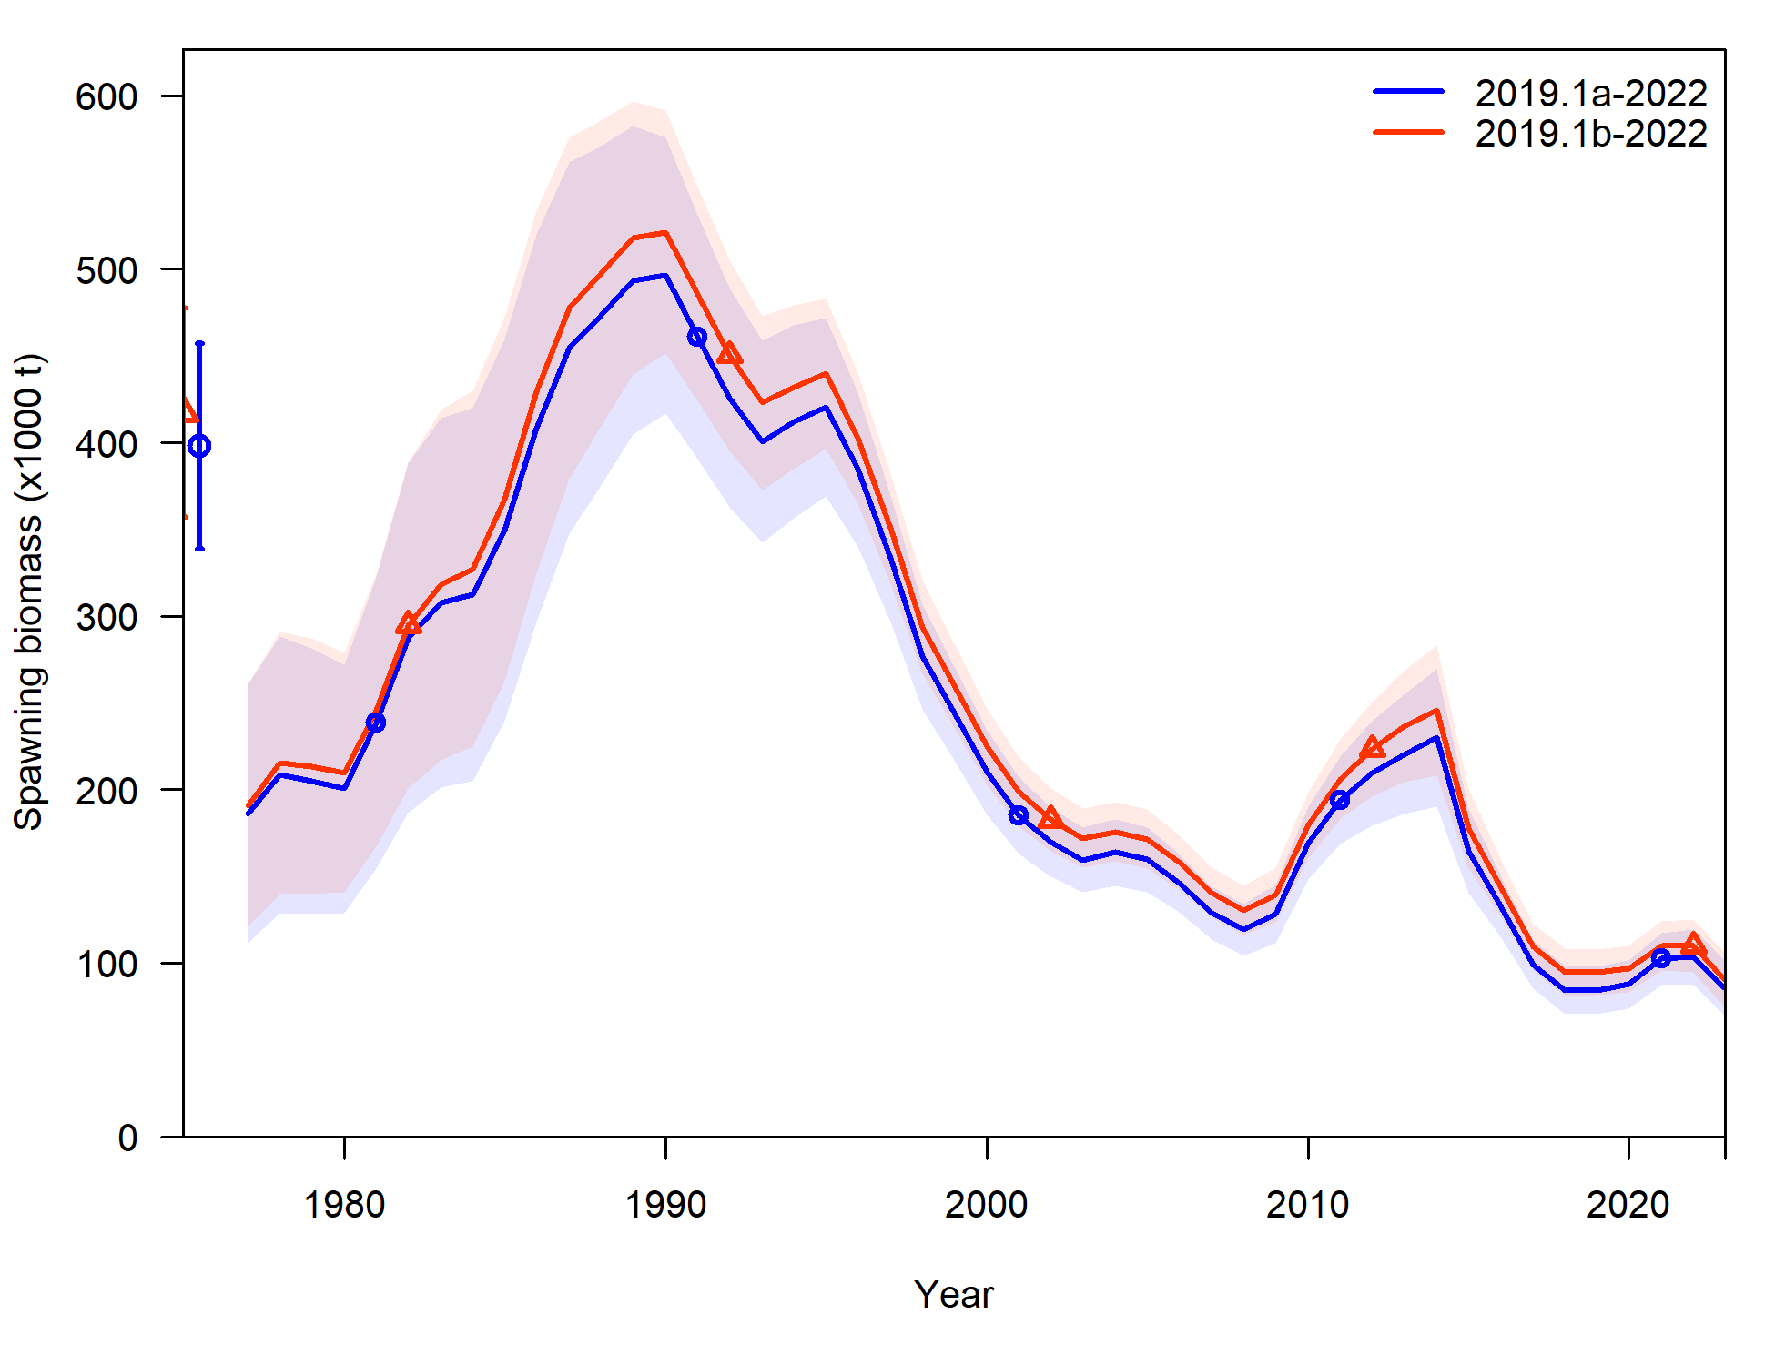
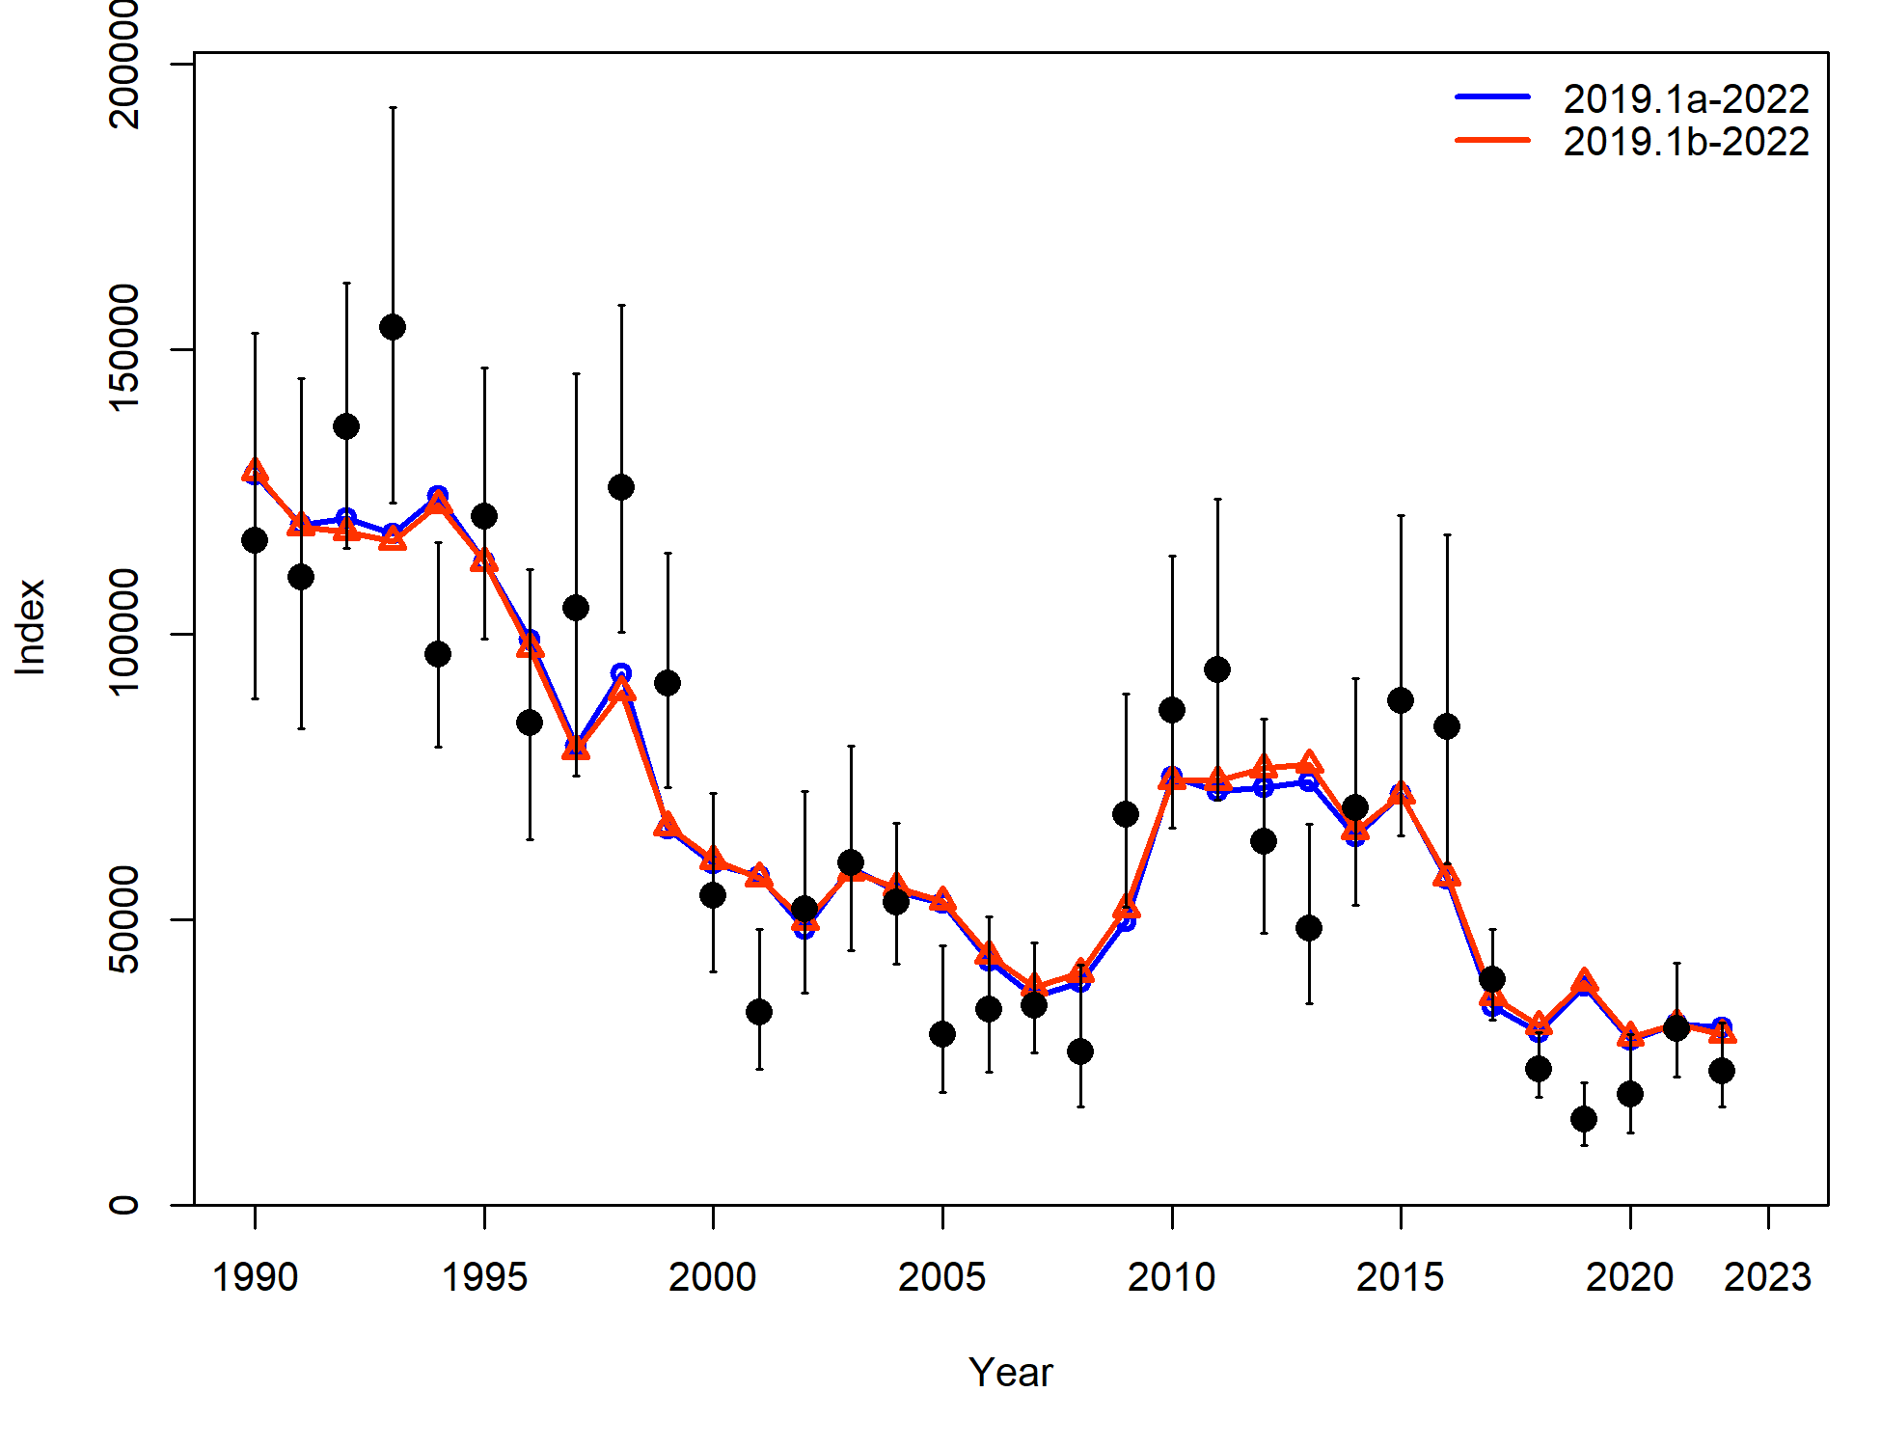
Housecleaning
Minsample size issue
This is new base model from here out

Slide 5
Environmental link
Description of cfsr
Available by length bin and month

Slide 6
Link for growth
Step 1:
Evaluated Linf and kappa across length bin and month
Evaluated Lzero across month for 0-20 cm length bin
Step 2:
Select best from Step 1, and run model with env link for all 3 growth parameters
Step 3:
Compare with base model
Statistics: current year AIC and model fits, retrospective AIC and performance

Slide 7
Link for growth
Step 1: difference in AIC with base model (EnvLnk – base, so negative number means EnvLnk model better)
Linf > Lzero > kappa for model improvement

Slide 8
Link for growth
Step 2: AIC & likelihoods

Slide 9
Link for growth
Step 2: Retrospective AIC
Mohns rho: 2019.1b = -0.073, 2023.1 = -0.022

