Slide 1


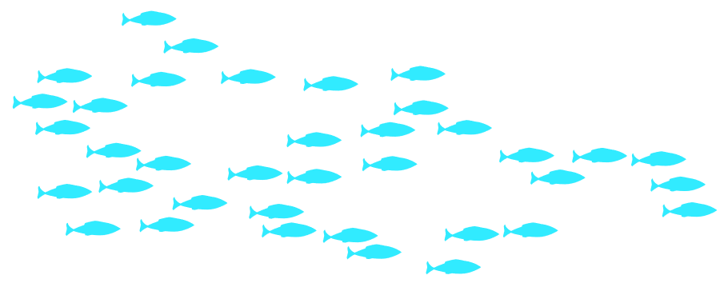
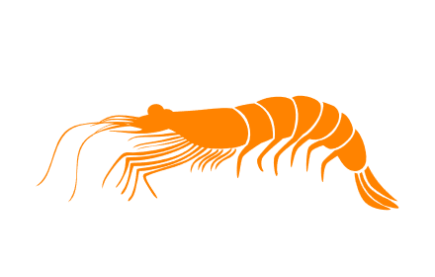
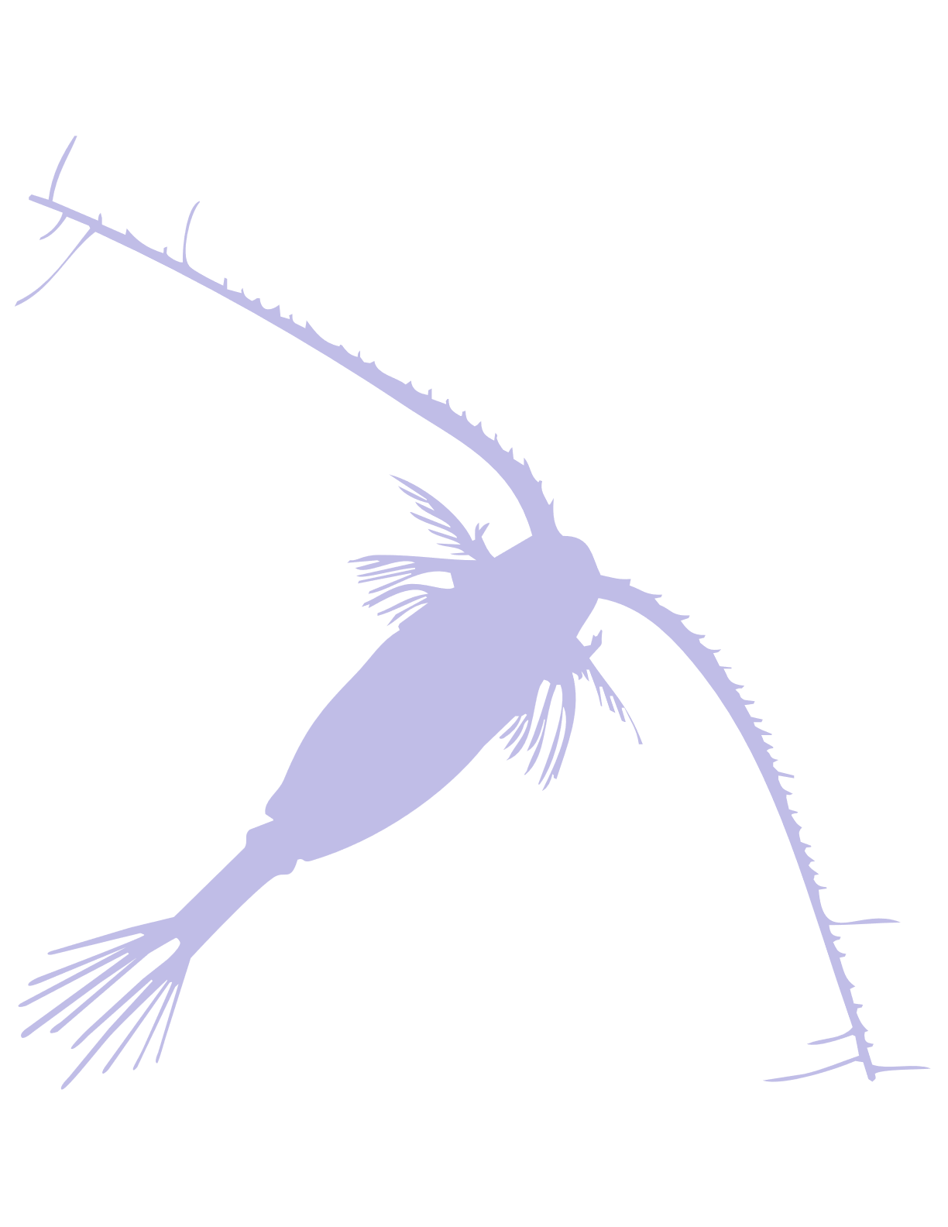



Ecosystem Status Report: Gulf of Alaska 2025
Bridget Ferriss
Alaska Fisheries Science Center, NOAA Fisheries
[full ESR attached to e-agenda: list of contributors p.1; Ecosystem Assessment p.4]
1. Warm at surface and depth, winter, spring and fall
[winter spawning; egg/larval survival; incr. demand for prey]
2. Similarities to 2014-2016 in reduced lower trophic level productivity
[less productive food web to directly and indirectly support cod prey]
3. Mixed upper trophic & ecosystem metrics
[cod body condition below average but some prey base and upper trophic indicators ok]
4. Cooling in 2026 but concerns of residual heat & cumulative ecosystem effects
[elevated concerns of cumulative ecosystem response to warm year]
Notes:
The Gulf of Alaska Ecosystem Status Report for 2025 was used to inform the GOA Pacific cod risk table. The full report is attached to the Council’s e-agenda.
In summary, 2025 Gulf of Alaska had warm water at the surface, at the depth on the shelf and offshore, through most of the seasons except a cooling at the surface in the summer – different this year was the warm water at depth (shelf bottom) persisting throughout the year (similar to 2015 temperatures).
There were signs of reduced lower trophic level production, similar to observations at the beginning of the 2014-2016 marine heatwave
Fewer signs of warm water impacts were observed in higher trophic levels, (different from the marine heatwave period)
2026 is predicted to experience average to cooler sea surface temperatures in the winter/spring
BUT there are concerns of residual heat in the GOA system that could lead to cumulative ecosystem effects in the marine ecosystem with potentially challenging environmental conditions for cod in 2026.

