Slide 1
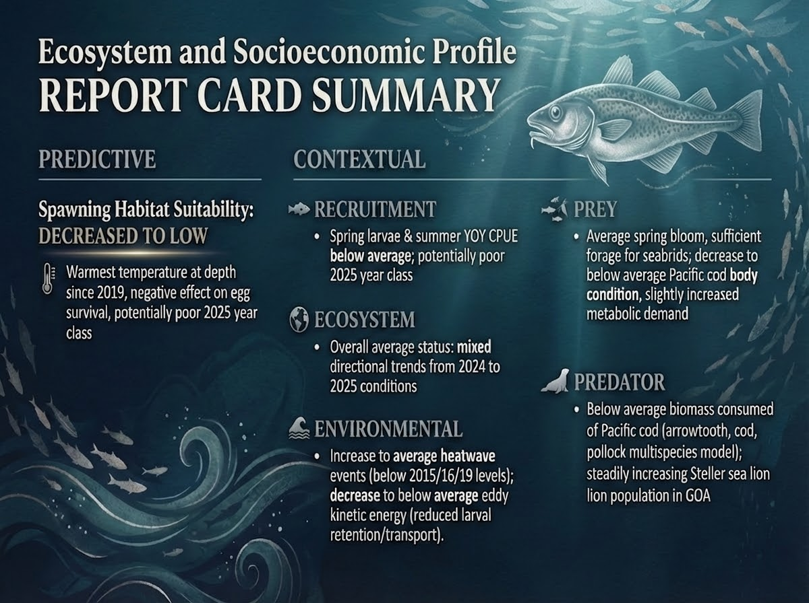
Notes:
This is a report card summary slide of the Ecosystem and Socioeconomic Profile or ESP for Pacific cod.
The suite of 18 ecosystem indicators from the ESP was categorized into predictive and contextual indicators based on the results of a statistical analysis. Just going to focus on the predictive indicator and some contextual indicators that are later referenced in the risk table.
This year the predictive indicator of Pacific cod recruitment was Spawning Habitat Suitability which decreased to a low status (below 1 standard dev of the long term mean) due to the warmest temperature at depth since 2019. The trend has been decreasing since 2022 and this may have a negative effect on egg survival and potentially mean a poor 2025 year class.
The poor 2025 year class was also supported by other contextual recruitment indicators of spring larvae from the EcoFOCI survey in Shelikof and summer young-of-the-year (YOY) catch per unit effort (CPUE) from the beach seine survey in the central GOA. Both were below average but not as low as in 2015, 16, and 19. The larval indicator has also been below average for the past decade and the YOY indicator has been below average for the past three years, but it did show signs of above average year classes in 2020 and 2022.
Other contextual environmental indicators imply average heatwave events during spawning with poor larval retention and cross-shelf transport from eddy kinetic energy.
Finally, contextual prey indicators that we monitor suggested sufficient forage, but body condition for juveniles has been below average since 2021 and there was a decreasing trend since 2019 to a current status of below average body condition for adults.
<Optional if asked> Please note that we did not cover the socioeconomic part of the ESP in this talk although the indicators are still included in the report. This was partly because only economic indicators are currently reported for the GOA Pacific cod ESP and they are lagged by one year and also because we are waiting for feedback from the Council discussion regarding what socioeconomic indicators should be included in an ESP. Happy to take any suggestions though.

