Slide 1
2023 GOA Pcod assessment
September 2023 Plan Team

Slide 2
Overview
Housecleaning (CAAL minimum sample size)
Review of environmental link
Refresher on CFSR
Link for Longline survey catchability
Retrospective comparison w/ and w/o environmental link (PT request)
Revaluation of CFSR index
Link for growth
Individual growth parameters: determining most appropriate CFSR index
Combined growth model & comparison with base model
Path forward
Recommendations for November 2023

Slide 3
Housecleaning:
Minimum sample size issue
Historical assessments removed CAAL data with minimum sample size less than 1 (i.e., weight)
1,812 of 2,825 (64%) CAAL length-age data removed
Model 2019.1b corrects minimum sample size so all CAAL data included

Slide 4
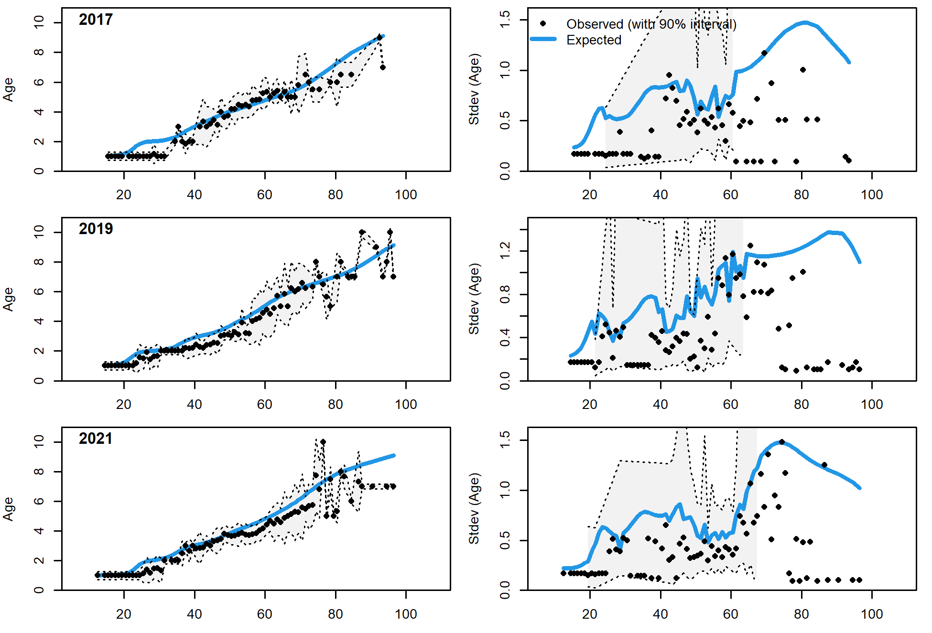
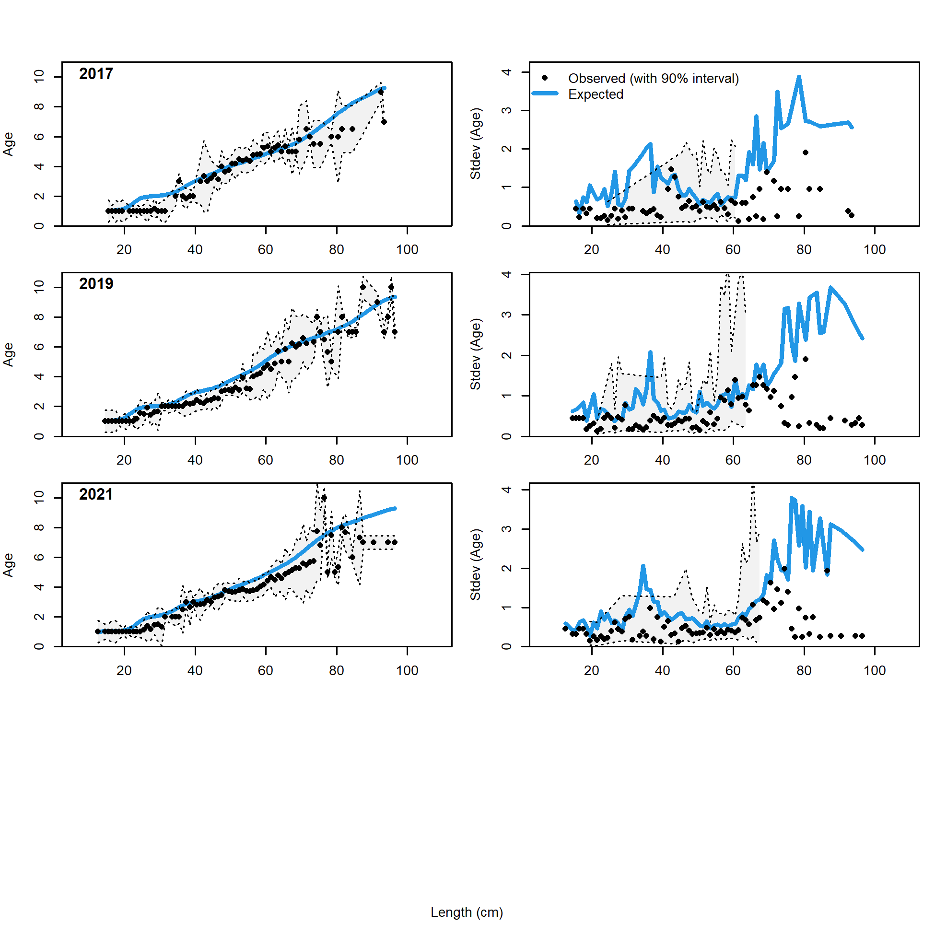
Housecleaning:
2019.1a (recent trawl survey)
Likelihoods & Fits
2019.1b

Slide 5
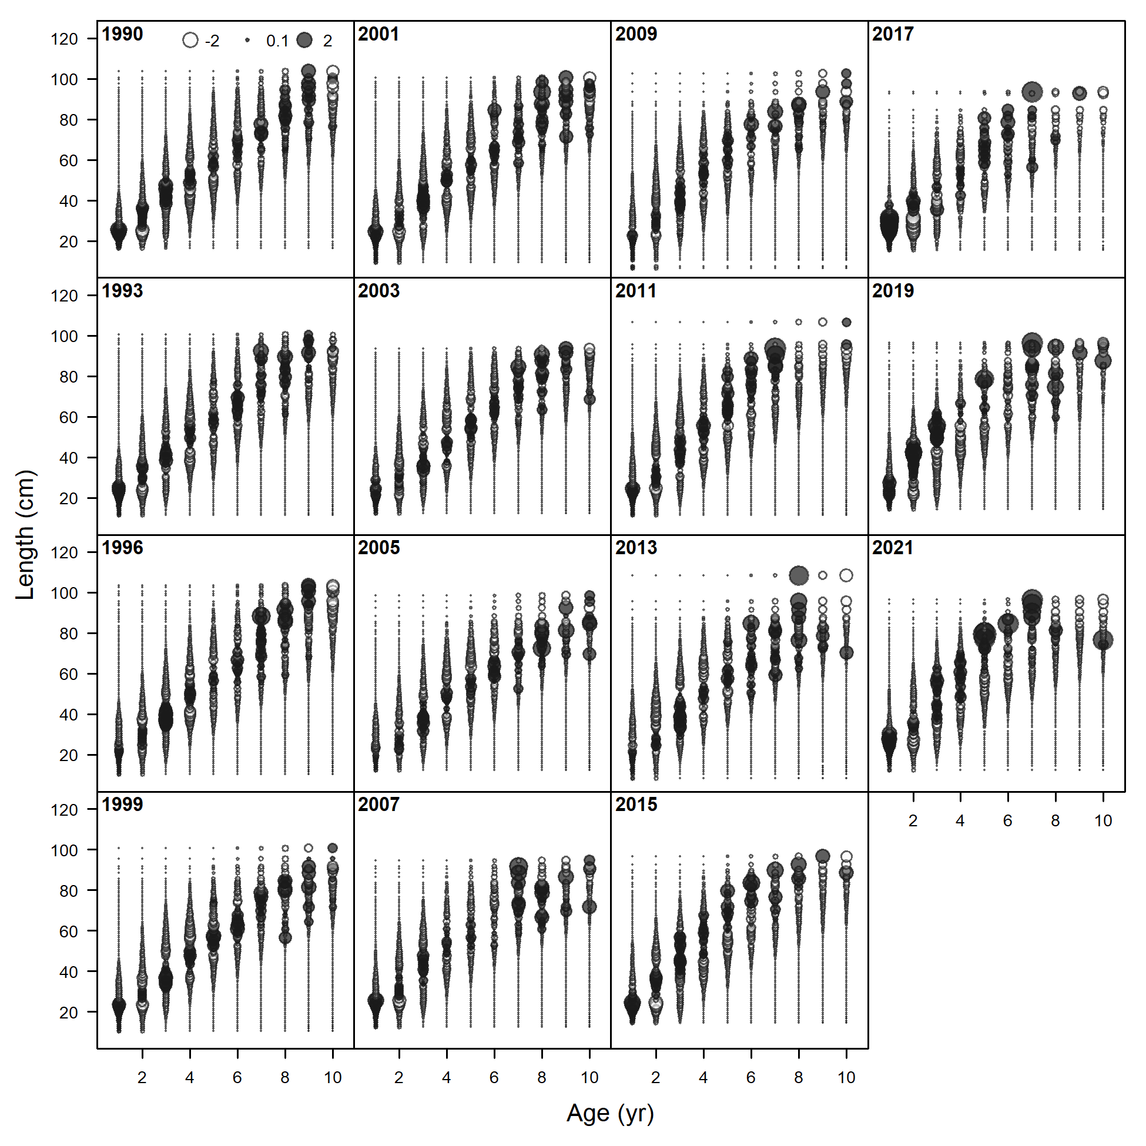
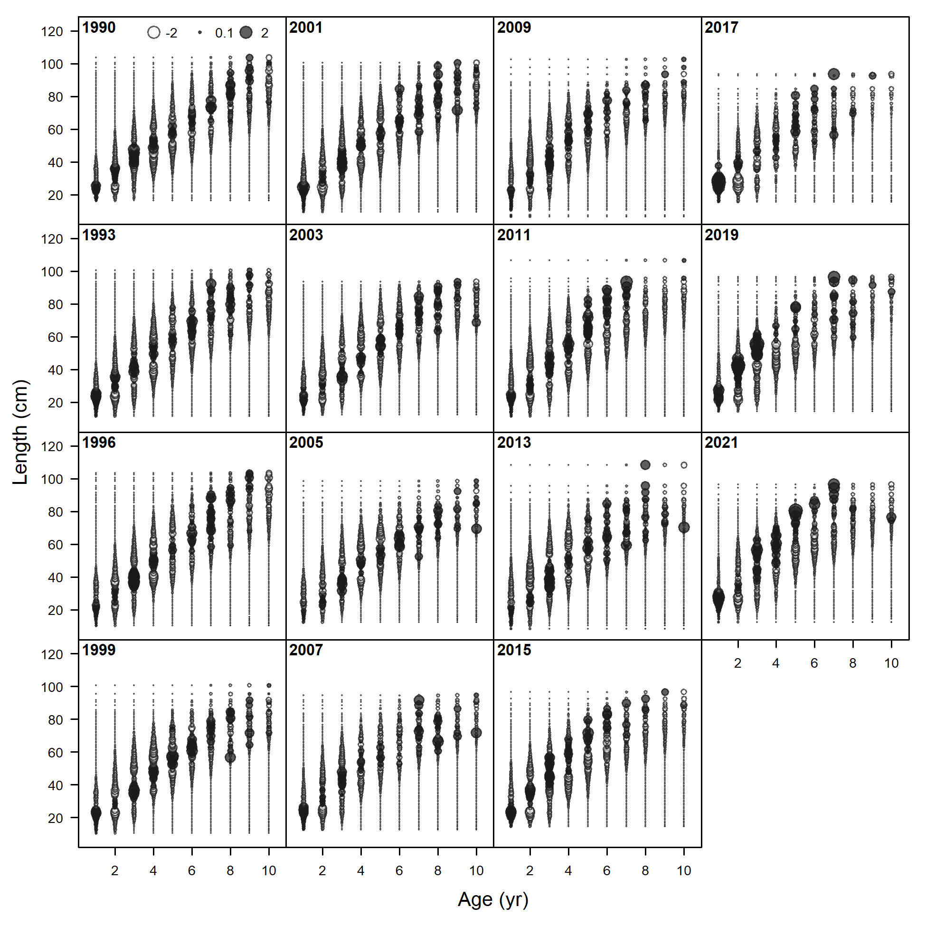
Housecleaning:
Pearson resids: trawl survey
2019.1a
2019.1b

Slide 6
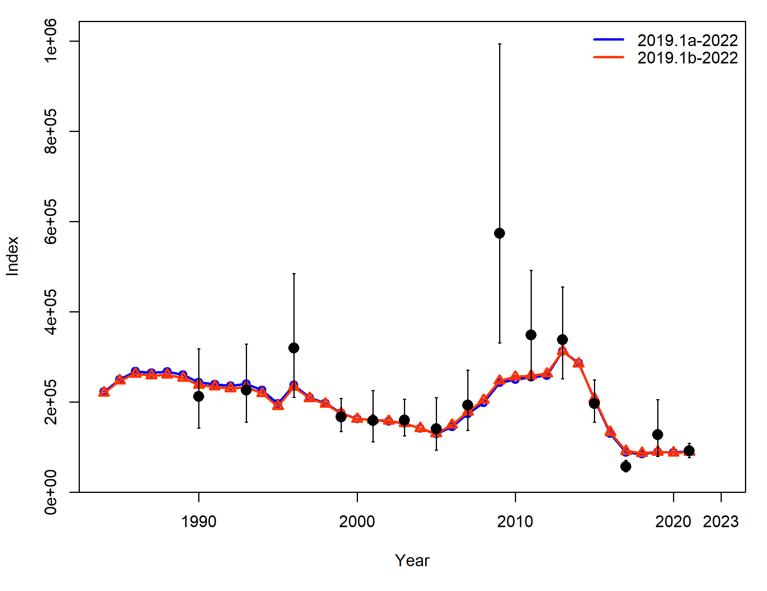
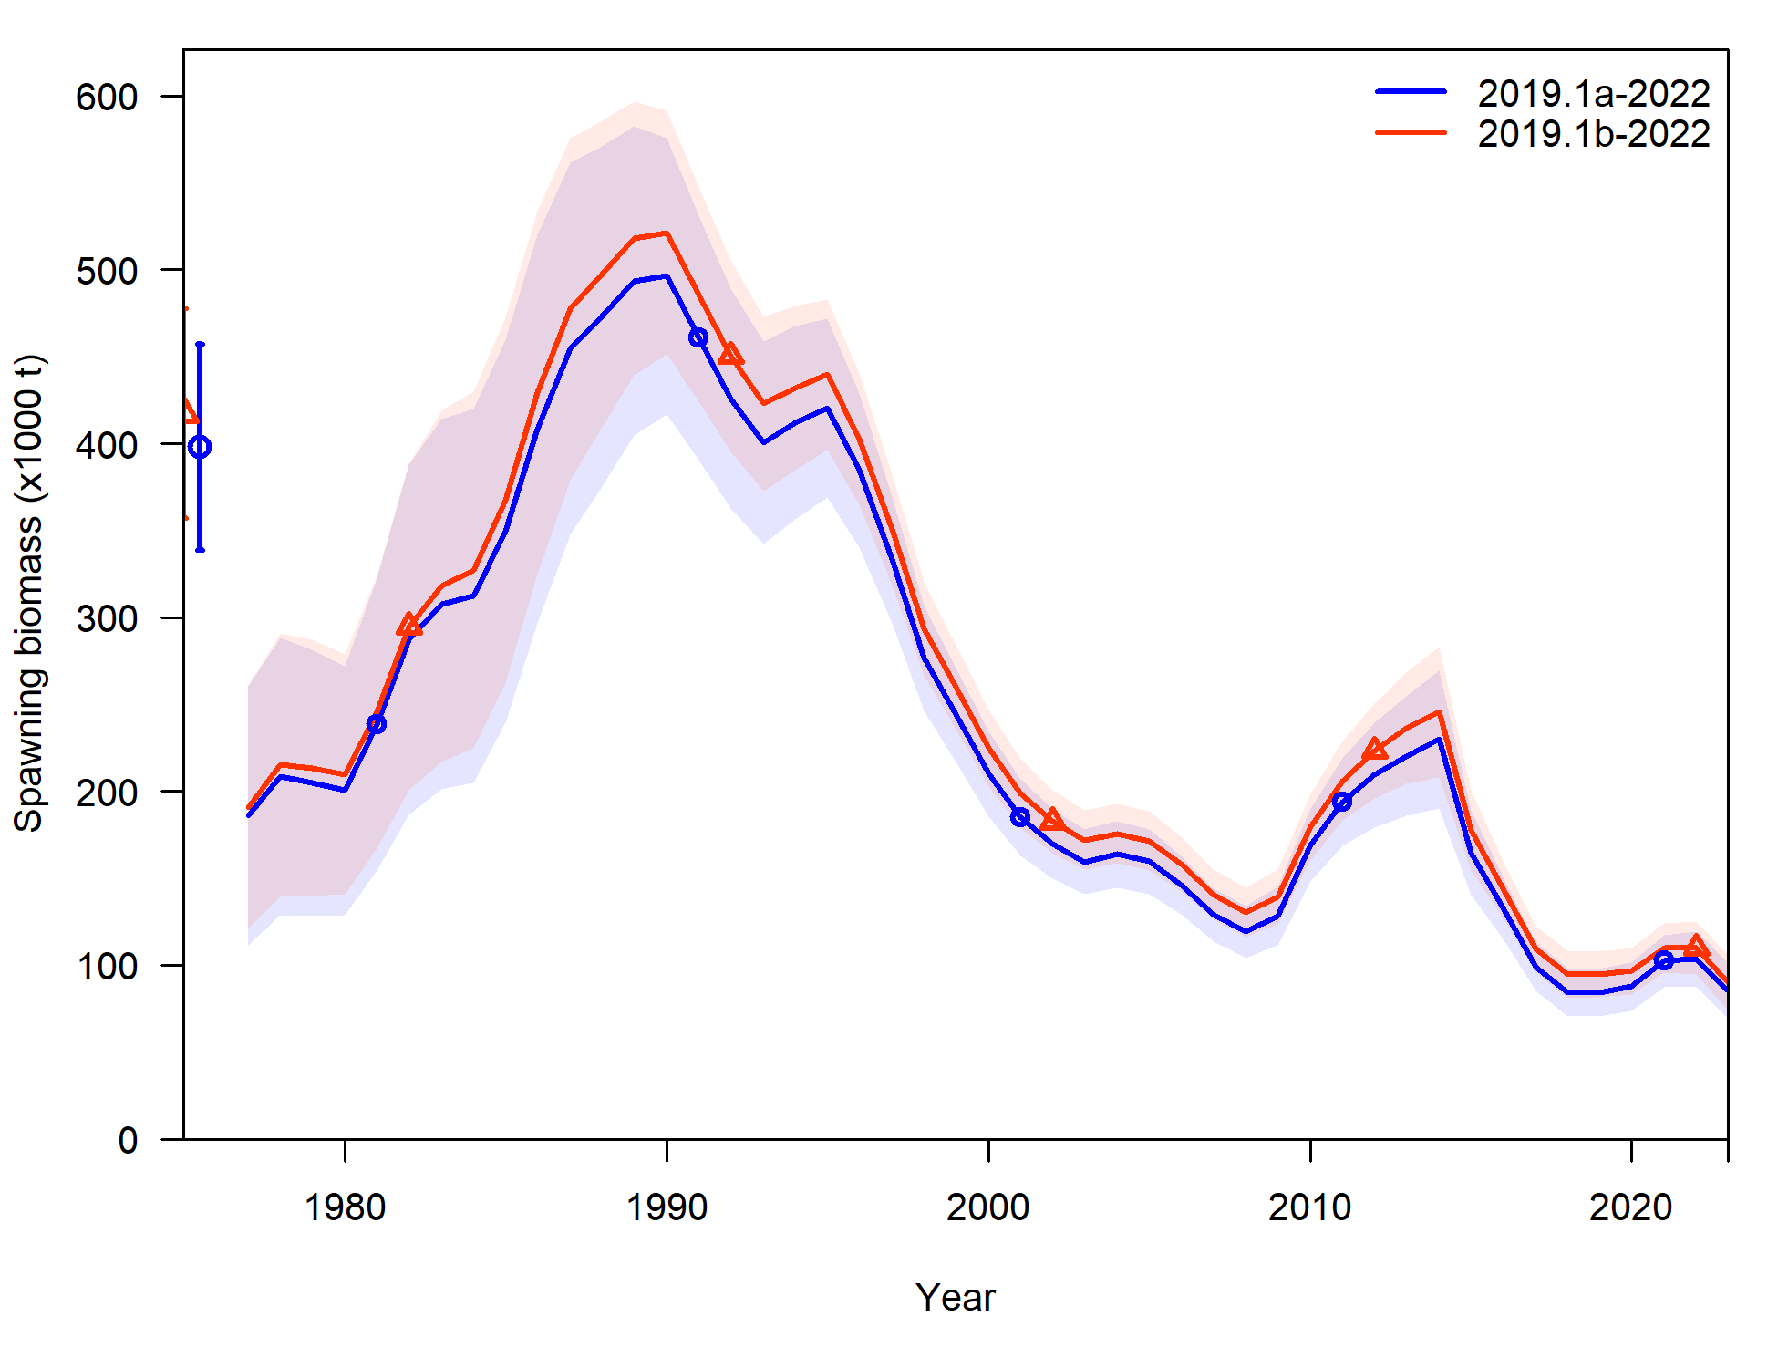
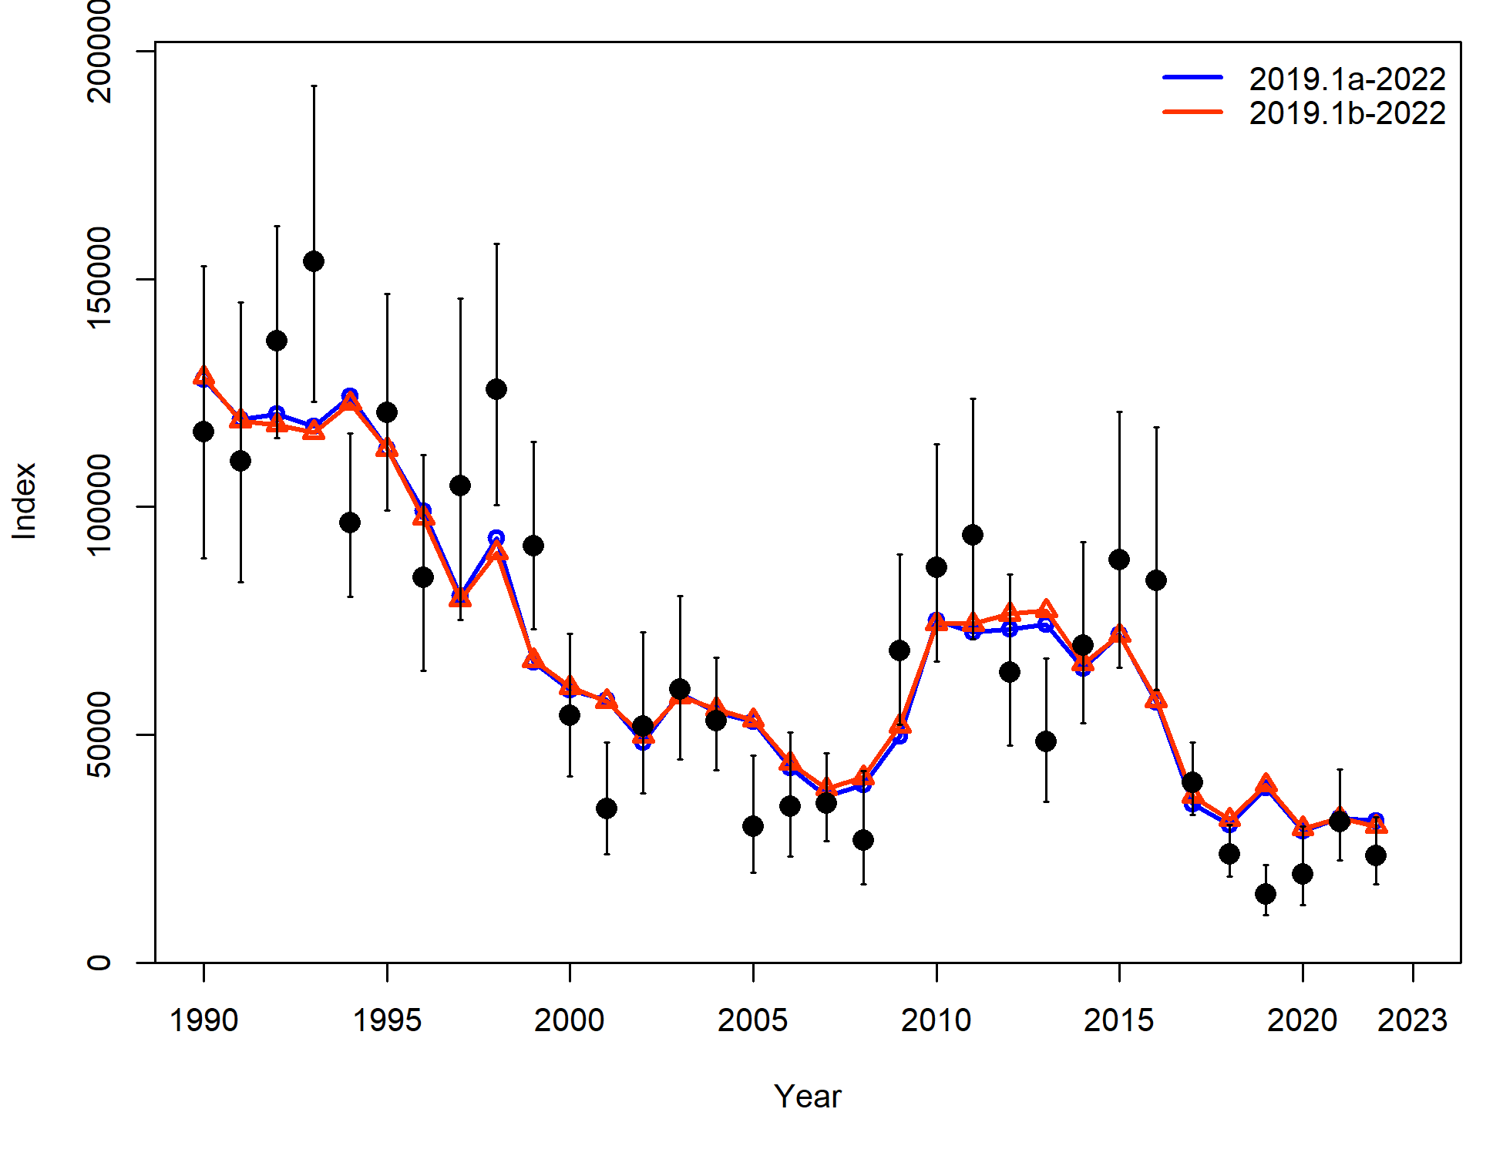
Housecleaning
Recommendation: Correct minimum sample size and use this as new base model (2019.1b)
6% increase in 2022 SSB

Slide 7
Environmental index
Description of CFSR
Available by length bin and month

Slide 8
Environmental Link for LL survey catchability
PT request to evaluate whether link still appropriate
Construct model with no environmental link to LL survey q (2019.1c)
Added... re-evaluate CFSR index used (2019.1d)
Step 1: Evaluated q env link across length bin and month
Step 2: Select best from Step 1 as new env link model
Performance metrics: current year AIC and model fits, retrospective AIC and performance

Slide 9
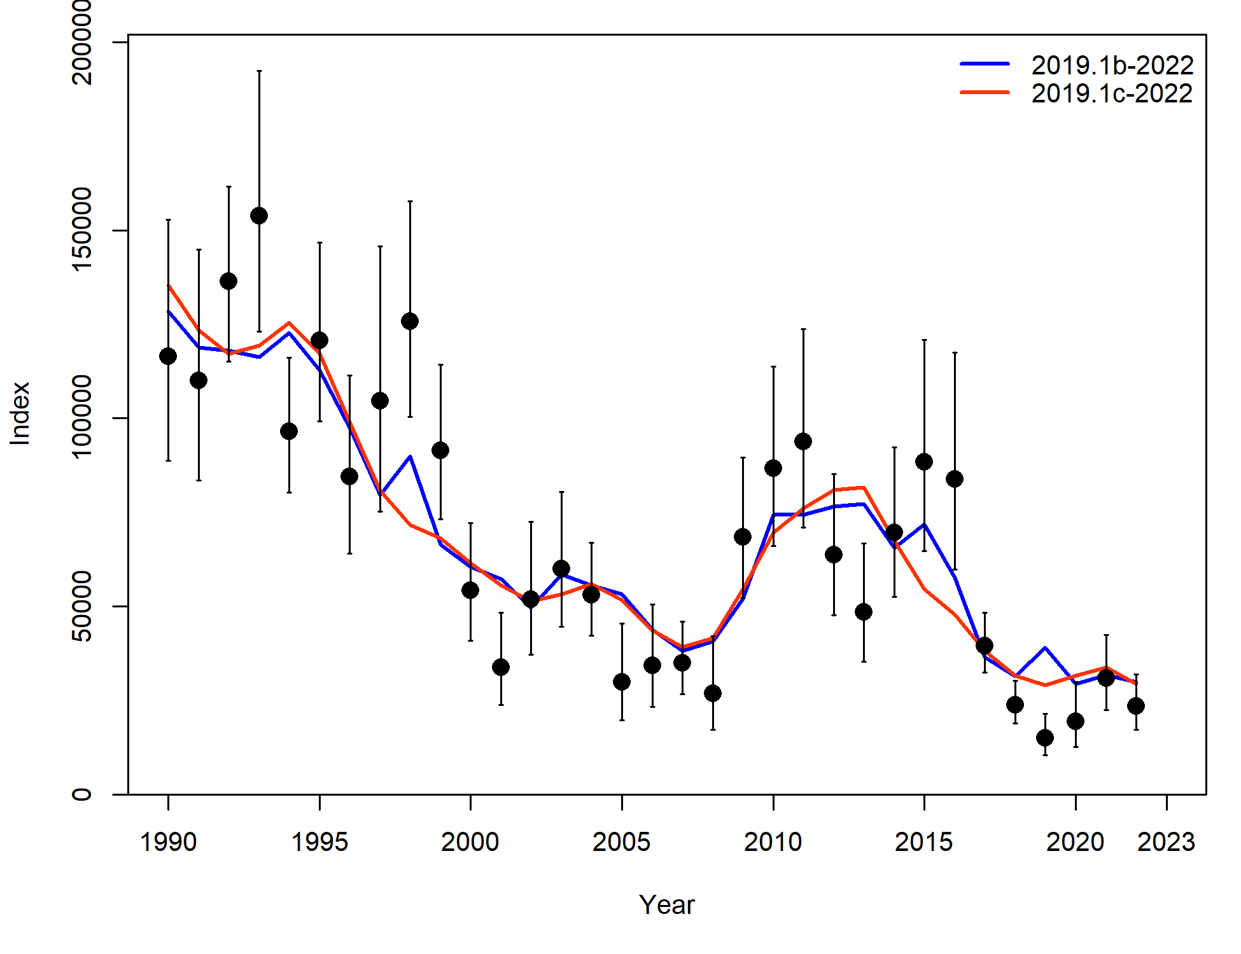
Link for LL survey q: no link comparison
Fit to LL survey index:

Slide 10
Link for LL survey q: no link comparison
In every retrospective year, model with link preferred over model without link
Mohn’s rho 2019.1b = -0.0727
Mohn’s rho 2019.1c = -0.0722

Slide 11
Link for LL survey q: no link comparison
Recommendation: continue with model that includes environmental link for LL survey q
Continue to monitor with retro AIC table in SAFE

Slide 12
Link for LL survey q: re-evaluation
Step 1: AIC difference = base model (2019.1b) – new env link model (2019.1d)

Slide 13
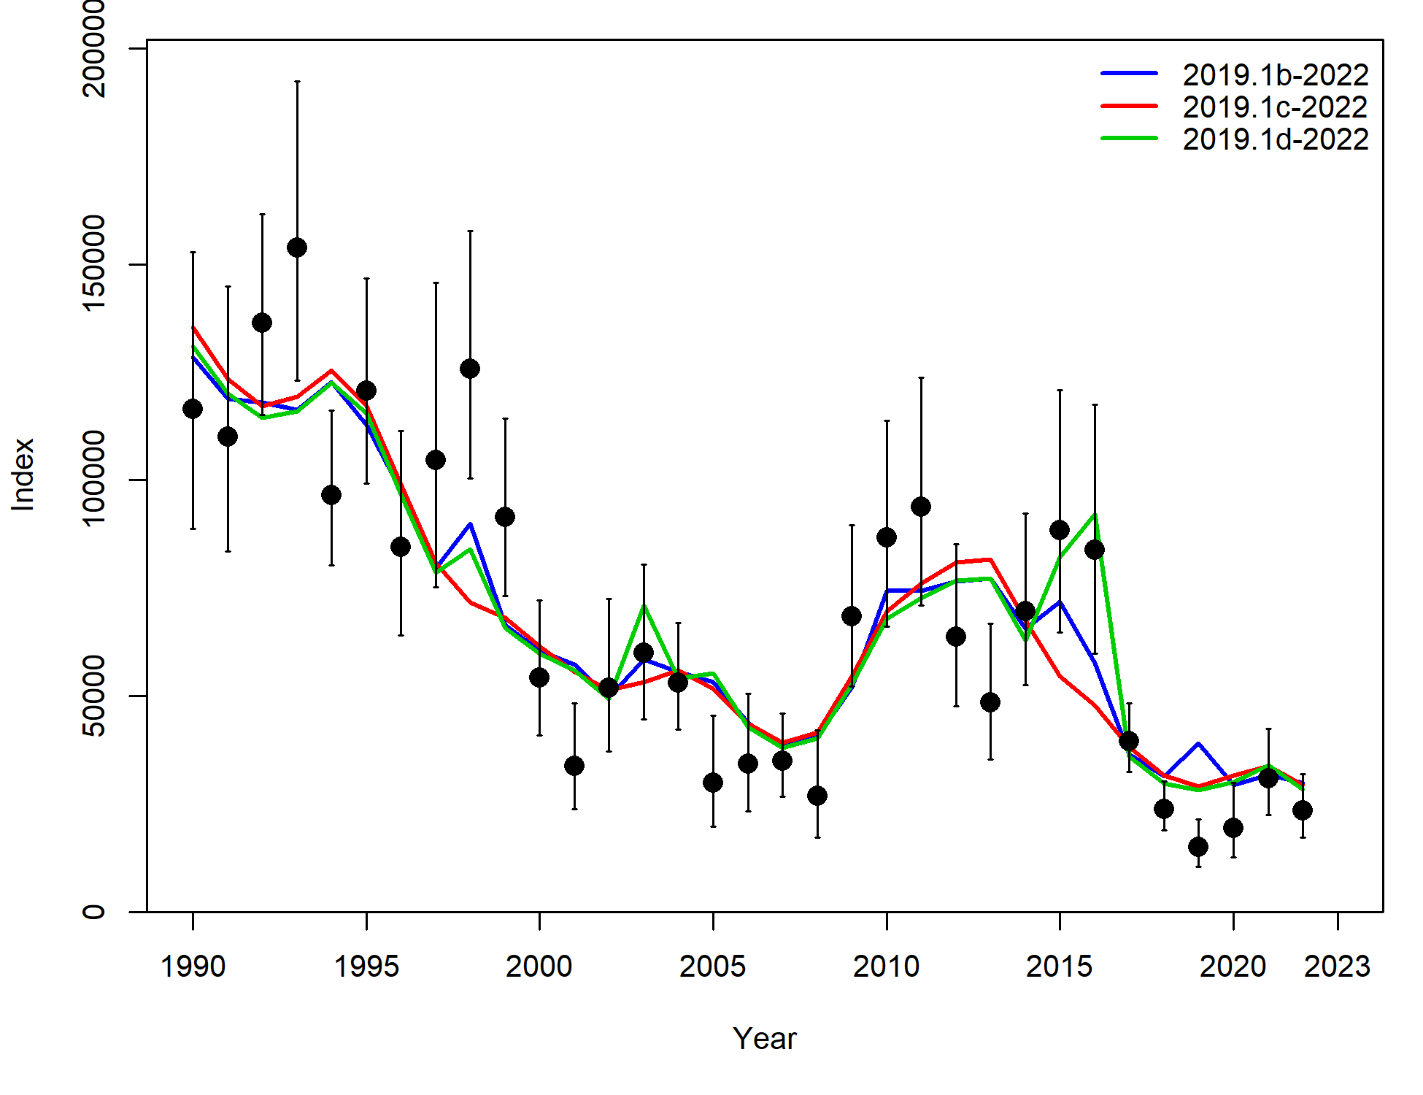
Link for LL survey catchability, re-evaluation
Fit to LL survey:

Slide 14
Link for LL survey catchability, re-evaluation

Slide 15
Link for LL survey, re-evaluation
Retro Total likelihood and mohns rho:
Mohn’s rho 2019.1b = -0.0727
Mohn’s rho 2019.1d = -0.0579

Slide 16
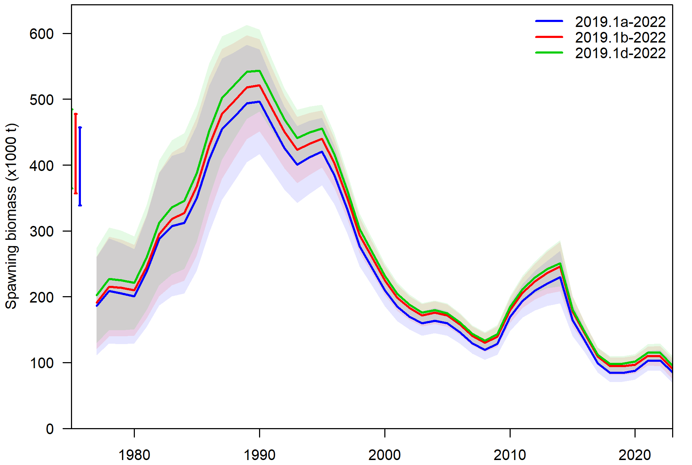
Link for LL survey, re-evaluation
11% increase in 2022 SSB compared to 2019.1a

Slide 17
Link for LL survey, re-evaluation
Recommendation: Bring forward 2019.1d, with new CFSR index, as alternative model in November
Food for thought:
Evaluation of environmental links is a fluid and iterative process
Will be evaluating new indices, will be evaluating links, will continually be evaluating model to find improvements

Slide 18
Environmental link for growth
Step 1:
Evaluated Linf and kappa across length bin and month
Evaluated Lzero across month for 0-20 cm length bin
Step 2:
Select best from Step 1, and run model with env link for all 3 growth parameters
Step 3:
Compare with base model
Statistics: current year AIC and model fits, retrospective AIC and performance

Slide 19
Link for growth
Step 1: difference in AIC with base model (EnvLnk – base, so negative number means EnvLnk model better)
Linf > Lzero > kappa for model improvement

Slide 20
Link for growth
Step 2: AIC & likelihoods

Slide 21
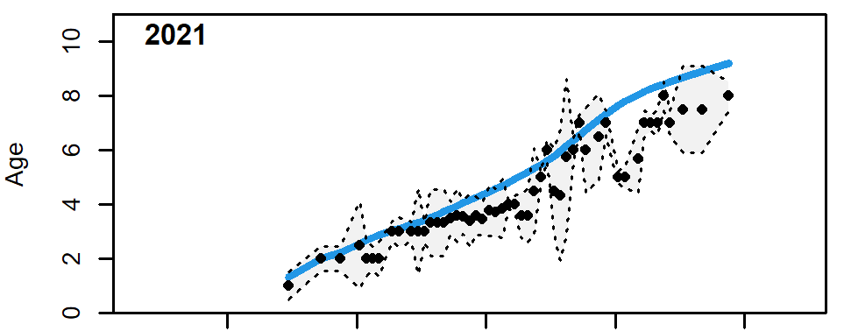

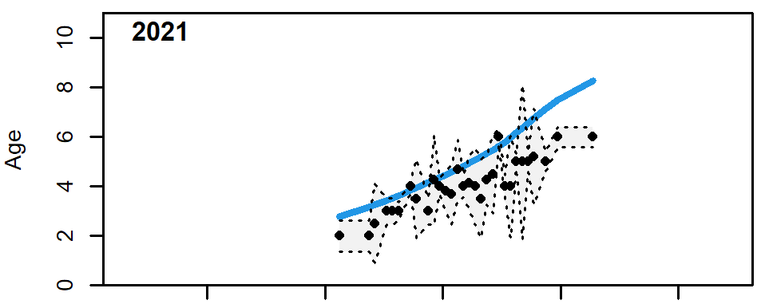
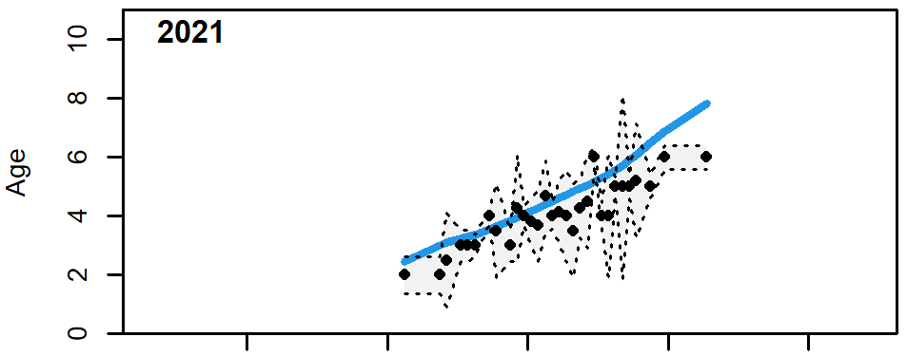
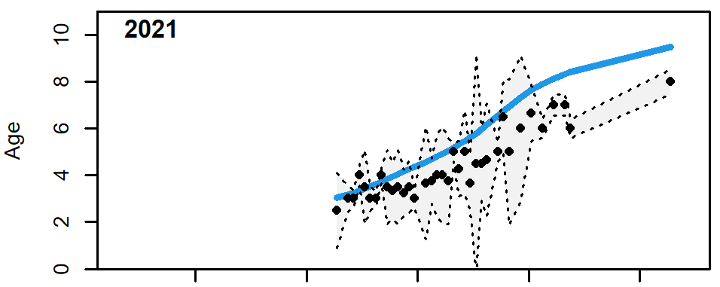

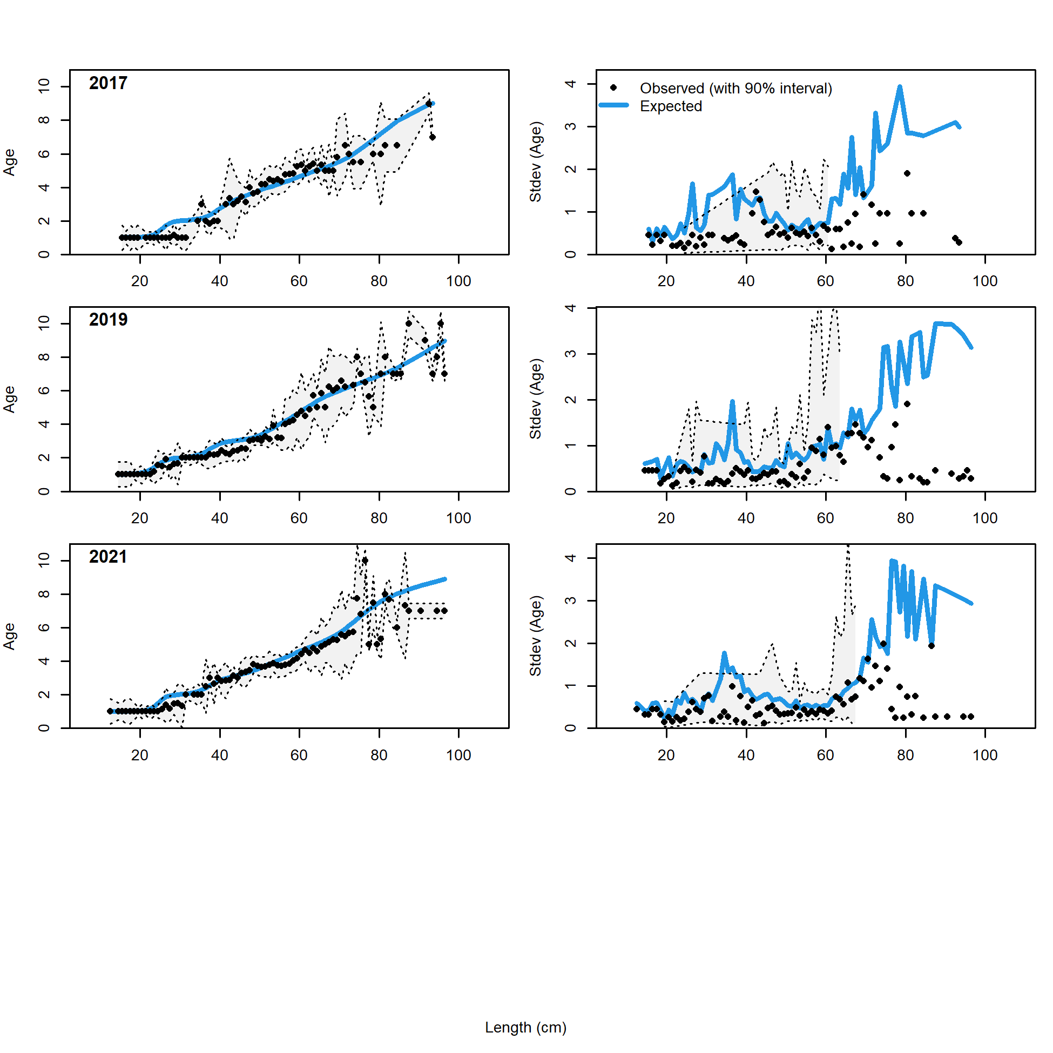
Link for growth
2019.1b
2023.1
Trawl fishery
Step 2: Example fits
Improvement to lack of fit identified in last assessment cycle
LL fishery
Pot fishery
Trawl survey

Slide 22
Link for growth
Step 2: Retrospective AIC
Mohns rho:
2019.1b = -0.073
2023.1 = -0.022

Slide 23
Link for growth
Things to consider:
What growth do we use in projections? (Most recent environmental conditions? Some time period of historical?)
Is there another, better, index?
Moving forward:
Not going to recommend an environmentally linked model for growth this cycle
Have a post doc (Krista Oke) that will be investigating environmental links over the next 2 years, will look to her results for guidance in future assessments

Slide 24
Overall summary
Recommended model changes for November:
Correct minimum sample size issue
Use different CFSR index for LL survey q environmental link
Questions?

