Slide 1


Pacific cod
in Space and Time
Steve Barbeaux and Pete Hulson
Joint NPFMC Groundfish Plan Team
September 9, 2026

Slide 2
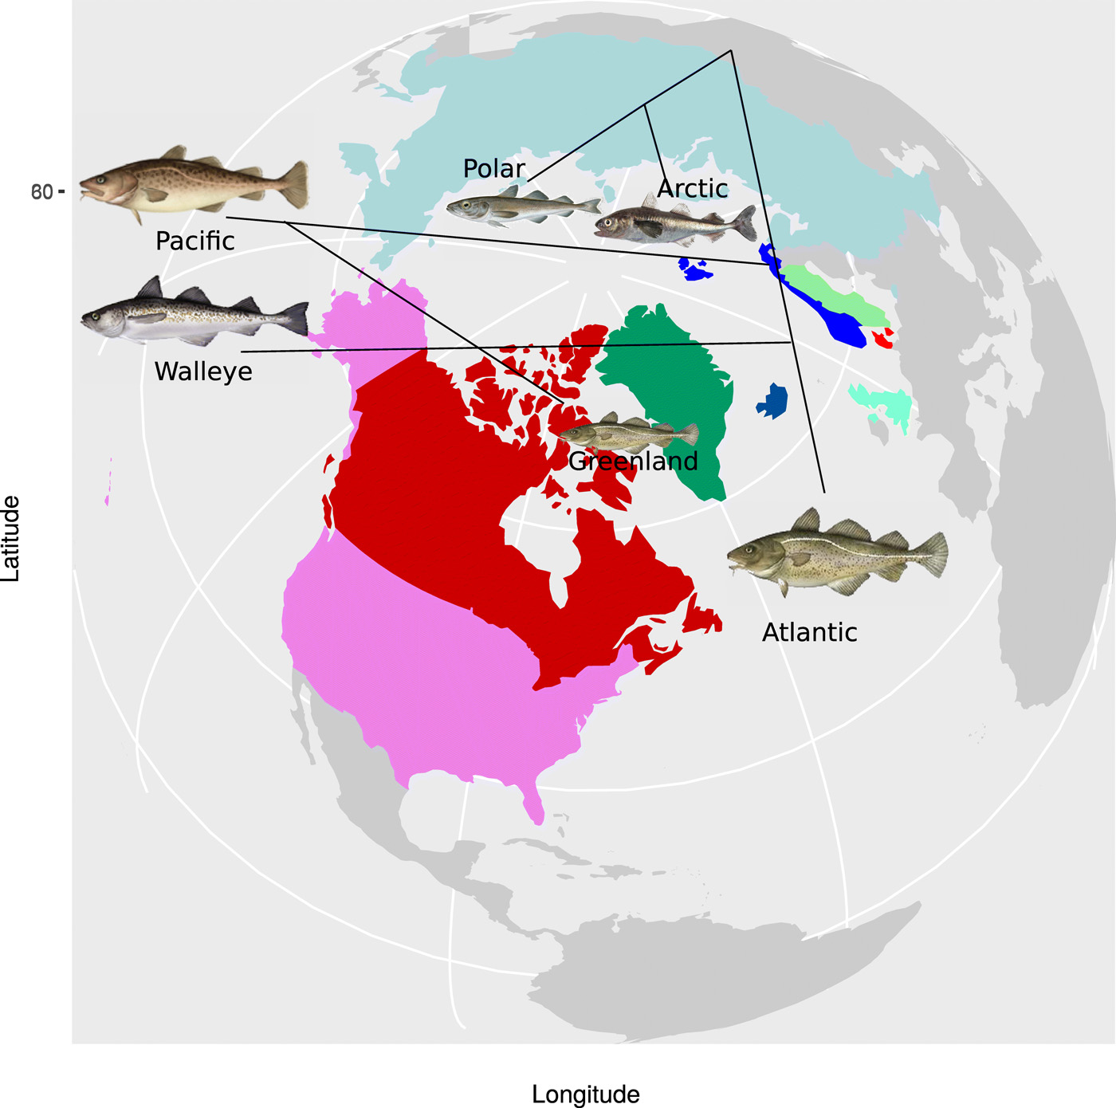
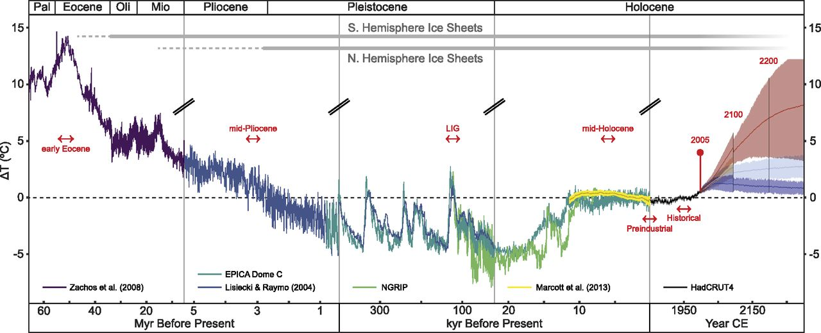
Pre-history of gadids in the Pacific Ocean
Pacific cod and walleye pollock are both derived from an Atlantic cod common ancestor
Pliocene divergence
  Pacific cod ~4 million years
  Pollock ~3.8 million years
Ice Ages
Pacific cod arrive
from Atlantic
Árnason and Halldórsdóttir (2019)
Homo sapiens
walk out of Africa
Burke et al. (2018.)
Pre-history from genetic studies
Coulson, M.W., Marshall, H.D., Pepin, P. and Carr, S.M., 2006. Mitochondrial genomics of gadine fishes: implications for taxonomy and biogeographic origins from whole-genome data sets. Genome, 49(9), pp.1115-1130
Árnason, E. and Halldórsdóttir, K., 2019. Codweb: Whole-genome sequencing uncovers extensive reticulations fueling adaptation among Atlantic, Arctic, and Pacific gadids. Science advances, 5(3), p.eaat8788.
.
Notes:
Touching on the prehistory of pacific cod.
Both Pacific cod and walleye pollock are derived from a common Atlantic cod ancestor.
Walleye pollock is more closely related to Atlantic cod than Pacific cod, with Pacific cod diverging from Atlantic cod about 4 million years ago and pollock diverging from Atlantic cod about 3.8 million years ago (click).
This was during the Pliocene when temperatures were a bit warmer than current conditions, and the Atlantic cod progenitors were found in the Arctic Ocean.
This was before the Ice Ages 2.4 million to 10,700 years ago (click) and before the first Homo sapiens were thought to have emerged in Africa 200 to 180 thousand years ago (click).
This pre-history of cod has been discovered through genetics and the estimated rates of mutations within its genome.

Slide 3
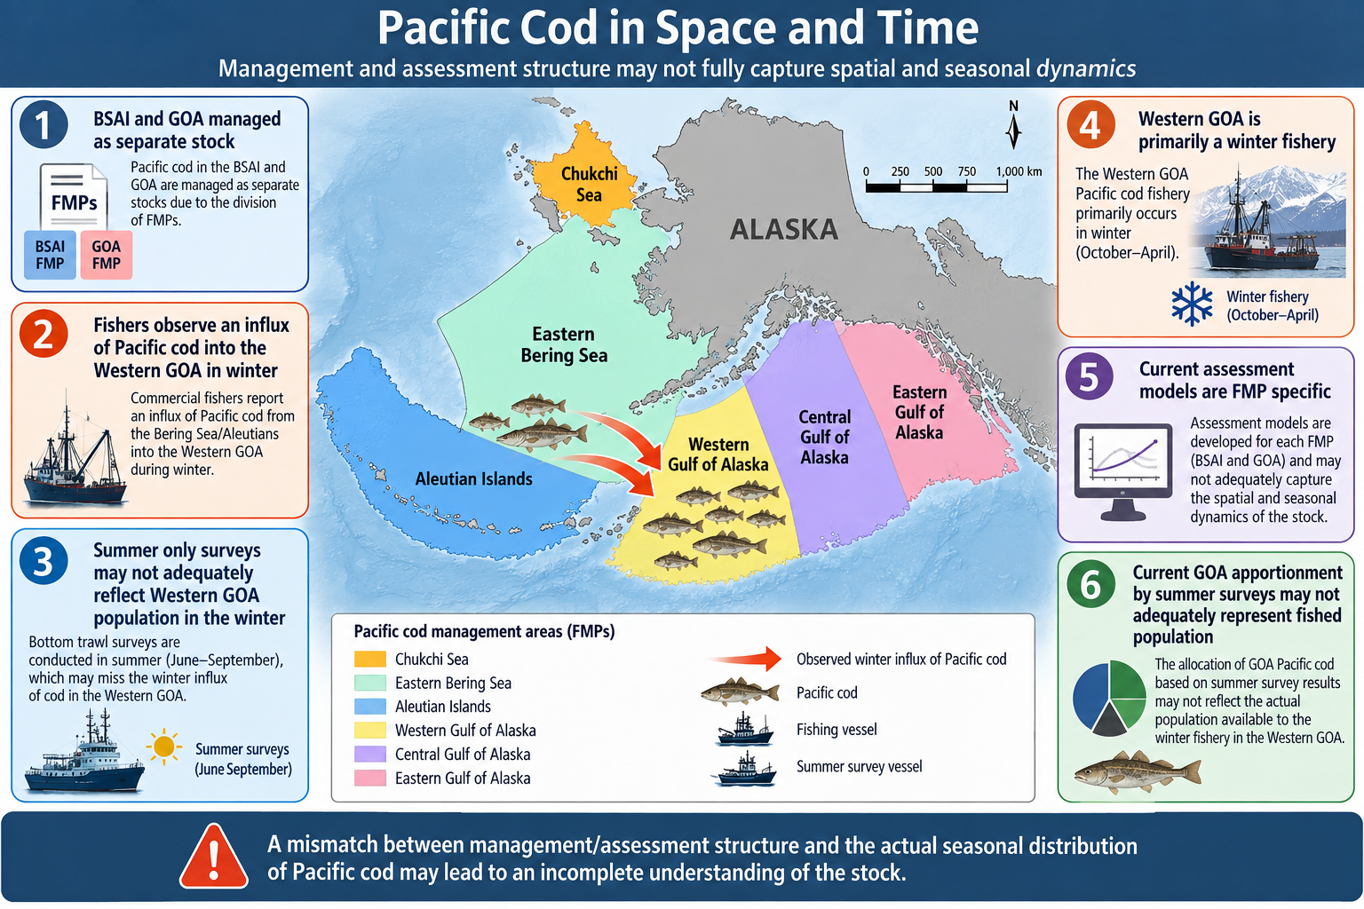
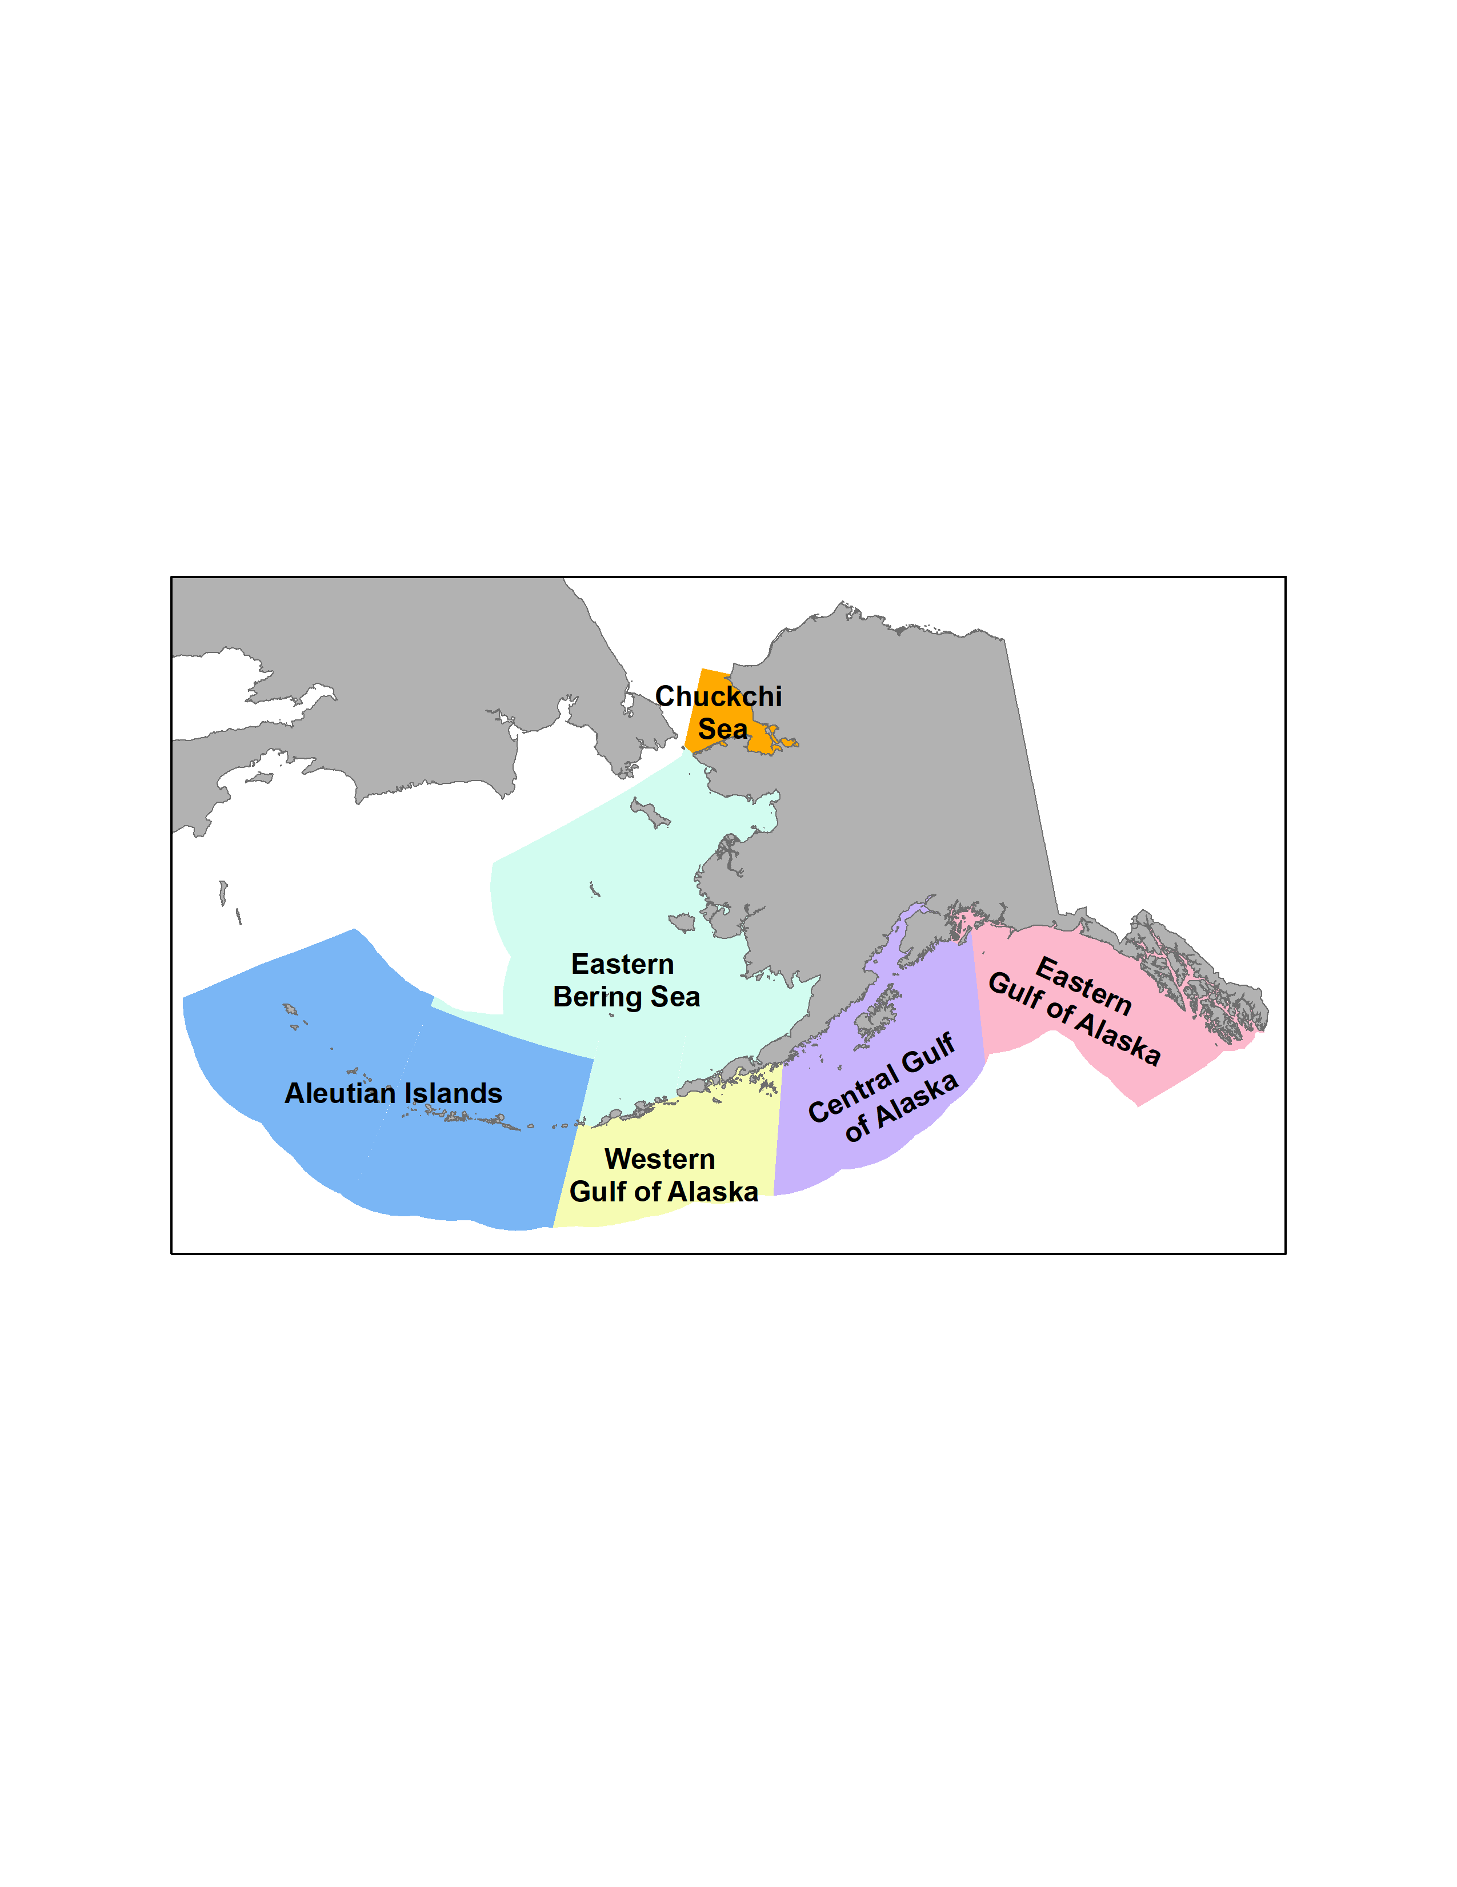
?
?

Slide 4
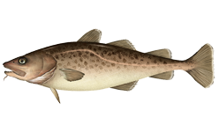
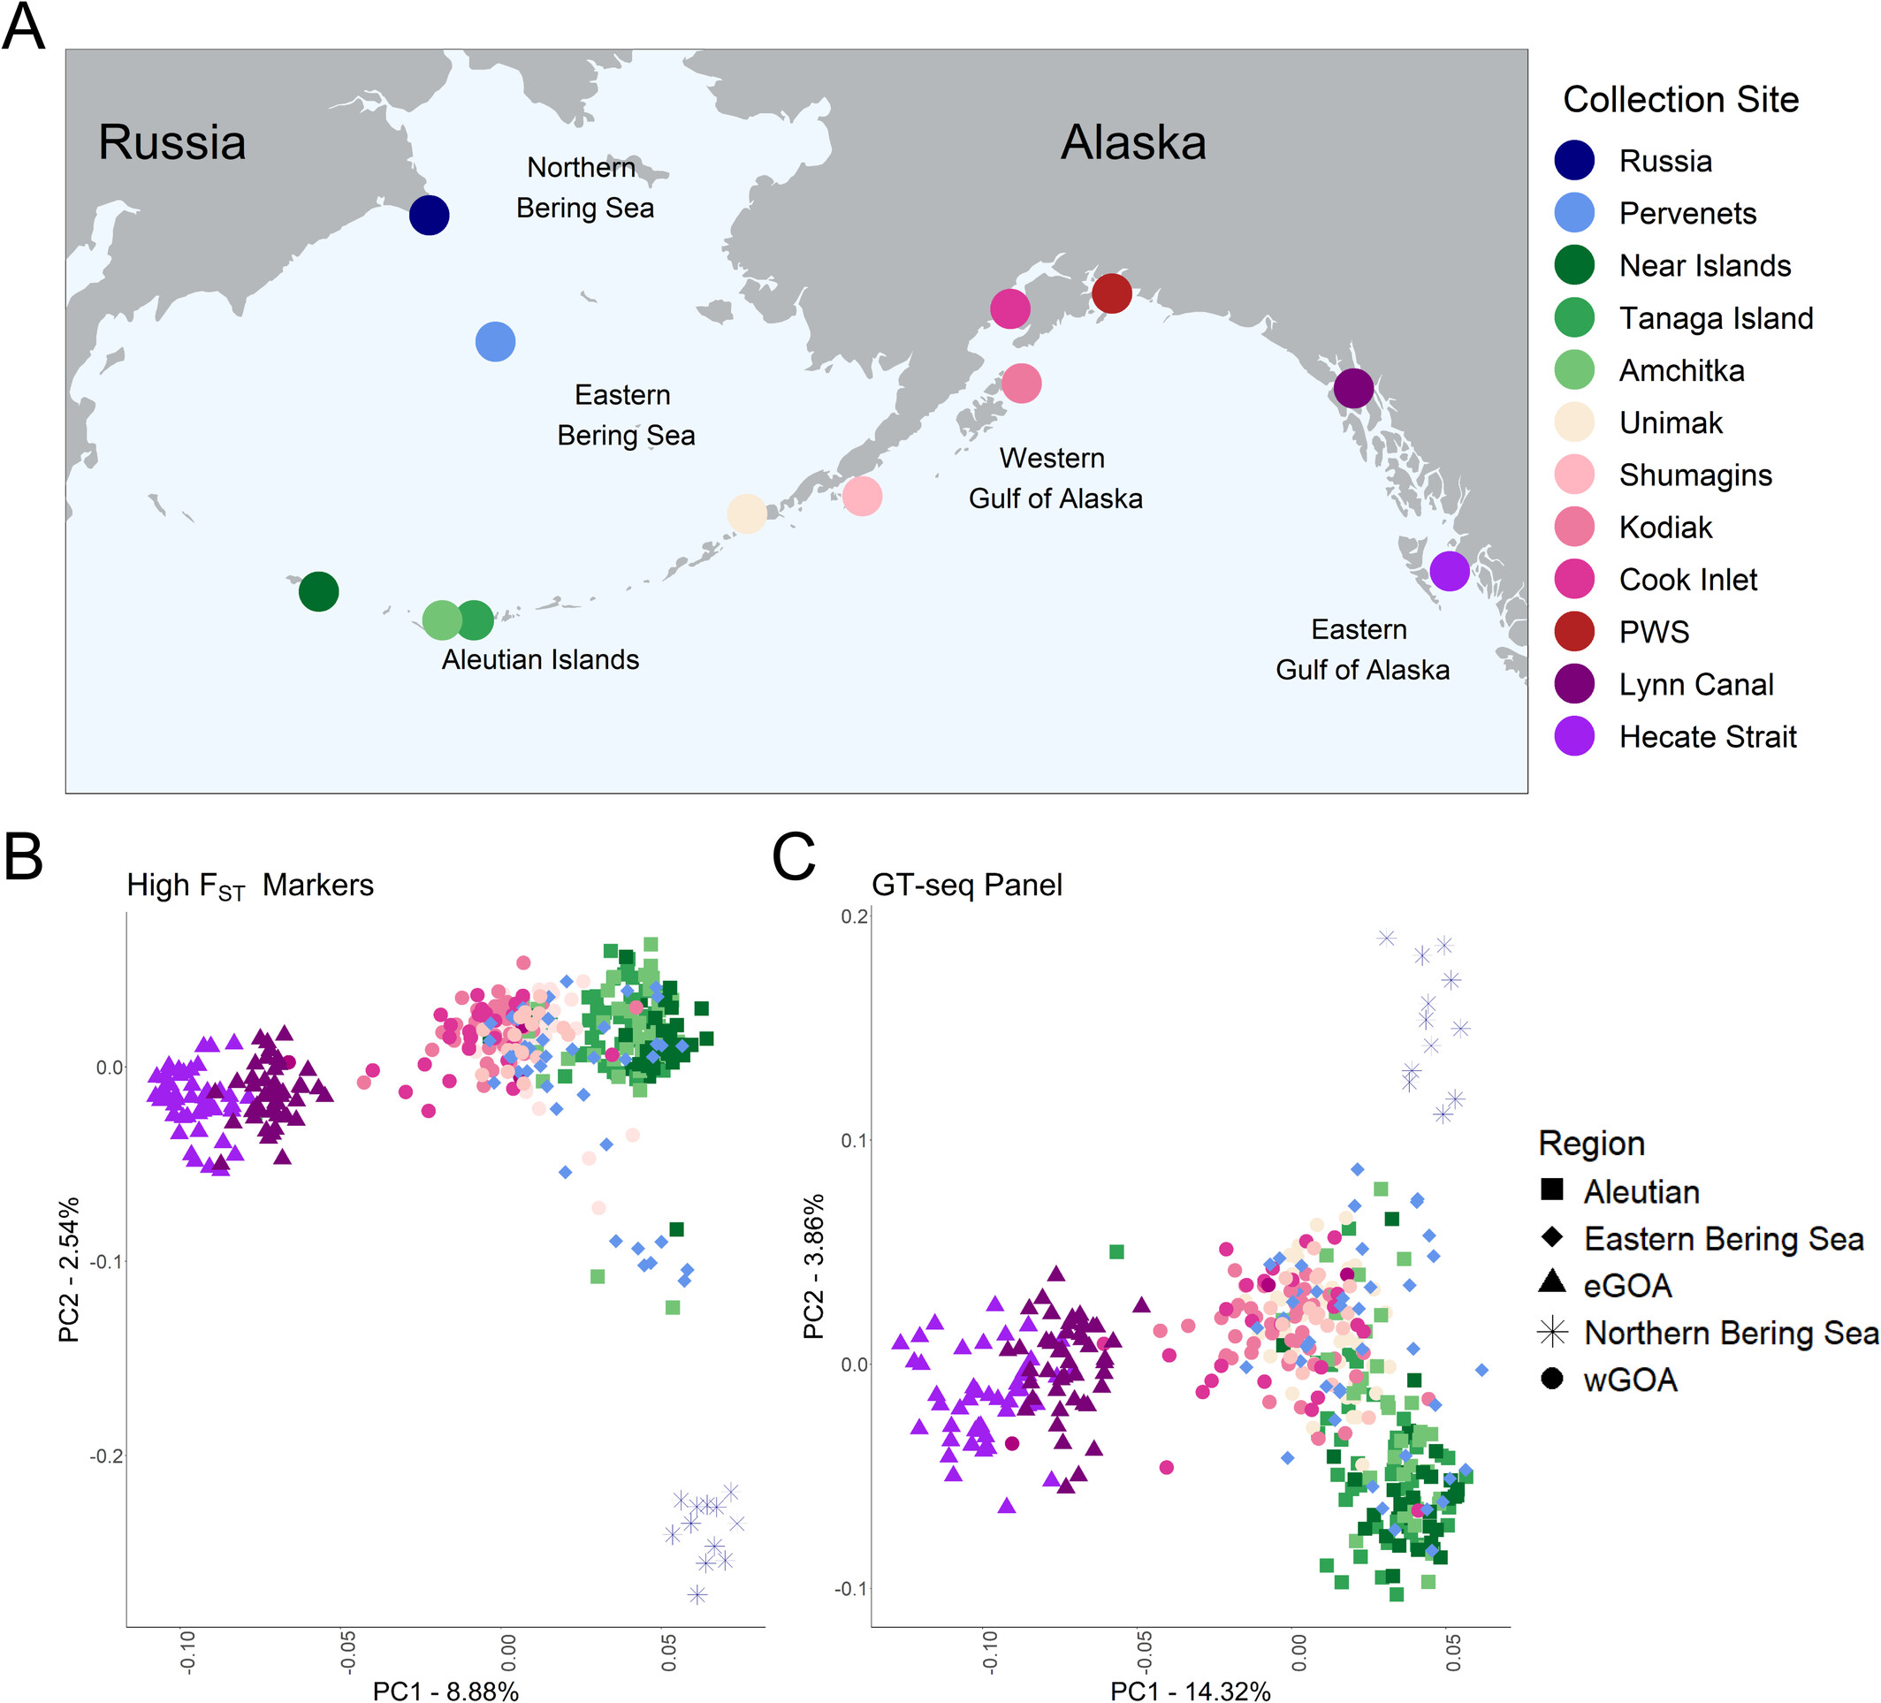
What does Genetics tell us?
Genetic break between Aleutian Islands and Eastern Bering Sea
Genetic break from Eastern Bering Sea to NBS/Russia
Genetic break from Eastern GOA to Western GOA
No break in genetic structure between the Central GOA, Western GOA, and EBS
Schaal et al. 2026. Genetic Data Reveal Nonlocal Juvenile Recruitment and Variable Seasonal Movement of a Highly Mobile Marine Fish Across Alaska. Evolutionary Applications 19:1 https://doi.org/10.1111/eva.70174Digital Object Identifier (DOI)

Slide 5
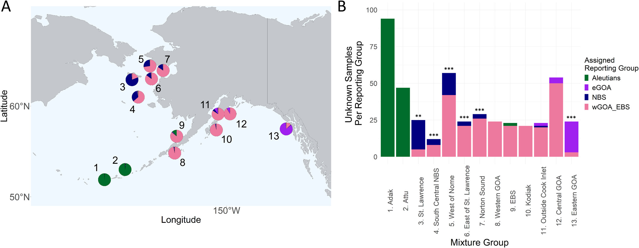
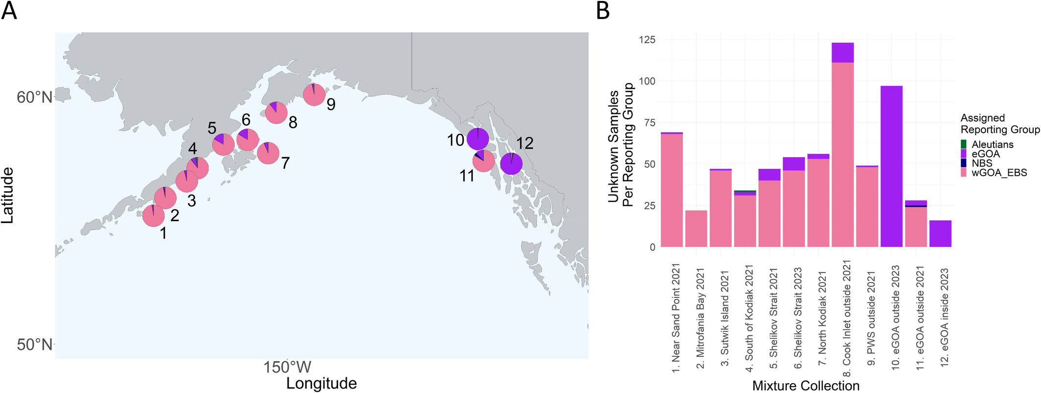
What does Genetics tell us?
Genetic break between Aleutian Islands and Eastern Bering Sea
Genetic break from Eastern Bering Sea to NBS/Russia
Genetic break from Eastern GOA to Western GOA
No break in genetic structure between the Central GOA, Western GOA, and EBS
Schaal et al. 2026. Genetic Data Reveal Nonlocal Juvenile Recruitment and Variable Seasonal Movement of a Highly Mobile Marine Fish Across Alaska. Evolutionary Applications 19:1 https://doi.org/10.1111/eva.70174Digital Object Identifier (DOI)

Slide 6
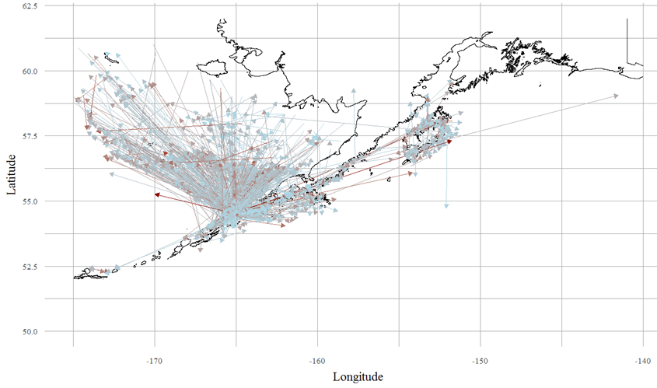
Conventional Tagging 1982-2020
Substantial movement between the Western GOA and Eastern Bering Sea
Limited movement between Central GOA and Western GOA
N=2,879

Slide 7
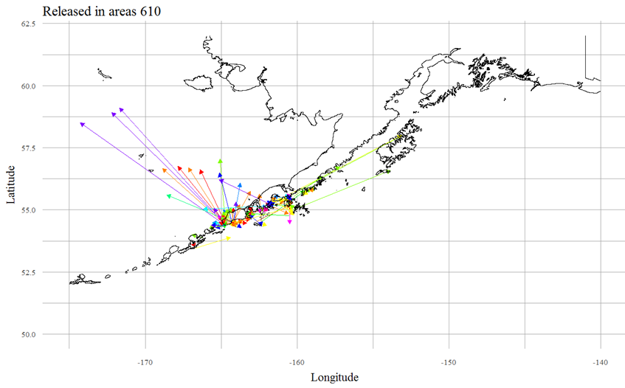
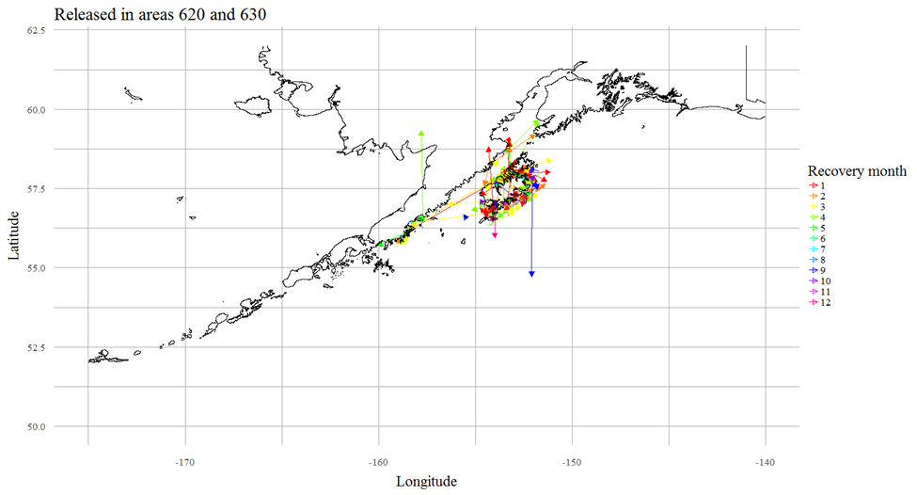
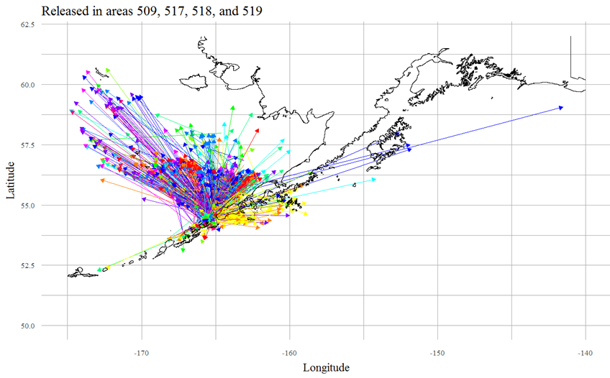
Conventional Tagging 1982-2020

Slide 8
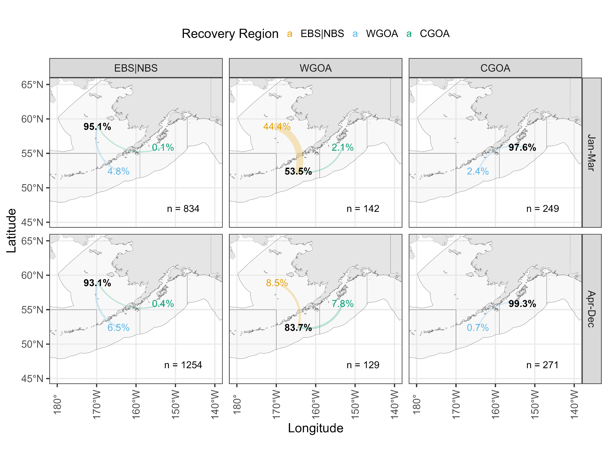
Conventional Tagging 1982-2020
Movement is seasonal with majority of movement among areas in January-March

Slide 9
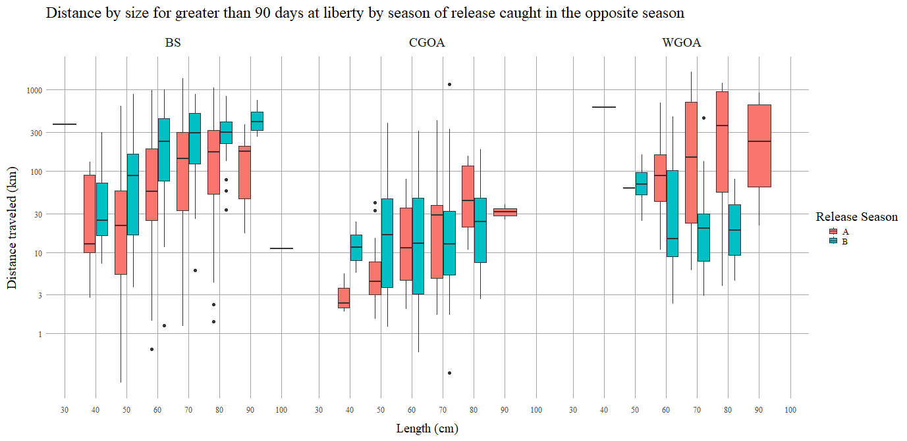
Conventional Tagging 1982-2020
Fish recovered in the opposite season from release
Distance traveled (km)
Distance traveled/movement rate is size dependent
Bering Sea and western GOA fish travel further distances
Central GOA fish do not travel long distances
Western GOA fish tagged in the summer appear to not travel long distances

Slide 10
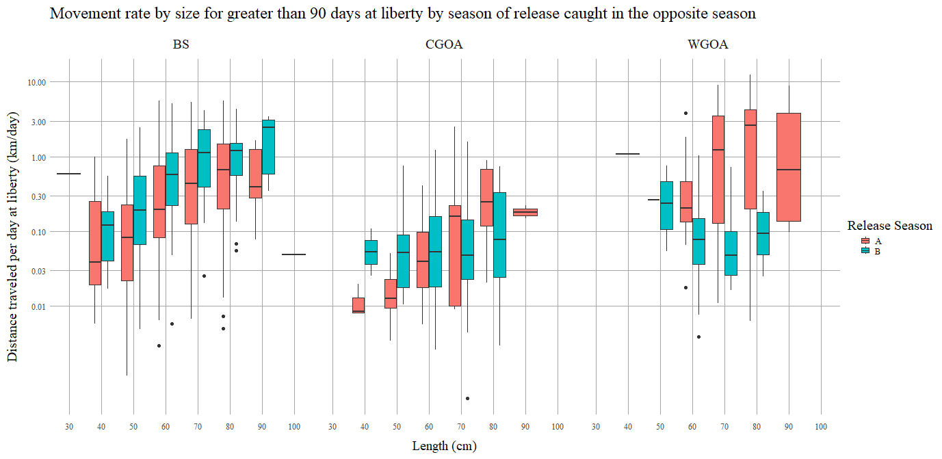
Conventional Tagging 1982-2020
Fish recovered in the opposite season from release
Movement rate (km/day)
Distance traveled/movement rate is size dependent
Bering Sea and western GOA fish travel further distances
Central GOA fish do not travel long distances
Western GOA fish tagged in the summer appear to not travel long distances

Slide 11
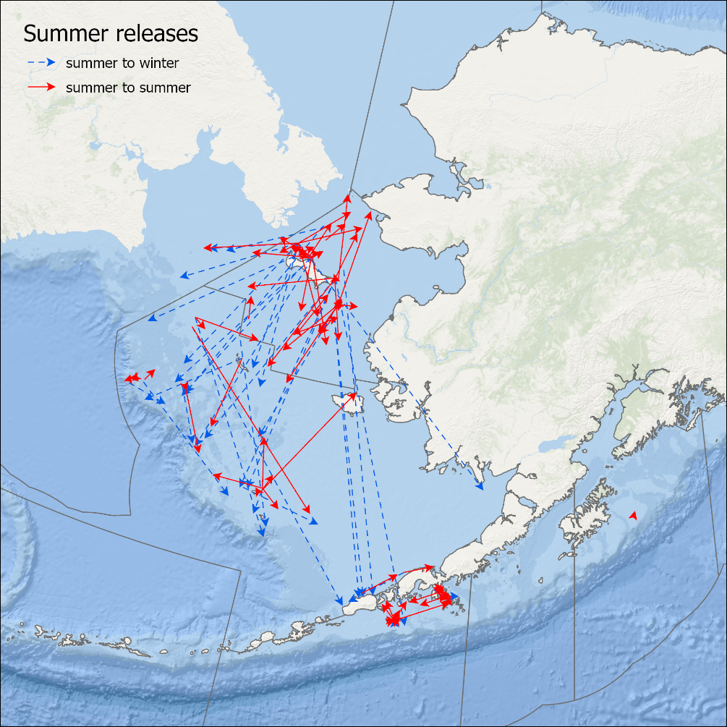
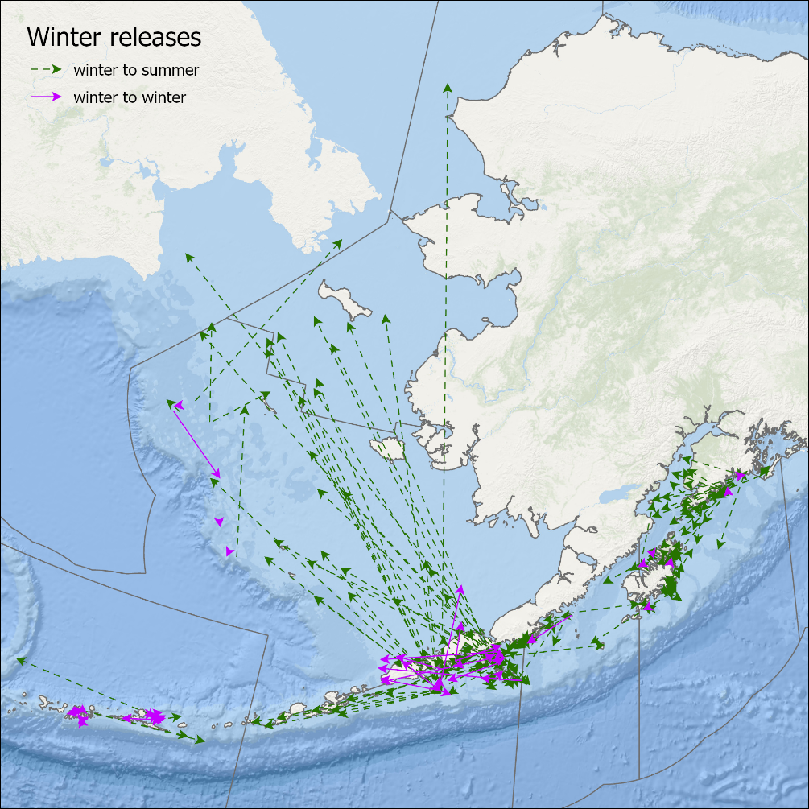
Pop-up Satellite Tagging 2019-2026
Movement between Western GOA and Eastern Bering Sea is Seasonal
Little movement between the Central and Western GOA

Slide 12
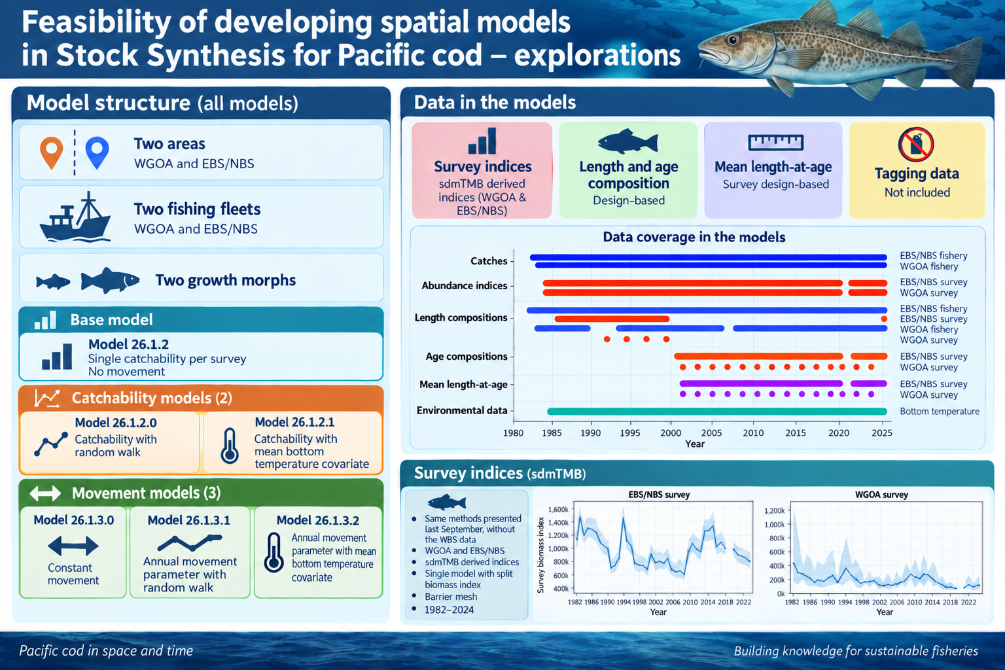

Slide 13
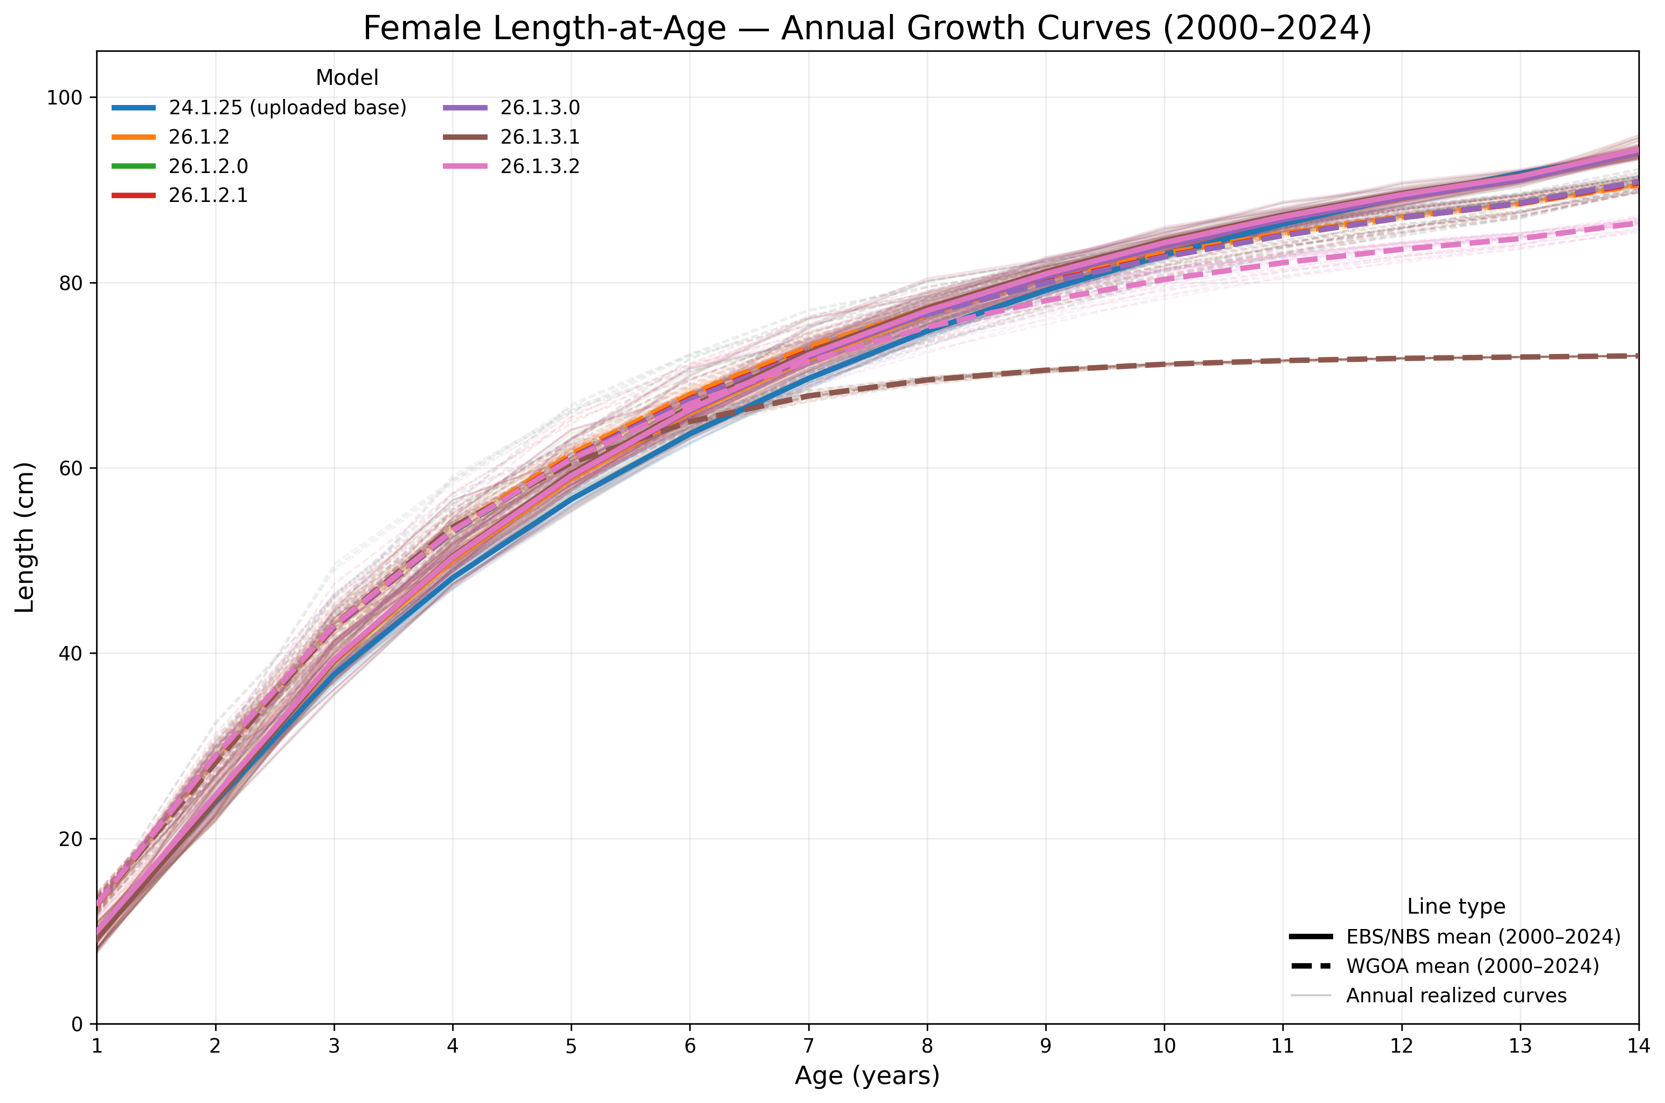
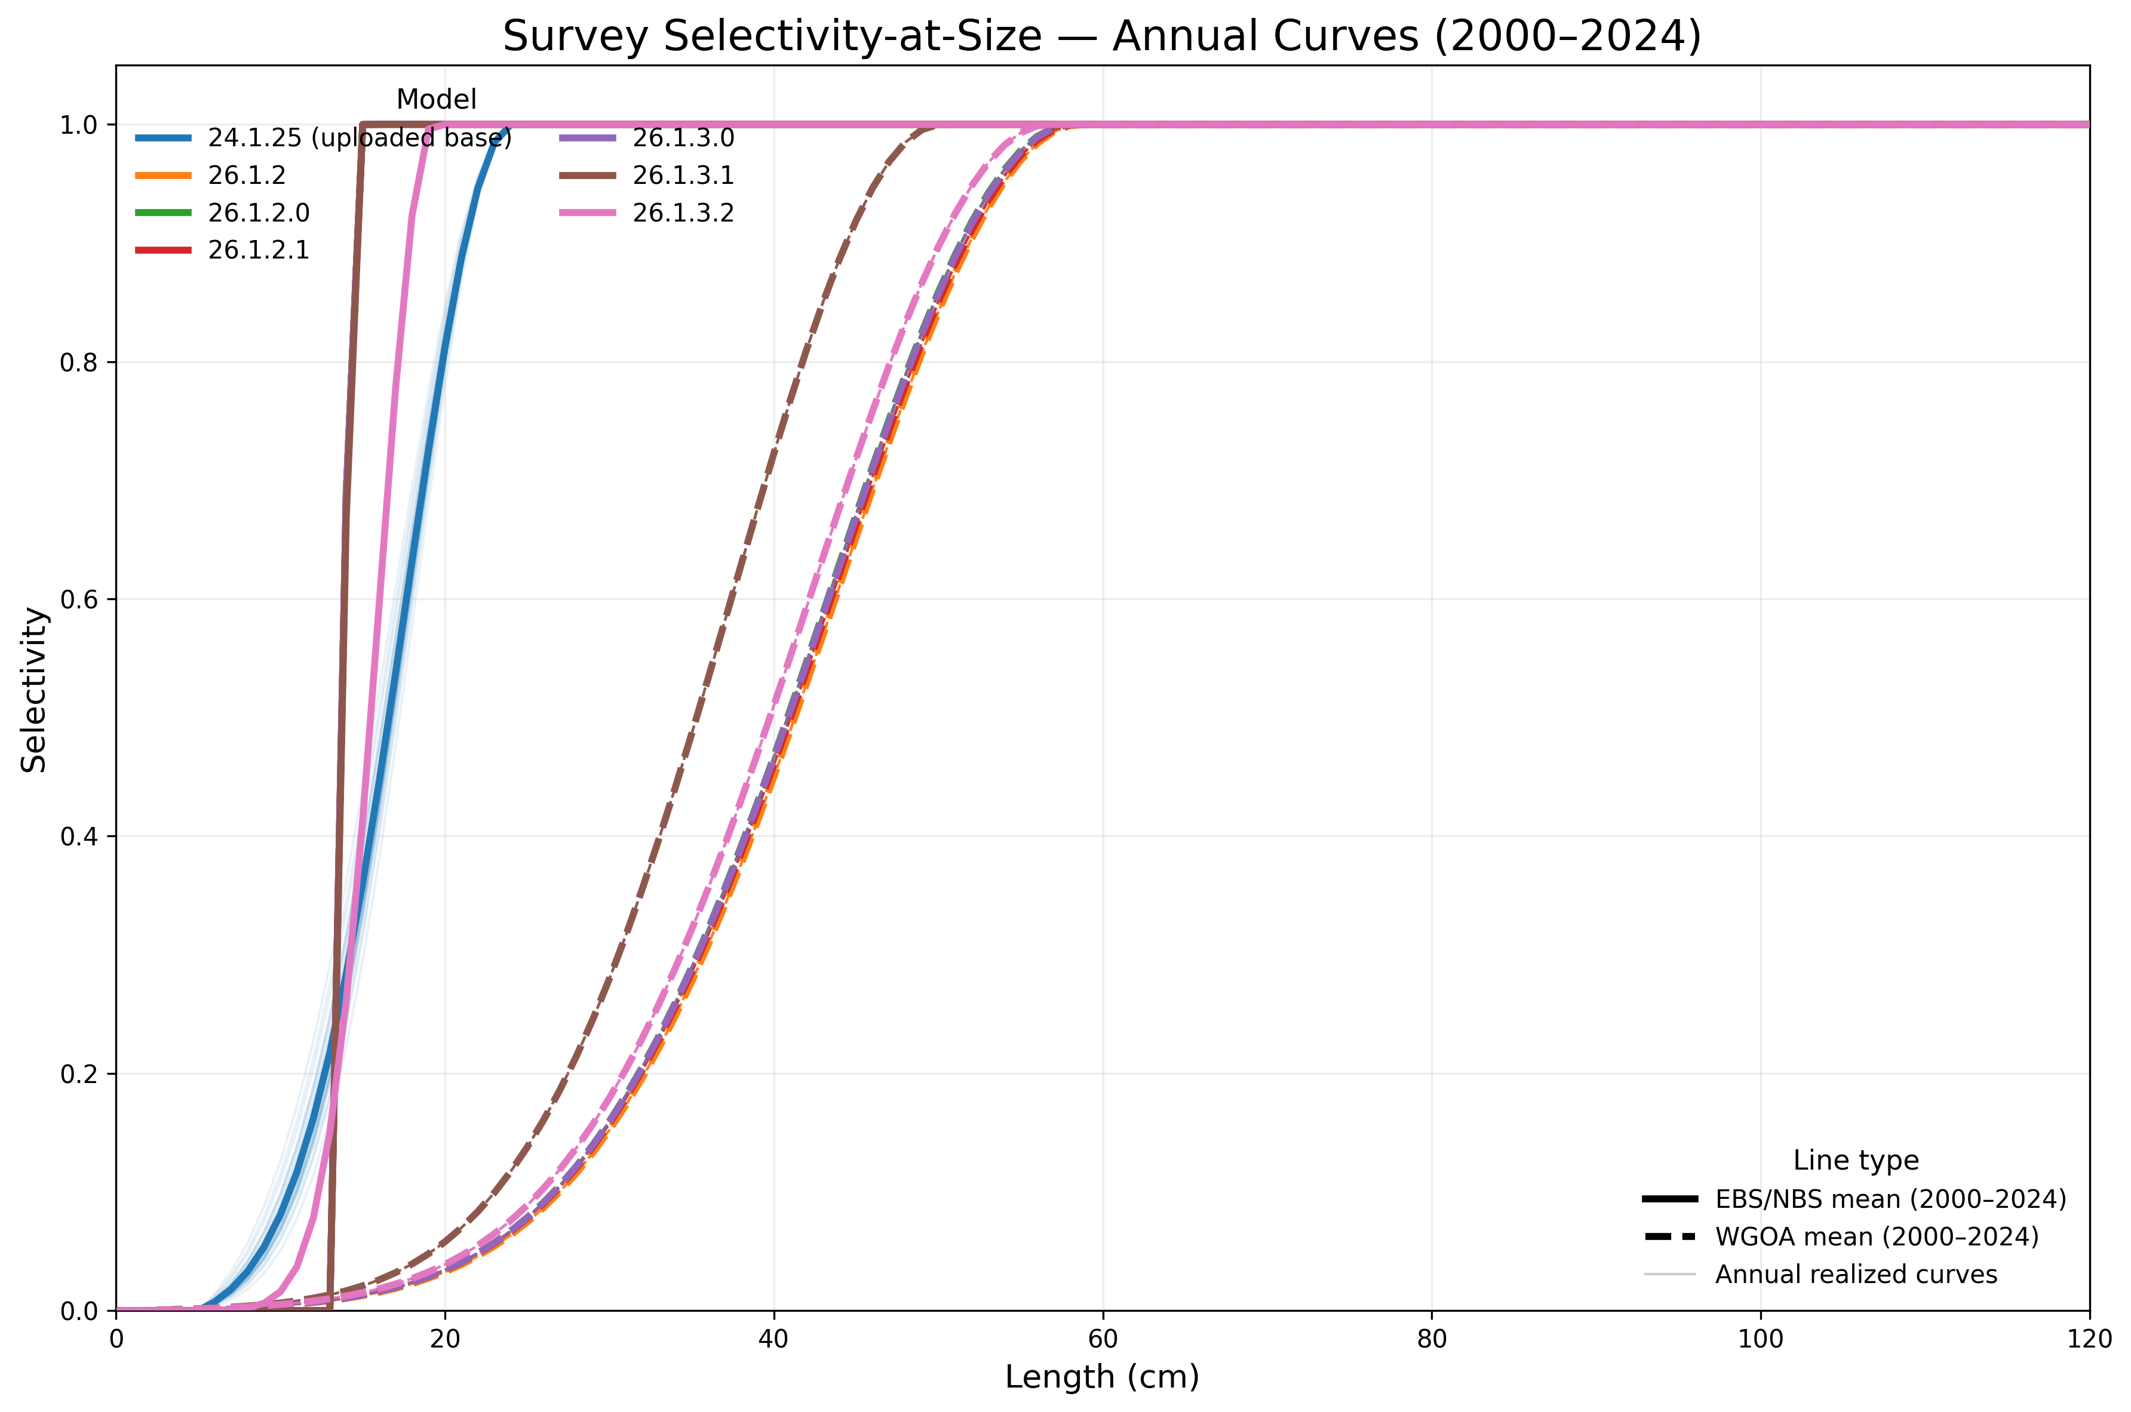
Stock Synthesis explorations
Models predict faster growth but smaller asymptote for WGOA fish
Growth is similar among models except:
  Model 26.1.3.1 RW has smaller asymptote in WGOA.
Survey selectivity has larger peak selectivity for WGOA
Selectivity patterns similar among models except:
  Model 26.1.3.1 differs from other models with smaller peak selectivity for WGOA

Slide 14
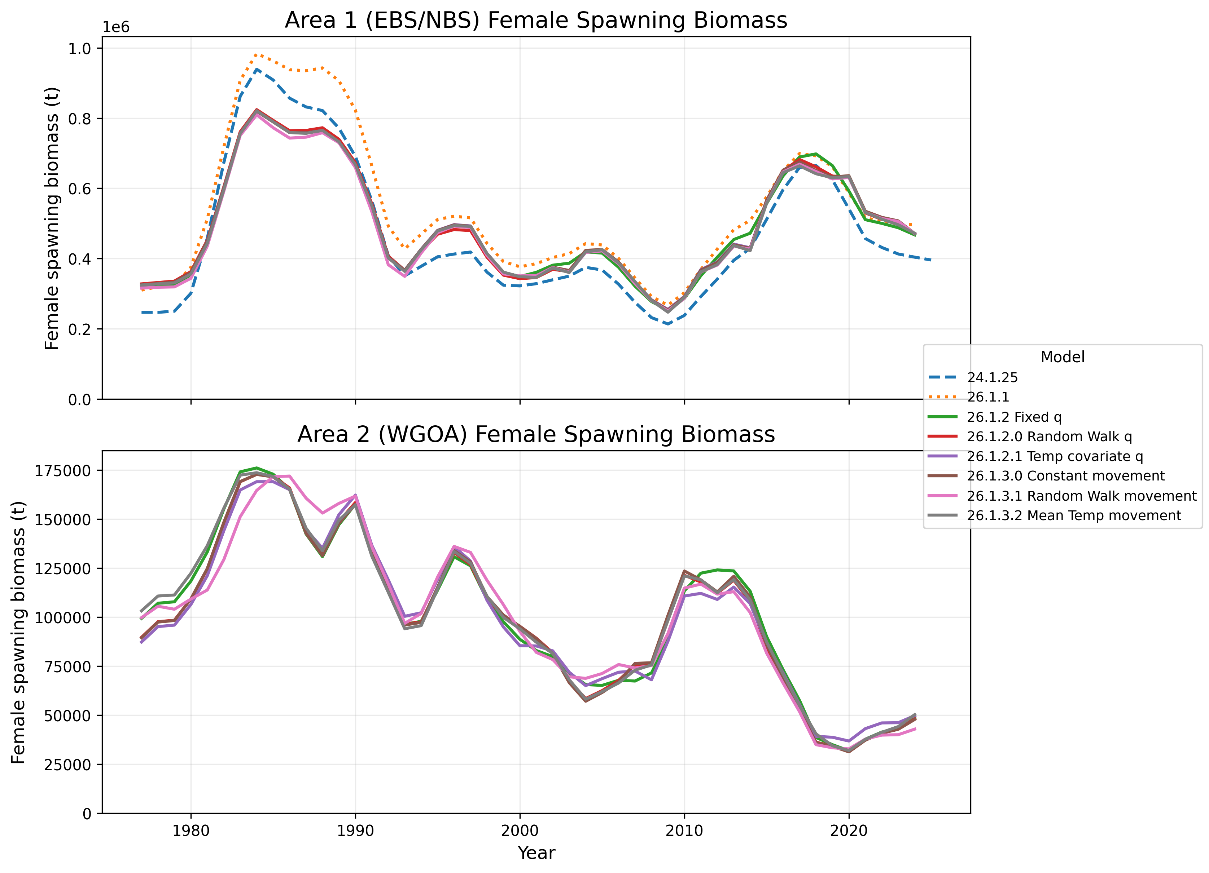
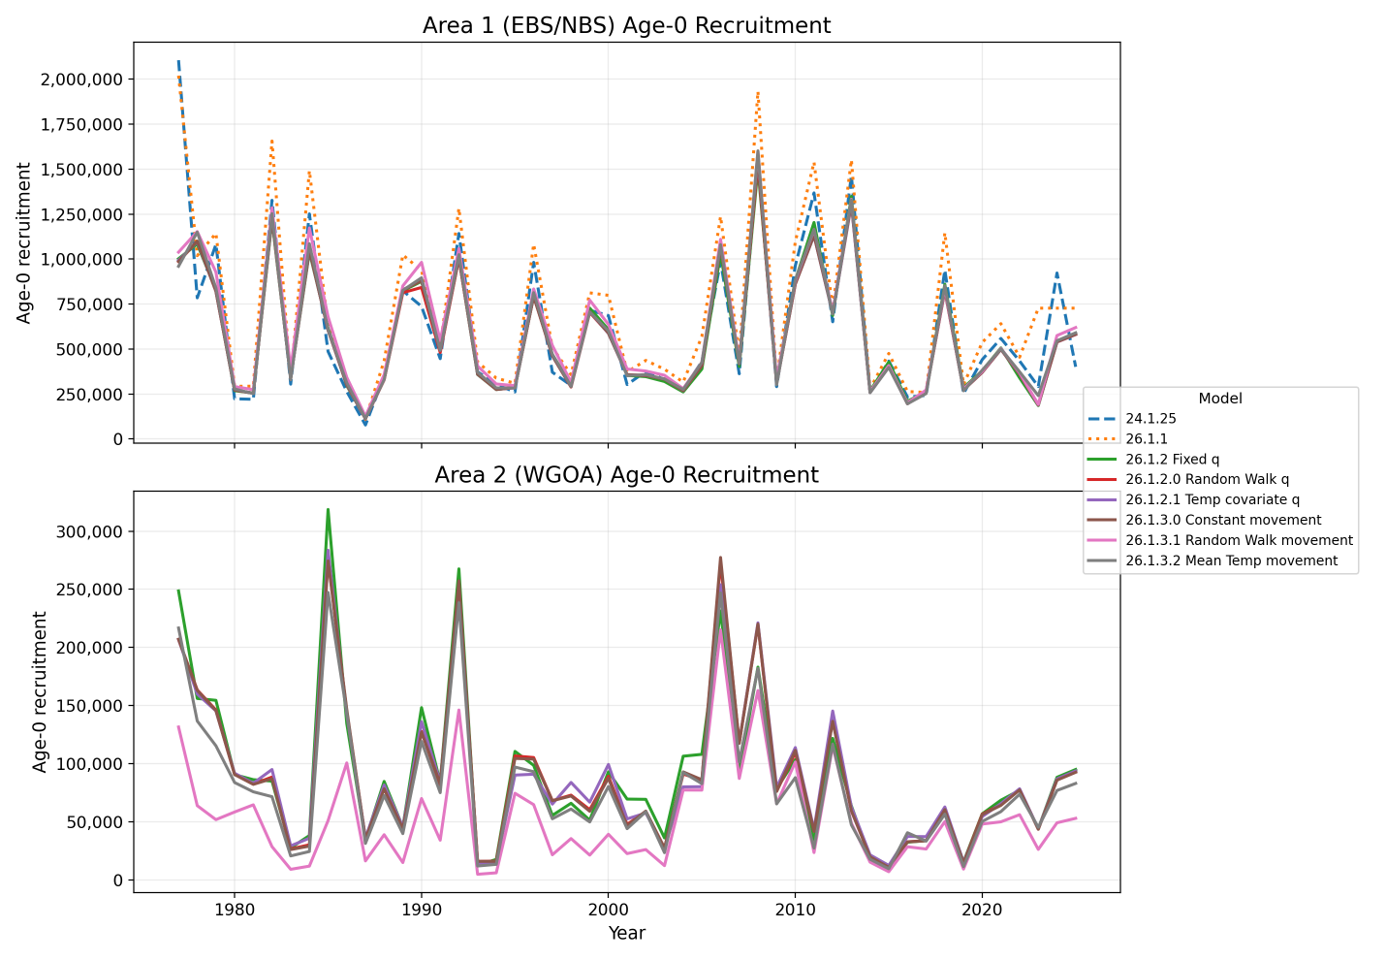
Stock Synthesis explorations
Little difference in results among models

Slide 15
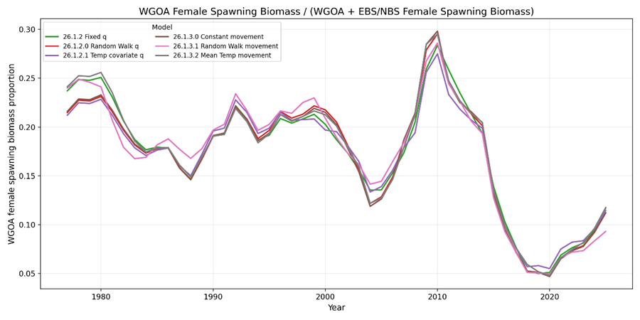
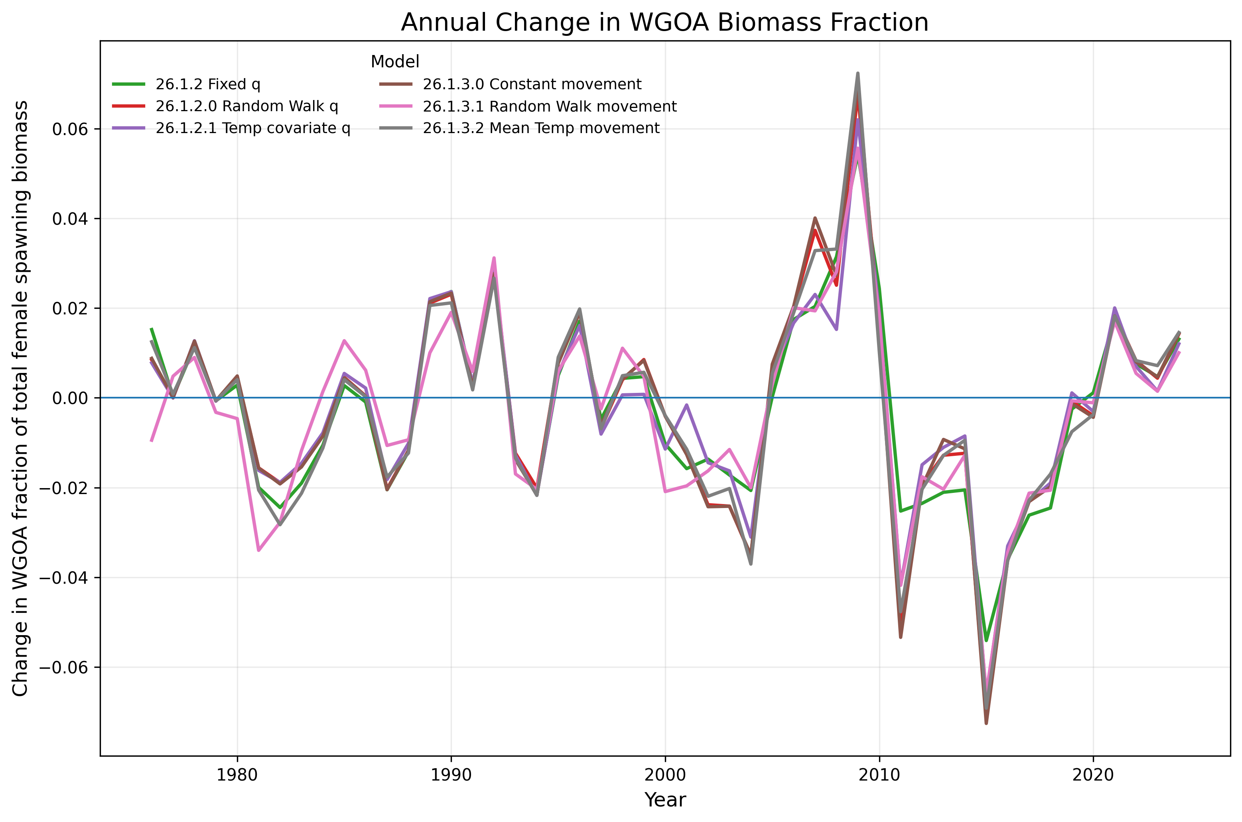
Proportionality
Little difference among model results
5-30% of spawning biomass in the Western GOA

Slide 16
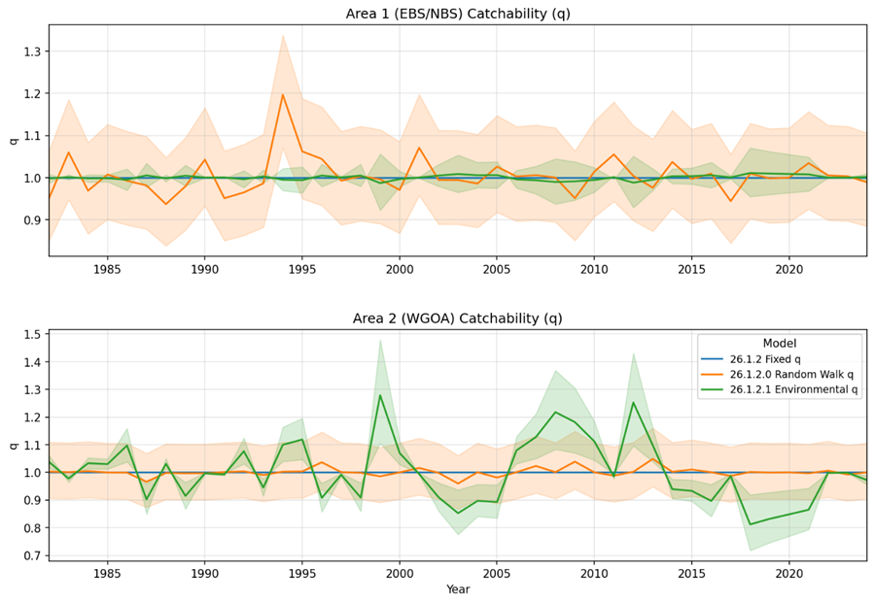
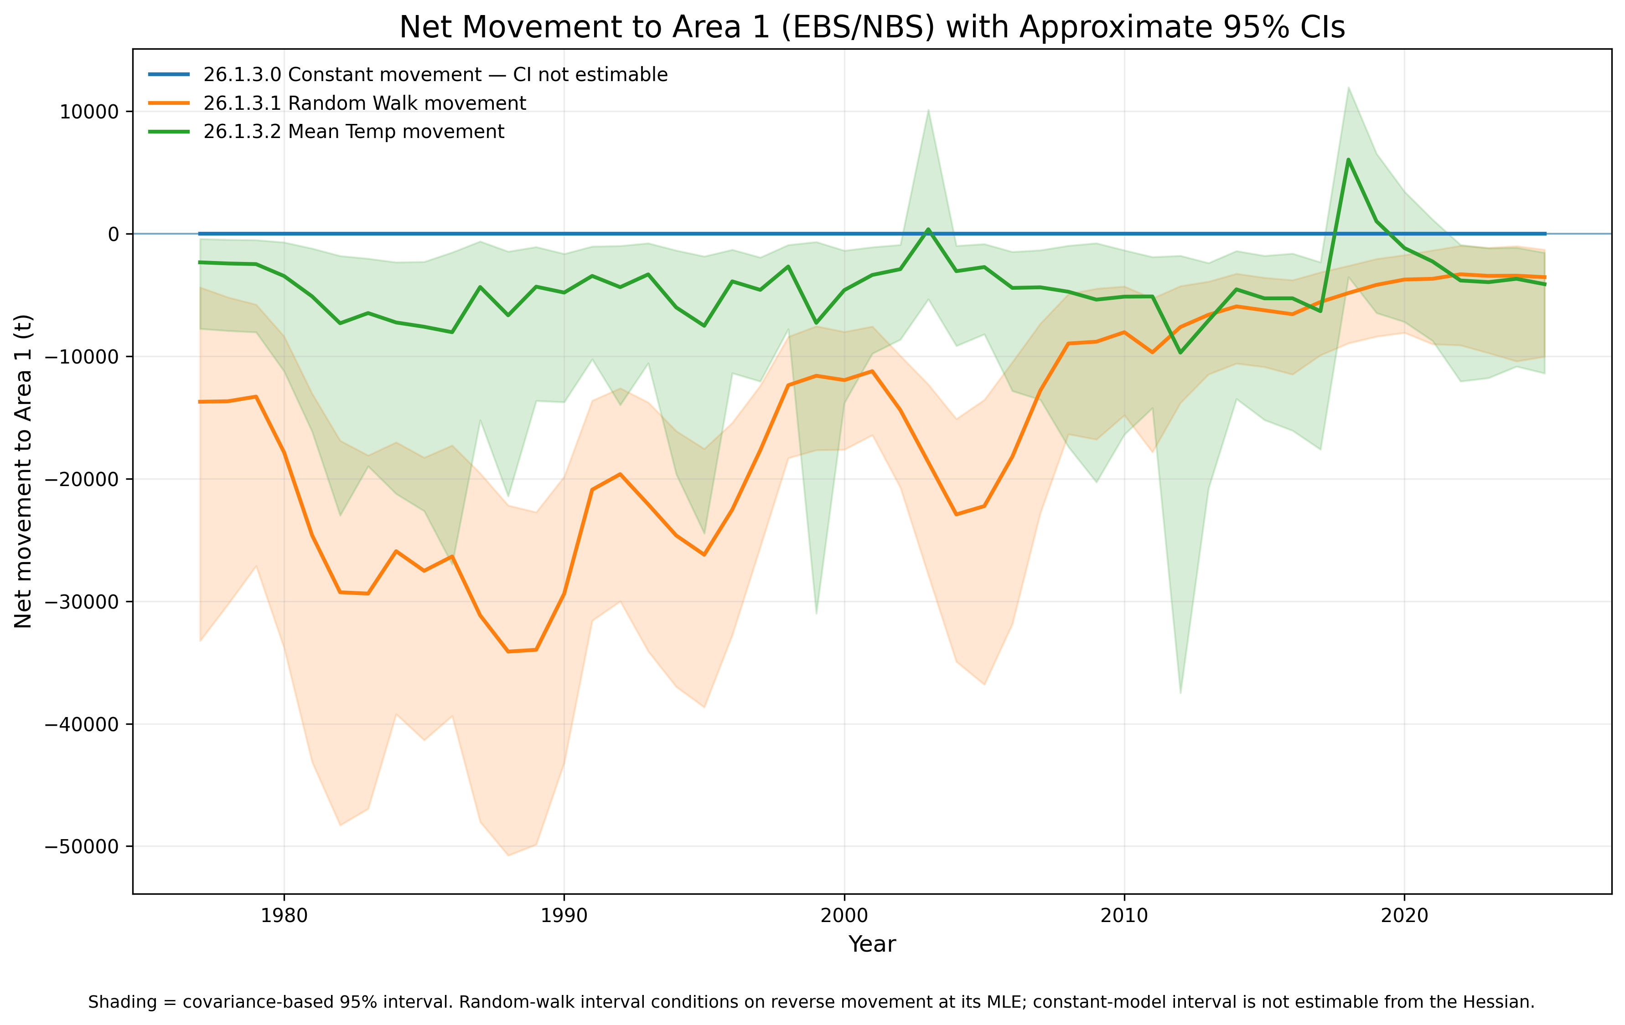
Catchability or movement?
  Agreement in spatial state among models but substantial structural uncertainty in spatial mechanism

Slide 17
Limitation of Stock Synthesis?
These models are finding multiple ways to explain essentially the same data. Changes or discrepancies in indices and composition can be absorbed by q, movement, recruitment allocation, and growth or selectivity.
In Stock Synthesis there is no easy ways to rigorously test among various hypothesis on how spatial processes impact stock dynamics.
Stock Synthesis demonstrates that a two-area Pacific cod model is feasible, but the current explorations reveal substantial confounding among catchability, movement, recruitment allocation, growth, and selectivity. A spatial-first RTMB framework such as SPoRC may provide a more flexible and sustainable platform for resolving these hypotheses, incorporating direct movement data, and developing the model further.

Slide 18
Twelve reasons to move to SPoRC and away from Stock Synthesis
ADMB is a legacy dependency with limited future development.
  The ADMB Foundation announced retirement from active development, with the goal of leaving a stable release that can continue compiling existing models such as Stock Synthesis.
SPoRC was designed as a spatial model from the outset.
  Multi-region, age-, sex-, and time-varying population processes are core design features rather than additions to a predominantly general-purpose integrated assessment framework. It supports flexible regional structures, recruitment allocation, fleet structures, and connectivity assumptions.
Stock Synthesis can do spatial models, but the implementation becomes complicated quickly.
  SS requires area-specific fleets/data, recruitment-distribution decisions, movement definitions, and often growth morphs to represent regional biological differences.

Slide 19
Twelve reasons to move to SPoRC and away from Stock Synthesis
Random effects are much more natural in RTMB/TMB.
  Allows more direct testing of spatial and movement processes: annual movement, annual catchability, recruitment allocation, and environmental effects. TMB was developed with efficient Laplace approximation for random effects, whereas SS/ADMB requires implementing these processes through large sets of annual deviation parameters and penalties.
A state-space formulation is a better conceptual match for time-varying spatial processes.
  Rather than treating annual movement or catchability variation primarily as fixed annual parameters with penalties, SPoRC explicitly supports stochastic time-varying processes as random effects.
It should be easier to separate competing hypotheses about spatial dynamics.
  We can explicitly formulate models such as “distribution changes through recruitment,” “distribution changes through movement,” “survey availability changes through q,” or combinations of these, while keeping the rest of the model structure more directly comparable unlike Stock Synthesis.

Slide 20
Twelve reasons to move to SPoRC and away from Stock Synthesis
The code is more transparent and easier to modify.
  SPoRC is implemented in R/RTMB, putting much more of the model in a language assessment scientists already use. That lowers the barrier to inspecting equations, adding a new movement function, changing an environmental relationship, or testing a new likelihood. Accessibility, collaboration, and knowledge transfer are explicitly stated as design goals.
Better suited to team development.
  A modular R package can be version-controlled, unit-tested, reviewed, and extended without requiring most assessment scientists to understand the internals of ADMB or the very large Stock Synthesis codebase.
Tagging data fit naturally into the spatial framework.
  SPoRC was designed to integrate catch, indices, compositions and tagging.

Slide 21
Twelve reasons to move to SPoRC and away from Stock Synthesis
Simulation and MSE are built into the philosophy of the platform.
  SPoRC includes simulation and closed-loop evaluation, making it much easier to ask whether your proposed spatial model can actually recover movement, recruitment allocation, and q under known truth before using it operationally.
Uncertainty estimation is more flexible.
  RTMB/TMB supports delta-method uncertainty and efficient random-effects integration, while SPoRC can also interface with NUTS/MCMC for Bayesian estimation when the likelihood surface is highly nonlinear.
It is better aligned with where assessment software development is going.
  TMB/RTMB-based approaches are now used in frameworks such as SAM, WHAM, FIMS, and SPoRC, particularly because of random-effects and state-space capabilities.

Slide 22
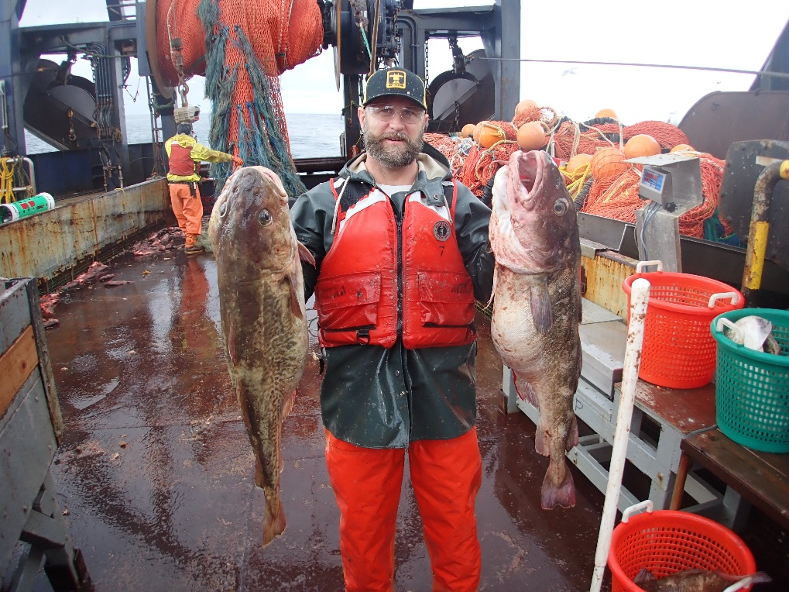
Western GOA Pcod assessment research
September 2026 Plan Team

Slide 23
Outline
What is SPoRC?
Model/Data set up
Model/Data scenarios
Data exploration
Next steps/timeline
Things to consider

Slide 24
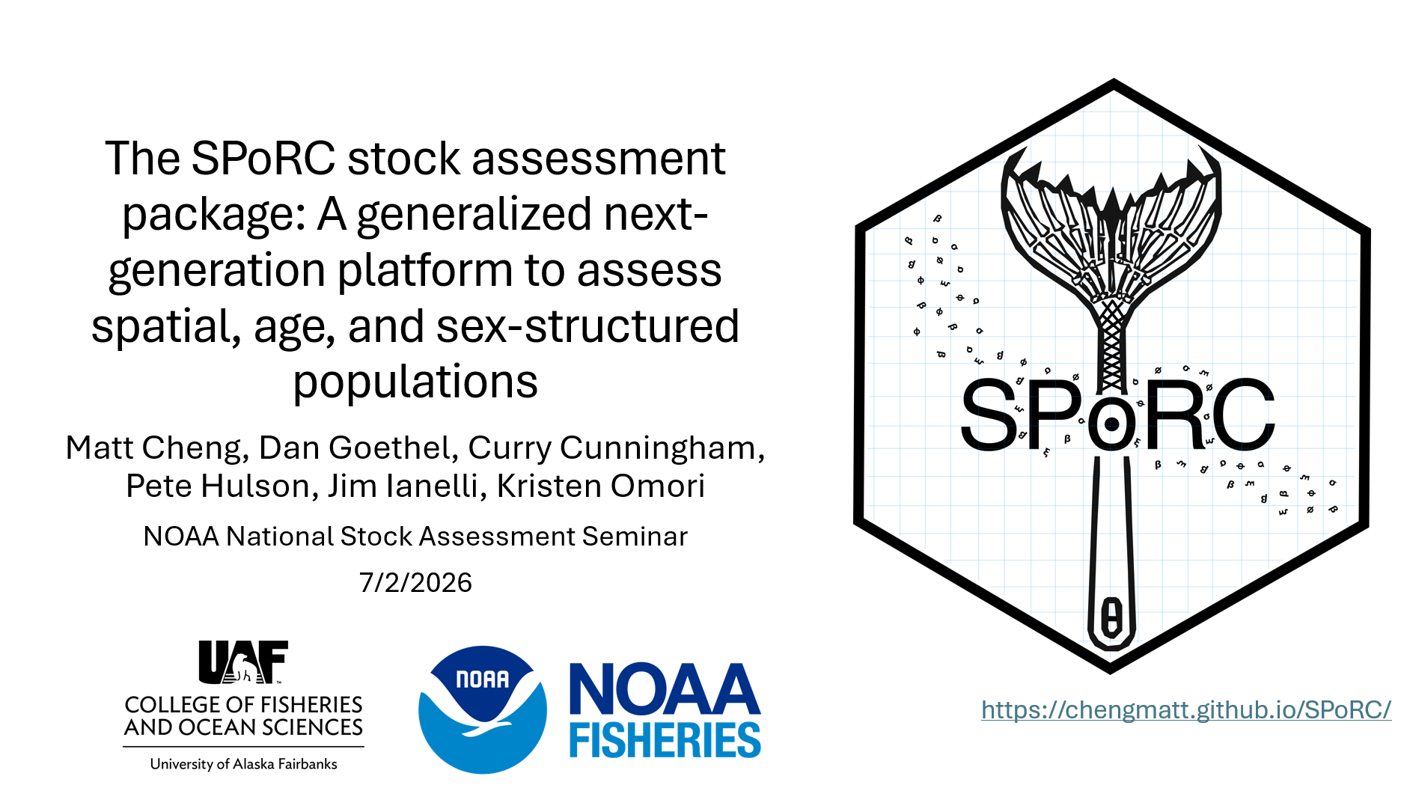
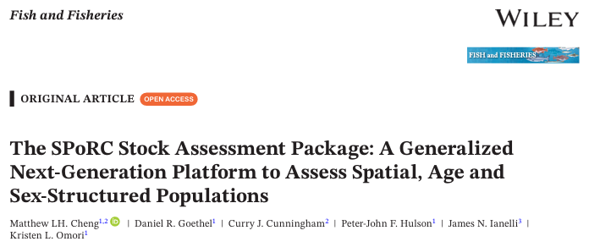
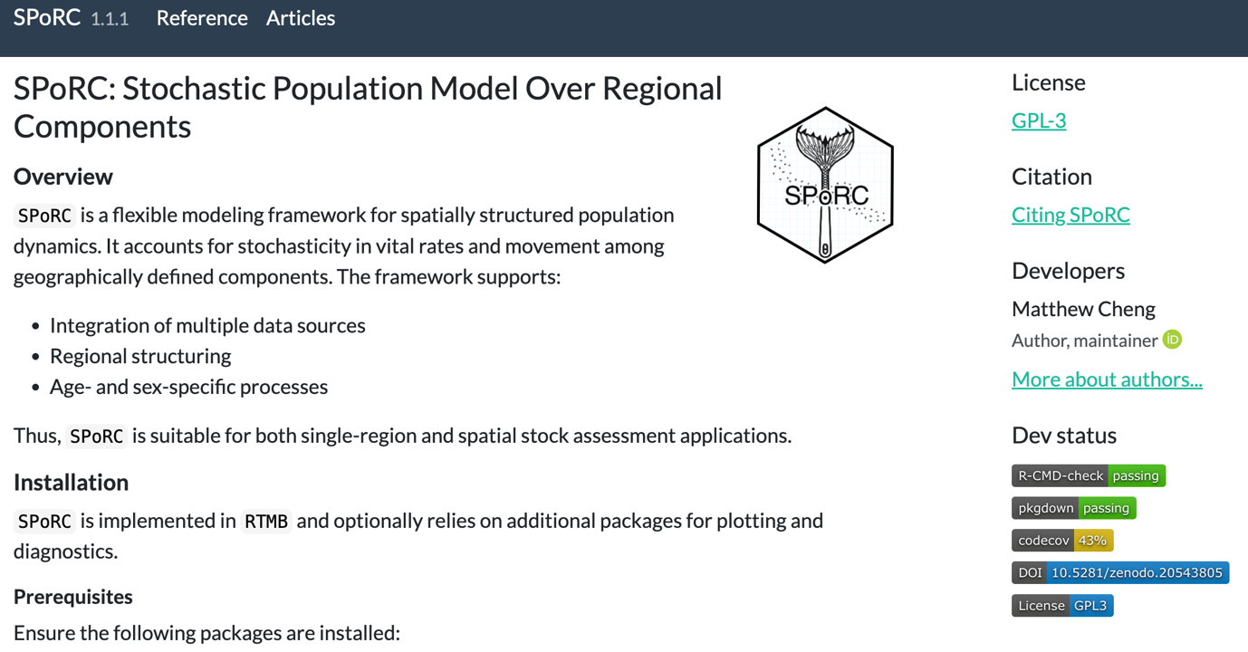
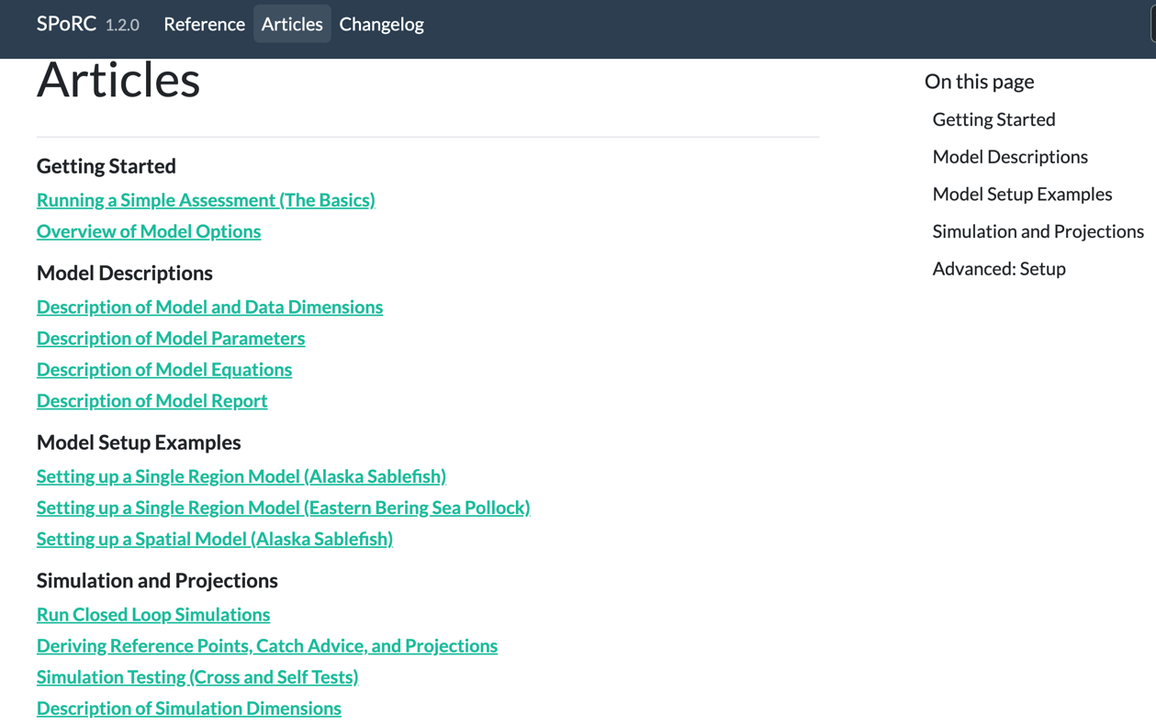
What is SPoRC?
Stochastic (S) Population (P) over (o) Regional (R) Components (C)
Stock assessment platform written in R and RTMB
Statistical catch-at-age model w/ spatial, sex, and fleet-structure
  Supports random effects (Laplace Approximation) and Bayesian inference (rstan)
R package that includes model fitting, comprehensive stock assessment model diagnostics, and simulation tools

Slide 25
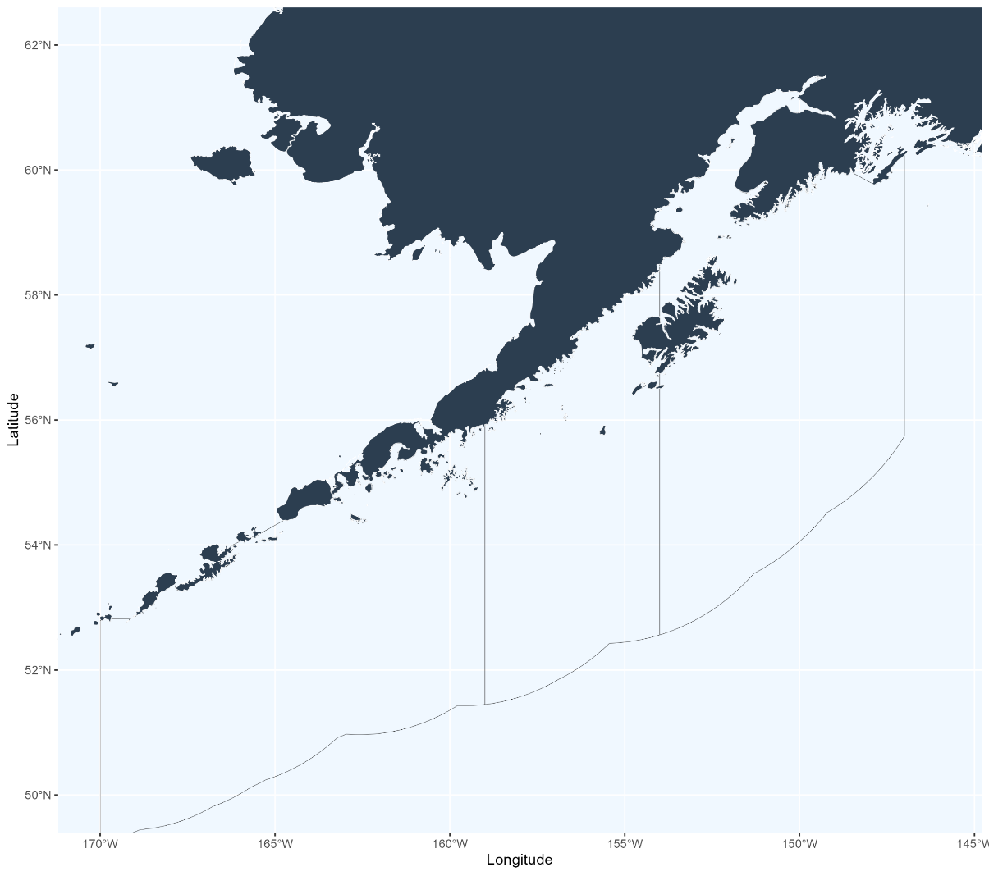
Model/Data set up
How do we think about populations and sub-populations?
Where do we draw the lines?
EBS
630
620
WGOA
CGOA

Slide 26
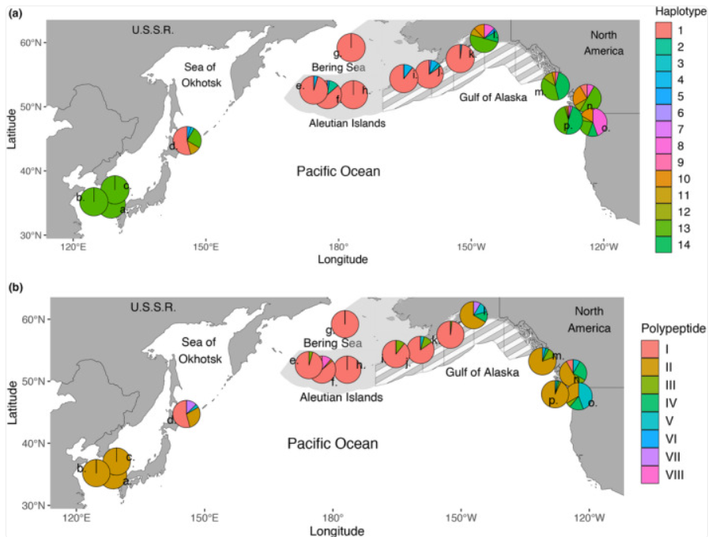
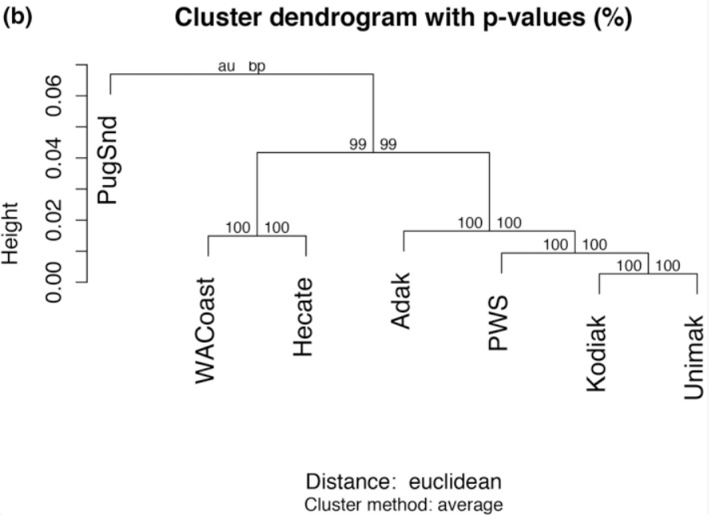
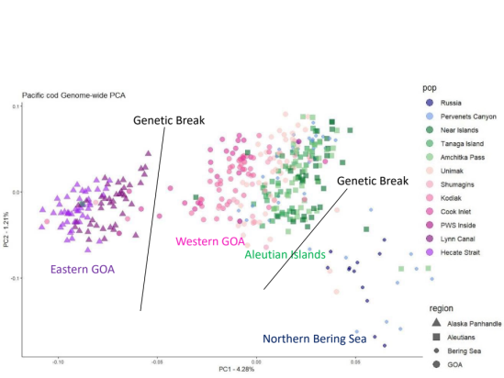
Model/Data set up
How do we think about populations and sub-populations? Genetics
EBS
630
620
WGOA
CGOA

Slide 27

Model/Data set up
How do we think about populations and sub-populations? Movement
Case 1: 2 Sub-populations based upon overall movement exchange
Case 2: 3 Sub-populations based upon seasonal movement exchange
EBS
EBS
630
630
620
620
WGOA
WGOA
CGOA
CGOA

Slide 28
Model/Data set up
Where do we draw the lines?
EBS
630
620
WGOA
CGOA

Slide 29
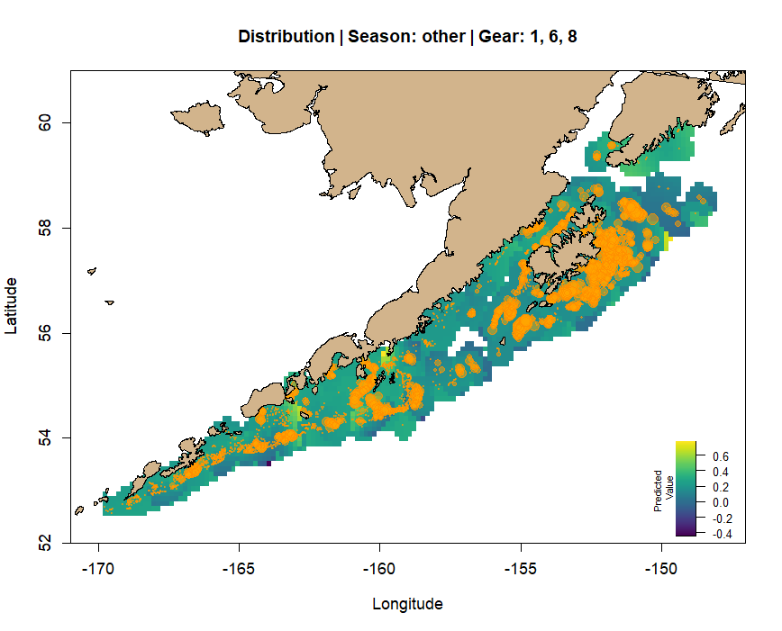
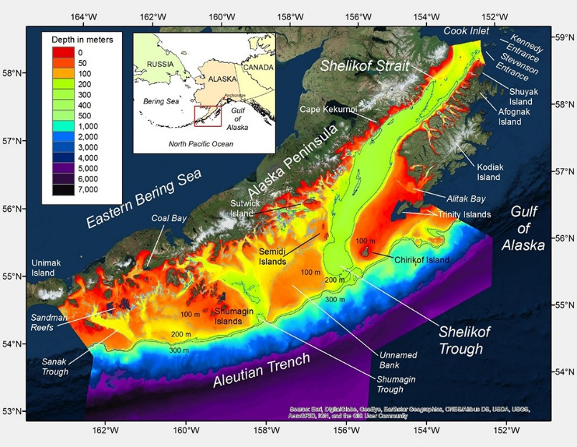
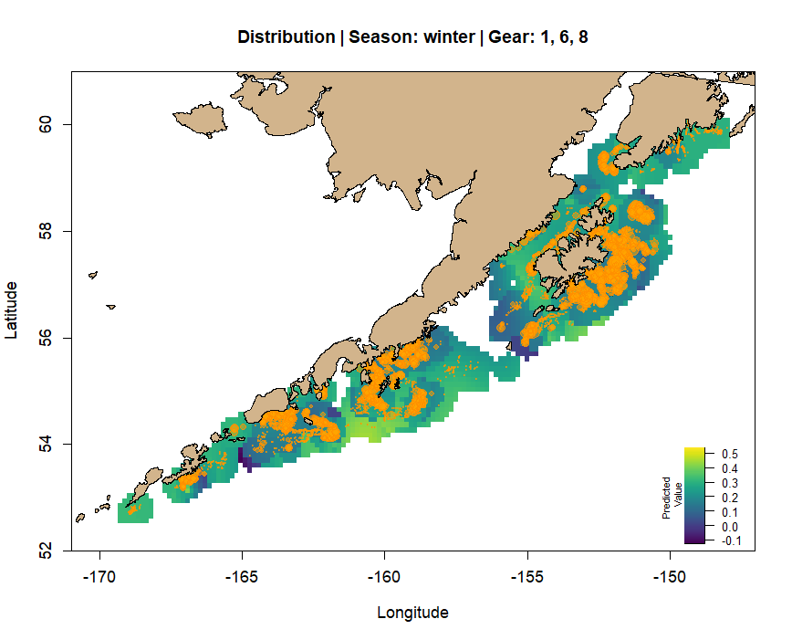
Model/Data set up
Where do we draw the lines? Fishery data (Rebecca Howard)
EBS
630
620
WGOA
CGOA

Slide 30
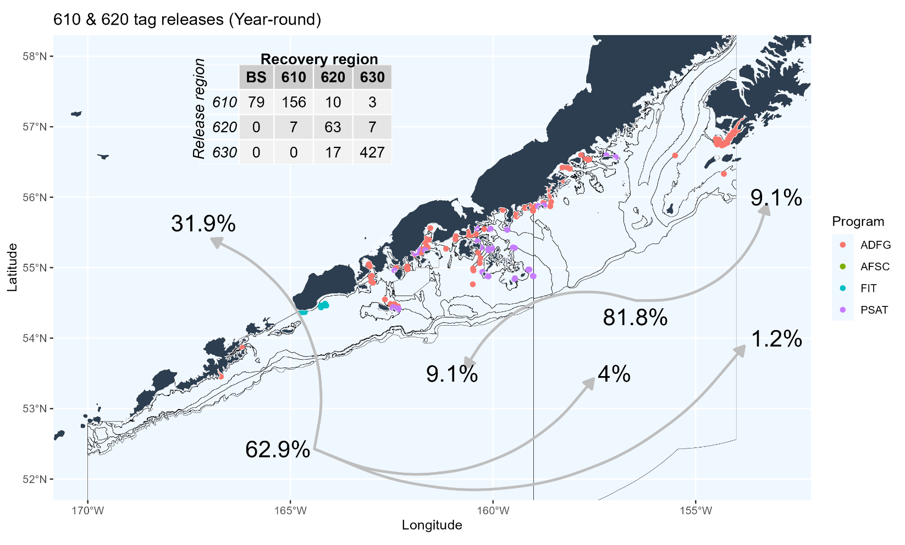
Model/Data set up
Where do we draw the lines? Tagging data
EBS
630
620
WGOA
CGOA

Slide 31
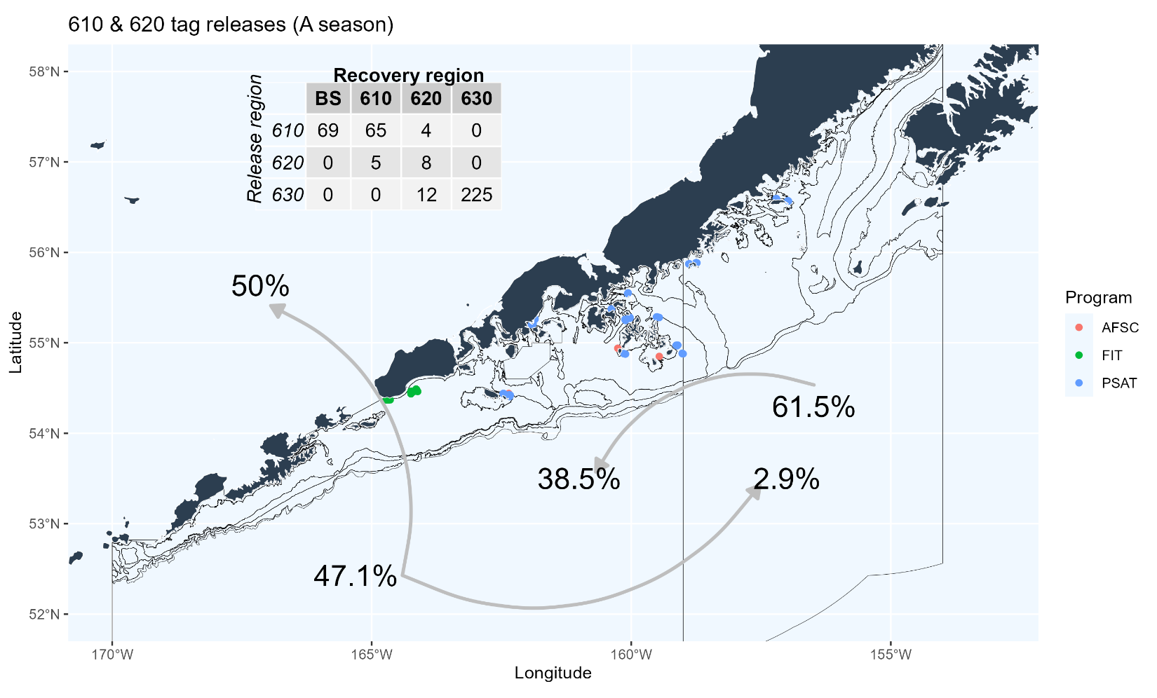
Model/Data set up
Where do we draw the lines? Tagging data
EBS
630
620
WGOA
CGOA

Slide 32
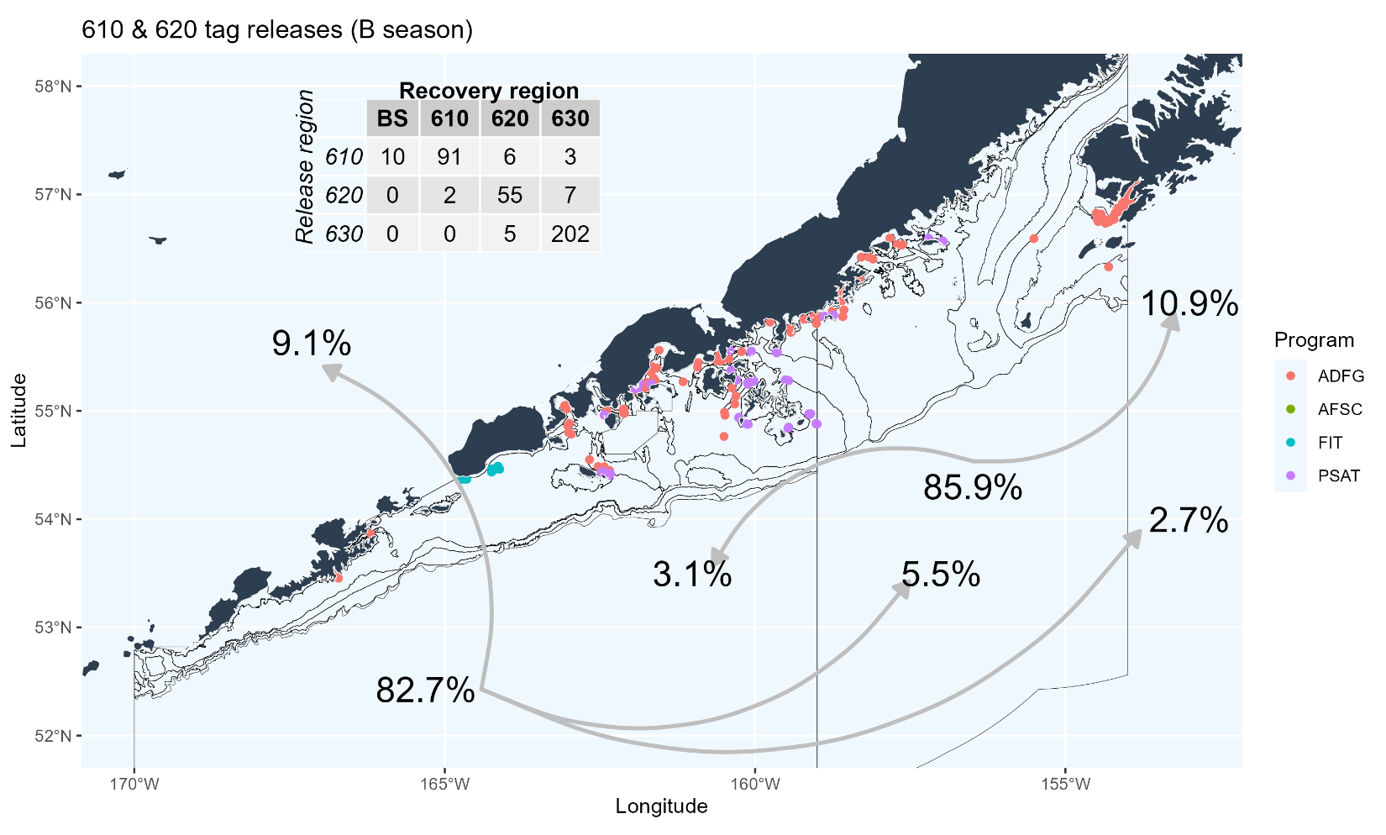
Model/Data set up
Where do we draw the lines? Tagging data
EBS
630
620
WGOA
CGOA

Slide 33
Model/Data set up
Where do we draw the lines?
Hard to know what to do with 620, and where to draw line defining the edge of the Central GOA sub-populations
2 cases for defining regions:
  Case 1: Define 620 & 630 as Central GOA, 610 as Western GOA (status quo)
  Case 2: Define 630 as Central GOA, 610 & 620 as Western GOA
EBS
630
620
WGOA
CGOA

Slide 34

Model/Data scenarios
Combination of 4 cases: 2 sub-population x 2 regional
2 sub-pop’n, 3 region
3 sub-pop’n, 3 region
EBS
EBS
630
630
620
620
WGOA
WGOA
CGOA
CGOA
EBS
EBS
630
630
620
620
WGOA
WGOA
CGOA
CGOA

Slide 35
Model/Data scenarios
Combination of 4 cases: 2 sub-population x 2 regional
2 sub-pop’n, 3 region
3 sub-pop’n, 3 region
EBS
EBS
630
630
620
620
WGOA
WGOA
CGOA
CGOA
EBS
EBS
630
630
620
620
WGOA
WGOA
CGOA
CGOA

Slide 36
Data explorations
Fitted data sources:
  Catch: by season (A – Jan-Mar, B – Apr-Dec) and region (EBS, WGOA, CGOA)
    Note: can only split back to 1991, set as model start year
  Index: Summer bottom trawl survey by region
    Note: Plan to add longline survey for GOA, mix of model-based (EBS) and design-based (GOA)
  Composition: Age and length (when age not available) for fishery (seasonal) and survey (summer/B season)
    Note: plus age-10+, 5 cm length bins

Slide 37
Data explorations
Other data sources:
  Growth: empirical weight/size-at-age, seasonal and regional
    Notes:
      Time-invariant, looking into time-dependent for EBS
      Little data available in A season to inform growth, particularly in GOA. Used SS3 beginning of year estimate from operational assessments to offset summer (mid-year) data from survey
  Maturity: taken directly from operational assessments (regional, WGOA = CGOA)
  Ageing error: taken from assessments
    Note: Ageing bias also implemented as in operational assessment, will discuss/explore regionally aggregated ageing error with collaborators

Slide 38
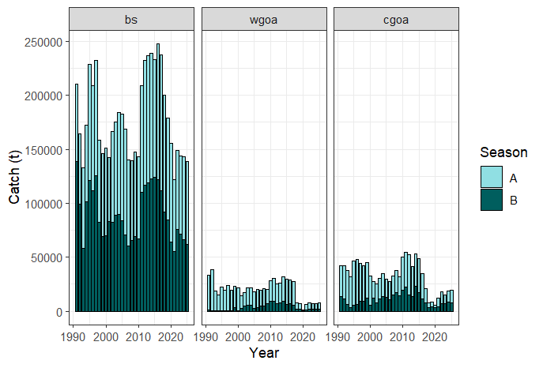
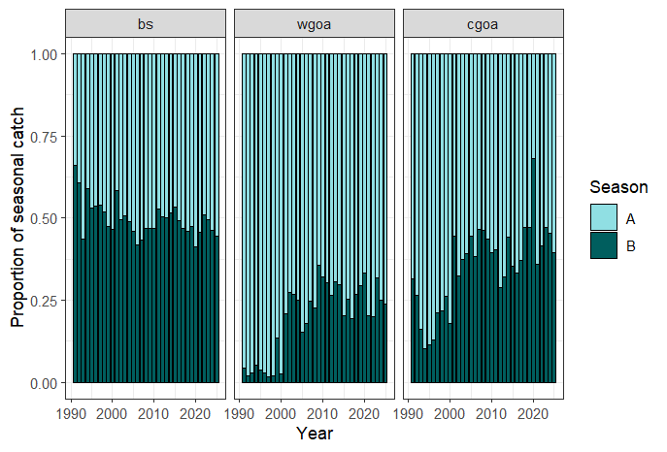
Data explorations
Catch (by season):

Slide 39
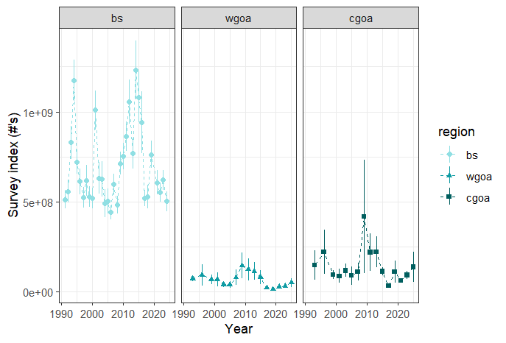
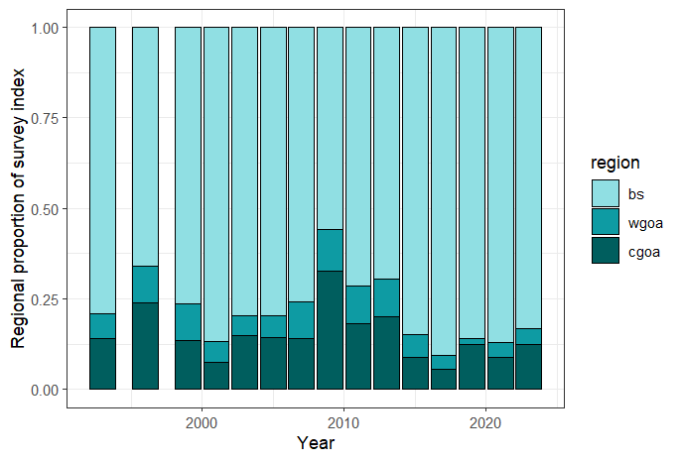
Data explorations
Bottom trawl survey index:

Slide 40
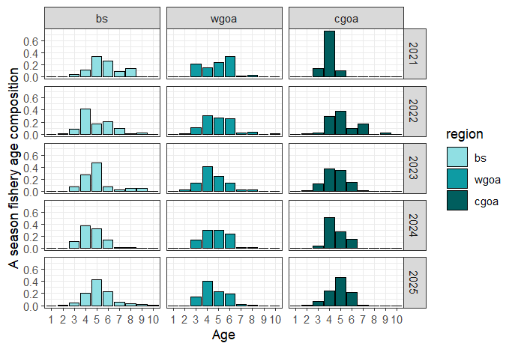
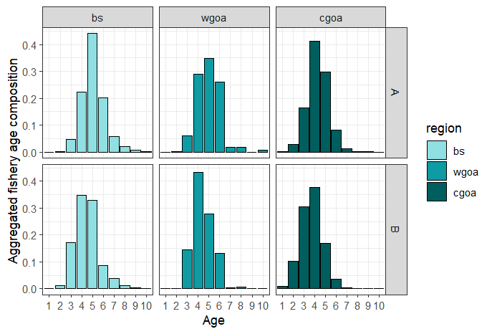
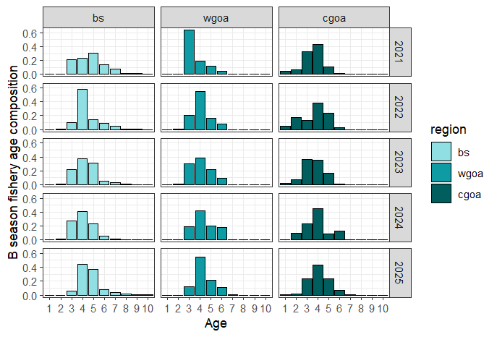
Data explorations
Fishery age comps

Slide 41
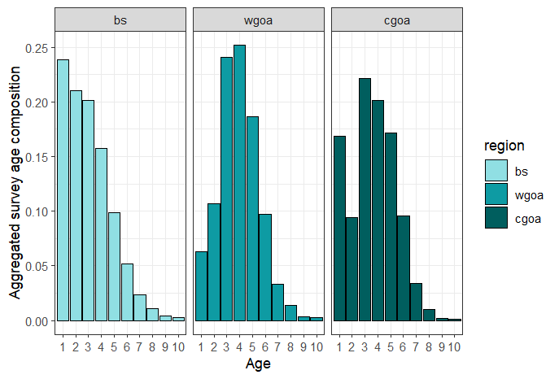
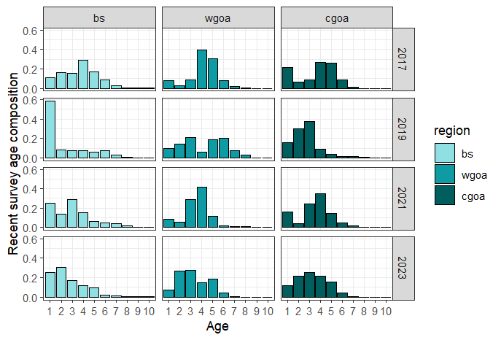
Data explorations
Survey age comps

Slide 42


Data explorations
Growth (survey)

Slide 43
Next steps/Timeline
Next steps:
  Continue to refine model/data assumptions
  Build and evaluate cases of sub-populations/regions
  Understand and explore results in comparison with operational assessments
  Ultimate goal: construct MSE to explore consequences of alternative and status quo ABC/TAC apportionment between EBS/WGOA
Timeline
  Present spatial model results 2027 Sept Plan Team
  Conduct CIE review of spatial model and apportionment alternatives in Spring 2028
  Present CIE results and potential apportionment alternatives in Fall 2028

Slide 44
Things to consider
Data limitations:
  We have NO index of abundance in the A season. Past explorations into fishery CPUE (particularly in WGOA) have proved fruitless. A season abundance is inferred from fits to tagging and fishery composition/catch data.
  We have limited tagging data, both across space and time. NEED consistent and reliable source of tagging data, particularly if we want to understand environmental influence on movement
Management conundrums
  If operational model used to set ABC and spatial model used to inform apportionment: GOA TAC > ABC? Increase in TAC must be seasonal
  Alternatively: if WGOA recommended to be incorporated within EBS assessment, cross-FMP complications to consider

Slide 45
Things to consider
Range of options, from complex to simple:
  Spatially and seasonally-explicit model that estimates movement
  Single area BS|WGOA integrated model (w or w/o seasonality)
  Ad hoc adjustment to current methodology informed by tagging
Simple example to get a feel for what magnitude we’re talking about:
% of BS biomass | Movement rate from WGOA
% of BS biomass | 30% | 40% | 50%
2019 | 2.2% | 3.4% | 5.1%
2021 | 2.9% | 4.5% | 6.7%
2023 | 3.7% | 5.7% | 8.6%
Avg | 2.9% | 4.5% | 6.8%

Slide 46
Questions?

