Slide 1

Western GOA Pcod assessment research
September 2026 Plan Team

Slide 2
Outline
What is SPoRC?
Model/Data set up
Model/Data scenarios
Data exploration
Next steps/timeline
Things to consider

Slide 3
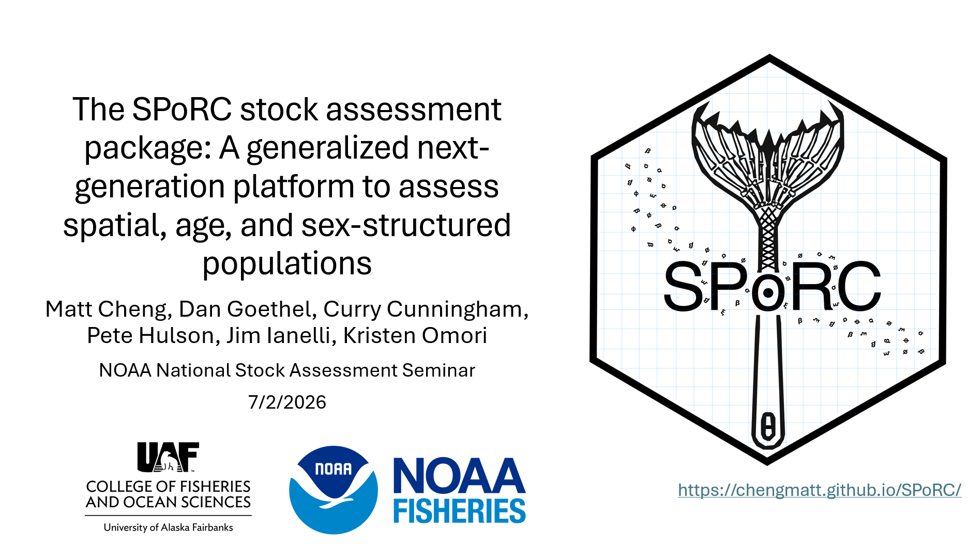
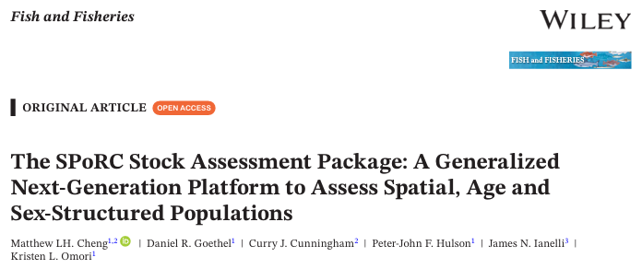
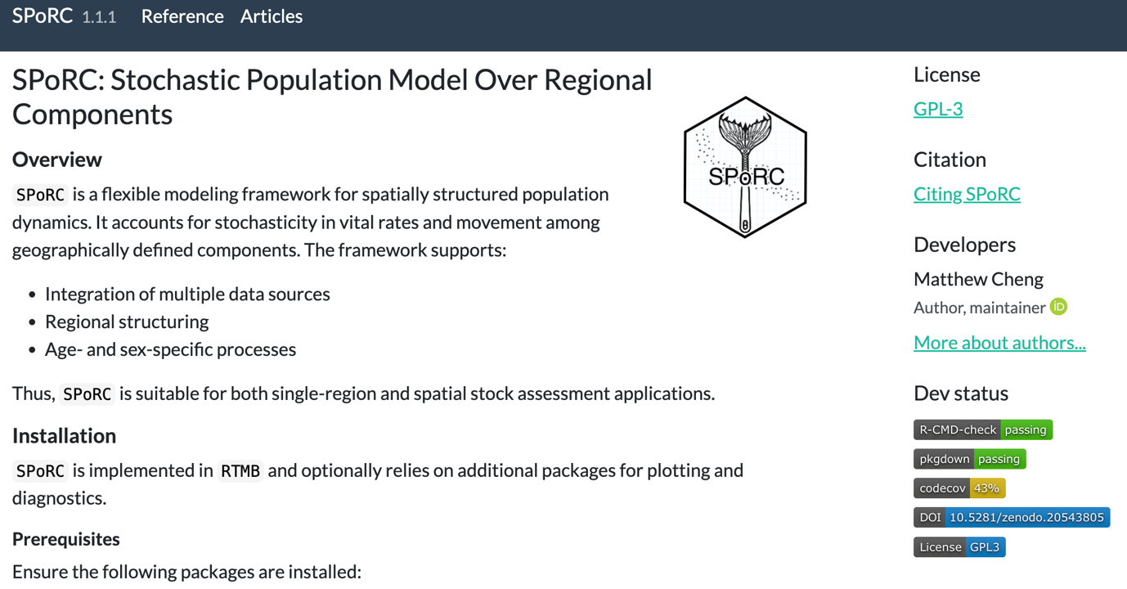
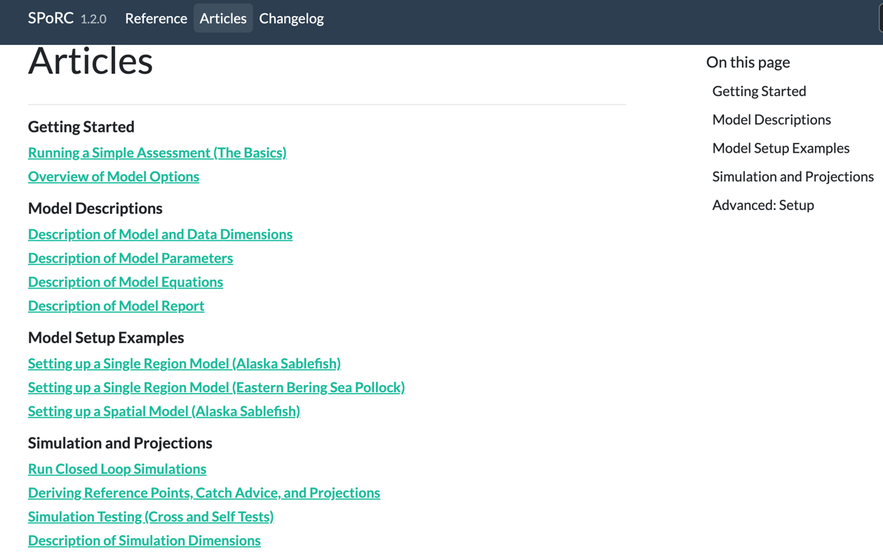
What is SPoRC?
Stochastic (S) Population (P) over (o) Regional (R) Components (C)
Stock assessment platform written in R and RTMB
Statistical catch-at-age model w/ spatial, sex, and fleet-structure
  Supports random effects (Laplace Approximation) and Bayesian inference (rstan)
R package that includes model fitting, comprehensive stock assessment model diagnostics, and simulation tools

Slide 4
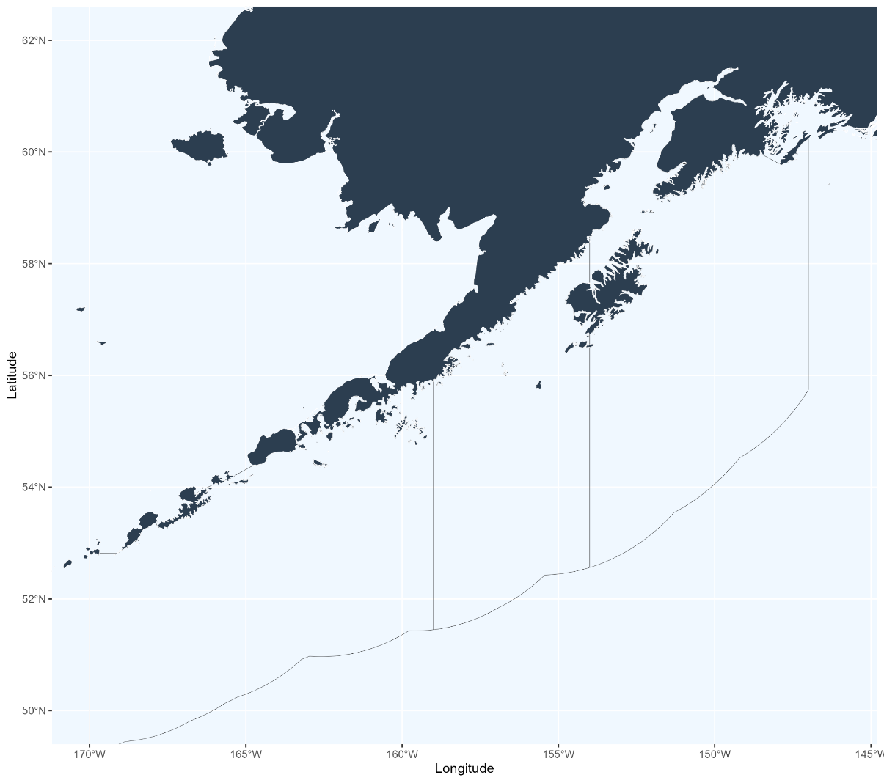
Model/Data set up
How do we think about populations and sub-populations?
Where do we draw the lines?
EBS
630
620
WGOA
CGOA

Slide 5
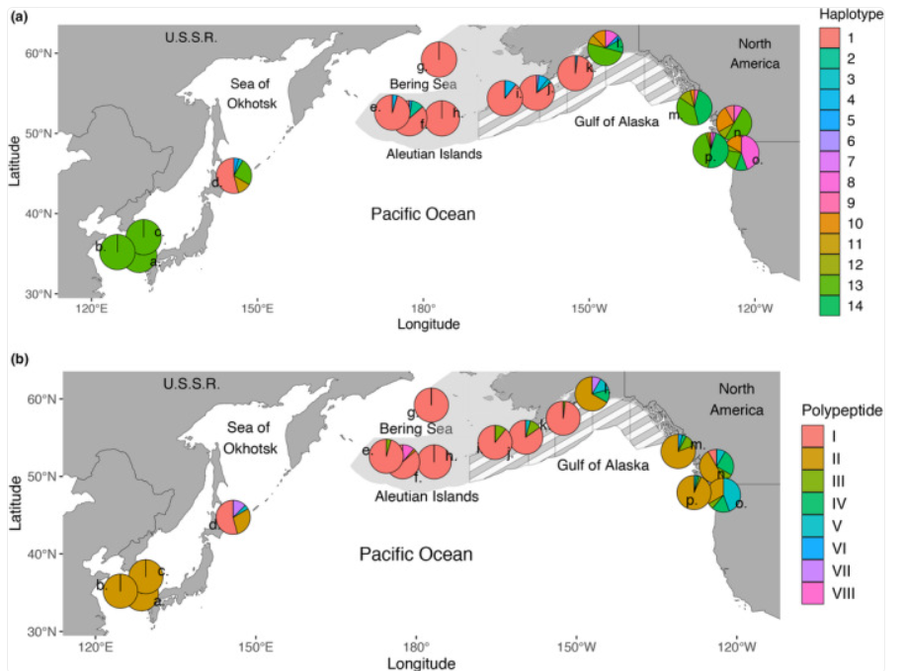
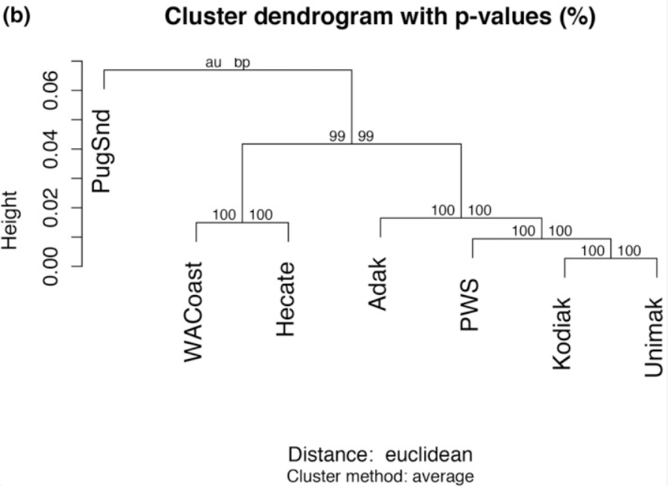
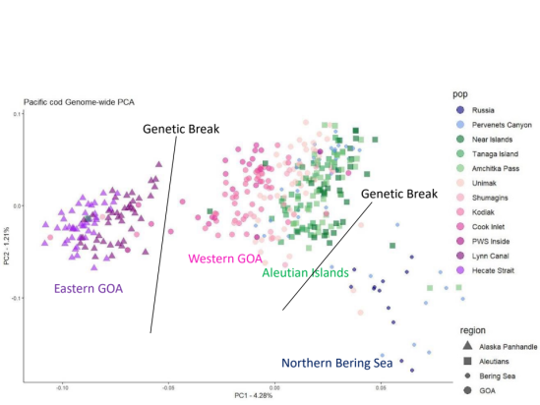
Model/Data set up
How do we think about populations and sub-populations? Genetics
EBS
630
620
WGOA
CGOA

Slide 6

Model/Data set up
How do we think about populations and sub-populations? Movement
Case 1: 2 Sub-populations based upon overall movement exchange
Case 2: 3 Sub-populations based upon seasonal movement exchange
EBS
EBS
630
630
620
620
WGOA
WGOA
CGOA
CGOA

Slide 7
Model/Data set up
Where do we draw the lines?
EBS
630
620
WGOA
CGOA

Slide 8
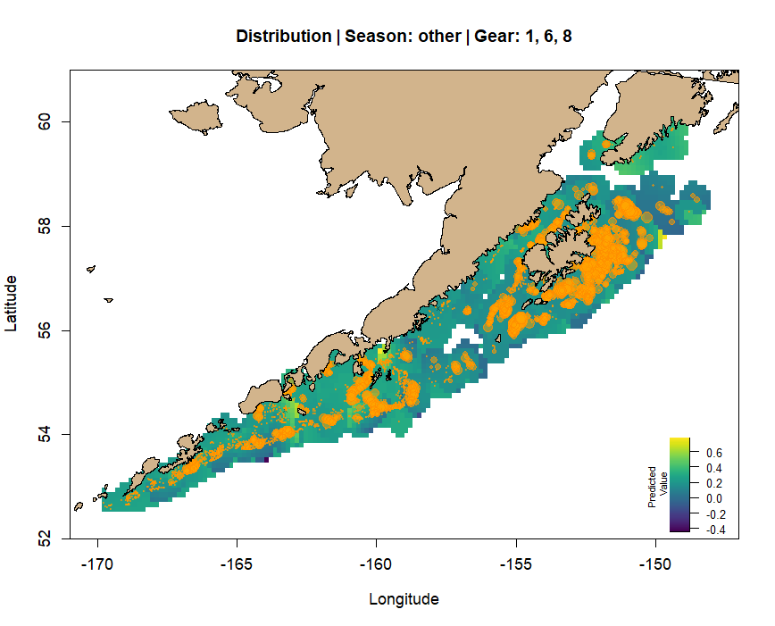
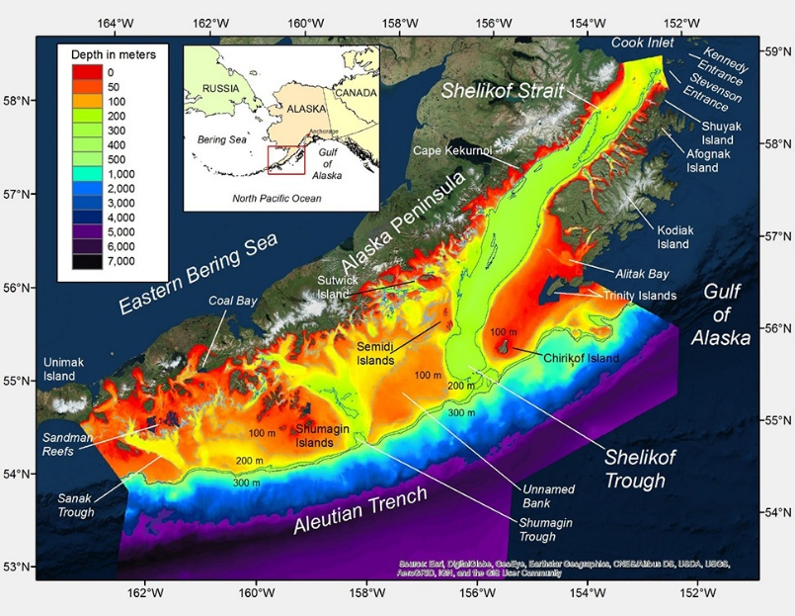
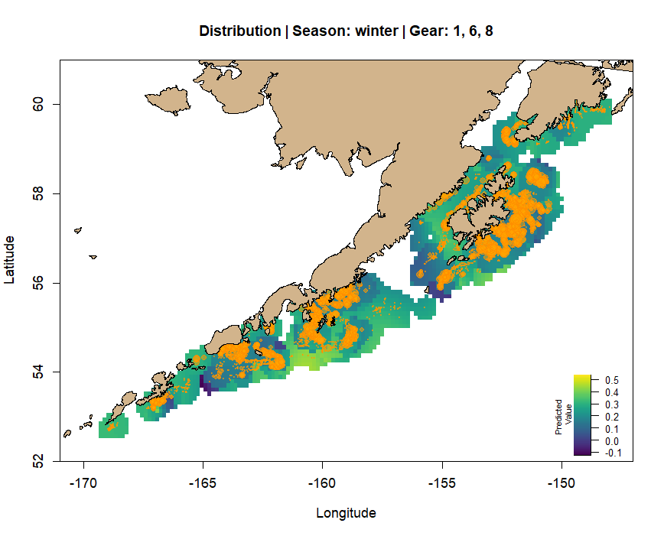
Model/Data set up
Where do we draw the lines? Fishery data (Rebecca Howard)
EBS
630
620
WGOA
CGOA

Slide 9
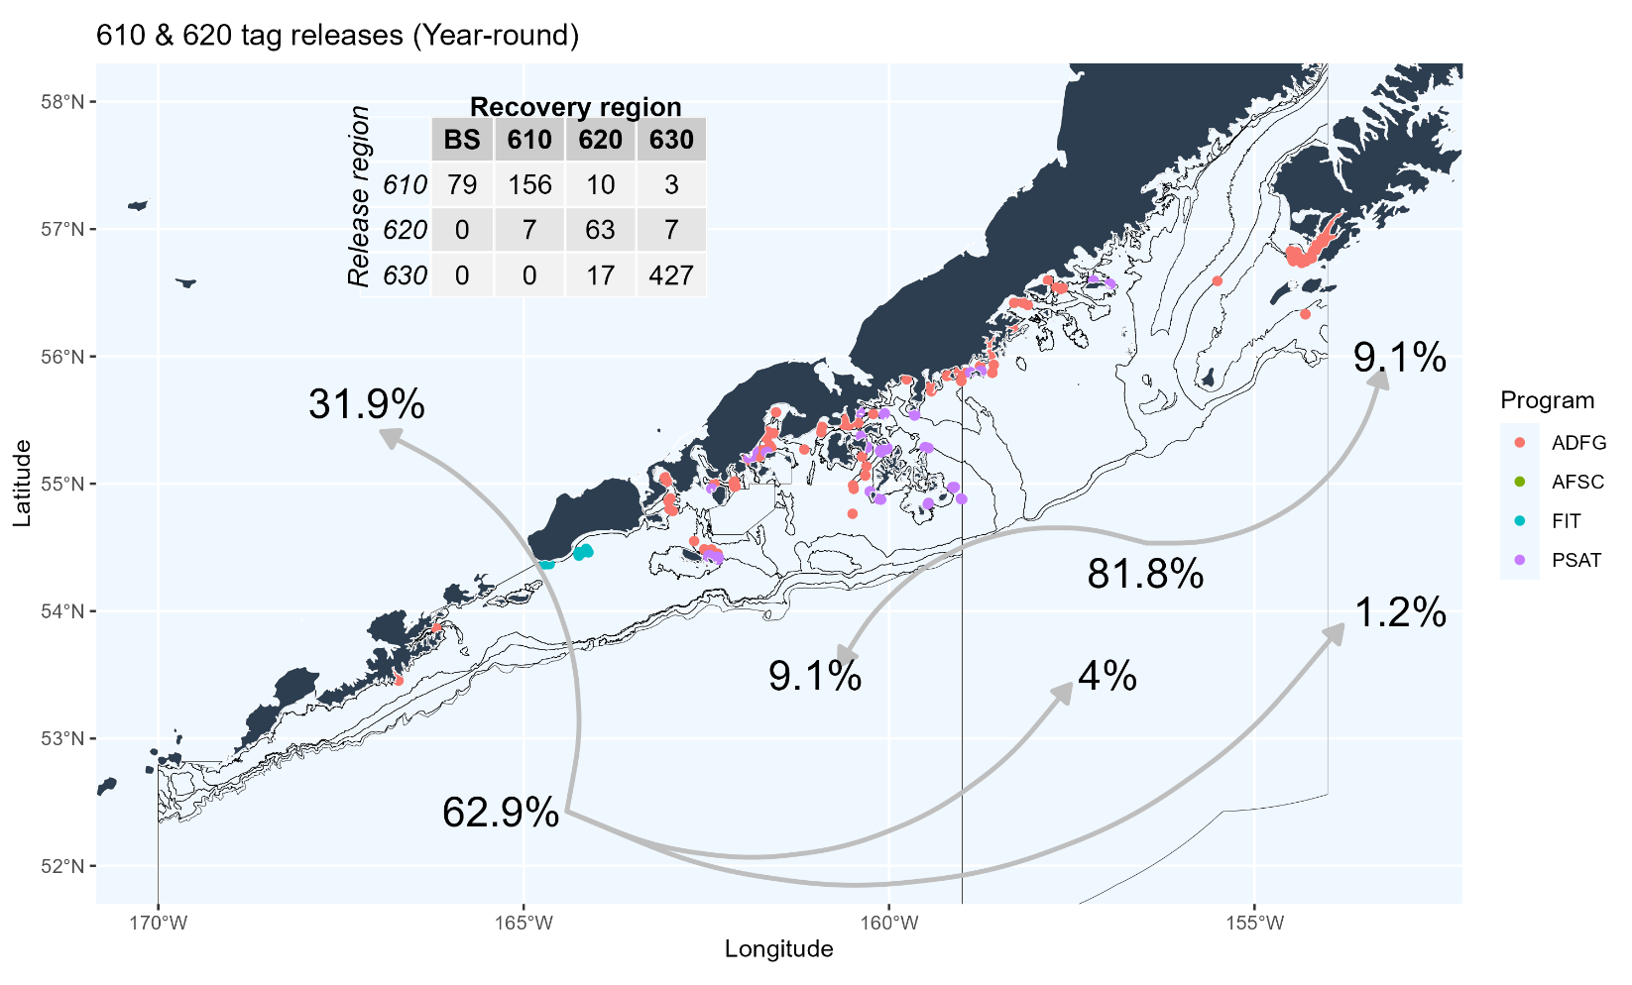
Model/Data set up
Where do we draw the lines? Tagging data
EBS
630
620
WGOA
CGOA

Slide 10
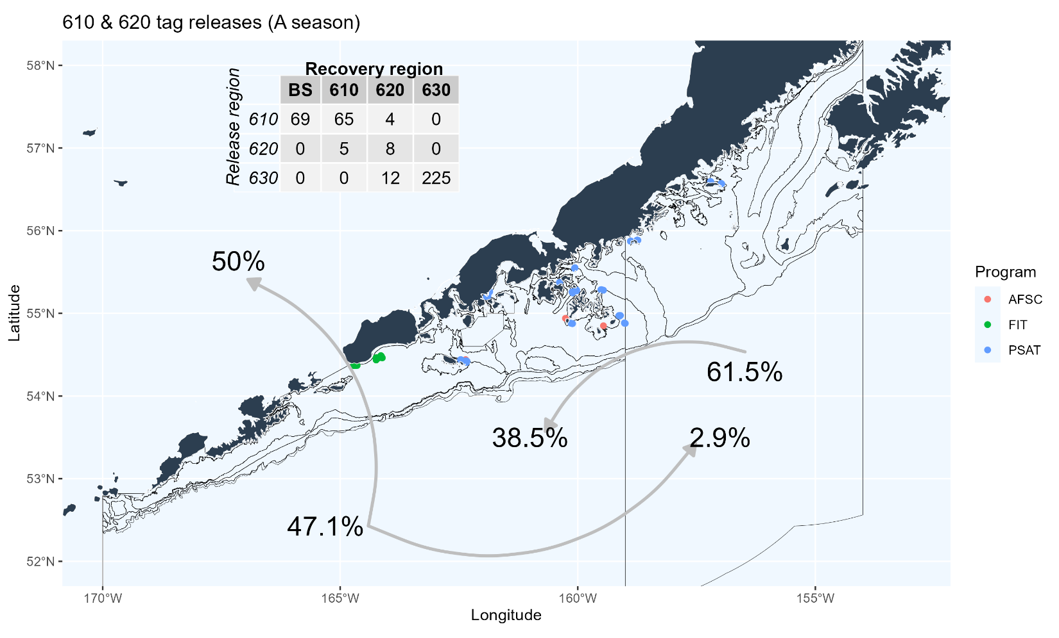
Model/Data set up
Where do we draw the lines? Tagging data
EBS
630
620
WGOA
CGOA

Slide 11
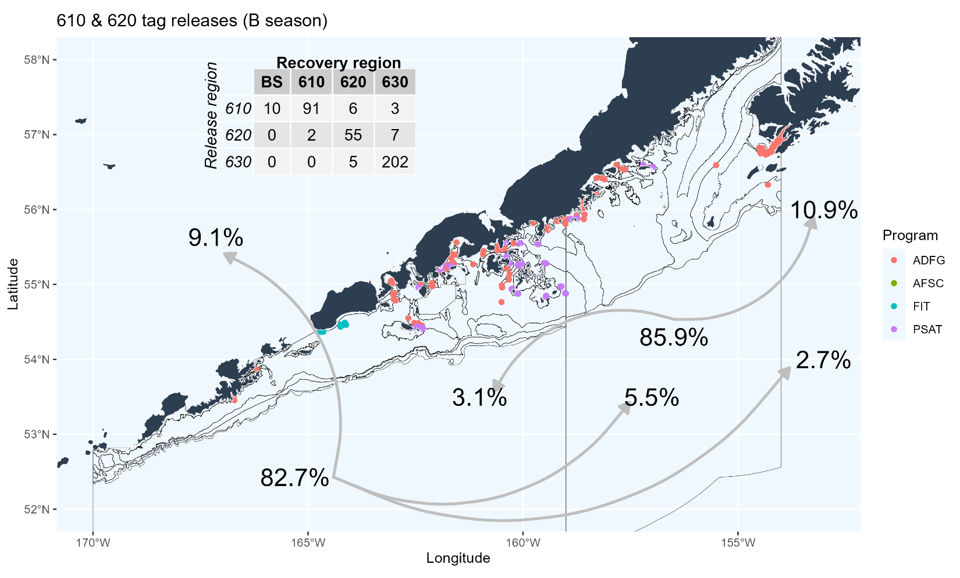
Model/Data set up
Where do we draw the lines? Tagging data
EBS
630
620
WGOA
CGOA

Slide 12
Model/Data set up
Where do we draw the lines?
Hard to know what to do with 620, and where to draw line defining the edge of the Central GOA sub-populations
2 cases for defining regions:
  Case 1: Define 620 & 630 as Central GOA, 610 as Western GOA (status quo)
  Case 2: Define 630 as Central GOA, 610 & 620 as Western GOA
EBS
630
620
WGOA
CGOA

Slide 13

Model/Data scenarios
Combination of 4 cases: 2 sub-population x 2 regional
2 sub-pop’n, 3 region
3 sub-pop’n, 3 region
EBS
EBS
630
630
620
620
WGOA
WGOA
CGOA
CGOA
EBS
EBS
630
630
620
620
WGOA
WGOA
CGOA
CGOA

Slide 14
Model/Data scenarios
Combination of 4 cases: 2 sub-population x 2 regional
2 sub-pop’n, 3 region
3 sub-pop’n, 3 region
EBS
EBS
630
630
620
620
WGOA
WGOA
CGOA
CGOA
EBS
EBS
630
630
620
620
WGOA
WGOA
CGOA
CGOA

Slide 15
Data explorations
Fitted data sources:
  Catch: by season (A – Jan-Mar, B – Apr-Dec) and region (EBS, WGOA, CGOA)
    Note: can only split back to 1991, set as model start year
  Index: Summer bottom trawl survey by region
    Note: Plan to add longline survey for GOA, mix of model-based (EBS) and design-based (GOA)
  Composition: Age and length (when age not available) for fishery (seasonal) and survey (summer/B season)
    Note: plus age-10+, 5 cm length bins

Slide 16
Data explorations
Other data sources:
  Growth: empirical weight/size-at-age, seasonal and regional
    Notes:
      Time-invariant, looking into time-dependent for EBS
      Little data available in A season to inform growth, particularly in GOA. Used SS3 beginning of year estimate from operational assessments to offset summer (mid-year) data from survey
  Maturity: taken directly from operational assessments (regional, WGOA = CGOA)
  Ageing error: taken from assessments
    Note: Ageing bias also implemented as in operational assessment, will discuss/explore regionally aggregated ageing error with collaborators

Slide 17
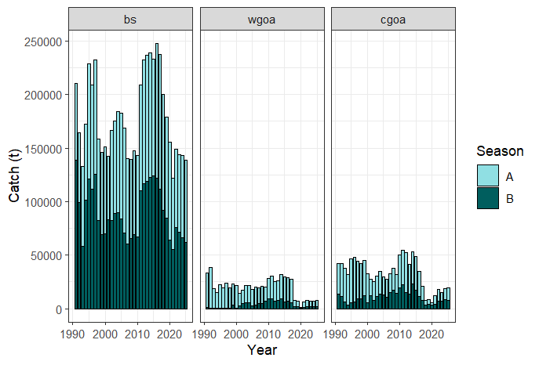
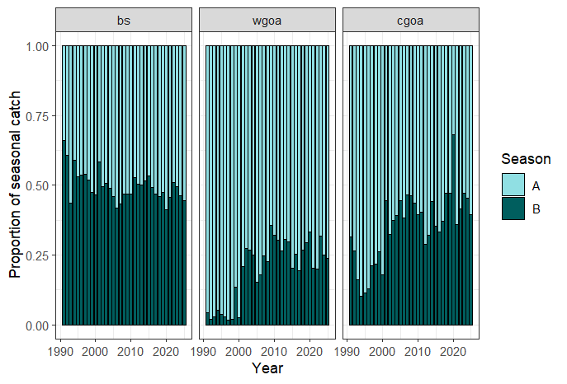
Data explorations
Catch (by season):

Slide 18
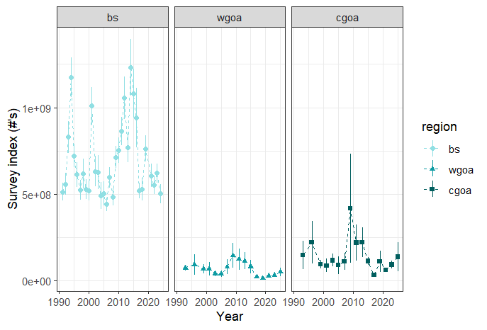
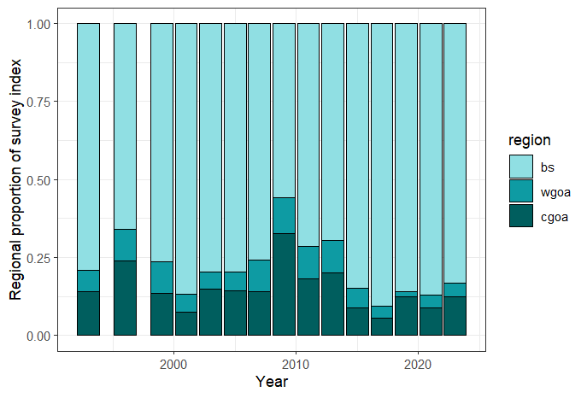
Data explorations
Bottom trawl survey index:

Slide 19
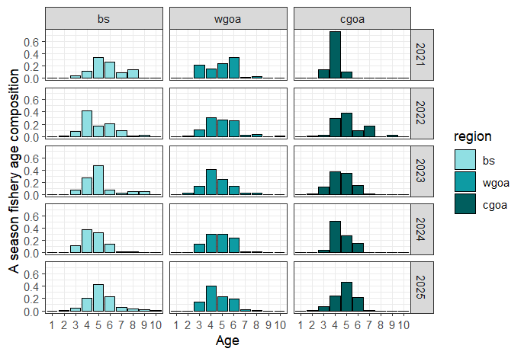
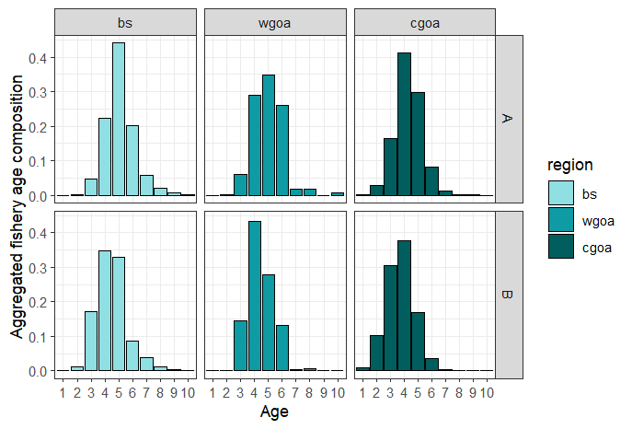
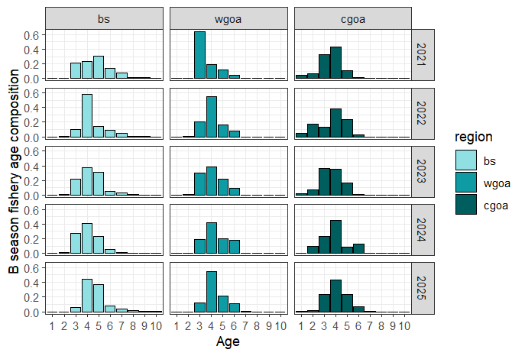
Data explorations
Fishery age comps

Slide 20
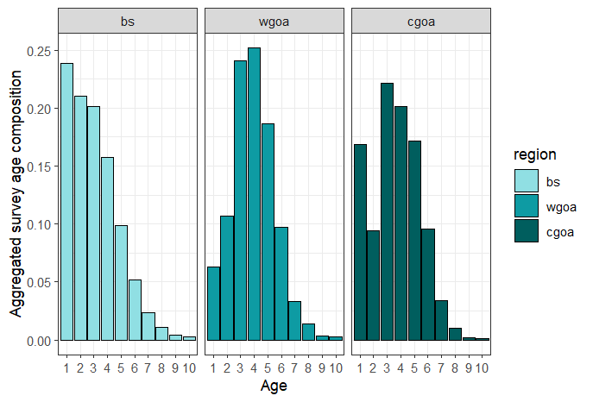
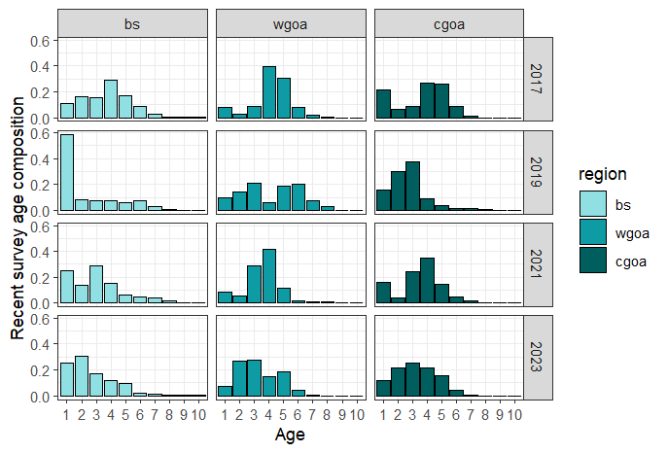
Data explorations
Survey age comps

Slide 21
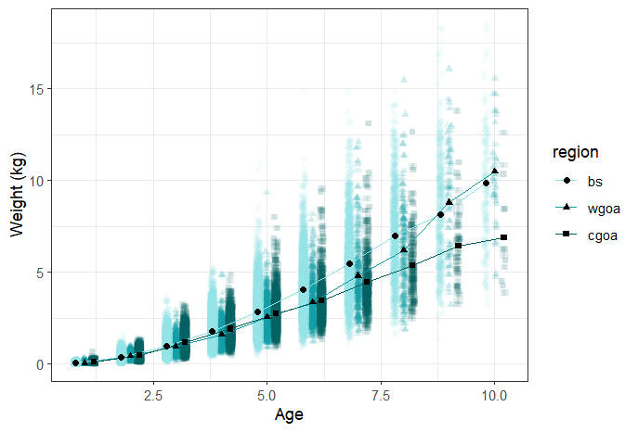
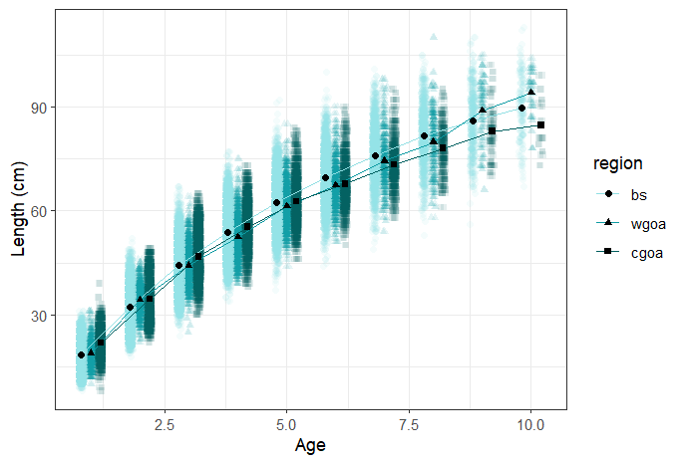
Data explorations
Growth (survey)

Slide 22
Next steps/Timeline
Next steps:
  Continue to refine model/data assumptions
  Build and evaluate cases of sub-populations/regions
  Understand and explore results in comparison with operational assessments
  Ultimate goal: construct MSE to explore consequences of alternative and status quo ABC/TAC apportionment between EBS/WGOA
Timeline
  Present spatial model results 2027 Sept Plan Team
  Conduct CIE review of spatial model and apportionment alternatives in Spring 2028
  Present CIE results and potential apportionment alternatives in Fall 2028

Slide 23
Things to consider
Data limitations:
  We have NO index of abundance in the A season. Past explorations into fishery CPUE (particularly in WGOA) have proved fruitless. A season abundance is inferred from fits to tagging and fishery composition/catch data.
  We have limited tagging data, both across space and time. NEED consistent and reliable source of tagging data, particularly if we want to understand environmental influence on movement
Management conundrums
  If operational model used to set ABC and spatial model used to inform apportionment: GOA TAC > ABC? Increase in TAC must be seasonal
  Alternatively: if WGOA recommended to be incorporated within EBS assessment, cross-FMP complications to consider

Slide 24
Things to consider
Range of options, from complex to simple:
  Spatially and seasonally-explicit model that estimates movement
  Single area BS|WGOA integrated model (w or w/o seasonality)
  Ad hoc adjustment to current methodology informed by tagging
Simple example to get a feel for what magnitude we’re talking about:
% of BS biomass | Movement rate from WGOA
% of BS biomass | 30% | 40% | 50%
2019 | 2.2% | 3.4% | 5.1%
2021 | 2.9% | 4.5% | 6.7%
2023 | 3.7% | 5.7% | 8.6%
Avg | 2.9% | 4.5% | 6.8%

