Slide 1
2023 GOA Pcod assessment
September 2023 Plan Team

Slide 2
Overview
Housecleaning (CAAL minimum sample size)
Review of environmental link
Refresher on CFSR
Link for Longline survey catchability
Retrospective comparison w/ and w/o environmental link (PT request)
Revaluation of CFSR index
Link for growth
Individual growth parameters: determining most appropriate CFSR index
Combined growth model & comparison with base model
Path forward
Recommendations for November 2023

Slide 3
Housecleaning:
Minimum sample size issue
Historical assessments removed CAAL data with minimum sample size less than 1 (i.e., weight)
1,812 of 2,825 (64%) CAAL length-age data removed
Model 2019.1b corrects minimum sample size so all CAAL data included

Slide 4
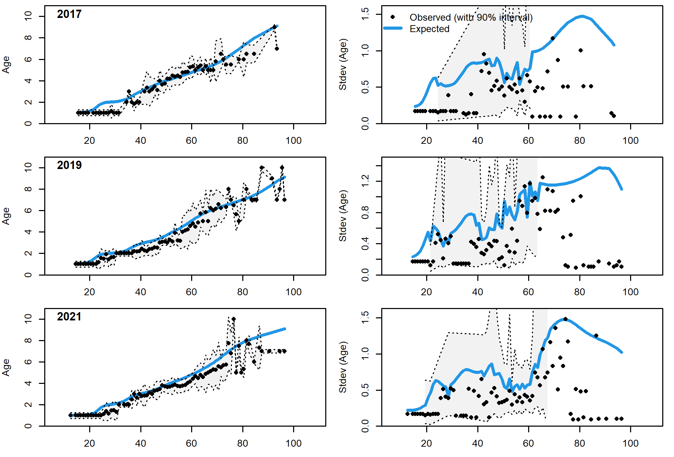
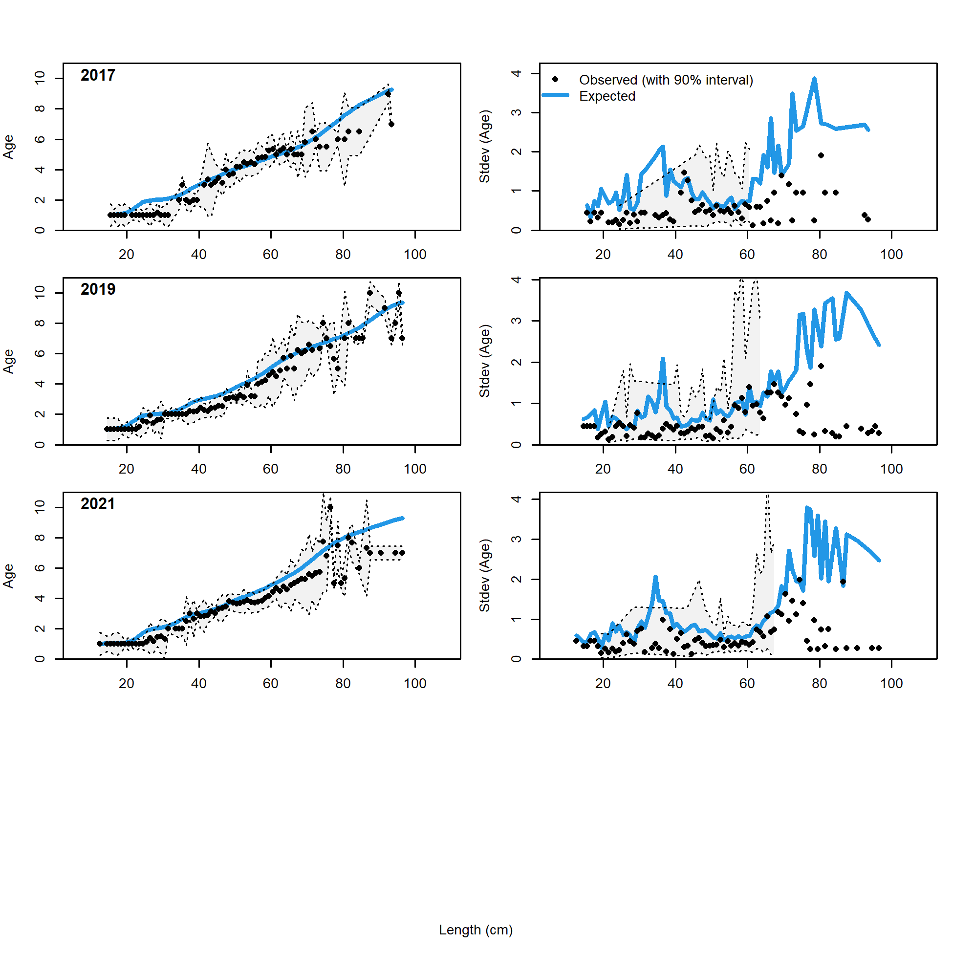
Housecleaning:
2019.1a (recent trawl survey)
Likelihoods & Fits
2019.1b

Slide 5
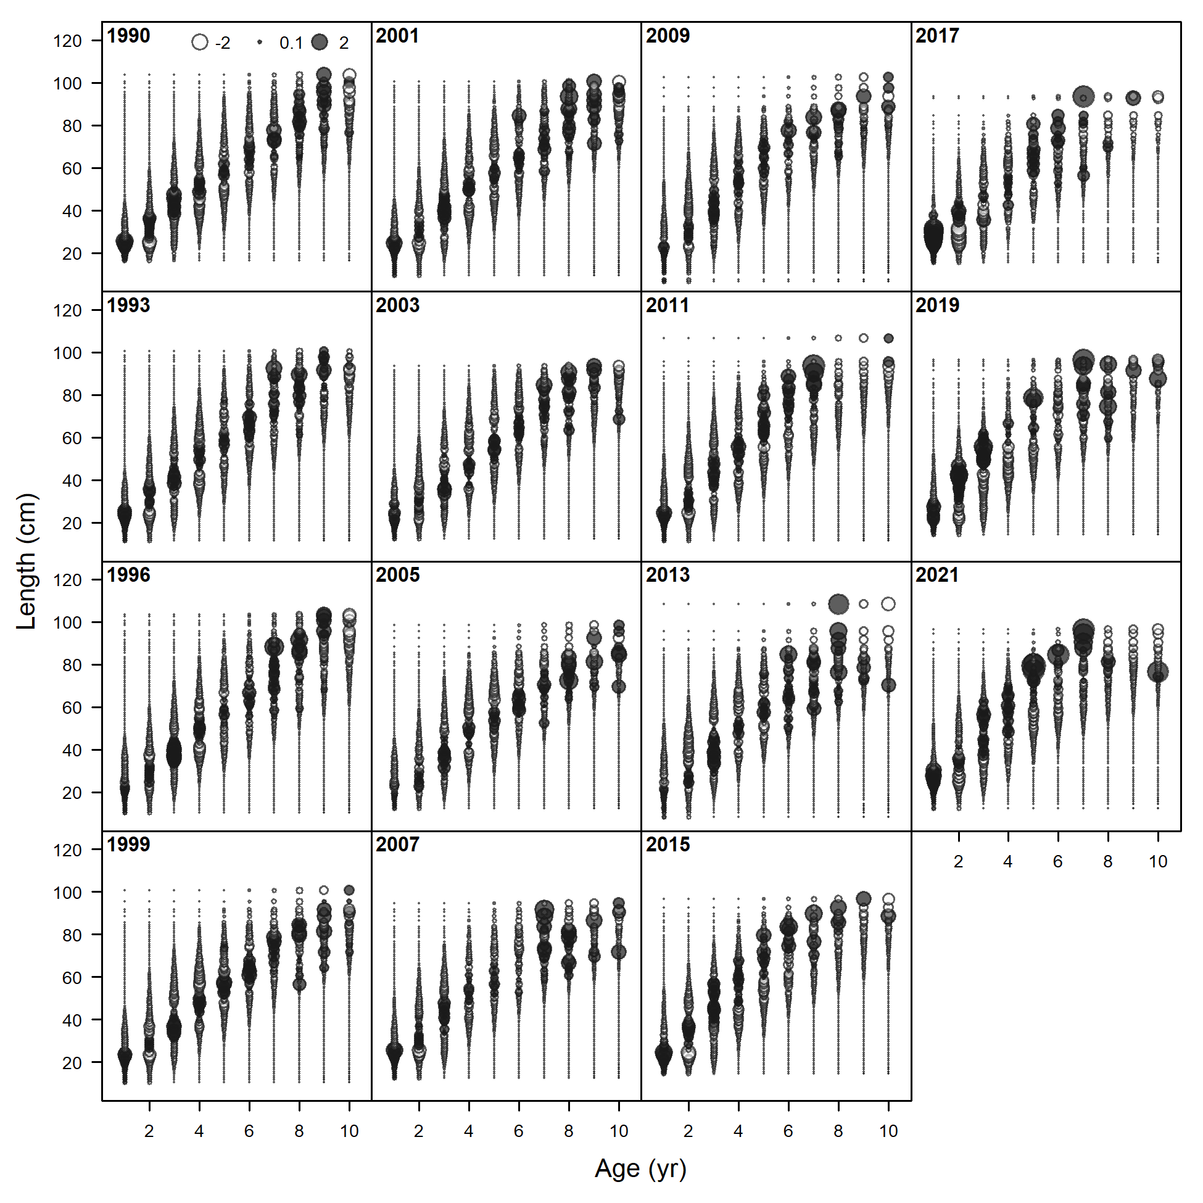
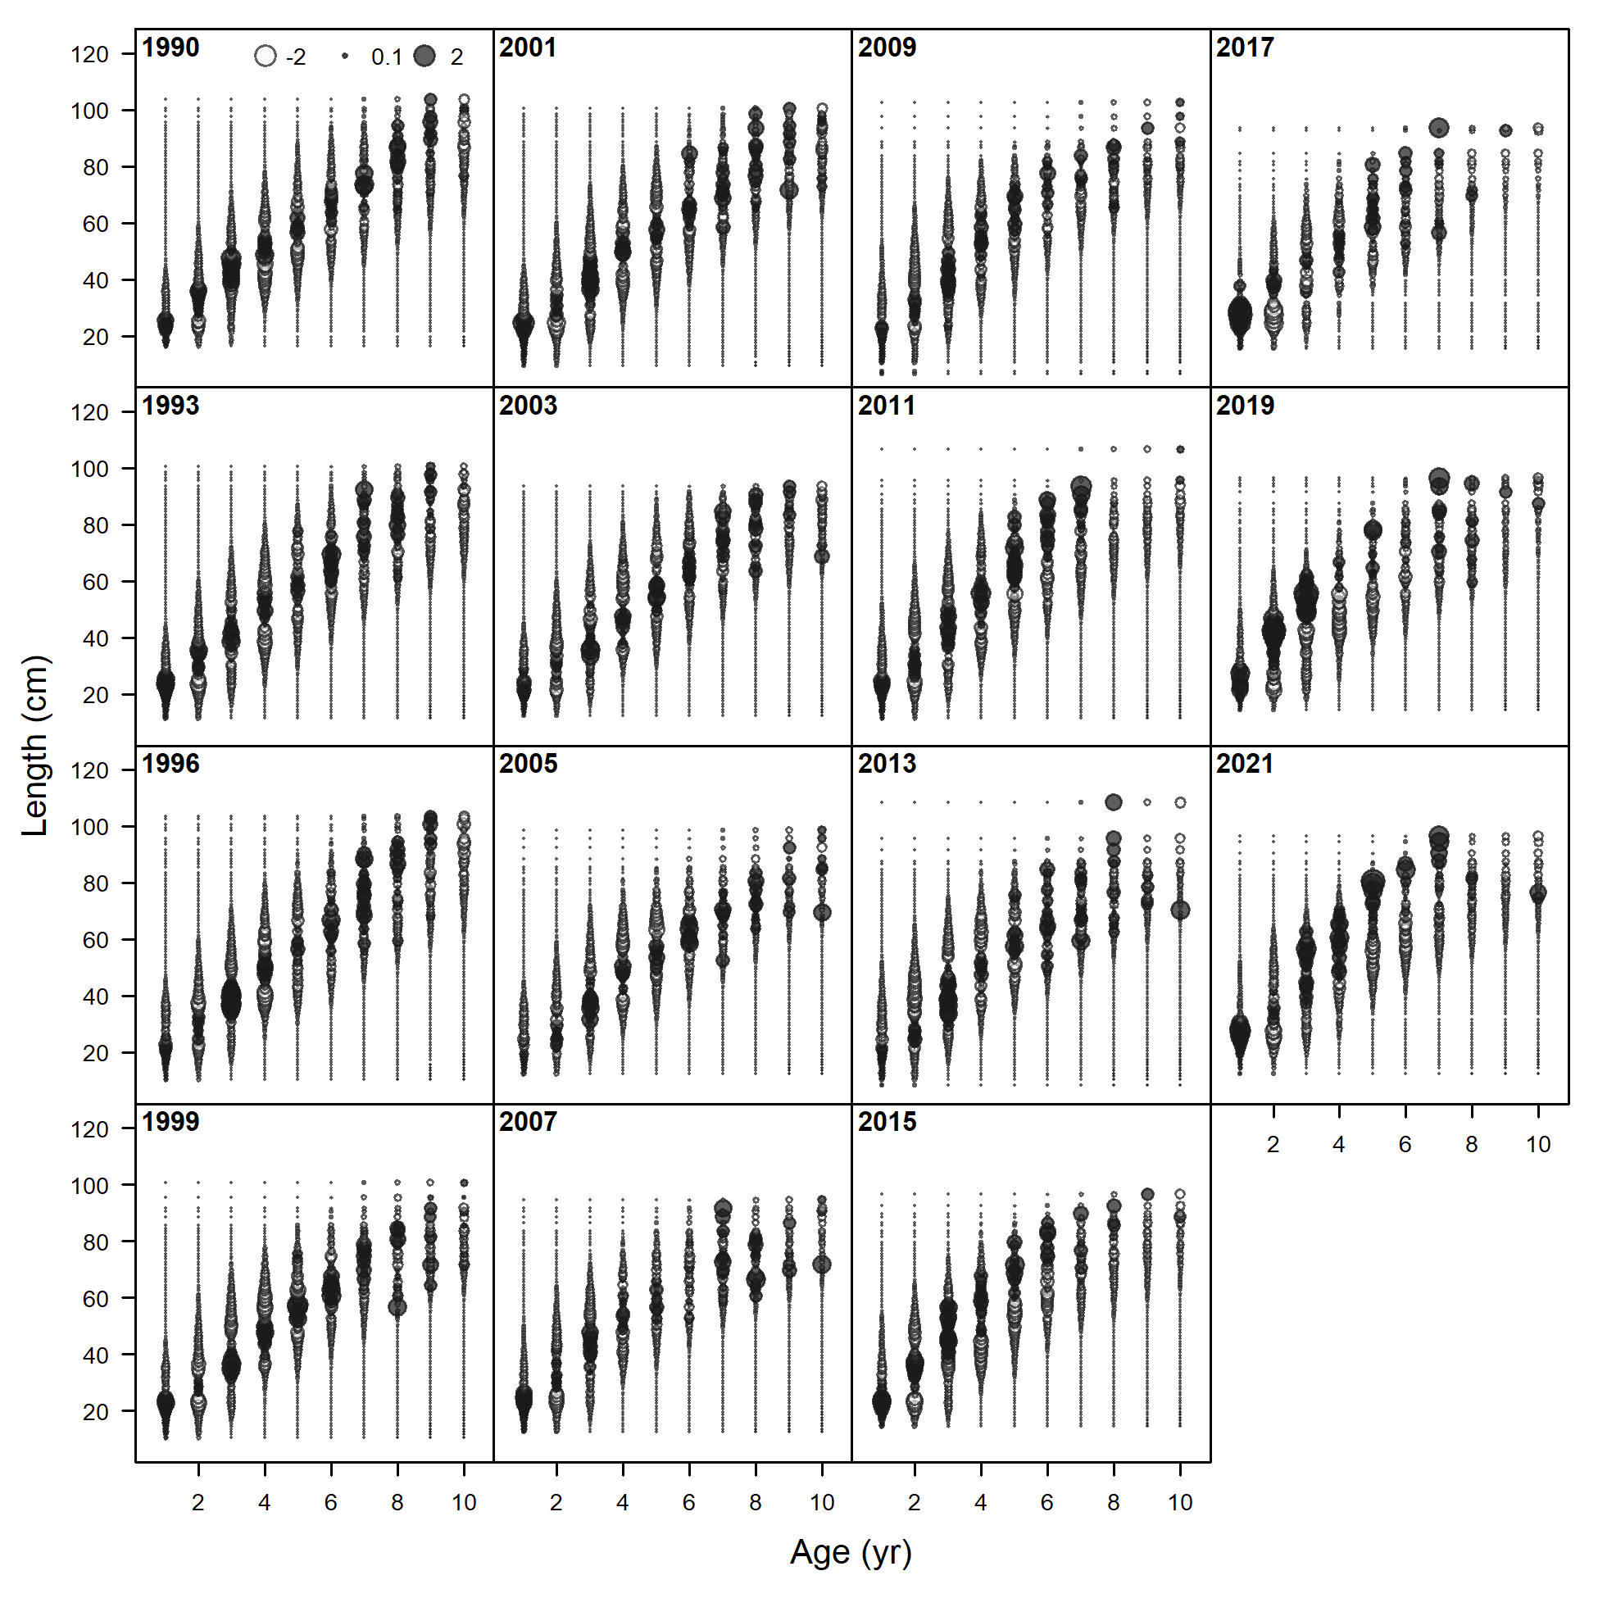
Housecleaning:
Pearson resids: trawl survey
2019.1a
2019.1b

Slide 6
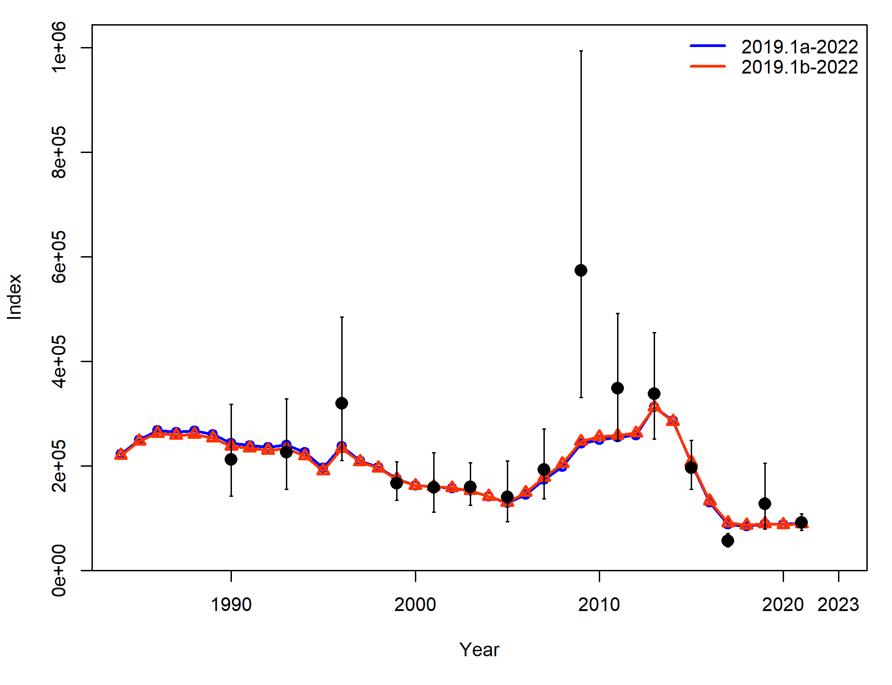
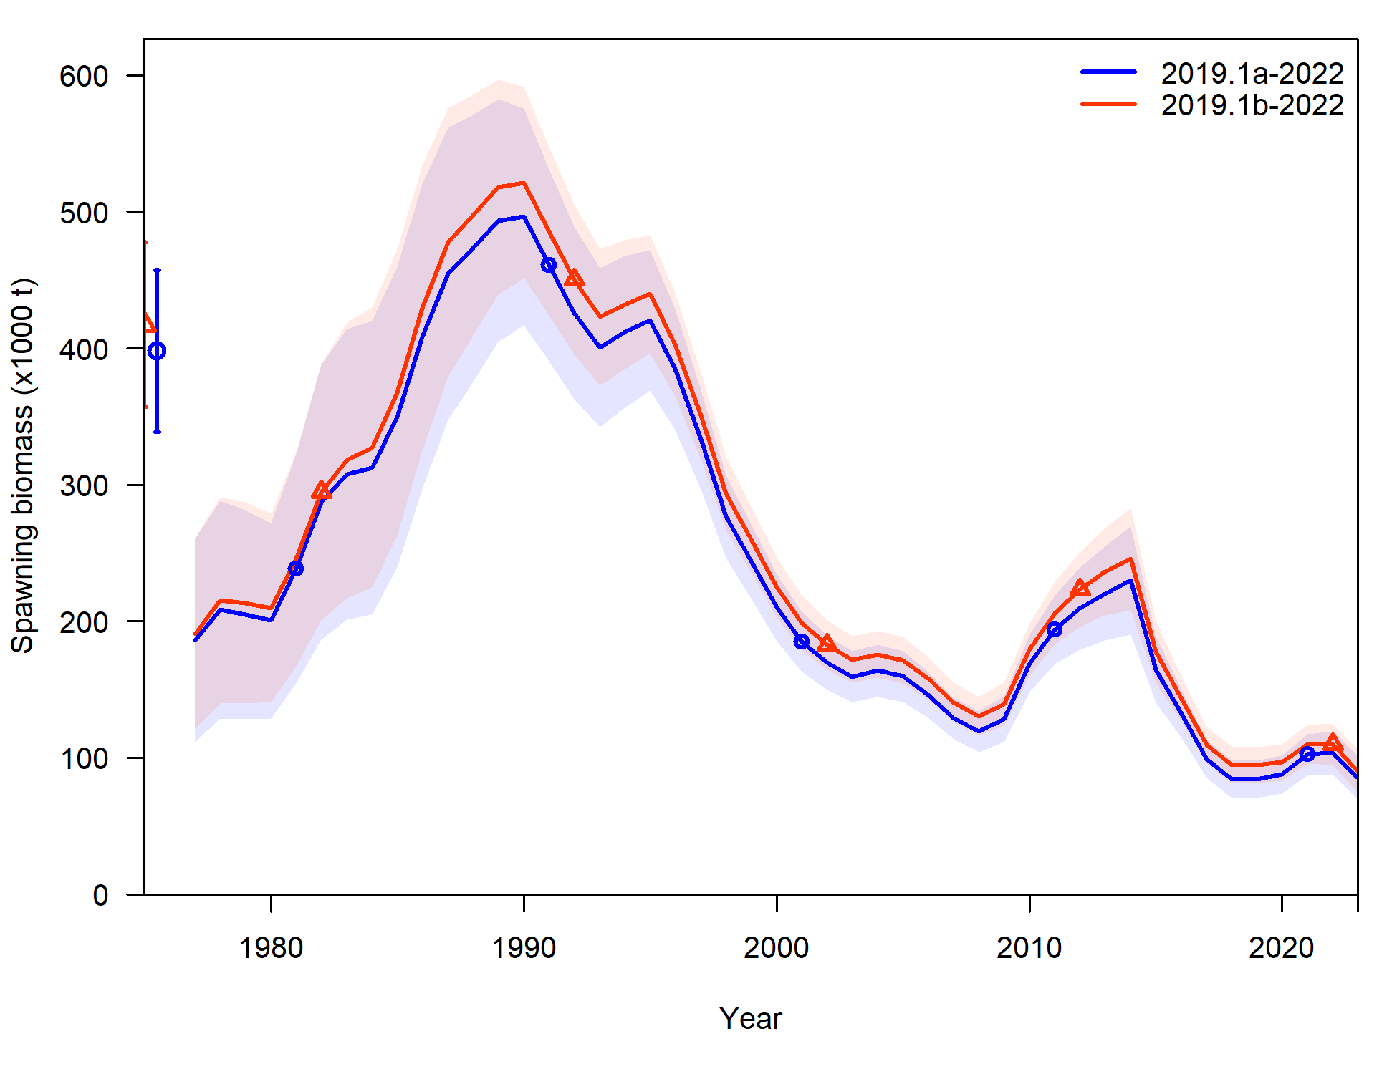
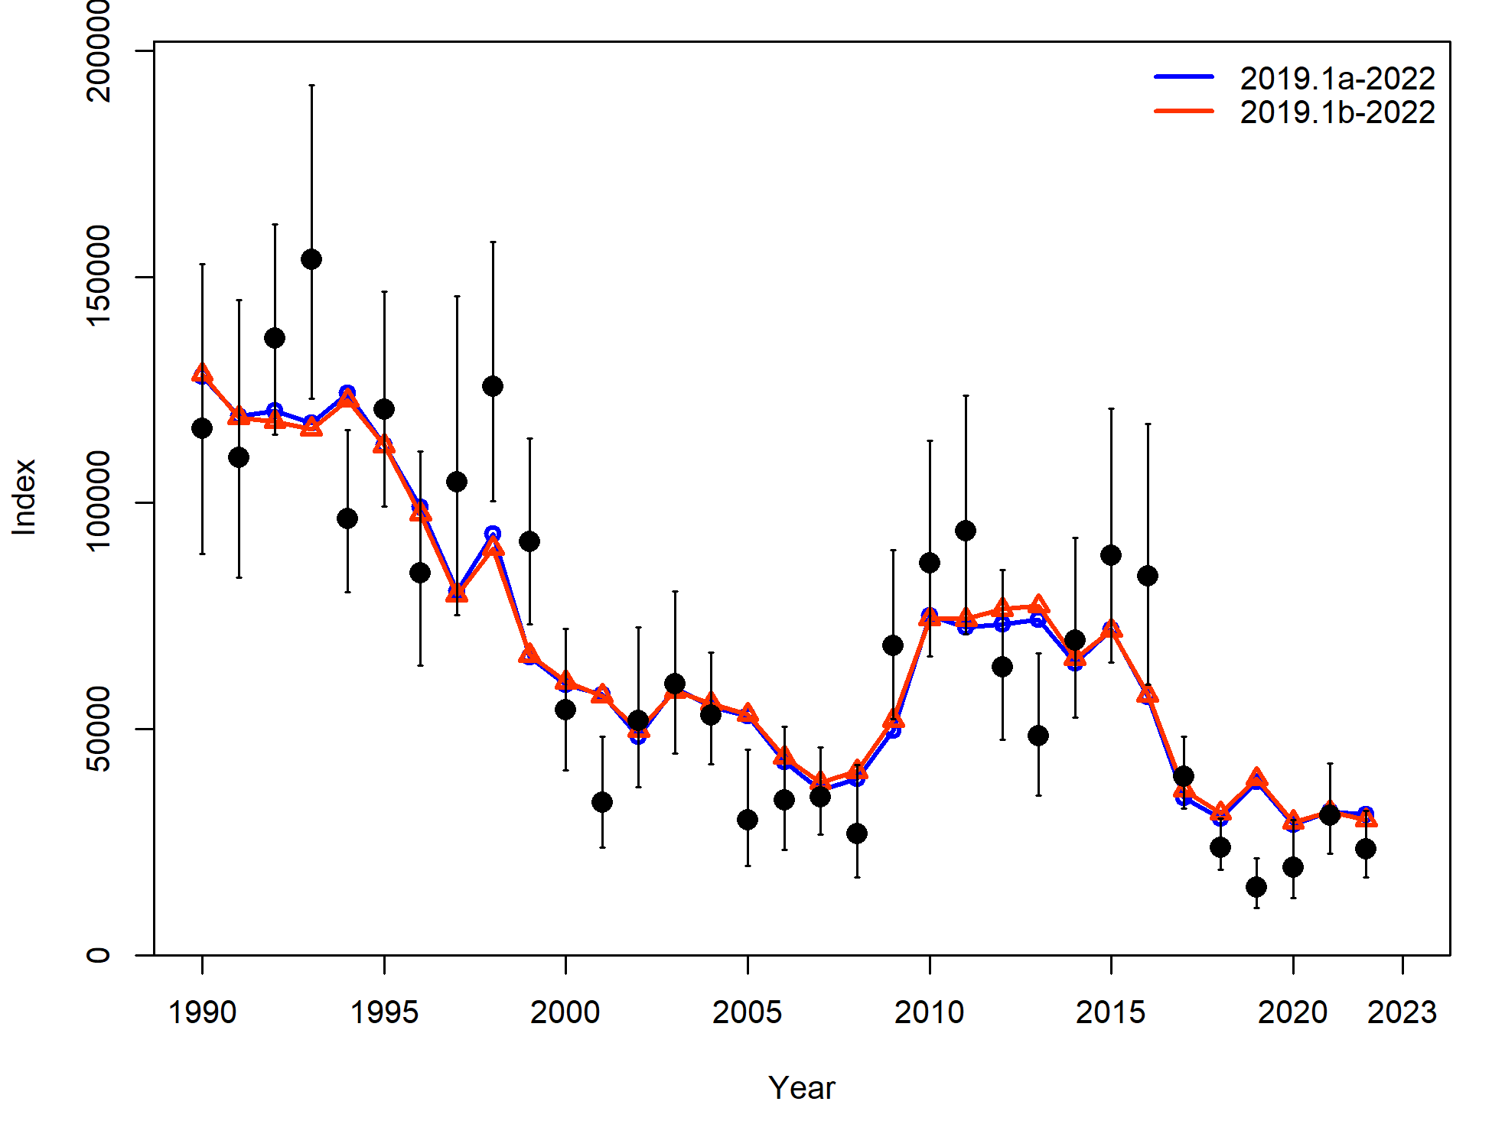
Housecleaning
Recommendation: Correct minimum sample size and use this as new base model (2019.1b)
6% increase in 2022 SSB

Slide 7
Environmental index
Refresher of Climate Forecast System Reanalysis (CFSR)
Provides temperature-at-depth
Depths determined from Bottom trawl survey for 0-20 cm, 20-40 cm, 40-60 cm, 60-80 cm, and 80+cm
Temperature-at-depth available by length bin and month
Index computed as difference from mean value from 1982-2012 (has been considered as ‘baseline’ for ‘normal’ conditions)

Slide 8
Environmental Link for LL survey catchability
PT request to evaluate whether link still appropriate (first added to model in 2017)
Construct model with no environmental link to LL survey q (2019.1c)
Added... re-evaluate CFSR index used (2019.1d)
Step 1: Evaluated q env link across length bin and month
Step 2: Select best from Step 1 as new env link model
Performance metrics: current year AIC and model fits, retrospective AIC and performance

Slide 9
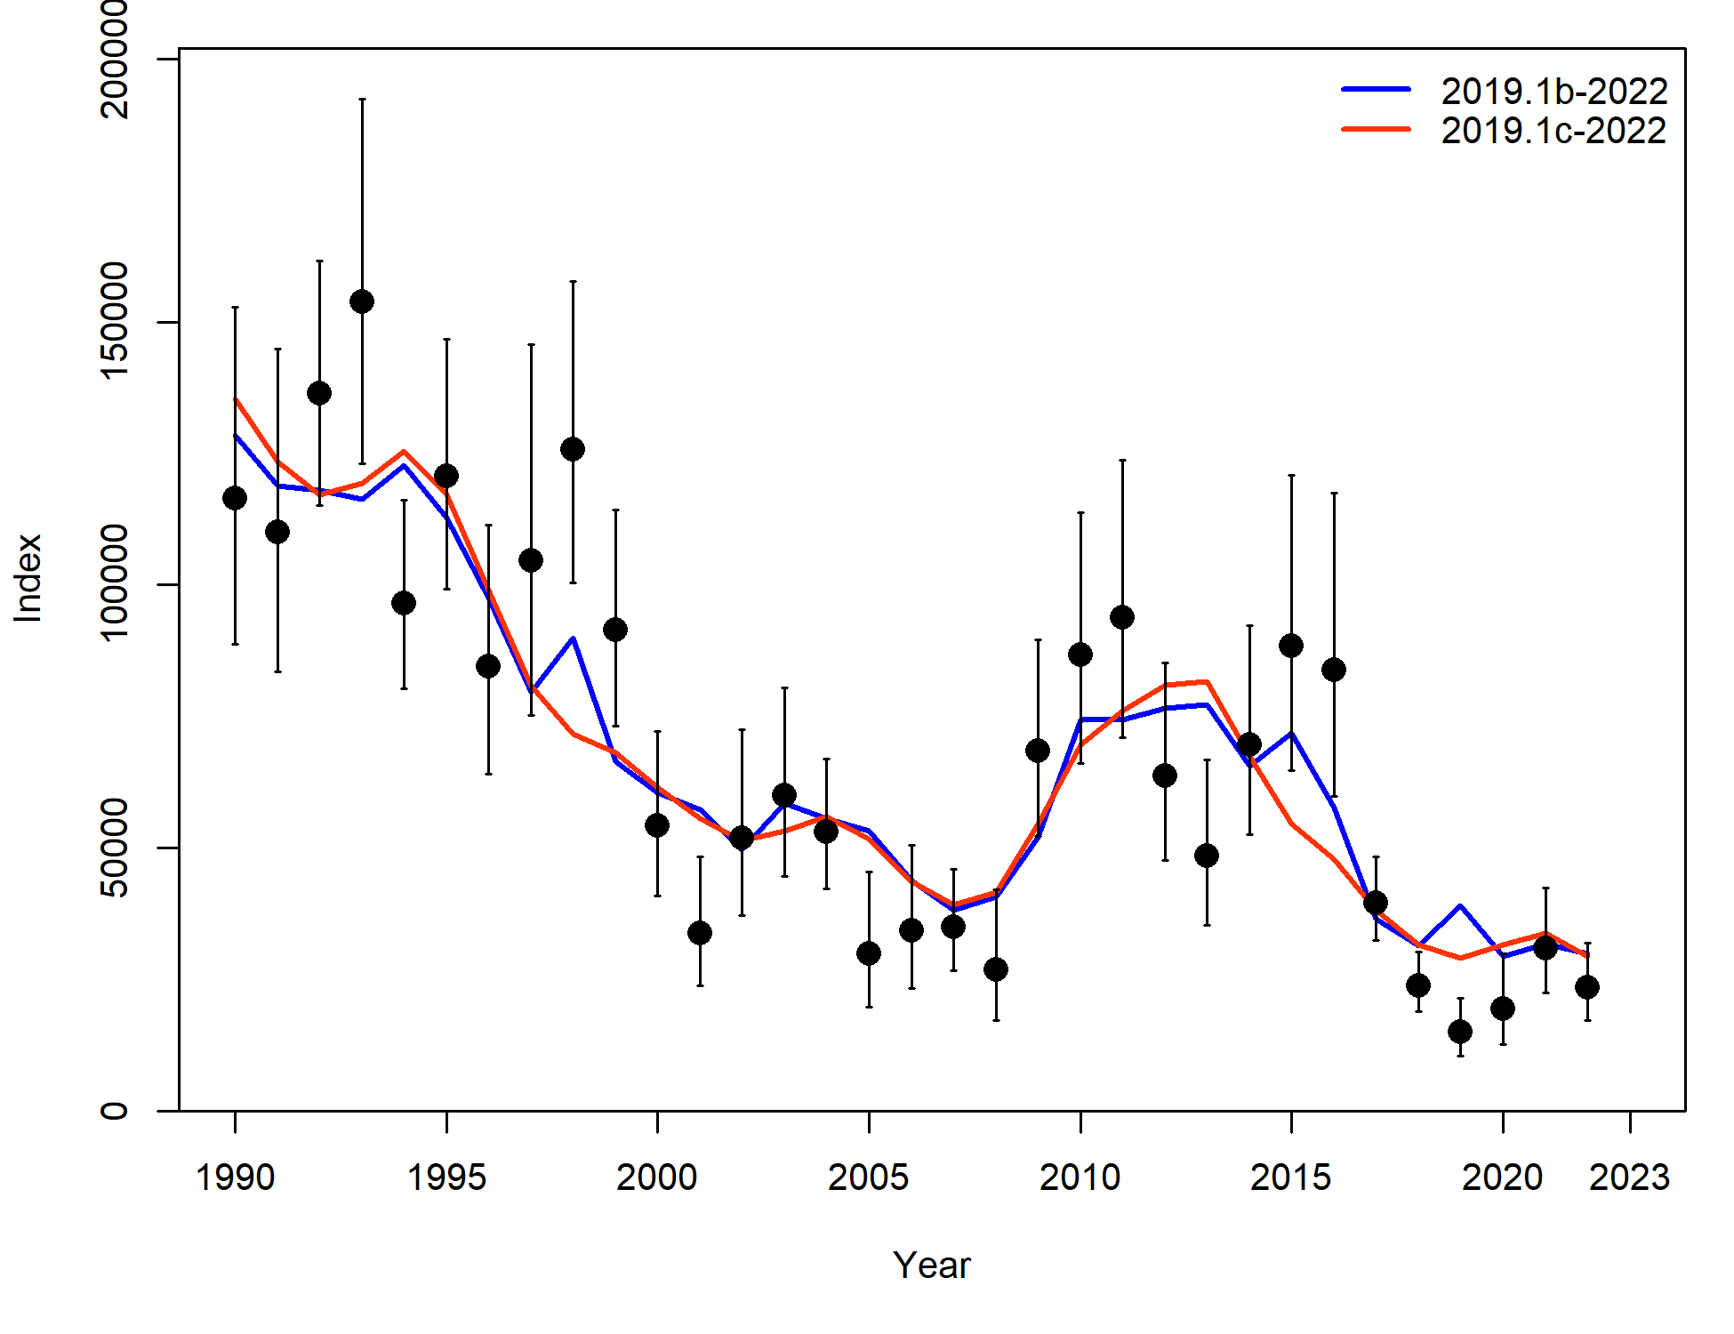
Link for LL survey q: no link comparison
Fit to LL survey index:

Slide 10
Link for LL survey q: no link comparison
In every retrospective year, model with link preferred over model without link
Mohn’s rho 2019.1b = -0.0727
Mohn’s rho 2019.1c = -0.0722

Slide 11
Link for LL survey q: no link comparison
Recommendation: continue with model that includes environmental link for LL survey q
Continue to monitor with retro AIC table in SAFE

Slide 12
Link for LL survey q: re-evaluation
Step 1: AIC difference = base model (2019.1b) – new env link model (2019.1d)

Slide 13
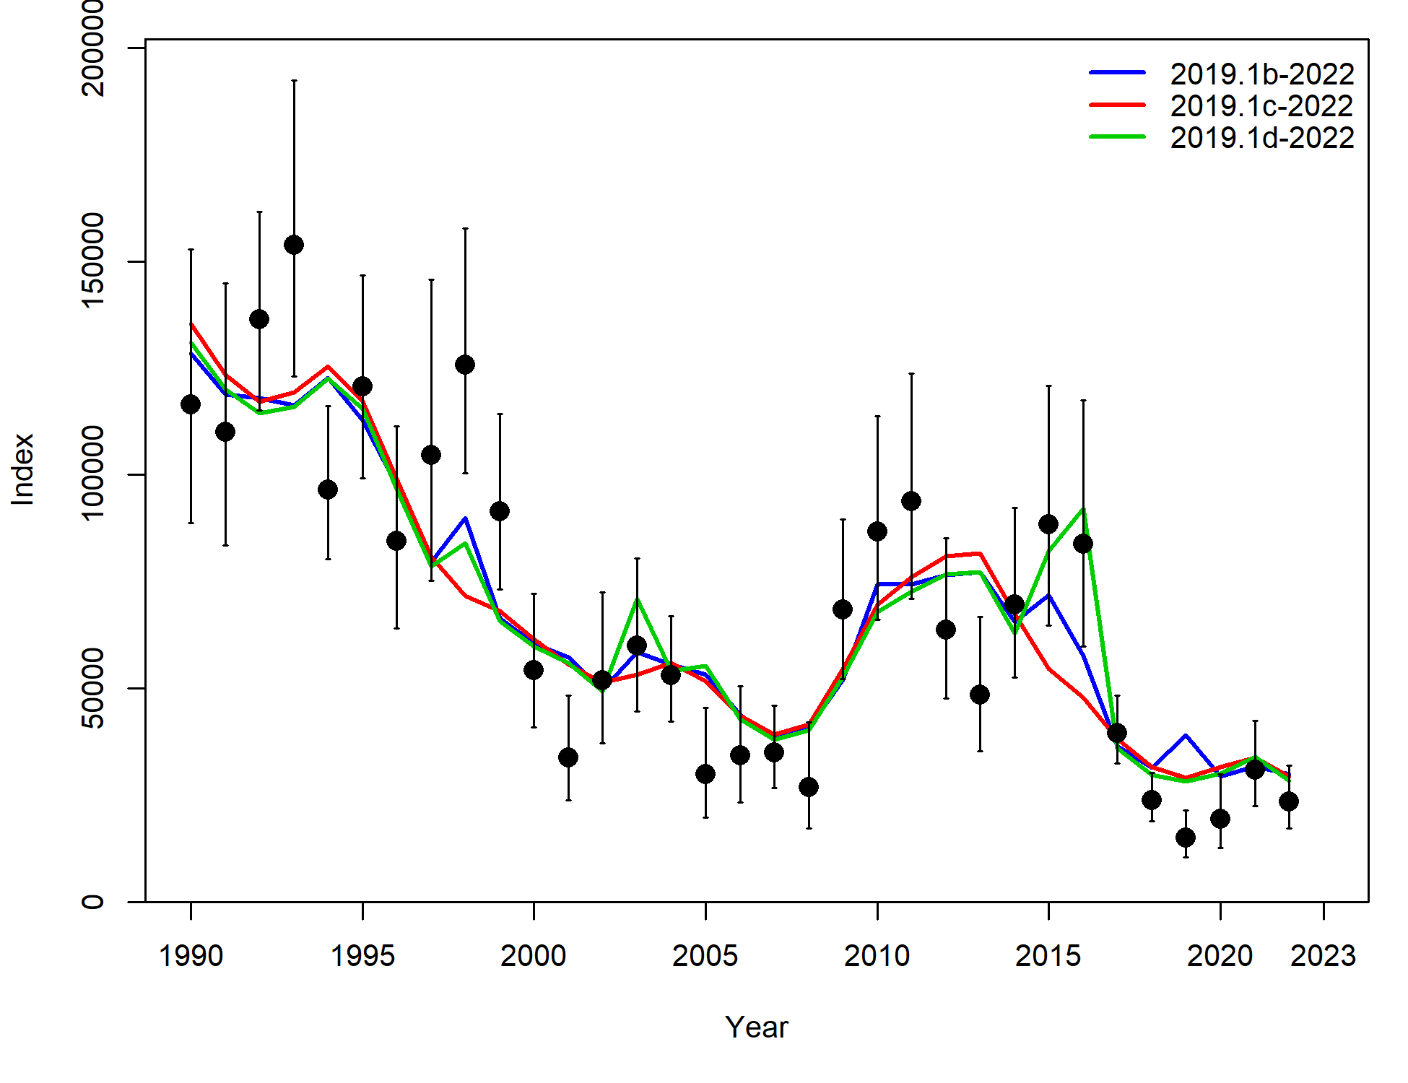
Link for LL survey catchability, re-evaluation
Fit to LL survey:

Slide 14
Link for LL survey catchability, re-evaluation

Slide 15
Link for LL survey, re-evaluation
Retro Total likelihood and mohns rho:
Mohn’s rho 2019.1b = -0.0727
Mohn’s rho 2019.1d = -0.0579

Slide 16
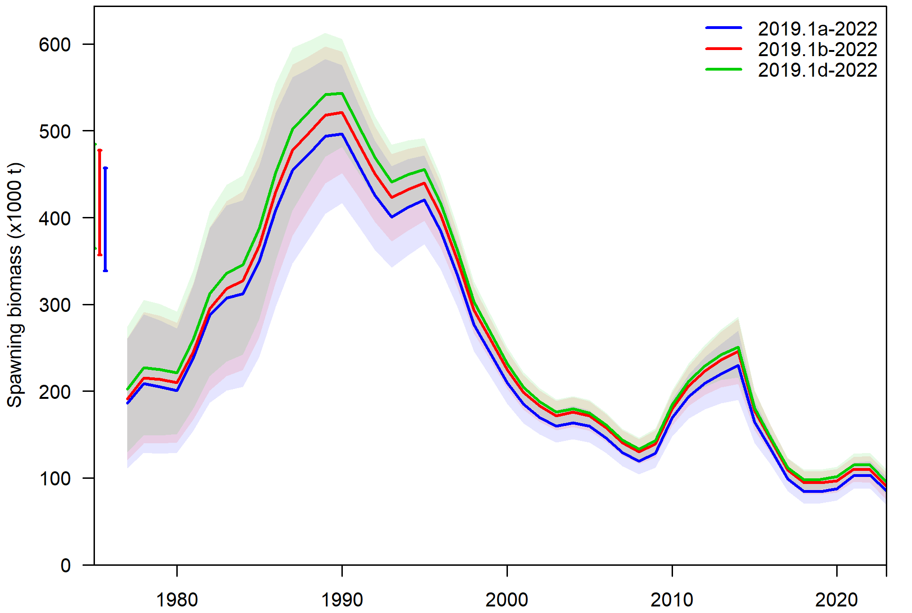
Link for LL survey, re-evaluation
11% increase in 2022 SSB compared to 2019.1a

Slide 17
Link for LL survey, re-evaluation
Recommendation: Bring forward 2019.1d, with new CFSR index, as alternative model in November
Food for thought:
Evaluation of environmental links is a fluid and iterative process
Will be evaluating new indices, will be evaluating links, will continually be evaluating model to find improvements
What is our ‘burden of proof’ when it comes to mechanistic processes as it pertains to a specific index (i.e., one month’s temperature as compared to another)

Slide 18
Environmental link for growth
Step 1:
Evaluated Linf and kappa across length bin and month
Evaluated Lzero across month for 0-20 cm length bin
Step 2:
Select best from Step 1, and run model with env link for all 3 growth parameters
Step 3:
Compare with base model
Statistics: current year AIC and model fits, retrospective AIC and performance

Slide 19
Link for growth
Step 1: difference in AIC with base model (EnvLnk – base, so negative number means EnvLnk model better)
Linf > Lzero > kappa for model improvement

Slide 20
Link for growth
Step 2: AIC & likelihoods

Slide 21
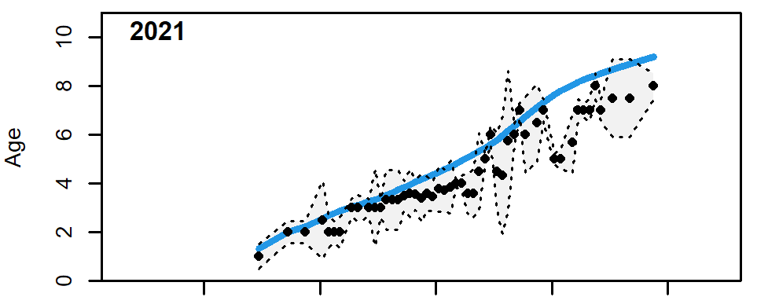

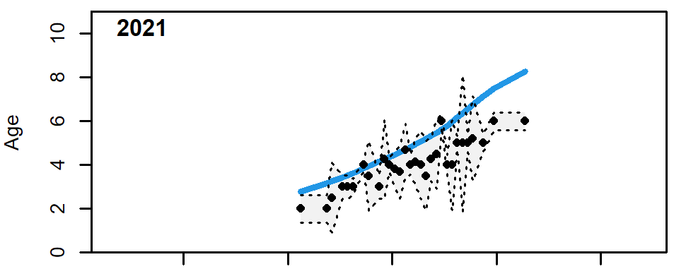
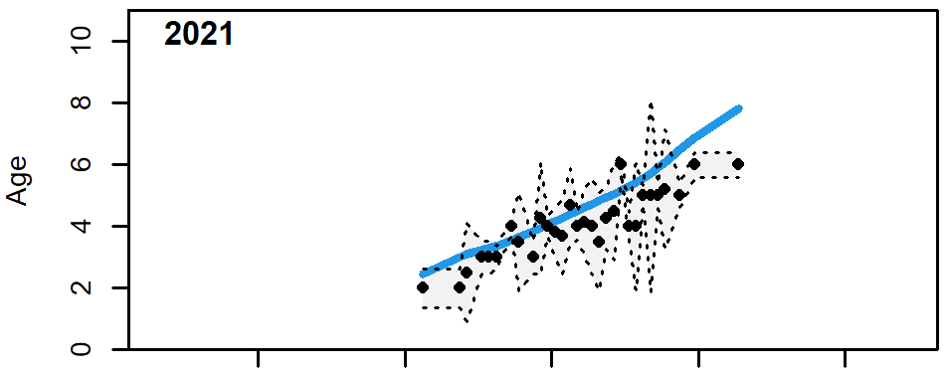
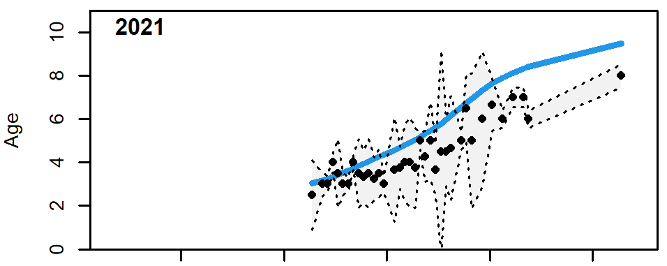

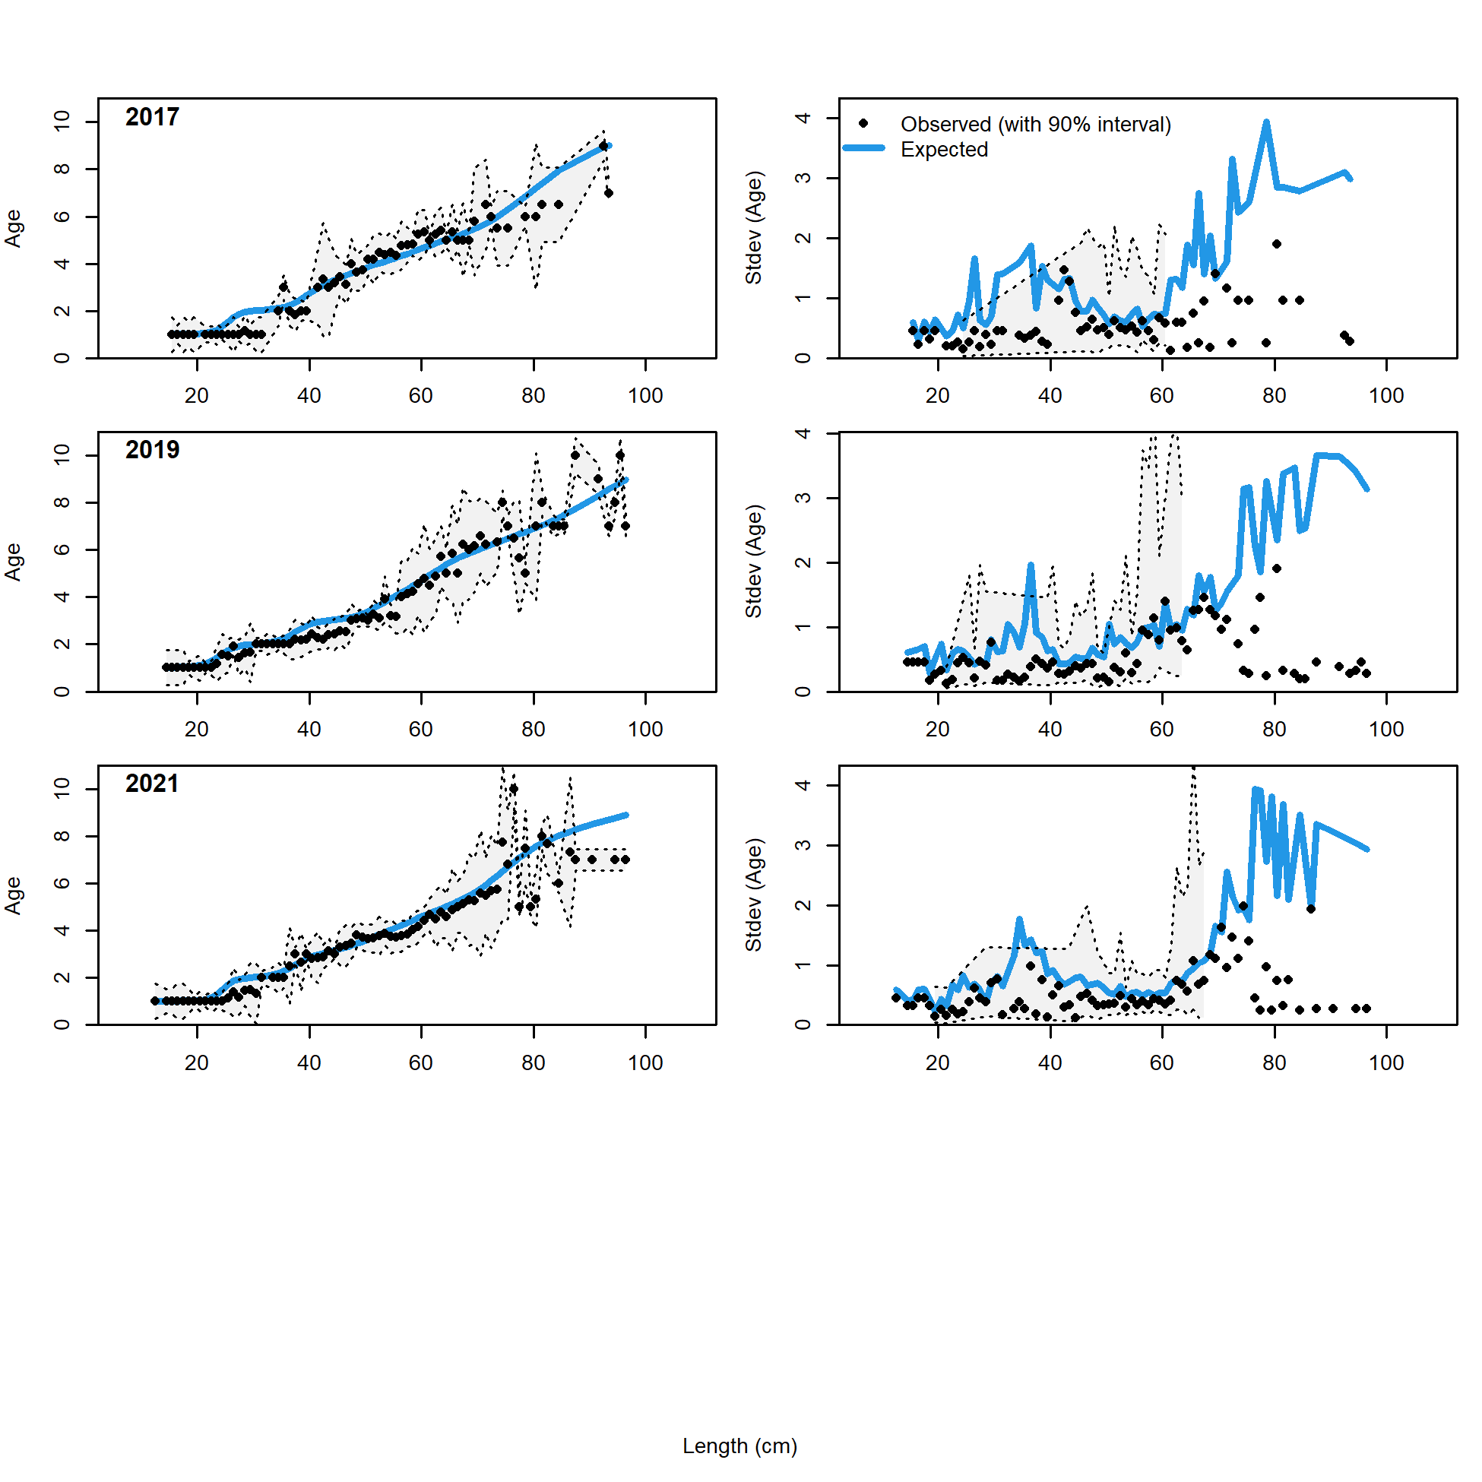
Link for growth
2019.1b
2023.1
Trawl fishery
Step 2: Example fits
Improvement to lack of fit identified in last assessment cycle
LL fishery
Pot fishery
Trawl survey

Slide 22
Link for growth
Step 2: Retrospective AIC
Mohns rho:
2019.1b = -0.073
2023.1 = -0.022

Slide 23
Link for growth
Things to consider:
What growth do we use in projections? (Most recent environmental conditions? Some time period of historical?)
Is there another, better, index?
Moving forward:
Not going to recommend an environmentally linked model for growth this cycle
Have a post doc (Krista Oke) that will be investigating environmental links over the next 2 years, will look to her results for guidance in future assessments

Slide 24
Overall summary
Recommended model changes for November:
Correct minimum sample size issue
Use different CFSR index for LL survey q environmental link
Questions?

