Slide 1
Trawl survey age and length composition input sample size
September Plan Team, 2023

Slide 2
Background on input sample size
Comes from observation that fish age/length are similar within a haul, and have more than expected variability across hauls
Using multinomial, variance is a function of sample size, inversely related
Reduce sample size to account for additional variability – this is input sample size

Slide 3
Coming up with input sample size
Variety of ways we’ve (AFSC and globally speaking) have come up with ISS
AFSC – fixed, number of hauls, some function of number of samples, some function of number of samples and hauls, quasibootstrap – only thing consistent is that we’re so inconsistent
Globally
Bootstrap (Crone and Sampson, 1997; Stewart and Hamel, 2014)
Model-based (Berg and Nielsen, 2016; Thorson, 2014; Thorson and Haltuch, 2018)
Design-based (Miller and Skalski, 2006)

Slide 4
Terminology
Effective sample size (ESS) is a term that get’s thrown around a lot, add to that a bunch of others that have been proposed over the years
Terms we’re using today:
Use Nominal sample size (NSS) to mean the number of samples you actually collected
Use Input sample size (ISS) as the number that you use to initially weight your comp data, ISS < NSS
Use Effective sample size (ESS) as the statistic to measure model fit to observed data, ESS < ISS
Use Realized sample size (RSS) in the bootstrap resampling sense, it’s computed similarly to ESS for each replicate of the bootstrap, then the ISS shown here is the harmonic mean of the RSS across the bootstrap replicates

Slide 5
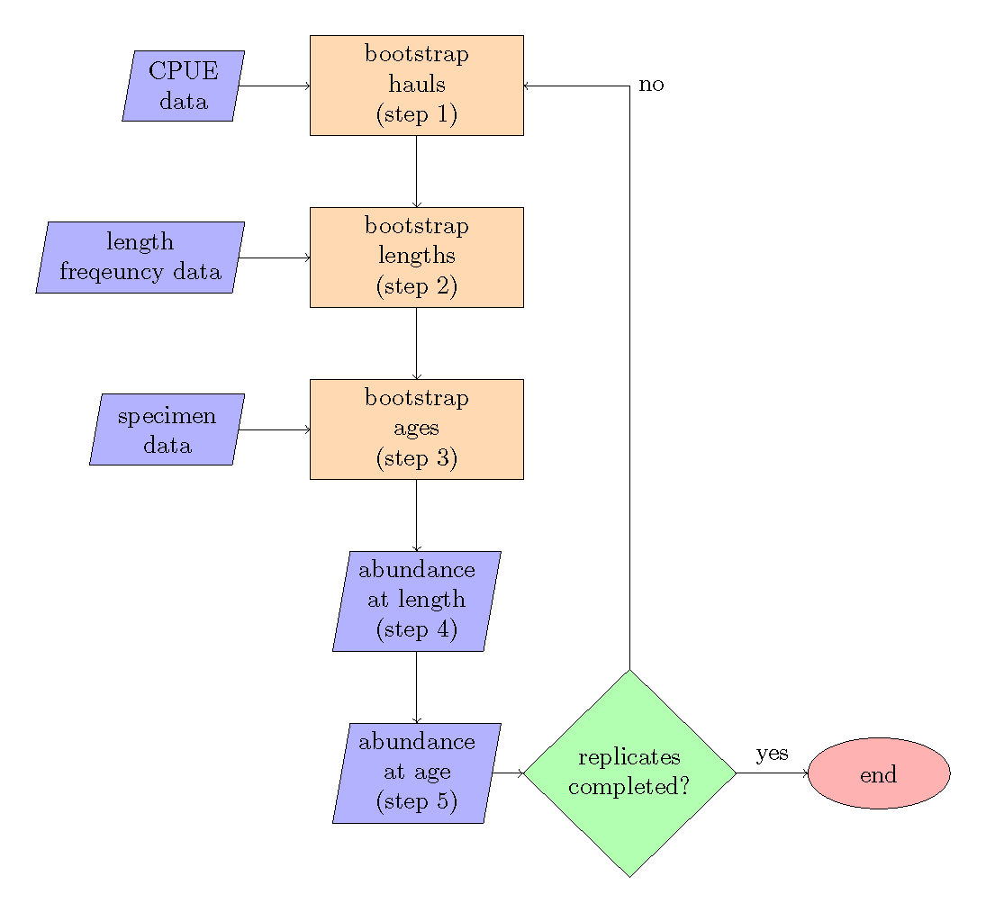
Production trawl survey ISS

Slide 6
Production trawl survey ISS
Expanded at strata level for sex-specific categories
Fist compute pop’n numbers in strata (area weighted avg cpue)
Partition pop’n numbers into length bins (cm) by haul-level cpue weighted length proportions, sum across hauls
Strata pop’n numbers at length are then summed to whatever desired level

Slide 7
Production trawl survey ISS
Expanded at management area
Create pooled age-length key (proportions of age-at-length)
Multiply by pop’n numbers at length, sum across lengths for each age

Slide 8
Application
Stock | Survey evaluated
Alaska plaice | EBS shelf
arrowtooth flounder | AI, EBS shelf, EBS slope, GOA
Atka mackerel | AI
Dover sole | GOA
Dusky rockfish | GOA
flathead sole | EBS shelf, GOA
Greenland turbot | EBS shelf, EBS slope
Kamchatka flounder | AI, EBS shelf, EBS slope
northern rock sole | EBS shelf, GOA
northern rockfish | AI, GOA
Pacific cod | AI, EBS shelf, GOA
Pacific ocean perch | AI, EBS slope, GOA
Rougheye/blackspotted rockfish | AI, GOA
rex sole | GOA
sablefish | GOA
southern rock sole | GOA
walleye pollock | AI, EBS shelf, GOA
yellowfin sole | EBS shelf
Ran for sex-specific data and combined sex data
All years of each survey

Slide 9
Special cases
Complexes : Blackspotted and Rougheye, or Rougheye and Blackspotted – don’t forget about duskies too
Spatial models: rex (wc & egoa), n/s rock sole (w & cgoa, egoa too)
Overall to say, these are generic functions that work for any species code (or vector of species codes)

Slide 10
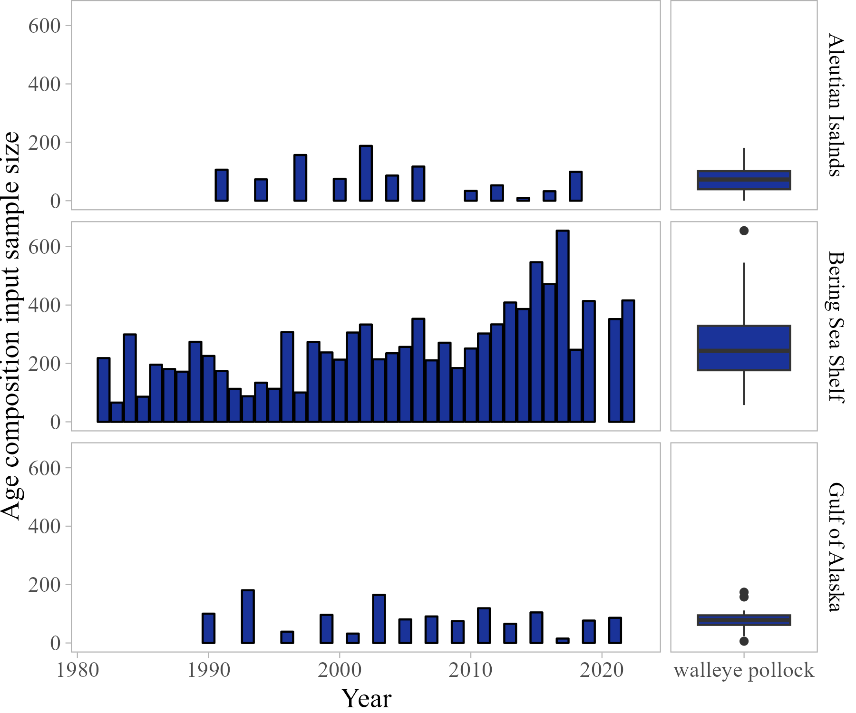
What you get

Slide 11
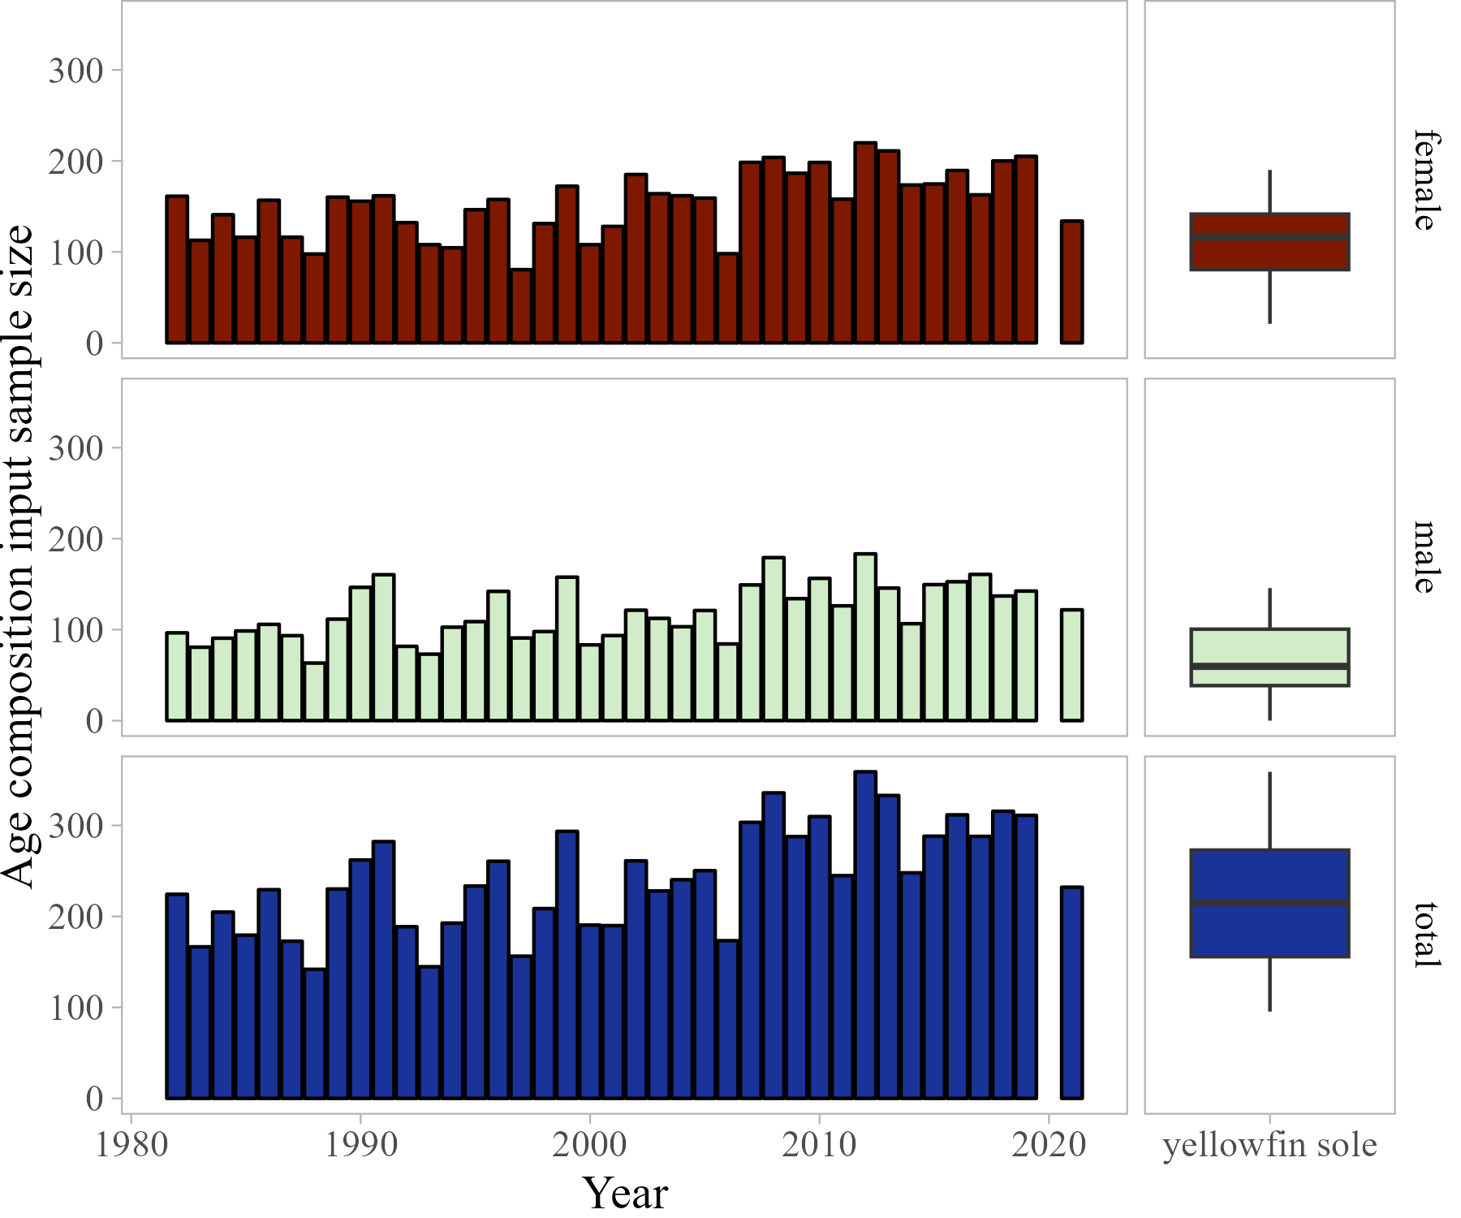
What you get

Slide 12
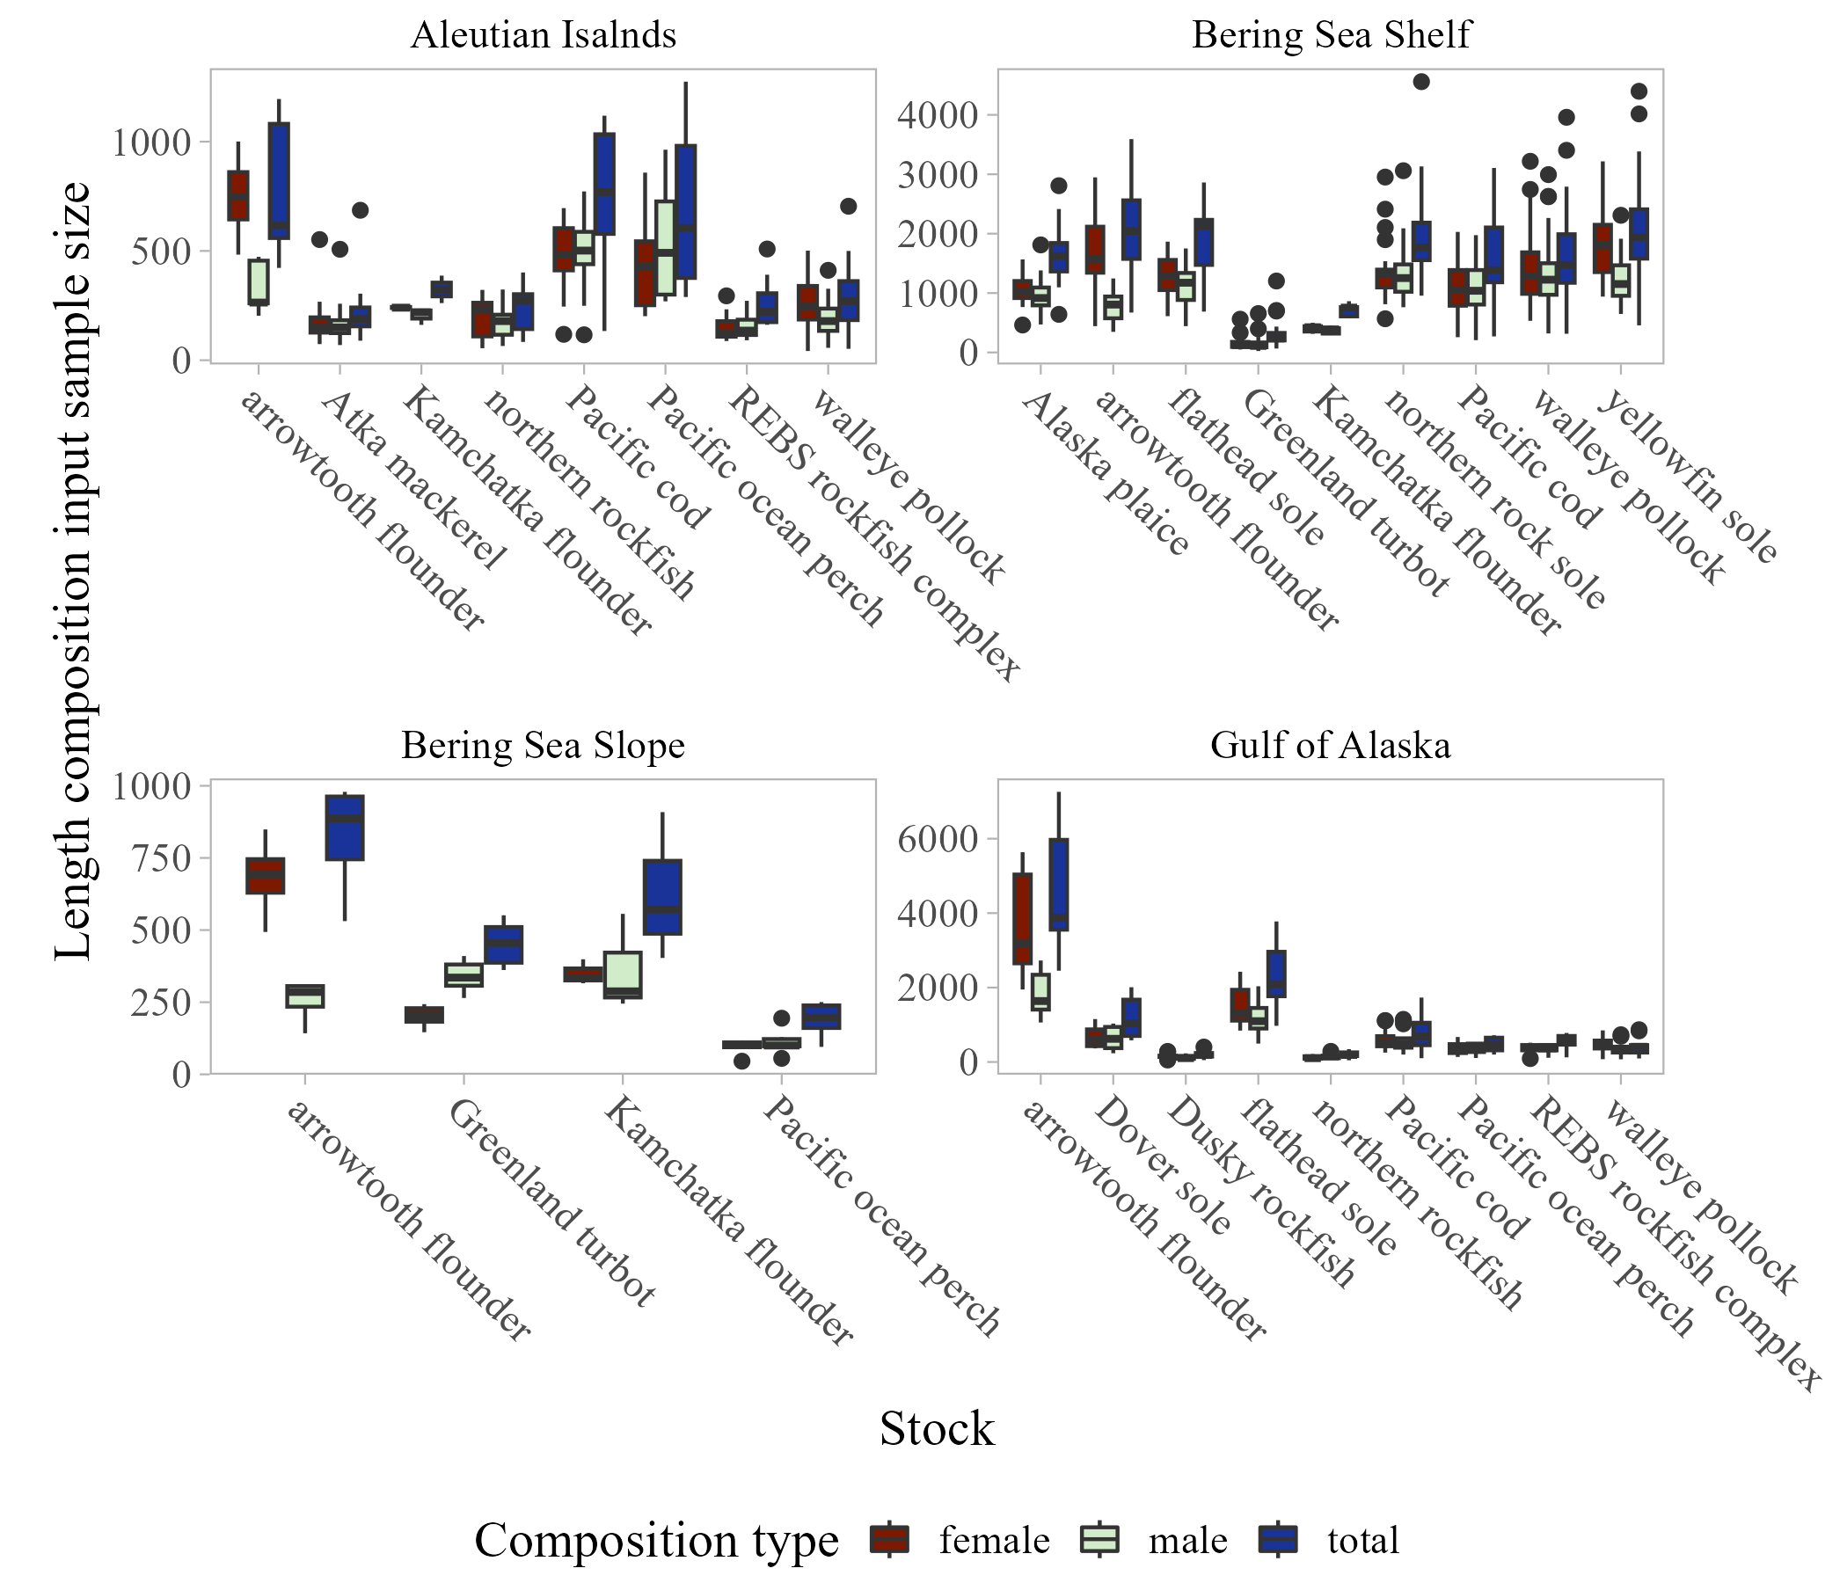
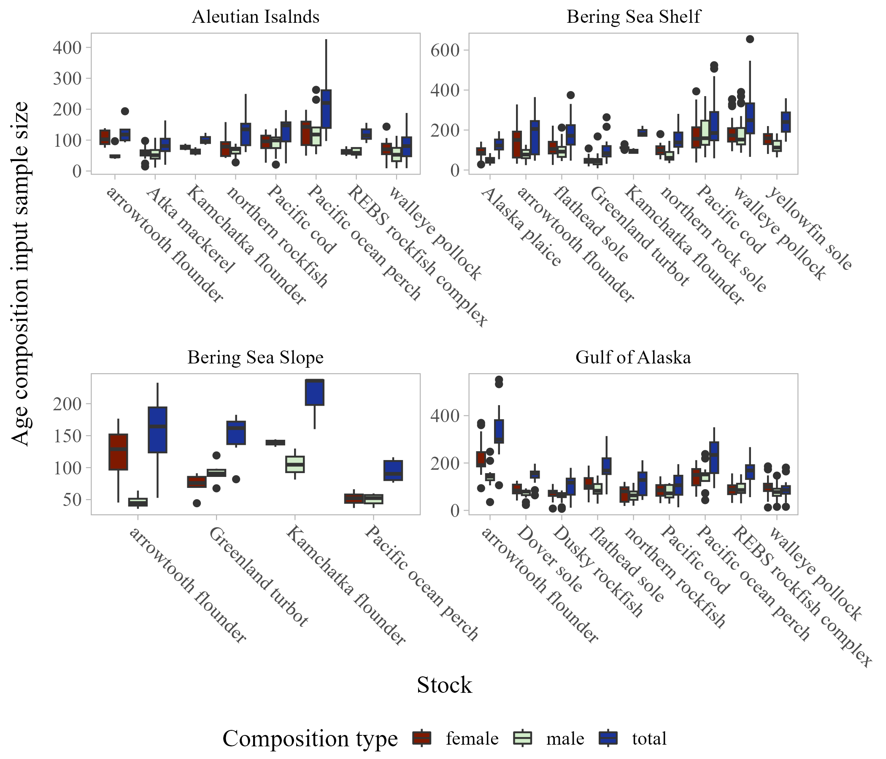
What you get

Slide 13
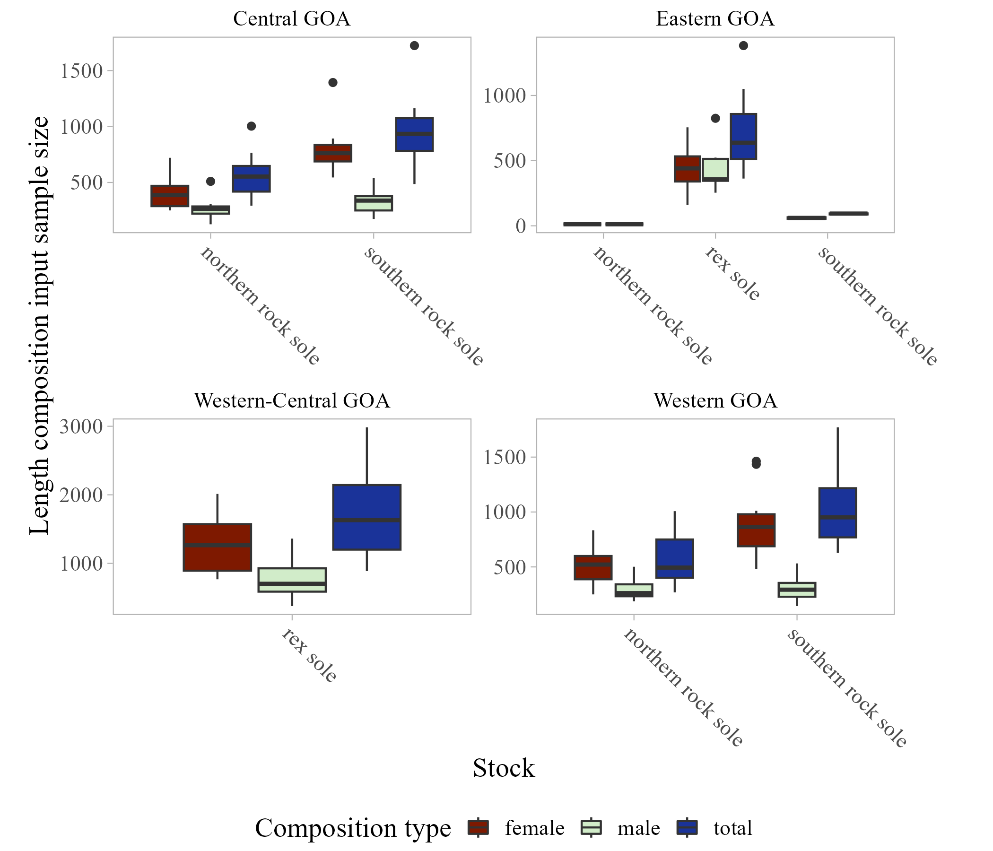
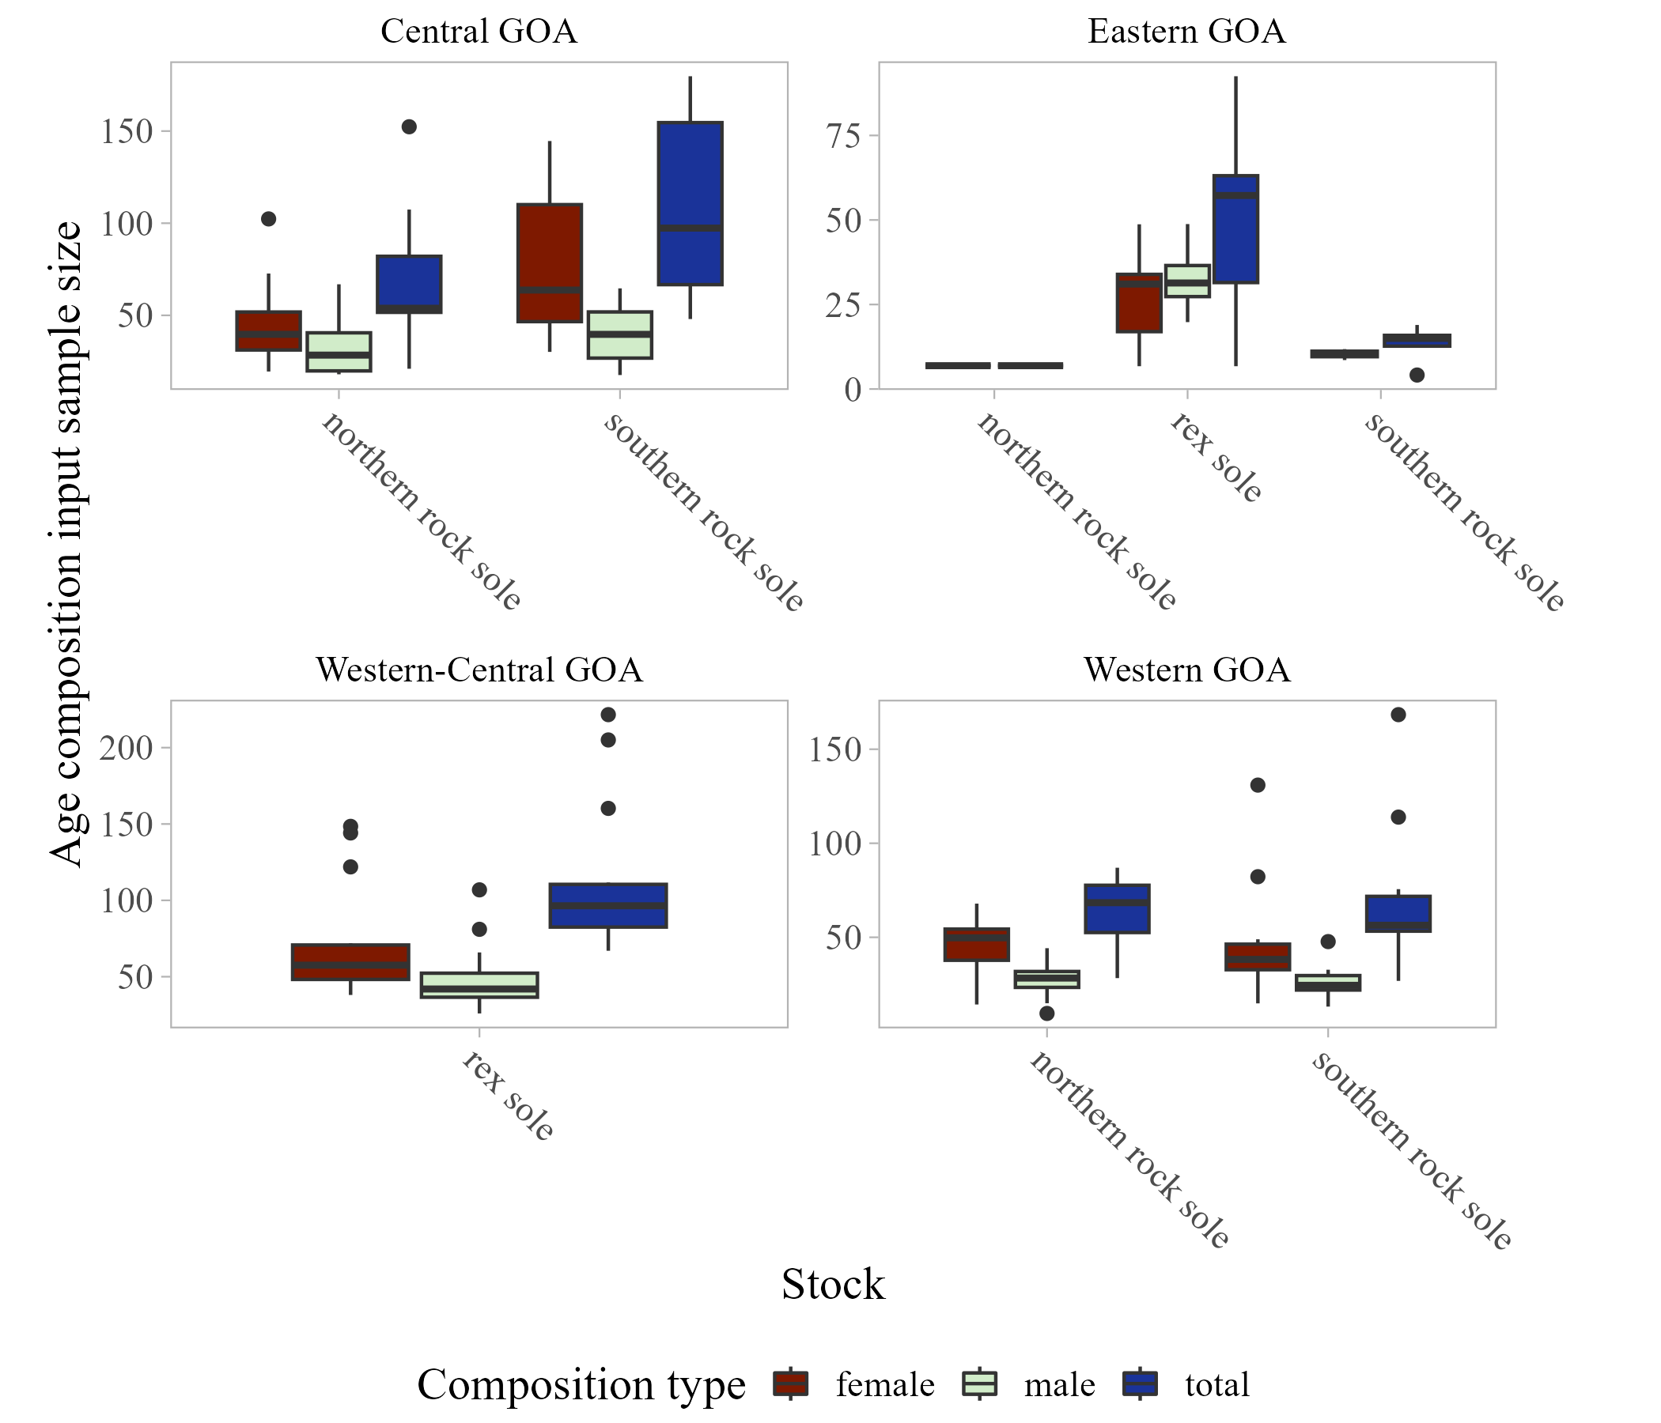
What you get
 | female |  |  |  |  | male
Species | cgoa | egoa | wcgoa | wgoa | goa | cgoa | egoa | wcgoa | wgoa | goa
10200 |  | 25 | 72 |  | 101 |  | 29 | 51 |  | 76
10261 | 48 | 9 |  | 46 | 88 | 32 |  |  | 29 | 54
10262 | 78 | 12 |  | 48 | 129 | 40 | 5 |  | 27 | 72

Slide 14
What we’ve got so far
Annual ISS for bottom trawl surveys for all Tier 3 and above species (for each combination that could be need for assessment)
Synthesizing results:
Length comp ISS > Age comp ISS
Total comp ISS > Sex-specific ISS
Male ISS ≠ Female ISS in many cases
Two packages:
https://github.com/BenWilliams-NOAA/swo: evaluates consequences of sub-sampling
https://github.com/BenWilliams-NOAA/surveyISS: production ISS script, also has options for what we’ll talk about next
Couple of tech memos

Slide 15
What we don’t got:
Code to get ISS for other surveys: longline, acoustic, adf&g
Code for fishery-dependent ISS: got funding for post doc, will be starting this early in the new year
Other dangling special cases:
AI northerns with spatial ALKs
Sex-specific comps that sum to 1

Slide 16
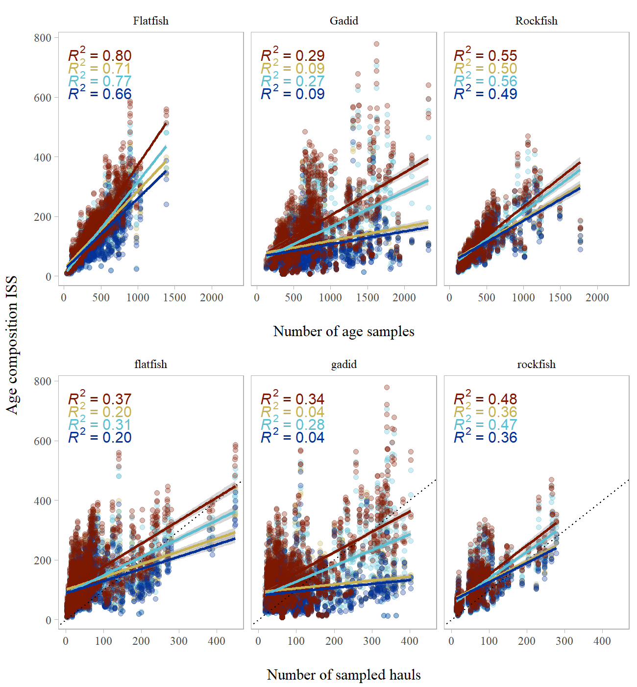
Some considerations:
Often hauls (or nomial sample size) can be used as proxy for ISS
Weak relationship between bootstrapped ISS with hauls/nominal sample size

Slide 17
Current research developments
Realized there’s two sources of error were not accounting for
When constructing the age-length key, not taking the variability in lengths for a given age into account
This is because when specimen data is resampled the age-length (and all other data) is paired together
When using the age data itself, not taking into account ageing error produced by the reader-tester agreement (or disagreement)

Slide 18
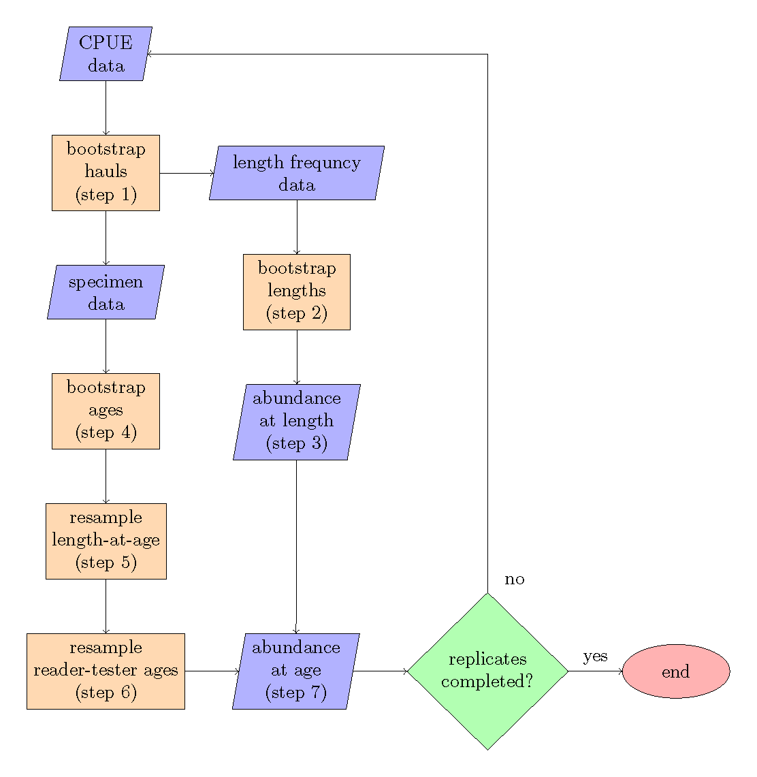

Slide 19
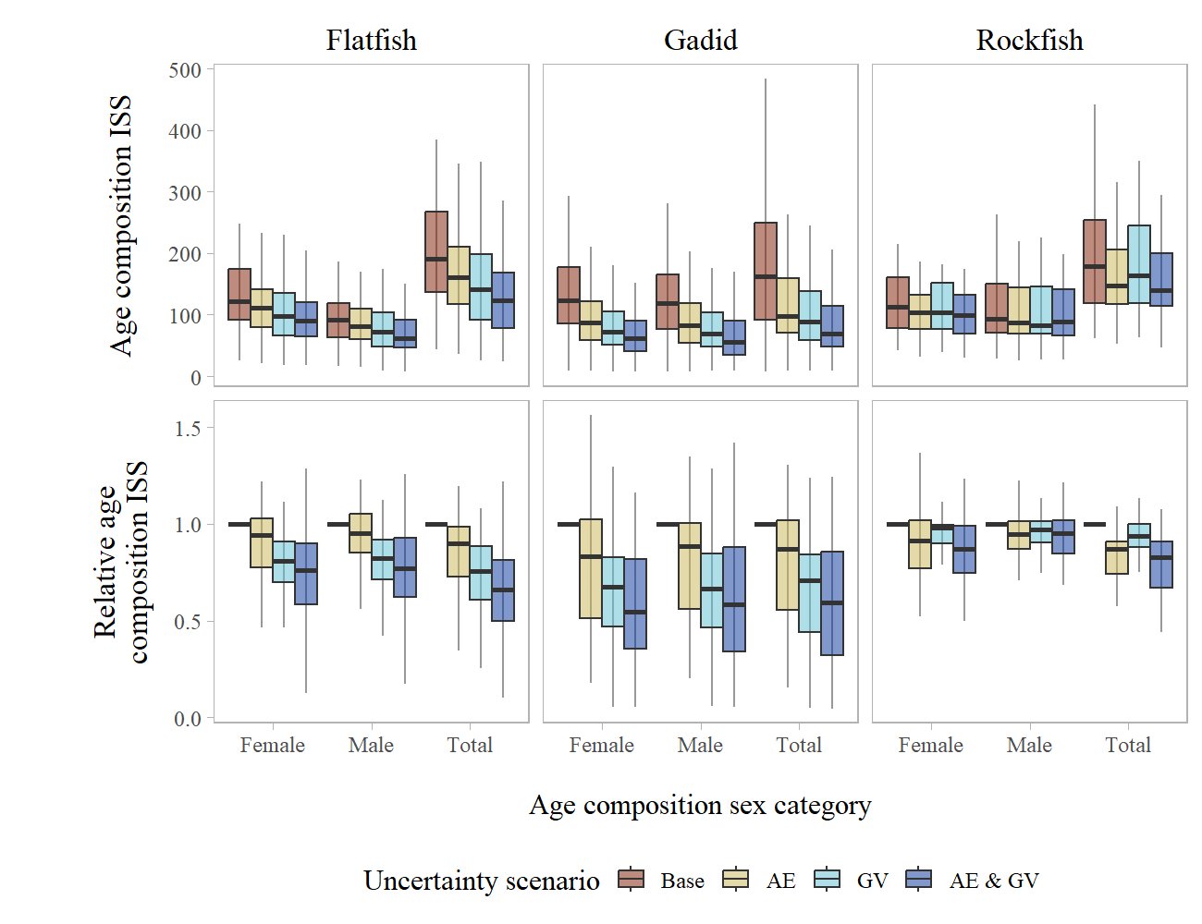
Adding ageing error and growth variability:

Slide 20
Wrap up:
Production age/length ISS available for trawl survey
Broader question: compared to other ways we weight comp data (hauls, samples, etc, etc) is the bootstrap really a better indication of ISS? Does it capture the variability we want it to? Are we including too much variability, or maybe not enough?

Slide 21

Questions?

