Slide 1
Base data differences
Trawl survey: GAP cleaned up old haul data, only includes specimen data associated with a haul that is used to compute abundance
Resulted in very minor differences in early trawl survey time series for abundance and comp data
LL survey:
Log correction in SD hadn’t been applied (but was applied to bottom trawl survey index), now is applied
Length comps off by a cm (i.e., 25 cm fish became 26 cm)
Length-weight relationship continually updated

Slide 2
Base data differences
Plot of base model vs data update model

Slide 3
Base data updates
Ageing error updated

Slide 4
Base data updates
Ageing error updated plots

Slide 5
Len comp inv
Post-91 data filtering: >10 per haul in fed data
Proportion of hauls removed:
 | Longline | Pot | Trawl
1991-2012 | 2% | 4% | 3%
2013 | 12% | 12% | 2%
2014 | 6% | 14% | 5%
2015 | 5% | 8% | 4%
2016 | 13% | 10% | 4%
2017 | 12% | 12% | 20%
2018 | 23% | 6% | 6%
2019 | 22% | 10% | 6%
2020 | 60% | -- | 79%
2021 | 20% | 14% | 72%
2022 | 6% | 30% | 76%
2023 | 34% | 36% | 68%

Slide 6
Len comp inv
State data used to ‘fill-in’ missing fed data:
2 steps:
Step 1: uses state data if has more than fed data
Step 2: uses state data if more than 30 lengths observed
Amount of state data not used:
Step 1 | Longline | Pot | Trawl
1997-2016 | 34% | 37% | 56%
2017 | 33% | 0% | --
2018 | 20% | 0% | --
2019 | 20% | 0% | --
2020 | 0% | 0% | --
2021 | 0% | 0% | --
2022 | 0% | 0% | --
2023 | 0% | 0% | --

Slide 7
Len comp inv
Post-91 data filtering: >10 per haul in fed data
Propose: remove filter and include all data
State data used to ‘fill-in’ missing fed data
Propose: rather than ‘fill-in’, merge with fed data
Requires restructure of how fed length comp data computed
Fed length comp computed at week-area-gear level, difference would require to aggregate at trimester-area-gear level
Propose: simplify and aggregate at trimester-area-gear level

Slide 8
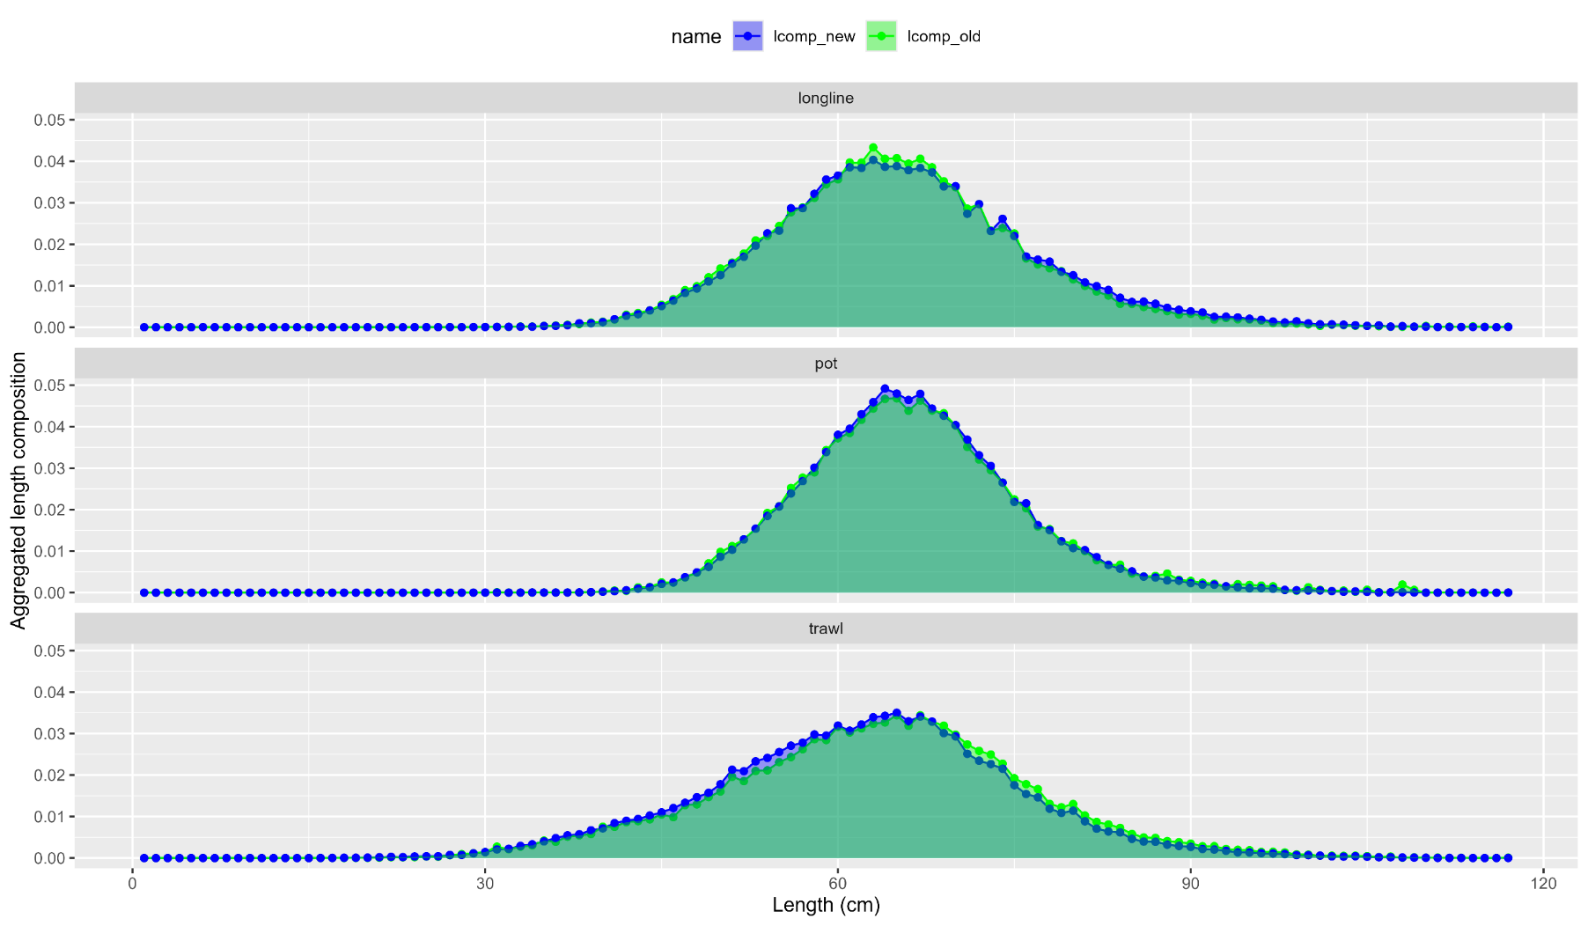
Len comp inv
Aggregated comps:

Slide 9
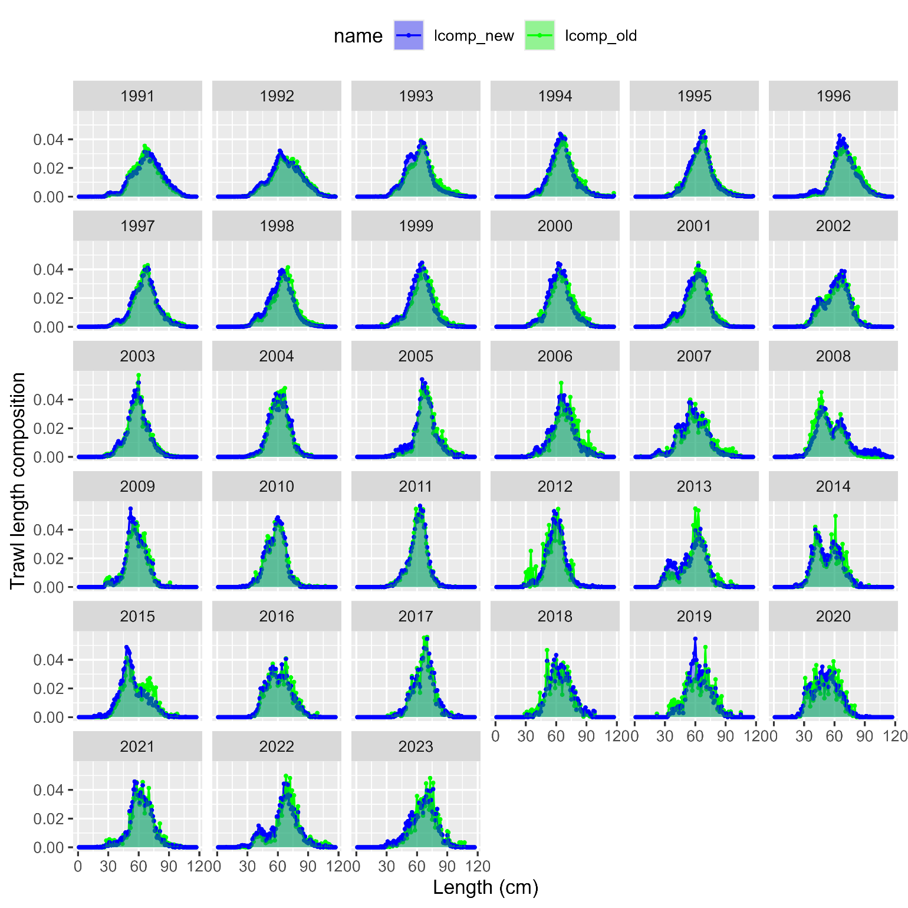
Len comp inv
Trawl comps:

Slide 10
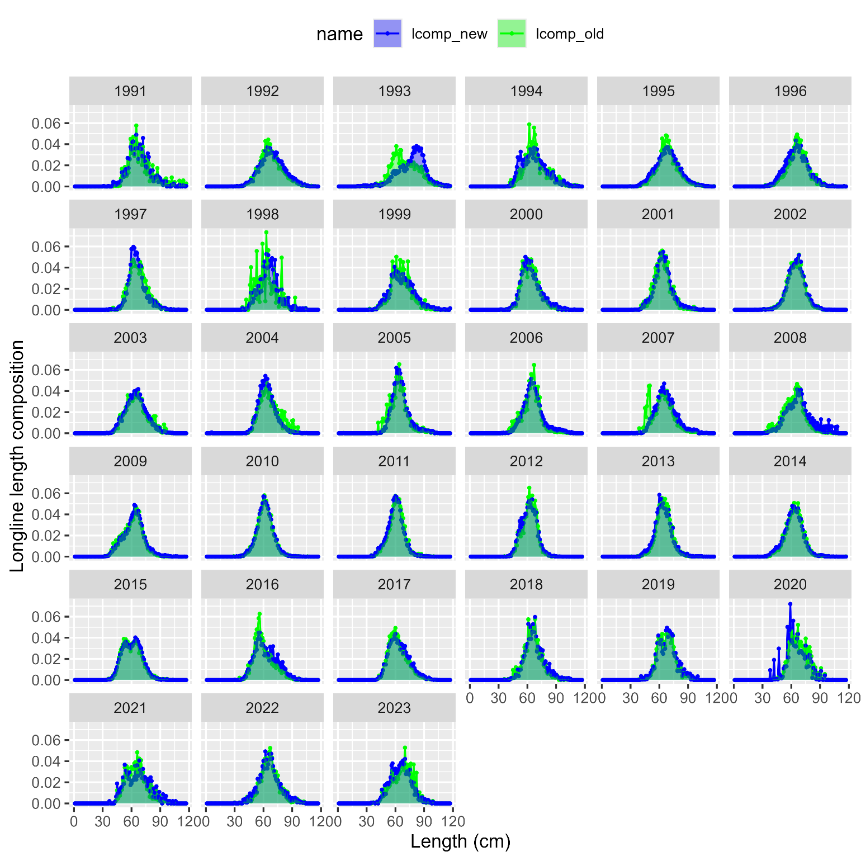
Len comp inv
Longline comps:

Slide 11
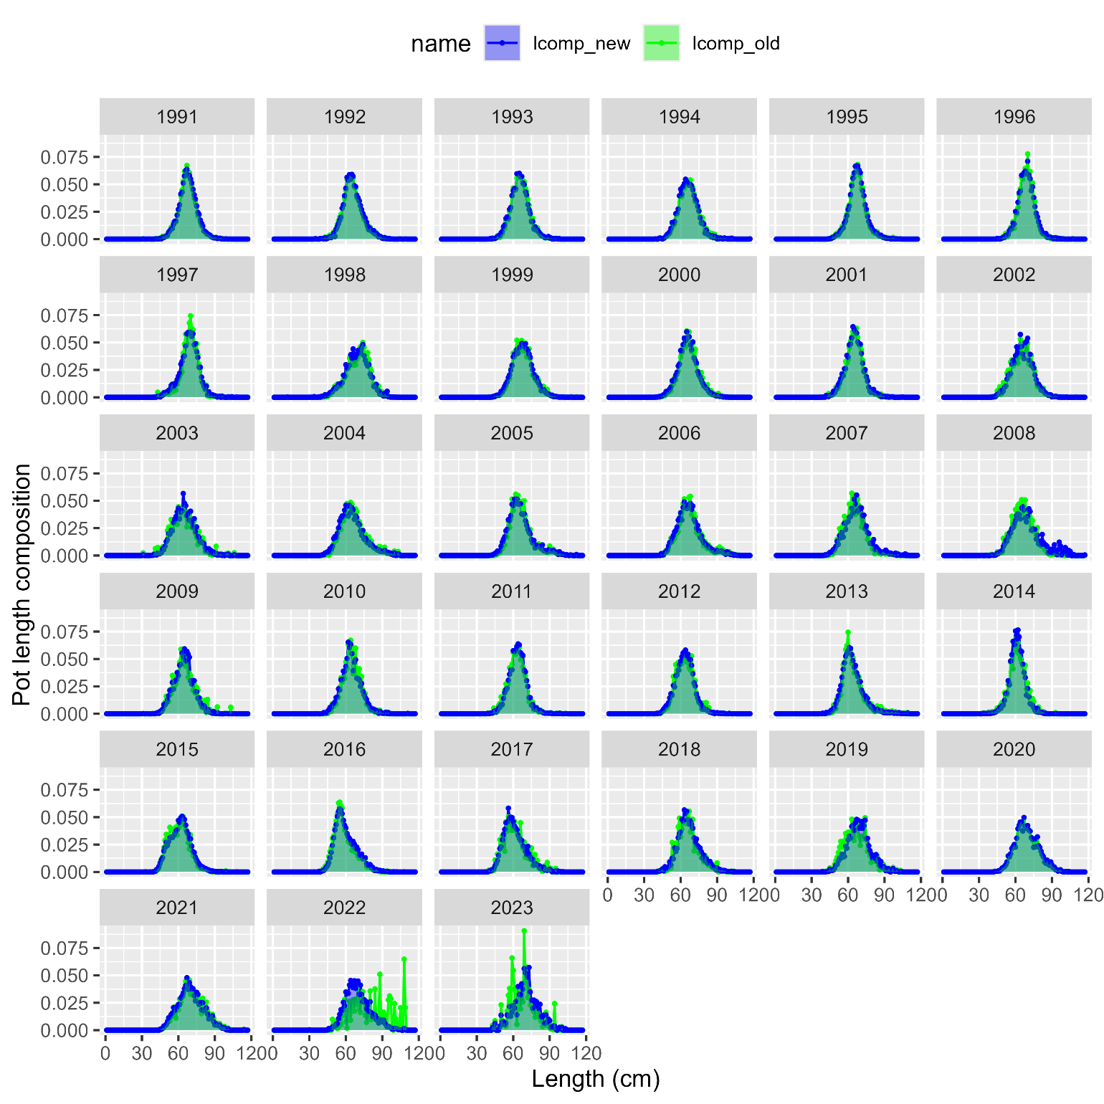
Len comp inv
Pot comps:

Slide 12
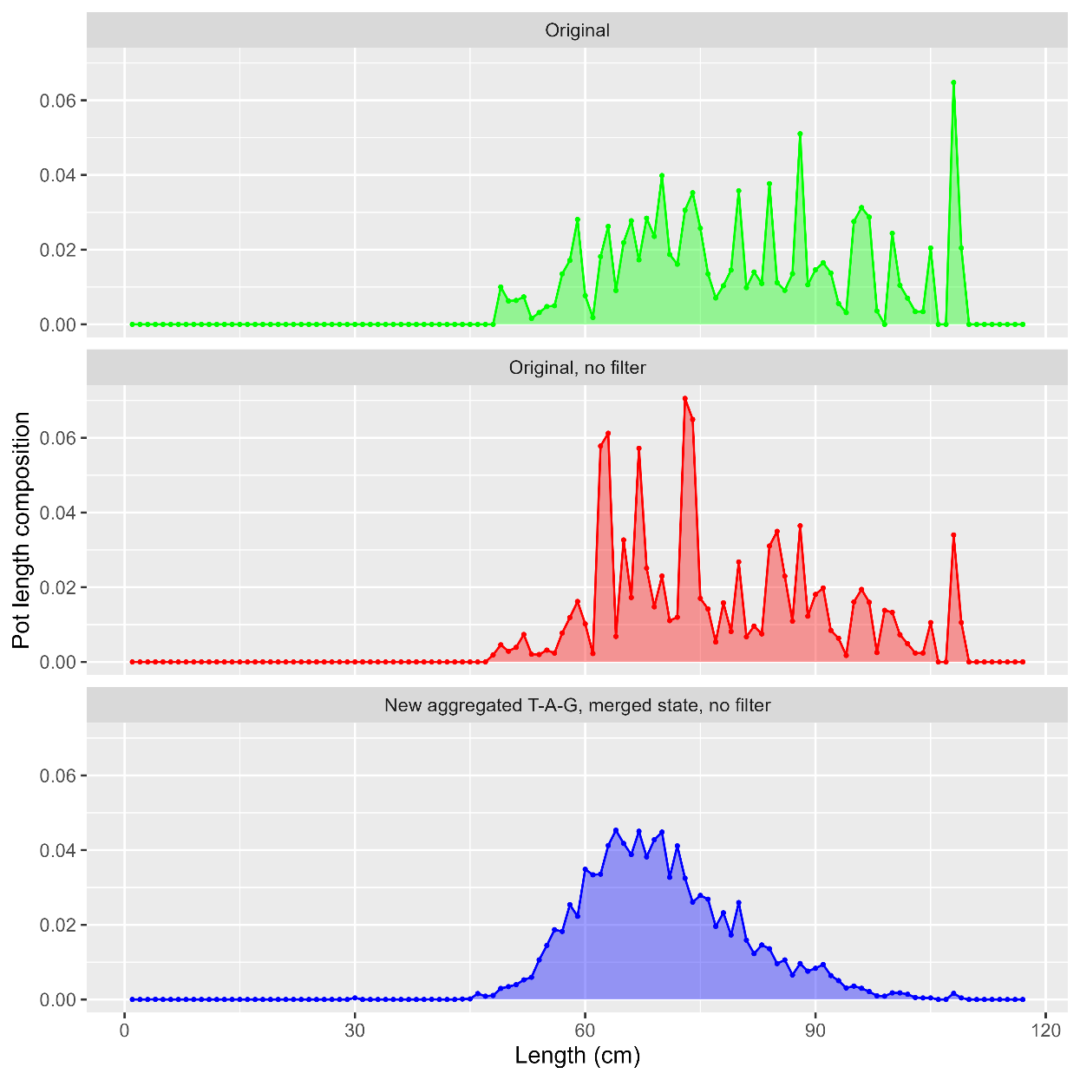
Len comp inv
Pot comps:

Slide 13
Len comp inv
Overall, removing filters, aggregating at trimester-area-gear level and merging state data helps to smooth out much of the variability in fishery length comps
Proposal: add this data treatment as alternative model ###

Slide 14
Len comp inv
Plots of new base vs alternative model ##

Slide 15
Len comp inv
Overall, removing filters, aggregating at trimester-area-gear level and merging state data helps to smooth out much of the variability in fishery length comps
But, only gets us so far
Proposal: align with EBS cod investigations this year, and investigate binning length data at 5 cm intervals
Affects: all length comp (surveys & fishery) and conditional age-at-length (trawl survey and fishery)

Slide 16
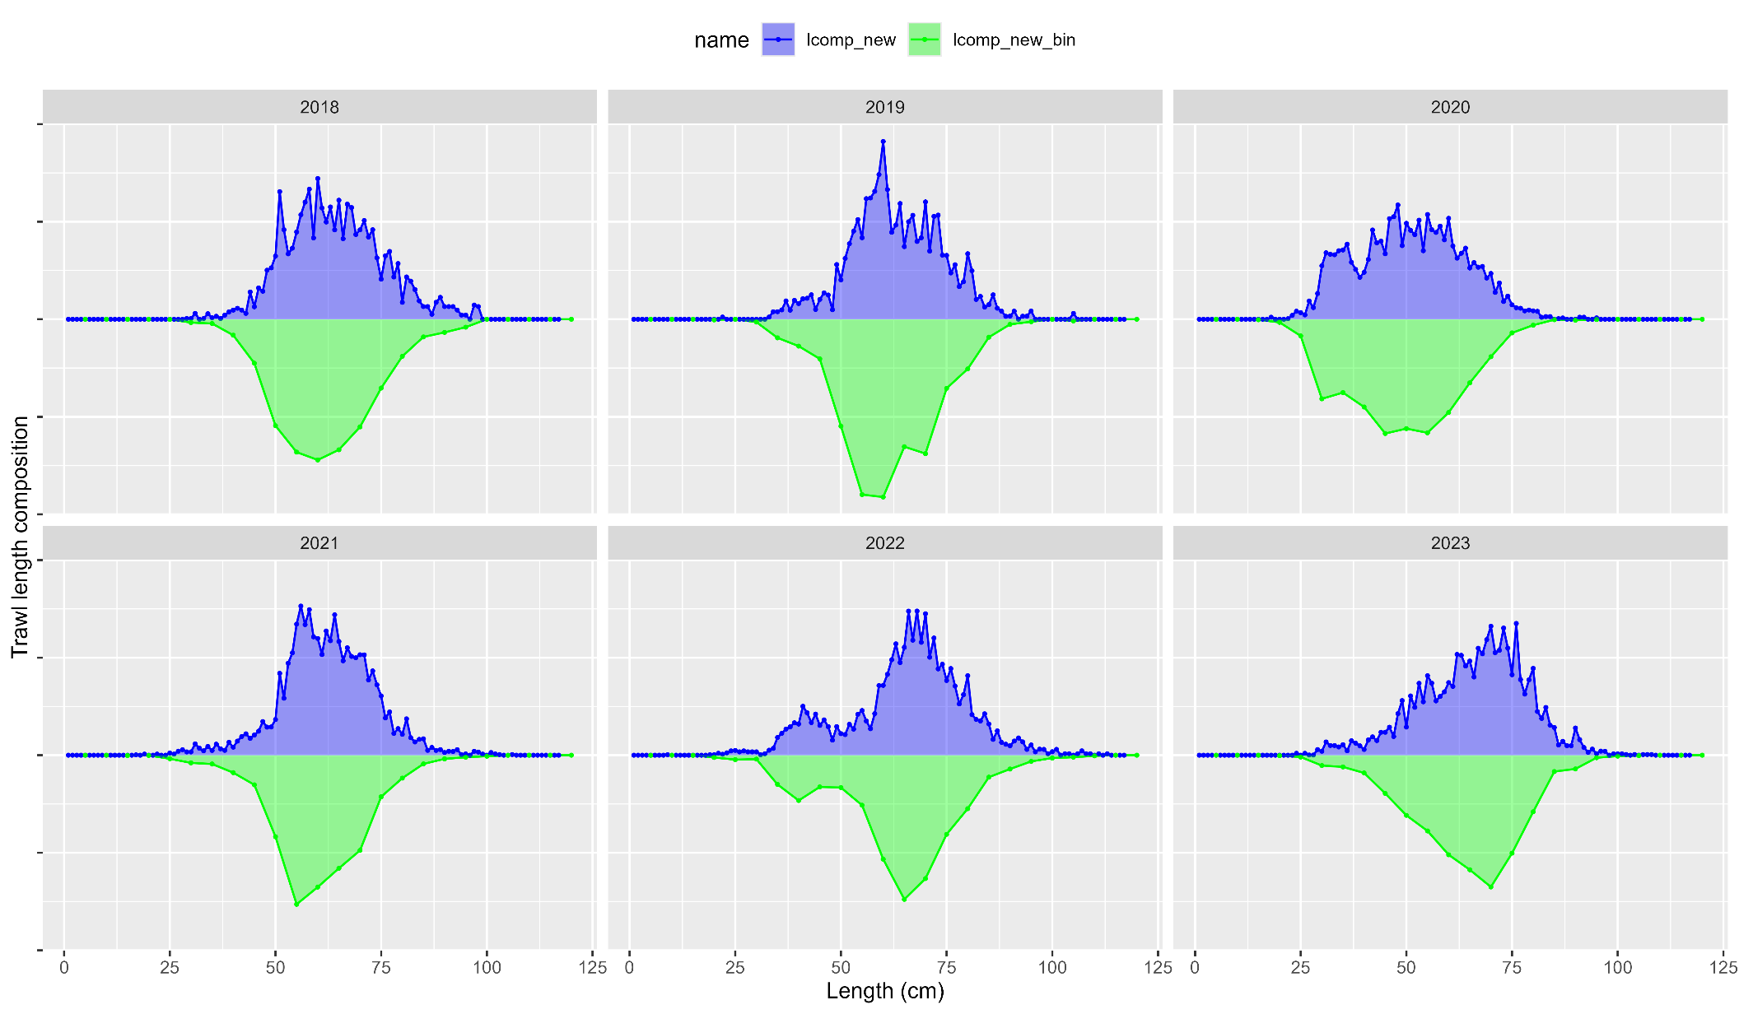
Len comp inv
Bin trawl:

Slide 17
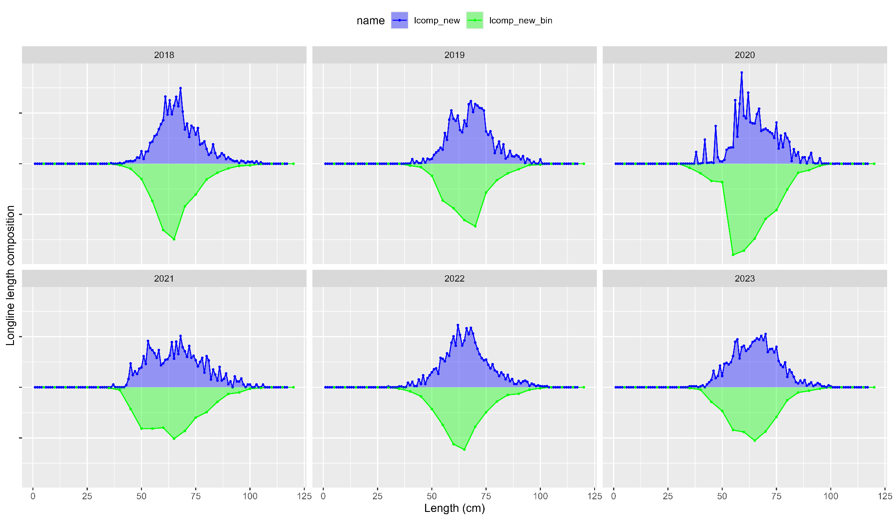
Len comp inv
Bin longline:

Slide 18
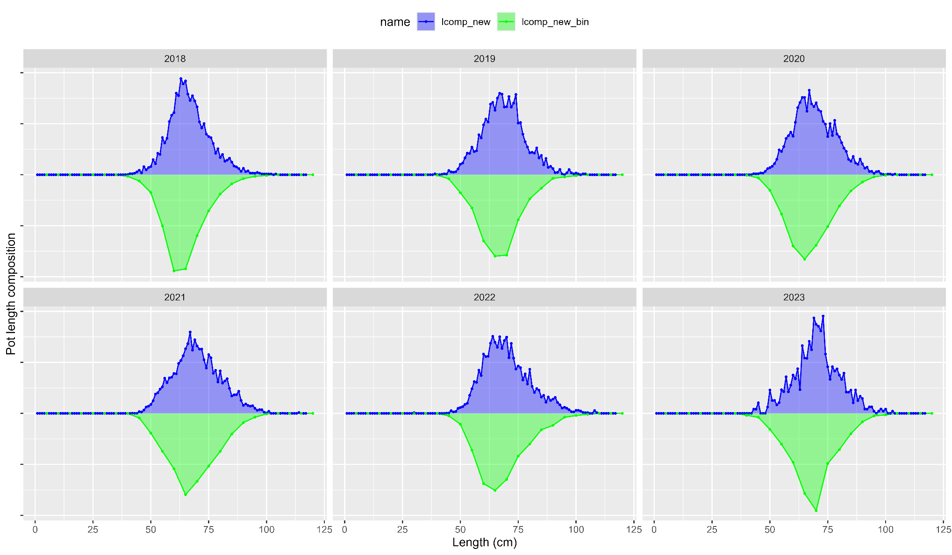
Len comp inv
Bin pot:

Slide 19
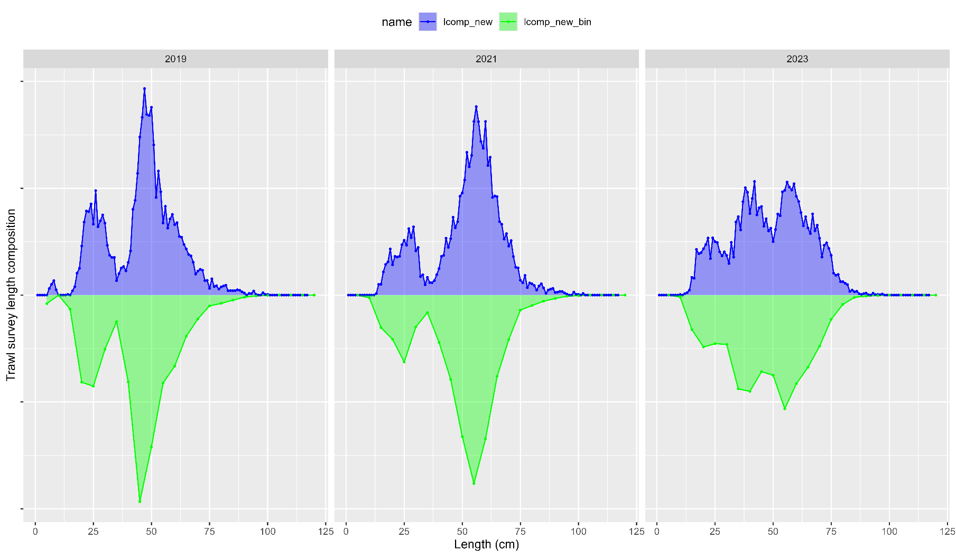
Len comp inv
Bin trawl survey:

Slide 20
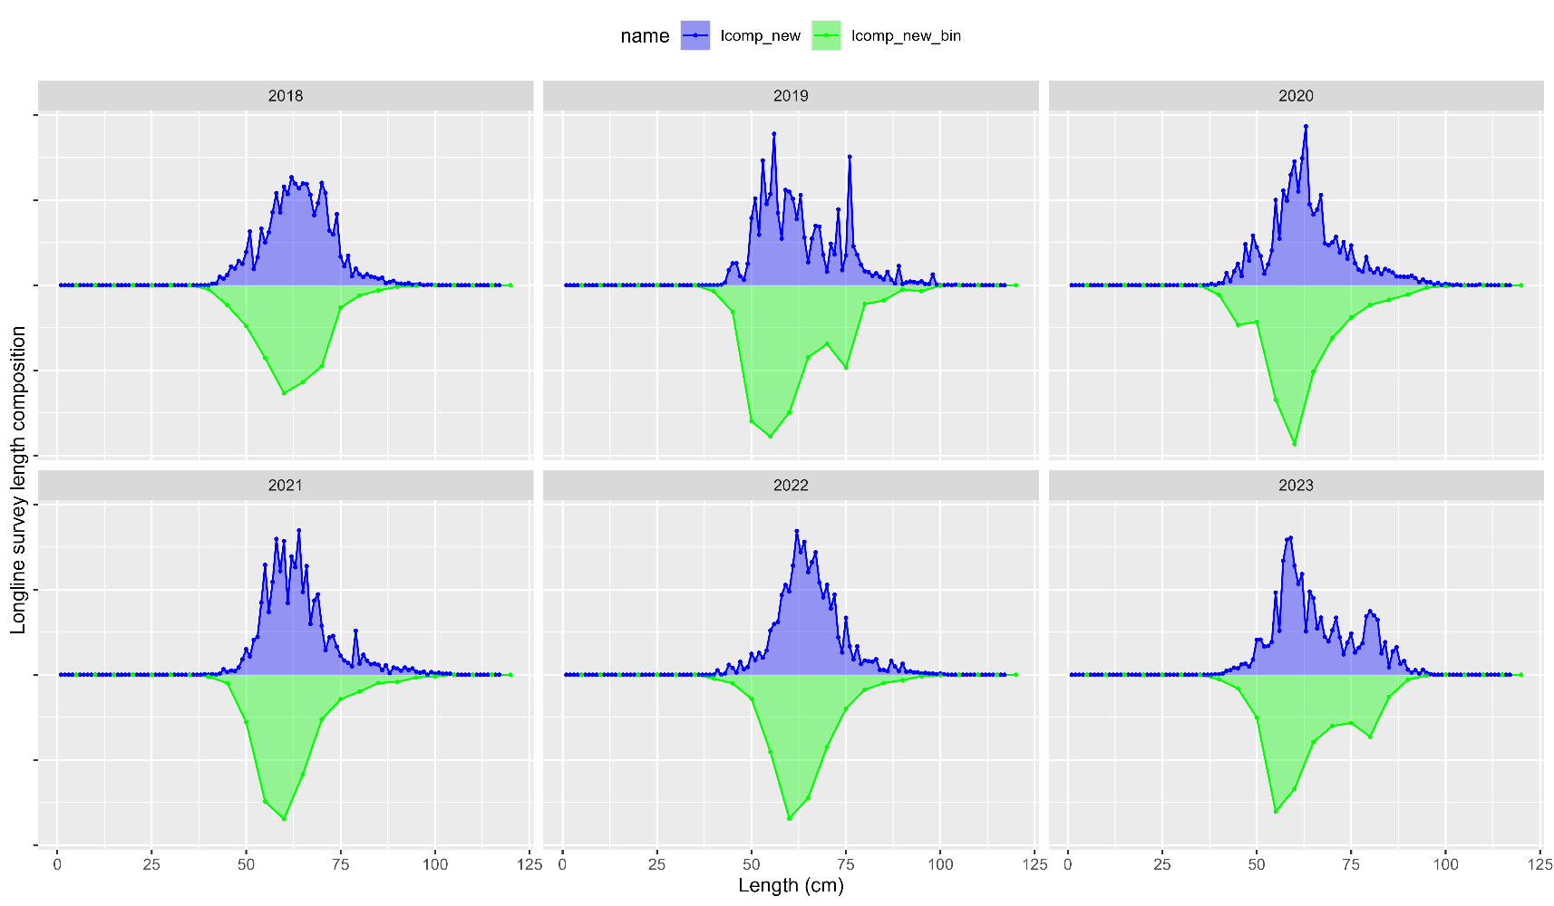
Len comp inv
Bin longline survey:

Slide 21
Len comp inv
Overall, removing filters, aggregating at trimester-area-gear level and merging state data helps to smooth out much of the variability in fishery length comps
And, binning to 5 cm removes variability in length composition without loosing important signal
Proposal: add this data treatment as alternative model ###

Slide 22
Len comp inv
Plots of new base vs alternative model ##

Slide 23
Age comp inv
Survey data: this has been the standard
Fishery data:
Currently computed for males/females, then combined (excludes unsexed data)
ALK computed with FSA package rather than the observed ALK (essentially, puts lengths into ages that weren’t actually observed)
Define smallest lengths in each year as age-1
Propose:
Both: combine age/length data across sexes pre-expansion
Fishery: use year-specific ALK, remove age-1 assignment

Slide 24
Apport inv
Reminder: LLS used in assessment as additional pop’n index, but not used in apportionment
And, includes an environmental link, where in warmer temps at depth cod move deeper and are more available to the LLS than in colder years
Including it in apportionment has been talked about for some time
Other, ‘tracked’, pop’n indices include IPHC FISS and ADF&G large mesh trawl survey

Slide 25
Apport inv
Here, look at including LLS into rema as an additional index to be used for apportionment
Step-wise approach:
First, look at AIC ‘preferred’ model when it comes to Process Error (PE) and index scaling (q) parameters
Next, with ‘preferred’ models investigate estimating additional observation error

Slide 26
Apport inv: Step 1
4 cases: factorial design of global (1), or regional (3) PE and q parameters
PE = 1, q = 1
PE = 3, q = 1
PE = 1, q = 3
PE = 3, q = 3

Slide 27
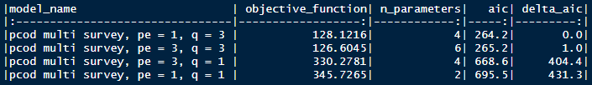
Apport inv: Step 1
AIC suggests that regional scaling parameters q are supported (and most influential)
Whether PE = 1 or 3, no real difference in model
So, to cover our bases, select PE = 1, q= 3 and PE = 3, q = 3 for additional uncertainty analysis

Slide 28
Apport inv: Step 2
6 cases: factorial design of 2 PE-q cases from step 1 x 3 uncertainty cases:
Additional uncertainty in trawl survey
Additional uncertainty in longline survey
Additional uncertainty in both

Slide 29
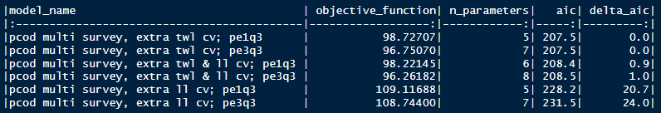
Apport inv: Step 2
Results in 4 models that are essentially the same, in terms of AIC
Preferred model:
For PE-q, argue for parsimony: select PE = 1 and q = 3 case
For additional uncertainty, argue:
When adding trawl survey uncertainty, largest decline in AIC (and is significant)
Acknowledge that these don’t include environmental link for longline survey, so, there’s a sources of uncertainty that we haven’t yet explained in this model
So, select additional uncertainty in both

Slide 30

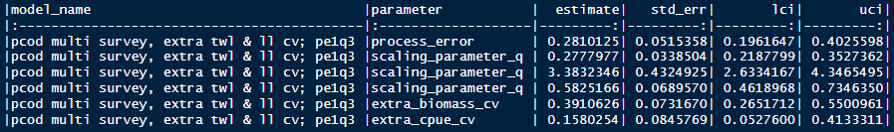
Apport inv: Comparisons
Compare between:
Base model: trawl survey only (pcod trawl survey)
Preferred model: both trawl and longline survey with 1 process error parameter, 3 scalar parameters, and additional uncertainty estimated for both surveys

Slide 31
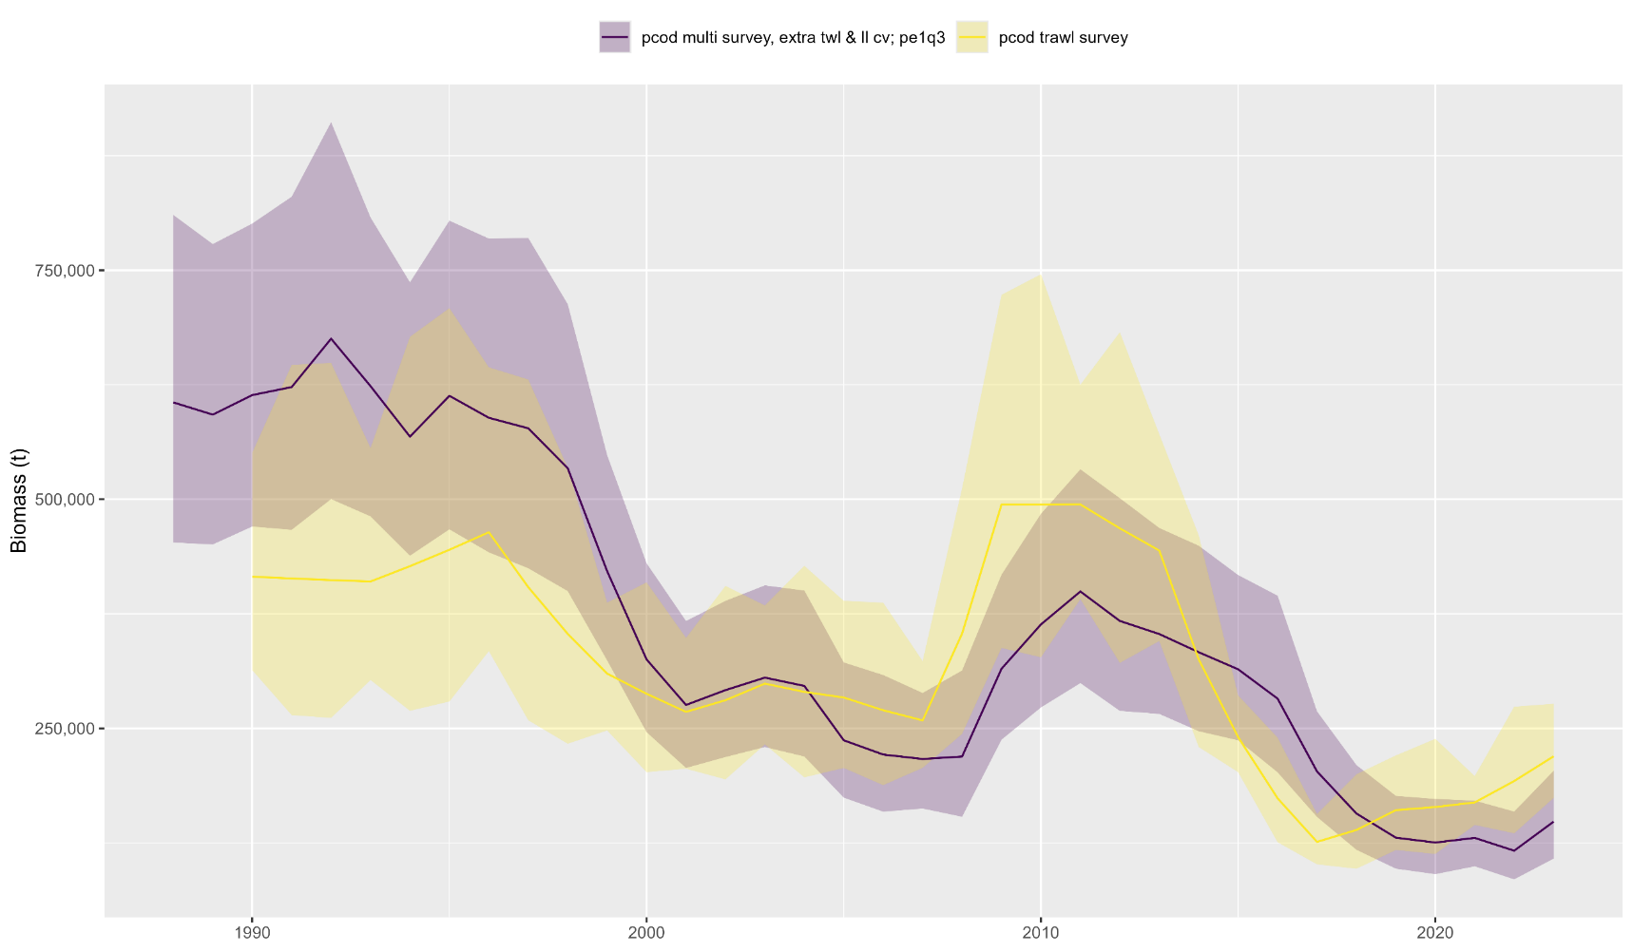
Apport inv: Comparisons
Estimated biomass:

Slide 32
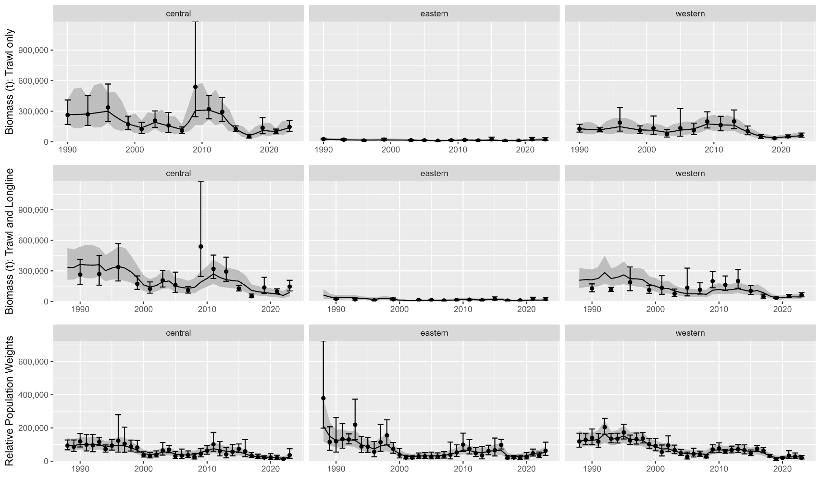
Apport inv: Comparisons
Data fits:

Slide 33
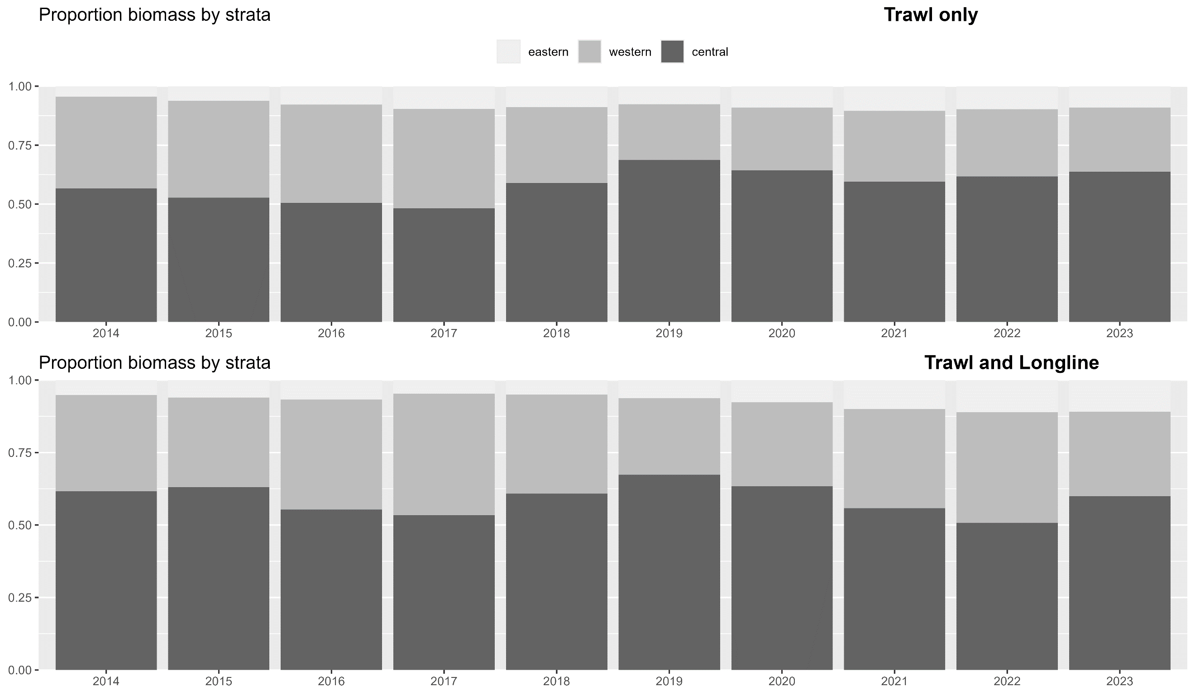

Apport inv: Comparisons
Apportionment:

Slide 34
Apport inv: Discussion
Recommendation: use rema with additional index with preferred parameterization
Makes apportionment consistent with data used in assessment
But, it will likely result in more variable apportionment compared to using only trawl survey
Next steps:
Working on environmental index, will be looking towards region indices to potentially be used in apportionment
Survey timing is slightly different in each region, whether/if this results in different environmental conditions by region remains to be seen
Currently rema not developed to include environmental index

Slide 35
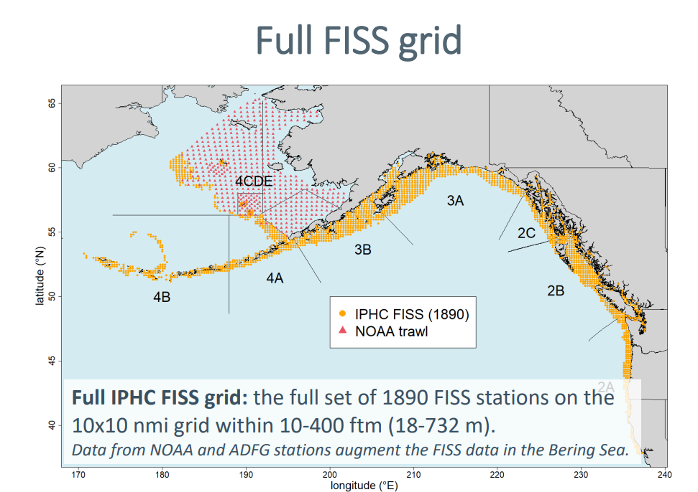
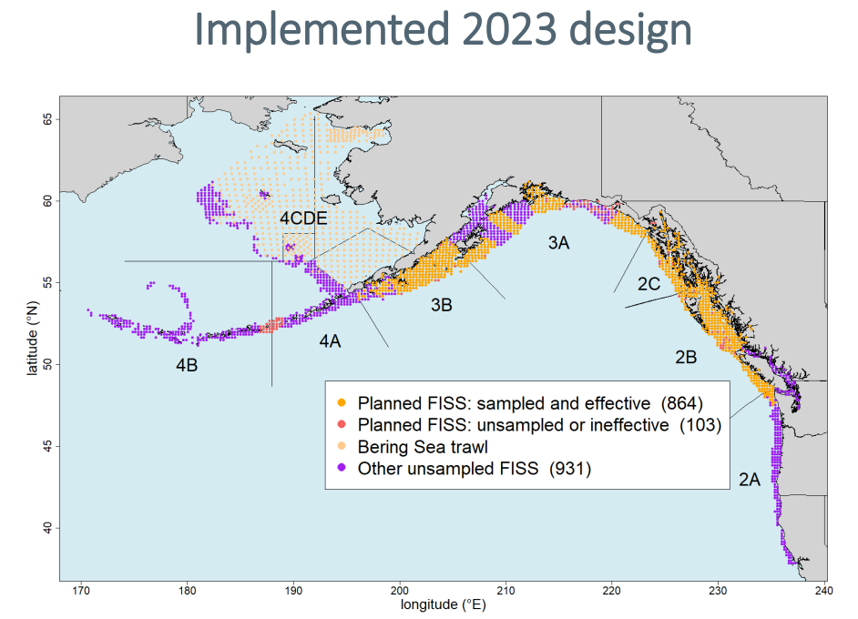
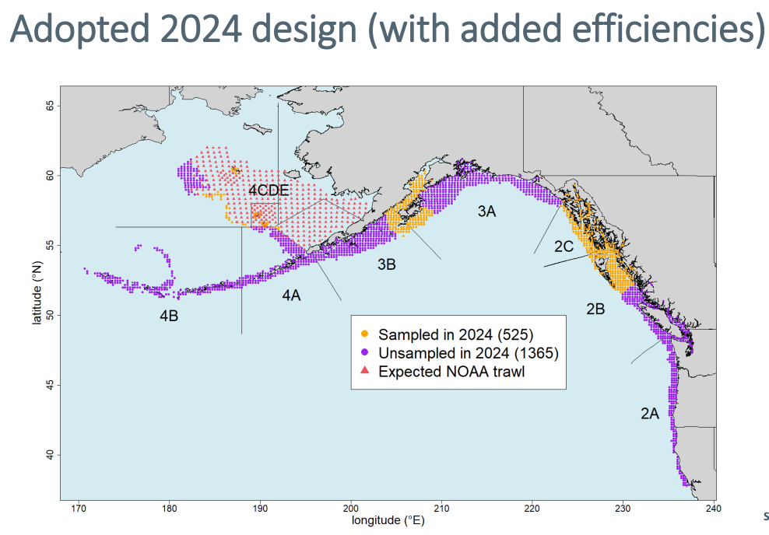
Apport inv: Discussion
Other indices: IPHC FISS
Has always been a promising additional index for apportionment, but, recent developments have made implementation questionable for Pacific cod
Recommend: not consider FISS as viable alternative index for Pacific cod until stations randomly subsampled or full FISS design is implemented

Slide 36
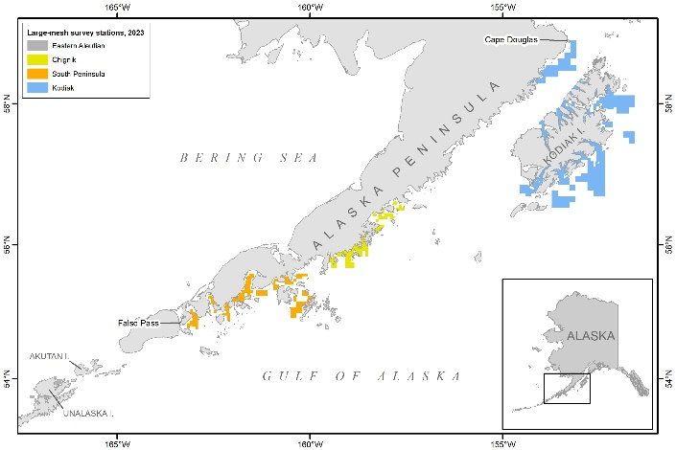
Apport inv: Discussion
Other indices: ADF&G large mesh survey
Rub here: only samples western and central gulf
But, if there is additional information about trend in these two subregions, could possibly use it in rema
However, rema currently not capable of including third index
Recommend: for now continue to track ADF&G survey in assessment, but since we have 2 indices in rema that have good spatial coverage, not spend time yet developing this as an additional index

