Slide 1
2023 GOA Pcod assessment
September 2023 Plan Team

Slide 2
Overview
Housecleaning (minsamplesize)
Environmental link
Description of environmental index
Link for LL survey q
Retrospective comparison w/ and w/o link
Evaluation of new index
Link for growth
Individual parameters: determining index
Combined model & comparisons with base model
Path forward

Slide 3
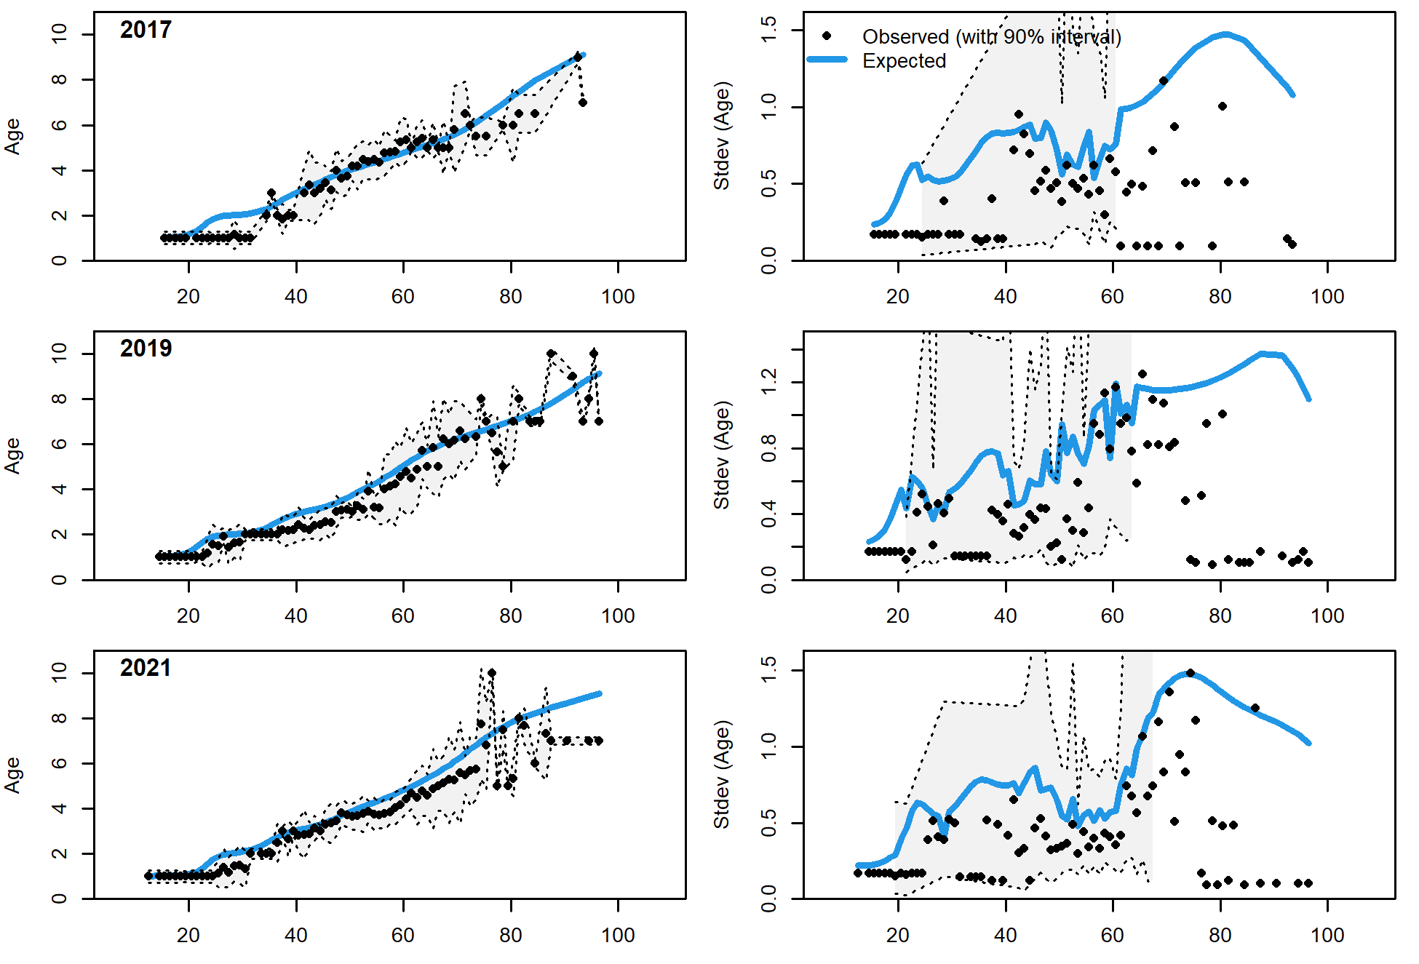
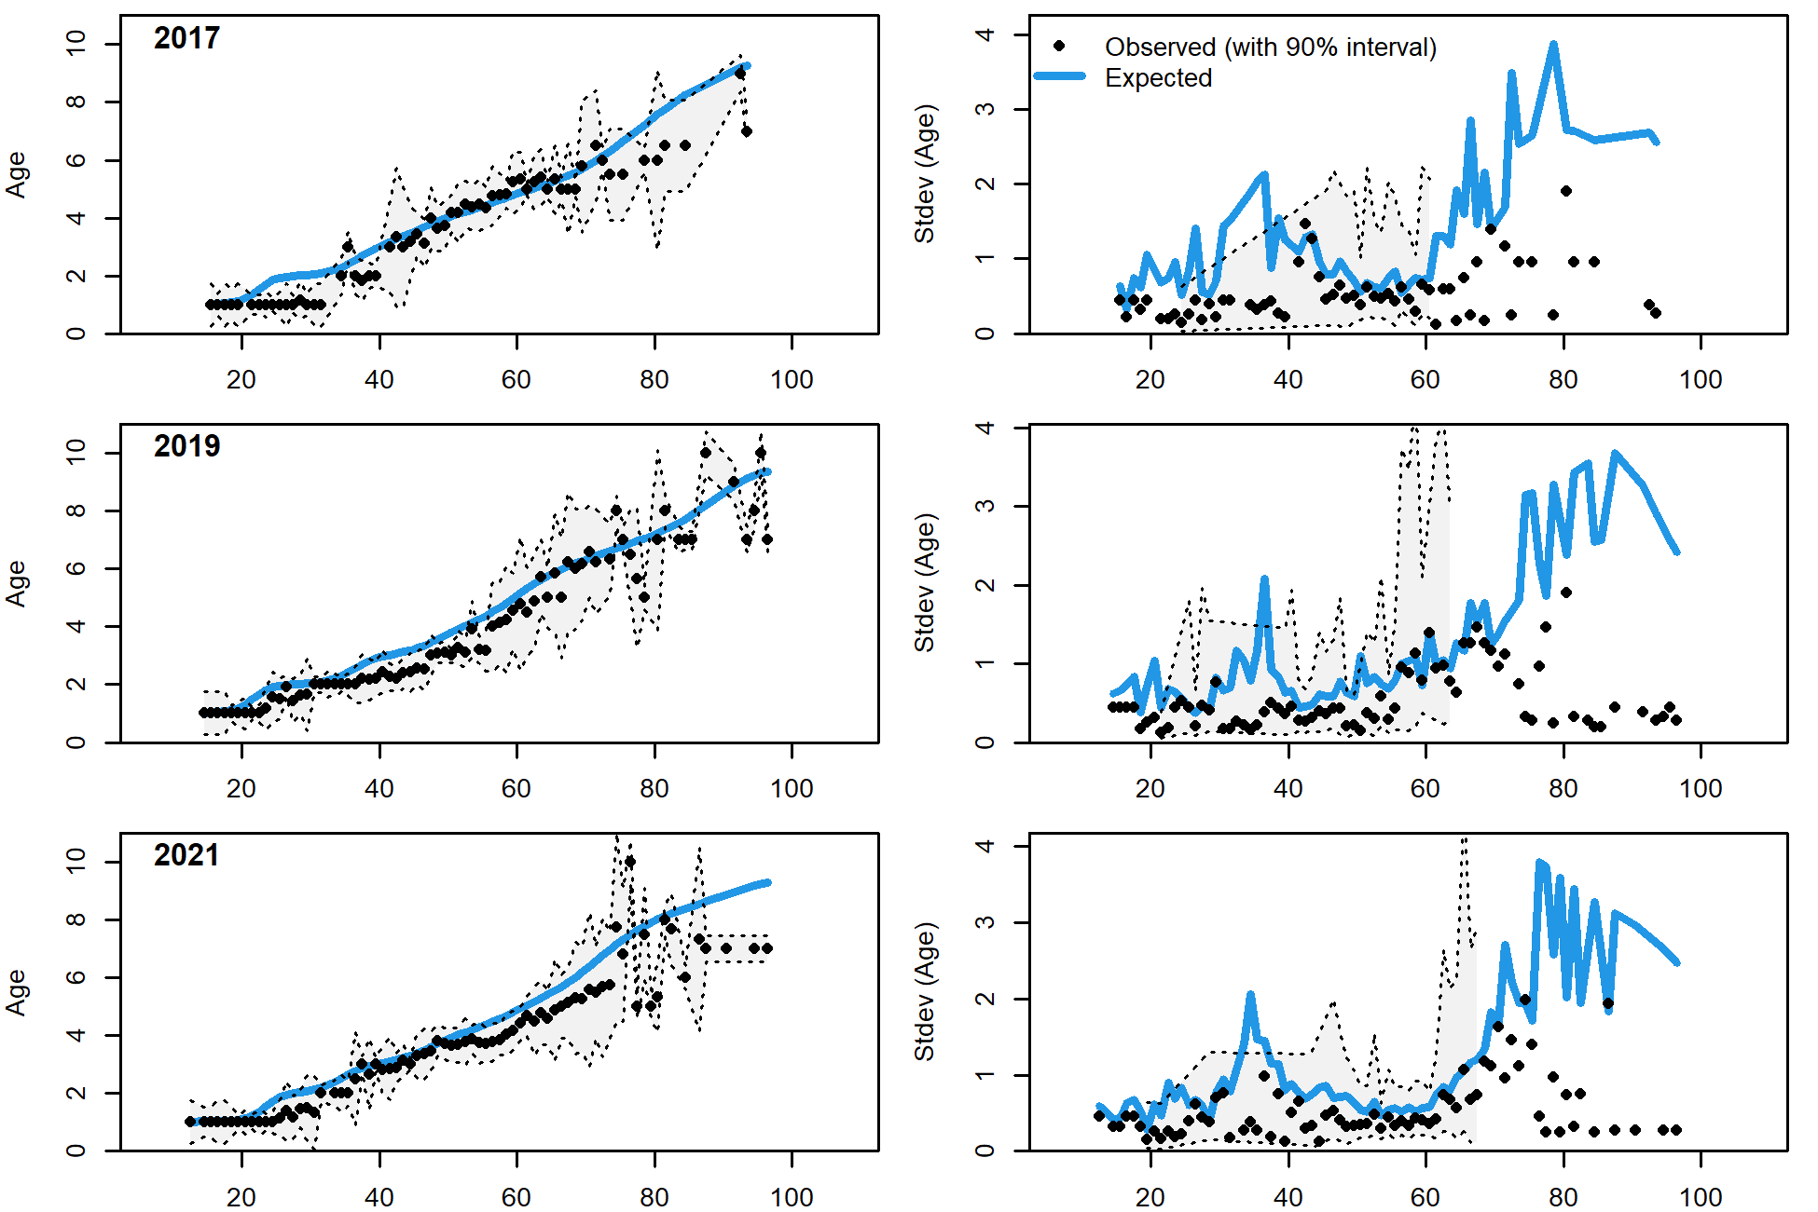
Housecleaning:
2019.1a
Minimum sample size issue
Removed CAAL data with minimum sample size less than 1 (i.e., weight)
1,812 of 2,825 CAAL rows (mostly the small/large fish)
Likelihoods
2019.1b

Slide 4
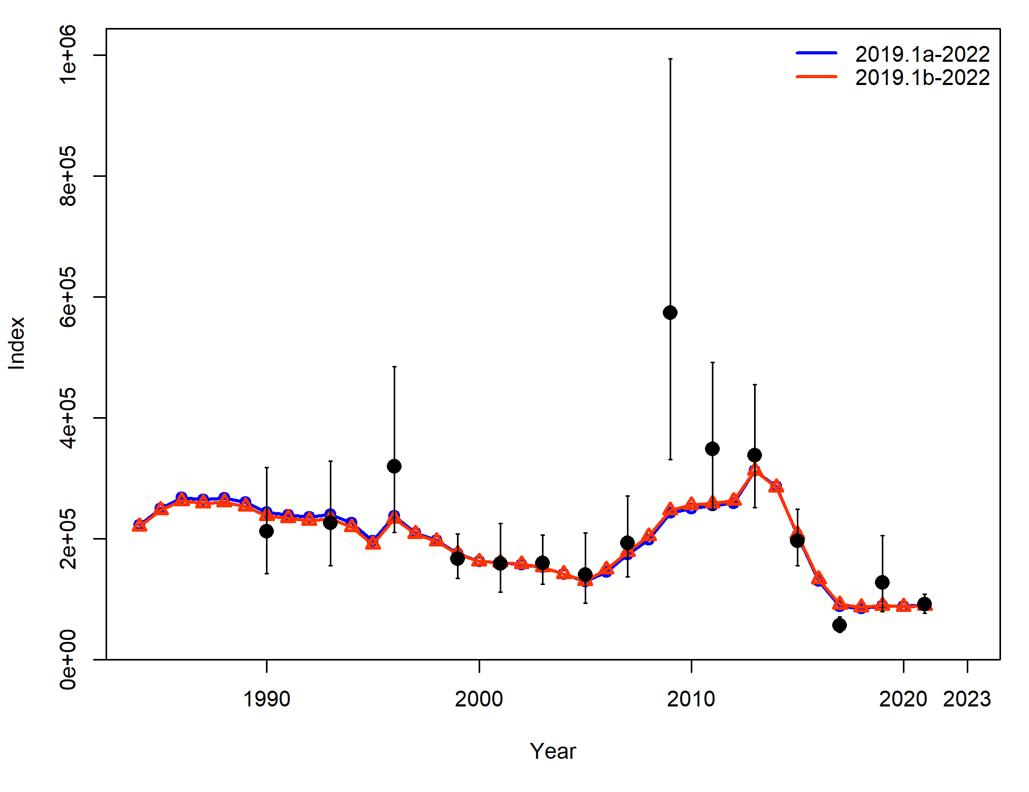
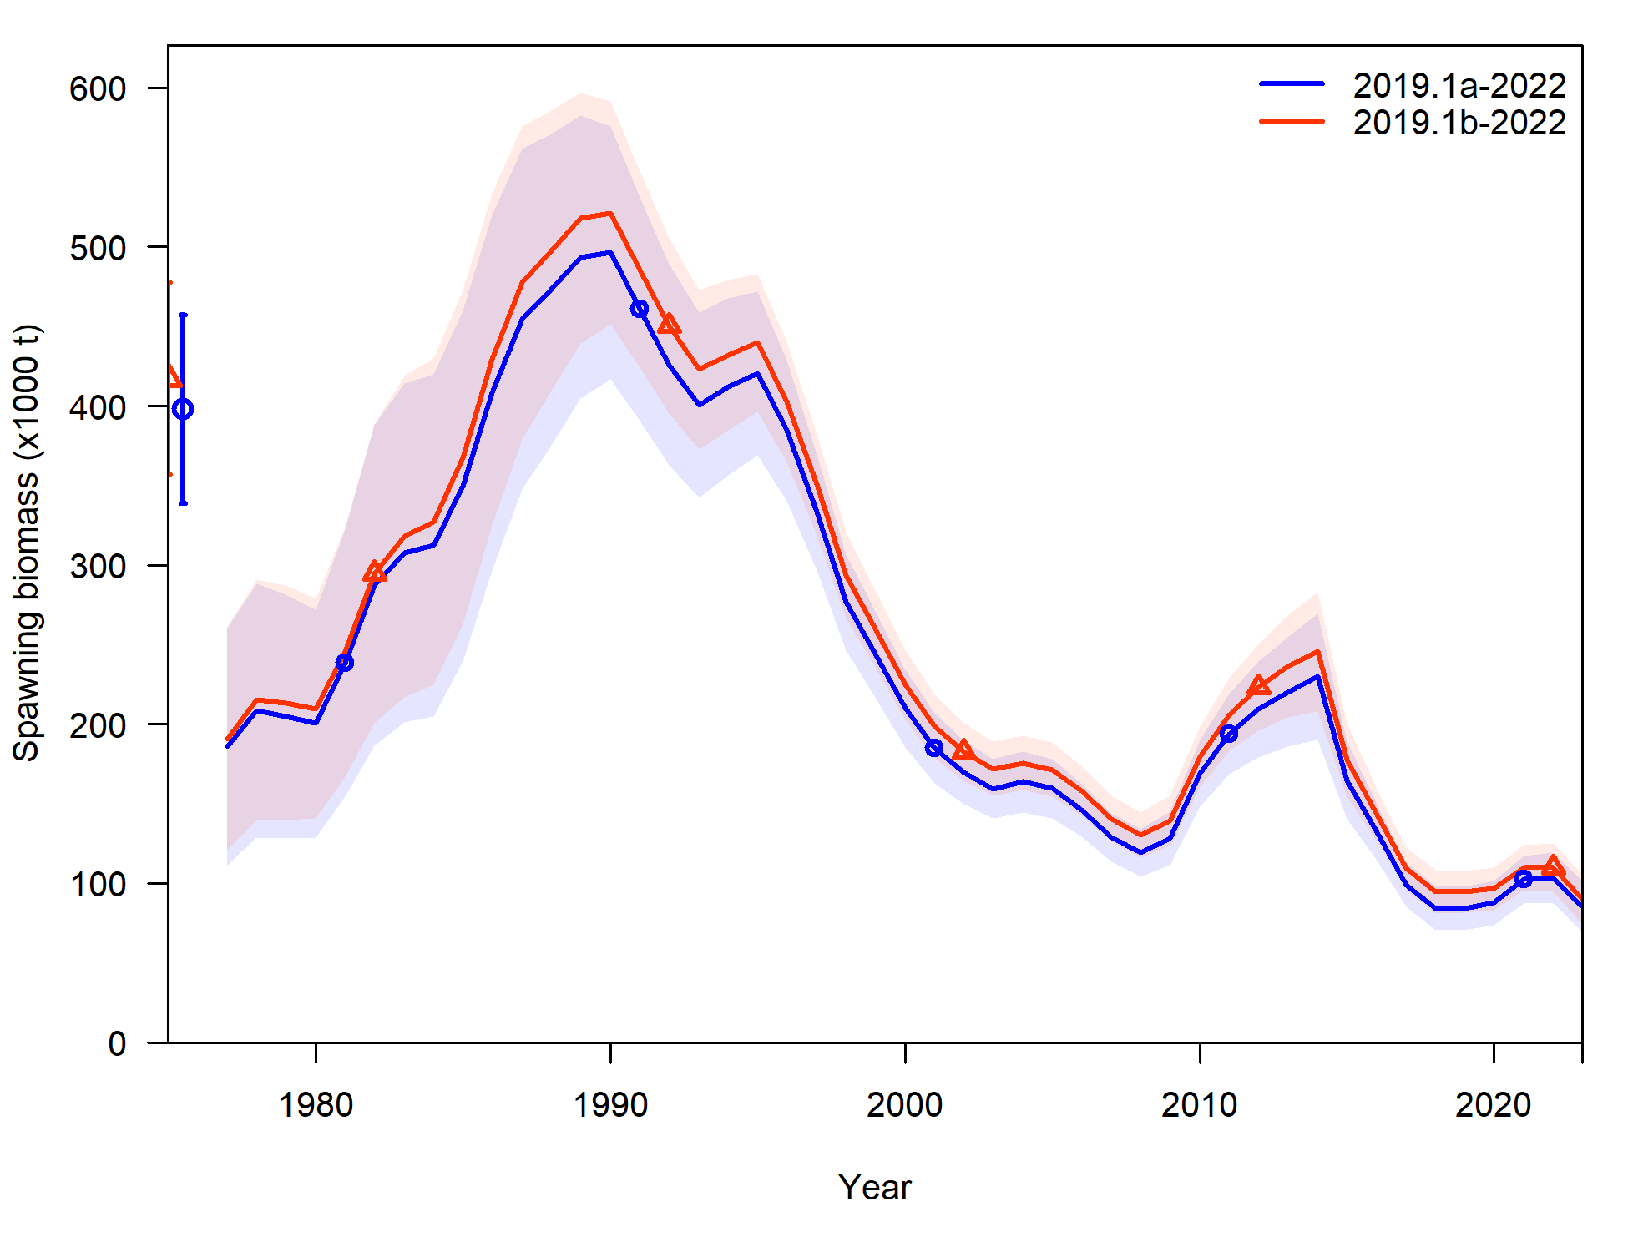
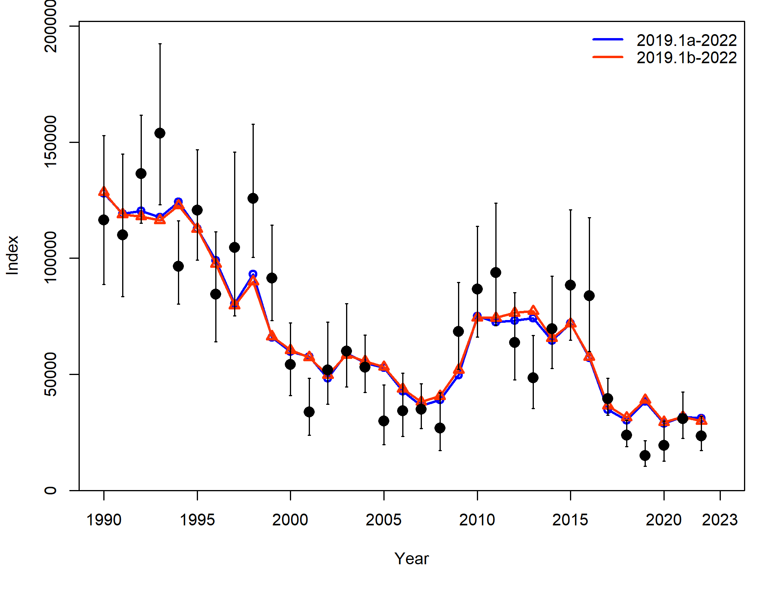
Housecleaning
This is new base model from here out (2019.1b)

Slide 5
Environmental link
Description of cfsr
Available by length bin and month

Slide 6
Link for LL survey
SSC request to evaluate whether link still appropriate
Construct model with no env link to LL survey q (2019.1c)
Added... re-evaluate cfsr index used
Step 1: Evaluated q across length bin and month
Step 2: best from Step 1 as new env link model (2019.1d), and run model with env link for all 3 growth parameters
Statistics: current year AIC and model fits, retrospective AIC and performance

Slide 7
Link for LL survey, re-evaluation
Step 1: AIC base model (2019.1b) – new env link model (2019.1d)

Slide 8
Link for growth
Step 1:
Evaluated Linf and kappa across length bin and month
Evaluated Lzero across month for 0-20 cm length bin
Step 2:
Select best from Step 1, and run model with env link for all 3 growth parameters
Step 3:
Compare with base model
Statistics: current year AIC and model fits, retrospective AIC and performance

Slide 9
Link for growth
Step 1: difference in AIC with base model (EnvLnk – base, so negative number means EnvLnk model better)
Linf > Lzero > kappa for model improvement

Slide 10
Link for growth
Step 2: AIC & likelihoods

Slide 11
Link for growth
Step 2: Retrospective AIC
Mohns rho: 2019.1b = -0.073, 2023.1 = -0.022

