Slide 1
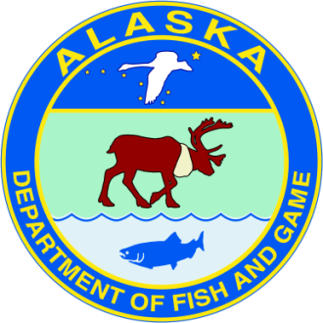
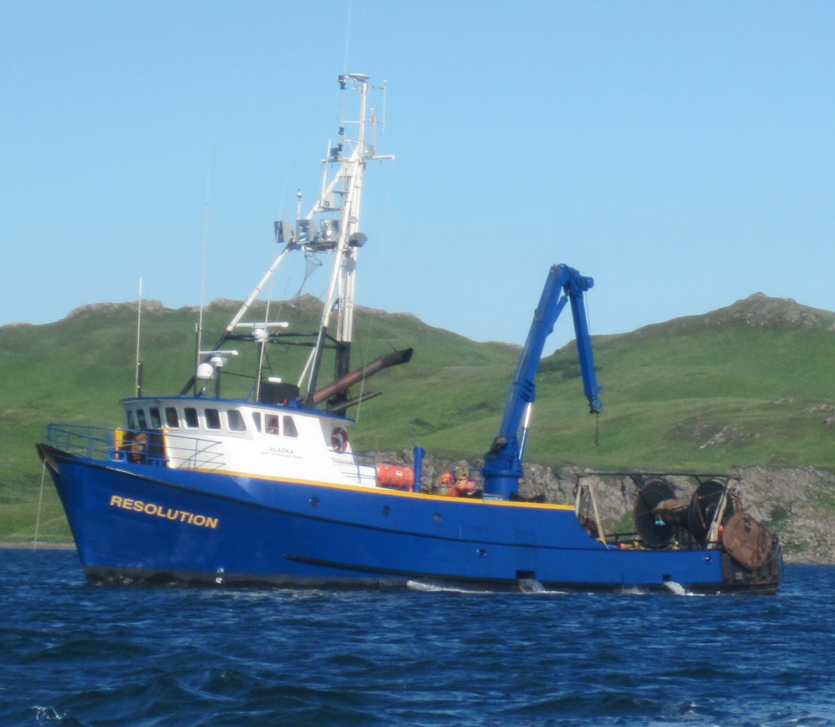
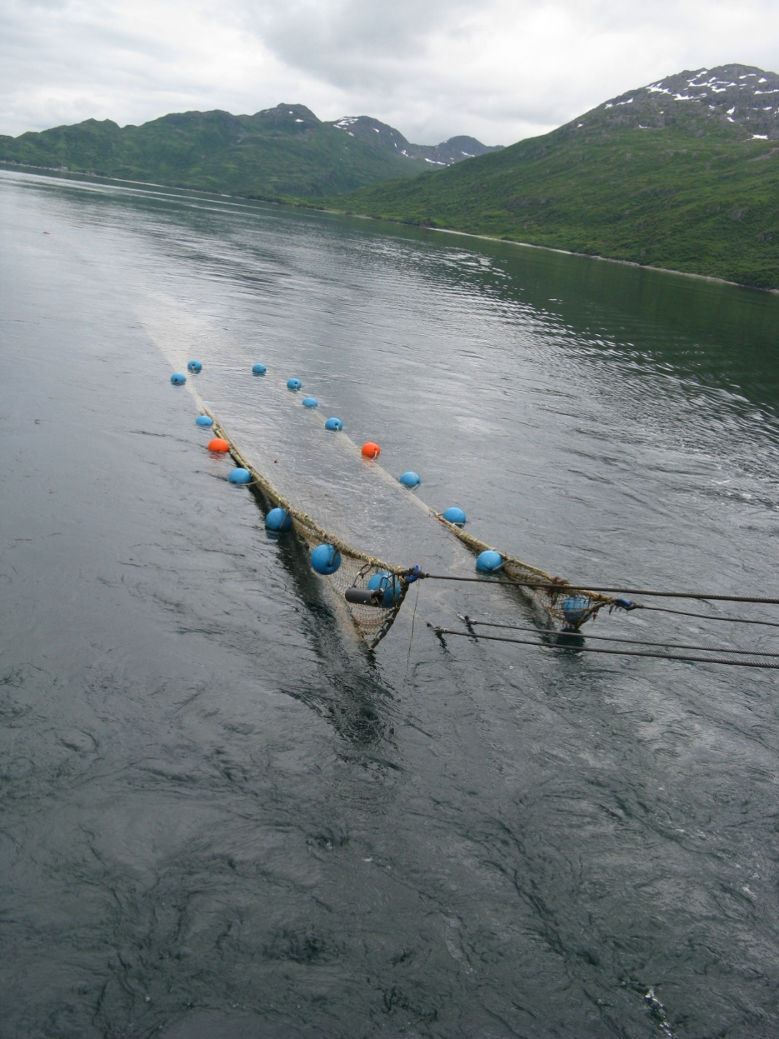
ADF&G Large-Mesh Trawl Survey
2022: 368 stations from Cape Douglas to False Pass
R/V Resolution, 95 feet
400-Eastern otter trawl is towed for 1.0 nmi
A subsample is taken to determine species composition
Commercially-important species are measured
Notes:
This survey uses the 92 foot ADF&G research vessel Resolution. At each station a 400-mesh eastern otter trawl is towed for 1.0 nautical mile. After the catch is brought on board a subsample is taken and sorted by species to determine species composition and commercially-important species are measured. Specific methods used are comparable to other trawl surveys in Alaska.

Slide 2
Preliminary Pacific cod results
2022 P. cod CPUE and abundance remains low, although there is a small increase from 2021.
Kodiak, Chignik, and Eastern Aleutian had increasing abundance, while South Peninsula declined.
Kodiak had a large number of 35 to 50 cm fish

