Slide 1
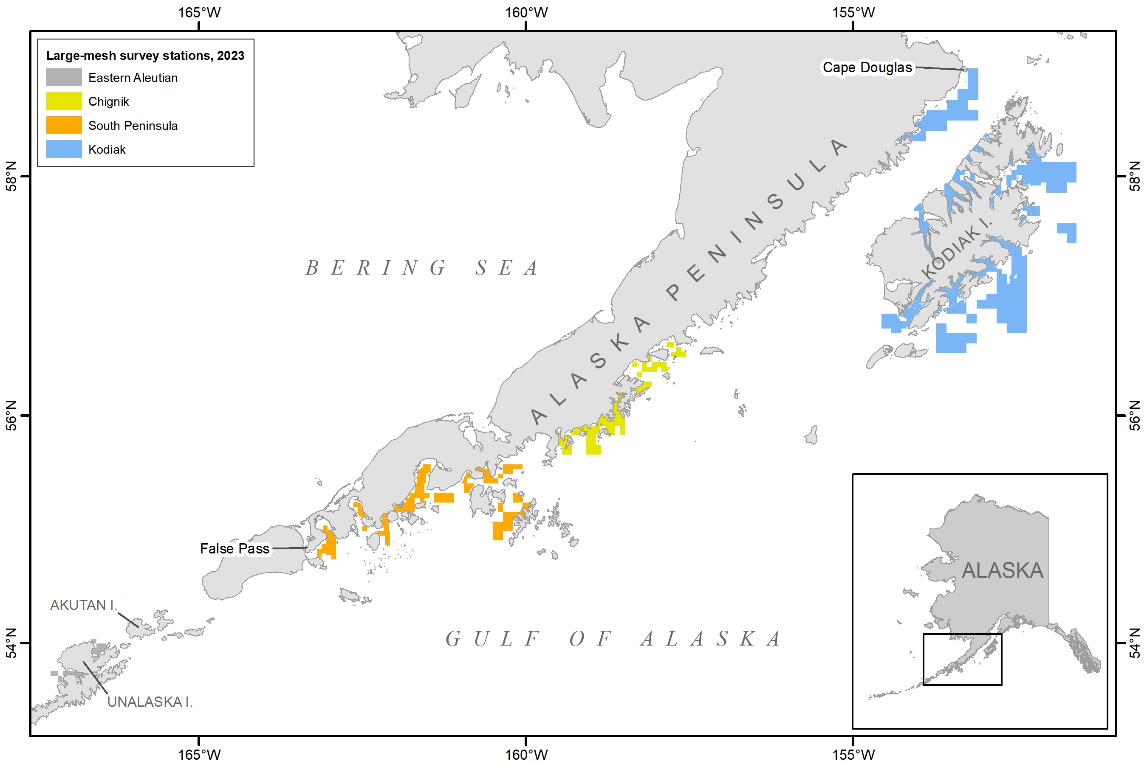
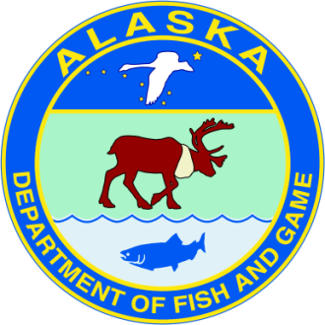
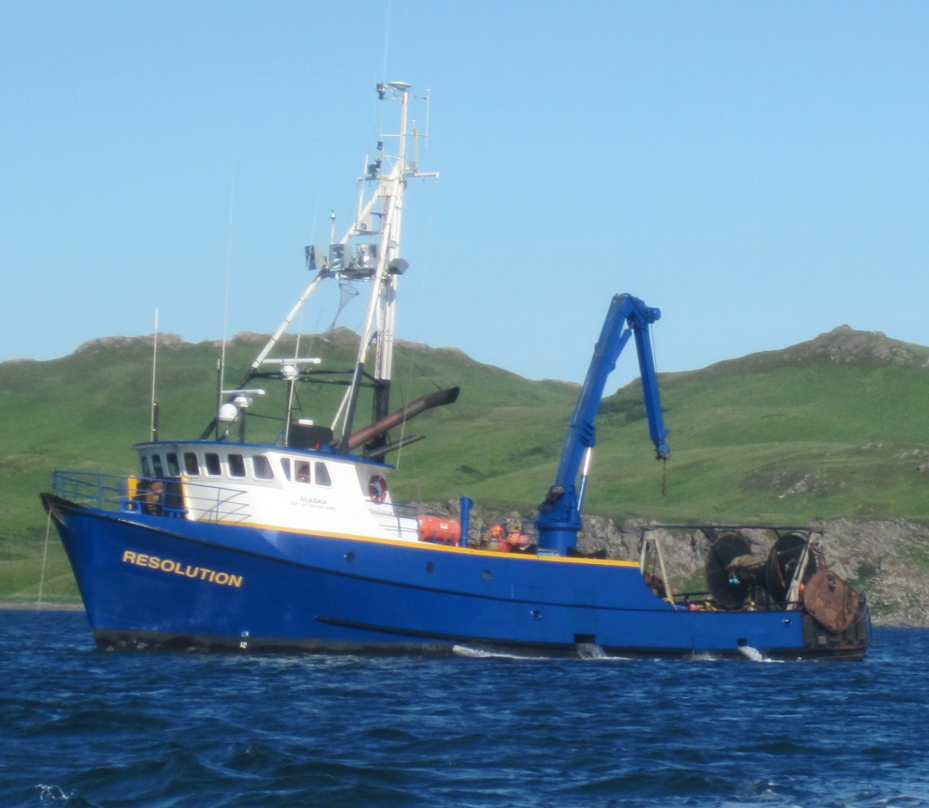
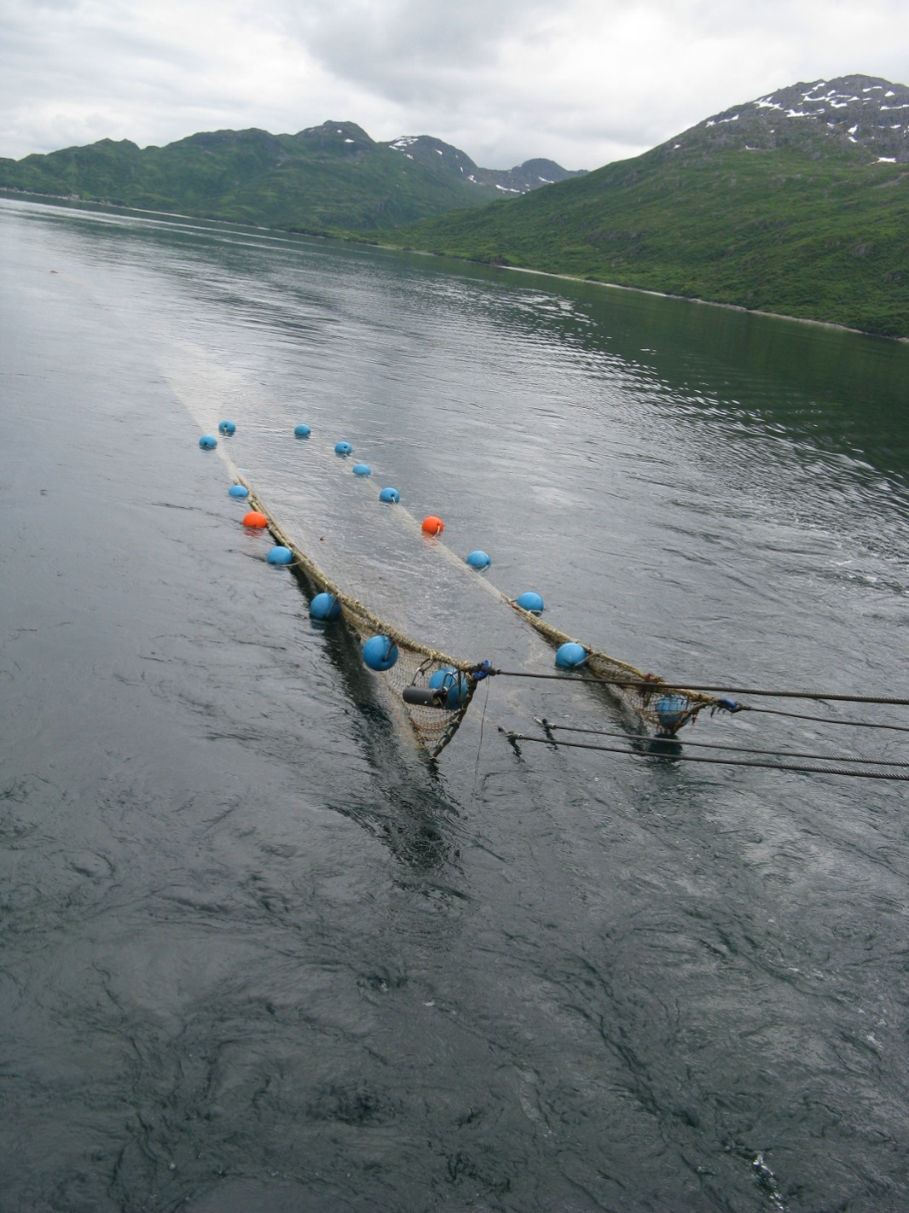
ADF&G Large-Mesh Trawl Survey
2023: 322 stations from Cape Douglas to False Pass
R/V Resolution, 95 feet
400-Eastern otter trawl is towed for 1.0 nmi
A subsample is taken to determine species composition
Commercially-important species are measured
Notes:
This survey uses the 92 foot ADF&G research vessel Resolution. At each station a 400-mesh eastern otter trawl is towed for 1.0 nautical mile. After the catch is brought on board a subsample is taken and sorted by species to determine species composition and commercially-important species are measured. Specific methods used are comparable to other trawl surveys in Alaska.

Slide 2
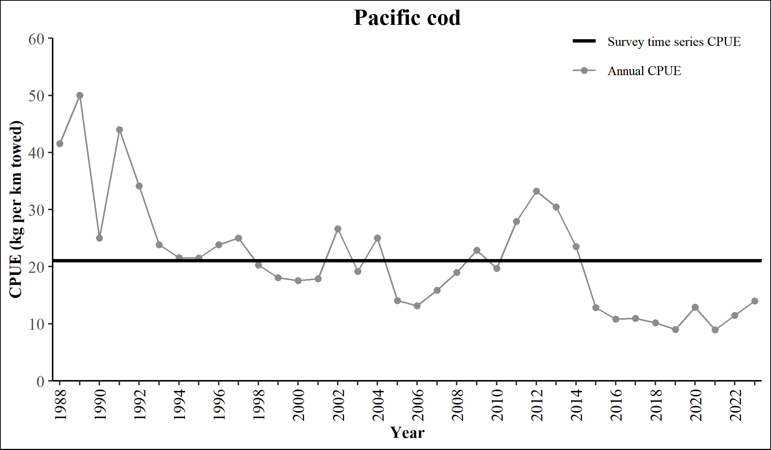
Preliminary Pacific cod results
2023 P. cod CPUE and abundance remains low, although there is a small increase from 2022.
Kodiak, Chignik, and South Peninsula had increasing abundance, while Eastern Aleutian declined, although that survey was incomplete.
South Peninsula had some high catches of YOY fish in Pavlof Bay.

