Slide 1
Visualize It
Designing Impactful and Accessible Data Visualizations
Peter Lawson, Ph.D.
Inna Kouper, Ph.D.
DLF 2026

Slide 2
Data visualization
What is it?
Data visualization is the creation and study of the visual representation of data.
Data visualization involves converting our data sources into visual representations.
These might be charts, maps, graphs.
“The simple graph has brought more information to the data analyst’s mind than any other device”
- John Tukey

Slide 3
Before you begin
Understand your audience.
  What is their expertise?
  What is your expertise?
  Is there a mismatch between your expertise and your audiences?
What is the purpose of your visualization?
  Are you trying to communicate some pattern?
  Are you exploring data to discover underlying trends?
  What is the story you are trying to tell?

Slide 4
Principles of visual perception
Notes:
Accessibility is not an afterthought – it’s fundamental.

Slide 5
0854256596610022901891854082732455179002848630084785932826838670785383733305567118973

Slide 6
0854256596610022901891854082732455179002848630084785932826838670785383733305567118973

Slide 7
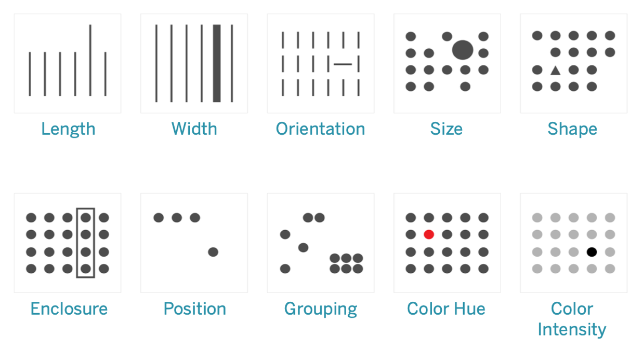
Pre-attentive attributes

Slide 8
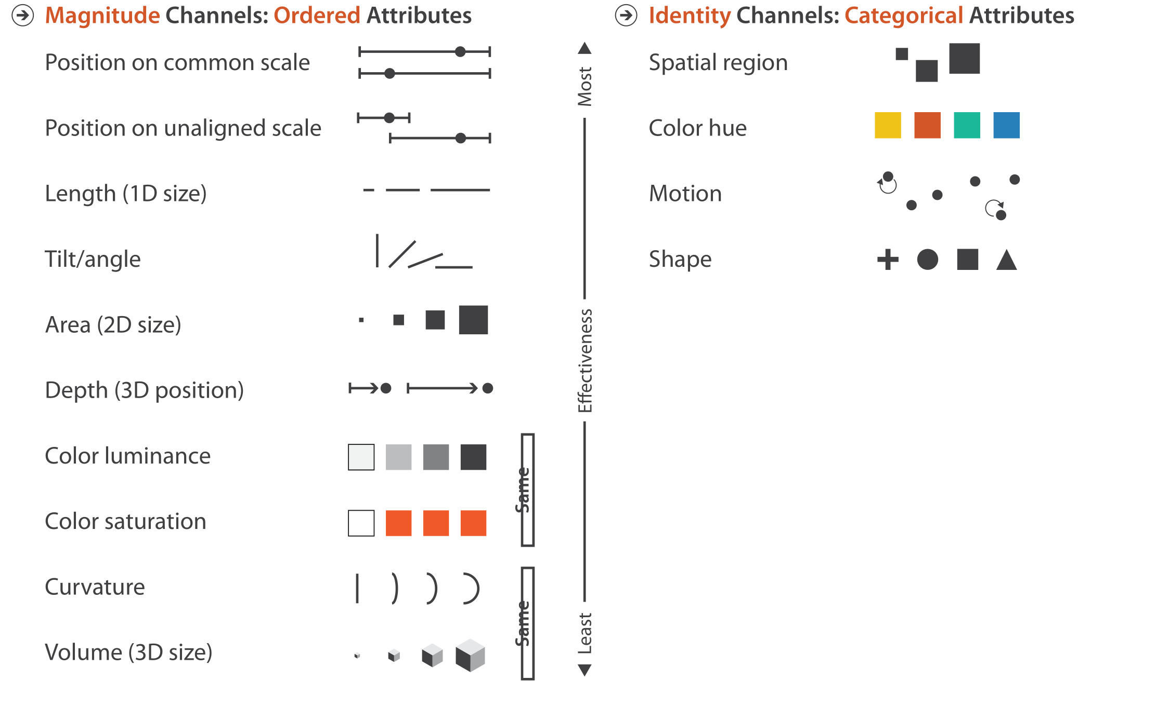
Ranking the effectiveness of visual encodings
Magnitude channels encode ordered attributes
Quantitative
Download counts
Number of consultations
Ordinal
Class year
(freshman, sophomore, junior, senior)
Likert response
(disagree, neutral, agree)

Slide 9
Ranking the effectiveness of visual encodings
Identity channels encode categorical attributes
Nominal
Resource type
(image, text, audio, dataset)
Publication type
(article, thesis, dataset, preprint)
Notes:
Latin nominalis "pertaining to a name or names.

Slide 10
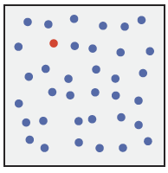
Pre-attentive processing: Color

Slide 11
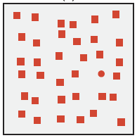
Pre-attentive processing: Color

Slide 12
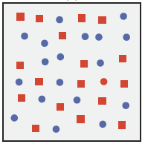
Pre-attentive processing: Combined

Slide 13
Pre-attentive processing: Combined
The power of pre-attentive processing is diminished or entirely eliminated when you have two (or more) conflicting styles of visual representation

Slide 14
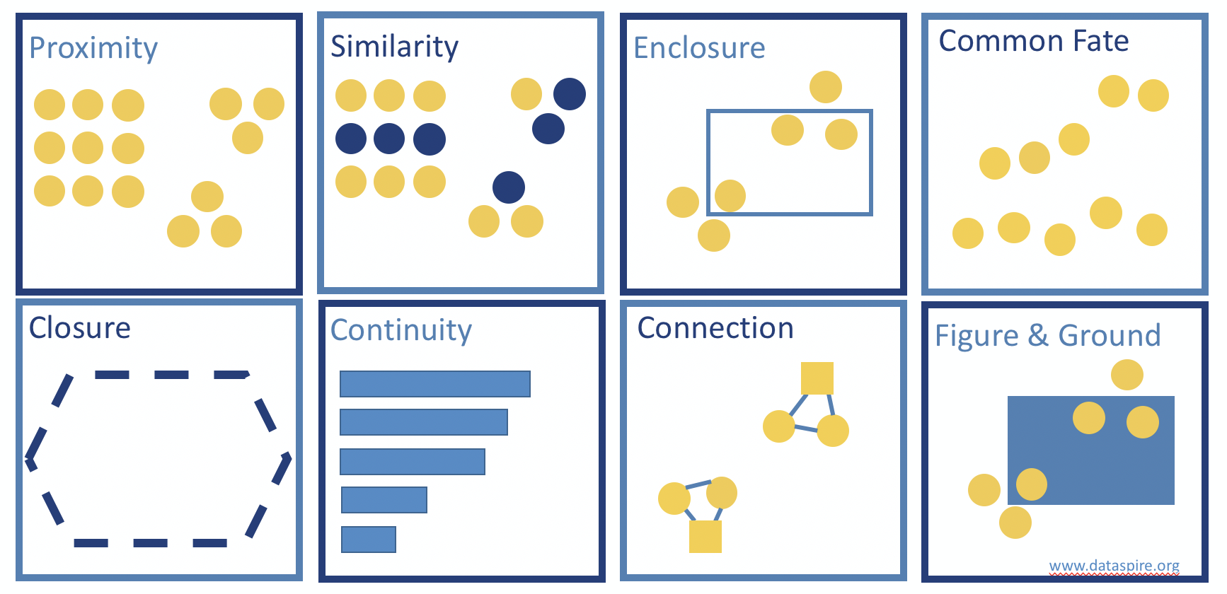
Gestalt Principles of Visual Perception
Notes:
The human perceptual system has two fundamentally different sensory modalities.
Humans naturally perceive objects as organized patterns and objects
known as Prägnanz
Gestalt: “more than the sum of its parts”
Early 20th century psychology
1923 Gestalt laws of perceptual organization - Max Wertheimer
Principles of how we perceive patterns can be important to data visualization
10 principles

Slide 15
Design of data visualizations
Notes:
Accessibility is not an afterthought – it’s fundamental.

Slide 16

Keep it simple.
Eliminate visual clutter.
If a part of a visualization doesn’t communicate information, remove it!

Slide 17
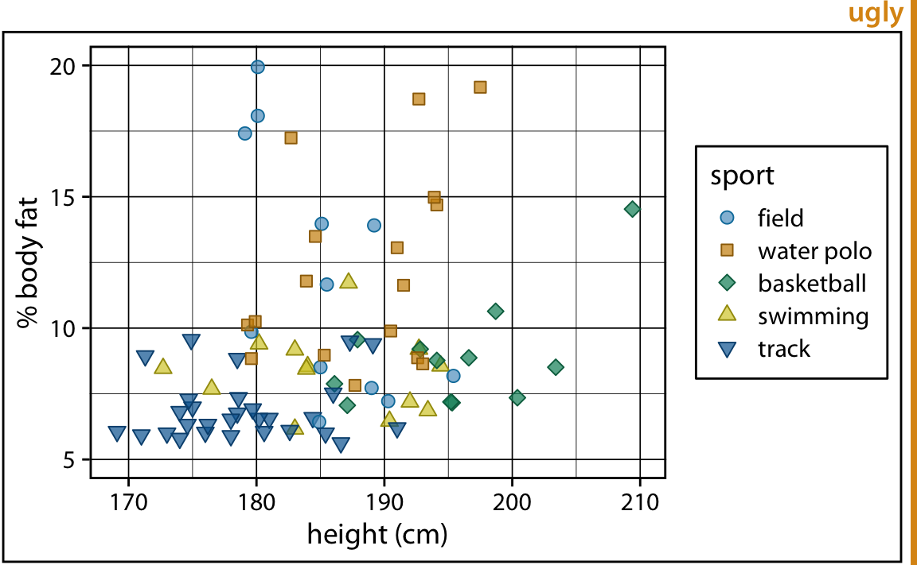
Remove non-encoding visual elements

Slide 18
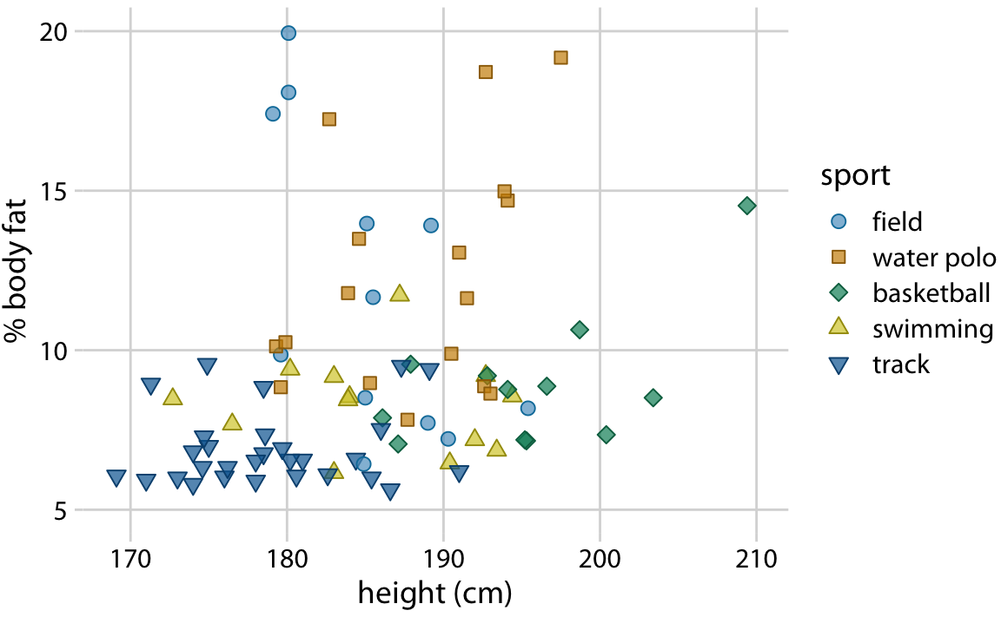
Remove non-encoding visual elements

Slide 19
Avoid 3D.
Three-dimensional data visualizations are rarely justified.

Slide 20
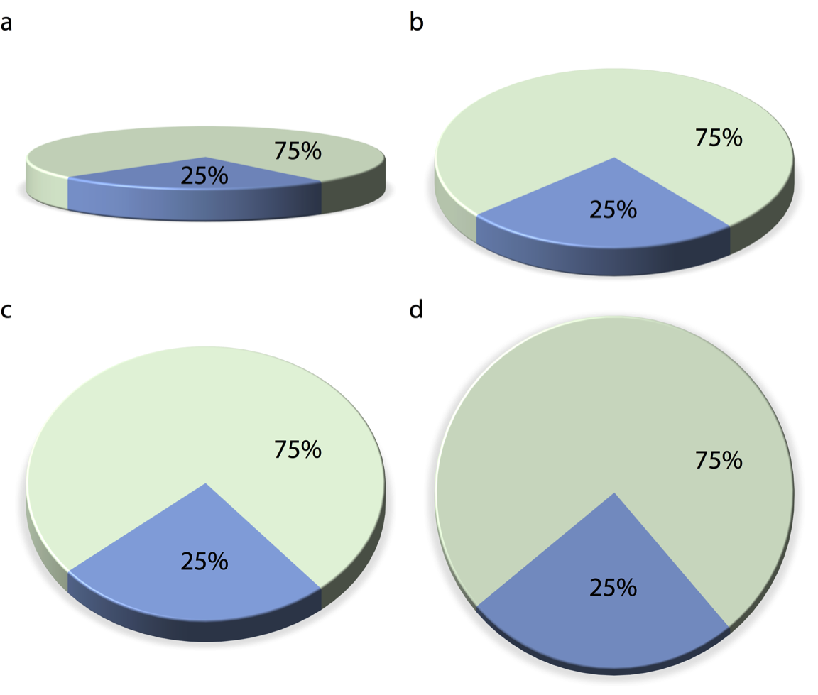
Is this 3D adding information?

Slide 21
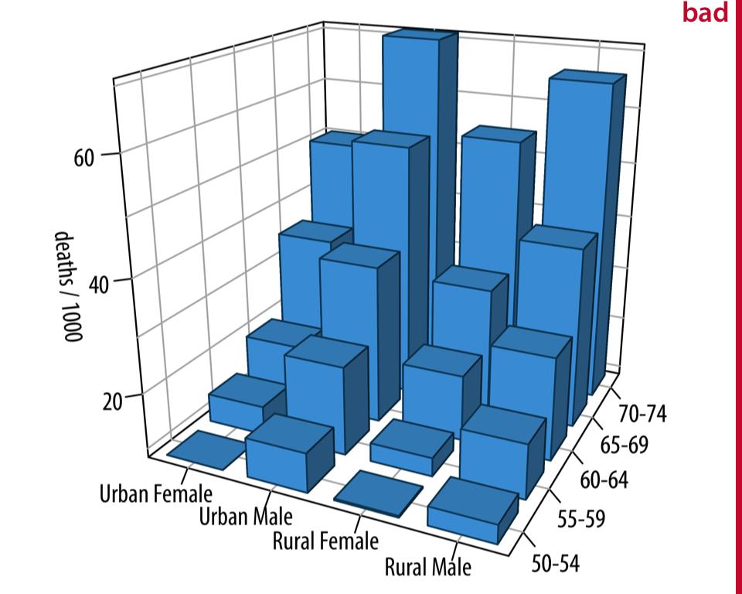
Use of 3D can impair interpretation

Slide 22
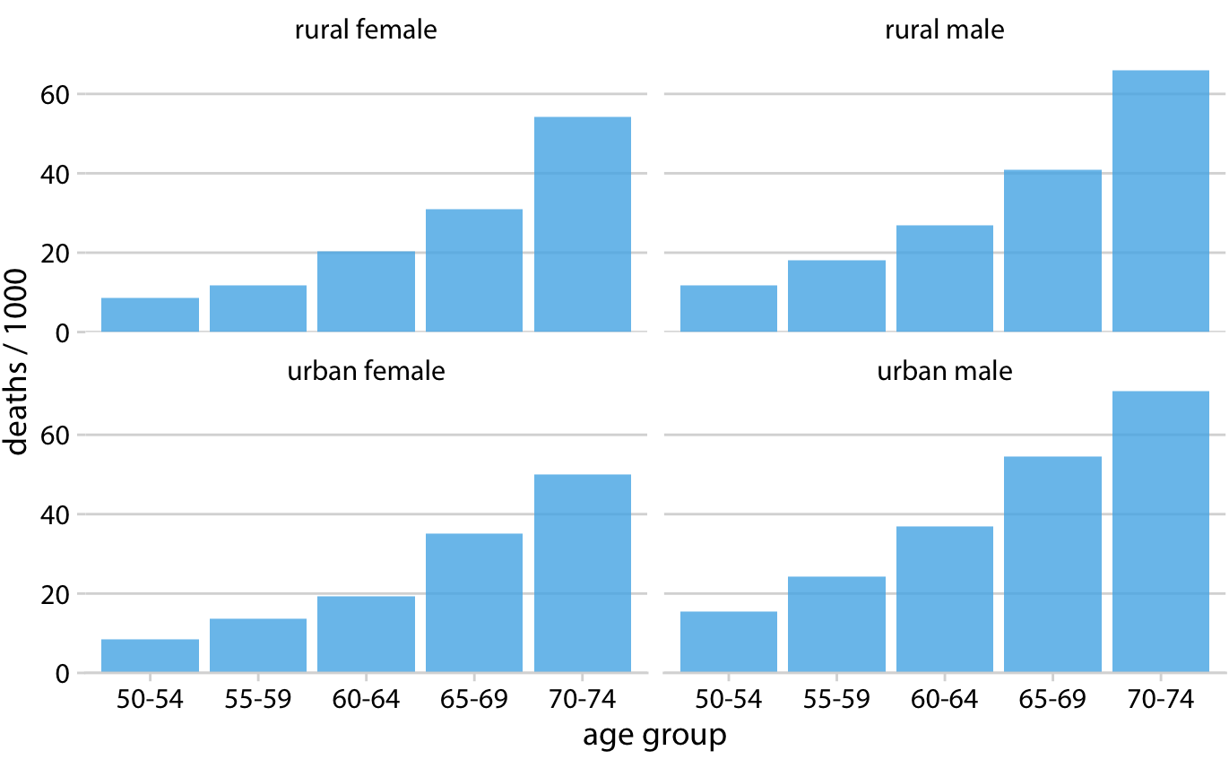
Too dense? Split into a grid.

Slide 23
Design for accessibility.
Good data visualization design
Notes:
Accessibility is not an afterthought – it’s fundamental.

Slide 24
WCAG 2.2
Web Content Accessibility Guidelines (WCAG)
2.2 AA Conformance Tier

Slide 25
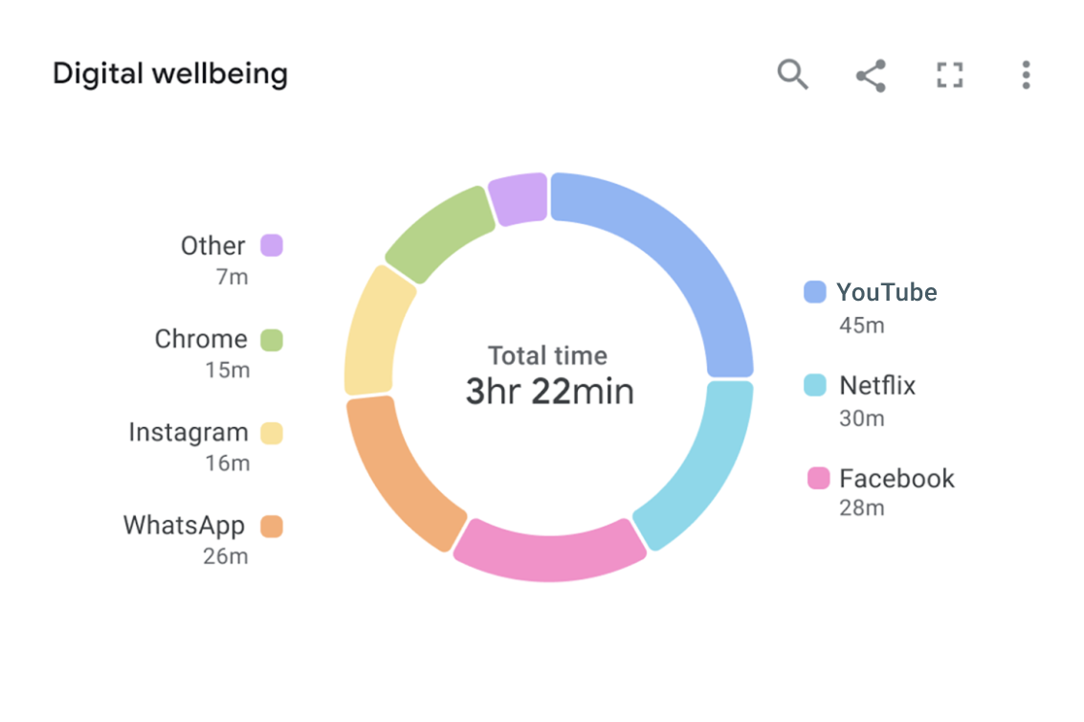
Contrast
WCAG 2.2 AA
Text elements should have a
4.5:1 contrast ratio
with their background
Chart elements should have a
3:1 contrast ratio
with their neighboring elements
Notes:
9.75 contrast ratoi

Slide 26
Contrast
WCAG 2.2 AA
Text elements should have a
4.5:1 contrast ratio
with their background
Chart elements should have a
3:1 contrast ratio
with their neighboring elements
2.08:1 FAIL
1.28:1 FAIL
2.23:1 FAIL
Notes:
9.75 contrast ratoi

Slide 27
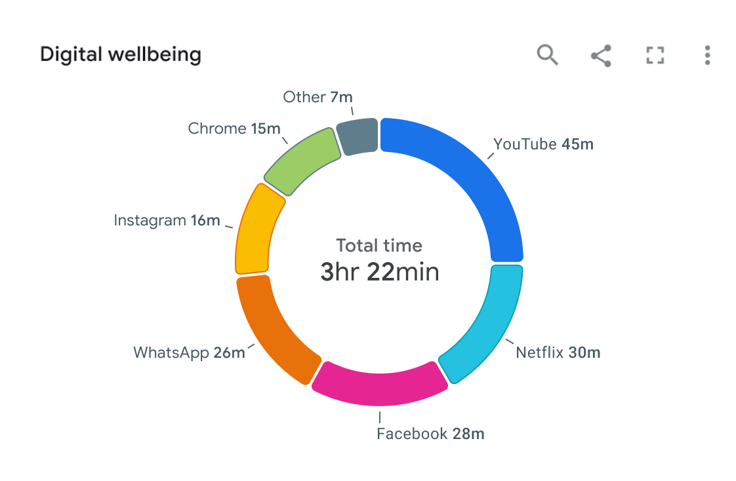
Contrast
WCAG 2.2 AA
Text elements should have a
4.5:1 contrast ratio
with their background
Chart elements should have a
3:1 contrast ratio
with their neighboring elements
Notes:
9.75 contrast ratoi

Slide 28
Contrast
WCAG 2.2 AA
Text elements should have a
4.5:1 contrast ratio
with their background
Chart elements should have a
3:1 contrast ratio
with their neighboring elements
3.04:1 PASS
4.56:1 PASS
4.41:1 PASS
Notes:
9.75 contrast ratoi

Slide 29
Use color carefully.
Color should illustrate rather than detract from your message

Slide 30
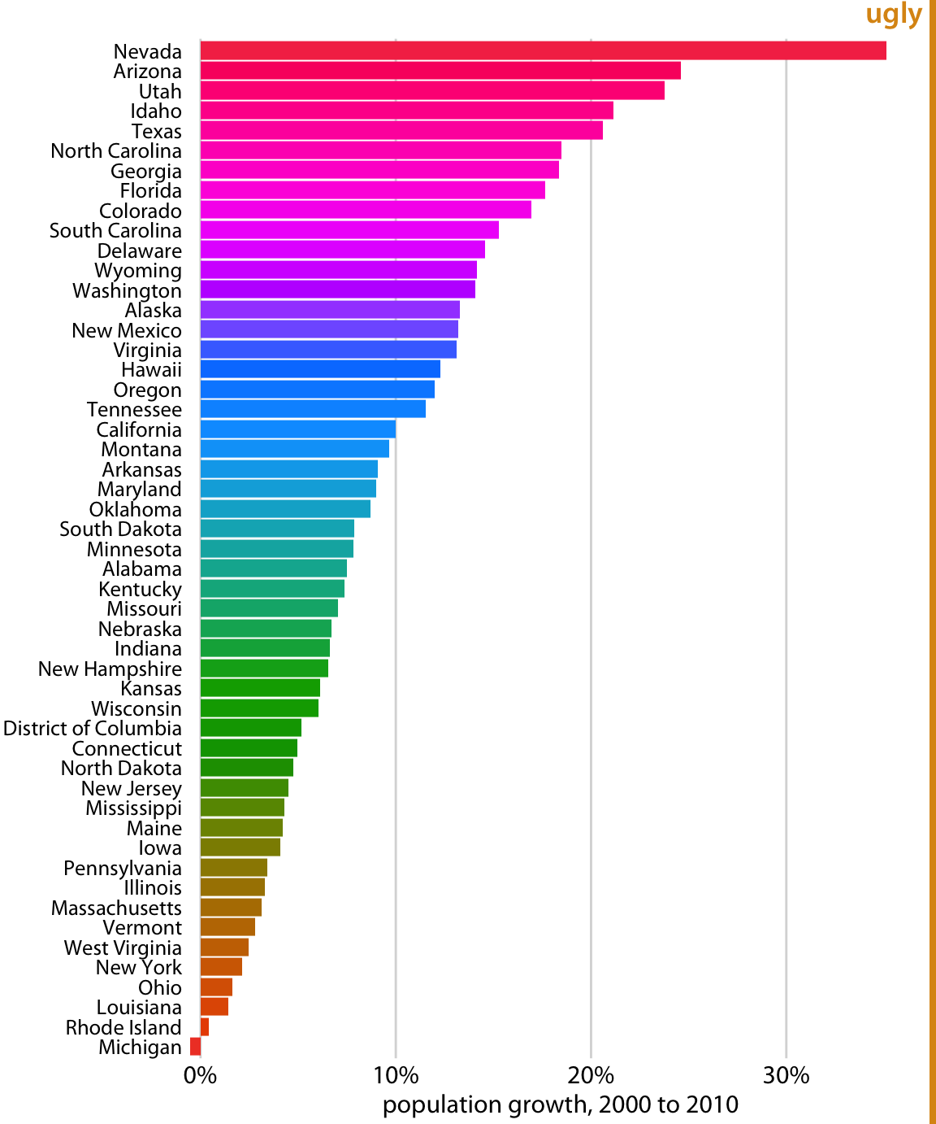
Population growth in the U.S. from 2000 to 2010.
Data source: U.S. Census Bureau

Slide 31
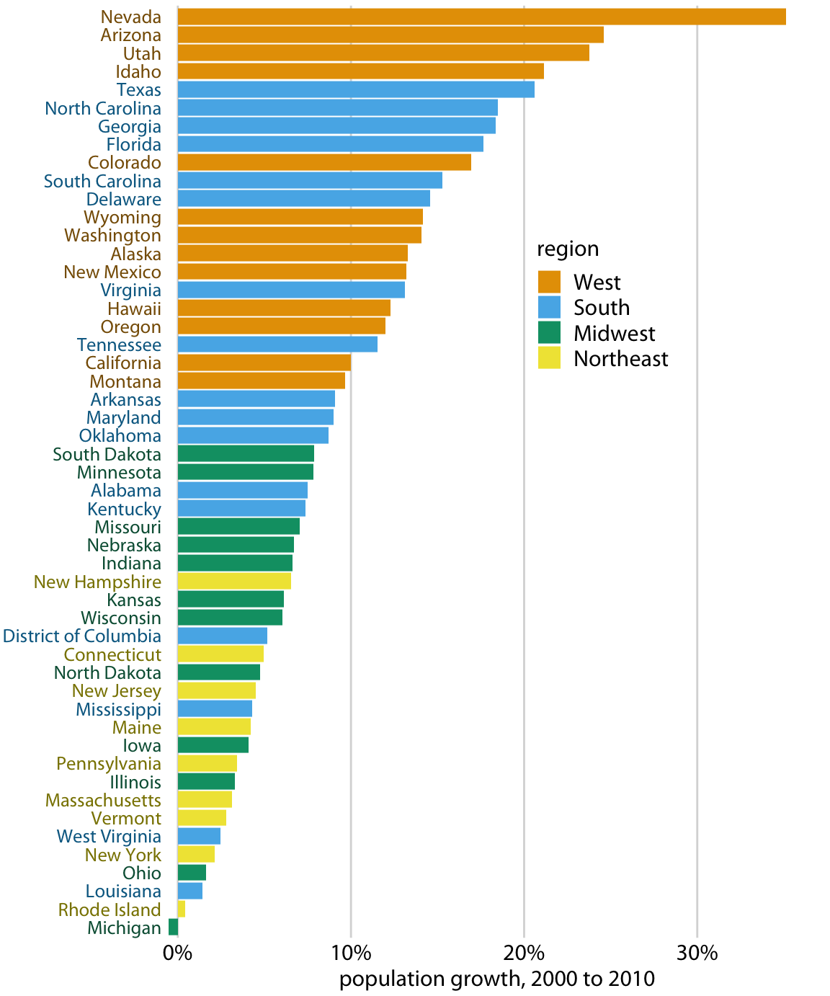
Color can represent data
Population growth in the U.S. from 2000 to 2010.
Data source: U.S. Census Bureau
States in the West and South have seen the largest increases, whereas states in the Midwest and Northeast have seen much smaller increases or even, in the case of Michigan, a decrease.

Slide 32
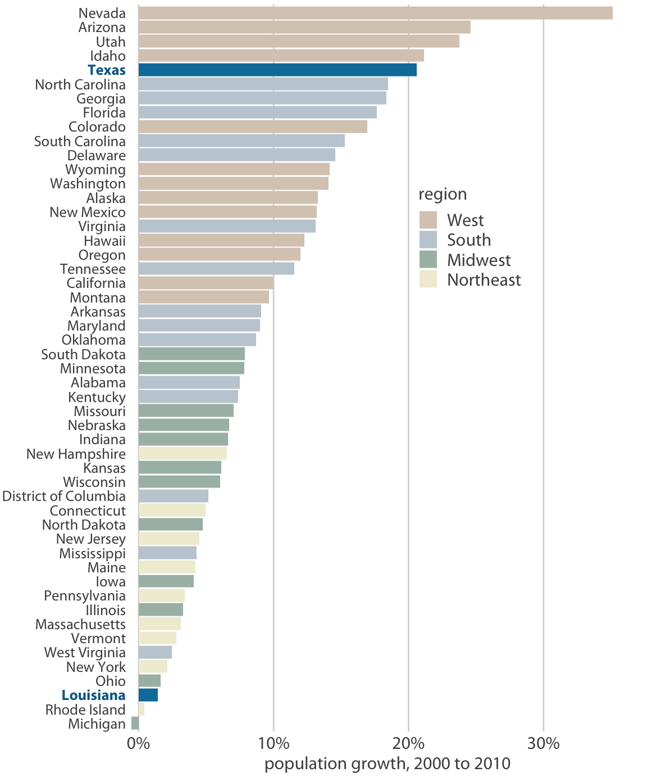
Color can highlight data
Population growth in the U.S. from 2000 to 2010.
Data source: U.S. Census Bureau
2000 to 2010, the two neighboring southern states Texas and Louisiana have experienced among the highest and lowest population growth across the U.S. Data

Slide 33
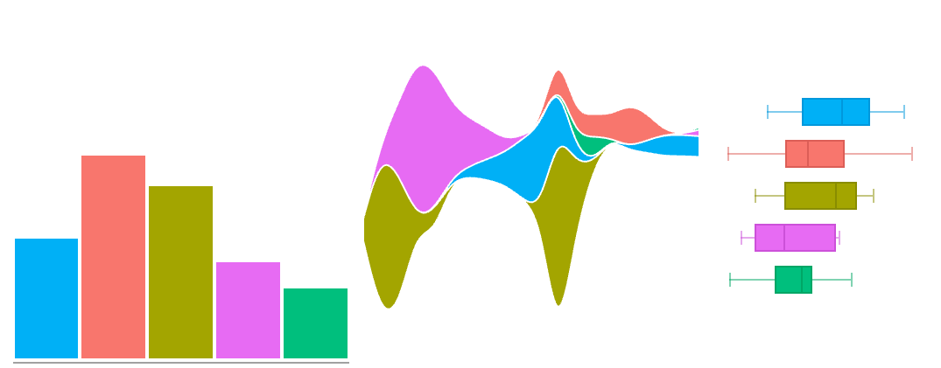
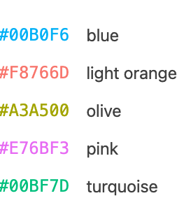
Choose a colorblind friendly color palette

Slide 34
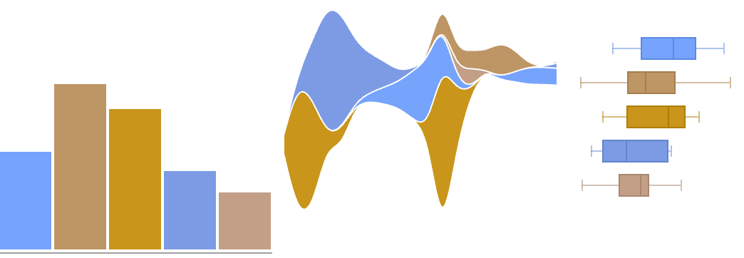
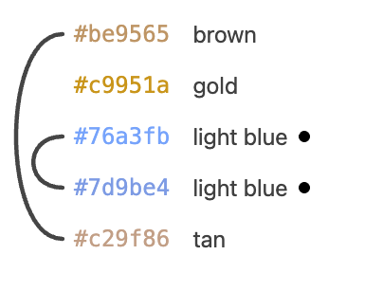
Choose a colorblind friendly color palette
As viewed with Deuteranopia – sever red-green colorblindness

Slide 35
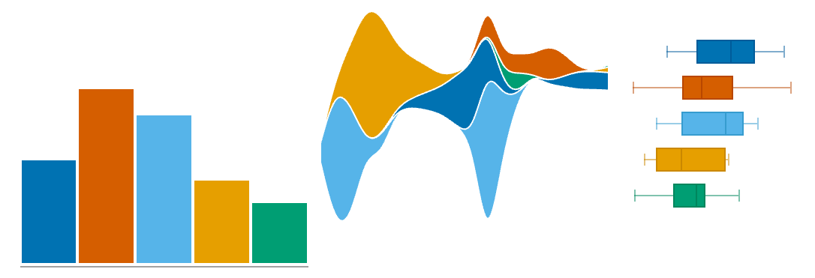
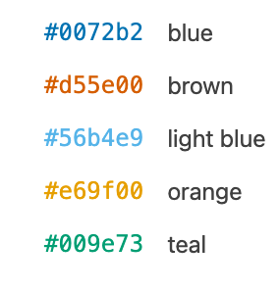
Choose a colorblind friendly color palette
Okabe-Ito
Color-Blind Friendly Palette

Slide 36
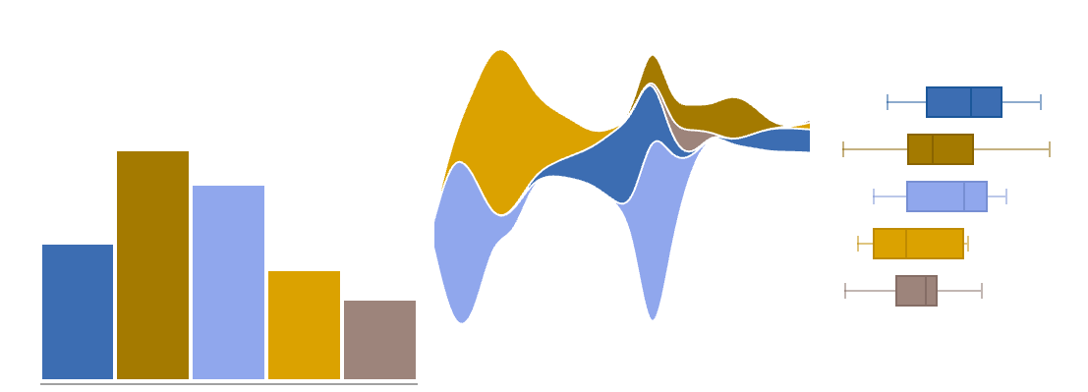
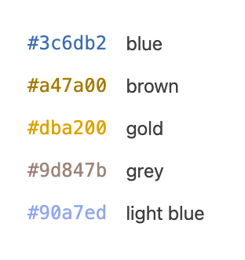
Choose a colorblind friendly color palette
As viewed with Deuteranopia – sever red-green colorblindness

Slide 37
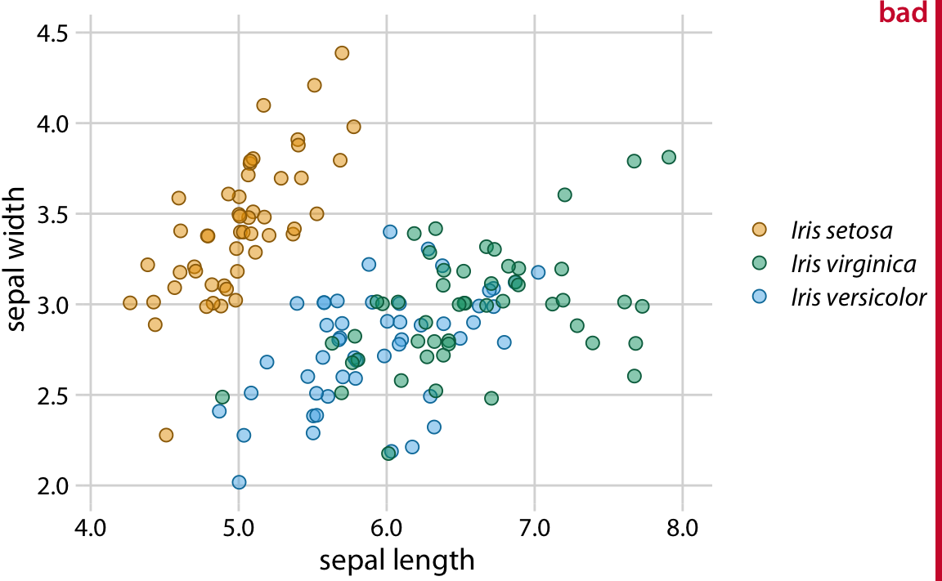
Redundant coding
Visualizing data with multiple encodings aids interpretation

Slide 38
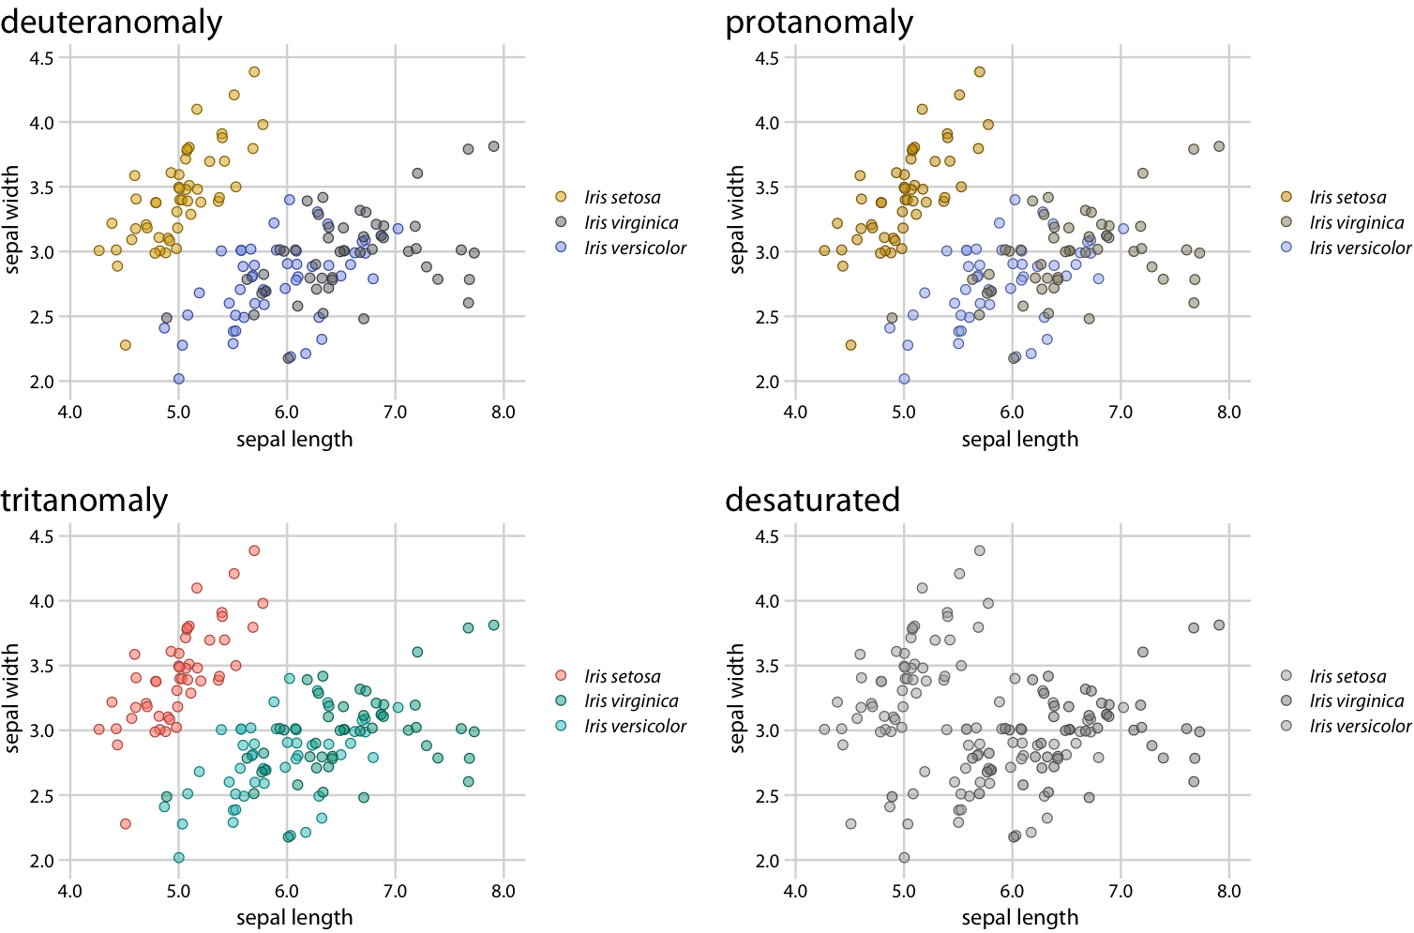

Slide 39
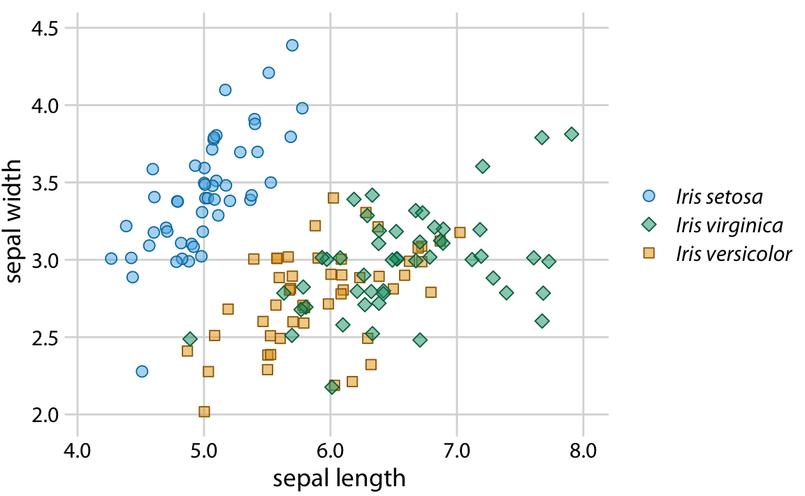
Redundant coding
Visualizing data with multiple encodings aids interpretation

Slide 40
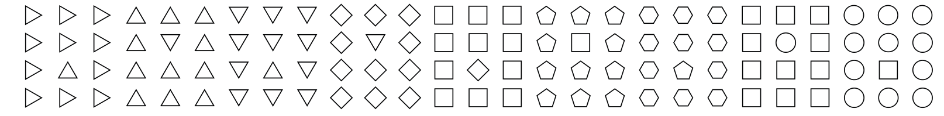
With dense data, use strong visual boundaries
Weak visual boundaries

Slide 41
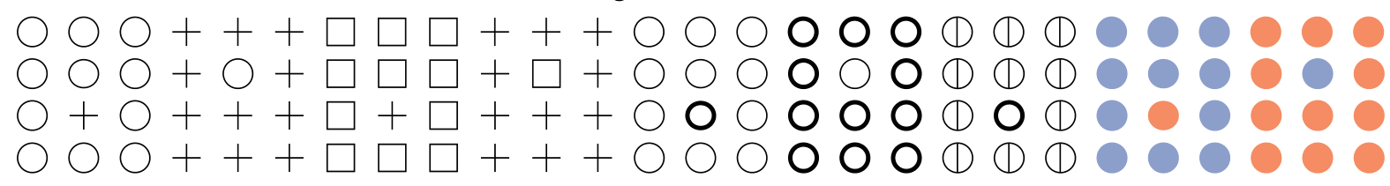
With dense data, use strong visual boundaries
Strong visual boundaries

Slide 42
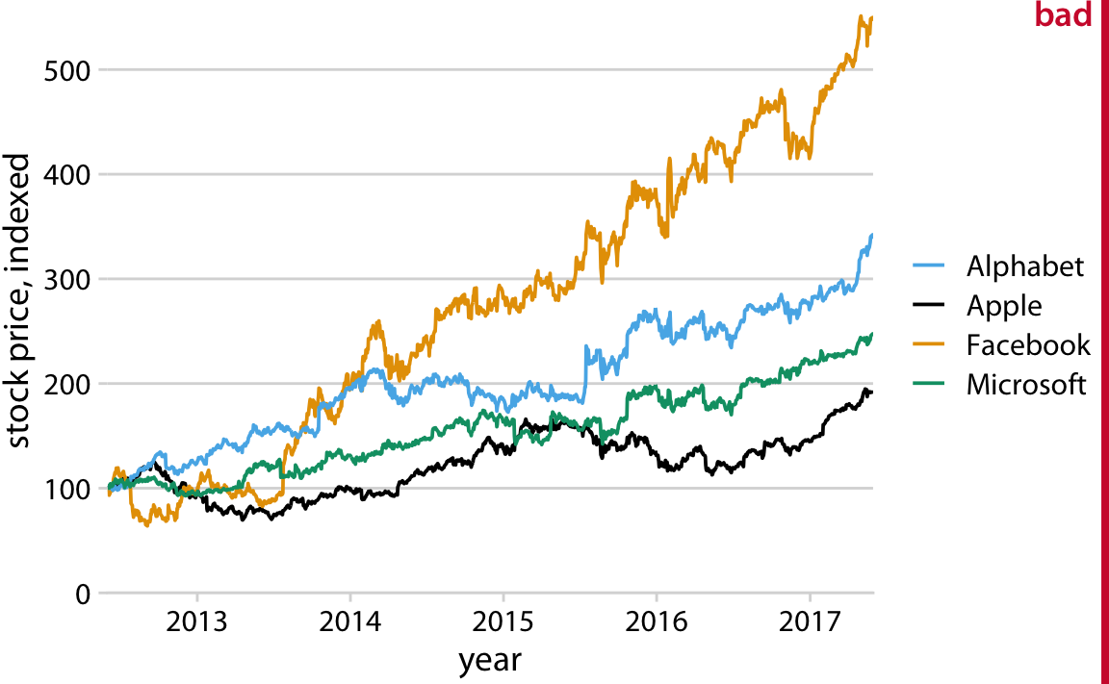
Legend Order
Legend order should follow data order

Slide 43
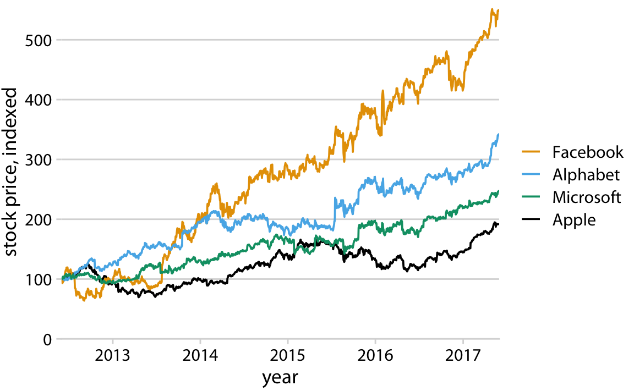
Legend Order
Legend order should follow data order

Slide 44
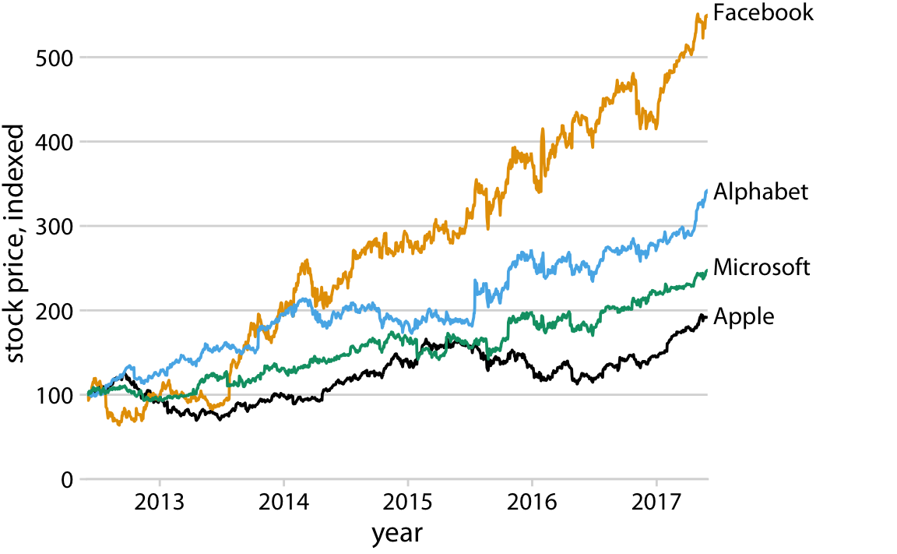
Direct labeling
When possible, design figures so they don’t need a legend

Slide 45
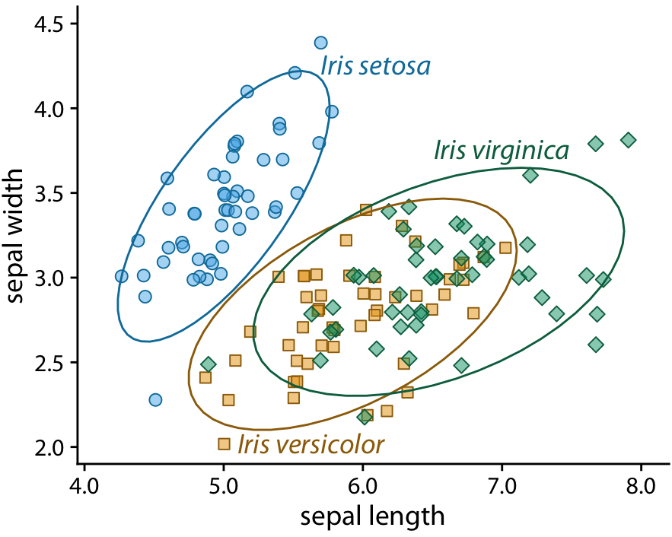
Direct labeling
When possible, design figures so they don’t need a legend

Slide 46
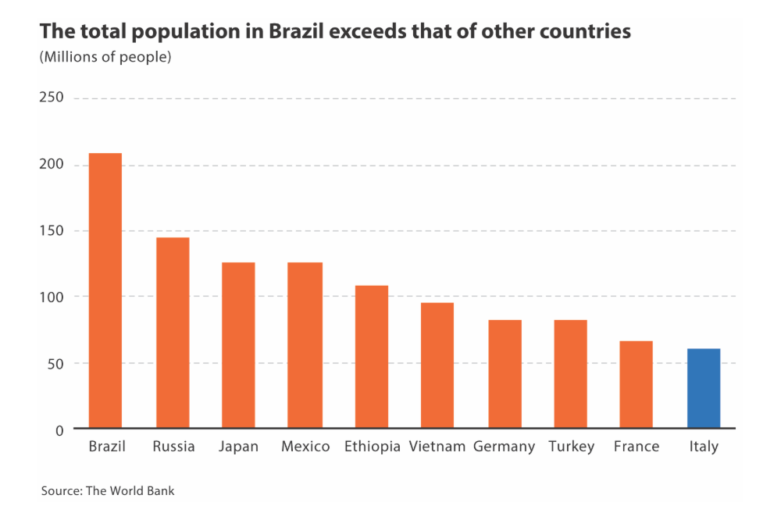
Direct labeling
Gridlines are not always necessary

Slide 47
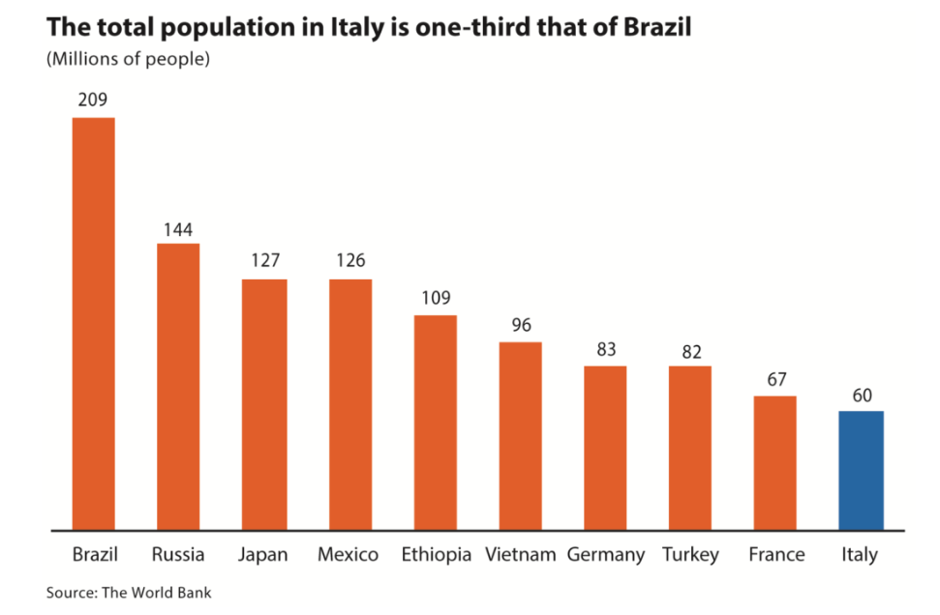
Direct labeling
Gridlines are not always necessary

Slide 48
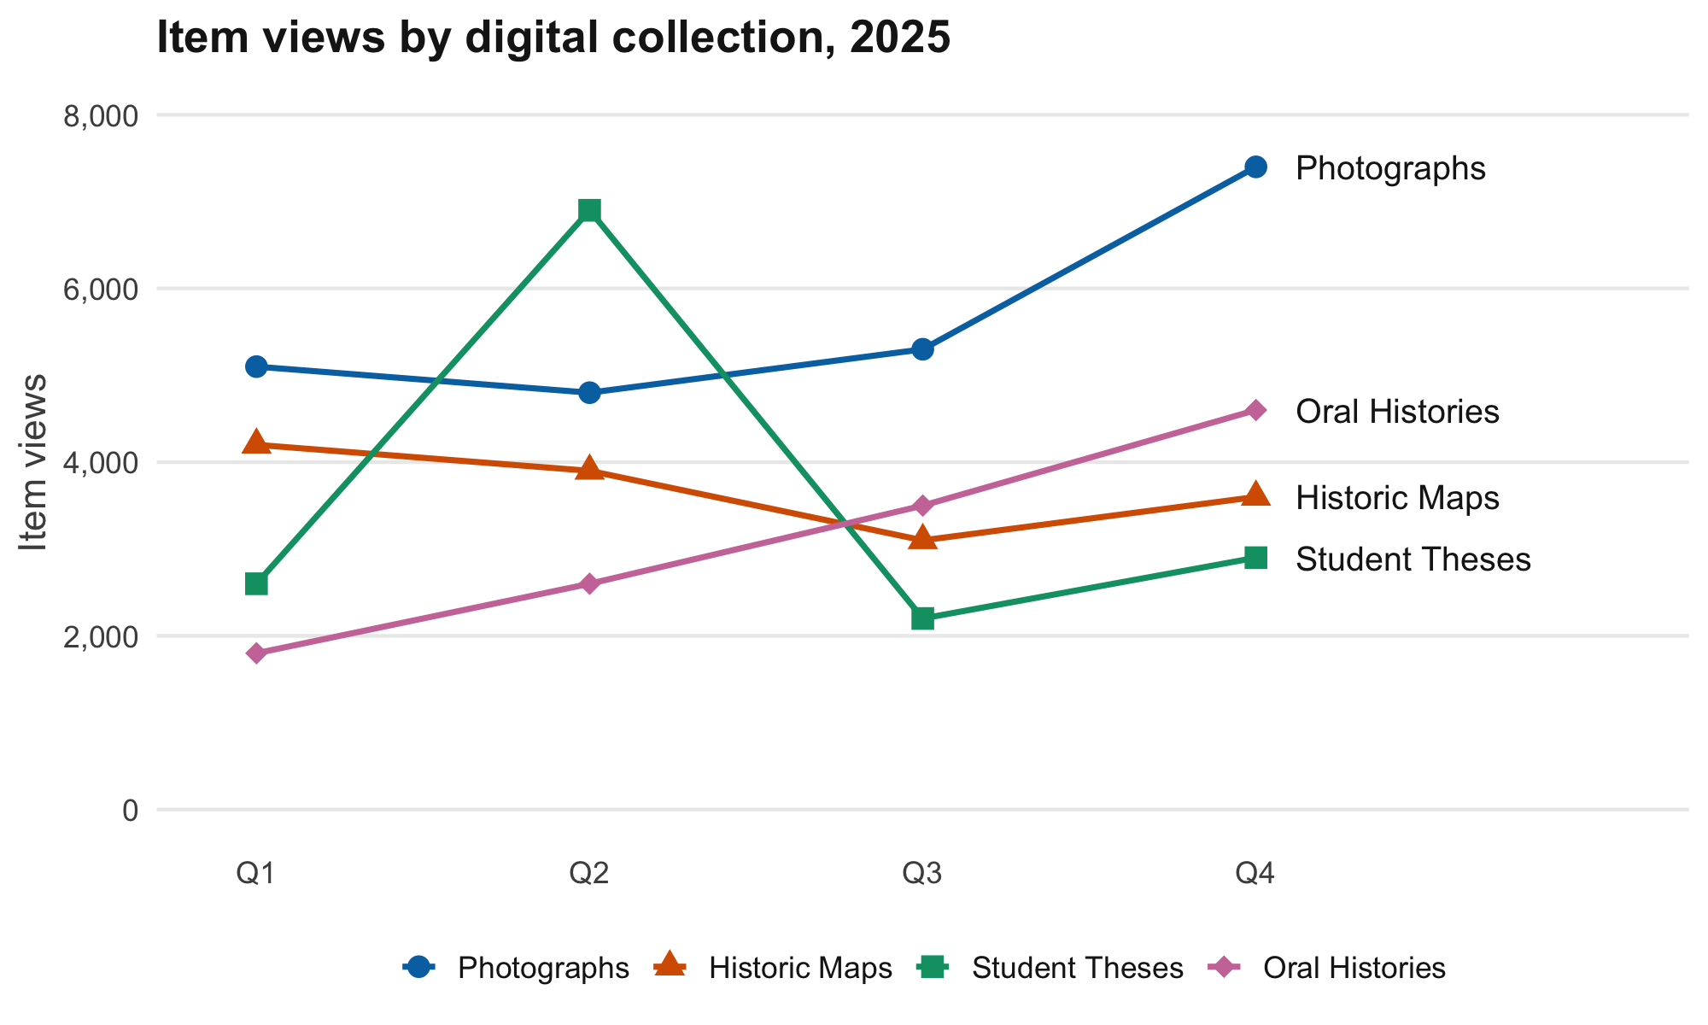
Alt-Text

Slide 49
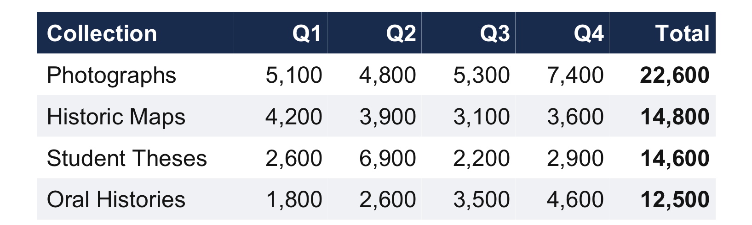
Alt-Text
Provide a short summary and a data table when possible
Alt Text (Short Summary)
Line chart of 2025 quarterly item views for four digital collections. Photographs leads all year and peaks in Q4; Student Theses spikes in Q2; Oral Histories rises every quarter; Historic Maps dips in Q3. Exact values are shown in the Data Table.
Data Table

