Slide 1
WEEK 9
Last Week, The Unit...
✓
Chose a branching strategy on purpose — and can defend it
✓
Ran the first cross-squad reviews with the checklist
✓
Restructured into src/ tests/ data/ reports/ — pytest still green
✓
Sealed the environment: venv + requirements.txt
The codebase is professional. Today, the data gets real. Treat it that way.

Slide 2
Are We On Track?
WKS 1–7 — Review, re-armed
WKS 8–12 — New material
WKS 13–FINALS — Ship it live
▶ Week 9 — real data week. Today the mission stops being practice.
ANSWER REPO: CLOSED for the semester. The review phase had reference solutions; the second half doesn't. From here, the traps in the data are nobody's design — finding them IS the audit. Your squad's judgment is the product now.
STANDUP (5 min, right now): Squads: confirm everyone has pandas installed and can import it. Environment problems die in the first 10 minutes, not minute 40.
Git happens.
ITSS/OPRE 3312 LECTURE 9 — The Reconciled Series
2

Slide 3
Case Briefing: The Real Evidence Arrives
Downloaded today, straight from the publishers: MAP's FBI homicide data and the Washington Post's 1,567 Dallas cases. Nobody has reconciled them. That starts now.
The DataFrame
Filtering & selecting
1
2
a spreadsheet with superpowers
Dallas rows out of a national file
groupby
Squad lab: FIRST CUT
3
4
the counting pattern you hand-built in wk4 — one line
clearance-by-year for Dallas + the suspicious-year list
ITSS/OPRE 3312 LECTURE 9 — The Reconciled Series
3

Slide 4
pandas: Loading the Archive
import pandas as pd
df = pd.read_csv("data/map_ucr.csv")
df.shape # (rows, columns)
df.columns # what fields exist
df.head() # eyeball the first 5
df["ORI"].nunique() # how many agencies
dallas = df[df["ORI"] == "TXDPD00"] # Dallas PD
FIRST MOVES, ALWAYS
shape → head → columns before ANY analysis. Know what you're holding.
df[condition] filters rows — week 3's if-inside-a-loop, vectorized.
Your quarantine instincts transfer: check for nulls with df.isna().sum(). Filter on ORI, not name — four US agencies are called ‘Dallas’.
One read_csv call loads more homicide records than every drill file combined. Weight, remembered.
“I don't always test my code. But when I do, I do it in production.” — nobody on this team, ever
ITSS/OPRE 3312 LECTURE 9 — The Reconciled Series
4

Slide 5
groupby: Week 4's Dict, One Line
# wk4: 12 lines of dict counting.
# pandas:
per_year = dallas.groupby("YEAR").agg(
reported=("MRD", "sum"),
cleared=("CLR", "sum"),
)
per_year["clearance"] = (
per_year["cleared"] / per_year["reported"]
)
per_year.to_csv("reports/dallas_series.csv")
READ IT
groupby("YEAR") — one bucket per year. MRD = murders reported, CLR = cleared
.agg — what to compute per bucket
New columns from old — the clearance rate is born
to_csv — your first published artifact. This file is deliverable #1's skeleton.
Programmer (n): a machine that turns coffee into code
ITSS/OPRE 3312 LECTURE 9 — The Reconciled Series
5

Slide 6
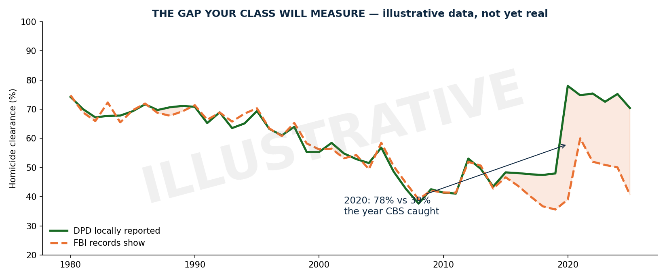
The Picture You're Building
Illustrative, not yet real — by standup, your squad's version of the green line exists. The orange line and the gap: weeks 11–12.
Some people see a problem and think “I'll use regex.” Now they have two problems.
ITSS/OPRE 3312 LECTURE 9 — The Reconciled Series
6

Slide 7
Sanity Checks: Auditor's Instincts
# rates must live between 0 and 1... right?
per_year[per_year["clearance"] > 1]
# gaps in the series?
years = per_year.index
set(range(1980, 2026)) - set(years)
# sudden jumps?
per_year["clearance"].diff().abs()
.sort_values(ascending=False).head()
REMEMBER DALLAS'S OWN DASHBOARD
The city's Datapoints site admits its clearance measure “can exceed 100%” — prior-year clearances inflate the numerator.
A rate over 100% isn't a bug in your code. It's a FINDING about how clearance is counted. Write those years down.
You're not cleaning data anymore. You're auditing it. Different verb, same skills, higher stakes.
Documentation is a love letter you write to your future self
ITSS/OPRE 3312 LECTURE 9 — The Reconciled Series
7

Slide 8
The pandas Conversion Experience
WEEKS 2–7
WEEK 9
60 lines,
artisanal,
hand-crafted
df.groupby(
"Year").agg(...)
and you needed every one of them to understand this:
one line — and now you know EXACTLY what it's doing under the hood
This is why the review phase existed. pandas is magic you can now explain — which makes it a tool, not a spell.
Weeks of coding can save you hours of planning
ITSS/OPRE 3312 LECTURE 9 — The Reconciled Series
8

Slide 9
Why Today's Brick Matters
Deliverable #1 — the corrected, definition-consistent Dallas series —
starts existing today. Anyone can chart what Dallas told the FBI.
Your squad starts checking whether it's true.
Today: the FBI-reported series + the suspicious-year list.
Week 10: the picture. Week 11: the city's own numbers, live.
Week 12: the reconciliation. That's the audit.

Slide 10
SQUAD LAB — Operation: First Cut
Mission: build Dallas's clearance-by-year series from the real archive, and flag every year that smells wrong.
THE EVIDENCE
data/map_ucr.csv (MAP's FBI archive, murderdata.org) + data/wapo_dallas.csv (the Post's 1,567 cases, filtered from the Post's GitHub file by your src/get_data.py). Real records. Real victims. Aggregate analysis only.
THE PRODUCT
src/series.py → writes reports/dallas_series.csv (year, reported, cleared, clearance) + prints the 5 most suspicious years with WHY
THE RULES
Branch feature/wk9-series • sanity checks are mandatory, not stretch • reviewed PR by standup
THE CLOCK
~45 min. shape/head first. Series second. Suspicion last.
ITSS/OPRE 3312 LECTURE 9 — The Reconciled Series
10

Slide 11
The Steps
1
python -m src.get_data (downloads both files into data/) → branch feature/wk9-series → shape, head, columns on BOTH files before any code
2
Filter the MAP file to ORI == "TXDPD00" (Dallas PD, 61 rows, 1965–2025) — confirm the row count before trusting it
3
groupby year → reported, cleared, clearance rate → write reports/dallas_series.csv
4
Run the three sanity checks: rates > 100%, missing years, biggest year-over-year jumps
5
Print your 5 most suspicious years, one line of reasoning each → PR → review → merge
Stuck >5 minutes? Read the error aloud to the squad → ask Claude to explain (not solve) → flag me.
ITSS/OPRE 3312 LECTURE 9 — The Reconciled Series
11

Slide 12
RESULTS TO ACHIEVE — Before You Leave
RESULTS — THE FIRST CUT:
reports/dallas_series.csv committed: year, reported, cleared, clearance
Sanity check output in the PR description (rates>1? gaps? jumps?)
SUSPICIOUS YEARS: 5 listed, each with a one-line reason
$ pytest -> still green
☑
series.py merged via reviewed PR; CSV committed to reports/
☑
Series covers every year present in the source — gaps NOTED, not papered over
☑
Suspicious-year reasoning is in the PR (this text seeds the audit writeup)
☑
Nobody hand-edited the CSV — everything reproducible from series.py
This week's score = this merged code on GitHub. Timestamped, reviewed, yours.
ITSS/OPRE 3312 LECTURE 9 — The Reconciled Series
12

Slide 13
Done Early? / Next Week
STRETCH (no extra credit — just better)
Add WaPo's yearly arrest counts as a second source column — do the sources agree?
Compute the cumulative unsolved pile per year (reported − cleared, summed)
Break the series by decade — which decade added the most cold cases?
NEXT WEEK: THE PICTURE
matplotlib + folium:
your series becomes the trend chart • WaPo's lat/longs become the Dallas map • low-arrest zones appear for 2007–2017.
A finding nobody can see isn't a finding yet.
The first cut of a series nobody has ever built is sitting in your repo. Let that land.
In case of fire: git commit, git push, THEN leave the building 🔥
ITSS/OPRE 3312 LECTURE 9 — The Reconciled Series
13

