Slide 1
WEEK 12
Last Week, The Unit...
✓
Tapped the city's live API — your token, your fetch, no intermediary
✓
Banked thousands of incidents in case.db and made SQL answer questions
✓
Compared the live feed against the FBI series — and found daylight
✓
Learned: fetch once, cache, query forever
Three sources on the record. Today we ask the dangerous question: WHY?

Slide 2
Are We On Track?
WKS 1–7 — Review, re-armed
WKS 8–12 — New material
WKS 13–FINALS — Ship it live
▶ Week 12 — the Freakonomics week. Correlation is cheap. Today you learn its price.
ANSWER REPO: CLOSED for the semester. Second half: your squad's judgment is the product.
STANDUP (5 min, right now): Squads: state your pre-registered hypothesis in one sentence — staffing, economy, case mix, or wildcard. Locked before lab. That's the pre-registration.
// TODO: fix later (narrator: they did not)
ITSS/OPRE 3312 LECTURE 12 — The Freakonomics Week
2

Slide 3
Case Briefing: Why Did Clearance Collapse?
Everyone has a theory about why cases go unsolved. Today your squad tests one — honestly, with controls, in public.
Correlation ≠ causation
OLS with statsmodels
1
2
the whole game, in one inequality
the regression, read line by line
Confounders & controls
Squad lab: THE FACTOR
3
4
the honest analyst's checklist
your pre-registered hypothesis vs the data
ITSS/OPRE 3312 LECTURE 12 — The Freakonomics Week
3

Slide 4
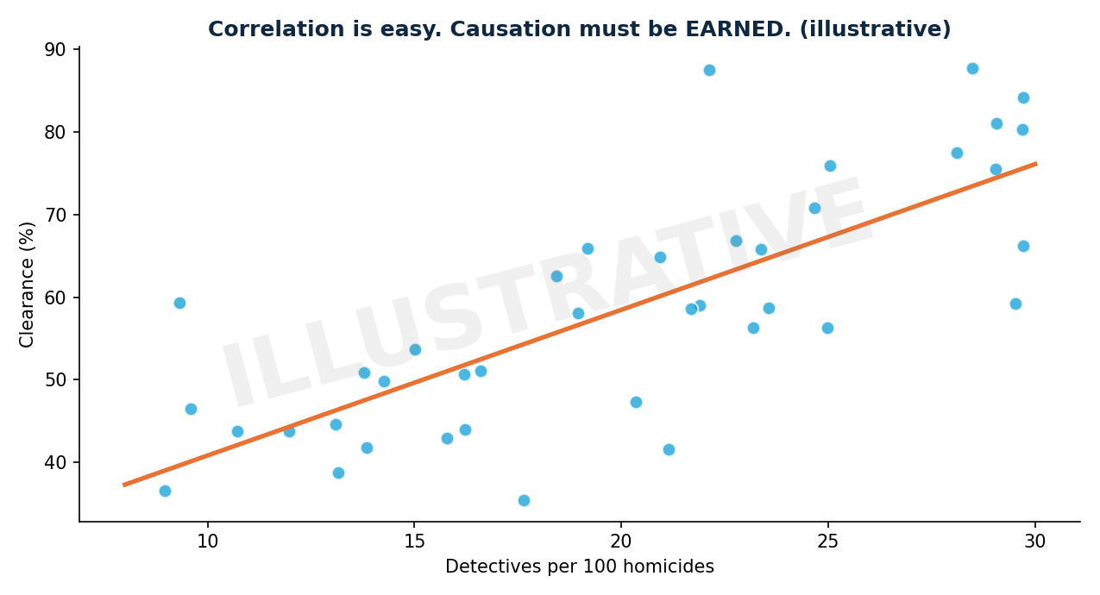
The Trap, Illustrated
More detectives per homicide, higher clearance — a strong correlation. Cause? Or do calmer years have both fewer murders AND better clearance? That question is today's entire lecture.
It works on my machine ¯\_(ツ)_/¯
ITSS/OPRE 3312 LECTURE 12 — The Freakonomics Week
4

Slide 5
OLS: The Regression, Line by Line
import statsmodels.formula.api as smf
# merged: year, clearance, detectives,
# unemployment (one row per year)
model = smf.ols(
"clearance ~ detectives + unemployment",
# only factors you actually sourced
data=merged).fit()
print(model.summary())
HOW TO READ IT
coef: +1 detective per 100 homicides ≈ +X points of clearance, HOLDING the others fixed
p-value: could chance alone produce this? (small = unlikely)
R²: how much of the story these factors tell. It will be humble. That's honest.
There are 2 hard problems in CS: cache invalidation, naming things, and off-by-one errors
ITSS/OPRE 3312 LECTURE 12 — The Freakonomics Week
5

Slide 6
The Honest Analyst's Checklist
Confounders
what moves BOTH your factor and clearance? (crime waves move staffing AND case difficulty)
Reverse causation
does low clearance cause budget cuts, not the other way around? Lag your factor and see
Case mix
stranger/gang shootings are harder — if their share grew, clearance falls with zero change in effort
Tiny N
61 yearly observations (1965–2025). One regression, maybe two — not thirty until one ‘works’ (that's p-hacking)
The language rule
findings say ‘associated with,’ never ‘causes’ — until a design truly earns it
The Freakonomics lesson isn't ‘clever correlations are fun.’ It's that identifying causes is HARD — and saying so out loud is what separates analysis from advocacy.
99 little bugs in the code... take one down, patch it around... 127 little bugs in the code
ITSS/OPRE 3312 LECTURE 12 — The Freakonomics Week
6

Slide 7
Lagged Effects: Asking Better Questions
# does LAST year's staffing predict
# THIS year's clearance?
merged["detectives_lag1"] = (
merged["detectives"].shift(1))
m2 = smf.ols(
"clearance ~ detectives_lag1",
data=merged.dropna()).fit()
# the lead-crime hypothesis used a
# 20-YEAR lag. Time arrows matter.
WHY LAGS HELP
Causes precede effects. A lagged factor can't be caused by this year's outcome — one confounder path, cut.
Not bulletproof (slow-moving third causes survive) — but a real step toward honest.
Squads using FRED/Census: lag your factor and compare.
A SQL query walks into a bar, approaches two tables and asks: “may I JOIN you?”
ITSS/OPRE 3312 LECTURE 12 — The Freakonomics Week
7

Slide 8
Two Analysts Look at r = 0.8
ANALYST A
ANALYST B (you)
“PROOF!”
“Interesting.
What else moves
both of these?”
publishes, goes viral, gets corrected by a grad student within the hour
boring, careful, correct — and cited for years
Ice cream sales correlate with drownings. Summer is the confounder. Always ask what summer is in YOUR data.
!false — it's funny because it's true
ITSS/OPRE 3312 LECTURE 12 — The Freakonomics Week
8

Slide 9
Why Today's Brick Matters
Deliverable #4 — the Factor Analysis — is born today. Nobody has
modeled what moves Dallas clearance. Your regressions, stated with
exactly the confidence they've earned, fill an actual gap.
Today: one hypothesis, one honest model.
Week 13: the squads cross-examine each other.
Finals: ‘associated with’ — in public, defensibly.

Slide 10
SQUAD LAB — Operation: The Factor
Mission: your pre-registered hypothesis meets the data. Report what survives.
THE EVIDENCE
Your merged series + your factor: DPD staffing (you assemble it: FBI CDE + city budgets), FRED API (unemployment/CPI), Census ACS, or wildcard (pre-cleared)
THE PRODUCT
src/factor.py → merged dataset + OLS summary + reports/factor_writeup.md: hypothesis, result, TWO named confounders, verdict in ‘associated-with’ language
THE RULES
Hypothesis locked at standup • one primary regression + optional lag variant • reviewed PR
THE CLOCK
~45 min. Merging the data is 30 of them — budget accordingly.
ITSS/OPRE 3312 LECTURE 12 — The Freakonomics Week
10

Slide 11
The Steps
1
Branch feature/wk12-factor → pull your factor's data → wrangle it to one row per year
2
Merge with your clearance series on year — print shape and eyeball 5 rows before modeling
3
Run the pre-registered OLS → read coef, p, R² out loud as a squad
4
Run the lag-1 variant → does the story hold, strengthen, or die?
5
Write factor_writeup.md: hypothesis → result → two confounders → honest verdict → PR → merge
Stuck >5 minutes? Read the error aloud to the squad → ask Claude to explain (not solve) → flag me.
ITSS/OPRE 3312 LECTURE 12 — The Freakonomics Week
11

Slide 12
RESULTS TO ACHIEVE — Before You Leave
RESULTS — THE FACTOR ON RECORD:
reports/factor_writeup.md: hypothesis / result / confounders / verdict
OLS summary in the PR (coef, p-value, R-squared quoted)
Verdict uses ‘associated with’ language — zero unearned ‘causes’
☑
factor.py + writeup merged via reviewed PR
☑
Hypothesis matches what was locked at standup (no silent pivots)
☑
Two confounders NAMED and discussed, not waved at
☑
Reviewer confirms the writeup's claims match the model output
This week's score = this merged code on GitHub. Timestamped, reviewed, yours.
ITSS/OPRE 3312 LECTURE 12 — The Freakonomics Week
12

Slide 13
Done Early? / Next Week
STRETCH (no extra credit — just better)
Add a second control variable — does your factor's coefficient survive?
Plot factor vs clearance with the fit line → reports/
Try the 2007–2011 collapse window alone — same story?
NEXT WEEK: THE MODELS + CROSS-EXAMINATION
scikit-learn — prediction and interpretation:
which case attributes predict going unsolved • train/test honesty • a neural-net taste • and each squad cross-examines another's factor writeup, confounders drawn.
Bring your writeup. It will be attacked. That's the point.
One theory entered the lab. What walked out is smaller, humbler, and TRUE. That's science.
Why do programmers prefer dark mode? Because light attracts bugs 🐛
ITSS/OPRE 3312 LECTURE 12 — The Freakonomics Week
13

