Slide 1



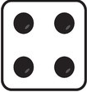
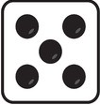
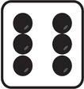

Slide 2
1/6
1/6
1/6
1/6
1/6
1/6

Slide 3
Event
1/6
1/6
1/6
1/6
1/6
1/6
Probability

Slide 4
Event
1/6
1/6
1/6
1/6
1/6
1/6
Probability

Slide 5

Event
1/6
1/6
1/6
1/6
1/6
1/6
$$Pr\left(\text{\{}\text{⚀},\text{⚁}\text{\}}\right)=1/3$$
Probability

Slide 6
Event
1/6
1/6
1/6
1/6
1/6
1/6
$$Pr\left(\text{\{}\text{⚀},\text{⚁}\text{\}}\right)=1/3$$
Probability

Slide 7
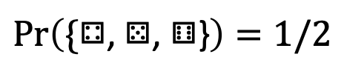
Event
1/6
1/6
1/6
1/6
1/6
1/6
$$Pr\left(\text{\{}\text{⚀},\text{⚁}\text{\}}\right)=1/3$$
$$Pr\left(\text{\{}\text{⚃}\text{,}\text{ ⚄}\text{,}\text{ ⚅}\text{\}}\right)=1/2$$
Probability

Slide 8
1/6
1/6
1/6
1/6
1/6
1/6

Slide 9
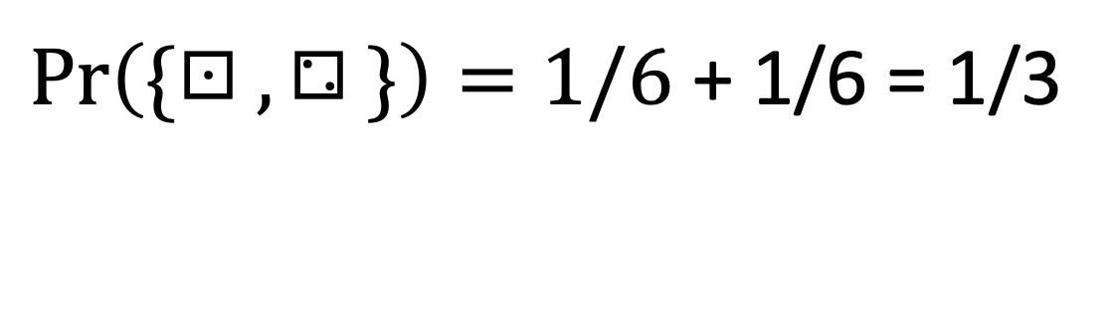
1/6
1/6
1/6
1/6
1/6
1/6
$\operatorname{Pr}\left(\text{\{}\text{⚀},\text{⚁}\}\right)=1/6$ + 1/6 = 1/3

Slide 10
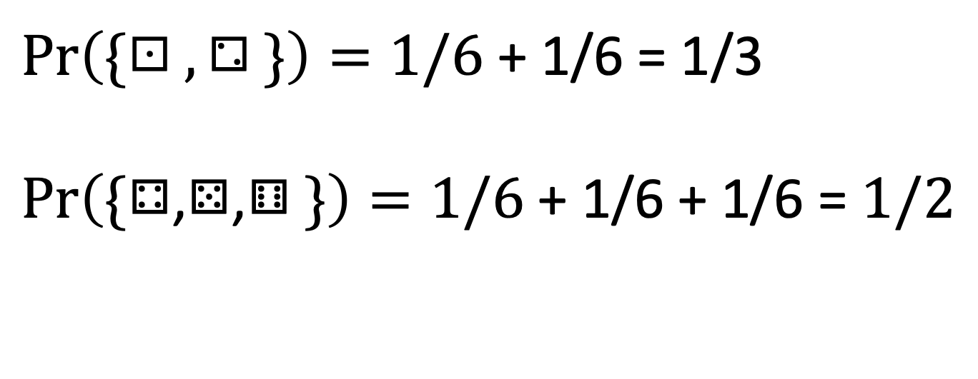
1/6
1/6
1/6
1/6
1/6
1/6
$\operatorname{Pr}\left(\text{\{}\text{⚀},\text{⚁}\}\right)=1/6$ + 1/6 = 1/3
$$\operatorname{Pr}\left(\text{\{}\text{⚃}\text{,}\text{⚄}\text{,}\text{⚅}\}\right)=1/6\text{ + 1/6 + 1/6}\text{ = }1/2$$

Slide 11
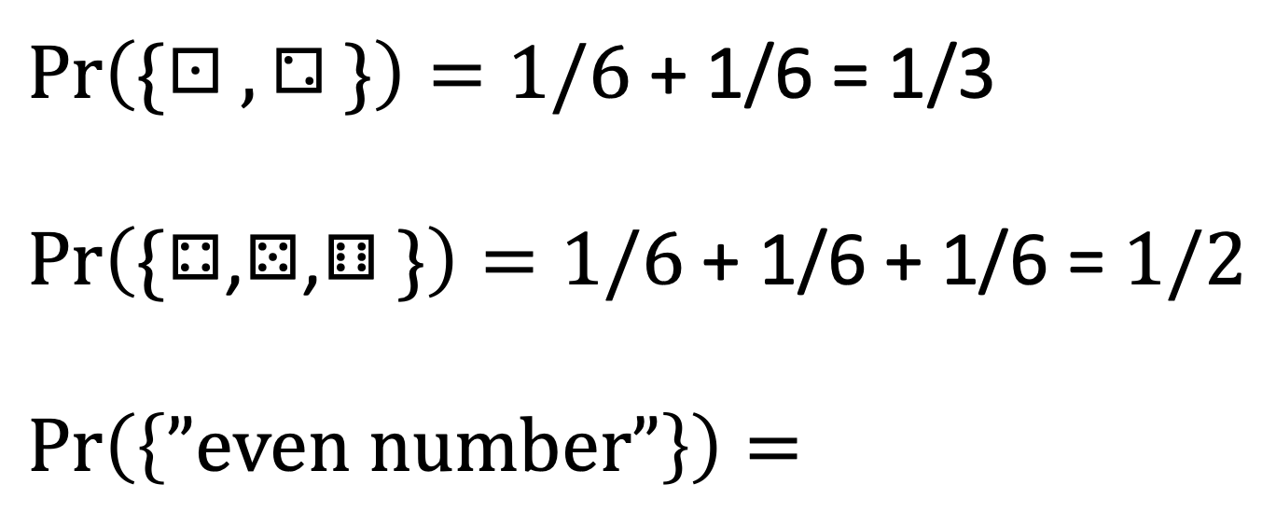
1/6
1/6
1/6
1/6
1/6
1/6
$\operatorname{Pr}\left(\text{\{}\text{⚀},\text{⚁}\}\right)=1/6$ + 1/6 = 1/3
$$\operatorname{Pr}\left(\text{\{}\text{⚃}\text{,}\text{⚄}\text{,}\text{⚅}\}\right)=1/6\text{ + 1/6 + 1/6} \text{= }1/2$$
$$\operatorname{Pr}\left(\left\{”even number”\right\}\right)=$$

Slide 12
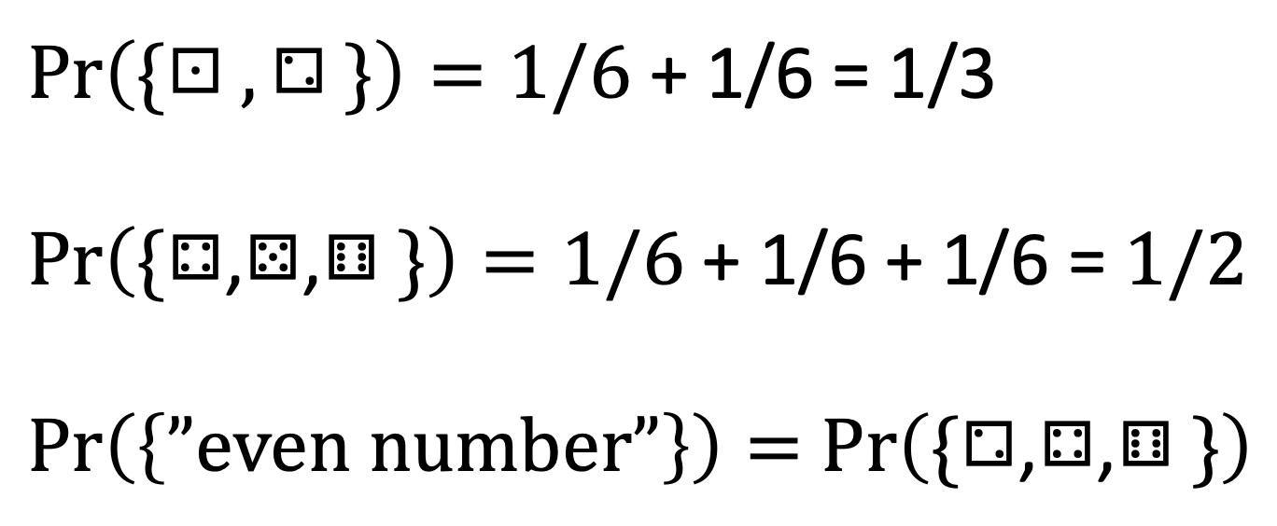
1/6
1/6
1/6
1/6
1/6
1/6
$\operatorname{Pr}\left(\text{\{}\text{⚀},\text{⚁}\}\right)=1/6$ + 1/6 = 1/3
$$\operatorname{Pr}\left(\text{\{}\text{⚃}\text{,}\text{⚄}\text{,}\text{⚅}\}\right)=1/6\text{ + 1/6 + 1/6} \text{= }1/2$$
$\operatorname{Pr}\left(\left\{”even number”\right\}\right)=$ $\operatorname{Pr}\left(\text{\{}\text{⚁}\text{,}\text{⚃}\text{,}\text{⚅}\}\right)$

Slide 13
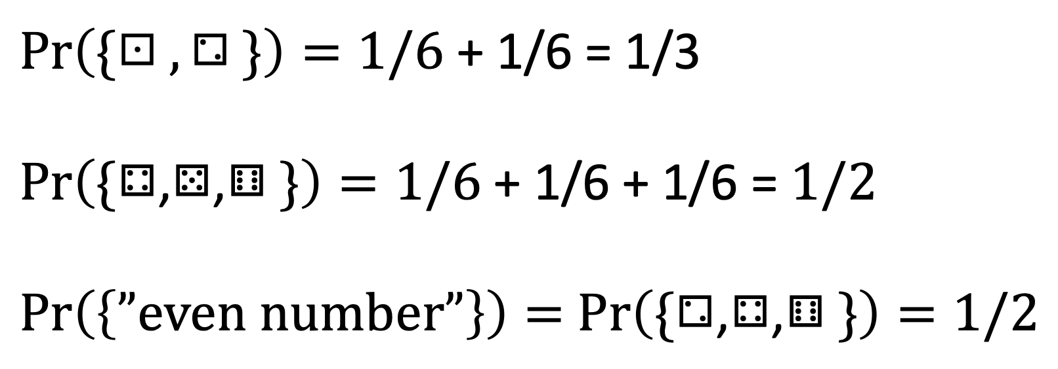
1/6
1/6
1/6
1/6
1/6
1/6
$\operatorname{Pr}\left(\text{\{}\text{⚀},\text{⚁}\}\right)=1/6$ + 1/6 = 1/3
$$\operatorname{Pr}\left(\text{\{}\text{⚃}\text{,}\text{⚄}\text{,}\text{⚅}\}\right)=1/6\text{ + 1/6 + 1/6} \text{= }1/2$$
$\operatorname{Pr}\left(\left\{”even number”\right\}\right)=$ $\operatorname{Pr}\left(\text{\{}\text{⚁}\text{,}\text{⚃}\text{,}\text{⚅}\}\right)=1/2$

