Slide 1
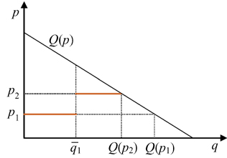

Slide 2
Consumers with unit demand, ranked by decreasing willingness to pay

Slide 3
Consumers with unit demand, ranked by decreasing willingness to pay
There is a positive residual demand for firm 2

Slide 4
Consumers with unit demand, ranked by decreasing willingness to pay
There is a positive residual demand for firm 2
Consumers with highest willingness to pay are served at firm 1’s low price

