Slide 1
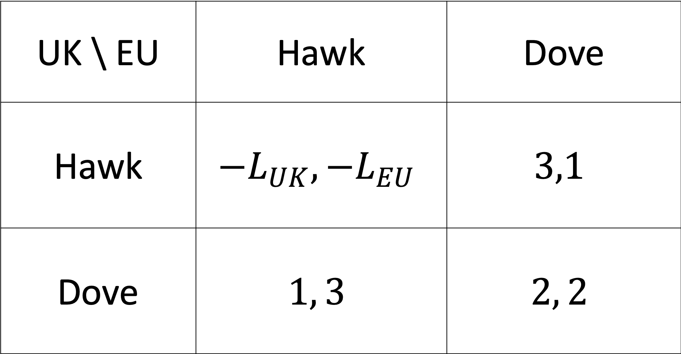
UK \ EU | Hawk | Dove
Hawk | $${−L}_{UK},{−L}_{EU}$$ | $$3,1$$
Dove | $$1, 3$$ | $$2, 2$$

Slide 2
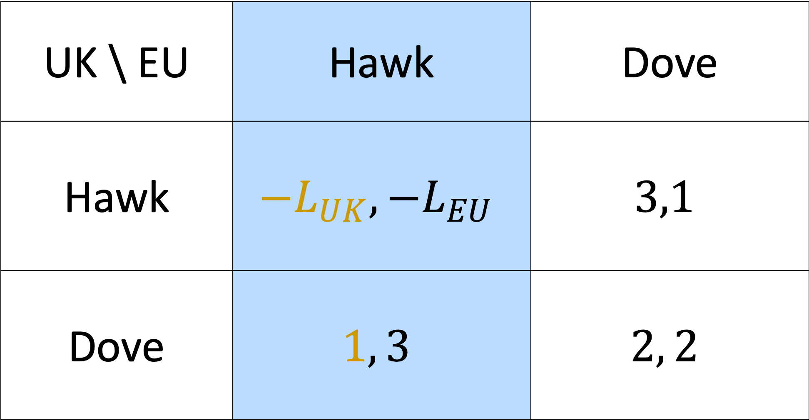
UK \ EU | Hawk | Dove
Hawk | $${−L}_{UK},{−L}_{EU}$$ | $$3,1$$
Dove | $$1, 3$$ | $$2, 2$$

Slide 3
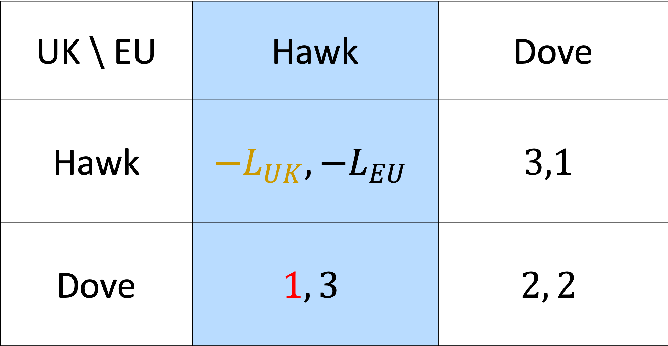
UK \ EU | Hawk | Dove
Hawk | $${−L}_{UK},{−L}_{EU}$$ | $$3,1$$
Dove | $$1, 3$$ | $$2, 2$$

Slide 4
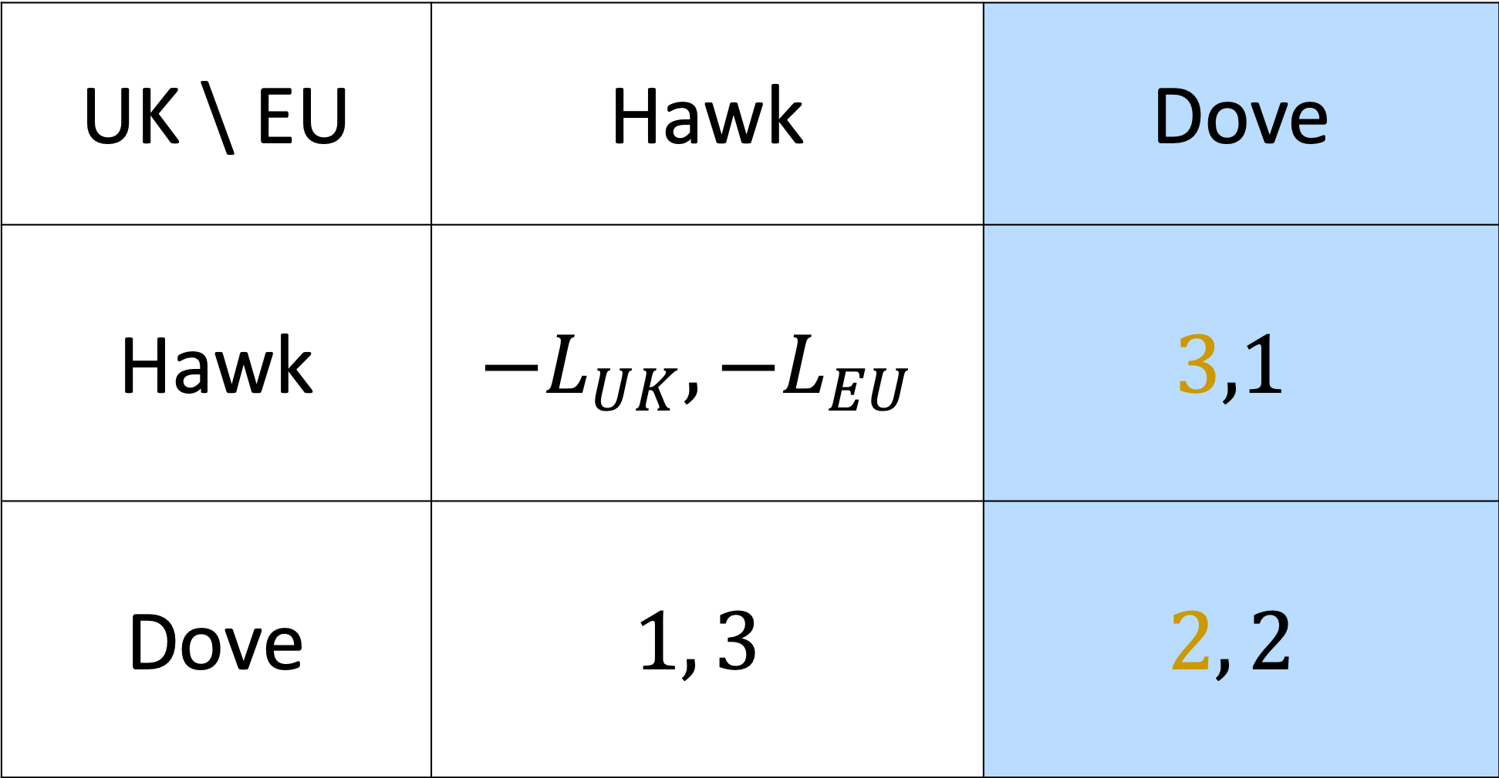
UK \ EU | Hawk | Dove
Hawk | $${−L}_{UK},{−L}_{EU}$$ | $$3,1$$
Dove | $$1, 3$$ | $$2, 2$$

Slide 5
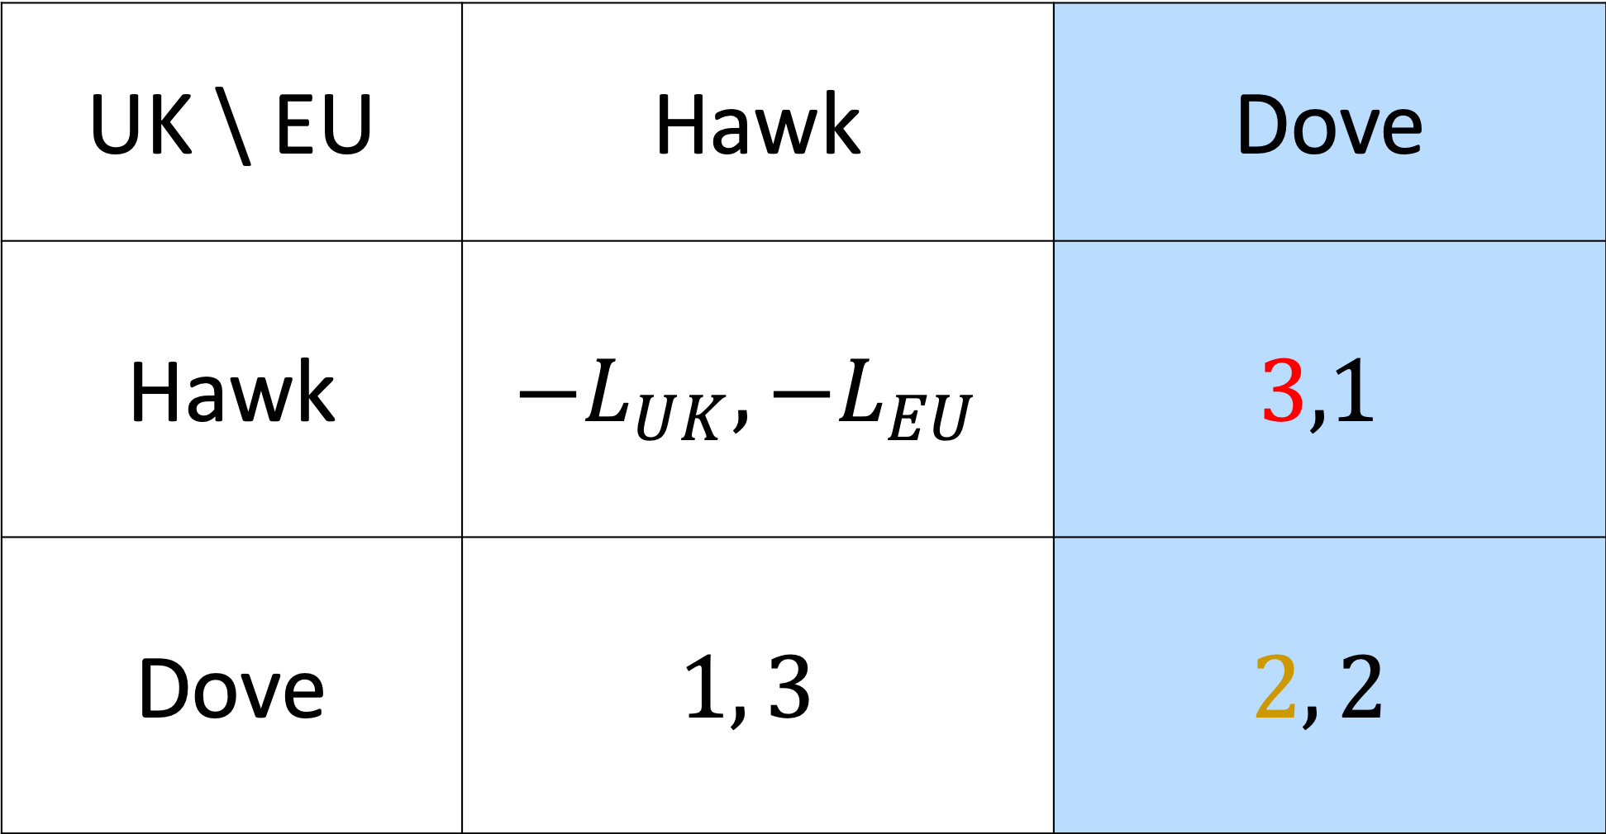
UK \ EU | Hawk | Dove
Hawk | $${−L}_{UK},{−L}_{EU}$$ | $$3,1$$
Dove | $$1, 3$$ | $$2, 2$$

Slide 6
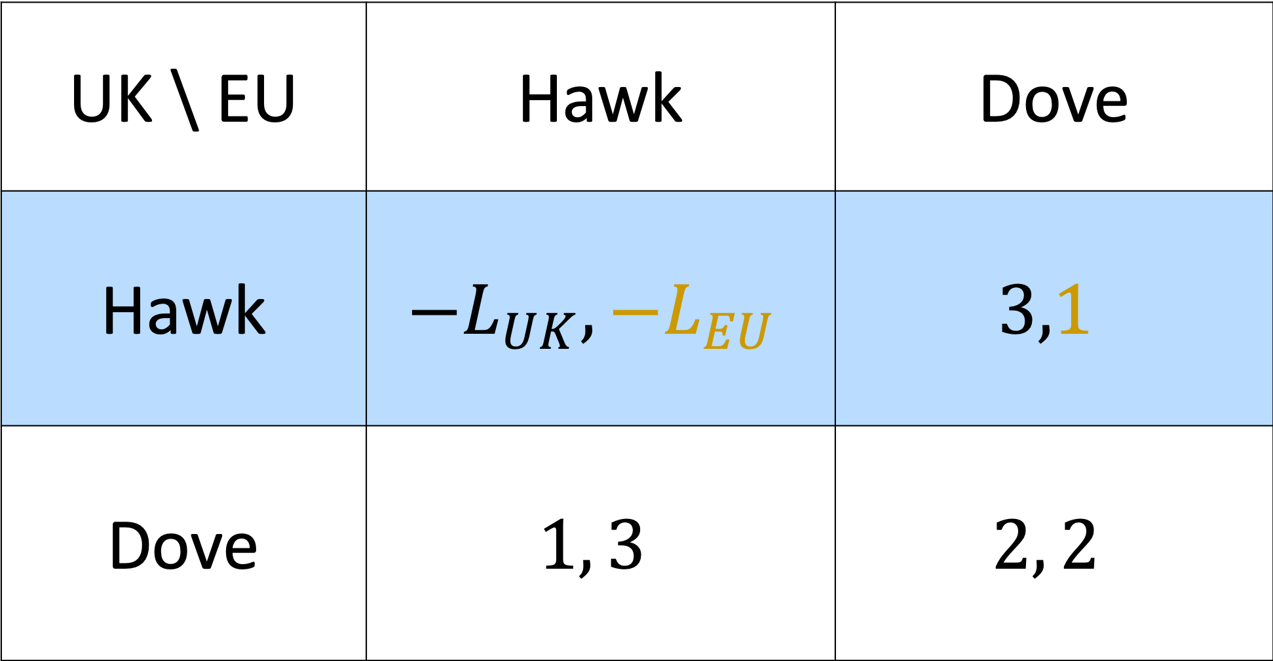
UK \ EU | Hawk | Dove
Hawk | $${−L}_{UK},{−L}_{EU}$$ | $$3,1$$
Dove | $$1, 3$$ | $$2, 2$$

Slide 7
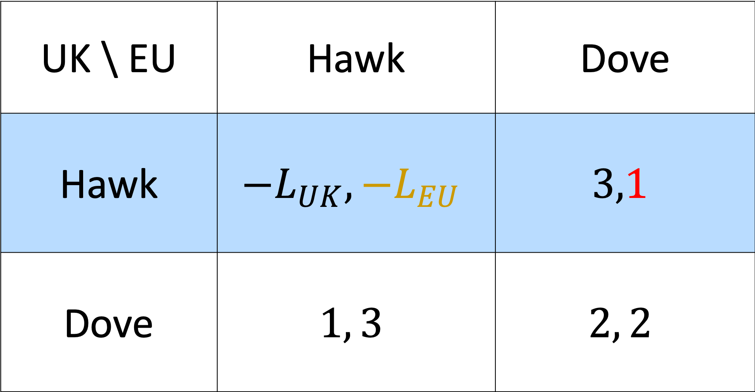
UK \ EU | Hawk | Dove
Hawk | $${−L}_{UK},{−L}_{EU}$$ | $$3,1$$
Dove | $$1, 3$$ | $$2, 2$$

Slide 8
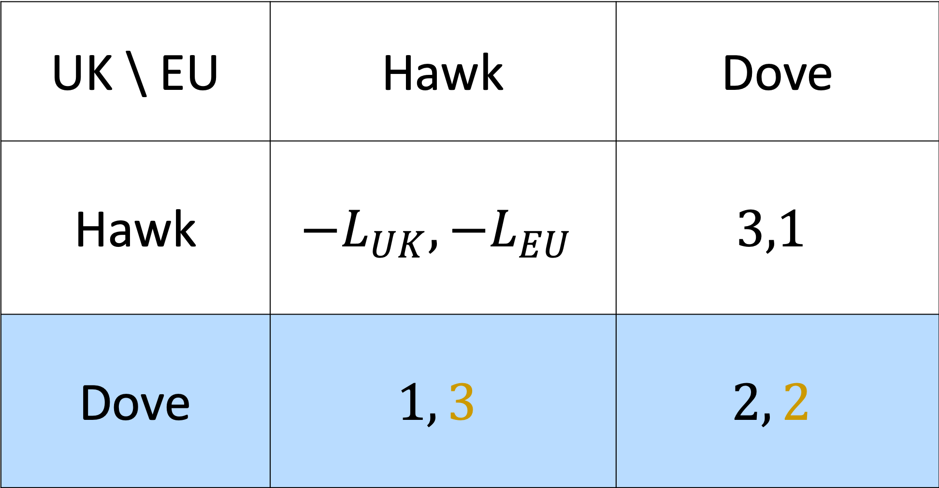
UK \ EU | Hawk | Dove
Hawk | $${−L}_{UK},{−L}_{EU}$$ | $$3,1$$
Dove | $$1, 3$$ | $$2, 2$$

Slide 9
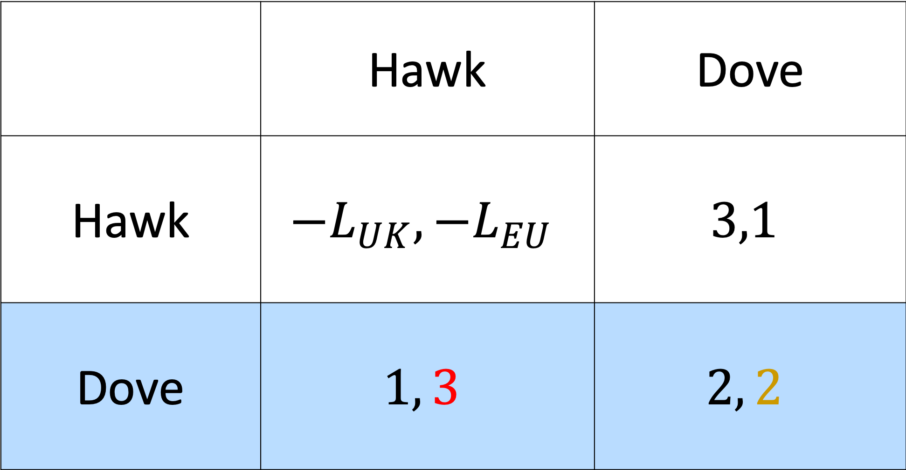
 | Hawk | Dove
Hawk | $${−L}_{UK},{−L}_{EU}$$ | $$3,1$$
Dove | $$1, 3$$ | $$2, 2$$

Slide 10
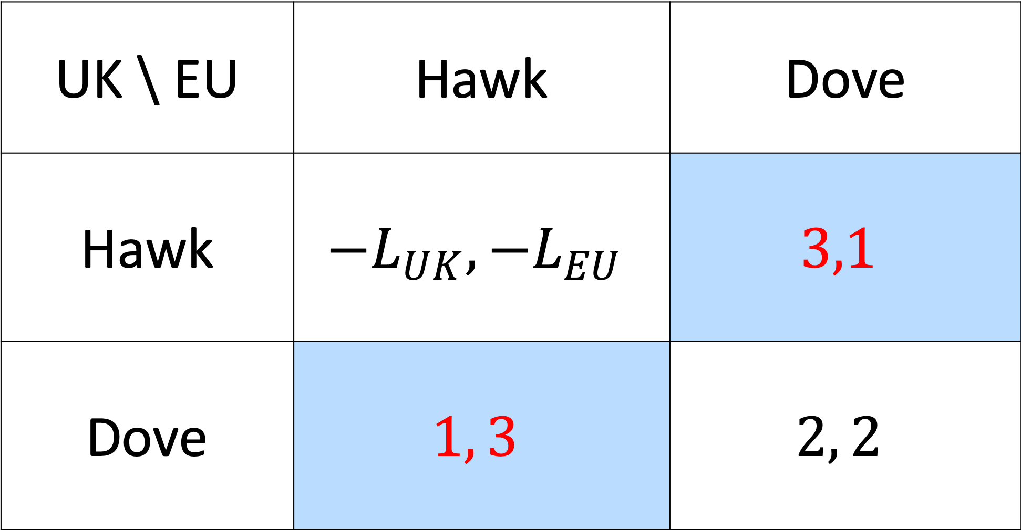
UK \ EU | Hawk | Dove
Hawk | $${−L}_{UK},{−L}_{EU}$$ | $$3,1$$
Dove | $$1, 3$$ | $$2, 2$$

Slide 11
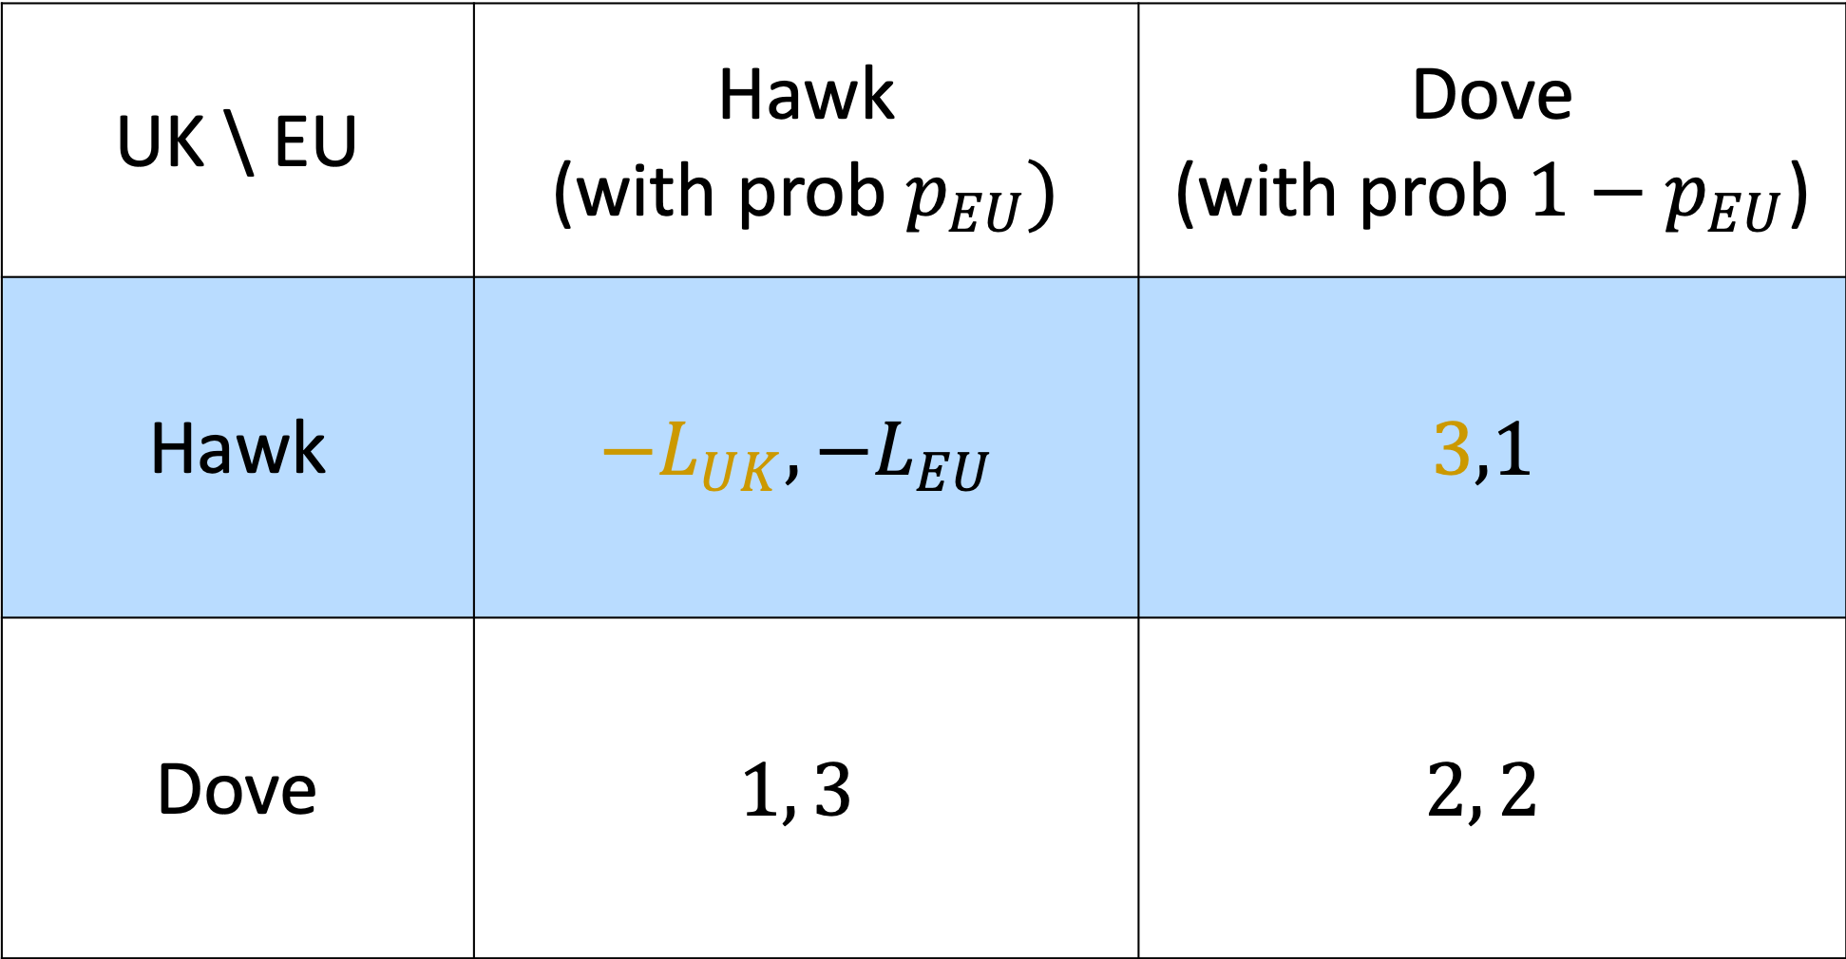
UK \ EU | Hawk (with prob $p_{EU})$ | Dove (with prob ${1−p}_{EU}$)
Hawk | $${−L}_{UK},{−L}_{EU}$$ | $$3,1$$
Dove | $$1, 3$$ | $$2, 2$$

Slide 12
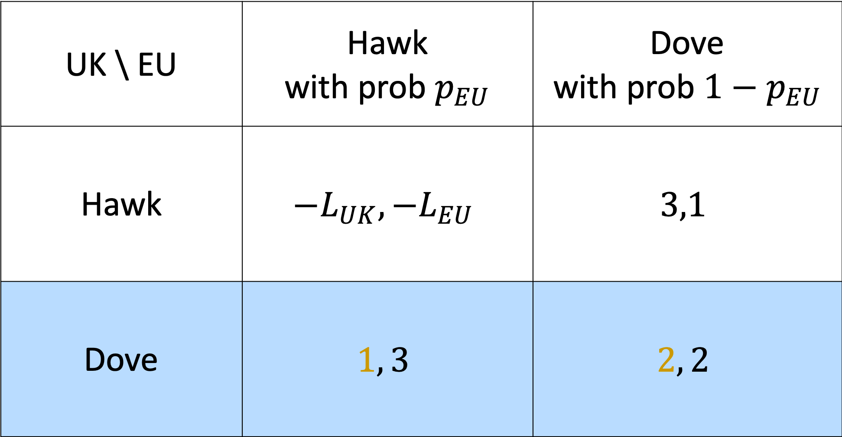
UK \ EU | Hawk with prob $p_{EU}$ | Dove with prob ${1−p}_{EU}$
Hawk | $${−L}_{UK},{−L}_{EU}$$ | $$3,1$$
Dove | $$1, 3$$ | $$2, 2$$

