Slide 1
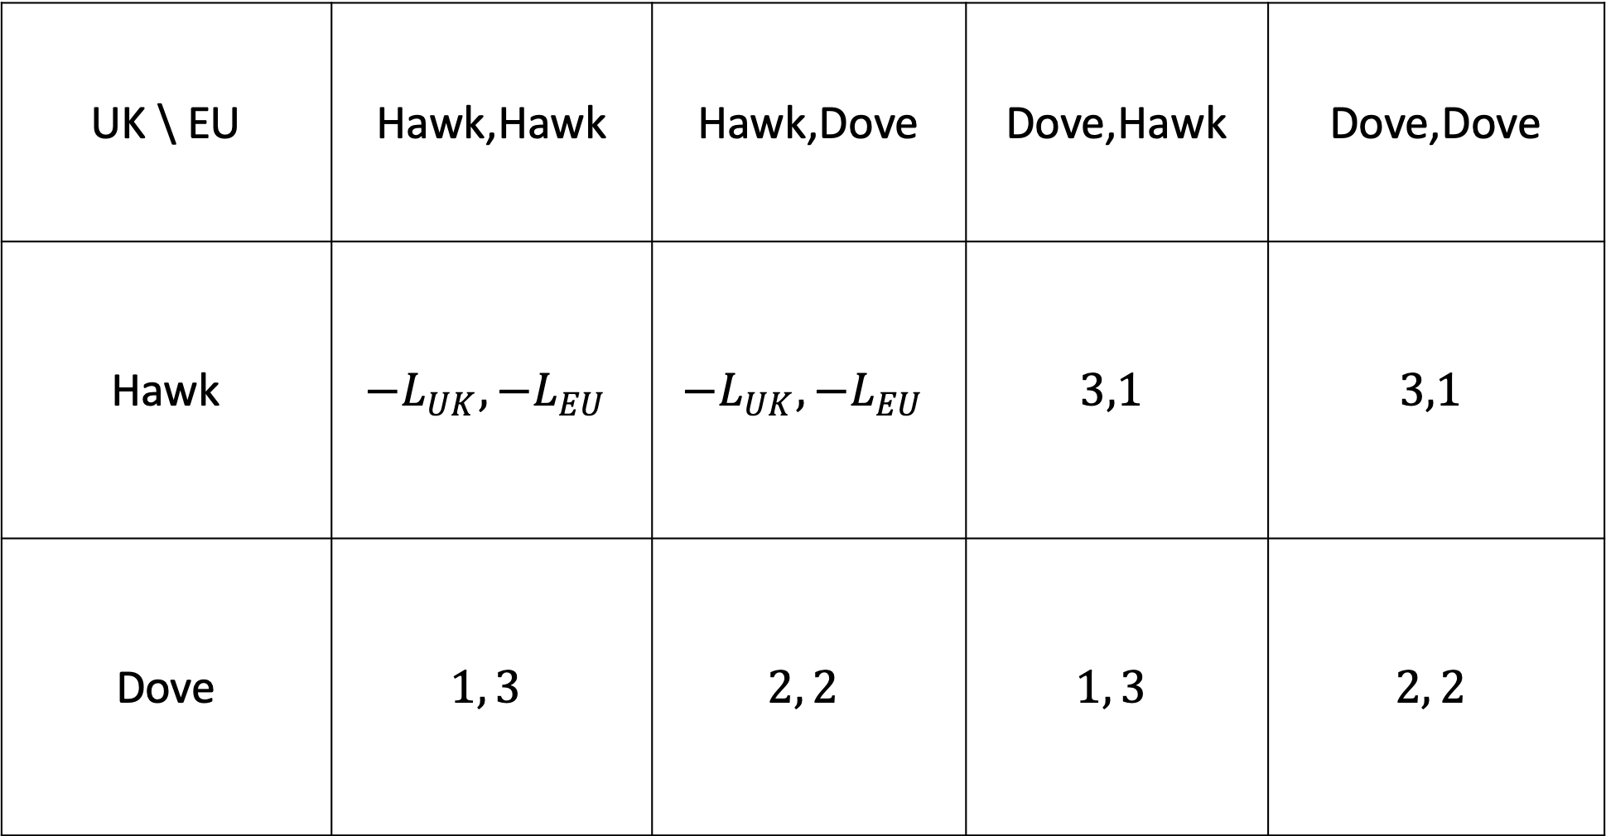
UK \ EU | Hawk,Hawk | Hawk,Dove | Dove,Hawk | Dove,Dove
Hawk | $${−L}_{UK},{−L}_{EU}$$ | $${−L}_{UK},{−L}_{EU}$$ | $$3,1$$ | $$3,1$$
Dove | $$1, 3$$ | $$2, 2$$ | $$1, 3$$ | $$2, 2$$

Slide 2
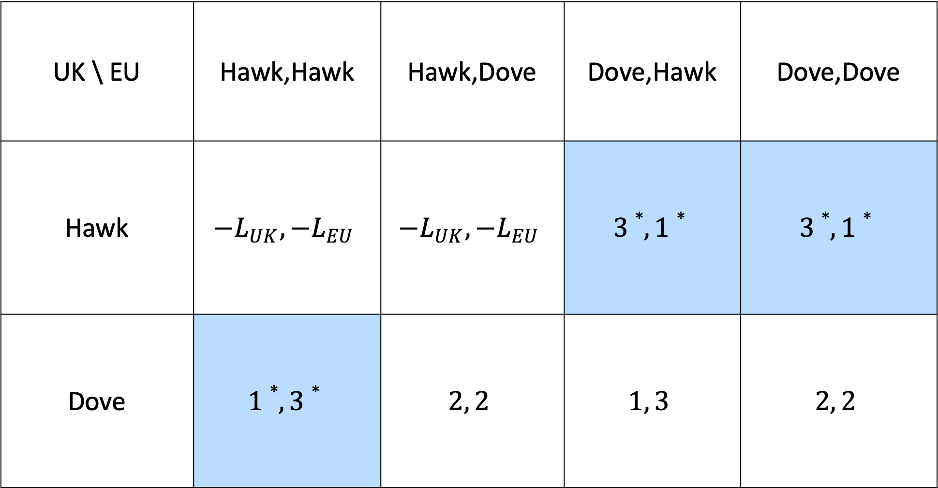
UK \ EU | Hawk,Hawk | Hawk,Dove | Dove,Hawk | Dove,Dove
Hawk | $${−L}_{UK},{−L}_{EU}$$ | $${−L}_{UK},{−L}_{EU}$$ | $$3∗,1∗$$ | $$3∗,1∗$$
Dove | $$1∗, 3∗$$ | $$2, 2$$ | $$1, 3$$ | $$2, 2$$

