Slide 1
Software Design Principles
Group Meeting
July 9, 2025
Henry Peterson

Slide 2
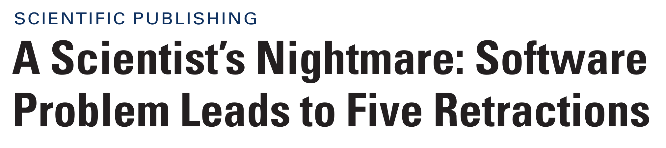
Why Care About Software Engineering?
Correctness
Reproducibility
Someone other than yourself should be able to run your code and change parts of it to understand what’s happening
Maintenance
How will you handle changes in the codebase when the requirements are updated?
Dave’s Software Levels:
Only you know how to run it
A close collaborator can run it
Any expert can run it
Sound familiar?
You write some code to do the thing
Now it has to do a slightly different thing
You copy-paste the old code into a new script/notebook and make some changes
Eventually, you have bunch of scattered code (and maybe the original even had a bug!)

Slide 3
Four Main Concepts for Today
Minimize Complexity with:
Low Coupling
High Cohesion
High Testability
High Re-usability
In essence: build small, sharp tools.

Slide 4
Software Components
A software component can be many different things. It could be a
  File
  Function
  Class
  Program
  …
Our goal is to manage the complexity of our system by designing its components in a good way
2
1
3
4
5
6
7

Slide 5
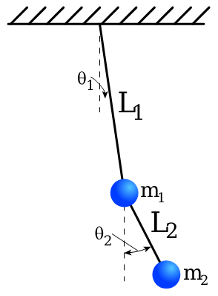
Coupling of Components
How strongly coupled are your software components?
Examples of high coupling:
  A script that relies on code/output from another script
  A function that requires knowledge of another function
  A class hierarchy
  A cell in a Jupyter notebook 😨
For highly coupled software, changes in one component will affect others
Prefer the design that minimizes coupling!

Slide 6
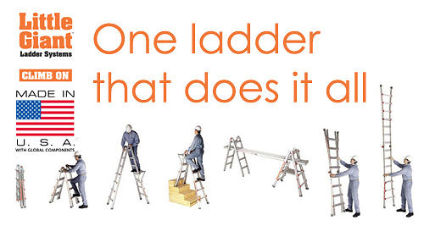
Cohesion of Components
How broad/specific is the focus of your software component?
Examples of low cohesion:
  A massive block of code inside a function/loop
  One file (or notebook!) with tons of functions covering lots of functionality
Low cohesion makes a component difficult to understand, hard to reuse, and dangerous to alter
Prefer the design that maximizes cohesion!

Slide 7
Coupling and Cohesion: Example
<see code in https://github.com/hgpeterson/Software_Example>

Slide 8
Testability
How do you verify correctness of your science?
How do you verify correctness of your code?
What makes something easier to test?
  Small pieces
  Minimal setup
  Well-defined input/output
Low coupling + high cohesion helps improve testability!

Slide 9
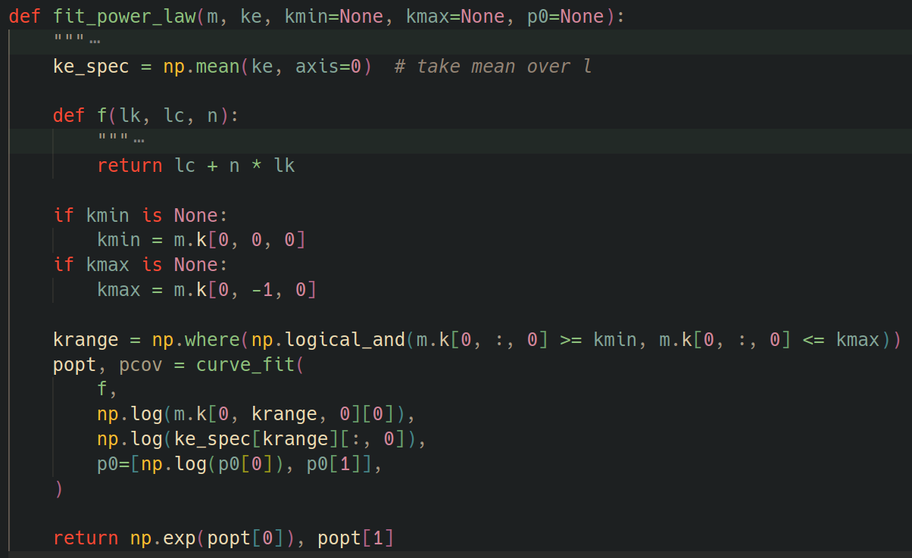
Testability: Example

Slide 10
Reusability
In science, it can be tempting to solve problems one script at a time. This can lead to:
  Lots of repeated code
  No version control
  Time lost due to bugs in multiple locations
In the long run, you’ll save yourself time if you make your code more reusable!
  Keeps you organized
  Makes keeping track of versions easier
  Bugs should only be in one place at a time (“Copying code copies bugs”)
Instead of the extreme “Don’t repeat yourself” adage, try the Rule of Three:
  “Do the thing. When you do it again, grimace but don’t fuss. When you do it a third time, write a function!”

Slide 11
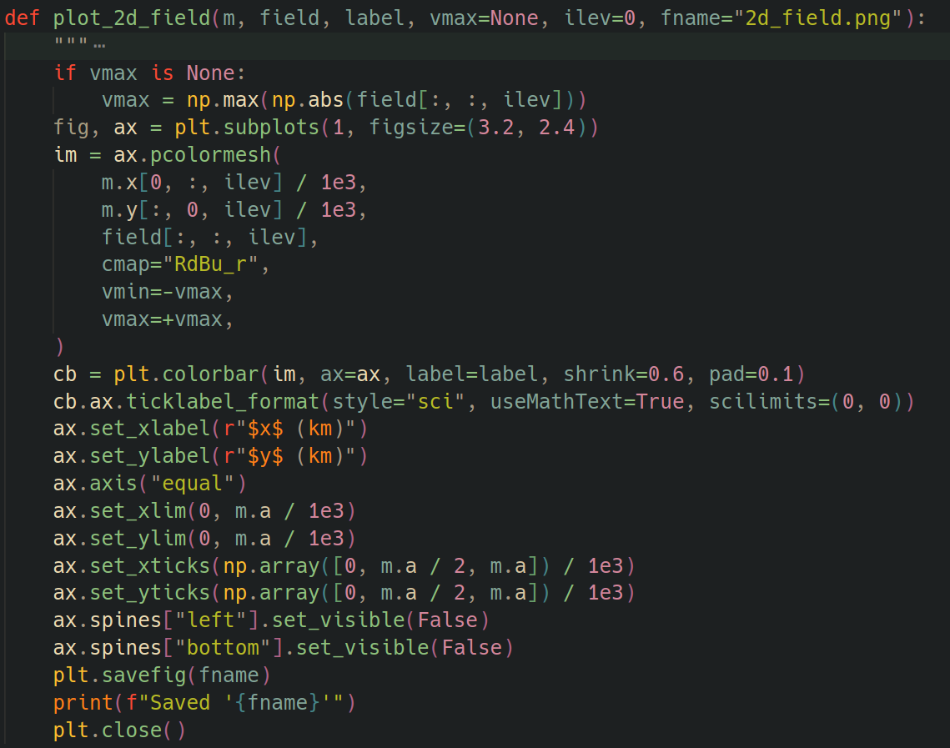
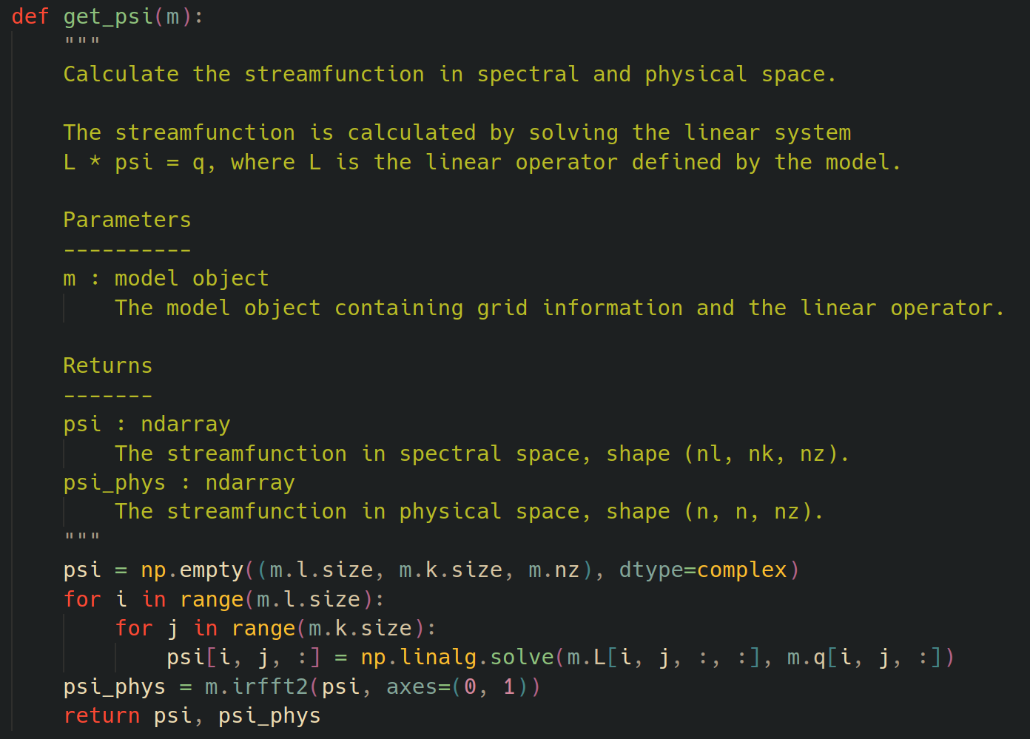
Re-usability: Examples

Slide 12
Other Useful Tips
Priorities: “Prepare to throw the first try away.”
Priorities: “Premature optimization is the root of all evil.”
Design: “Code is a liability, not an asset. What code does for you is an asset.”
Design: “Everyone knows that debugging is twice as hard as writing a program in the first place. So if you’re as clever as you can be when you write it, how will you ever debug it?”
Design, Documentation: “Any code of your own that you haven't looked at for six or more months might as well have been written by someone else.”
Design: “Easy things should be easy, hard things should be doable.”
Testing: “The longer a bug exists, the more expensive it is to fix.”

Slide 14
Extra Slides

Slide 15
Software Engineering != Programming
Added concepts: Systematic, Disciplined, Maintainable
Phases of software development:
Determine software requirements (What does it need to do?)
Design (Consider: user-interface, database schema, modularity, extensibility, security, safety, performance, etc.)
Implement
Test (Verification: Does the code do what I thought it should? Validation: Does the code do what the user thought it should?)
Document
Maintain

Slide 16
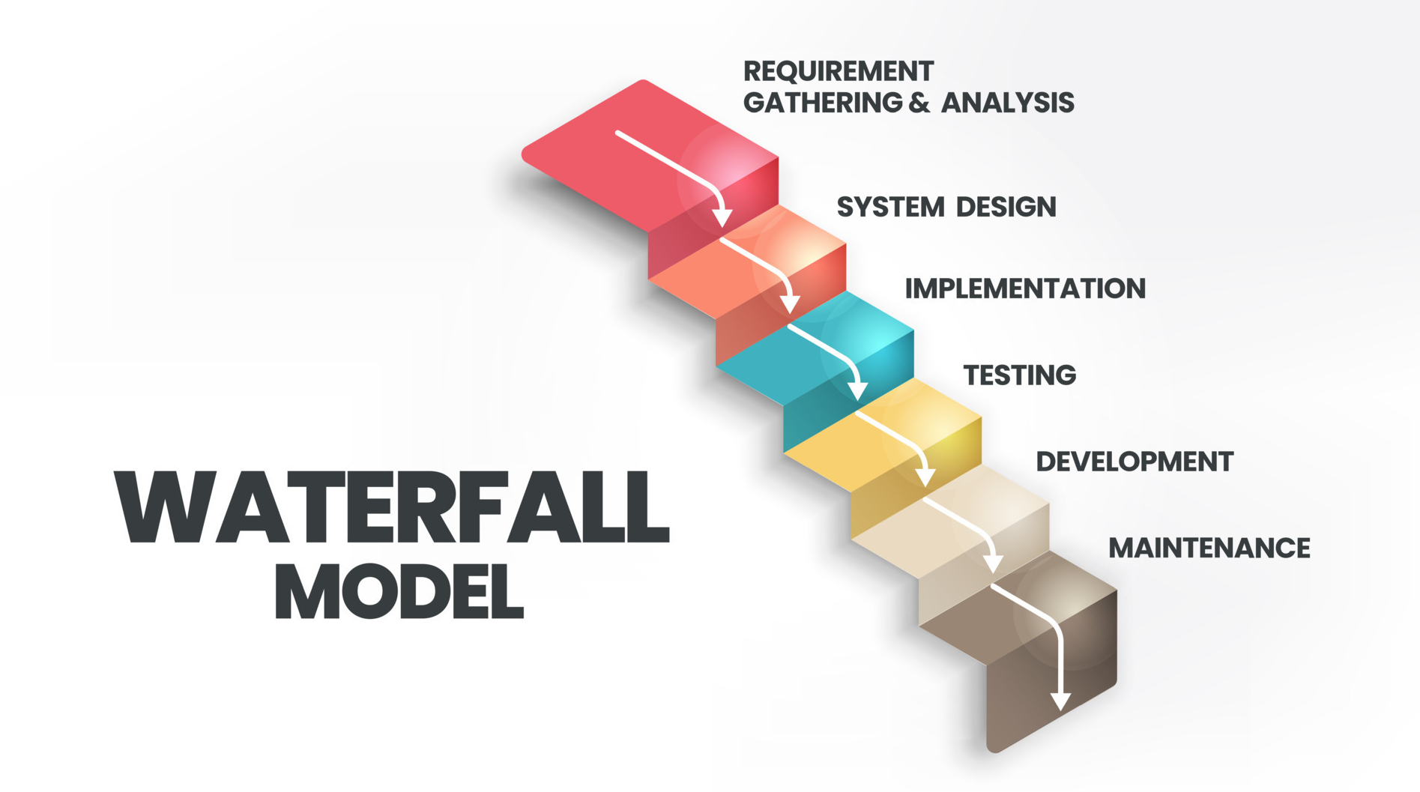
Waterfall
Idea: Try to complete each phase before the next phase begins
Issues:
  Impossible to know how long each step will take without experience
  User doesn’t see product until testing/release
Need a way to iteratively test requirements!
bap-software.net

Slide 17
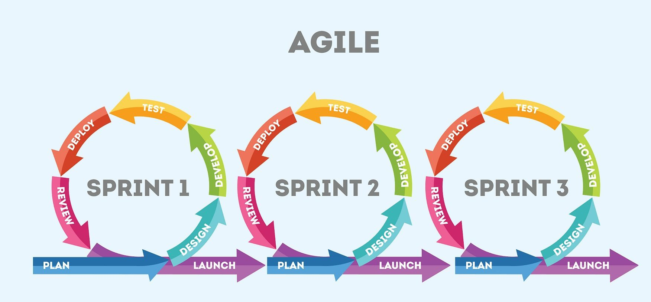
Agile
Iterative approach: Each next step informs changes on previous step
Value:
  Individuals and interactions over processes and tools
  Working software over comprehensive documentation
  Customer collaboration over contract negotiation
  Responding to change over following a plan
SolDevelo

Slide 18
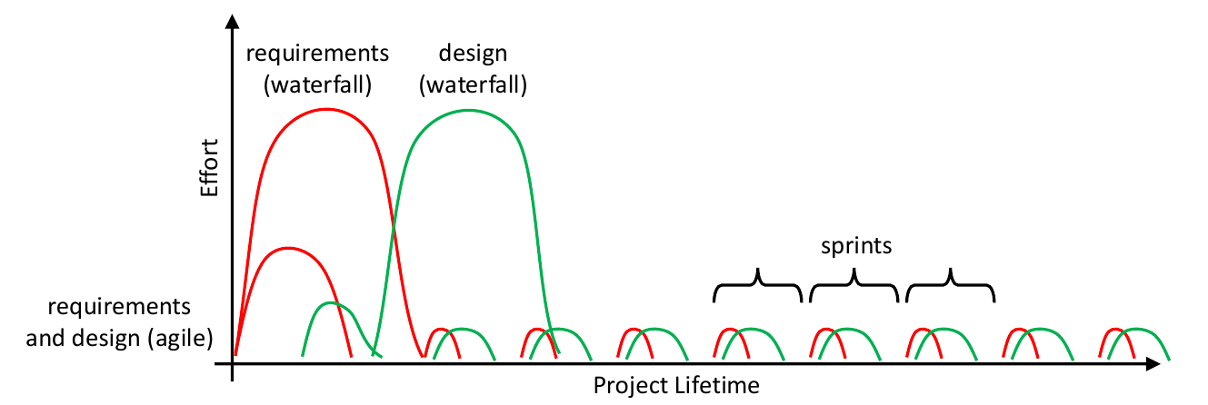
Waterfall vs. Agile
Waterfall works well when:
  Requirements don’t change
  Design is straight-forward/well understood
  Developers are experienced in application area
Agile works well when
  Requirements are not well understood
  Design is complex/challenging
  Developers are new to the application
What is more common in your research?
Which scenario is more common in your research?

