Slide 1




SSA QLD Sept 2019 Showcase on Shiny
Follow us on:
@ssaqld
@StatSocAus
@SSAQLD

Slide 2
Branch Committee 2019
Miranda Mortlock | President
Lee Jones | Vice President
Dimitrios Vagenas | Secretary
Laura Ziems | Treasurer
Adrian Barnett | Website (President of SSA Australia)
Mingzhu Sun | Young Stats Representative
Carmen Lim | Media and Communications
Megan Steele | Membership
Jeeva Kanesarajah | Newsletter
Peter Baker | Continuing Professional Development

Slide 3
Menu for dinner Burger Urge Please choose a Burger or salad, we can eat there at 7:15. I will phone ahead the order
https://burgerurge.com.au/menu/

Slide 4
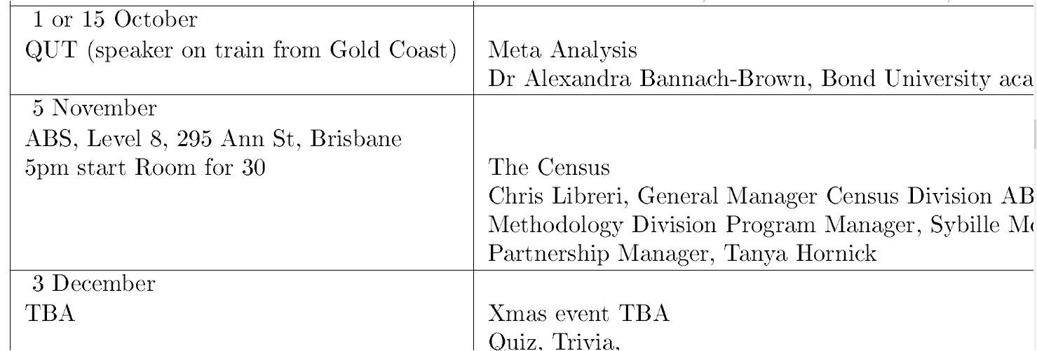
2020 ASC Conference Gold Coast Leaflets
UPCOMING EVENTS 2019

Slide 5

UPCOMING R Shiny Workshop

