Slide 1
Pollution, Health,
and Economics
in 70 Select US Cities
Data Analytics Bootcamp: Oct. 9, 2019
Pete Farquhar, Ben O’Neal, Cassy Myers,
Reid Powell, Randall Davis

Slide 2
Data Sources: for 70 US Cities
Urban Centers Database of European Commision - pollution, CO2, Temperature Change
CDC 500 Cities- Asthma, Pulmonary and other health
US Census API - 2017 Poverty and Median Income
Milken Institute - Best Performing Cities rank (jobs, income, high tech GDP)
Plus, CDC life expectancy pulled separately

Slide 3
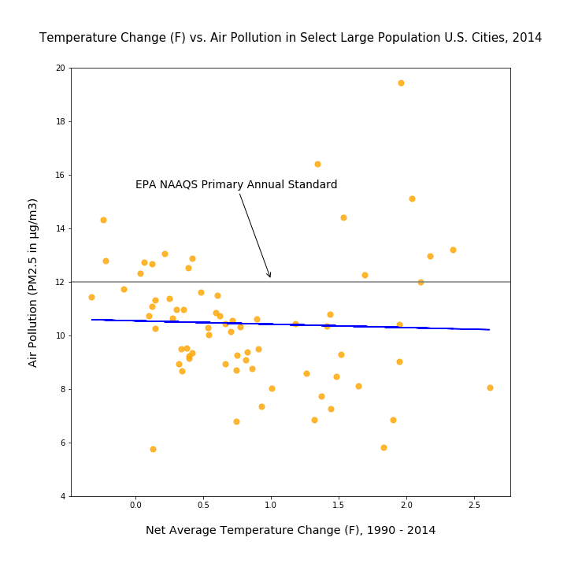

Slide 4
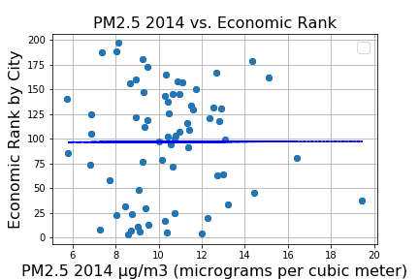
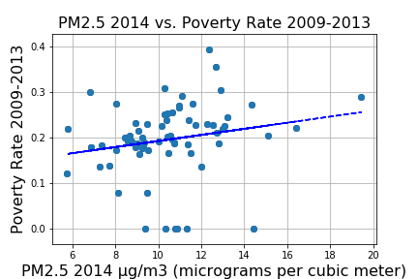

Slide 5
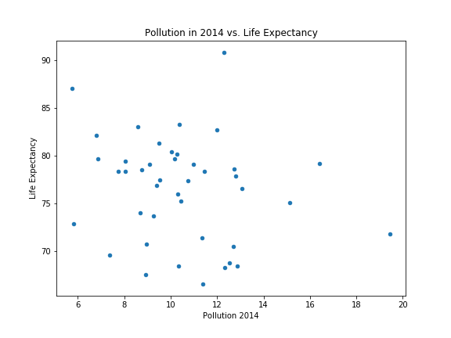
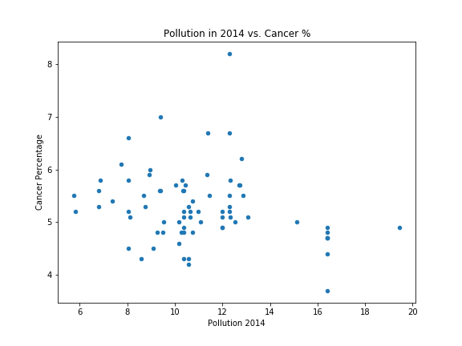

Slide 6
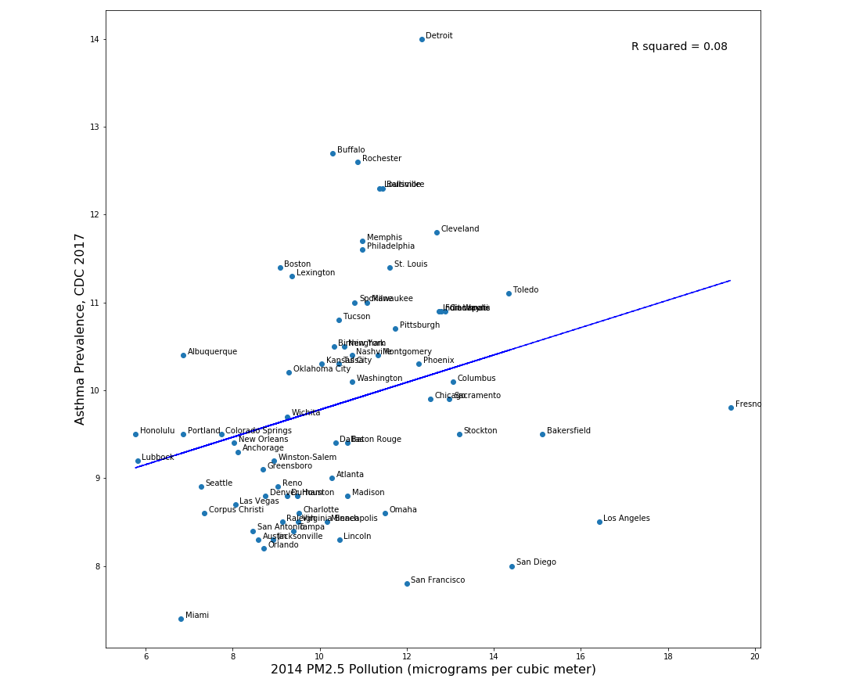
Pollution
vs.
Asthma

Slide 7
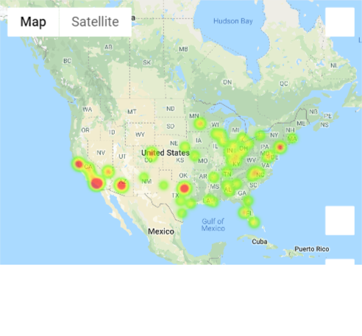

Particulate Matter Heat Map
Asthma Percentage Heat Map

